Slide 1



INFOSYS SPRINGBOARD · DATA VISUALIZATION PROJECT
SMART URBAN MOBILITY AND TRAFFIC INTELLIGENCE DASHBOARD
Urban Pulse — Smart City Mobility Intelligence Platform
Group 1 · DV-Team E · Power BI Analytics · Multimodal Mobility Data
07
04 / 04
08
09
ANALYTICS MODULES
MILESTONES COMPLETE
WEEK DELIVERY SPRINT
LIVE DASHBOARD VIEWS
TEAM
Sameer Singh & Deepak Gavhane
Data Engineering & Geospatial Analytics
Suyash Agrawaal
BI Lead & Project Management
Vaishnavi Gorakhanath Kshirsagar
Micromobility & Equity Analysis
Chandushree J B
Transit & Ride-Hailing Analytics
CITIES ANALYZED
: Bengaluru · Delhi
Infosys Springboard · Data Visualization Project

Slide 2
PROJECT STATEMENT
Why Urban Pulse?
Mobility data is abundant but fragmented — planners still lack one unified view of the city
01
Siloed Data Sources
02
No Cross-Modal View
03
Reactive, Not Predictive
04
Equity Blind Spots
Transit, ride-hailing, cycling and weather data are collected and managed independently, with no shared model.
Analysts can't see how demand shifts between transit, ride-hailing and micromobility across the same trip.
Without forecasting or anomaly detection, agencies respond to congestion instead of anticipating it.
Underserved neighborhoods and accessibility gaps go unmeasured without a common access index.
GOAL
Build a unified smart-city mobility intelligence platform that integrates multimodal transportation data, weather information, demographic indicators, and geospatial datasets into one decision-support system — enabling city planners, transit operators, and administrators to monitor demand, evaluate equity, and forecast mobility trends through interactive dashboards.
Raw multimodal data, disconnected. We turned it into one integrated mobility-intelligence platform.
Smart Urban Mobility and Traffic Intelligence Dashboard · Urban Pulse · Group 1 · DV-Team E
Infosys Springboard · 02 / 22

Slide 3
PROJECT OBJECTIVES
Objectives & Deliverables
End-to-end scope of what Urban Pulse delivers
1
Unified Multimodal Analytics
2
Interactive Dashboards
3
Automated ETL Pipeline
Integrate transit, ride-hailing, cycling, weather & demographic data into one model.
Role-based Power BI dashboards for demand, reliability and equity reporting.
Ingest and refresh mobility datasets from multiple public sources automatically.
4
Geospatial Analytics
5
Mobility Health Scoring
6
Forecasting & Anomaly Detection
Heatmaps, flow maps, accessibility isochrones and mobility-corridor visualization.
Mobility Access Index (MAI) and City Mobility Health Score for performance monitoring.
Predict demand trends and flag operational disruptions before they escalate.
KEY DELIVERABLES
Unified Mobility Datamart
9-Page Power BI Dashboard Suite
Final PPT + Project Report
GitHub Repository
Smart Urban Mobility and Traffic Intelligence Dashboard · Urban Pulse · Group 1 · DV-Team E
Infosys Springboard · 03 / 22

Slide 4
PLATFORM MODULES
Seven Analytics Modules
Each module is owned by a team track and feeds the shared mobility datamart
01
Data Acquisition & Integration
02
Geospatial Mobility Analytics
03
Transit Performance Analytics
04
Ride-Hailing & Demand Intelligence
Collect & standardize transit, ride-hailing, bike-share, weather and demographic data from 5 public sources.
Origin-destination flows, accessibility isochrones, congestion hotspot visualization.
Reliability metrics, schedule adherence, headway variance, route performance.
Demand patterns, surge behavior, modal substitution, fare elasticity.
05
Cycling & Micromobility Analytics
06
Mobility Equity Analysis
07
Executive Intelligence & Forecasting
Bike-share utilization, station availability, rebalancing prediction.
Mobility Access Index (MAI), demographic accessibility comparison.
City-wide mobility health metrics, trend forecasting, anomaly detection.
Smart Urban Mobility and Traffic Intelligence Dashboard · Urban Pulse · Group 1 · DV-Team E
Infosys Springboard · 04 / 22

Slide 5
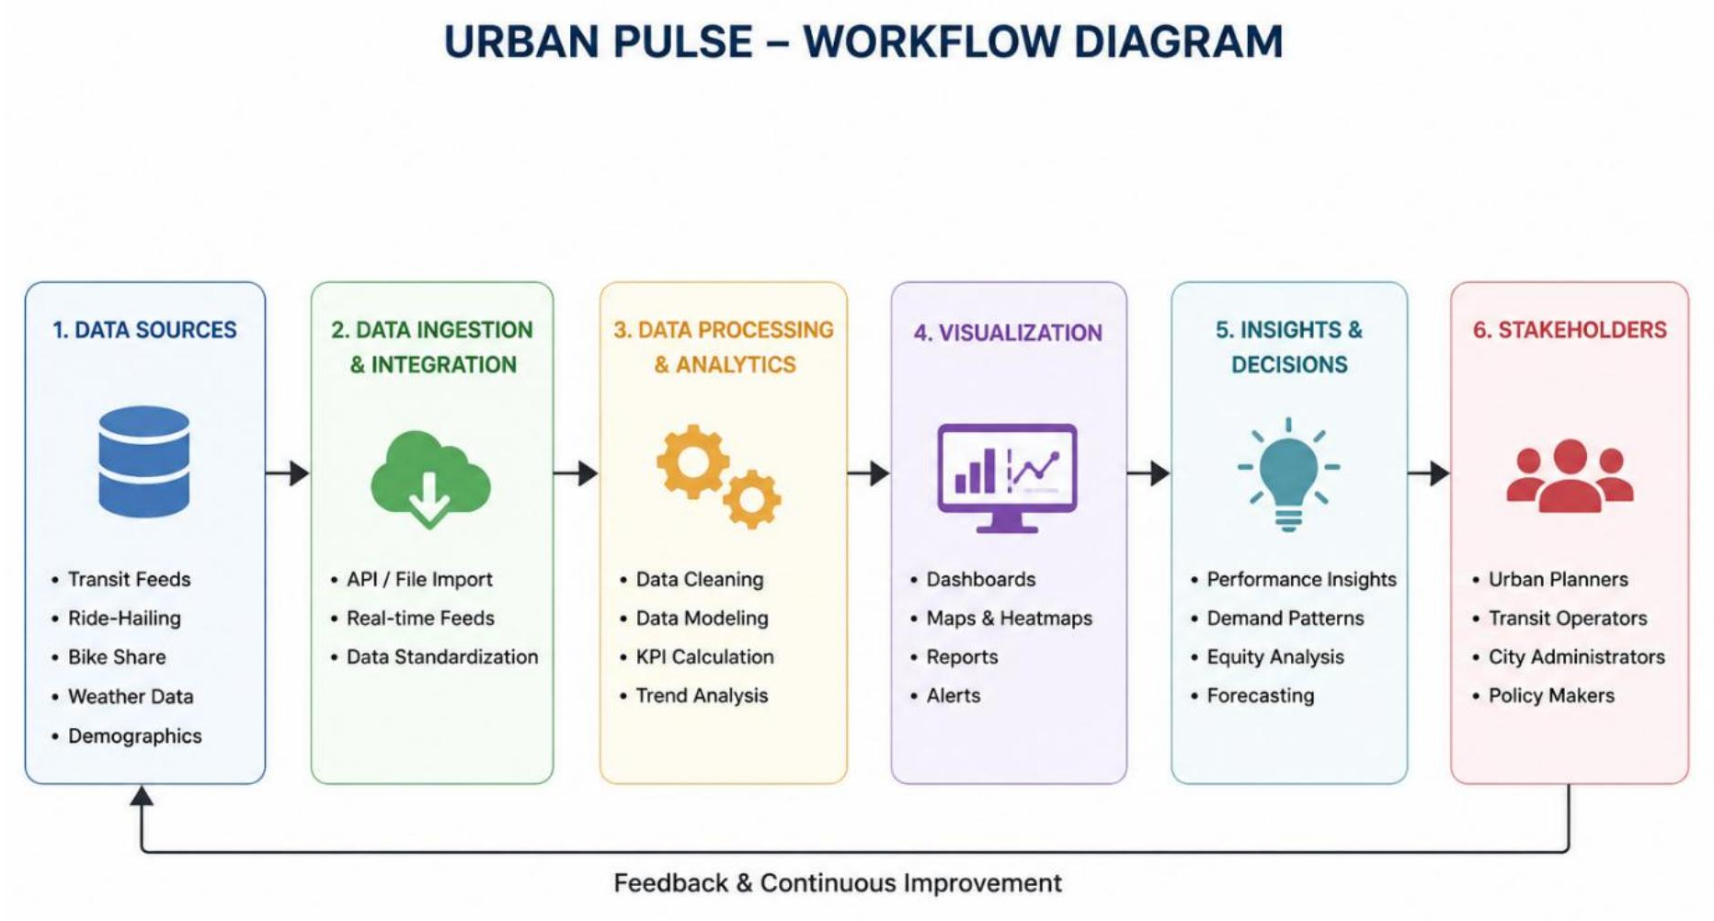
SYSTEM DESIGN
System Workflow
From raw multimodal data to stakeholder decisions, in six stages
Smart Urban Mobility and Traffic Intelligence Dashboard · Urban Pulse · Group 1 · DV-Team E
Infosys Springboard · 05 / 22

Slide 6
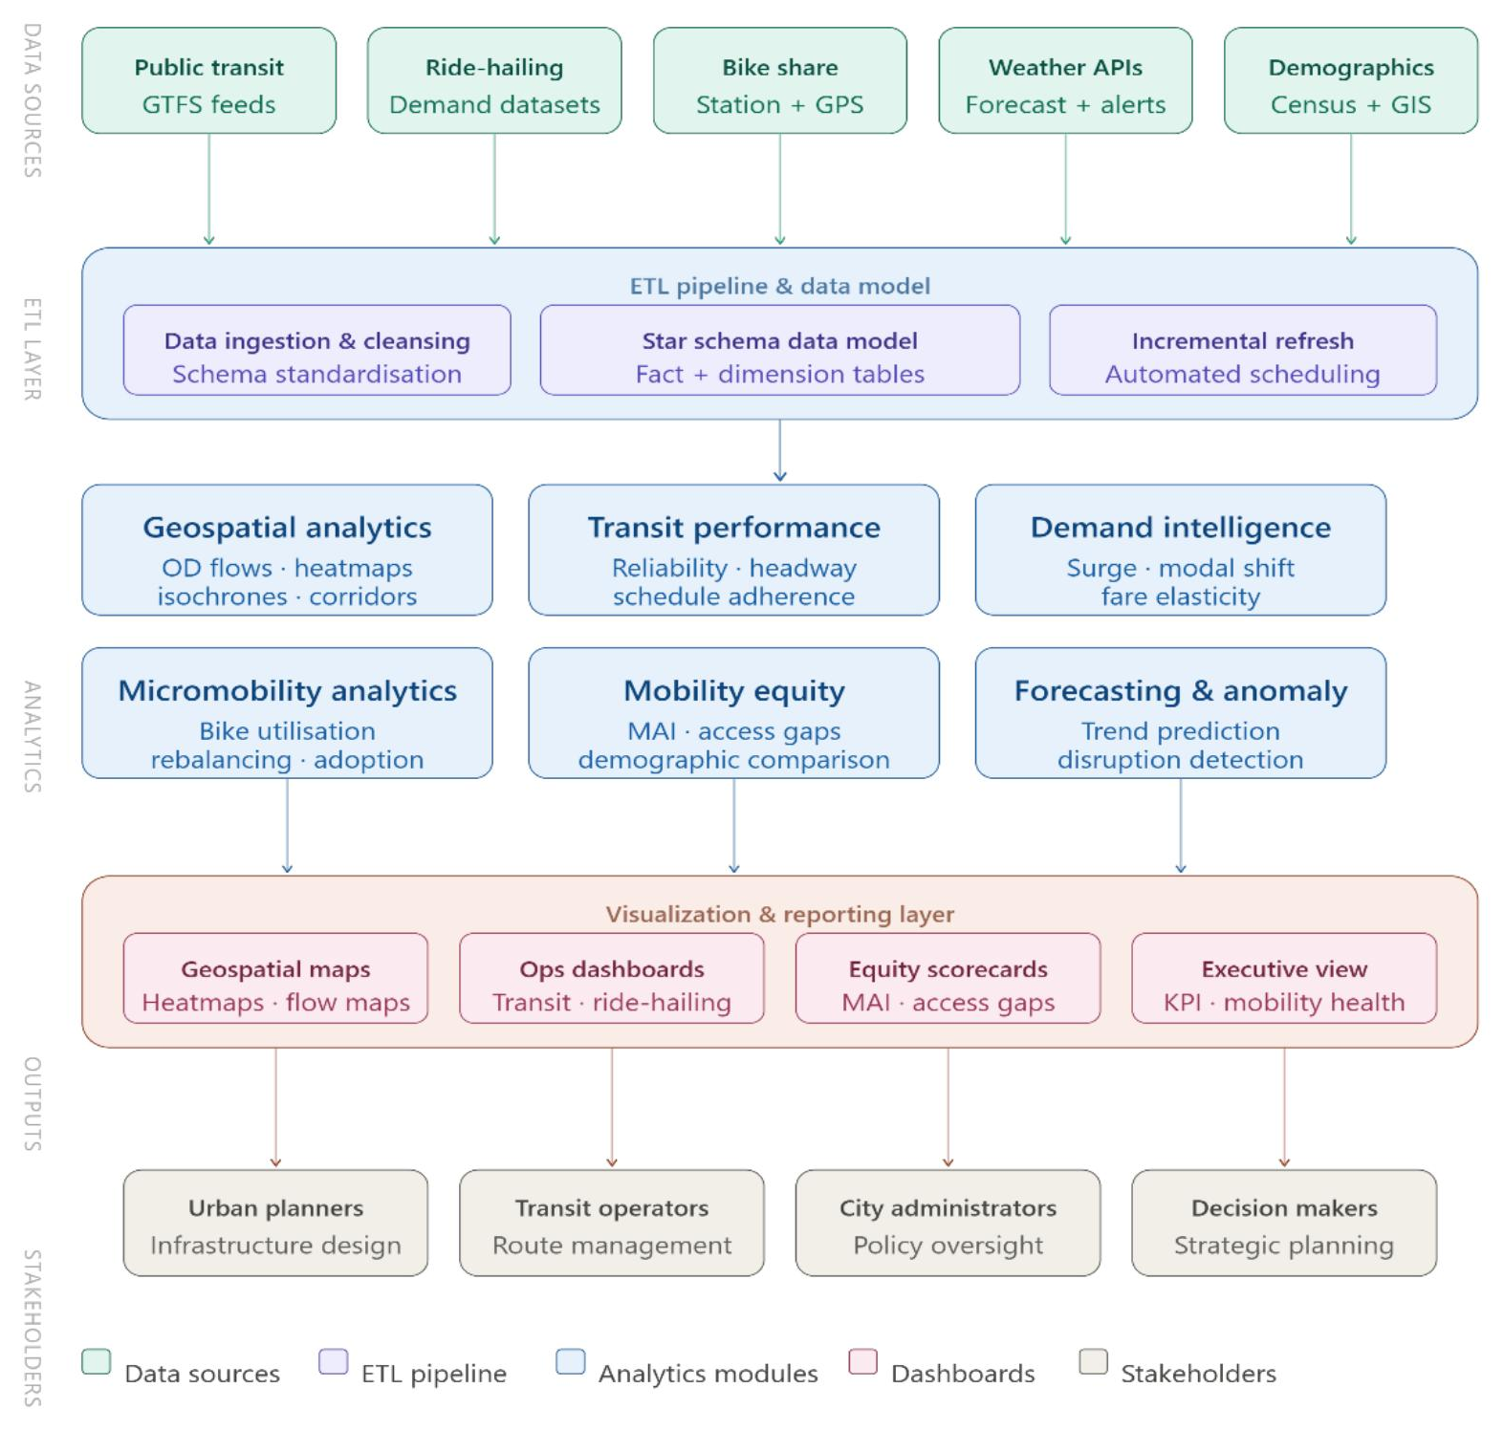
SYSTEM DESIGN
System Architecture
Data sources → ETL & modeling → analytics modules → visualization → stakeholders
Smart Urban Mobility and Traffic Intelligence Dashboard · Urban Pulse · Group 1 · DV-Team E
Infosys Springboard · 06 / 22

Slide 7
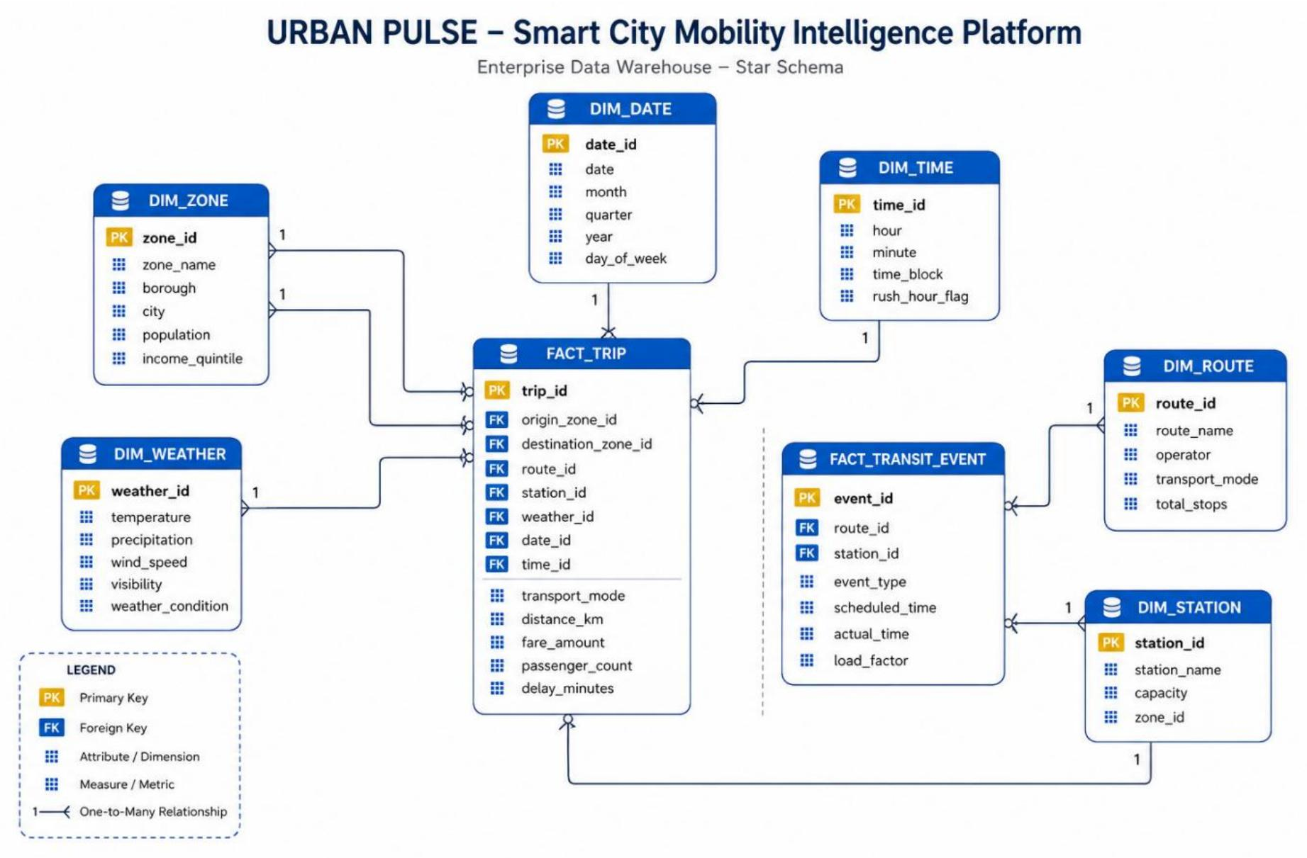
SYSTEM DESIGN
Database Schema
Enterprise data warehouse — star schema design, 2 fact tables + 6 shared dimensions
Smart Urban Mobility and Traffic Intelligence Dashboard · Urban Pulse · Group 1 · DV-Team E
Infosys Springboard · 07 / 22

Slide 8
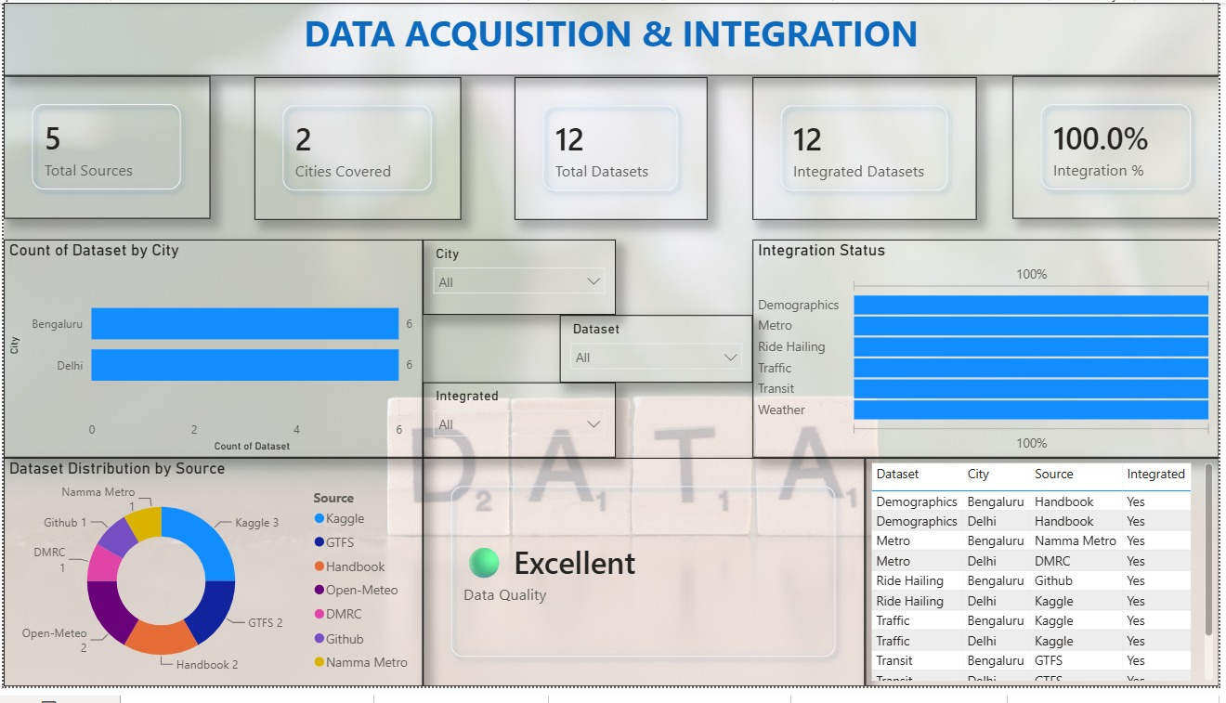
MILESTONE 01 · WEEKS 1–2
Data Acquisition & Data Modeling
Connected 5 data sources — GitHub, GTFS feeds, government handbooks, Kaggle and Open-Meteo — spanning transit, ride-hailing, traffic, weather and demographic data.
Integrated 6 core datasets — Demographics, Metro, Ride-Hailing, Traffic, Transit and Weather — across the 2 cities in scope, Bengaluru and Delhi.
Reached 100% integration status: every dataset validated and confirmed in the integration tracker before downstream analytics began.
Assessed overall data quality as Moderate, flagging the checks the team prioritized before building dashboards on top of the datamart.
Designed a star-schema data model — Fact_Trip, Fact_Transit_Event and shared dimension tables — to support this level of cross-domain analysis.
Data Acquisition & Integration Dashboard — 5 sources, 6 datasets, 100% integration status
Smart Urban Mobility and Traffic Intelligence Dashboard · Urban Pulse · Group 1 · DV-Team E
Infosys Springboard · 08 / 22

Slide 9
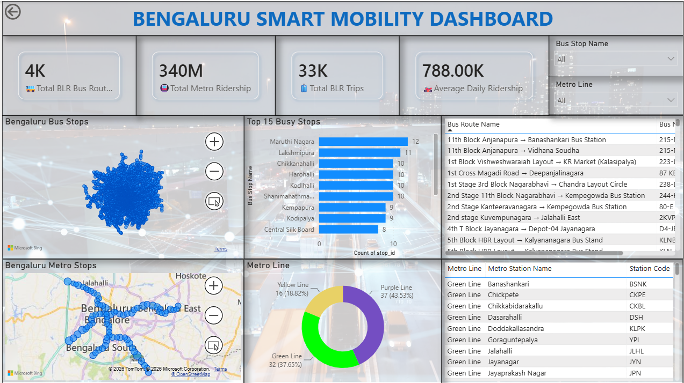
MILESTONE 02 · WEEKS 3–4
Geospatial & Transit Analytics
Mapped Bengaluru's full bus-stop and metro-station network, with interactive zoom and pan.
Ranked the busiest stops (Top 15) to flag high-demand pickup and interchange points.
Broke down metro ridership share by line — Green, Purple and Yellow — with station-level detail.
Added Bus Stop Name and Metro Line filters for multi-level, on-demand geographic drill-down.
Delivered map-based views for both the bus network (4K+ routes) and the metro network side by side on one page.
Bengaluru Smart Mobility Dashboard — bus & metro stop network, busiest stops
‘
Infosys Springboard · 09 / 22
Smart Urban Mobility and Traffic Intelligence Dashboard · Urban Pulse · Group 1 · DV-Team E

Slide 10
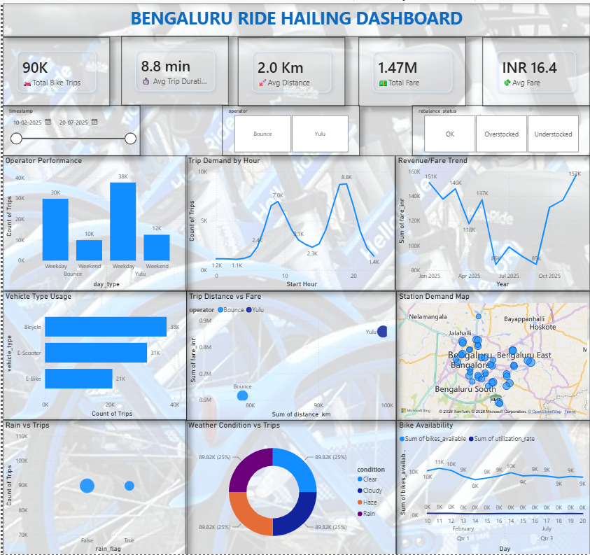
MILESTONE 03 · WEEKS 5–6
Demand Intelligence & Mobility Analytics
Tracked bike and e-scooter trip demand across operators — Bounce and Yulu — split by weekday vs weekend.
Analyzed trip-demand patterns by hour and revenue/fare trends across the year.
Compared vehicle-type usage (bicycle, e-scooter, e-bike) and trip distance vs fare by operator.
Monitored station-level rebalancing status (OK / overstocked / understocked) and rain impact on trips.
Surfaced two sharp daily demand peaks — morning and evening commute windows — to guide fleet rebalancing.
Ride-Hailing Dashboard — Bounce & Yulu bike/e-scooter trip demand, fare trend & rebalancing status
Smart Urban Mobility and Traffic Intelligence Dashboard · Urban Pulse · Group 1 · DV-Team E
Infosys Springboard · 10 / 22

Slide 11
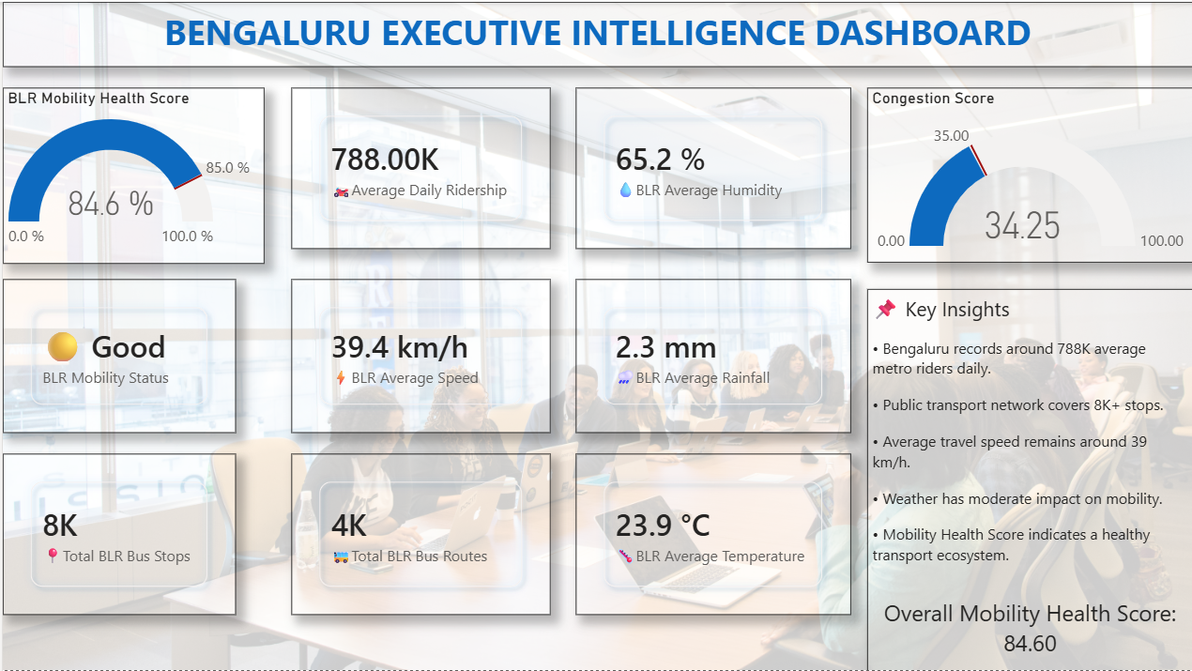
MILESTONE 04 · WEEKS 7–8
Equity, Forecasting & Finalization
Built the City Mobility Health Score (84.6%) — a single KPI combining transit, traffic and weather signals.
Tracked congestion score, average speed and daily ridership alongside citywide bus-stop and route coverage.
Rolled up weather conditions — humidity, rainfall, temperature — into the executive mobility-status read-out ('Good').
Summarized city-wide performance into plain-language key insights for non-technical stakeholders.
Delivered a single-page executive rollup covering 8K bus stops and 4K routes for citywide oversight.
Bengaluru Executive Intelligence Dashboard — Mobility Health Score 84.6%
Smart Urban Mobility and Traffic Intelligence Dashboard · Urban Pulse · Group 1 · DV-Team E
Infosys Springboard · 11 / 22

Slide 12
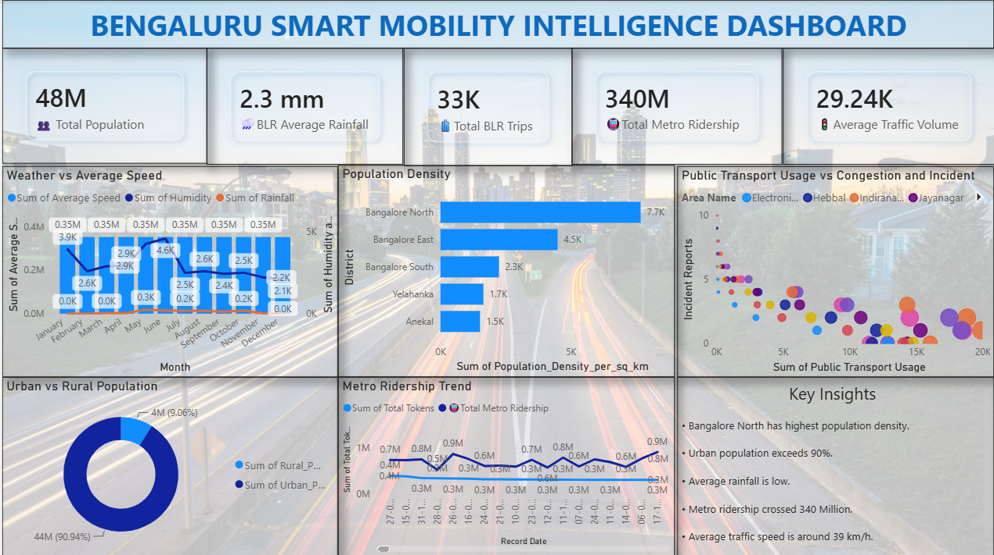
DASHBOARD DEEP-DIVE
Bengaluru Smart Mobility Intelligence
A single-page view that fuses population, weather and traffic signals for the whole city
Layers four independent domains — population (48M), traffic volume (29.24K), rainfall (2.3mm) and metro ridership (340M) — onto one canvas.
The weather-vs-speed chart shows average speed holding steady near 39 km/h all year, largely unaffected by humidity or rainfall swings.
Population-density bars single out Bangalore North (7.7K/sq km) as the city's densest — and highest-priority — district for transit investment.
The usage-vs-congestion scatter cross-references incident reports against ridership to surface corridors needing both service and safety attention.
A 90.9% urban population share reinforces why the platform is built mobility-first, not roads-first.
48M
90.9%
340M
Smart Mobility Intelligence Dashboard — population, weather & traffic overview
TOTAL POPULATION
URBAN POPULATION SHARE
METRO RIDERSHIP TRACKED
Smart Urban Mobility and Traffic Intelligence Dashboard · Urban Pulse · Group 1 · DV-Team E
Infosys Springboard · 12 / 22

Slide 13
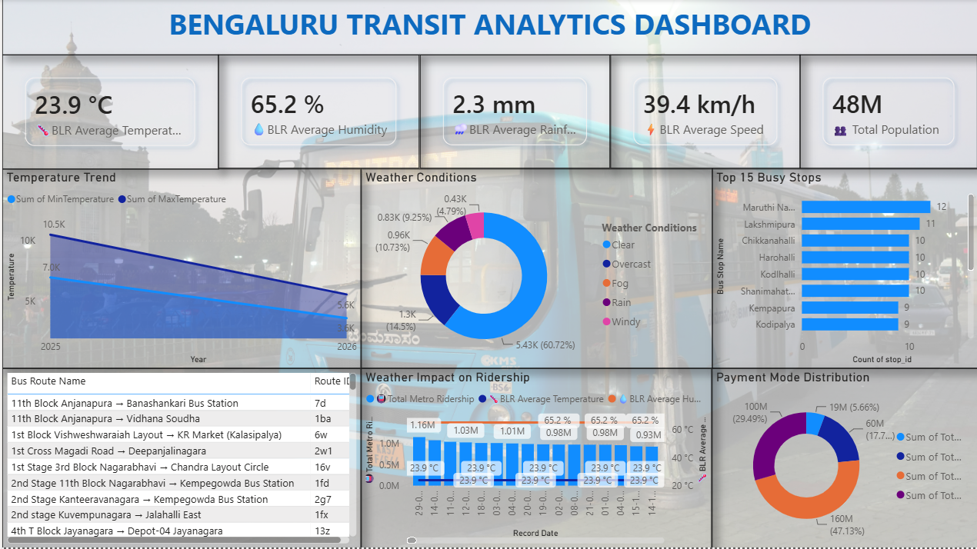
DASHBOARD DEEP-DIVE
Bengaluru Transit Analytics
Weather, routes and payments — the operational pulse of the bus network
The temperature-trend chart tracks Bengaluru's min/max range narrowing into 2026, giving planners a seasonal baseline for service planning.
60.7% of tracked days are clear weather, with rain (14.5%), overcast (10.7%) and fog (9.3%) making up the rest — each with a measurable ridership effect.
The Top-15 busy-stops ranking, led by Maruthi Nagara and Lakshmipura, flags where extra buses or shelters would help most.
The weather-impact-on-ridership chart lines up temperature and humidity against metro ridership day by day, isolating weather-driven demand swings.
The payment-mode split shows a near-even mix with one mode narrowly leading, pointing to where fare-collection modernization has the most reach.
65.2%
39.4 km/h
15
AVERAGE HUMIDITY
AVERAGE SPEED
STOPS RANKED BY DEMAND
Transit Analytics Dashboard — weather impact, top stops & payment mode
Smart Urban Mobility and Traffic Intelligence Dashboard · Urban Pulse · Group 1 · DV-Team E
Infosys Springboard · 13 / 22

Slide 14
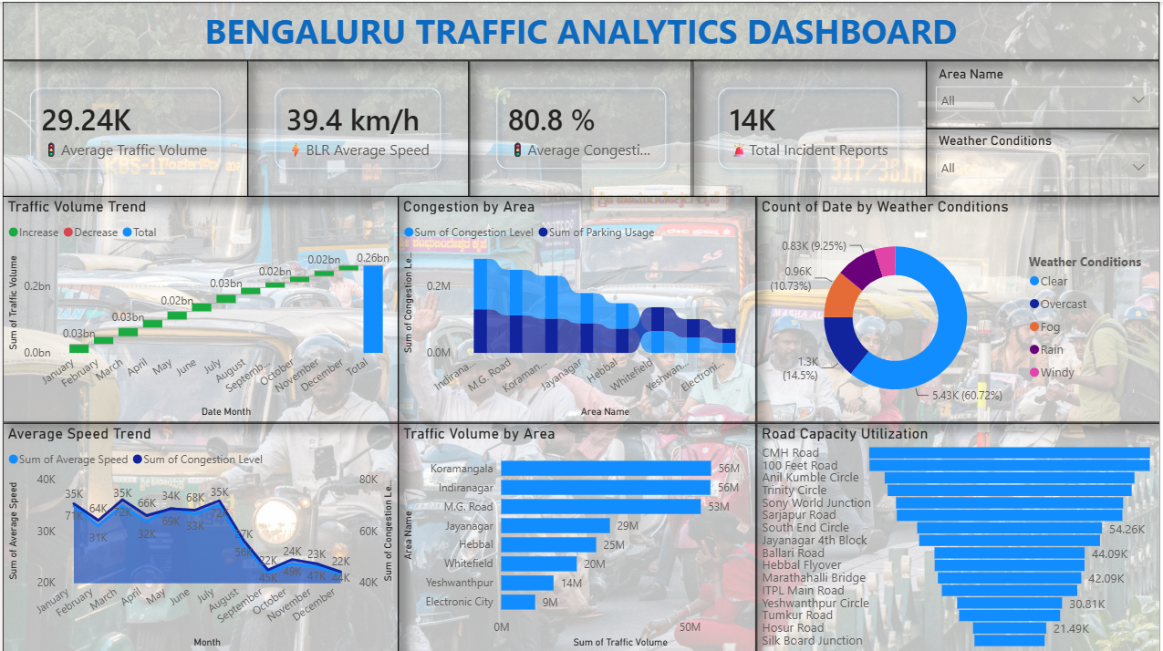
DASHBOARD DEEP-DIVE
Bengaluru Traffic Analytics
Congestion, road capacity and incidents across the city's busiest corridors
Average congestion sits at 80.8% with 14K total incident reports logged — the two headline numbers that define where intervention is most urgent.
The traffic-volume trend climbs steadily from January through August before easing into year-end, a pattern worth planning maintenance around.
Congestion-by-area bars single out Indiranagar and M.G. Road as the most congested corridors in the combined congestion and parking-usage load.
The road-capacity-utilization ranking tops out at CMH Road and 100 Feet Road — the clearest candidates for capacity expansion.
Most congestion occurs on clear-weather days (60.7%), confirming this is primarily a demand problem, not a weather problem.
80.8%
14K
29.24K
Traffic Analytics Dashboard — volume, congestion & road-capacity utilization
AVERAGE CONGESTION SCORE
TOTAL INCIDENT REPORTS
AVERAGE TRAFFIC VOLUME
Smart Urban Mobility and Traffic Intelligence Dashboard · Urban Pulse · Group 1 · DV-Team E
Infosys Springboard · 14 / 22

Slide 15
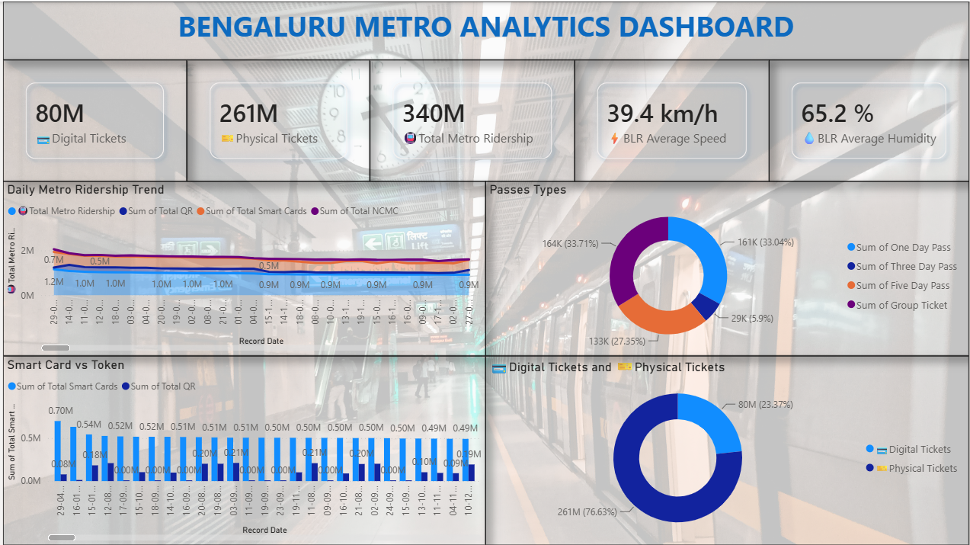
DASHBOARD DEEP-DIVE
Bengaluru Metro Analytics
Ticketing behavior and ridership trends across the metro network
340M total metro rides are logged, split 76.6% physical ticket vs 23.4% digital — the clearest digitization opportunity the platform surfaces.
The daily-ridership trend stays flat around 0.9–1.0M riders across the tracked window, pointing to a mature, saturated ridership base.
Smart-card usage consistently runs ahead of token/QR use, though neither channel is dominant yet.
One Day passes (33.0%) and Group tickets (33.7%) together make up two-thirds of all passes sold — a signal for multi-day pricing opportunities.
These ticketing patterns feed directly into the Executive Intelligence dashboard's ridership and mobility-health KPIs.
340M
76.6%
4
TOTAL METRO RIDERSHIP
PHYSICAL TICKET SHARE
PASS TYPES TRACKED
Metro Analytics Dashboard — ridership trend, ticket & pass types
Smart Urban Mobility and Traffic Intelligence Dashboard · Urban Pulse · Group 1 · DV-Team E
Infosys Springboard · 15 / 22

Slide 16
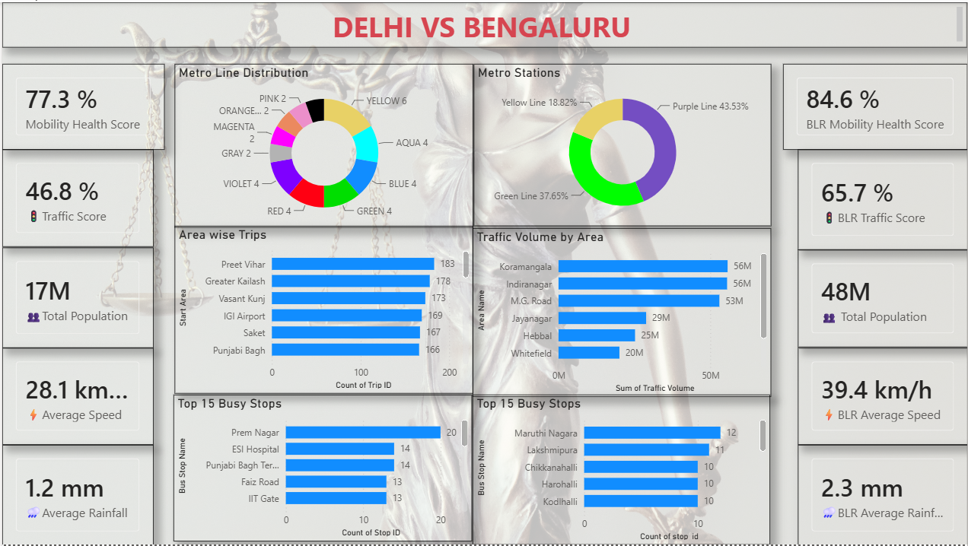
COMPARATIVE ANALYSIS
Cross-City Benchmarking
Comparative mobility health — Delhi vs Bengaluru
KEY TAKEAWAYS
Bengaluru's Mobility Health Score (84.6%) reflects a denser metro + bus network across a larger population base (48M vs 17M).
Bengaluru posts a higher average travel speed (39.4 km/h) than Delhi (28.1 km/h) in this sample corridor set.
Delhi's metro ridership skews toward the Purple and Yellow lines; Bengaluru's Green and Purple lines dominate.
Cross-city benchmarking helps prioritize which mobility interventions transfer well between metros.
Delhi vs Bengaluru — comparative mobility dashboard
Smart Urban Mobility and Traffic Intelligence Dashboard · Urban Pulse · Group 1 · DV-Team E
Infosys Springboard · 16 / 22

Slide 17
SYNTHESIS
Key Insights & Business Impact
What the numbers add up to, why it matters, and what we recommend doing about it
INSIGHT
INSIGHT
INSIGHT
Physical ticketing still dominates the metro (76.6%).
Bangalore North is the densest, highest-demand district.
Congestion averages 80.8% with 14K incidents logged.
IMPACT
IMPACT
IMPACT
Slower boarding, thinner ridership data and higher cash-handling overhead for operators.
Under-investment here compounds overcrowding faster than in any other zone.
Two corridors account for a disproportionate share of delays and safety risk.
RECOMMENDATION
RECOMMENDATION
RECOMMENDATION
Prioritize digital-ticket incentives to cut queue times and boost data granularity.
Front-load transit and micromobility infrastructure investment here first.
Target CMH Road and 100 Feet Road first for capacity and safety upgrades.
INSIGHT
INSIGHT
INSIGHT
Weather has a measurable but moderate effect on mobility.
Bike & e-scooter demand peaks sharply at two daily windows.
Bengaluru's Mobility Health Score (84.6%) leads the benchmark.
IMPACT
IMPACT
IMPACT
Fixed schedules over- or under-provision service on atypical-weather days.
Fixed rebalancing timers leave fleets empty or overstocked outside peak hours.
The underlying data model has already proven itself at city scale.
RECOMMENDATION
RECOMMENDATION
RECOMMENDATION
Build weather-adjusted forecasting rather than static, fixed schedules.
Shift to dynamic fleet rebalancing around commute peaks, not fixed timers.
Use Bengaluru's data model as the template for future city rollouts.
Smart Urban Mobility and Traffic Intelligence Dashboard · Urban Pulse · Group 1 · DV-Team E
Infosys Springboard · 17 / 22

Slide 18
UNDER THE HOOD
Technology Stack
The tools and platforms powering Urban Pulse, end to end
01
Data Sources
02
Data Preparation & Modeling
Public transit, ride-hailing, bike-share, weather and demographic data ingested from five external sources.
Schema standardization, cleansing and star-schema modeling before analytics begins.
KEY TOOLS
KEY TOOLS
GitHub
GTFS Feeds
Open-Meteo API
Govt. Handbooks
Power Query
Star Schema
DAX Measures
Incremental Refresh
Kaggle
03
Visualization & BI
04
Collaboration & Delivery
Nine interactive Power BI dashboards, one for every analytics module in the platform.
Agile, sprint-based delivery across four milestones with shared version control.
KEY TOOLS
KEY TOOLS
Power BI Desktop
Power BI Service
Geospatial Maps
GitHub
Agile Sprints
PowerPoint
Stakeholder Reviews
Drill-Through
Smart Urban Mobility and Traffic Intelligence Dashboard · Urban Pulse · Group 1 · DV-Team E
Infosys Springboard · 18 / 22

Slide 19
OUR TEAM
Team & Responsibilities
DV-Team E · Group 1 · 5-student, 8-week sprint
01
Data Engineer
02
Geospatial Analyst
03
Transit & Ride-Hailing Analyst
Sameer Singh / Deepak Gavhane
Sameer Singh / Deepak Gavhane
Chandushree J B
Data Acquisition & Integration · Database / Star Schema
Geospatial Mobility Analytics
Transit Performance Analytics · Ride-Hailing & Demand Intelligence
Collected & standardized transit, ride-hailing, bike-share, weather and demographic data; built ETL pipelines with incremental refresh; designed and loaded the star schema; ensured data-quality thresholds were met.
Built origin-destination flow analysis, accessibility & isochrone maps, congestion hotspot visualization, geographic drill-down and weather overlays.
Calculated reliability metrics, schedule adherence and headway variance; analyzed ride-hailing demand, surge behavior, modal substitution and fare elasticity.
04
Micromobility & Equity Analyst
05
BI Lead / Project Manager
Vaishnavi Gorakhanath Kshirsagar
Suyash Agrawaal
Cycling & Micromobility Analytics · Mobility Equity Analysis
Executive Intelligence & Forecasting · Project Coordination & QA
Tracked bike-share utilization & station availability, predicted rebalancing needs; calculated the Mobility Access Index (MAI) and identified underserved neighborhoods.
Built the City Mobility Health Score, forecasting & anomaly detection, executive dashboards; coordinated sprint planning, integration testing and stakeholder reporting.
Smart Urban Mobility and Traffic Intelligence Dashboard · Urban Pulse · Group 1 · DV-Team E
Infosys Springboard · 19 / 22

Slide 20
RETROSPECTIVE
Challenges & Solutions
Key issues encountered during the sprint and how the team resolved them
CHALLENGE
SOLUTION
Heterogeneous Data Formats
Built a standardized schema-mapping layer and automated cleansing workflows before loading into the shared star schema, so every dashboard reads from one validated source of truth.
Five independent sources — GTFS feeds, ride-hailing exports, bike-share logs and weather APIs — each shipped different schemas, units and identifiers, risking silent data-quality errors downstream.
CHALLENGE
SOLUTION
Defining a Fair Mobility Access Index
Benchmarked MAI against transit frequency, walk-time and income-quintile data to produce a normalized 0–100 score city planners can act on directly.
Comparing accessibility across demographic groups needed a normalized, defensible scoring method — an ad-hoc metric would have undermined the equity findings.
CHALLENGE
SOLUTION
Dashboard Performance at Scale
Optimized the star schema with incremental refresh and pre-aggregated tables, keeping every executive-level view fast under real data volumes.
Trip-level and transit-event-level fact tables grew large enough to slow interactive filtering, threatening the responsiveness executives expect from a live dashboard.
CHALLENGE
SOLUTION
Coordinating Five Parallel Tracks
Ran weekly sprint check-ins against a shared milestone tracker, catching integration gaps early and keeping all four milestones on schedule.
Five module owners working independently on a tight 8-week timeline risked integration drift between datasets, naming conventions and delivery dates.
Smart Urban Mobility and Traffic Intelligence Dashboard · Urban Pulse · Group 1 · DV-Team E
Infosys Springboard · 20 / 22

Slide 21
WHAT'S NEXT
Future Scope
Where Urban Pulse goes beyond this 8-week sprint
1
Scale to More Cities
Extend the same data model beyond Bengaluru and Delhi to additional Tier-1 and Tier-2 Indian cities.
2
Real-Time Data Refresh
Move from batch-based ETL to streaming refresh so dashboards reflect live operational conditions.
3
Public Equity Scorecard
Publish the Mobility Access Index as a public-facing scorecard for city administrators and residents.
4
Predictive Maintenance Alerts
Feed anomaly detection directly into transit-operator workflows and real-time alerting.
5
Citizen-Facing Companion App
Surface personalized, MAI-aware route recommendations for everyday commuters.
6
Open Data & API Access
Publish anonymized mobility datasets via a public API for researchers and civic-tech partners.
Smart Urban Mobility and Traffic Intelligence Dashboard · Urban Pulse · Group 1 · DV-Team E
Infosys Springboard · 21 / 22

Slide 22
INFOSYS SPRINGBOARD
Thank You
Smart Urban Mobility and Traffic Intelligence Dashboard · Urban Pulse — Smart City Mobility Intelligence Platform
We'd love to answer your questions.
PRESENTED BY
Sameer Singh
Data Engineer
Deepak Gavhane
Geospatial Analyst
Chandushree J B
Transit & Ride-Hailing Analyst
Suyash Agrawaal
BI Lead / Project Manager
Vaishnavi Gorakhanath Kshirsagar
Micromobility & Equity Analyst
DELIVERABLES
Unified Mobility Datamart
Power BI Dashboard (9 pages)
Final PPT Report
GitHub Repository
Infosys Springboard · Data Visualization Project · August 2026

