Slide 1
Universal Dependencies v1:
A Multilingual Treebank Collection

Slide 2
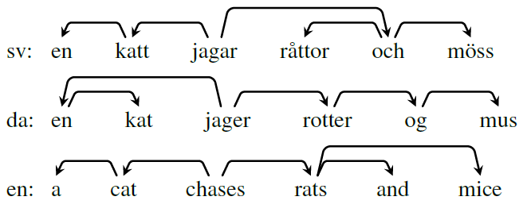
Question Statement
The syntactic information is critical in various NLP tasks.
However, existing treebanks vary in their annotation schemes across languages.
It’s therefore necessary to create cross-linguistically consistent treebank annotation for various languages, to encourage multilingual and cross-lingual researches.

Slide 3
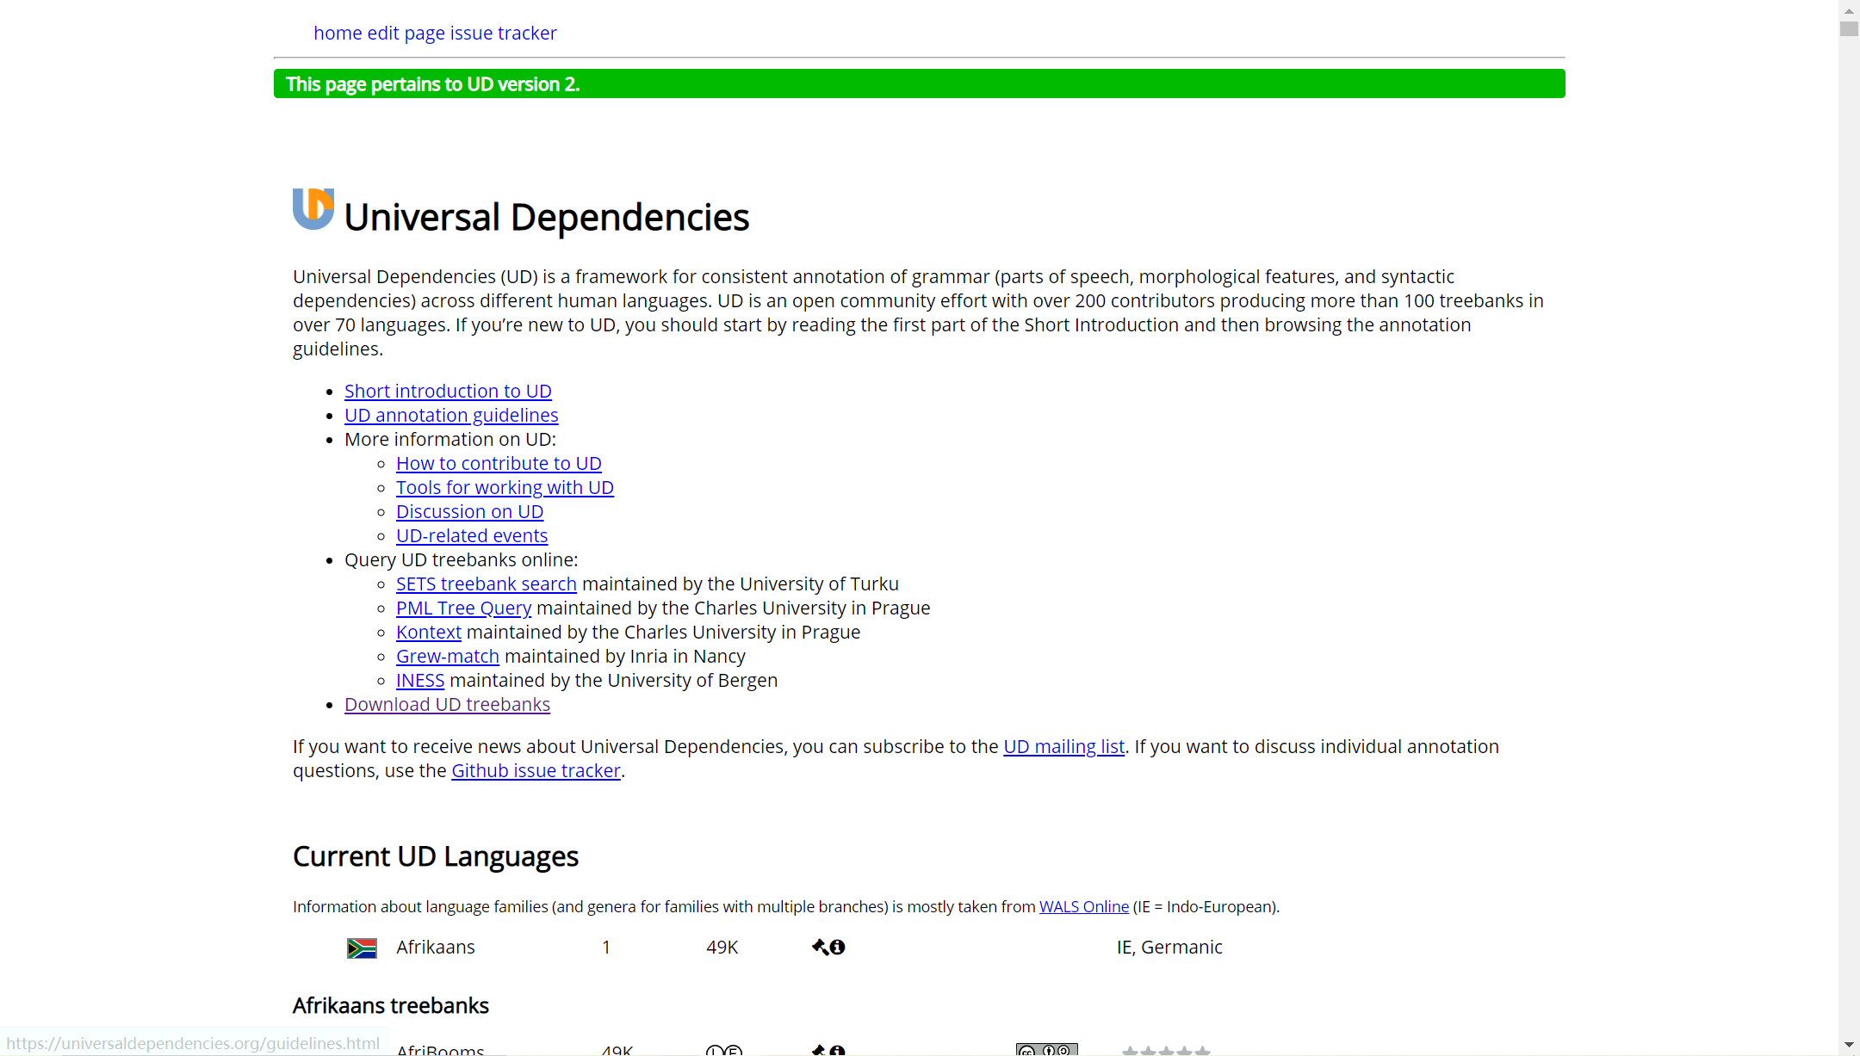
https://universaldependencies.org/

Slide 4
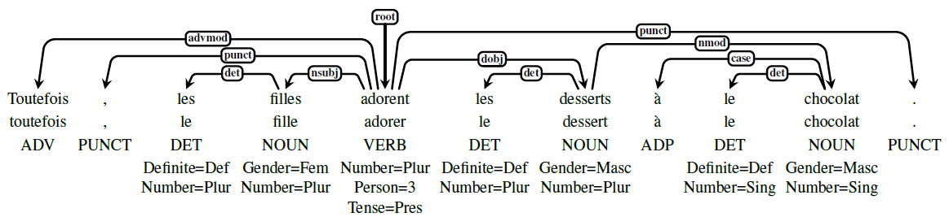
Dataset Annotation
General principles: To maximize the parallelism between languages and make sure that the same construction is annotated in the same way across languages, we use a universal pool of structural and functional categories that languages select from. Moreover, it should be possible to refine the analysis by adding language-specific subtypes of universal categories.
Principle 1: Word Segmentation
Clitics (附着语素) are split off (e.g., Spanish d´amelo ‘give me it’ = d´a me lo)
Do not allow words with spaces
Multiword expressions (idiosyncratic interpretations that cross word boundaries) are annotated using special dependency relations, rather than by collapsing multiple tokens into one.

Slide 5
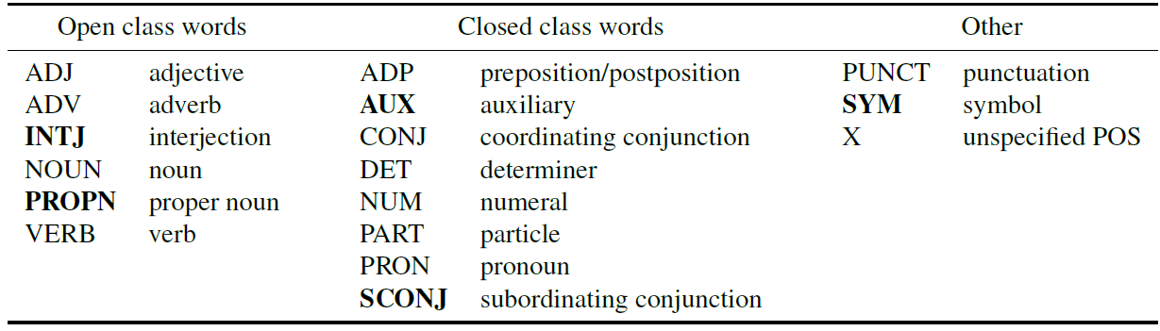
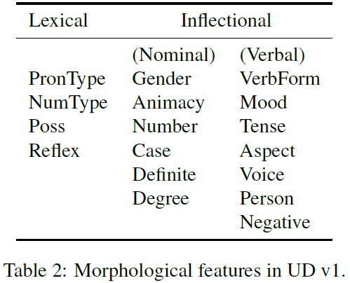
Dataset Annotation
Principle 2: Morphology
A lemma
A part-of-speech tag (not all categories have to be used in all languages)
A set of features which encode lexical and grammatical properties associated with the word form

Slide 6
Dataset Annotation
Principle 3: Syntax
UDv1 contains 40 grammatical relations between words
Grammatical Relations
The organization of the relations distinguishes between three types of structure: nominals, clauses and modifier words.
It also makes a distinction between core arguments (e.g., subject and object) and other dependents, but does not attempt to distinguish complements vs. adjuncts.
It also recognizes a non-canonical voice subject.
The UD scheme has a rich taxonomy of noun dependents inherited from the Stanford dependencies.
Use mwe for fixed grammaticized expressions with function words, left-headed (e.g., instead of : mwe(instead, of), de facto: mwe(de, facto)).
Use name for names constituted of multiple proper nouns.
Use compound to label other types of multiword lexeme.

Slide 7
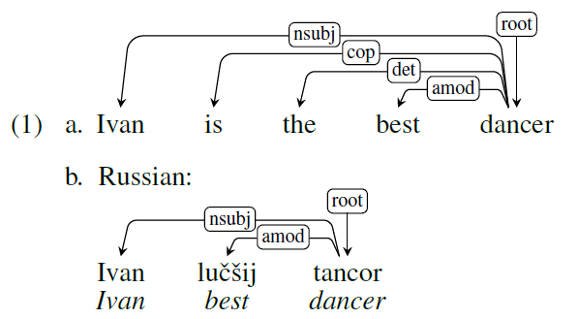
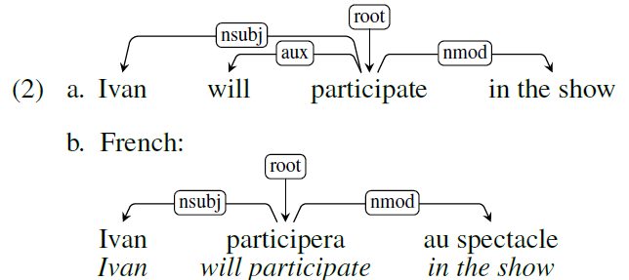
Dataset Annotation
Principle 3: Syntax
Relations between Content Words
Each word depends either on another word in the sentence or on a notional “root” of the sentence.
Three principles:
Content words are related by dependency relations;
Function words attach to the content words they further specify;
Punctuation attaches to the head of the phrase or clause in which it appears.

Slide 8
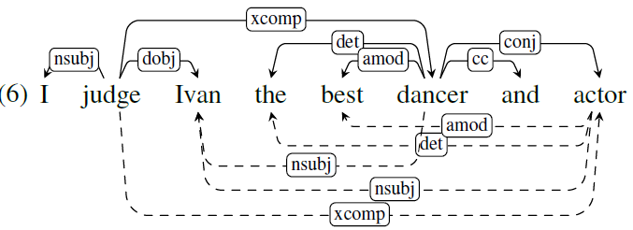
Dataset Annotation
Principle 3: Syntax
Enhanced Representations
UD allows additional dependencies in an enhanced dependency representation.
Explicitly mark external subjects and the external role in relative clauses as well as to propagate relations over conjunctions.

Slide 9
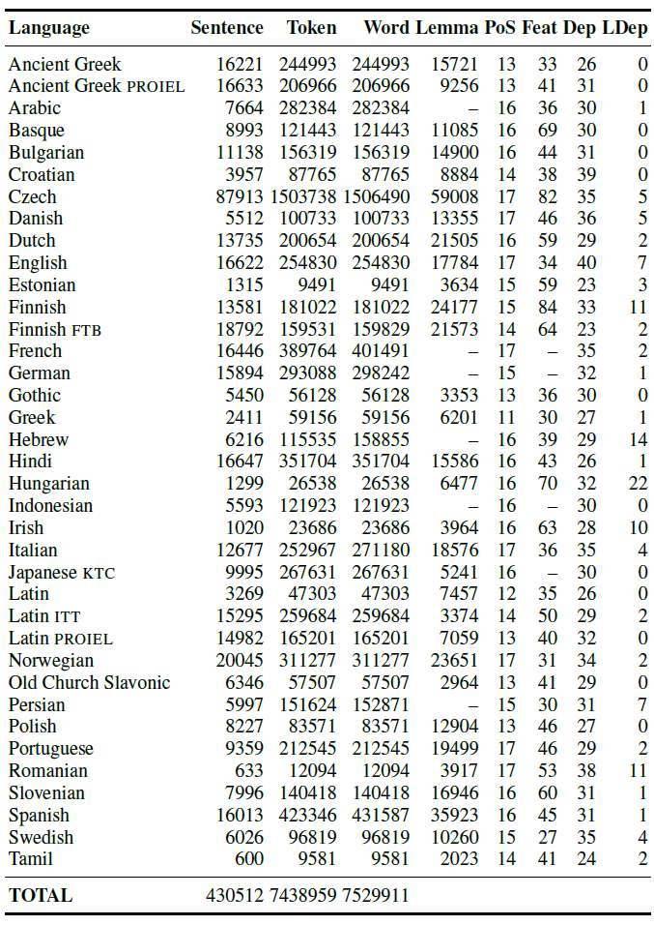
Dataset Annotation
Principle 3: Syntax
Language-Specific Relations
UD allows the use of language-specific subtypes to capture special phenomena in different languages.

Slide 10
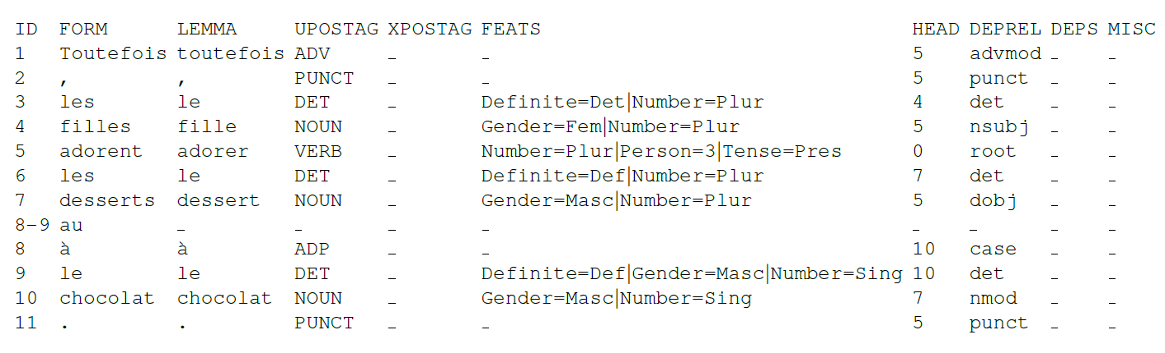
Dataset Annotation
Principle 4: Format and Tools
Data is encoded in the CoNLL-U format, which is an evolution of the widely used CoNLL-X format, where each word/token is represented in tab-separated columns on one line and sentence boundaries are marked by blank lines.

Slide 11
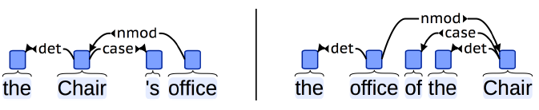
Dataset Annotation
Principle 4: Format and Tools
Python and JavaScript libraries for reading and validating CoNLL-U are provided.
Annotation visualizations generated using brat are also available (http://brat.nlplab.org/).
The treebanks can also be queried online using the SETS6 (http://bionlp-www.utu.fi/dep_search) and PML TreeQuery7 (http://lindat.mff.cuni.cz/services/pmltq/) tools.

