Slide 1
Transformer Embeddings
Pritha Ghosh
Daniel Xing
Matt Anderson
May 2026

Slide 2
Transformer Model Deep Dive

Slide 3
Executive Summary
Current Reality
Transformer Embeddings (TE) have consistently shown strong performance and efficiency gains over traditional feature engineering
However, today’s TE ecosystem is operationally fragmented, with separate pipelines, refresh cadences, and ownership across LOBs
The current TE foundation was trained under legacy constraints and does not support scalable, governed, cross-LOB adoption
What We’ve Done
Established a unified “latest” TE access layer across Commercial, Medicaid, and Medicare to unblock evaluation
Created a stable consolidated dataset for downstream users while underlying pipelines remain heterogenous
Completed TE v3 retraining and downstream evaluations
Constructed reusable TE explainability framework for better transparency
What’s Next
Align on inference strategy, refresh cadence, and migration approach for downstream models
Partner with downstream teams to validate performance, manage adoption, and sunset legacy embeddings
INTERNAL USE AND NOT FOR DISTRIBUTION OR RECIRCULATION

Slide 4
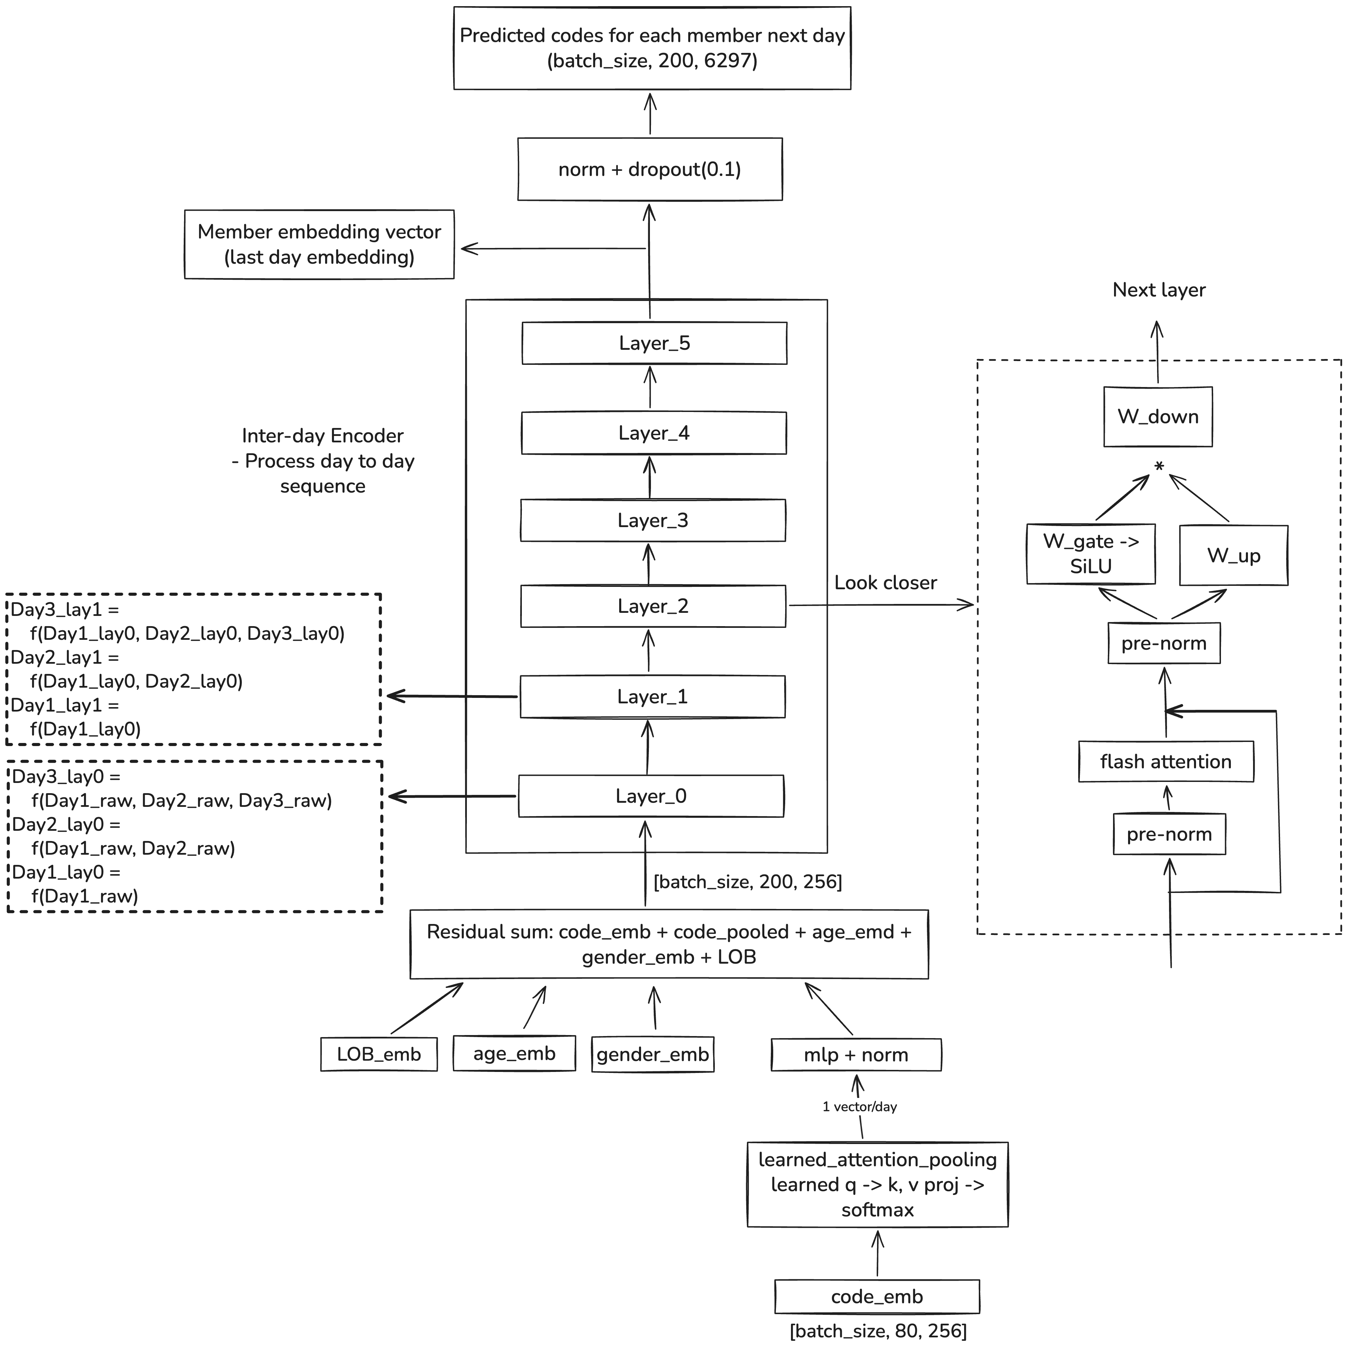
Model Architecture & Refactoring
Preserve hierarchical structure
Hierarchical structure for encoding within- (80 codes) and inter-day (200 days)
ICD-10 diagnoses, CPT procedures, GPI medications, DRG codes, revenue codes, provider taxonomy, and place of service
Trained to predict next-day medical codes (multi-label, 6,297 target groups)
Training & inference efficiency
Replace the single-layer transformer daily encoder with a learnt attention pooling layer
Replace the attention layer with flash attention to avoid GPU IO bottleneck and provides faster training with less GPU memory
Replace the regular FFN with SwiGLU FFN for stable training and context-aware feature selection
Optimize training strategy
Weighted BCE loss accounting for rare codes
Enable mixed precision training
SGD -> Adam learning rate optimizer
Head dimension 16 -> 32 (fit flash attention)
INTERNAL USE AND NOT FOR DISTRIBUTION OR RECIRCULATION
Notes:
Model architecture overview and modification rationale
Data augmentation for claim
Daniel A12.001
Danel2 A12.0

Slide 5
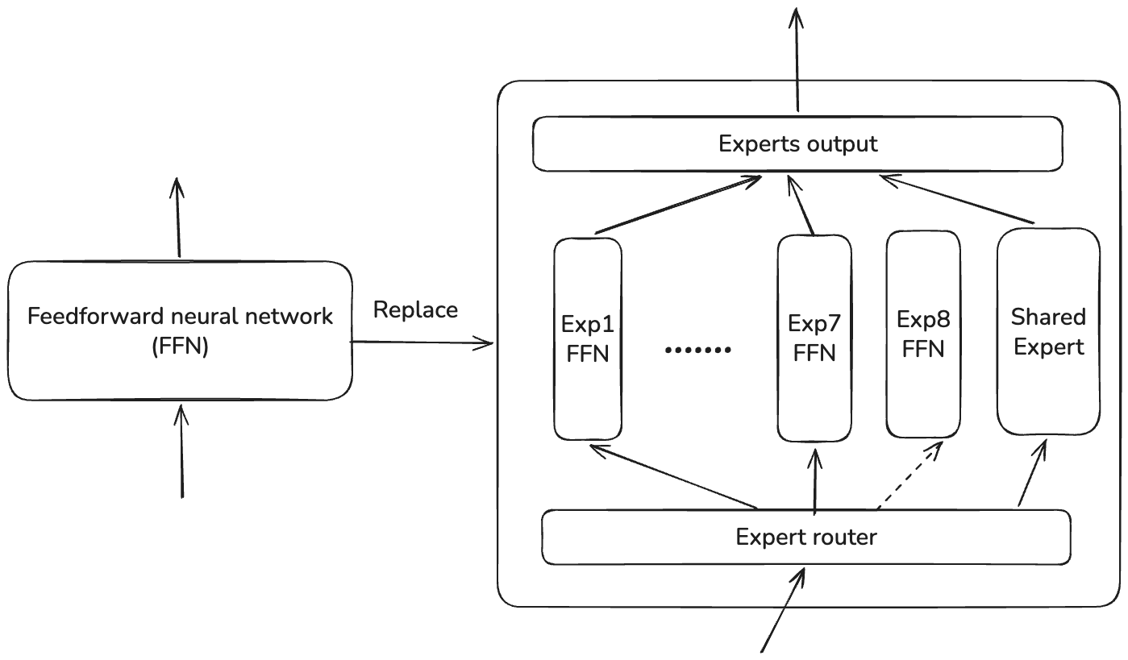
Mixture of Expert (MoE): right idea, wrong scale
Original hypothesis
Clinical population are heterogeneous. MOE let’s experts specialize per clinical taxonomy/member archetype
Expert collapse
Definition: a small subset of experts carries most of the useful computation, while others are underused.
Dilemma: The TE has to either sacrifice task performance for load balance or vice versa.
Potential root cause
Scale mismatch: MoE benefits emerges at larger LLM (> 1B parameters) and the model is taxed by routing overhead
Domain homogeneity: Clinical claims involves only one type of “language” but MoE benefits cross-domain language (natural language); e.g., the top 10% of code pairs explain 91.7% of all pair occurrences
Architecture | Recall@10 | Model param | Expert Collapse
TE v3 | 0.947 | 27.56M | --
MoE 8 experts | 0.830 | 35.07M | 0.6
MoE 7 + 1 shared | 0.832 | 34.94M | 0.48
MoE 16 experts | 0.774 | 34.26M | 3.83
MoE 7 + 1 shared + auxiliary loss | 0.835 | 34.90M | 0.13
MoE 7 + 1 shared + auxiliary free bias correction | 0.875 | 34.90M | 1.98
MoE 7 + 1 shared + auxiliary free bias correction (starting from layer 4) | 0.962 | 84.47M | 3.57

Slide 6
Transformer Embeddings Explainability Results

Slide 7
Making Transformer Embeddings Clinically Interpretable
Current Challenge
To operationalize transf
However, today’s TE ecosystem is operationally fragmented, with separate pipelines, refresh cadences, and ownership across LOBs
The current TE foundation was trained under legacy constraints and does not support scalable, governed, cross-LOB adoption
What We’ve Done
Established a unified “latest” TE access layer across Commercial, Medicaid, and Medicare to unblock evaluation
Created a stable consolidated dataset for downstream users while underlying pipelines remain heterogenous
Laid the groundwork for retraining on GCP, enabling evaluation, migration planning, and future standardization
What’s Next
Retrain TE model on a governed, cross-LOB GCP foundation
Align on inference strategy, refresh cadence, and migration approach for downstream models
Partner with downstream teams to validate performance, manage adoption, and sunset legacy embeddings
INTERNAL USE AND NOT FOR DISTRIBUTION OR RECIRCULATION

Slide 8
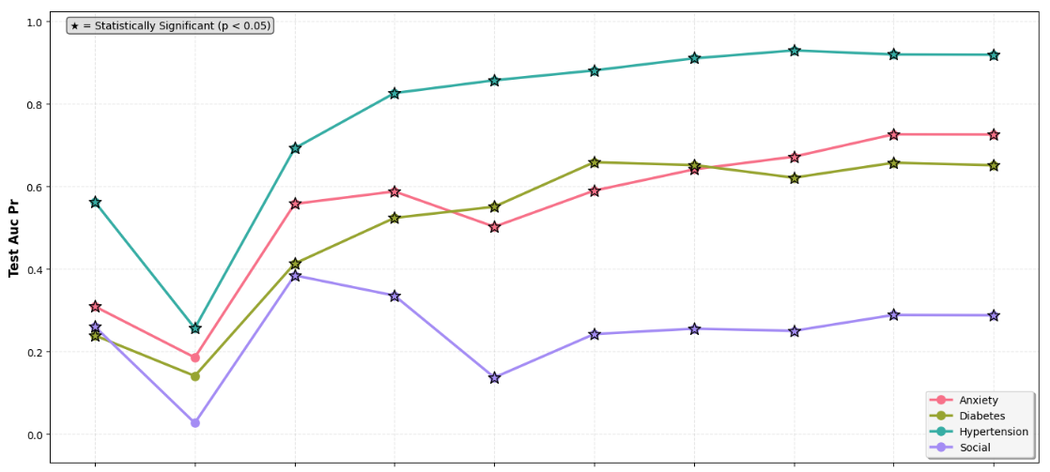
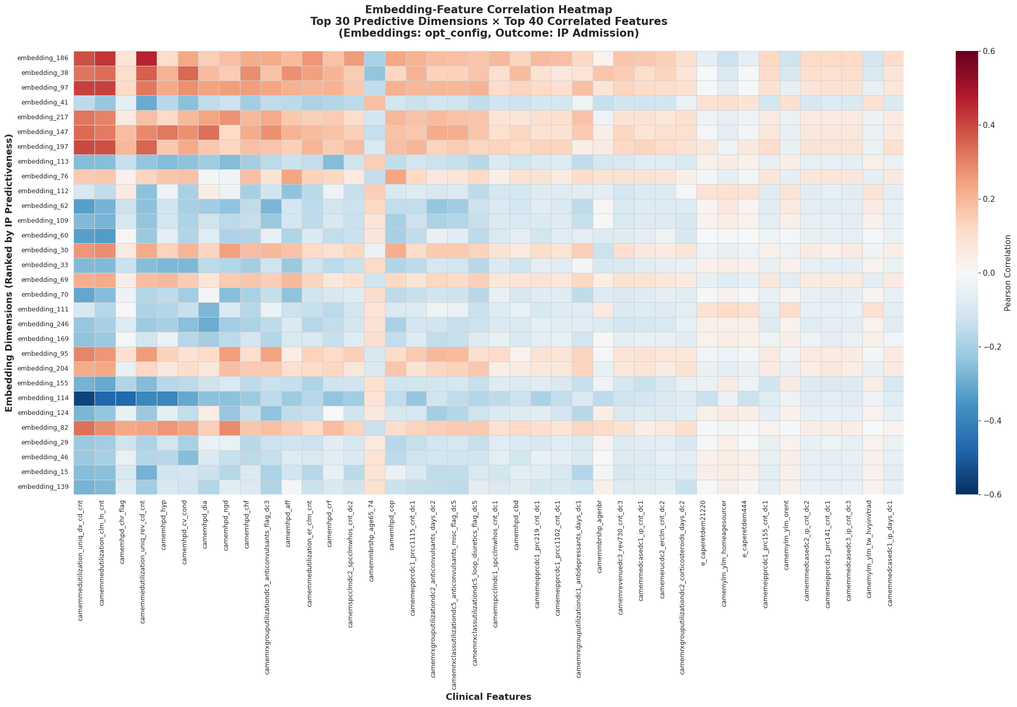
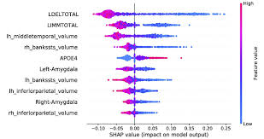
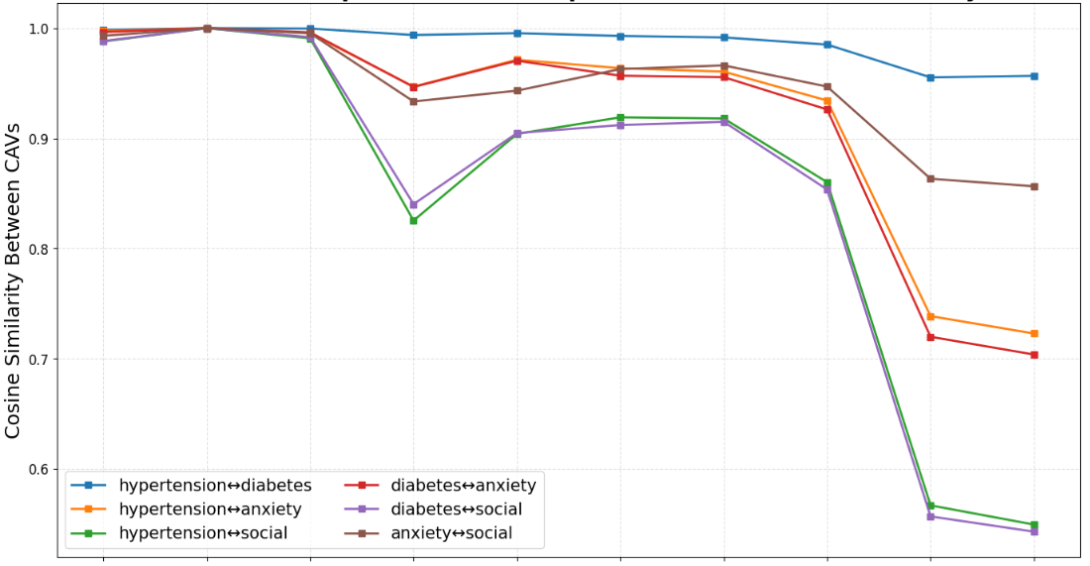
Methodology review in TE explainability
Task-agnostic
(Model behavior)
Task-oriented
Semantic meanings of the embedding
Primary driver of predictions
TCAV + LLM
Model learning dynamics and concept representations
Correlation between a given TE dimension with traditional features, e.g., emb154 is associated with diabetes in Medicaid; emb186 encodes claims volume and utilization patterns
Identify importance of specific embedding dimensions on downstream classification tasks by measuring effects of removing such dimensions
TO BE EDITED (PRITHA method)
Dissect the transformer model layer-by-layer to understand what clinical concepts are learned, where they are encoded, and how the learning information evolves through the network's depth
Gemini: “The member faces a high likelihood of inpatient admission in the next three months due to several compounding clinical factors…...“

Slide 9
TE explainability framework
What stakeholders really want to understand?
Semantic meanings of the embedding dimensions and the impact of each dimension on the downstream classification tasks
TE learning progression and how it builds the clinical understanding internally
The ”explainability” means differently to DS to CM; extra efforts are needed when communicating with CMs.
What principles we should follow?
Faithfulness: The explanation should accurately reflect the models’ true behavior, not post-hoc rationalization; and align with domain knowledge and expectations
Consistency: The same inputs yield the same explanations across contexts (i.e., cross population, upstream-downstream)
Transparency: The transparency should be operated at three levels, i.e., algorithm, procedure and limitations; caution on LLM-based explanation
Completeness: Explanations should capture a sufficient portion of the outputs and model behaviors
What methods we need?
Simple correlation with traditional features with directional check
Task-driven methods include Shapley value, LIME
Model behaviors methods include test with concept activation vector (TCAV), linear probing, attention mechanism visualization
Experts’ generated meaning clinical concepts and ground truth

Slide 10
How the framework creates reliable dimension labels
Design Choice | What We Do | Why | What Happens Without It
Define Concepts | Curate claims-based HPD, utilization, behavioral concepts | Gives the framework meaningful labels to test against the embedding space | Poor concept definitions create misleading explanations
Matched Cohorts | Match positives to controls on age, gender, LOB, chronic conditions, and utilization intensity | Isolates the clinical signal by reducing demographic and comorbidity confounding | A diabetes probe learns “old + high utilization = diabetic”. You get a demographic classifier, not a clinical one
Bootstrap Probes | Train repeated L2-regularized logistic regression probes on resampled matched cohorts; keep stable associations | Separates reproducible signal from sampling noise | One-off noisy dimension labels enter the dictionary
Rank & Assign Concepts to Dimensions | Percentile-rank dimension importance within each concept; assign top stable concepts per dimension | Creates a reusable dimension dictionary without comparing raw weights across concept models | Misleading comparisons across concepts with different prevalence, cohorts, and scales
Generate Narratives | Rule-based stability and coherence tiers + Gemini-generated clinical summaries | Makes the dictionary understandable and usable by downstream teams | Users see technical labels without enough clinical concept

Slide 11
Appendix

Slide 12
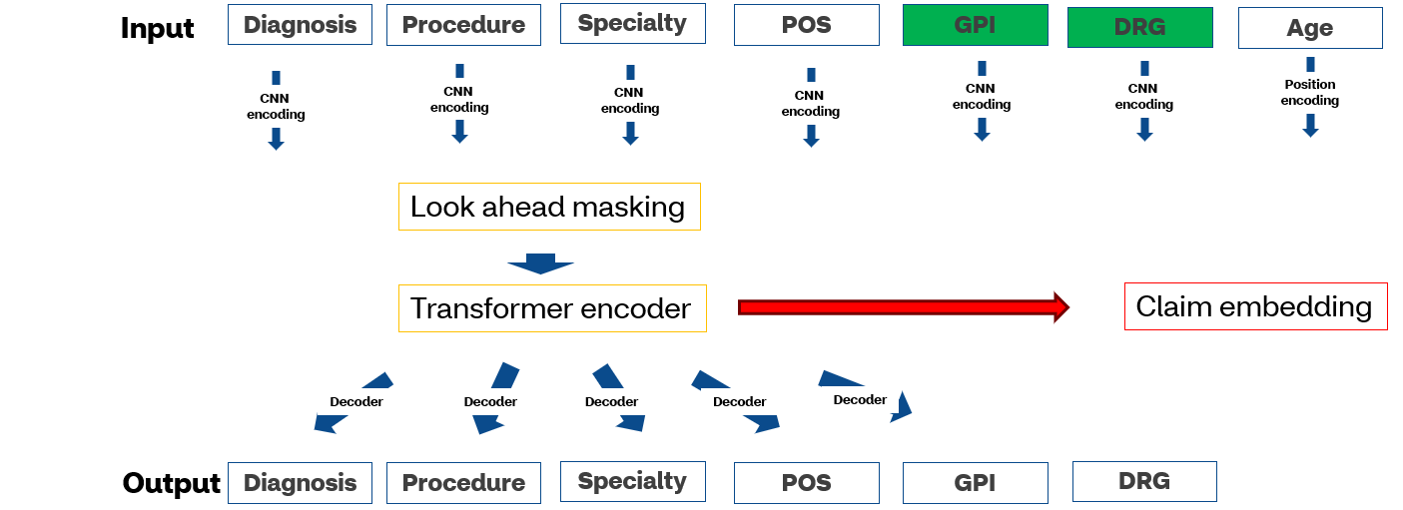
What Are Transformer Embeddings (and why we use them)
Introduction
Transformer Embeddings (TE) summarize a member’s entire medical history into a single, dense representation that models sequence, timing, and context – not just counts
Medical events are treated as a time-ordered sequence, not independent rows
The model learns relationships across diagnoses, procedures, settings, and time
More recent and more relevant events naturally matter more
Why this is better than traditional features
Captures order and timing, not just frequency
Handles irregular, sparse medical data naturally
Reduces hundreds of hand-crafted features into a single reusable signal
Improves performance across many downstream models, not just one
INTERNAL USE AND NOT FOR DISTRIBUTION OR RECIRCULATION

Slide 13
Why Retraining Is Necessary: Rebuilding the Embedding Foundation
Core Reasons for Retraining
Retaining is not a routine model refresh – it is required to rebuild transformer embeddings on a governed, scalable GCP foundation that supports long-term enterprise use
Establish a governed and reusable foundation
Current embeddings were trained on legacy, undocumented pipelines
Training data lineage was not preserved during migration to GCP
Improve coverage and population representativeness
Inclusion of Medicaid for full population representation
Better generalization across diverse member cohorts
Alignment with current utilization patterns, not legacy behavior
Dimension | Current State (V2) | Retrained State (V3)
Data Coverage | Commercial, Medicare from 2016 | All LOBs – Commercial, Medicare, Medicaid from 2023
Infrastructure | Legacy Hadoop, undocumented | Fully migrated and governed on GCP
Coverage | Limited data sources | Expanded to include GPI, DRG and National Provider Taxonomy
Governance | None | Full lineage, reproducibility, and metadata tracking
Key Takeaway: To move from a shared access layer to a true shared product, retraining is required to ensure governance, representativeness, and long-term scalability
INTERNAL USE AND NOT FOR DISTRIBUTION OR RECIRCULATION

