Slide 1
Transformer Embeddings
Pritha Ghosh
Daniel Xing
Matt Anderson
January 2026

Slide 2
Model Architecture & Training Ablations

Slide 3
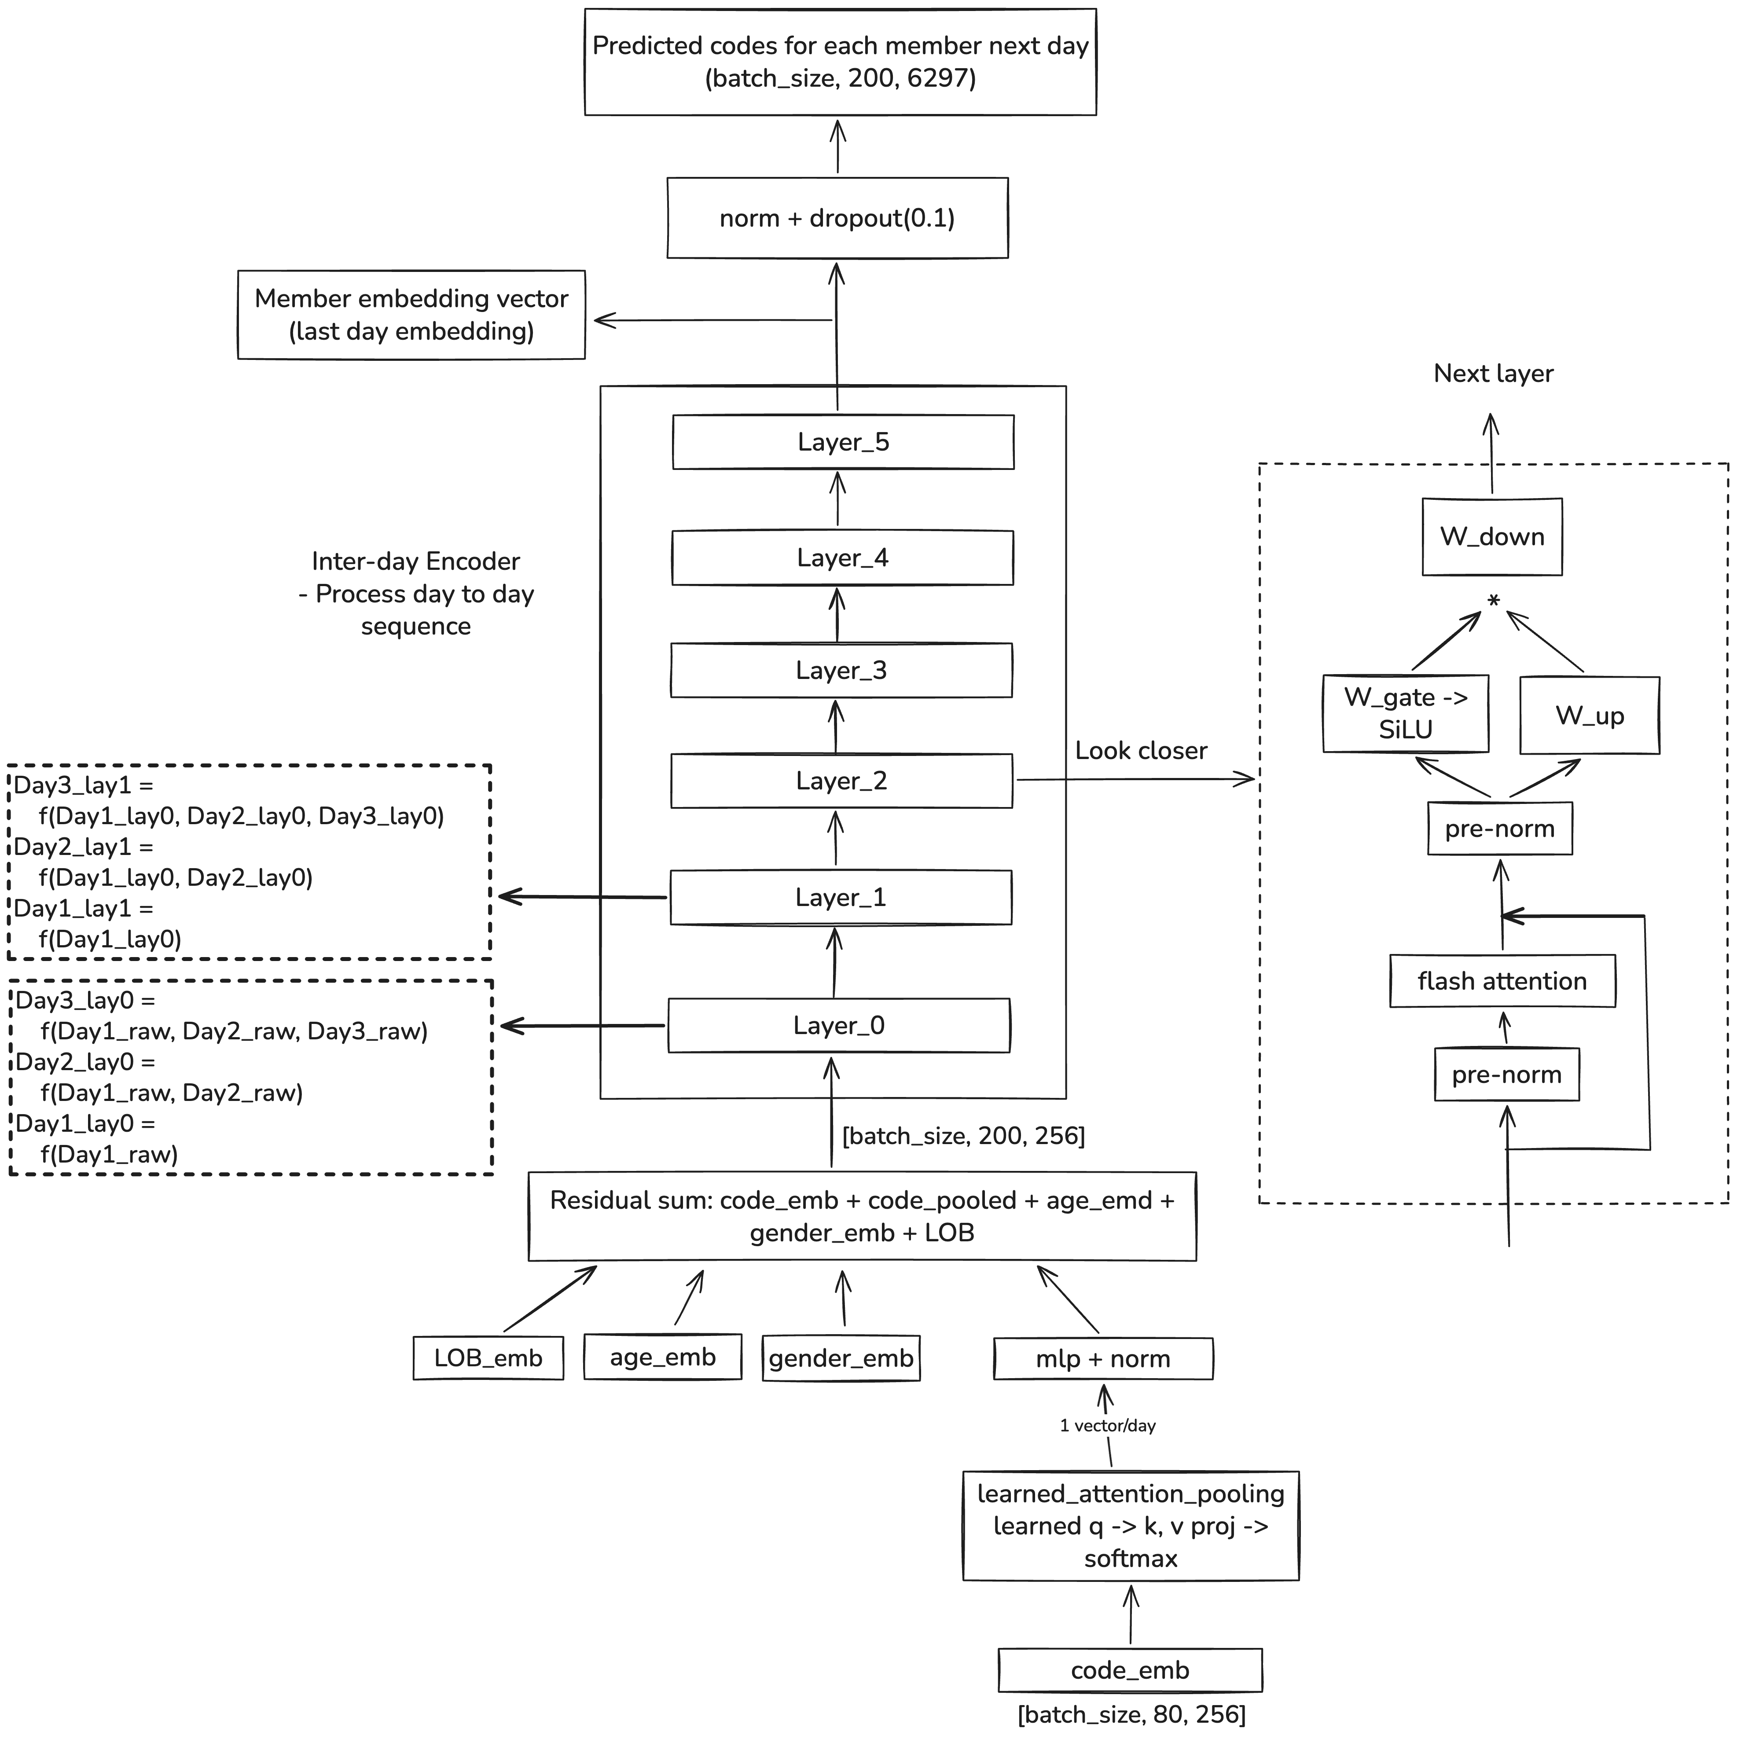
Model Architecture and Refactoring
Preserve hierarchical structure
Hierarchical structure for encoding within- (80 codes) and inter-day (200 days)
Trained to predict next-day medical codes (multi-label, 6,297 target groups)
Training & inference efficiency
Replace the attention layer with flash attention (FA) to avoid GPU IO bottleneck and provides faster training with less GPU memory
Replace the regular FFN with SwiGLU FFN for stable training and context-aware feature selection
Optimize training strategy
Weighted BCE loss accounting for rare codes
Enable mixed precision training
SGD -> Adam learning rate optimizer
Head dimension 16 -> 32 (fit flash attention)
INTERNAL USE AND NOT FOR DISTRIBUTION OR RECIRCULATION
Notes:
Model architecture overview and modification rationale
Data augmentation for claim
Daniel A12.001
Danel2 A12.0

Slide 4
Ablation Results
Data
Commercial: 1.06M
Medicare: 0.56M
Medicaid: 0.13M
Day count > 10
Time period: 1/1/2023 – 12/31/2023
Claim lookback period: 36 months with 90d delay
Full input codes: 75.51k
Target codes: 6.30k
Ablation config.:
Legacy baseline: Dense + legacy config
Exp2: Dense + optimized config (OC)
Exp3: Dense + OC + flash attention (FA)
Exp4: MOE + FA + OC
One epoch
Infrastructure:
GPU: T4 * 4 (16GB HBM each)
Machine type: n1-highmem-64
Data parallelism applied
Observations
Optimized training strategy achieves over 2x improvement in prediction performance
Flash attention reduced training cost by 34% and reduced GPU memory usage by 61%
MOE matched dense model performance
Notice: intrinsic metrics captures only internal metrics for training quality and outcomes on predicting next day’s labels; downstream evaluation provides definite and business-driven measure of the embedding quality.
Ablation config. | Recall @10¹ | Precision @10² | Micro Recall@10³ | NDCG @10⁴ | Training time (hrs) | GPU peak memory (GB)
Random reference | 0.007 | 0.001 | 0.002 | 0.001 | NA | NA
Legacy model (baseline) | 0.579 | 0.120 | 0.234 | 0.169 | 6.15 | 28.29
Optimized model | 0.825 | 0.235 | 0.478 | 0.401 | 9.65⁵ | 20.58
Optimized + FA | 0.828 | 0.237 | 0.462 | 0.398 | 4.09 | 11.13
Optimized + FA + MOE | 0.827 | 0.237 | 0.461 | 0.399 | 4.74 | 13.39
1. Recall@10: fraction of members have at least 1 correct code in top-10 predictions
2. Precision@10: fraction of correct predictions at top-10 predictions
3. Micro-recall@10: fraction of true codes found in top-10 predictions
4. NDCG@10 (normalized discounted cumulative gain at top-10), indicates ranking quality, where 1 is perfect and 0 is none is relevant at top10 predictions
5. Due to the constraints of GPU memory and use of data parallelism, this experiment used 16 batch size instead of 32. The training time, given more advanced GPU, should be less than 6 hours
INTERNAL USE AND NOT FOR DISTRIBUTION OR RECIRCULATION

Slide 5
Model Explainability

Slide 6
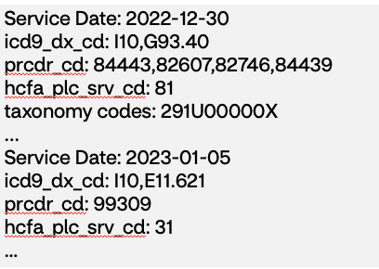
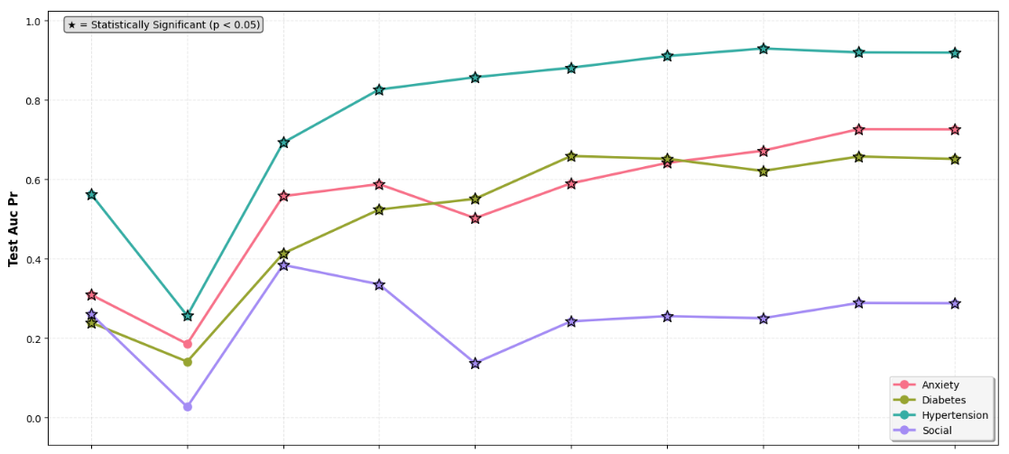
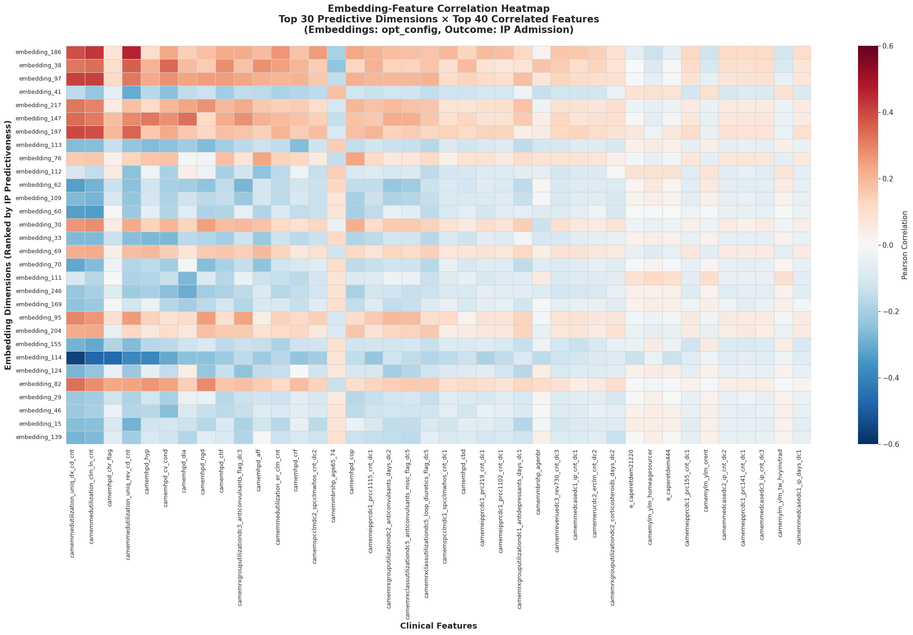
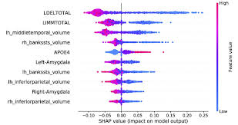
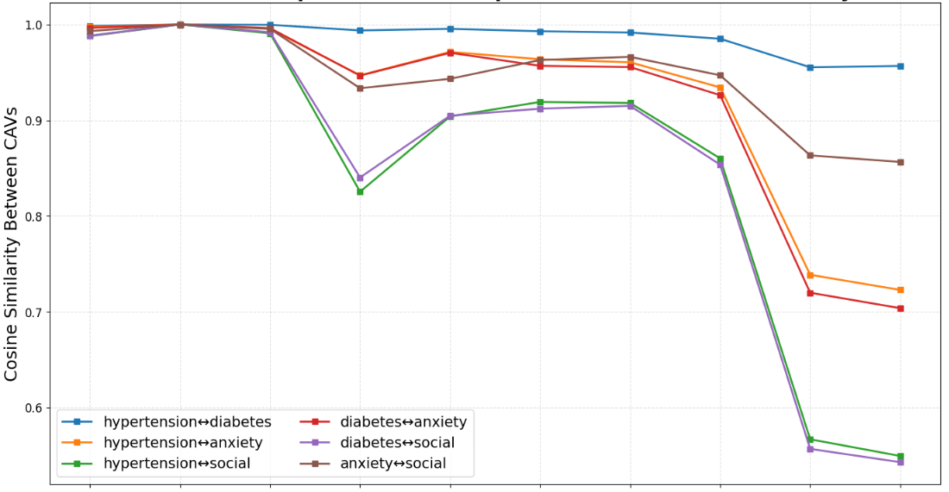
Review of previous work in TE explainability
Task-agnostic
(Model behavior)
Task-oriented
Semantic meanings of the embedding
Primary driver of predictions
Primary driver of prediction – LLM
Model learning dynamics and concept representations
Correlation between a given TE dimension with traditional features, e.g., emb154 is associated with diabetes in Medicaid; emb186 encodes claims volume and utilization patterns
Identify importance of specific embedding dimensions on downstream classification tasks by measuring effects of removing such dimensions
Use LLM to directly generate reasoning and explanations of the prediction outcomes, given the raw claim inputs and derived feature importance.
Dissect the transformer model layer-by-layer to understand what clinical concepts are learned, where they are encoded, and how the learning information evolves through the network's depth
Member A:
LLM
Gemini: “The member faces a high likelihood of inpatient admission in the next three months due to several compounding clinical factors…...“

Slide 7
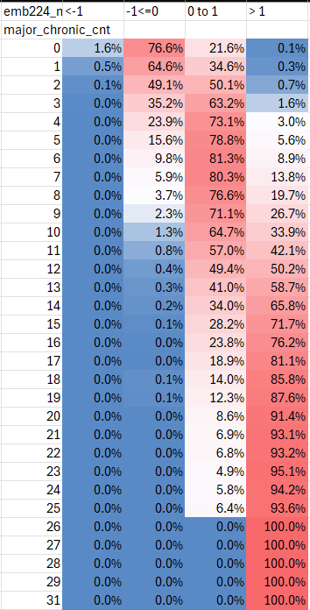
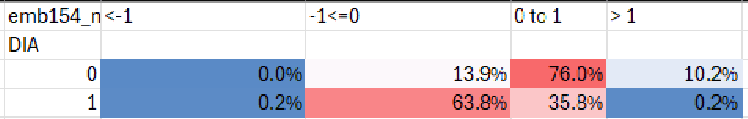
Semantic meanings of embeddings with correlation
Embedding 224 is associated with nearly everything
Most statistically significant association is major chronic count
Directionality check shows higher value indicative of greater disease burden
Strong future IP risk associations has been found in all LoBs
Embedding 154 is the top embedding associated with diabetes across LoBs
Directionality check shows that a lower embedding value is indicative of having diabetes (Medicaid shown)
Notes:
Results (secondary): We can give a global interpretation of the TEs by looking at traditional feature associations. This will be helpful for segmentation analyses and population explanations, even if they aren’t what we set out to do (individual explanations).

Slide 8
Primary driver of prediction – LLM
Service Date: 2022-12-30
icd9_dx_cd: I10,G93.40
prcdr_cd: 84443,82607,82746,84439
hcfa_plc_srv_cd: 81
taxonomy codes: 291U00000X
...
Service Date: 2023-01-05
icd9_dx_cd: I10,E11.621
prcdr_cd: 99309
hcfa_plc_srv_cd: 31
…
Reasoning narrative:
The member faces a high likelihood of inpatient admission in the next three months due to several compounding clinical factors.
Complex Diabetes with Complications: Uncontrolled Type 2 Diabetes, evidenced by recurrent foot ulcers, cellulitis, abscesses, and osteomyelitis, presents a continuous risk for severe infections and surgical needs. The recent inpatient stay for these issues underscores this vulnerability.
Advanced Cognitive Impairment: Diagnoses of Alzheimer's disease, metabolic encephalopathy, and altered mental status increase the risk of self-neglect, medication non-adherence, falls, and inability to manage acute symptoms, often necessitating hospitalization.
Recurrent Infections and Dehydration: Episodes of C. difficile enterocolitis and urinary tract infections, coupled with dehydration, indicate a fragile immune system and poor physiological reserve, making the member susceptible to acute medical crises.
Multisystemic Disease: The combination of cardiovascular disease, cognitive decline, and chronic infections creates a complex clinical picture where an exacerbation in one system can quickly lead to decompensation requiring acute hospital care.
Claim history into TE
+
Gemini Flash 2.5 & prompt
# of claim lines in the past 6 months: 20.86,
age: 80.0,
# of PCP visits in the past 3 months: 1.0,
# of days from recent rx to index_dt: 20.0, Dementia condition: 1.0
…
Other individualized top non-TE features by SHAP
Notes:
NOTE: CM and DS products differ due to governance and legal requirements. We can use approximates and risk some hallucination. Clinical cannot (good enough for interpretation, not action). Get original features into gemini, SHAP values didn’t make sense, we just used to individualize the most important non-TE features for a given member.

Slide 9
Model behavior with probing and CAV – what clinical concepts are learned and where
Key clinical concepts are captured well over the architecture
The concept information accumulates over layers and the capability varied across the clinical concepts
The transformer encodes both shared and specialized information about concepts
It starts to differentiate different clinical concepts approaching the end of layers
Figure 1: Performance of the transformer encoding different clinical concepts, indicated by probe classifier AUC-PR in predicting the presence of a concept within a Medicaid sampled population.
Figure 2: Cosine similarity between clinical concept vectors, indicating how much specialized information each layer encodes for a concept.
INTERNAL USE AND NOT FOR DISTRIBUTION OR RECIRCULATION
Notes:
Picking up more knowledge at each layer (left).
TE not capturing social well because there are not a lot of data that go into it. Size of the data we input for a concept set is important.
(right) concept vectors – representation of each clinical concept. Similarity between them, the layer is picking up common knowledge shared across the concepts. High cosine similarity = higher variance, lower specific information captured in that layer First three layers pick up “common knowledge”, no differentiation. Each layer is picking up some of that differentiation. Layers function differently in how they encode and transfer the information. Need to be careful with understanding. Sepeartion shows where the model has learned something new about the various concepts and hwo they are different.

Slide 10
TE explainability framework
What stakeholders really want to understand?
Semantic meanings of the embedding dimensions and the impact of each dimension on the downstream classification tasks
TE learning progression and how it builds the clinical understanding internally
The ”explainability” means differently to DS to CM; extra efforts are needed when communicating with CMs.
What principles we should follow?
Faithfulness: The explanation should accurately reflect the models’ true behavior, not post-hoc rationalization; and align with domain knowledge and expectations
Consistency: Similar inputs yield similar explanations across contexts (i.e., cross population, upstream-downstream)
Transparency: The transparency should be operated at three levels, i.e., algorithm, procedure and limitations; caution on LLM-based explanation
Completeness: Explanations should capture a sufficient portion of the outputs and model behaviors
What methods we need?
Simple correlation with traditional features with directional check
Task-driven methods include Shapley value, LIME
Model behaviors methods include test with concept activation vector (TCAV), linear probing, attention mechanism visualization
Experts’ generated meaning clinical concepts and ground truth

Slide 11
Method 1 – Concept Activation Vectors (CAV)
Objective
Make the embeddings interpretable using Concept Activation Vectors (CAV) to identify which embedding dimensions encode clinically meaningful information
Method
Defined 74 claims-based clinical concepts across 9 categories – Chronic Conditions, Cardiovascular Conditions, Neurological & Mental Health, Cancer & Complex Care, Acute Events, Utilization Patterns, Risk Factors, Care Coordination and others
Generated member-level labels from the same data used to train the transformer
Used CAVs to test which embedding dimensions predict each concept
What is CAV?
Train a linear classifier (logistic regression) to predict each concept from the embeddings
How to interpret CAV weights:
Positive weight: Higher dimension value -> Higher probability of concept
Negative weight : Higher dimension value -> Lower probability of concept
Large absolute weight: This dimension is important for this concept
Results (Partial)
Dim 97 (Importance 0.492) : Members with higher values have Chronic Kidney Disease, often with metabolic and respiratory comorbidities (obesity, sleep apnea)
Dimension 38 (Importance 0.478): Members experiencing severe acute medical events such as ER use, IP, surgical procedure, myocardial infarction, pneumonia
Dimension 52 (Importance 0.423): Identifies members undergoing cancer treatment or with severe frailty markers like malnutrition, seizures
Dimension 189 (Importance 0.397): Members experiencing sepsis, frequent IP visits and other surgical procedures

Slide 12
Semantic meanings of embeddings with correlation
Strong alignment with utilization and disease burden signals
Diagnosis count
Total claim lines
Revenue code count
Chronic condition indicators – Hypertension, Diabetes, CVD
Embeddings encode patterns of healthcare interaction
Dimensions reflect overall care intensity and complexity
Chronic disease burden (CHF, Hypertension, Diabetes, CV condition) emerge implicitly, which are key risk drivers
Embedding_186 (illustrative)
Higher claim volume and diverse service usage
Frequent acute utilization (ER visits)
Representative of high-touch, more complex members
This single dimension captures multi-feature clinical and utilization patterns that would otherwise require many hand-engineered variables

Slide 13
High-Quality, Interpretable Embeddings with Actionable Insights
Validation : Stability & Robustness
Sample Results
Quality Metric | Value | Interpretation
Directional Consistency (avg sign-rate) | 99.9% | Directions are consistent across bootstrap resamples
Mean Stability (std dev) | 0.06 | Coefficient estimates show low dispersion across samples
Dimensions with clinical meaning | 184/256 | 72% of dimensions have >=1 stable concept association
Dimension | Clinical Pattern | Example Concepts | Stability
234 | Metabolic – Renal | Diabetes (+0.32), Dialysis (-0.31) | 100% (2 concepts)
40 | SDOH | Financial Strain (+0.13) | 99% (1 concept)
211 | Cardiovascular | Heart Failure (+0.56) | 100% (1 concept)
210 | Acute Utilization | ER (+0.91) , Preventable ER (+0.84), Preventative care (-0.32) | 100% (7 concepts)

Slide 14
Member-Level Explainability Framework
Method
Step 1 – Load member embedding
256-dimensional vector summarizing clinical history
Step 2 – Concept Scoring
For each clinical concept:
Apply trained concept detectors
Detect whether the embedding contains signals for that concept
Produce a concept score
Step 3 – Dimension Attribution
Identify which embedding dimensions contributed most to the score
Contribution = Member Value x Concept Weight
Step 4 – Clinical Interpretation
Link important dimensions to their meanings using the global dimension dictionary
Example: High ER Utilizer
Step 1 – Concept Scores
Any ER Visit : 0.92
Preventable ER Visit: 0.81
Pneumonia: 0.73
Poor Care Coordination: 0.58
Step 2 – Top Contributing Dimensions
Dimension 210: +0.48, Dimension 52: +0.35, Dimension 29: +0.31
Step 3 – Clinical Interpretation (LLM-Enhanced)
Example output :
This member demonstrates a high-risk emergency utilization profile, with 92% ED visit likelihood and 81% preventable ED likelihood. The primary driver is Dimension 210, which captures emergency-driven care engagement and inverse associations with preventive behaviors, suggesting reactive rather than proactive healthcare interactions

