Slide 1
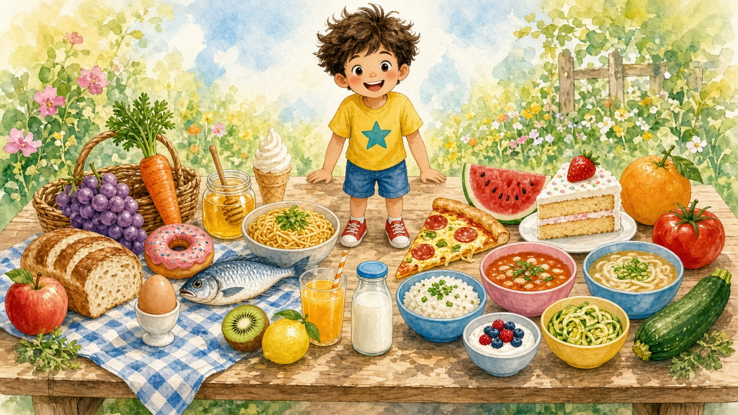
A to Z Foods
Sentence Flashcards
Beginner ESL · A1 · Ages 5–9
24 foods · cook · tools · origins · ingredients

Slide 2

How to use this set
Teacher / Parent Guide
1 Show and read
Word List (24) — skip Q & X
Look at the food picture. Read the sentence. The child repeats. Point to the big letter.
A. apple
M. milk
2 Name the details
B. bread
N. noodle
Point to the small pictures on the left and say each word together.
C. carrot
O. orange
D. donut
P. pizza
3 Talk the angle
E. egg
R. rice
Right side rotates: how you cook it · what you cook with · where it comes from · ingredients.
F. fish
S. soup
G. grape
T. tomato
4 Worksheets
H. honey
U. udon
Worksheet 1: Circle & Match. Worksheet 2: Alphabet Find.
I. ice cream
V. vanilla
J. juice
W. watermelon
5 Category + extras
K. kiwi
Y. yogurt
Food Group Sort, then optional Cook Match, World, Build a Dish, Picnic.
L. lemon
Z. zucchini

Slide 3


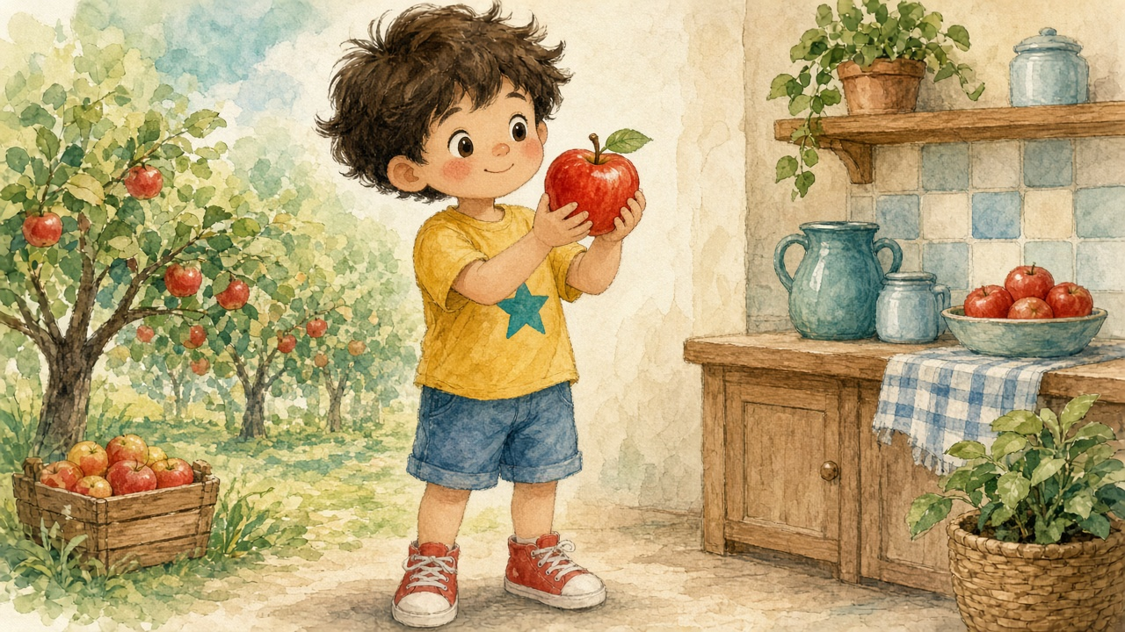
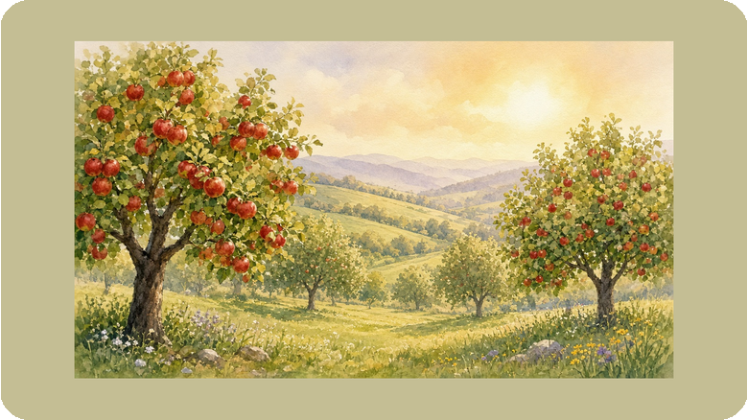

A
Apples grow in many cool countries.
People grow apples all over the world.
stem
Do you like red or green apples?
leaf
I like a red apple.
A to Z Foods · A · 1 / 24

Slide 4

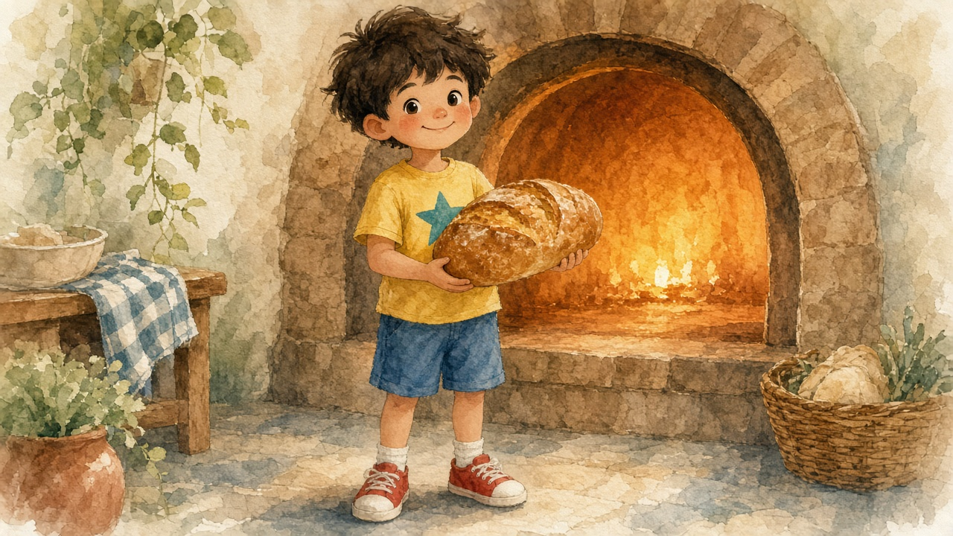
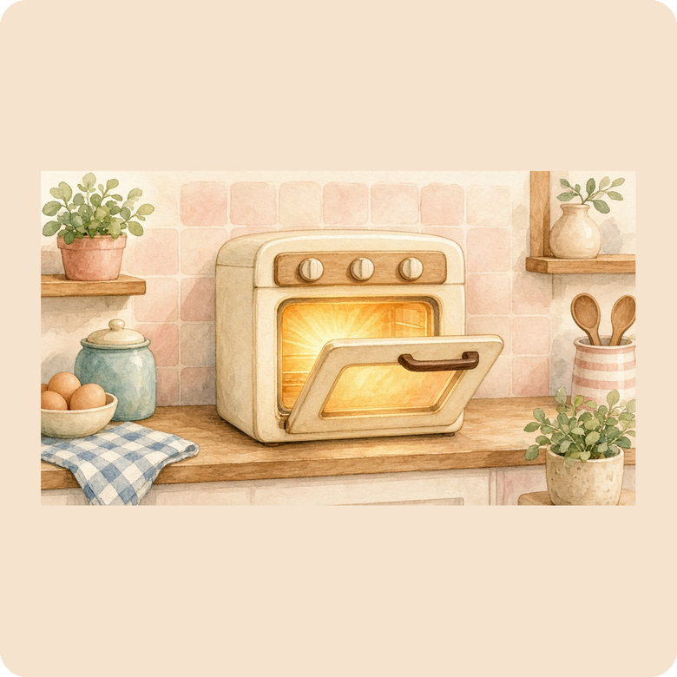
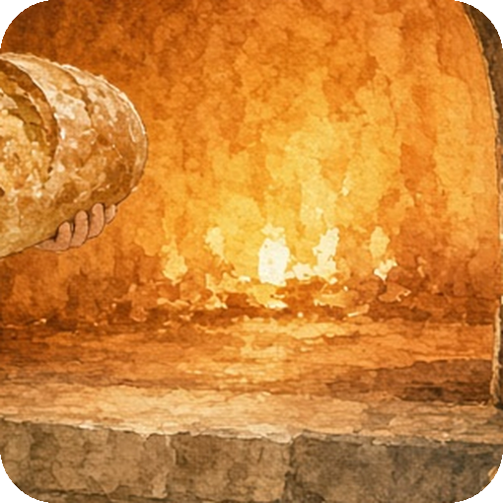
B
I bake the bread in a hot oven.
Bake means cook with dry heat.
crust
slice
bake
Can you smell fresh bread?
I bake fresh bread.
A to Z Foods · B · 2 / 24

Slide 5



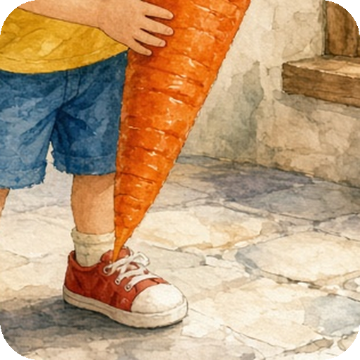
C
I cook carrots in a pot.
I add water and boil them.
top
tip
pot
Do you like carrots raw or cooked?
I cook a sweet carrot.
A to Z Foods · C · 3 / 24

Slide 6


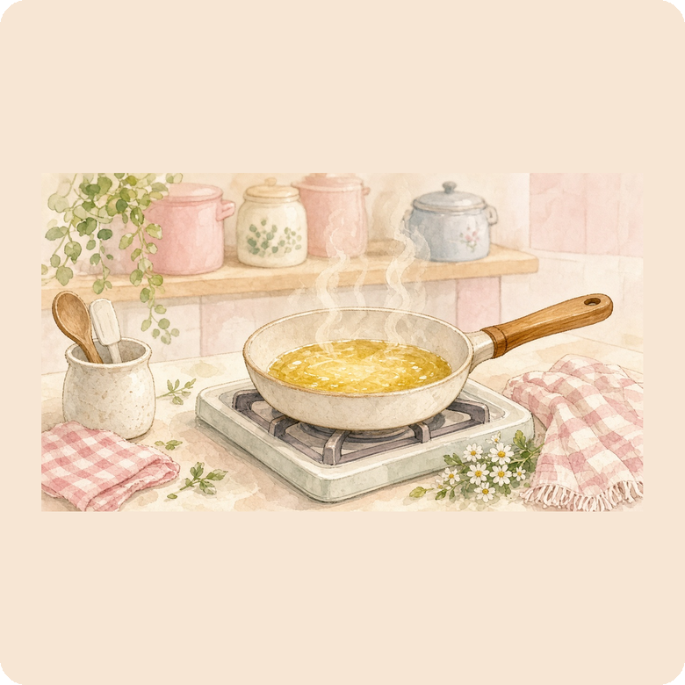

D
I fry the donut in hot oil.
Fry means cook in hot oil.
icing
hole
fry
Do you like icing on your donut?
I love a sweet donut.
A to Z Foods · D · 4 / 24

Slide 7
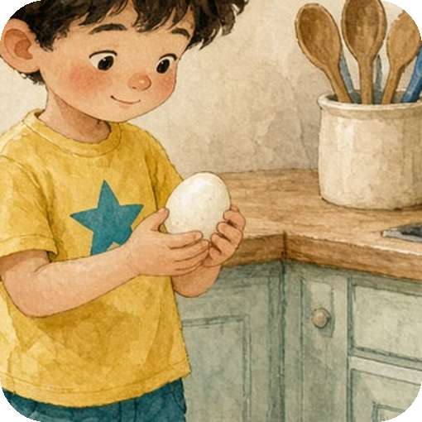


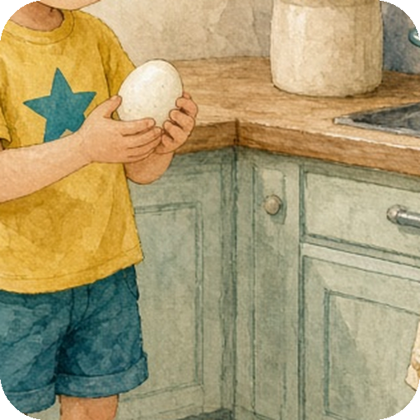
E
I boil the egg in water.
I can also fry an egg in a pan.
shell
yolk
boil
Do you like boiled eggs or fried eggs?
I boil an egg.
A to Z Foods · E · 5 / 24

Slide 8

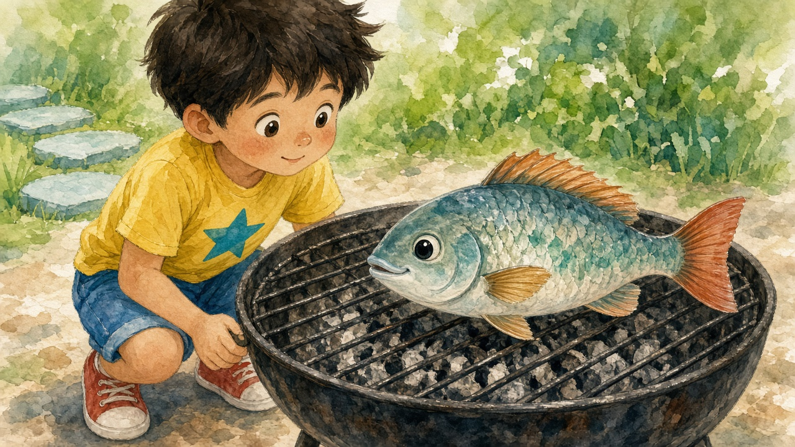
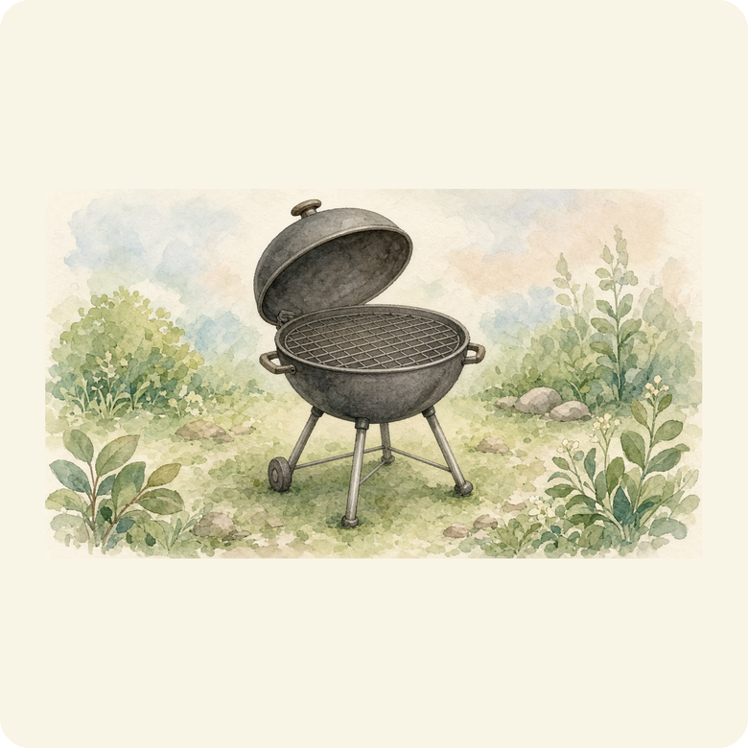
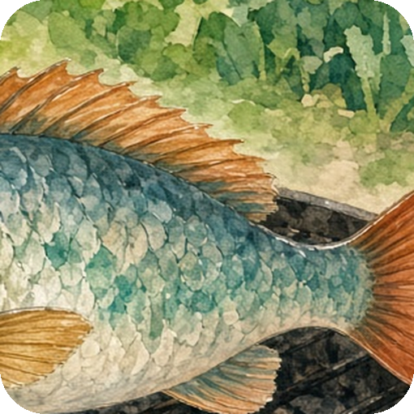
F
I cook fish on a grill.
A barbecue is a kind of grill.
fin
tail
grill
Have you eaten grilled fish?
I grill the fish.
A to Z Foods · F · 6 / 24

Slide 9


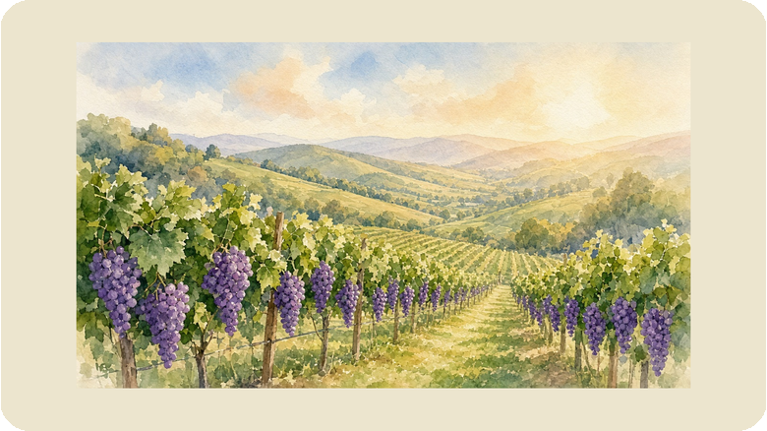
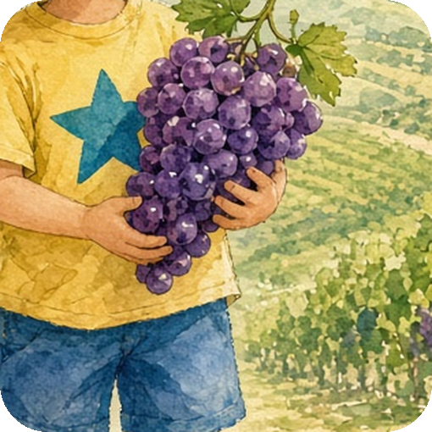
G
Grapes grow in sunny places.
Italy and Spain are famous for grapes.
bunch
Do you like purple or green grapes?
seed
I eat purple grapes.
A to Z Foods · G · 7 / 24

Slide 10


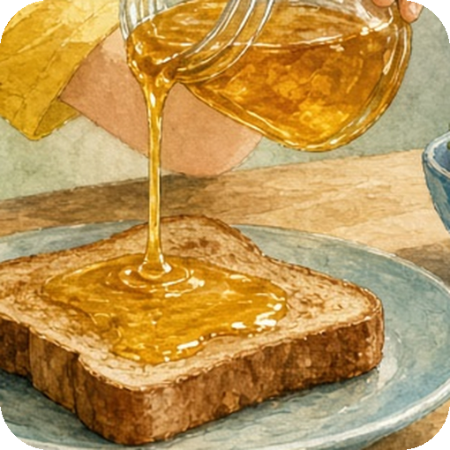
H
Honey toast needs bread,
butter, and sweet honey.
jar
bread
butter
honey
What do you put honey on?
drip
I put honey on toast.
A to Z Foods · H · 8 / 24

Slide 11



I
Ice cream is made with milk,
sugar, and sometimes fruit.
scoop
milk
sugar
fruit
What flavour of ice cream do you like?
cone
I eat cold ice cream.
A to Z Foods · I · 9 / 24

Slide 12


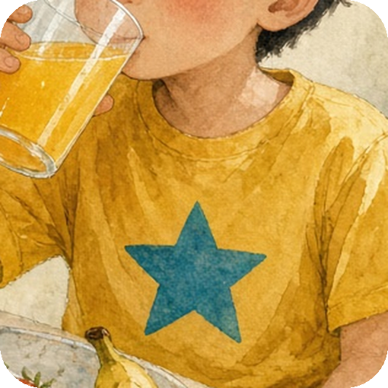
J
Juice needs fresh fruit,
a little water, and maybe ice.
straw
fruit
water
ice
Orange juice or apple juice?
glass
I drink fresh juice.
A to Z Foods · J · 10 / 24

Slide 13




K
New Zealand is famous for kiwi fruit.
Kiwis also grow in other warm places.
skin
Have you tried a kiwi?
seeds
I peel a green kiwi.
A to Z Foods · K · 11 / 24

Slide 14

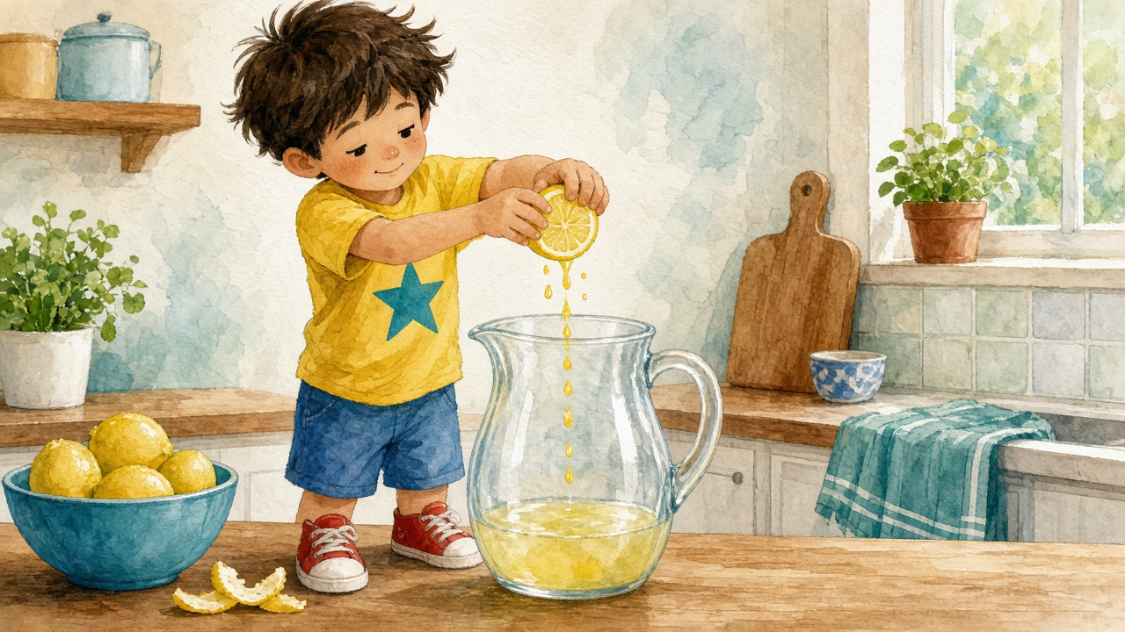

L
Lemonade needs lemon,
water, and a little sugar.
peel
lemon
water
sugar
Is lemonade sweet or sour?
juice
I squeeze a yellow lemon.
A to Z Foods · L · 12 / 24

Slide 15




M
I warm milk in a pan.
A pan sits on the stove.
splash
glass
pan
Do you like cold milk or warm milk?
I drink cold milk.
A to Z Foods · M · 13 / 24

Slide 16
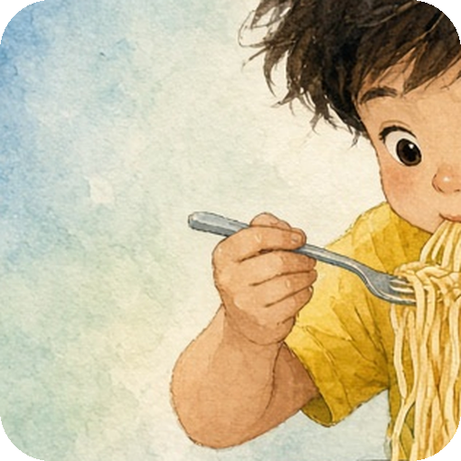
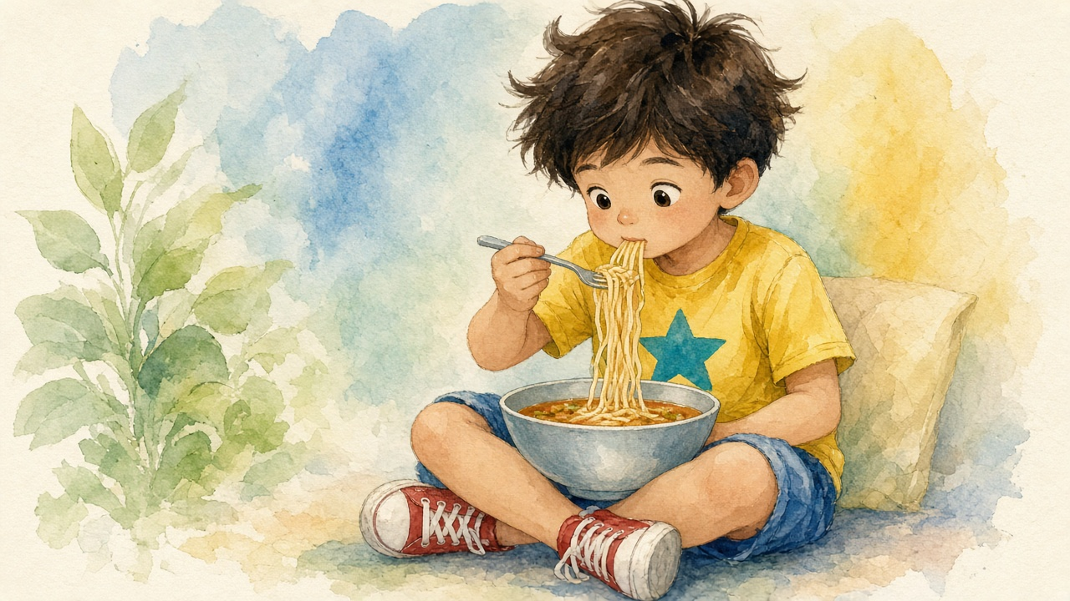
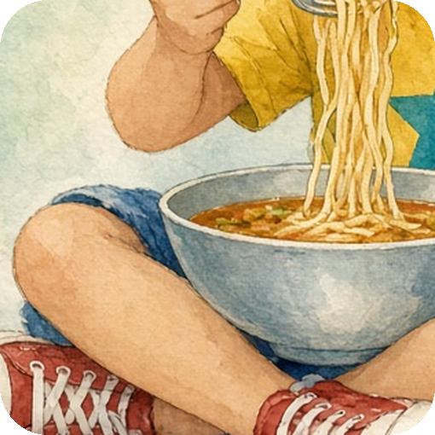
N
I boil noodles in hot water.
Then I put them in a bowl.
strand
bowl
boil
Do you use chopsticks or a fork?
I eat long noodles.
A to Z Foods · N · 14 / 24

Slide 17

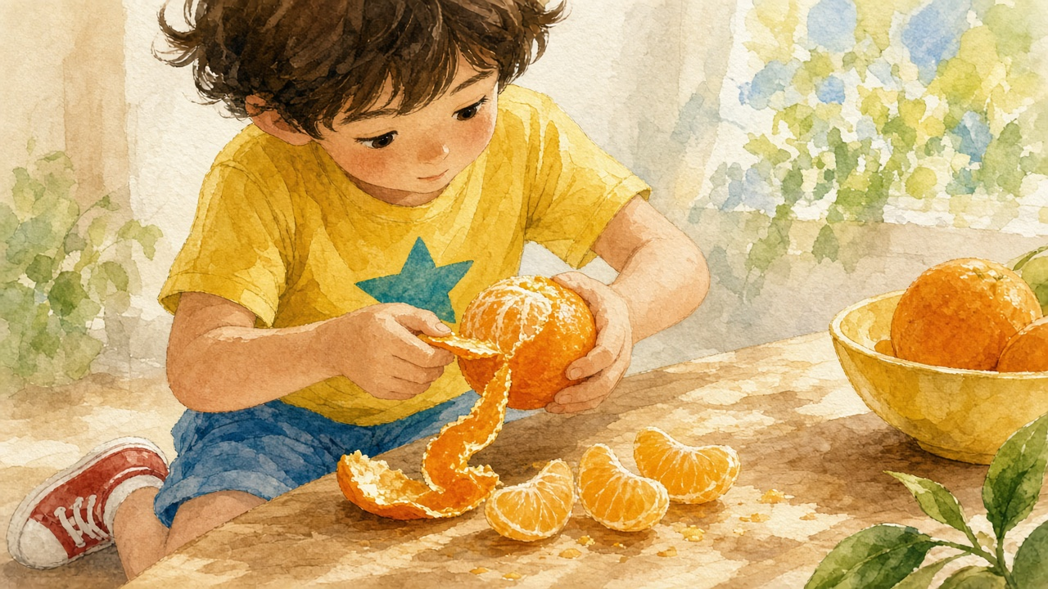
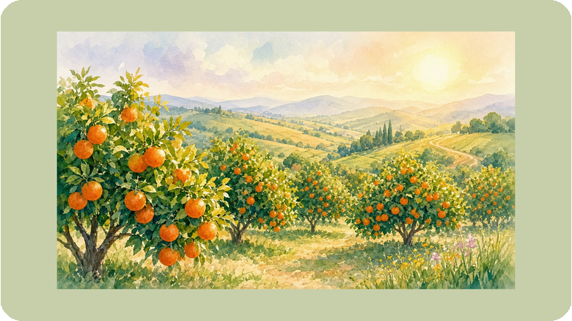
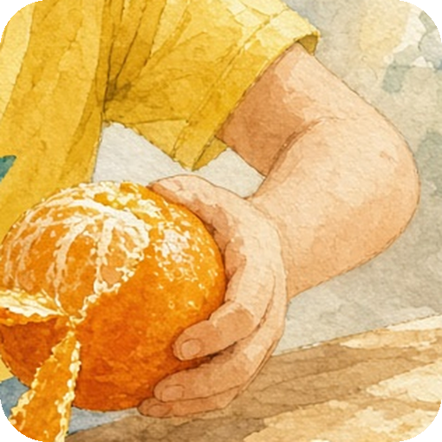
O
Oranges grow in warm sunny places.
Spain is famous for sweet oranges.
peel
Can you peel an orange by yourself?
segment
I peel a juicy orange.
A to Z Foods · O · 15 / 24

Slide 18

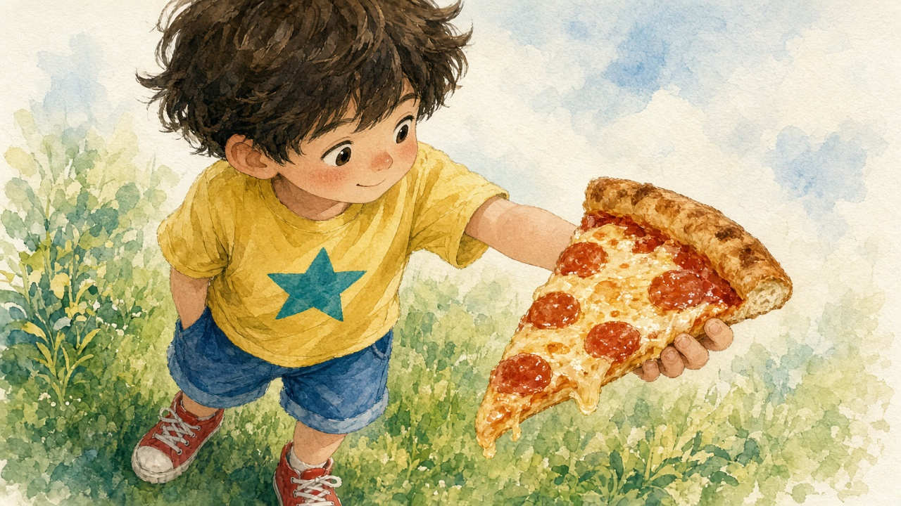

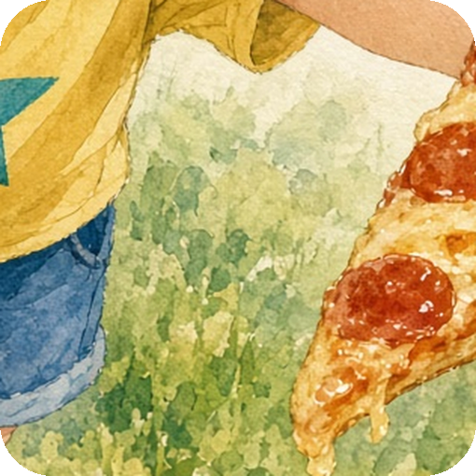
P
I bake pizza in an oven.
The oven gets very hot.
cheese
crust
oven
What toppings do you like on pizza?
I eat hot pizza.
A to Z Foods · P · 16 / 24

Slide 19


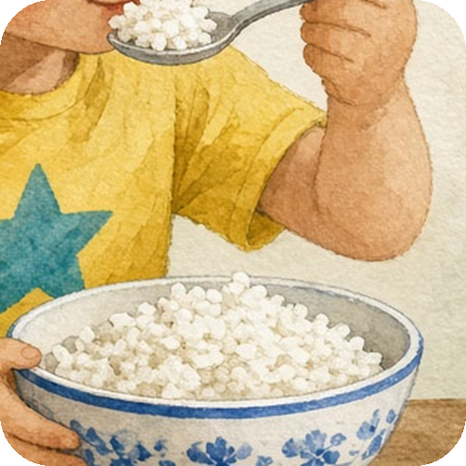
R
I cook rice in a pot.
I add water and put on the lid.
grain
bowl
pot
Do you eat rice with a spoon or chopsticks?
I cook white rice.
A to Z Foods · R · 17 / 24

Slide 20

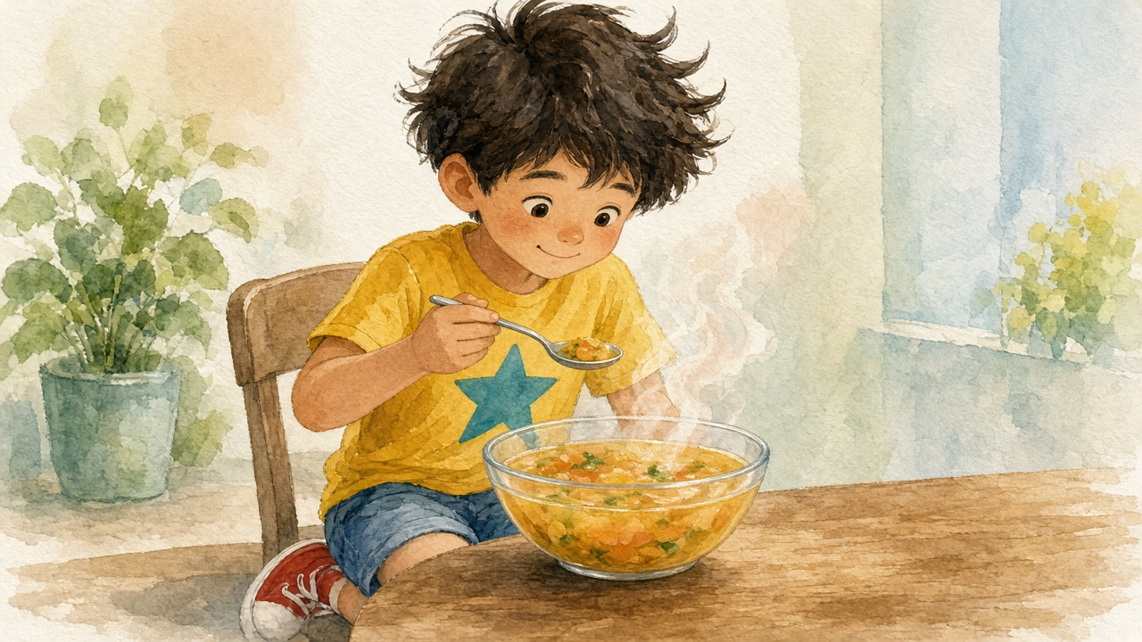

S
I cook soup in a big pot.
I stir it with a spoon.
spoon
bowl
pot
Do you like hot soup?
I eat warm soup.
A to Z Foods · S · 18 / 24

Slide 21

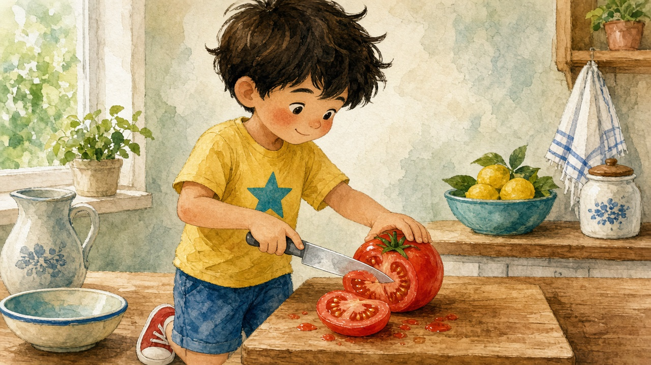
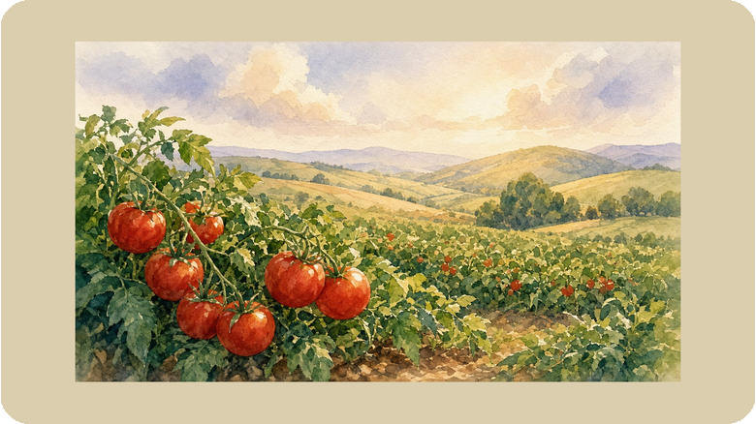
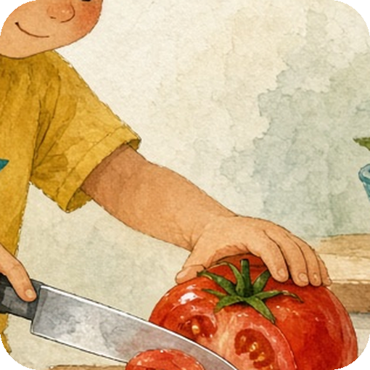
T
Tomatoes first grew in the warm Americas.
Now people grow tomatoes all over the world.
stem
Do you like tomatoes on pizza?
slice
I cut a red tomato.
A to Z Foods · T · 19 / 24

Slide 22


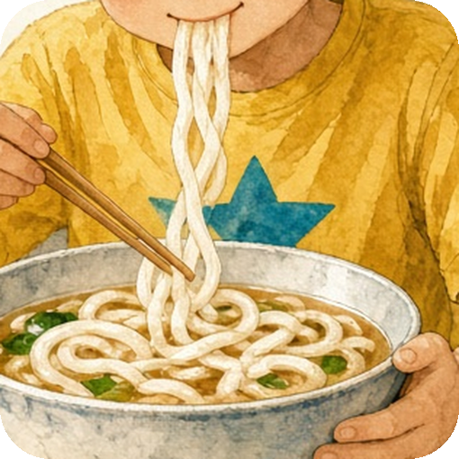
U
I boil soft udon noodles.
Udon is a thick noodle from Japan.
noodles
broth
boil
Have you tried udon soup?
I eat soft udon.
A to Z Foods · U · 20 / 24

Slide 23


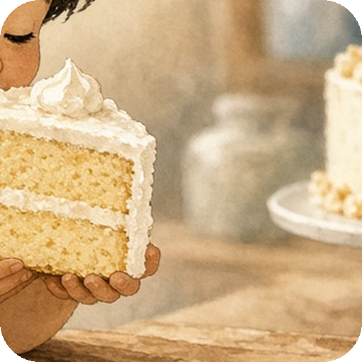
V
Vanilla cake needs flour,
eggs, sugar, and vanilla.
pod
flour
eggs
sugar
Do you like vanilla or chocolate?
cake
I smell sweet vanilla.
A to Z Foods · V · 21 / 24

Slide 24
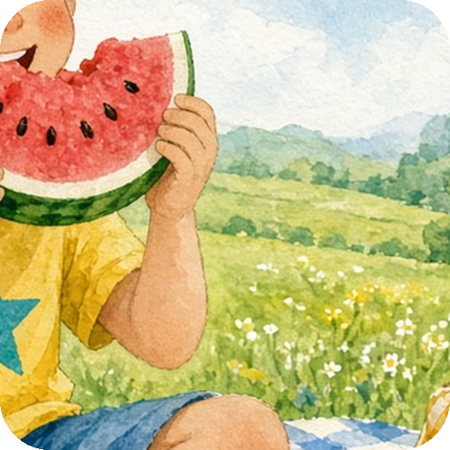
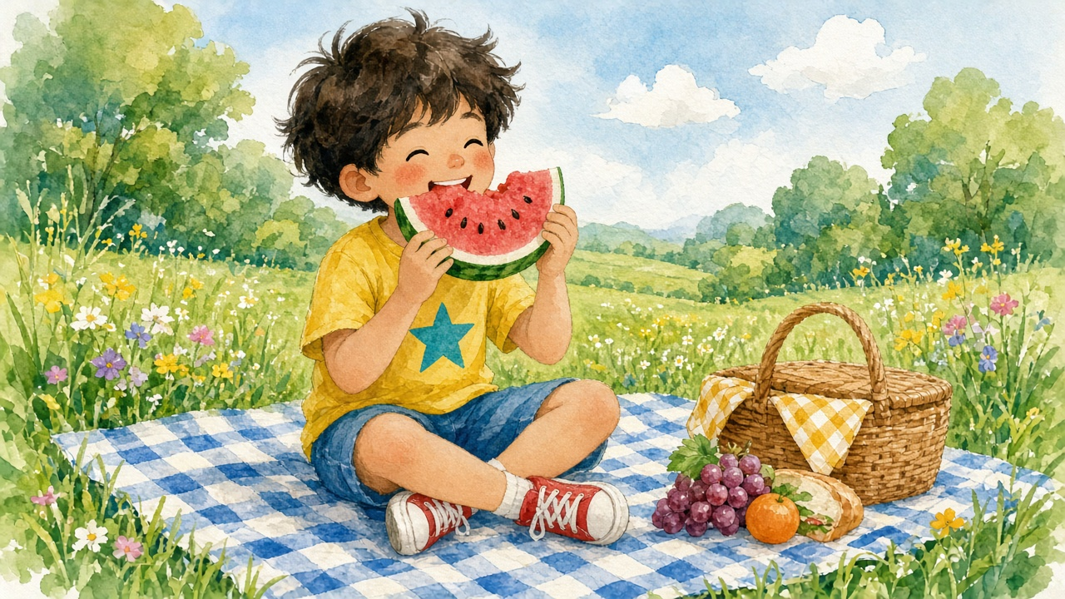
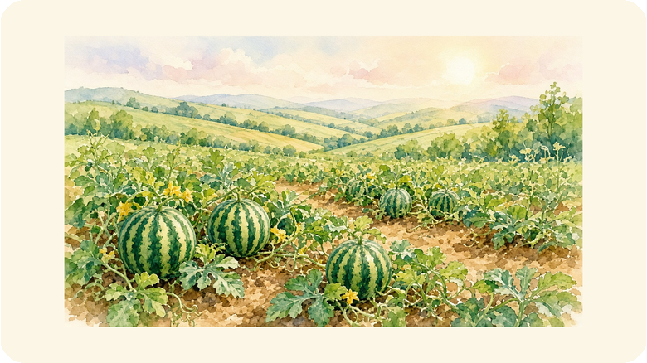
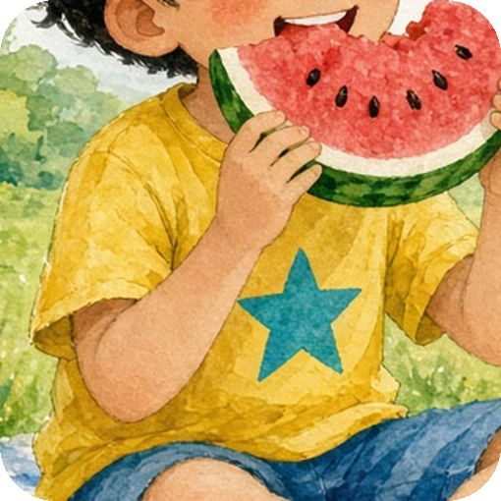
W
Watermelons love hot sunny weather.
They first grew in warm parts of Africa.
seeds
Do you spit out the seeds?
rind
I eat juicy watermelon.
A to Z Foods · W · 22 / 24

Slide 25


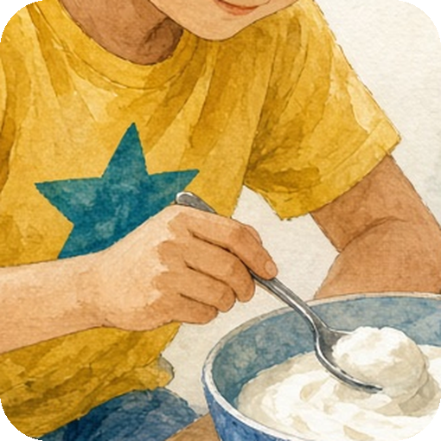
Y
A parfait needs yogurt,
fresh fruit, and a little honey.
spoon
yogurt
fruit
honey
What fruit do you put in yogurt?
bowl
I eat creamy yogurt.
A to Z Foods · Y · 23 / 24

Slide 26
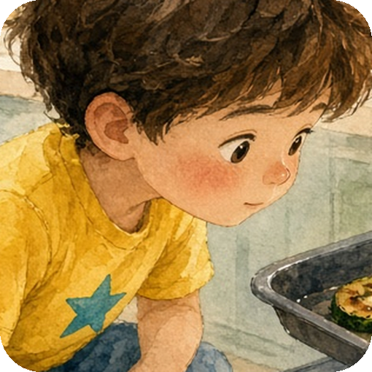
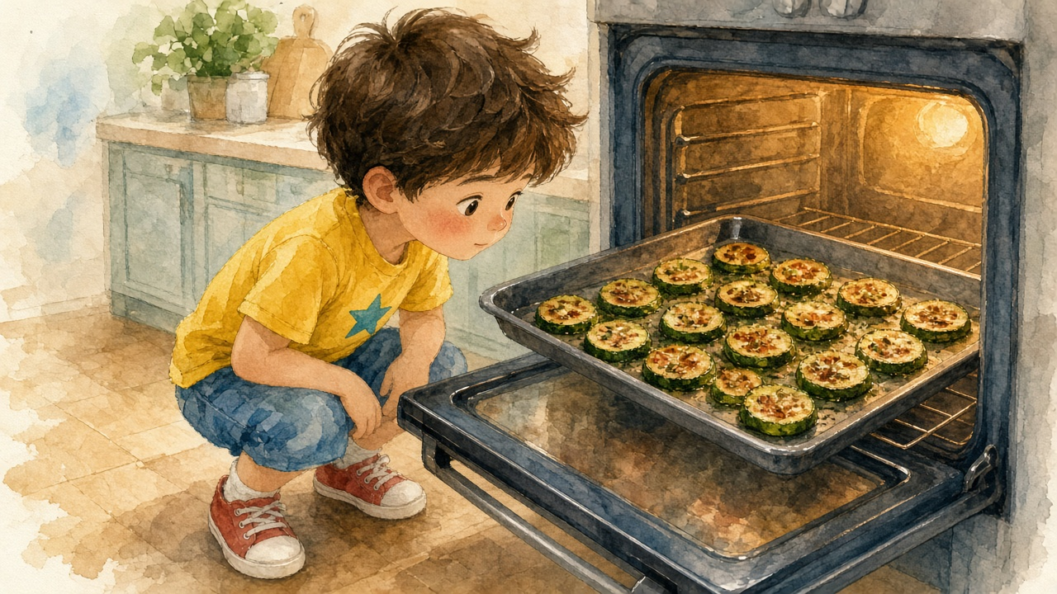
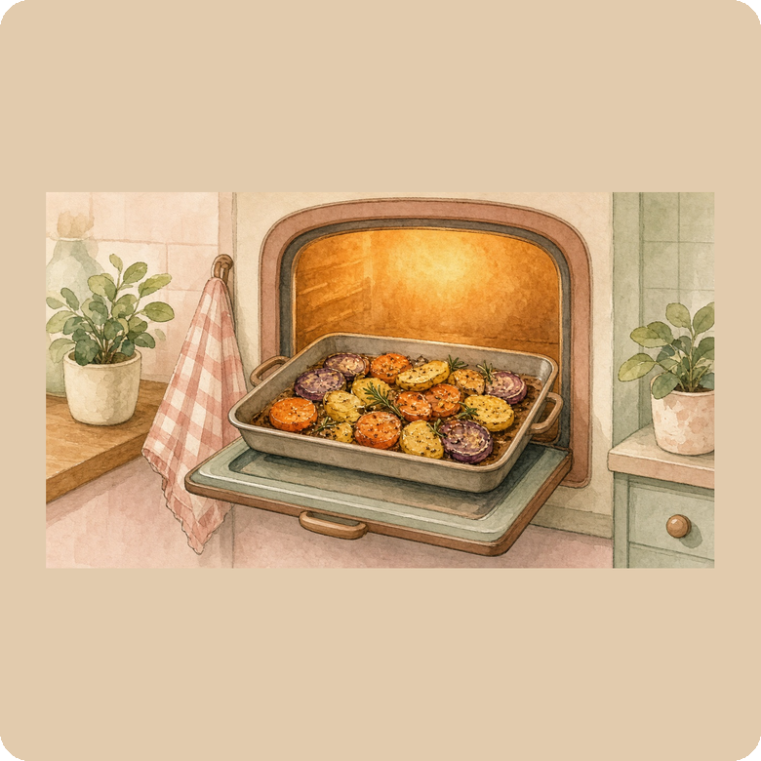
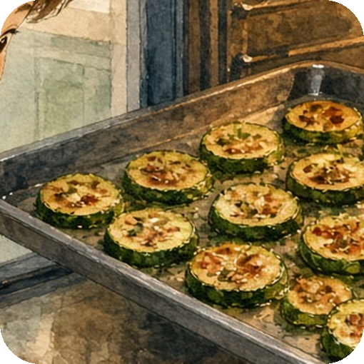
Z
I roast zucchini in the oven.
Roast means cook with dry heat, like bake.
skin
slice
roast
Have you tried roasted zucchini?
I roast green zucchini.
A to Z Foods · Z · 24 / 24

Slide 27


Worksheet 1 · Circle & Match
Read the sentence. Draw a line to the right word. Then circle the word.
1. I like a red ______.
pizza
2. I bake fresh ______.
zucchini
3. I boil an ______.
bread
4. I eat hot ______.
apple
5. I drink cold ______.
milk
6. I roast green ______.
egg
A to Z Foods · Worksheet 1

Slide 28
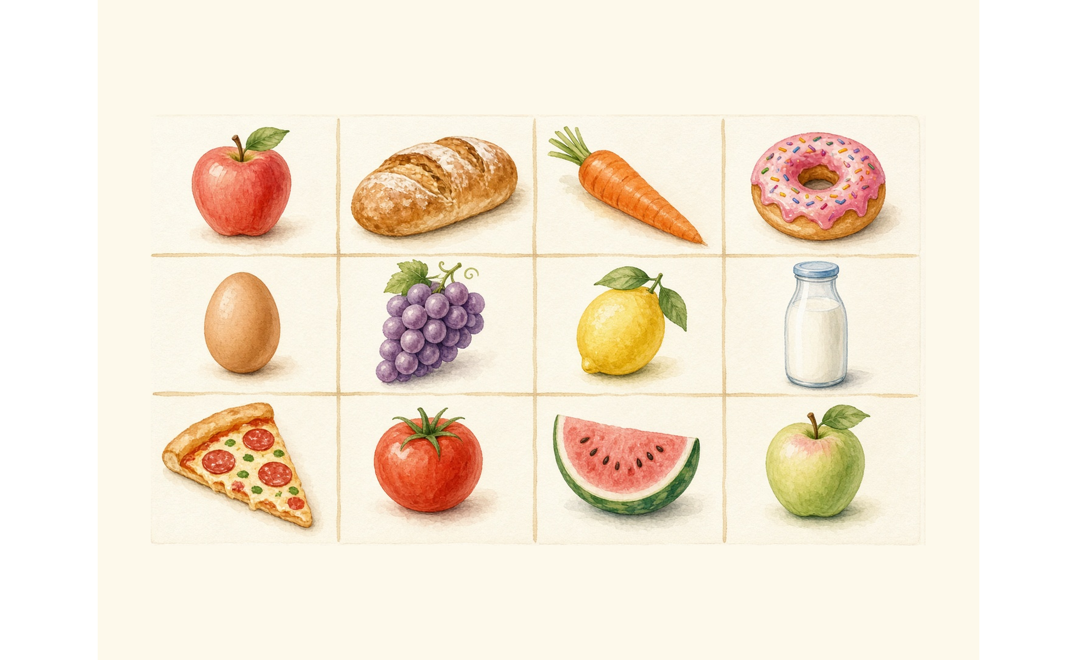
Worksheet 2 · Alphabet Find
Find 8 foods. Circle them.
A — apple
B — bread
E — egg
F — fish
M — milk
P — pizza
R — rice
Z — zucchini
A to Z Foods · Worksheet 2

Slide 29
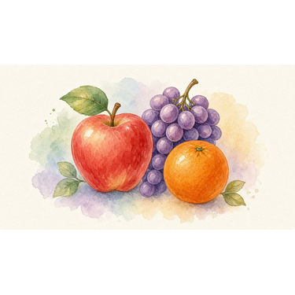
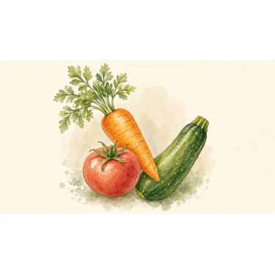
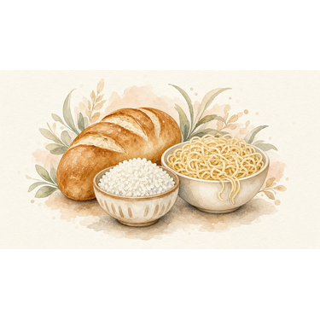

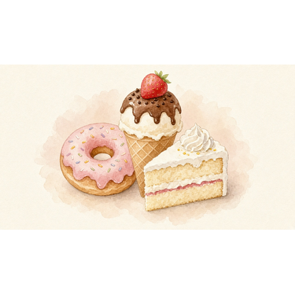
Category Game · Food Groups
Foods from this book belong in groups. Look, say, and sort!
Fruit
Vegetable
Grain
Protein
Sweet treat
A to Z Foods · Category Game 1 / 2

Slide 30
Category Game · Sort the Foods
Write or tick each food under its group. (Answers in Teacher-Guide.)
Fruit
Vegetable
Grain
apple, grape, kiwi, lemon, orange, watermelon
carrot, tomato, zucchini
bread, noodle, rice, udon, pizza
Protein
Sweet treat
egg, fish, milk, yogurt
donut, honey, ice cream, juice, vanilla
A to Z Foods · Category Game 2 / 2

Slide 31


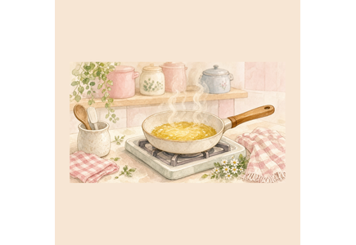
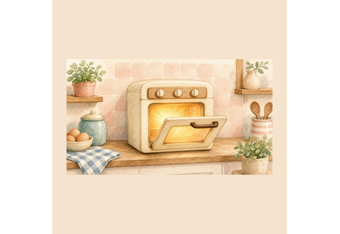
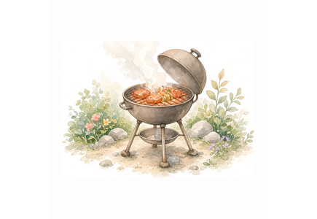







OPTIONAL EXTRA
Cook Match
Match each food picture to a cooking method: boil / fry / bake / grill / roast. Uses foods whose card angle was cook_method or cook_with.
Draw a line from each food to how we cook it.
boil
fry
bake
grill
roast
egg
donut
bread
fish
zucchini
noodle
A to Z Foods · OPTIONAL EXTRA · Cook Match

Slide 32

OPTIONAL EXTRA
Where in the World?
Friendly soft map + country/place chips. Match origin-angle foods (apple, grape, kiwi, orange, tomato, watermelon) to warm/cool/sunny place labels — light and age-appropriate, no politics.
Match the food to a place
kiwi
→ New Zealand
orange
→ sunny Spain
grape
→ Italy / Spain
tomato
→ the Americas
watermelon
→ warm Africa
apple
→ cool countries
A to Z Foods · OPTIONAL EXTRA · Where in the World?

Slide 33



OPTIONAL EXTRA
Build a Dish
Two mini kitchens: circle the ingredients that go into pizza OR lemonade OR honey toast. Drawn from ingredients-angle cards.
Build a pizza
Make lemonade
Make honey toast
Circle what you need:
Circle what you need:
Circle what you need:
dough · cheese · tomato · toppings
(+ maybe salt / oil — teacher choice)
lemon · water · sugar
(+ maybe salt / oil — teacher choice)
bread · butter · honey
(+ maybe salt / oil — teacher choice)
A to Z Foods · OPTIONAL EXTRA · Build a Dish

Slide 34

OPTIONAL EXTRA
Alphabet Picnic
Busy picnic scene with as many A–Z foods as readable. Find-and-circle list on the side. Experimental hidden-picture finisher.
Find and circle:
A apple
D donut
G grape
J juice
M milk
P pizza
T tomato
W watermelon
Can you find more?
A to Z Foods · OPTIONAL EXTRA · Alphabet Picnic

Slide 35

Thanks for learning with us!
A to Z Foods · Sentence Flashcards
24 foods · ages 5–9 · A1
For one classroom or one home.

