Slide 1
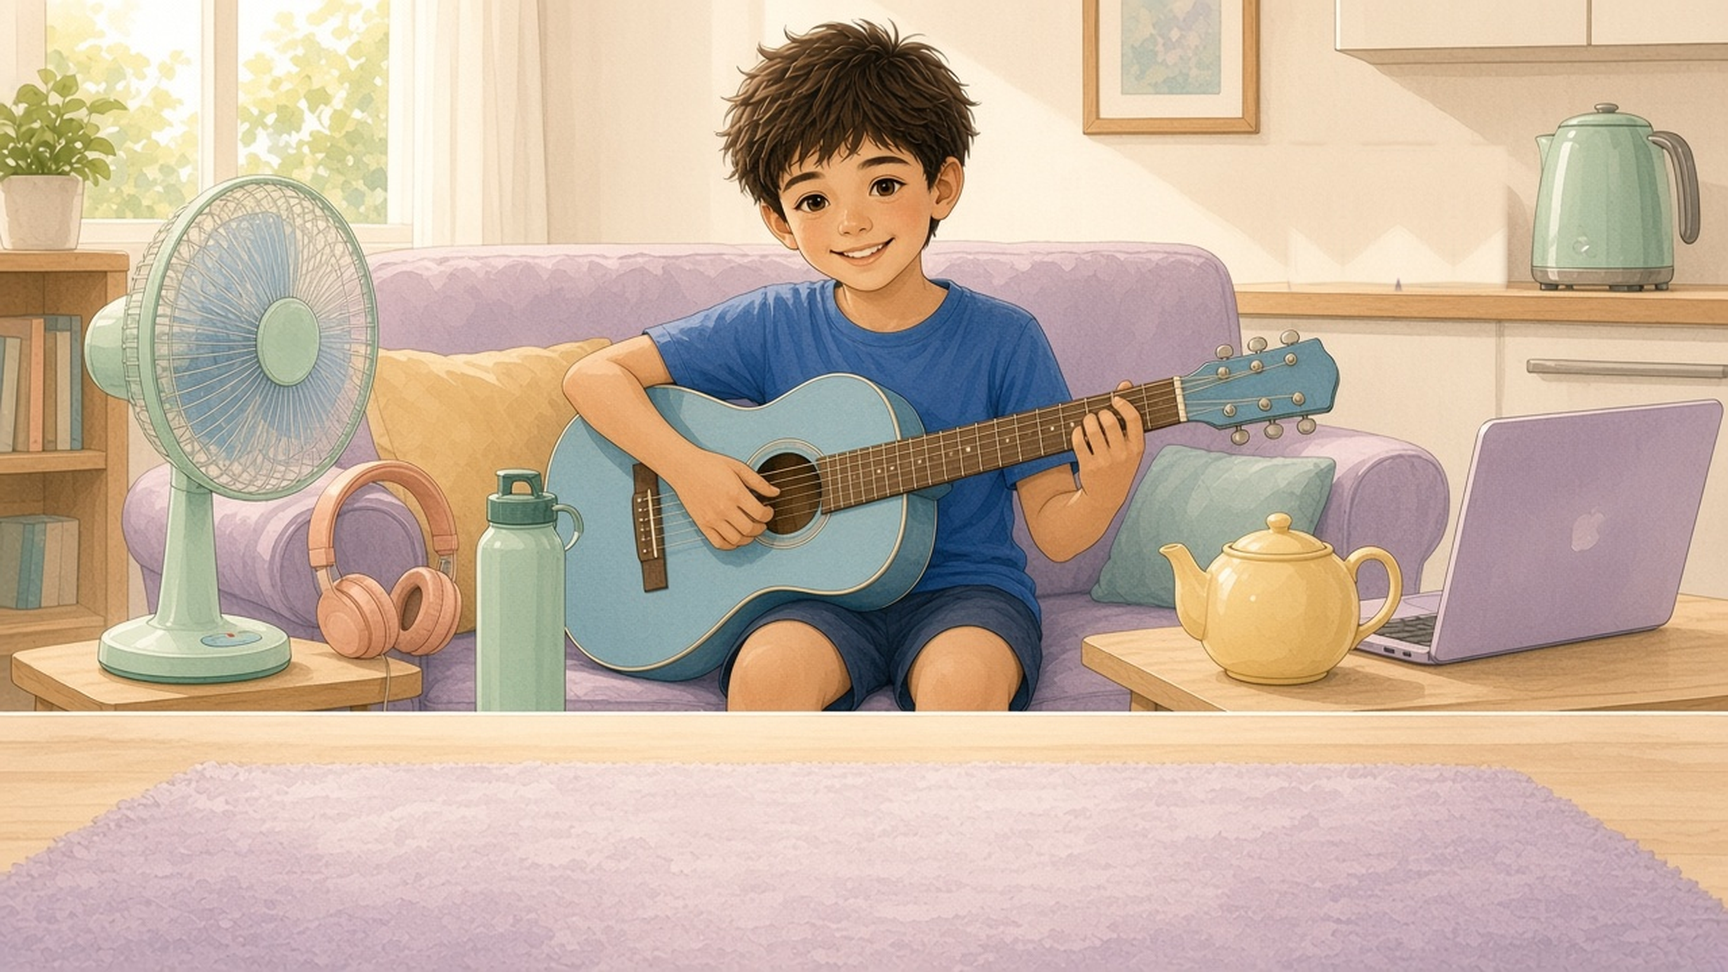

Everyday Objects 3
Sentence Flashcards
Beginner ESL · A1 · Ages 5–9
15 cards · For parents, teachers & tutors

Slide 2

How to use this set
Teacher / Parent Guide
1 Show and read
Word List (15)
Look at the picture. Read the sentence together. The child repeats.
1. bottle
9. desk
2 Name the details
2. heater
10. bath
Point to the small pictures on the left and say each word together.
3. headphones
11. lantern
4. sofa
12. washing machine
3 Talk and ask
5. fan
13. teapot
Use the sentences, questions and mini pictures on the right of each card.
6. laptop
14. kettle
4 Worksheets
7. bin
15. guitar
Worksheet 1: Circle & Match. Worksheet 2: Find and Circle (10 objects).
8. paintbrush
5 Action Pairs
6 picture pairs (turn on / turn off ...). Act them out and say both sentences.

Slide 3


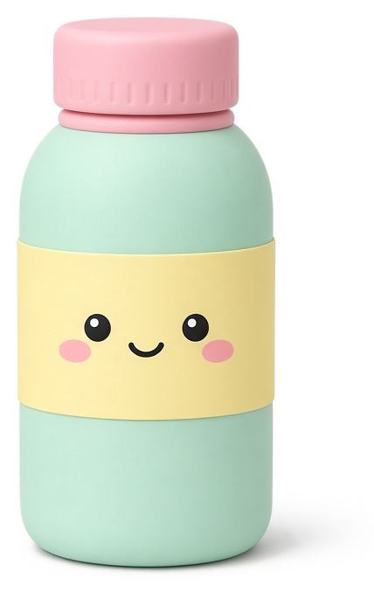
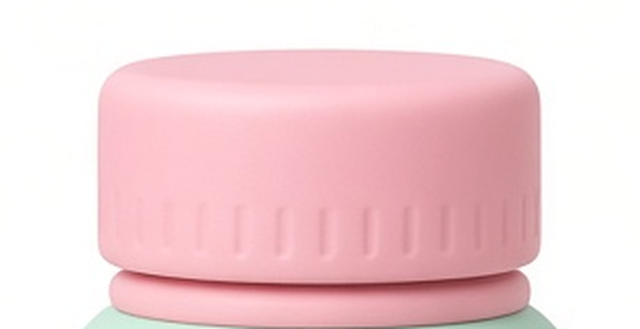
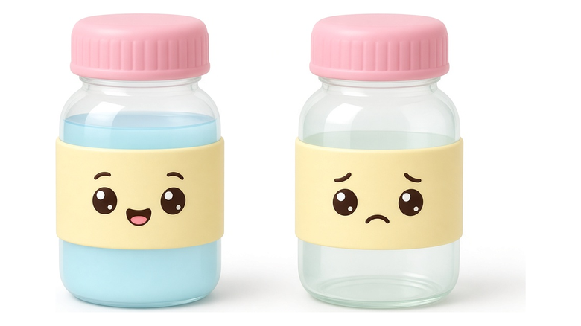
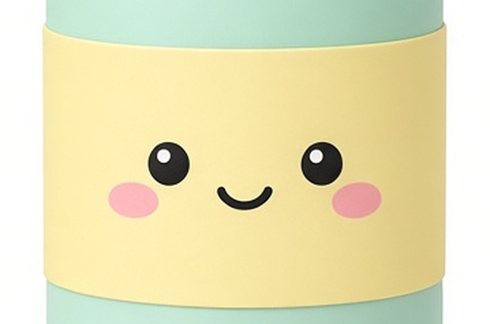
The bottle is full.
The bottle is empty.
cap
full
empty
Do you have a bottle?
Does your bottle have a label?
label
Is your bottle full or empty?
bot·tle
I drink water from my bottle.
Everyday Objects 3 · 1 / 15

Slide 4

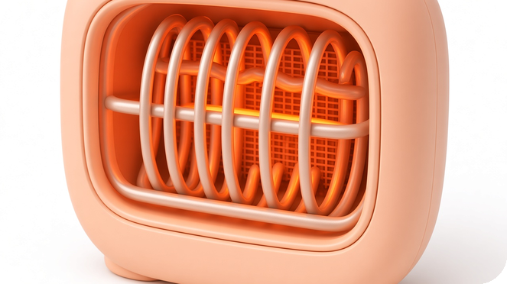
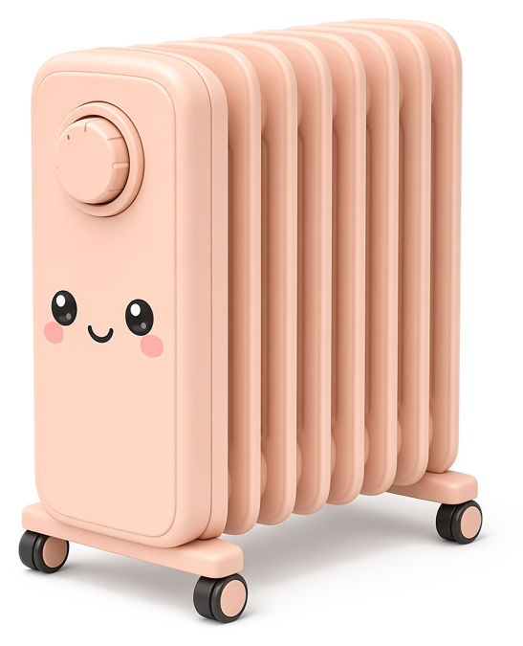
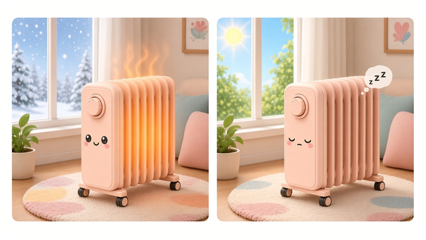
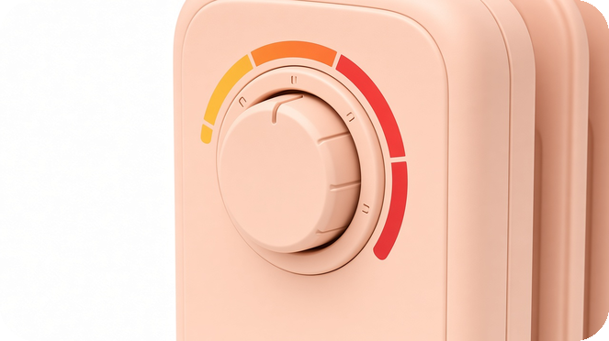
It is cold. The heater is on.
It is hot. The heater is off.
wires
on
off
Should we use the heater when it's hot?
YES
NO
dial
Should we use the heater when it's cold?
warm · warmer · warmest
YES
NO
heat·er
The heater keeps me warm.
Everyday Objects 3 · 2 / 15

Slide 5

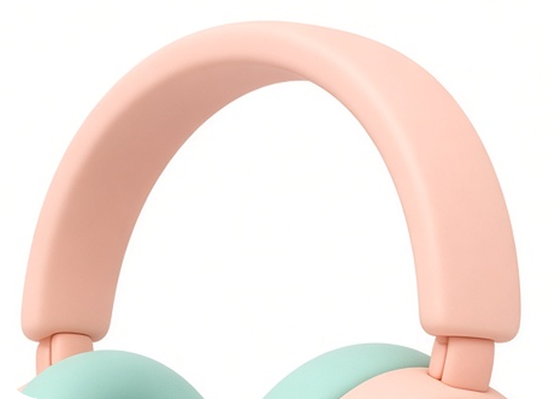
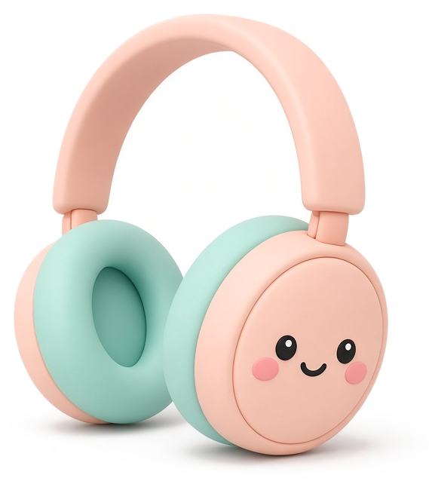
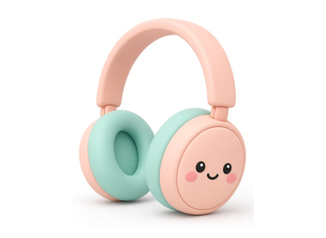
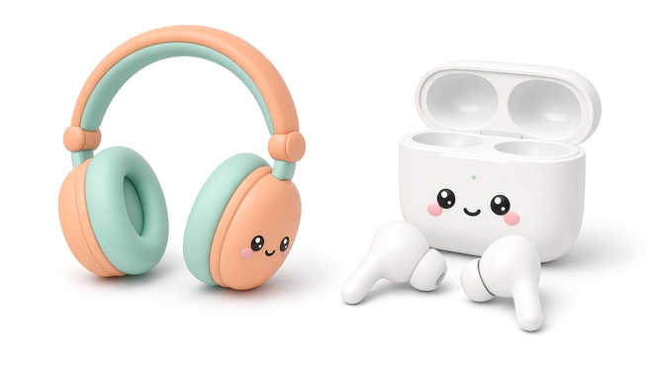
♪♫♪♫♪♫♪
♪ ♪
headband
loud
quiet
The music is loud.
The music is quiet.
How do we wear our headphones?
→ On my head.
How do we wear our earphones?
earphones
→ In my ears.
head·phones
I listen to music with my headphones.
Everyday Objects 3 · 3 / 15

Slide 6
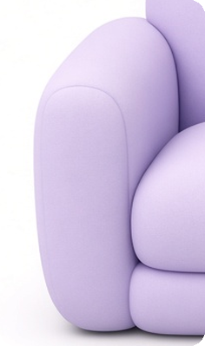

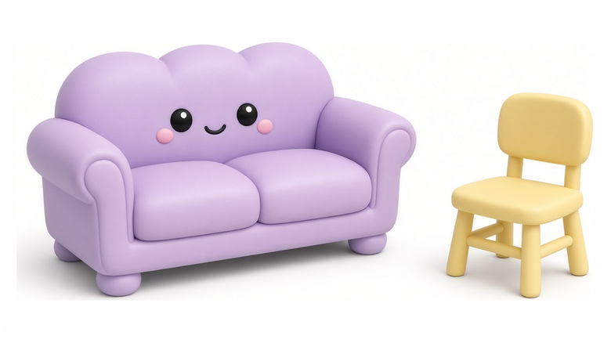
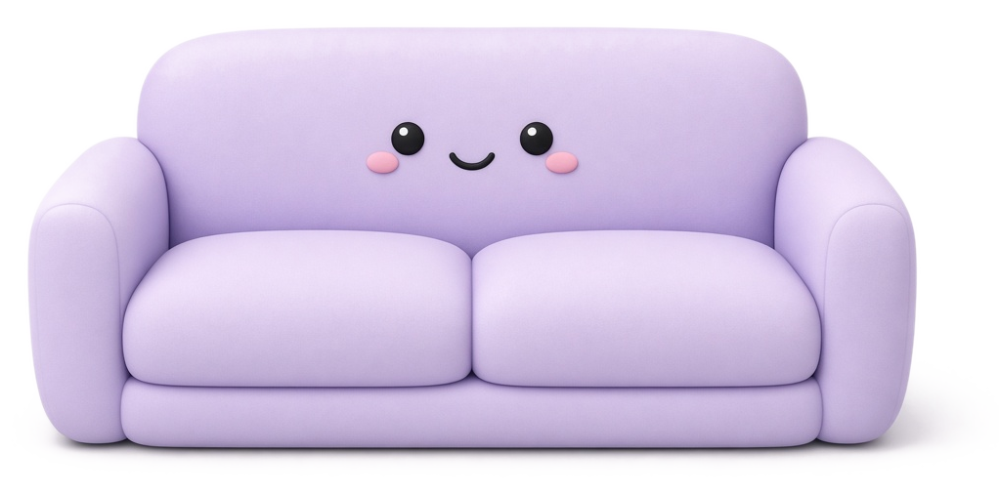

armrest
sofa
chair
How many people can sit on the chair?
How many people can sit on the sofa?
cushion
Where do you sit at home?
Where do we sit, on the armrest or the cushion?
so·fa
We sit on the sofa.
Everyday Objects 3 · 4 / 15

Slide 7
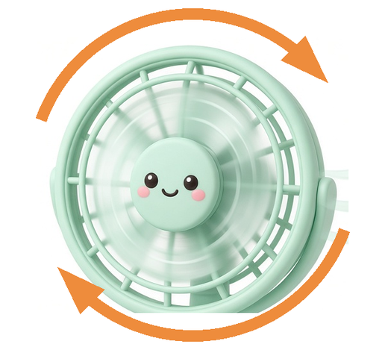

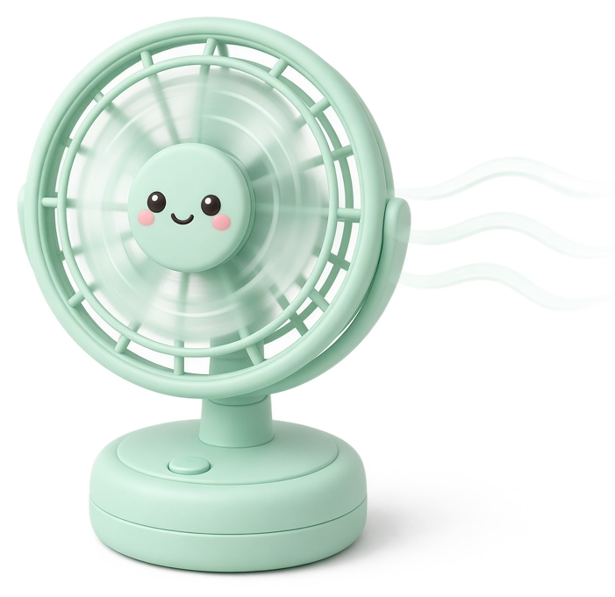
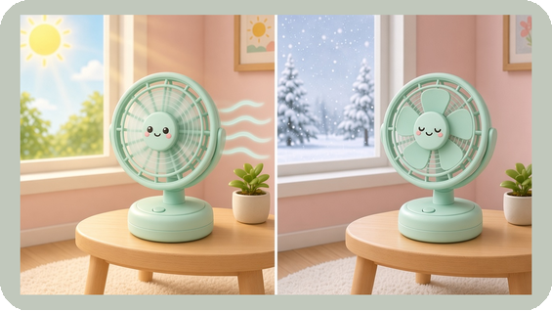
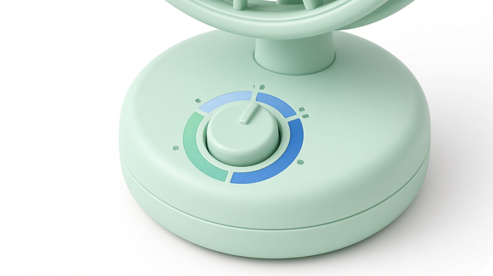
It is hot today.
The fan makes me cool.
spin
hot
cold
Do we use the fan when it's hot?
YES
NO
dial
Do we use the fan when it's cold?
cool · cooler · coolest
YES
NO
fan
The fan keeps me cool.
Everyday Objects 3 · 5 / 15

Slide 8
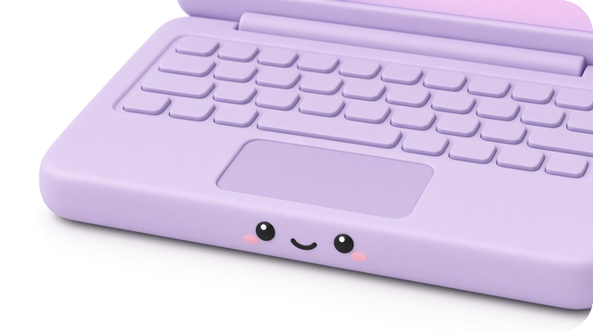
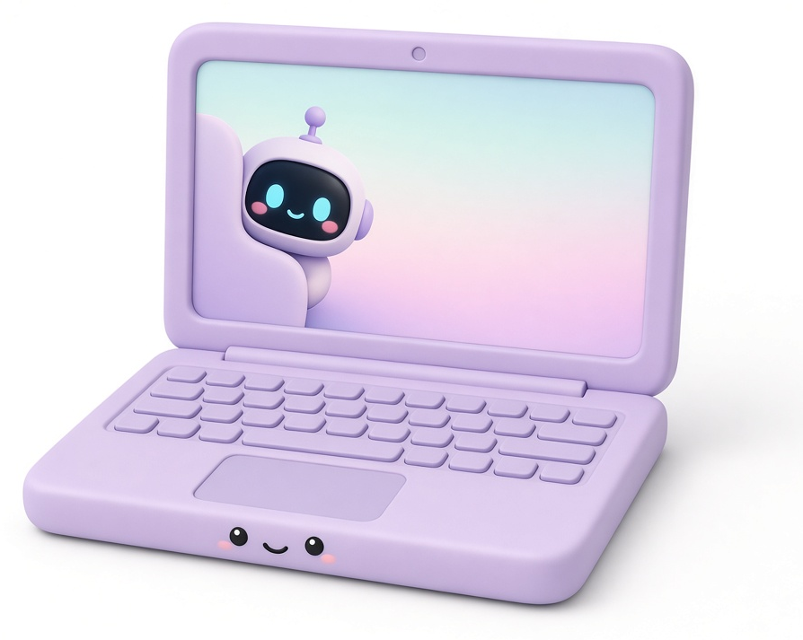
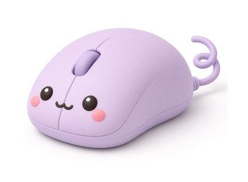
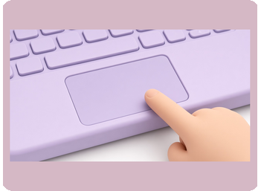
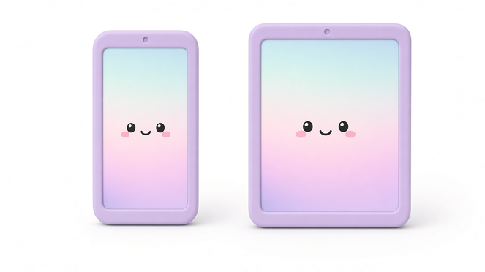
I click with the mouse.
I tap with the pad.
keyboard
I type with the keyboard.
mouse
touchpad
Click, click, click. Is that a mouse or a touchpad?
Tap, tap, tap. Is that a mouse or a touchpad?
Mobile devices
lap·top
I type on the laptop.
Everyday Objects 3 · 6 / 15

Slide 9
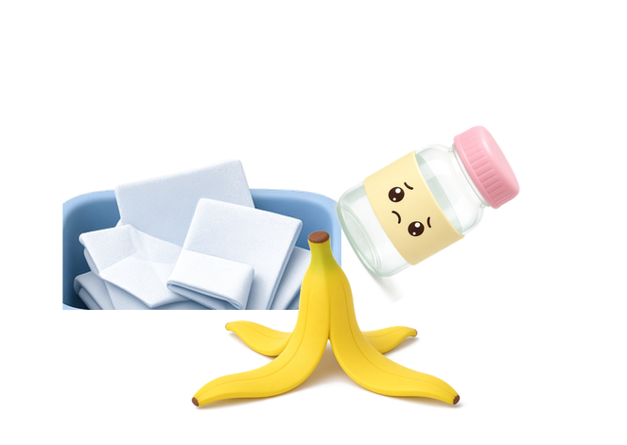
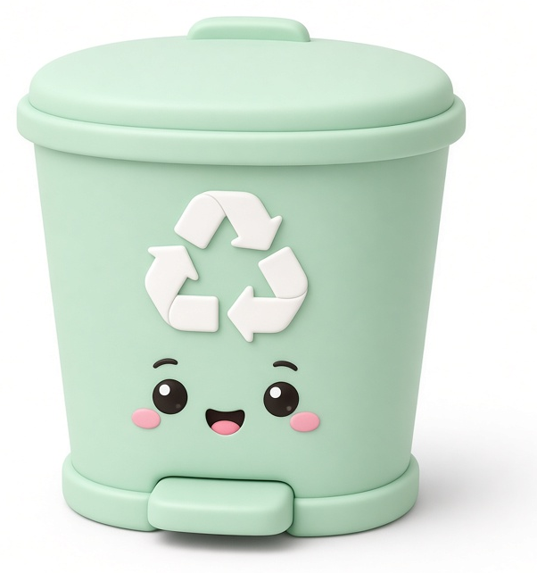
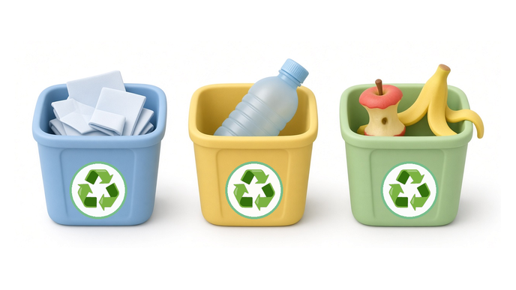
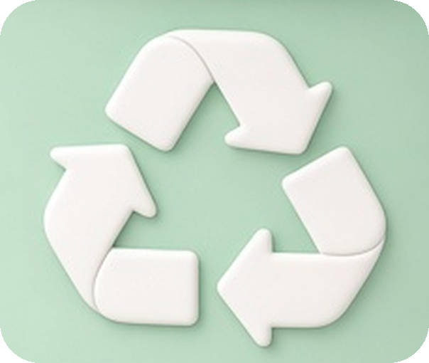
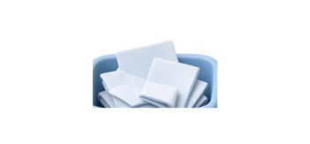
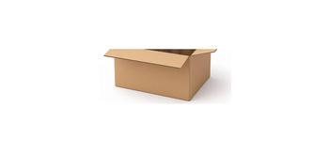
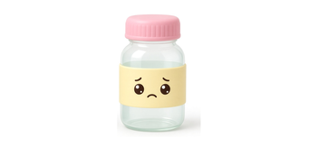
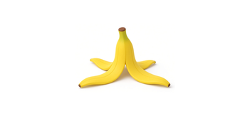
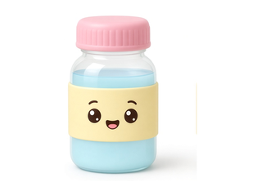
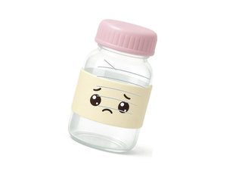
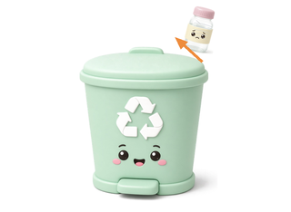
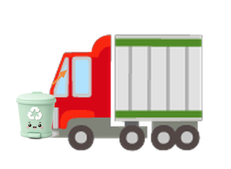
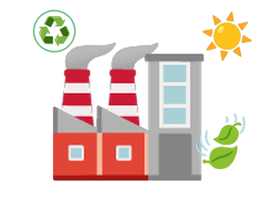
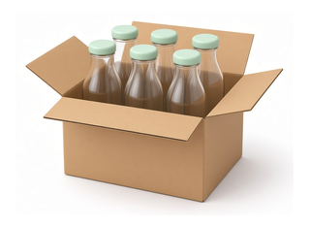
rubbish
paper
plastic
food
Where does the bottle go?
newspaper
box
recycle
bottle
banana peel
bin
I put rubbish in the bin.
♻ Recycling
→
→
→
→
→
bottle to bottle
full bottle
empty bottle
recycling bin
collected
eco factory
new bottles
Everyday Objects 3 · 7 / 15

Slide 10
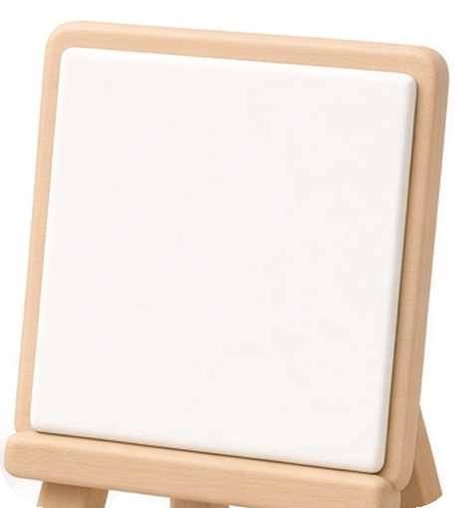
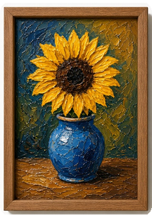
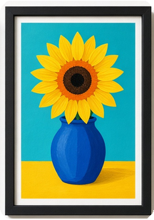
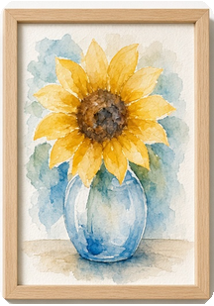
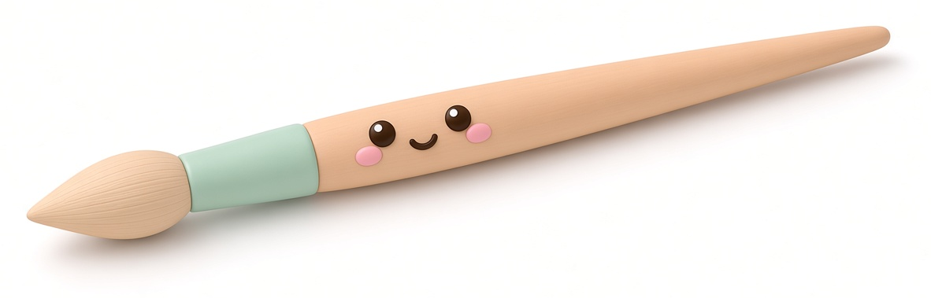
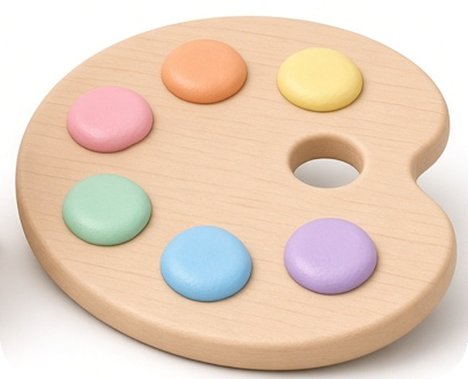
Three kinds of paint
canvas
oil
acrylic
watercolor
Which kind of paint do you like the most?
palette
paint·brush
I paint with a paintbrush.
Everyday Objects 3 · 8 / 15

Slide 11
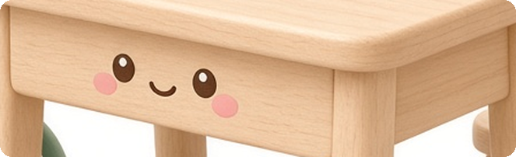
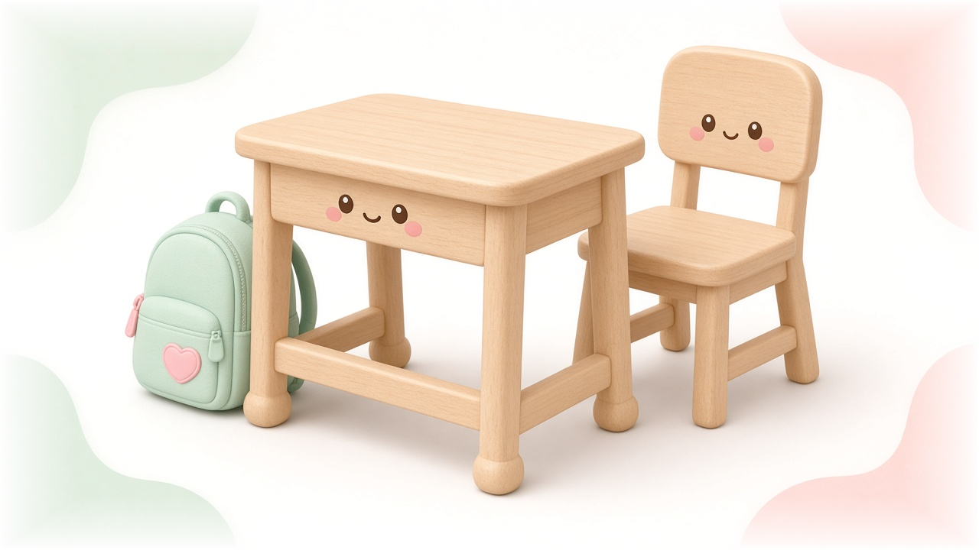
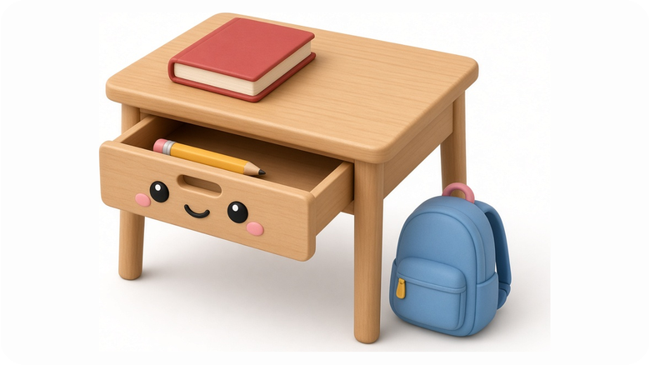
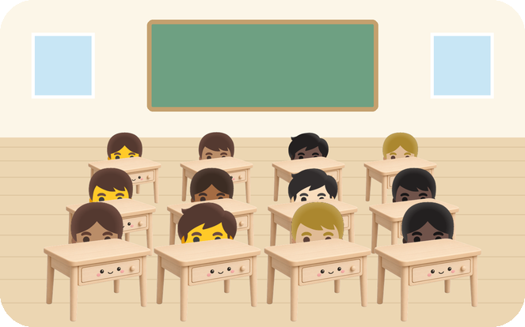
The book is on the desk.
The bag is under the desk.
drawer
The pencil is in the drawer.
classroom
How many desks are in the classroom?
What is on your desk?
desk
I do my homework at my desk.
Everyday Objects 3 · 9 / 15

Slide 12
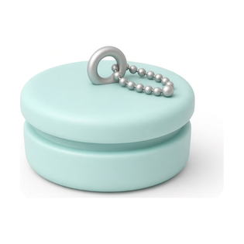




I take a bath.
I take a shower.
The plug is in.
bath
shower
Do you like a bath or a shower?
The plug is out.
bath
I take a bath every night.
Everyday Objects 3 · 10 / 15

Slide 13







Lanterns around the world
handle
UK
China
Thailand
USA
light
Where is this lantern from?
lan·tern
My lantern shows me the way.
Everyday Objects 3 · 11 / 15

Slide 14




buttons
dirty → wash → clean
Are your clothes dirty or clean?
spin
wash·ing ma·chine
The washing machine washes my clothes.
Everyday Objects 3 · 12 / 15

Slide 15





spout
teapot
hot water
Do you like tea?
Do you take sugar?
tea bag
Do you take milk?
tea·pot
Mum makes tea in the teapot.
Everyday Objects 3 · 13 / 15

Slide 16




The water is cold.
↓ 2 minutes ↓
The water is hot.
steam
cold
hot
Careful! Do not touch.
cold to hot
ket·tle
I boil water in the kettle.
Everyday Objects 3 · 14 / 15

Slide 17







Musical instruments
strings
drum
piano
violin
flute
speaker
gui·tar
I play the guitar.
Everyday Objects 3 · 15 / 15

Slide 18







Worksheet 1 · Circle & Match
Read the sentence. Draw a line to the right word. Then circle the word.
1. I drink water from my ______.
sofa
2. We sit on the ______.
lantern
3. I put rubbish in the ______.
heater
4. I do my homework at my ______.
bottle
5. My ______ shows me the way.
desk
6. The ______ keeps me warm.
bin
Everyday Objects 3 · Worksheet 1

Slide 19

Worksheet 2 · Find and Circle
Find it! Point to it. Circle it.
Point to something you drink from.
Point to something that keeps you warm.
Point to something you listen with.
Point to something you sit on.
Point to something that keeps you cool.
Point to something you type on.
Point to something you put rubbish in.
Point to something you paint with.
Point to something that boils water.
Point to something with six strings.
Everyday Objects 3 · Worksheet 2

Slide 20



I turn on the
I turn off the
fan
Everyday Objects 3 · Action Pairs 1 / 6

Slide 21



I fill my
I empty my
bottle
Everyday Objects 3 · Action Pairs 2 / 6

Slide 22



I put clothes in the
I take clothes out of the
washing machine
Everyday Objects 3 · Action Pairs 3 / 6

Slide 23



I open my
I close my
laptop
Everyday Objects 3 · Action Pairs 4 / 6

Slide 24



I sit down on the
I stand up from the
sofa
Everyday Objects 3 · Action Pairs 5 / 6

Slide 25



I pull out my
I push in my
chair
Everyday Objects 3 · Action Pairs 6 / 6

Slide 26

Thank you for learning with Everyday Objects 3.
For one classroom or one home.
Everyday Objects 3 · Sentence Flashcards · Beginner ESL

