Slide 1
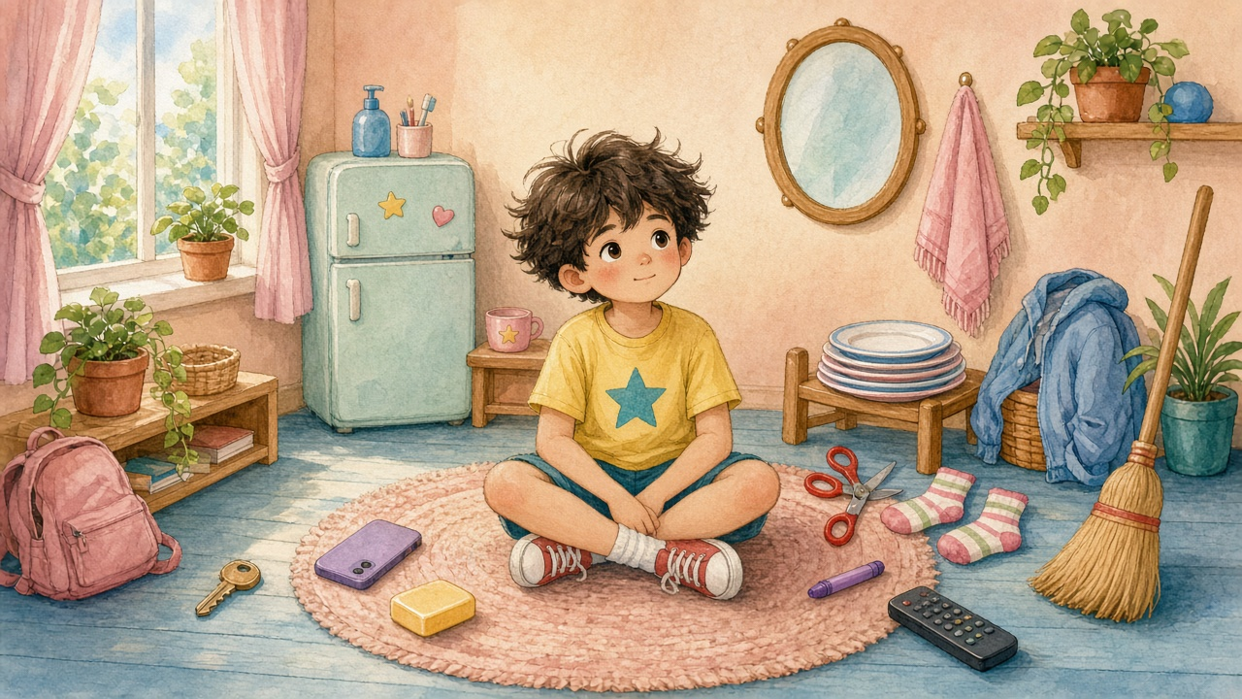

Everyday Objects 2
Sentence Flashcards
Beginner ESL · A1 · Ages 5–9
15 cards · For parents, teachers & tutors

Slide 2

How to use this set
Teacher / Parent Guide
1 Show and read
Word List (15)
Look at the picture. Read the sentence together. The child repeats.
1. window
9. scissors
2 Name the details
2. fridge
10. crayon
Point to the small pictures on the left and say each word together.
3. phone
11. sock
4. key
12. jacket
3 Talk and ask
5. soap
13. broom
Use the notes, questions and mini activities on the right of many cards.
6. towel
14. plant
4 Worksheets
7. mirror
15. remote
Worksheet 1: Circle & Match. Worksheet 2: Find and Circle (all 15 objects).
8. plate
5 Action Pairs
6 picture pairs (put on / take off ...). Act them out and say both sentences.

Slide 3


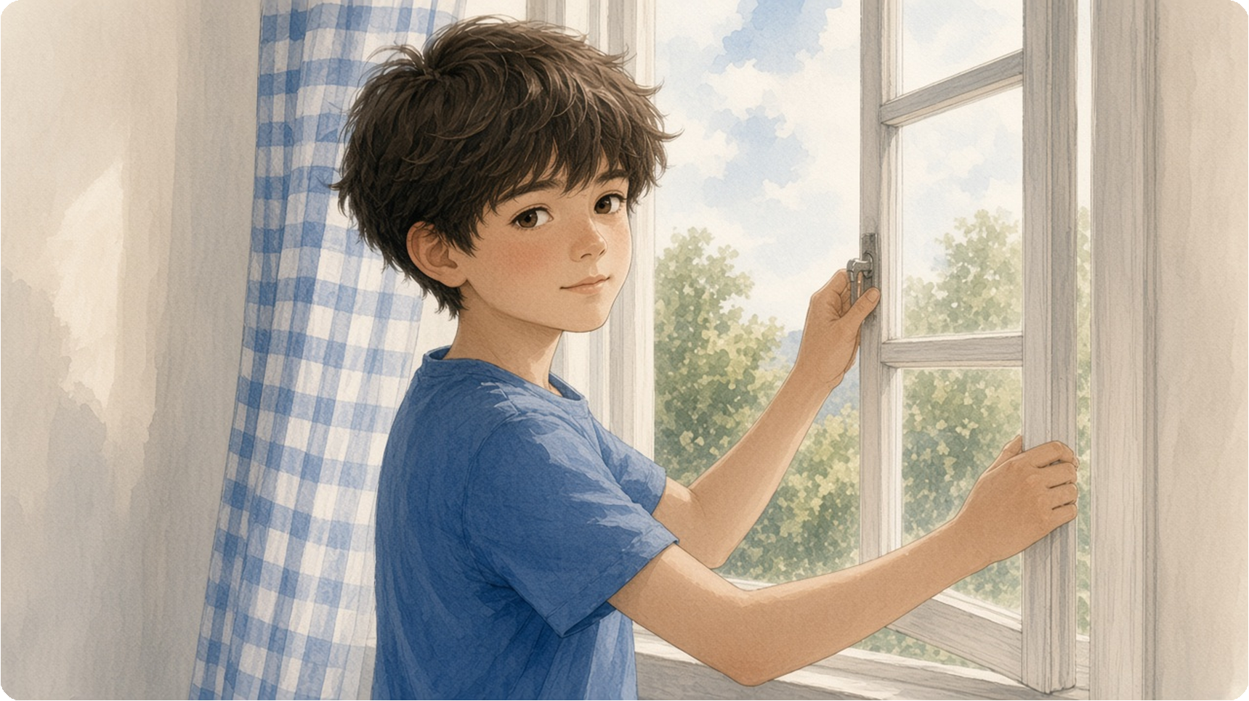


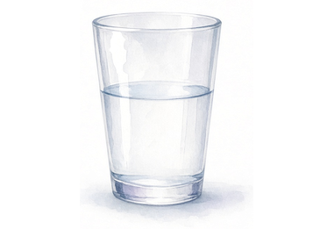
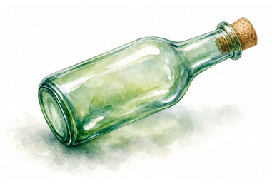

Please open the window.
Please close the window.
frame
glass pane
glass
glass bottle
curtain
Is your window open or closed?
Please open the window.
Everyday Objects 2 · 1 / 15

Slide 4
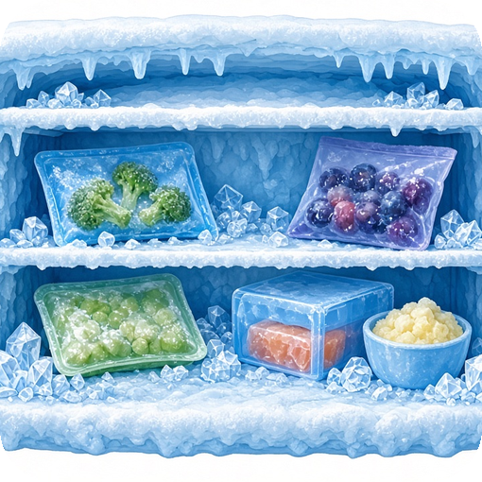
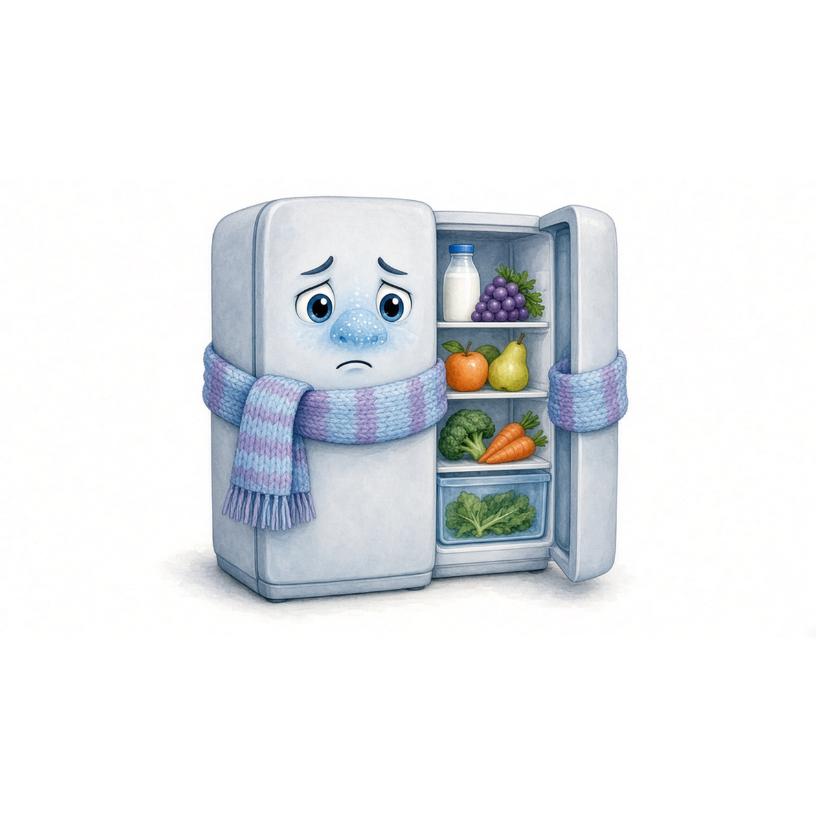
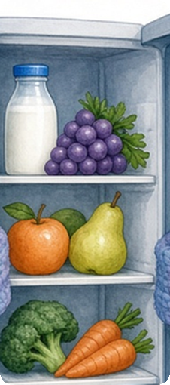
A fridge is cold.
A freezer is freezing.
Is the fridge cold or hot?
freezer
What do we put in the freezer?
shelf
The fridge keeps food cold.
Everyday Objects 2 · 2 / 15

Slide 5
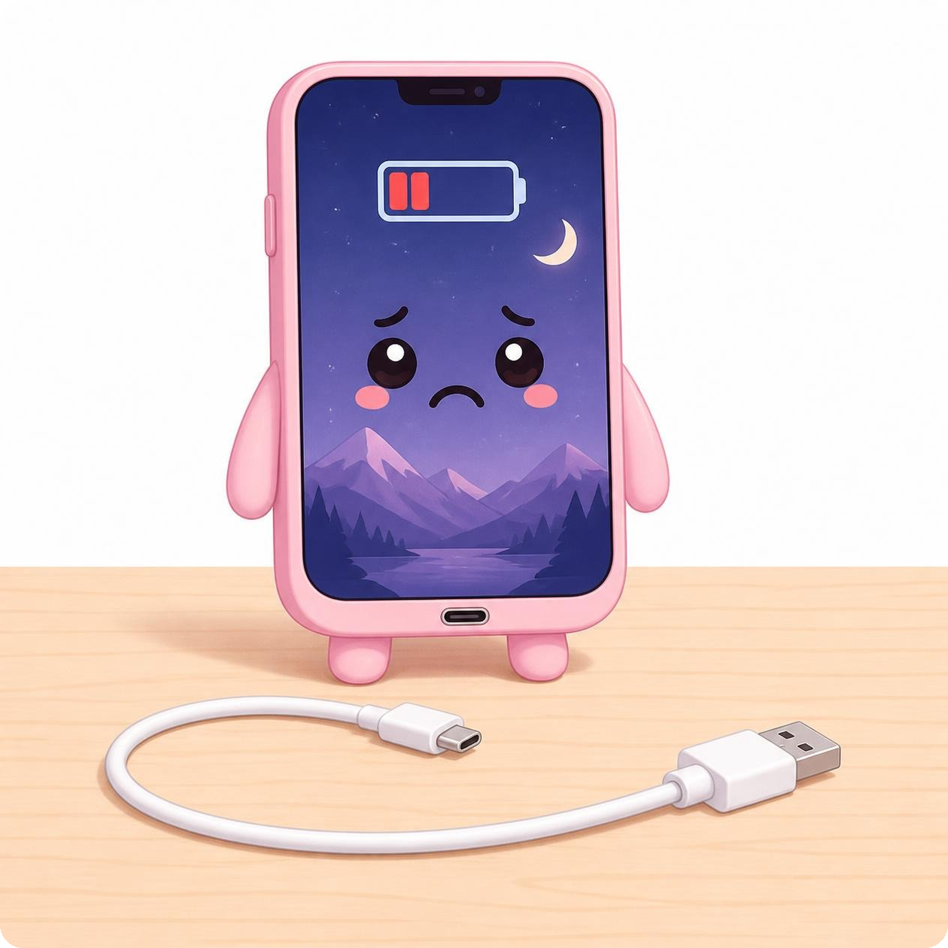


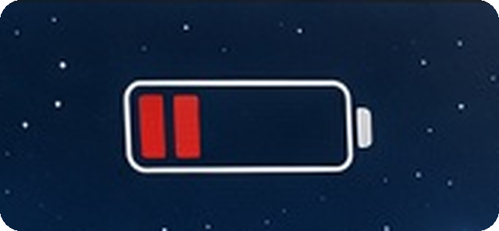
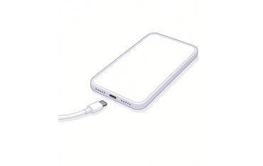
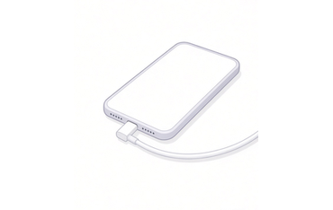
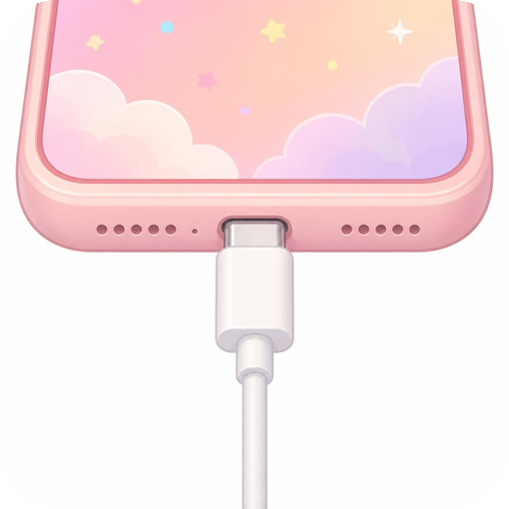
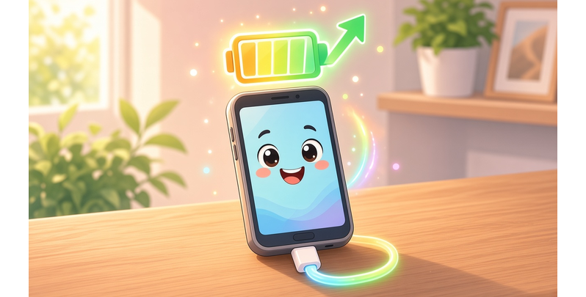
answer
hang up
I answer the phone.
battery
I hang up the phone.
Connect your charger.
Your phone is connected.
charger
Your phone is charging.
I talk on the phone.
Everyday Objects 2 · 3 / 15

Slide 6
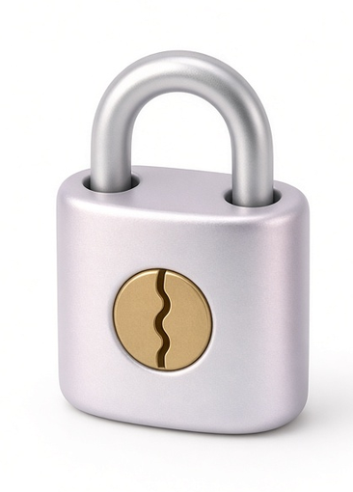
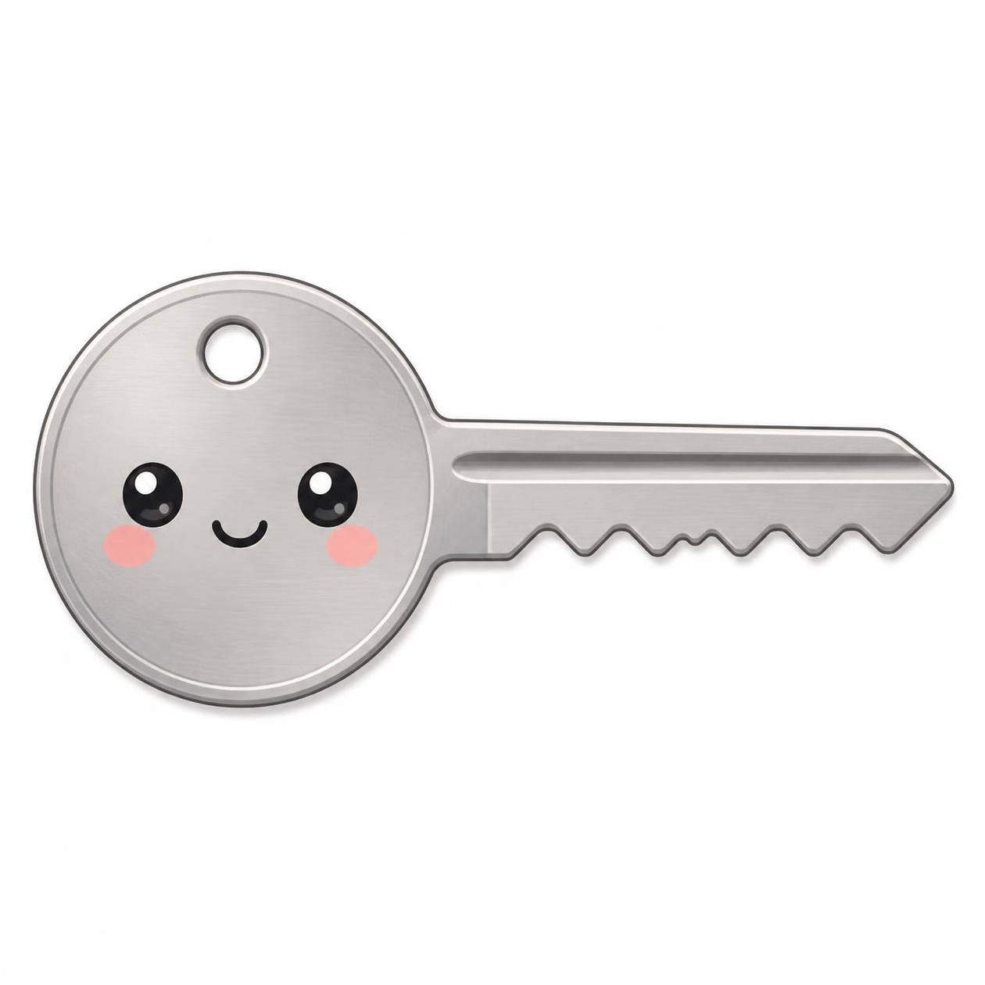
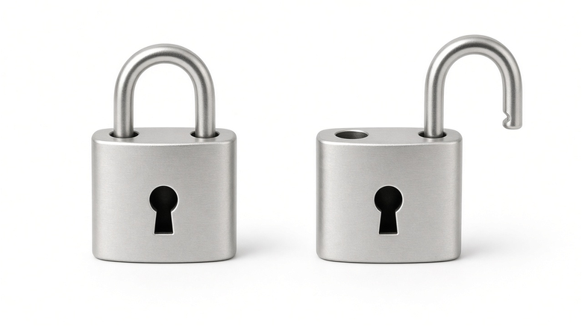
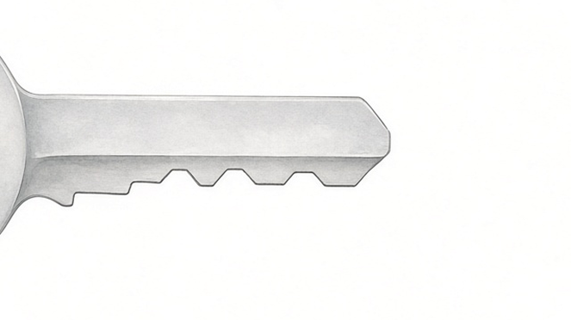
I lock the door with my key.
I unlock the door with my key.
lock
locked
unlocked
teeth
This key opens the door.
Everyday Objects 2 · 4 / 15

Slide 7

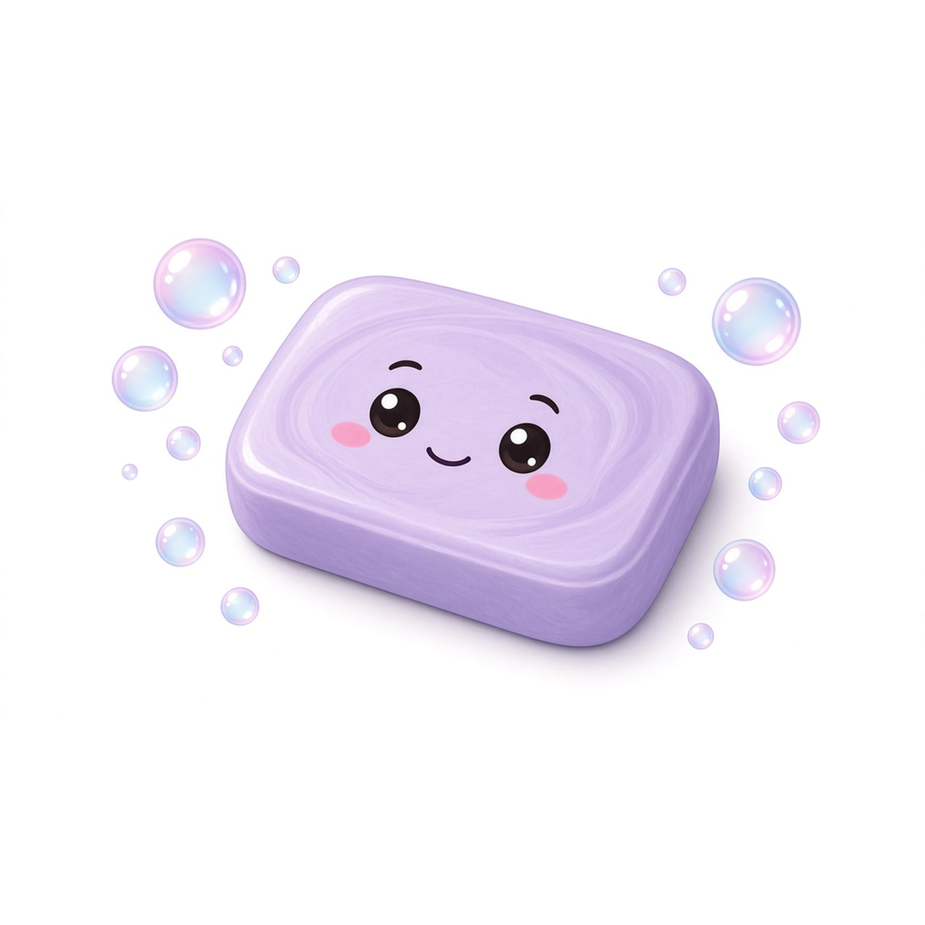
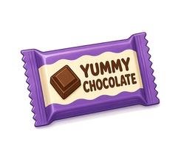
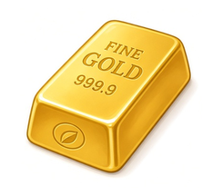
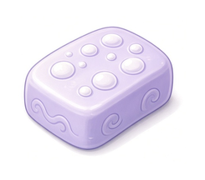
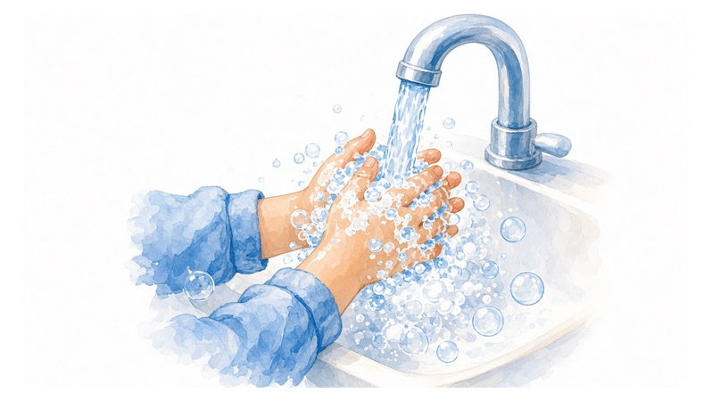
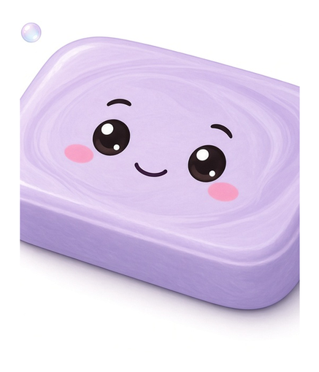
a bar of
a bar of
a bar of
chocolate
gold
soap
bubbles
soap + water = bubbles
bar
I wash my hands with soap.
Everyday Objects 2 · 5 / 15

Slide 8
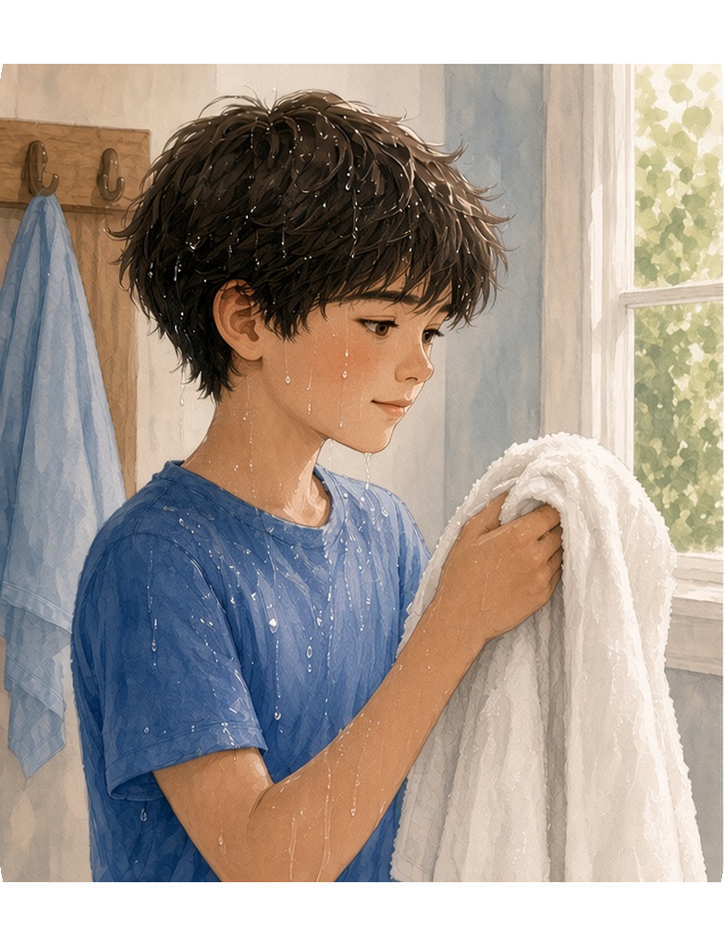
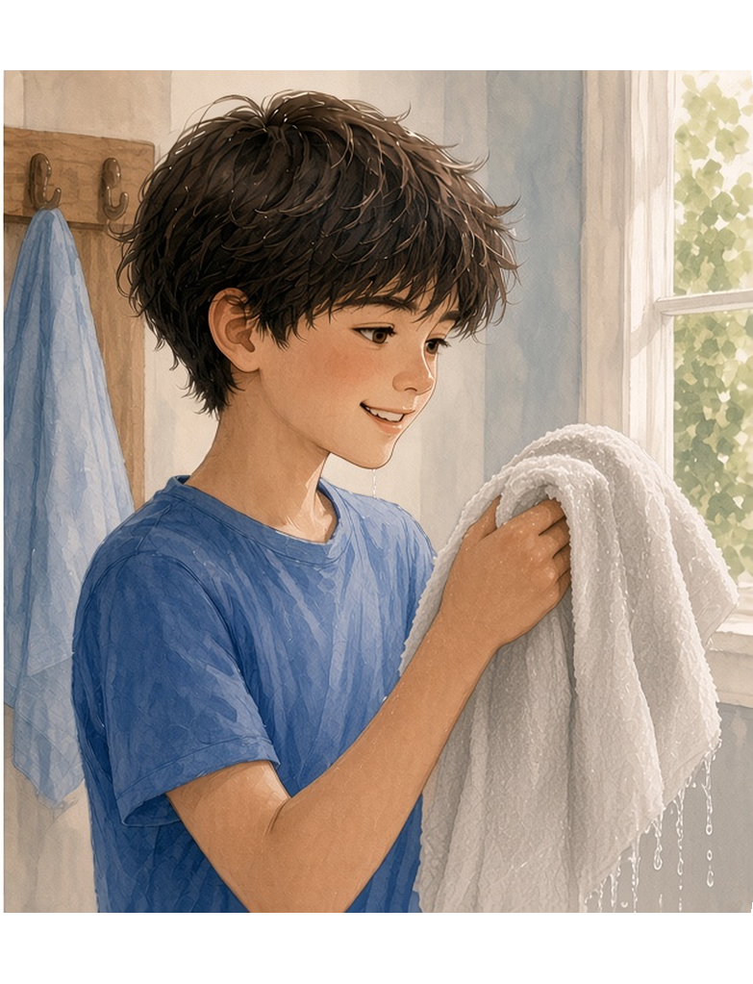
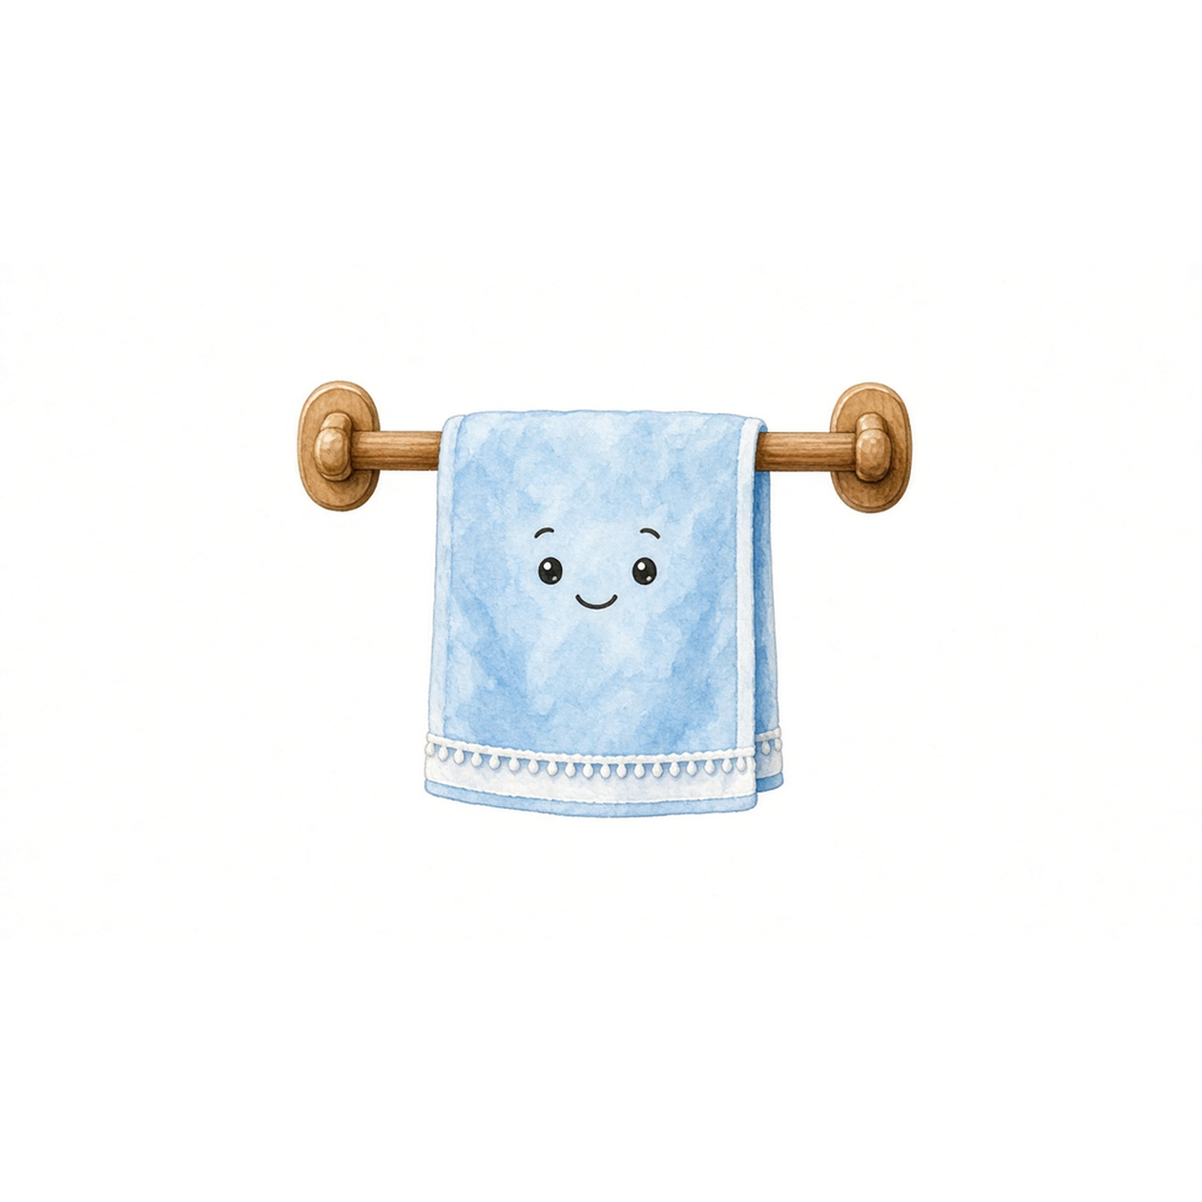
He is wet.
He is dry.
The towel is dry.
The towel is wet.
I dry my hands with a towel.
Everyday Objects 2 · 6 / 15

Slide 9
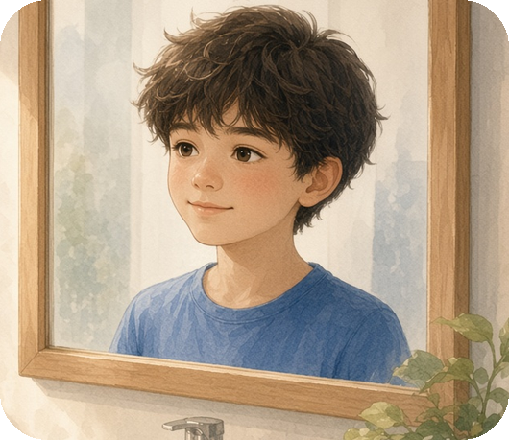
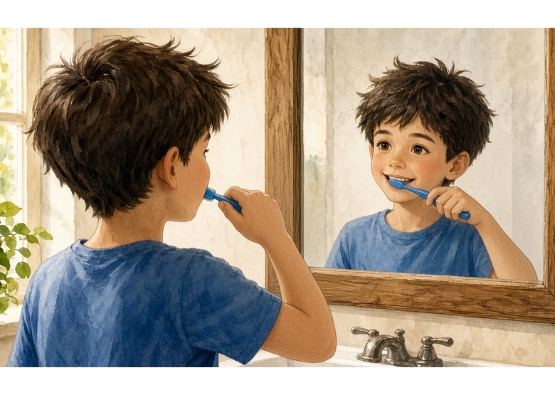
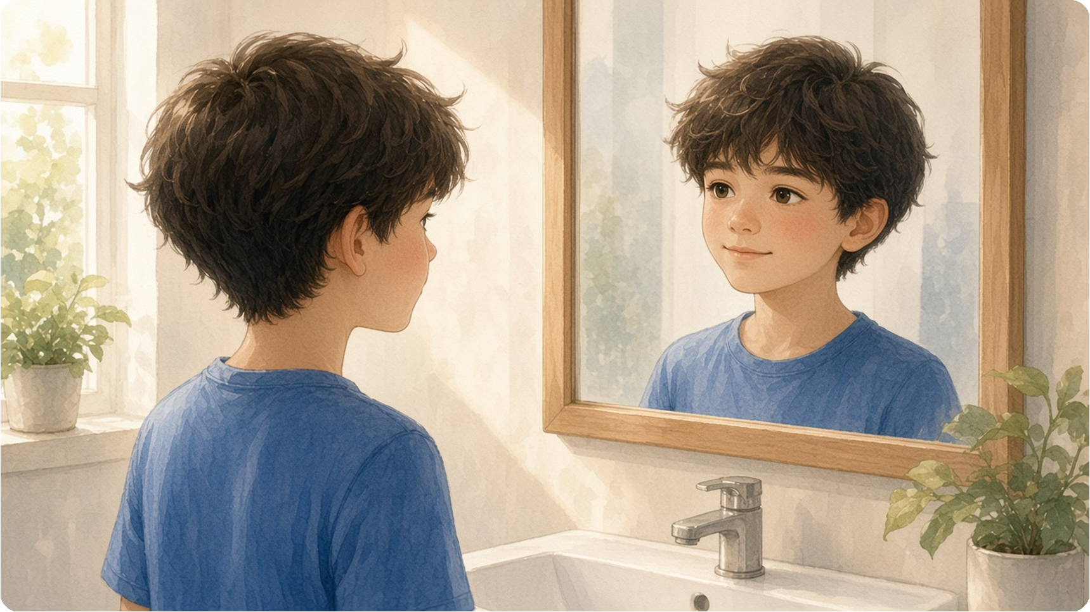
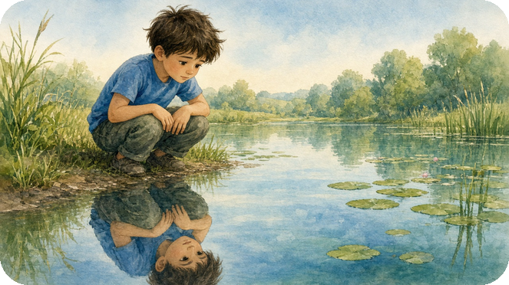
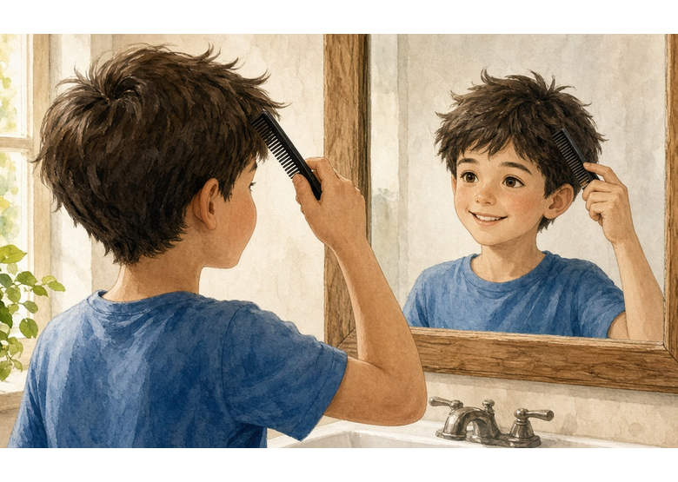
reflection
I brush my teeth
in the mirror.
pond
reflective surface
I comb my hair
in the mirror.
I look in the mirror.
Everyday Objects 2 · 7 / 15

Slide 10
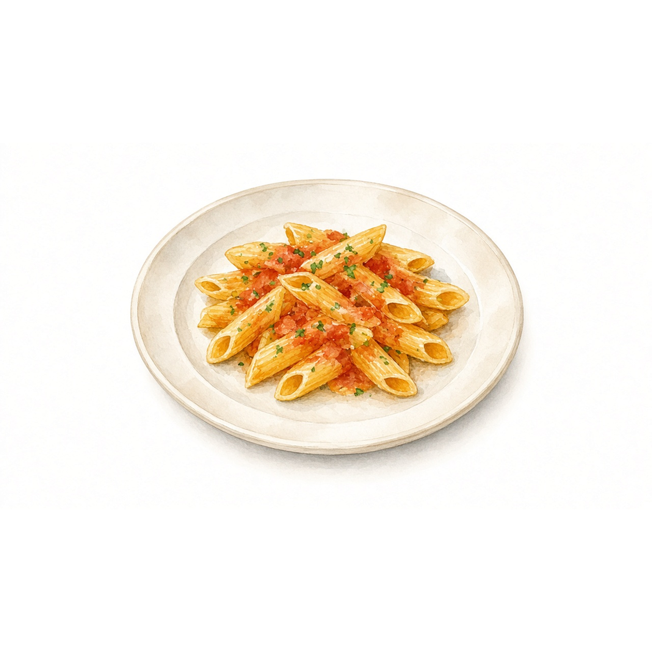
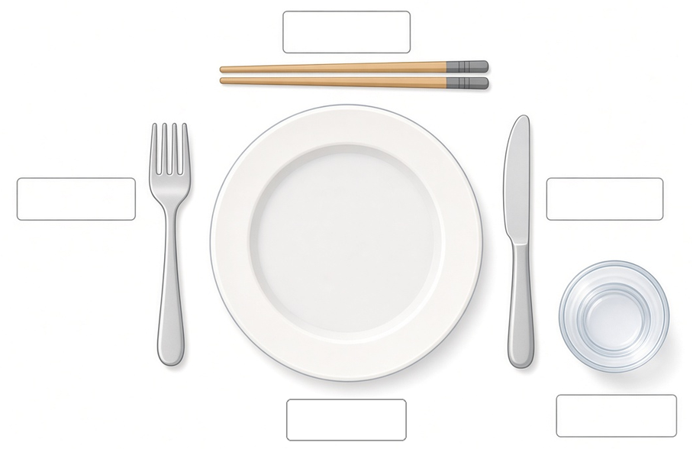
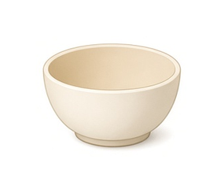
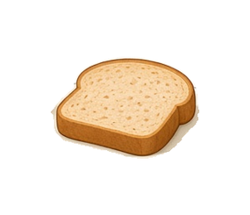
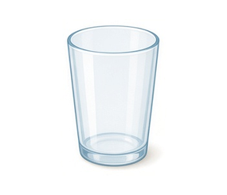
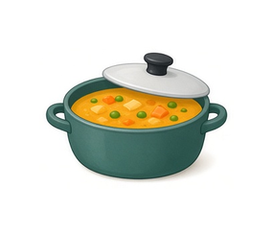
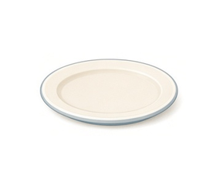

Mini match
Draw a line.
bowl
bread
plate
knife
fork
glass
soup
glass
chopsticks
plate
juice
My food is on the plate.
Everyday Objects 2 · 8 / 15

Slide 11
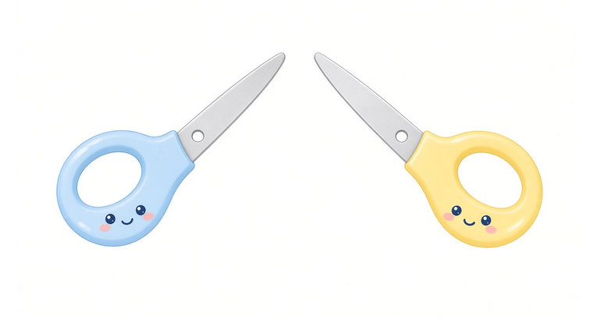

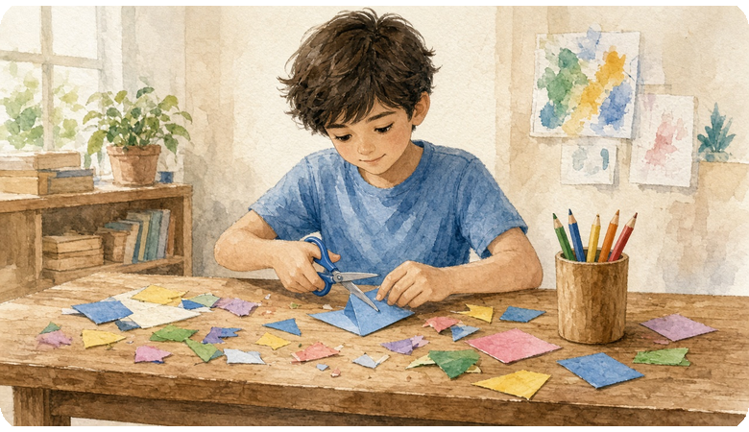
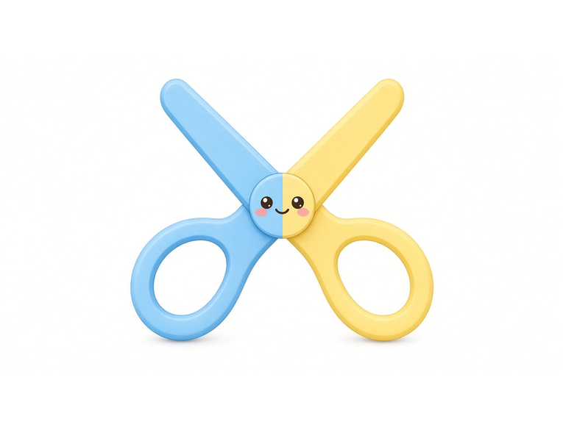
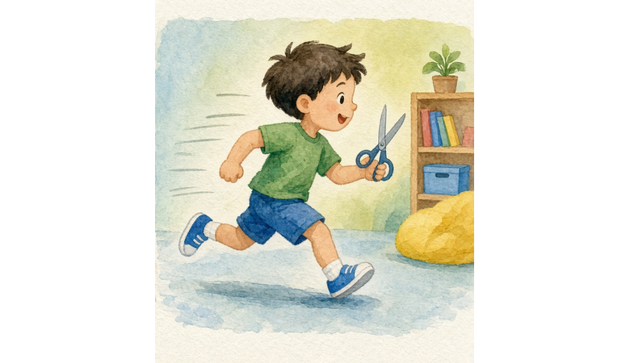
What do we do with scissors?
a pair of scissors
We cut with scissors.
What do we not do with scissors?
We do not run with scissors.
I cut paper with scissors.
Everyday Objects 2 · 9 / 15

Slide 12
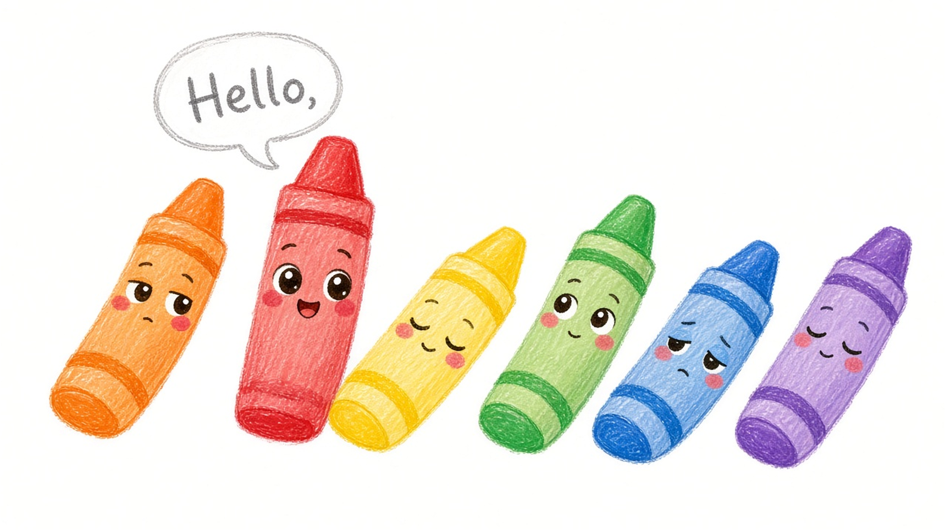
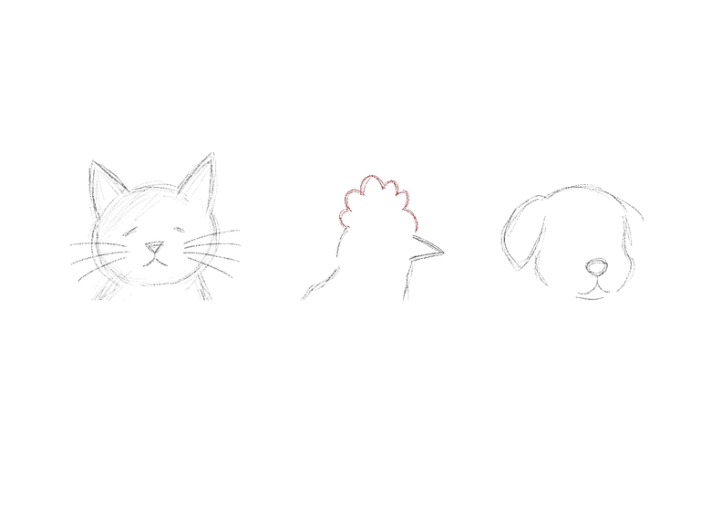
Color Chart
Dark
Light
Guess what it is!
dark blue
light blue
dark yellow
light yellow
dark green
light green
Do you like dark colors?
or
Do you like light colors?
I colour with the red crayon.
Everyday Objects 2 · 10 / 15

Slide 13
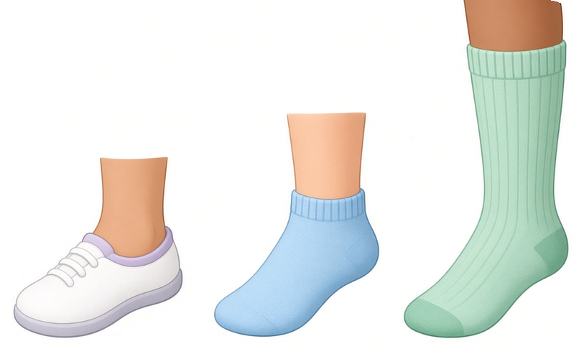
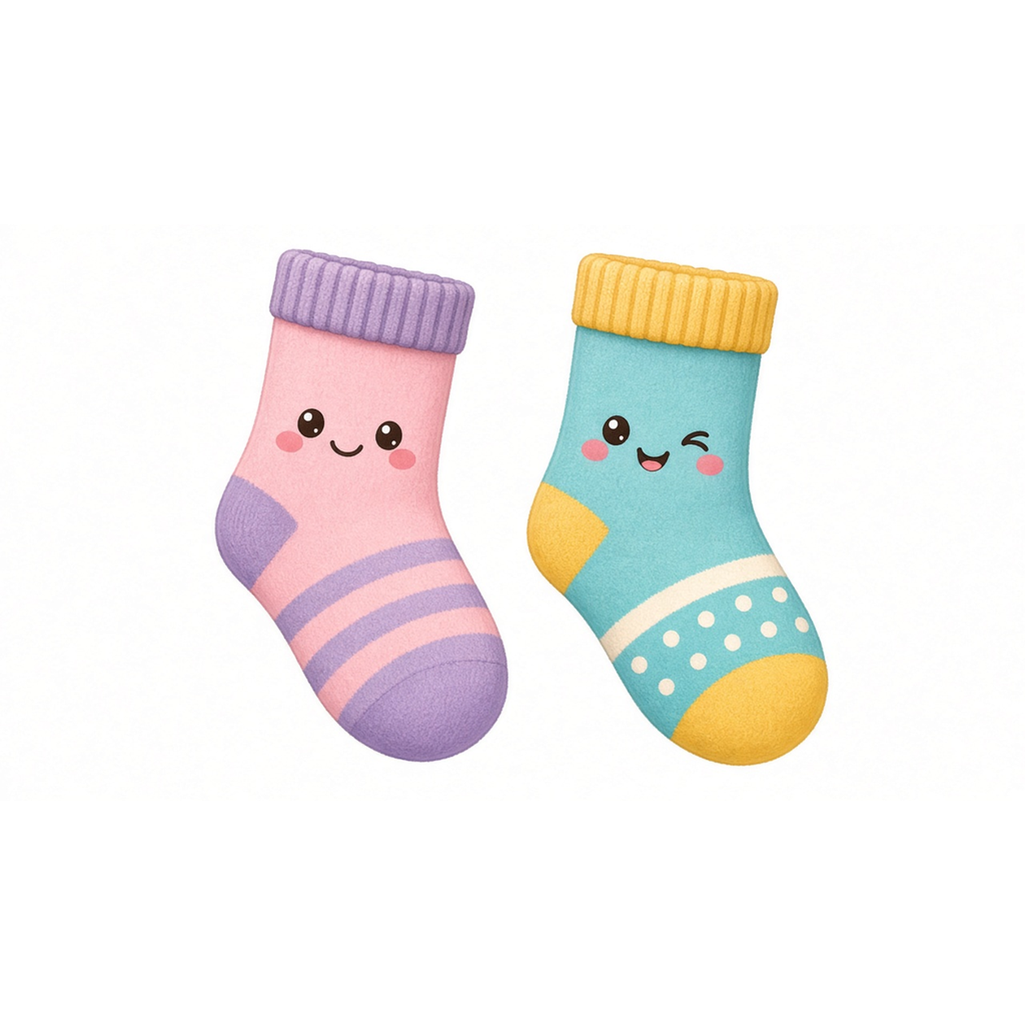
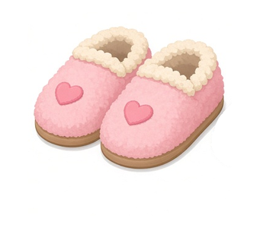
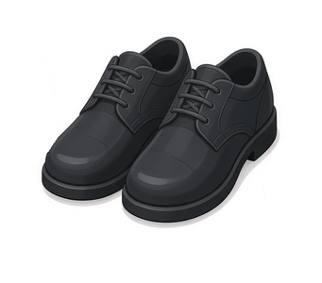
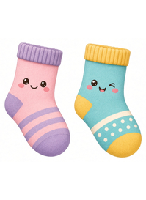
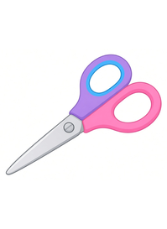



Do you wear socks with …?
secret
socks
low-cut
socks
knee-high
socks
socks with
slippers?
socks with
school shoes?
pairs = 2
Yes
No
Yes
No
a pair of
socks
a pair of
scissors
a pair of
glasses
socks with
sneakers?
socks with
sandals?
Yes
No
Yes
No
I put on my socks.
Everyday Objects 2 · 11 / 15

Slide 14





zipper
I put on my jacket.
pocket
What do you have in your pocket?
I take off my jacket.
I wear my jacket outside.
Everyday Objects 2 · 12 / 15

Slide 15



sweeping
I sweep the floor.
mopping
I mop the floor.
I sweep with a broom.
Everyday Objects 2 · 13 / 15

Slide 16






Plants
need
water.
and
leaf
sunlight.
Plants give us ?
leaves
clean air
The plant needs water.
Everyday Objects 2 · 14 / 15

Slide 17







on
off
click
I turn on the TV.
I turn off the TV.
down
up
buttons
I turn the volume up / down.
I change the channel with the remote.
Everyday Objects 2 · 15 / 15

Slide 18






Worksheet 1 · Circle & Match
Read the sentence. Draw a line to the right word. Then circle the word.
1. Please open the ______.
towel
2. The ______ keeps food cold.
jacket
3. I talk on the ______.
❄
❄
fridge
4. I wash my hands with ______.
window
5. I dry my hands with a ______.
soap
6. I wear my ______ outside.
phone
Everyday Objects 2 · Worksheet 1

Slide 19

Worksheet 2 · Find and Circle
Find it! Point to it. Circle it.
Point to something you open for fresh air.
Point to something that keeps food cold.
Point to something you talk on.
Point to something that opens a door.
Point to something you wash your hands with.
Point to something you dry your hands with.
Point to something you look in.
Point to something your food sits on.
Point to something you colour with.
Point to something that needs water.
Everyday Objects 2 · Worksheet 2

Slide 20



I open the
I close the
window
Everyday Objects 2 · Action Pairs 1 / 6

Slide 21



I put on my
I take off my
jacket
Everyday Objects 2 · Action Pairs 2 / 6

Slide 22



I wash my
I dry my
hands
Everyday Objects 2 · Action Pairs 3 / 6

Slide 23



I pick up the
I put down the
phone
Everyday Objects 2 · Action Pairs 4 / 6

Slide 24



I turn on the
I turn off the
TV
Everyday Objects 2 · Action Pairs 5 / 6

Slide 25



I water the
I watered the
plant
Everyday Objects 2 · Action Pairs 6 / 6

Slide 26

Thank you for learning with Everyday Objects 2.
For one classroom or one home.
Everyday Objects 2 · Sentence Flashcards · Beginner ESL

