Slide 1

Introduction to Rust
For assistance:@geekyshiva
geekyshiva.xyz
Notes:
https://manishearth.github.io/blog/2015/05/30/how-rust-achieves-thread-safety/ (Thread Safety)

Slide 2
Agenda
Basic Terminologies
Common System programming bugs
Why Rust?
Intro to Rust
Type System
Ownership and Borrowing
Getting started with Rust community
???
Notes:
Spelling mistakes are compile errors, not runtime errors like with dynamic languages like Python or JavaScript

Slide 3
Basic Terminologies
Low and high level language
System programming
Stack and heap
Concurrency and parallelism
Compile time and run time
Type system
Garbage collector
Mutability
Scope

Slide 4
Common System Programming Errors
Segmentation Fault
Buffer OverFlow

Slide 5
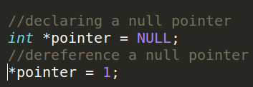
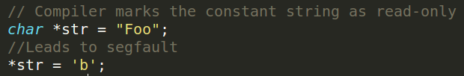
Segmentation Fault
Dereference a null pointer
Try to write to a portion of memory that was marked as read-only
Notes:
Errors associated with the way we access the memory, occurs commonly when we access the memory which does not belong to a particular entity
A null pointer is a command used to direct a software program or operating system to an empty location in the computer memory

Slide 6
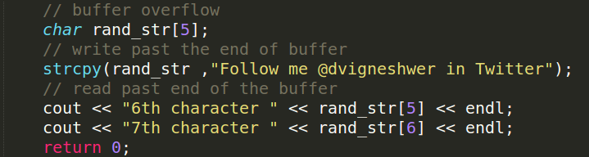
Buffer OverFlow
Writing and reading the past end of buffer
Notes:
Writing outside the allocated memory

Slide 7


Sample Error Outputs
Segmentation fault
BufferOverFlow

Slide 8
Why do we need a new system programming language?
State or art programming language
Solves a lot of common system programming bugs
Cargo : Rust Package manager
Improving your toolkit
Self learning
It's FUN ...

Slide 9
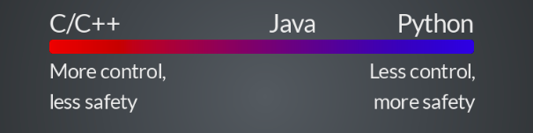
Rust
System programming language
Has great control like C/C++
Safety and expressive like python
Notes:
Rust is a great system programming language which enables high level features of python,JS with low level features of C/C++
Rust is a systems programming language that runs blazingly fast, prevents segfaults, and guarantees thread safety

Slide 10
Best things about Rust
Strong type system
Reduces a lot of common bugs
Borrowing and Ownership
Memory safety
Freedom from data races
Zero Cost abstraction

Slide 11
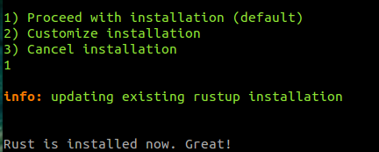
Installing Rust
# Ubuntu / MacOS
Open your terminal (cntrl + Alt +T)
curl -sSf https://static.rust-lang.org/rustup.sh | sh

Slide 12


Installing Rust
rustc --version
cargo --version
# Windows
Go to https://win.rustup.rs/
This will download rustup-init.exe
Double click and start the installation

Slide 13
Type System

Slide 14
Hello World
fn main() {
let greet = “world”;
println!("Hello {}!”, greet);
}

Slide 15
A bit complex example
fn avg(list: &[f64]) -> f64 {
let mut total = 0;
for el in list{
total += *el
}
total/list.len() as f64
}

Slide 16
HLL version
fn avg(list: &[f64]) -> f64 {
list.iter().sum::<f64>() / list.len() as f64
}

Slide 17
Parallel Version (Rayon)
fn avg(list: &[f64]) -> f64 {
list.par_iter().sum::<f64>() / list.len() as f64
}

Slide 18
Fold
fn avg(list: &[f64]) -> f64 {
list.par_iter().fold(0., |a,b| a + b) / list.len() as f64
}

Slide 19
Primitive Types

Slide 20
bool
let bool_val: bool = true;
println!("Bool value is {}", bool_val);

Slide 21
char
let x_char: char = 'a';
// Printing the character
println!("x char is {}", x_char);

Slide 22
i8/i16/i32/i64/isize
let num =10;
println!("Num is {}", num);
let age: i32 =40;
println!("Age is {}", age);
println!("Max i32 {}",i32::MAX);
println!("Max i32 {}",i32::MIN);

Slide 23
Other Primitive Types
u8/u16/u32/u64/usize
f32/f64

Slide 24
Tuples
// Declaring a tuple
let rand_tuple = ("Mozilla Science Lab", 2016);
let rand_tuple2 : (&str, i8) = ("Viki",4);
// tuple operations
println!(" Name : {}", rand_tuple2.0);
println!(" Lucky no : {}", rand_tuple2.1);

Slide 25
Arrays
let rand_array = [1,2,3]; // Defining an array
println!("random array {:?}",rand_array );
println!("random array 1st element {}",rand_array[0] ); // indexing starts with 0
println!("random array length {}",rand_array.len() );
println!("random array {:?}",&rand_array[1..3] ); // last two elements

Slide 26
String
let rand_string = "I love Mozilla Science <3"; // declaring a random string
println!("length of the string is {}",rand_string.len() ); // printing the length of the string
let (first,second) = rand_string.split_at(7); // Splits in string
let count = rand_string.chars().count(); // Count using iterator count

Slide 27
Complex Data structures

Slide 28
struct
// define your custom user datatype
struct Circle {
x : f64,
radius : f64,
}

Slide 29
Rust “Class”
impl Circle {
// pub makes this function public which makes it accessible outsite the scope {}
pub fn get_x(&self) -> f64 {
self.x
}
}

Slide 30
Traits
Interfaces
Operator overloading
Indicators of behaviour
Bounds for generic
Dynamic dispatch

Slide 31
Trait Sample
// create a functionality for the datatypes
trait HasArea {
fn area(&self) -> f64;
}
// implement area for circle
impl HasArea for Circle {
fn area(&self) -> f64 {
3.14 * (self.r *self.r)
}
}

Slide 32
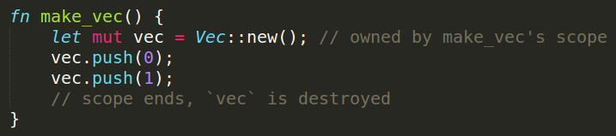
Ownership
In Rust, every value has an “owning scope,” and passing or returning a value means transferring ownership (“moving” it) to a new scope

Slide 33
Example 1
fn foo{
let v = vec![1,2,3];
let x = v;
println!(“{:?}”,v); // ERROR : use of moved value: “v”
}

Slide 34
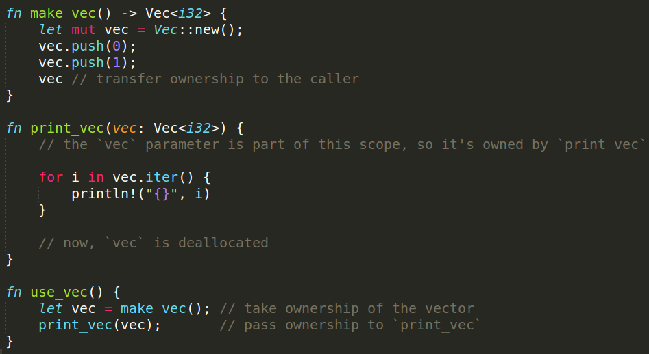
Ownership - Ex 2

Slide 35
fn print(v : Vec<u32>) {
println!(“{:?}”, v);
}
fn make_vec() {
let v = vec![1,2,3];
print(v);
print(v); // ERROR : use of moved value: “v”
}

Slide 36
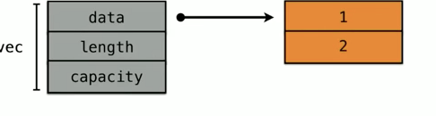
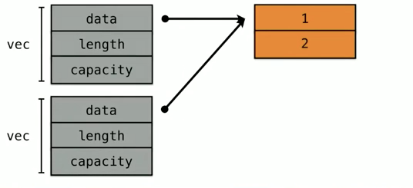
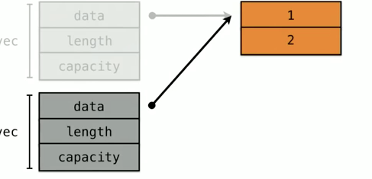
Ownership
Step 1.
Step 2. Step 3.

Slide 37
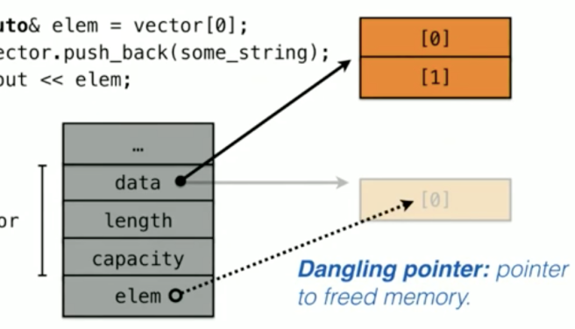
Aliasing
More than one pointer to the same memory
Ownership concepts avoids Aliasing

Slide 38
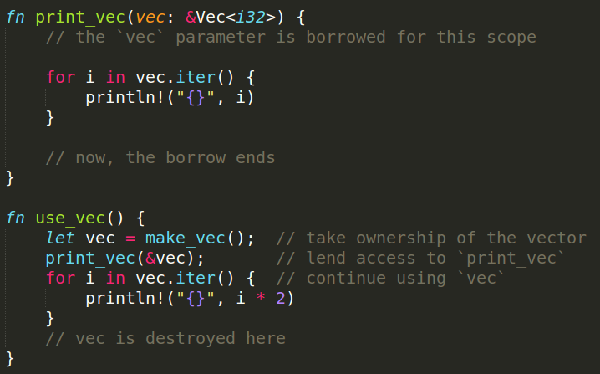
Borrowing
If you have access to a value in Rust, you can lend out that access to the functions you call
Notes:
https://rustbyexample.com/scope/borrow.html

Slide 39
Types of Borrowing
There is two type of borrowing in Rust, both the cases aliasing and mutation do not happen simultaneously
Shared Borrowing (&T)
Mutable Borrow (&mut T)

Slide 40
&mut T
fn add_one(v: &mut Vec<u32> ) {
v.push(1)
}
fn foo() {
let mut v = Vec![1,2,3];
add_one(&mut v);
}

Slide 41
Rules of Borrowing
Mutable borrows are exclusive
Cannot outlive the object being borrowed

Slide 42
Cannot outlive the object being borrowed
fn foo{
let mut v = vec![1,2,3];
let borrow1 = &v;
let borrow2 = &v;
add_one(&mut v): // ERROR : cannot borrow ‘v’ as mutuable because
} it is also borrowed as immutable

Slide 43
Lifetimes
let outer;
{
let v = 1;
outer = &v; // ERROR: ‘v’ doesn’t live long
}
println!(“{}”, outer);

Slide 44
Getting started with Rust community
Follow all the latest news at Reddit Channel
https://www.reddit.com/r/rust/
Have doubts, post in
https://users.rust-lang.org
#rust IRC channel
Want to publish a crate,
https://crates.io
Follow @rustlang in twitter,
https://twitter.com/rustlang
Subscribe to https://this-week-in-rust.org/ newsletter

Slide 45
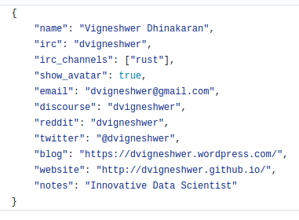
Getting started with Rust community
Create your rustaceans profile,
Fork https://github.com/nrc/rustaceans.org
Create a file in data directory with <github_id>.json
Ex: dvigneshwer.json

Slide 46
Adopt Rust today !!

Slide 47
References
Segfault: http://stackoverflow.com/questions/2346806/what-is-a-segmentation-fault
BufferOverFlow: http://stackoverflow.com/questions/574159/what-is-a-buffer-overflow-and-how-do-i-cause-one
Rust Website: https://www.rust-lang.org/en-US/
Community Forum: https://users.rust-lang.org/
Rust Book: https://doc.rust-lang.org/book/
Unraveling Rust Design: https://dvigneshwer.wordpress.com/2017/02/25/unraveling-rust-design/
Rust Cookbook: https://www.packtpub.com/application-development/rust-cookbook

Slide 48
Contribute
https://github.com/MozillaTN/Rust
https://github.com/dvigneshwer/deeprust
https://github.com/dvigneshwer/Benchmarking_Rust
https://github.com/servo

Slide 49

Slide Credits : @dvigneshwer
Lives in Bengaluru, India
Works at MuSigma Research
Mozilla Representative in India
Developing DeepRust Crate
Author of Rust CookBook by Packt
Mozilla TechSpeaker Program member

Slide 50
Thank You
Tweet at #RustIndia
Join RustIndia Telegram group

