Slide 1

Your Mind Skill
Kingcean Tuan · Sep 2026
Improve AI efficiency and accuracy
through appropriate engineering practices
Notes:
Since the advent of GPT, people have been proclaiming that the Fourth Industrial Revolution has arrived.

Slide 2
AI Powers Everything
Today, AI
permeates every aspect
of our lives,
supporting us in
both learning and work.
Notes:
Today, AI permeates every aspect of our lives, influencing nearly everything we do while supporting our learning and work.

Slide 3
High Efficiency AI
How to use AI more efficiently
by using
while achieving greater
fewer tokens
accuracy
reliability
less time
predictability
— is a skill worth exploring and developing.
Notes:
However, learning how to use AI more efficiently—using fewer tokens and less time while achieving greater accuracy, reliability, and predictability—is a valuable skill that deserves our attention and effort.
Although today’s AI is already intuitive enough to perform complex tasks from simple instructions, technological progress does not imply the weakening of human capabilities. Instead, we will continue to build on the innovations of this new era and take on ever more demanding tasks. Challenges will always remain, and we will never back down.
As AI grows increasingly intelligent, we still need effective methods to unlock its potential more fully and thoroughly. Even if doing so requires greater effort, it is well worth it.

Slide 4
How AI Skills Work
Background
Solid Soft Skill
Engineering
By understanding the underlying reasons
can we know how to optimize
Notes:
Before exploring how to improve AI efficiency, we first need some foundational context. After all, understanding the reasoning behind something allows us to master it more effectively. However, given the space constraints—and assuming that most readers already have a solid understanding of AI—we will begin directly with Skills, the concept most closely related to the optimization techniques discussed here.

Slide 5
Workflow
Requirement Input
Skills Load
Action
Built-in Skills
Imported Skills
√
Task Orchestration
Result
Doc
Skills allow us to direct AI to complete complex tasks
—even engineering tasks requiring specialized expertise—
in a simple and intuitive way.
Notes:
Skills enable us to guide AI through complex tasks—including engineering tasks that require specialized expertise—using concise, intuitive instructions. But how does this work?
With tools such as Codex, we can express our ideas in natural language. The large language model then combines its built-in capabilities with the Skills provided to it, creating an actionable plan. This includes breaking the task down, directing attention to the right areas, and determining how various tools and Skills may be used.
The plan is then carried out automatically, with the model continuing to reason and adapt throughout the process until it produces the final result—a truly intelligent assistant.

Slide 6
Start From Tools
LLM
Understand and process text
Possess vast amounts of built-in knowledge
Enhanced JSON support
AI Tools
LLM
JSON
API
Notes:
LLMs fundamentally understand and process text, while drawing on a vast store of knowledge acquired during training. Because text is generally expressed through language, LLMs can gradually learn different languages from their training data, including widely used languages such as English and Chinese.
LLMs are also proficient at expressing content in Markdown because they were trained extensively on text in this format. From an LLM’s perspective, Markdown is therefore part of language itself. In addition, earlier LLMs were specifically fine-tuned to generate and interpret JSON. This enhancement was introduced to enable a capability that would profoundly influence the subsequent development of LLMs: AI tool calling.
In computing, JSON is commonly used for data exchange. By instructing an LLM to produce structured data in a predefined JSON format, we make that data readable by a preconfigured API. This allows the AI to invoke external programs when it needs to process information—or obtain information—it does not fully understand or possess. The program then returns its result in JSON format, which the LLM reads and interprets before continuing with the rest of the AI workflow. This is known as AI tool calling.
To support multiple tools, the JSON generated by the LLM typically includes the name or identifier of the tool to invoke, together with the parameters required by that tool—that is, the API. The JSON returned by the tool is then appended to the prompt and sent back to the LLM, along with the original context, so that it can continue executing the task.

Slide 7
AI Tools
AI connects with the outside world through AI tools
Task Intent
Function Call
History Evolution
Call Stack
MCP Tool
AI Skill
Notes:
AI tools have evolved through several stages—from early plugin mechanisms to function calling, then to the more distributable MCP tools, and now to today’s increasingly popular AI Skills. There may also have been various intermediate forms and offshoots along the way.
Even today, many of these earlier forms still play a role in AI task execution through layered invocation rather than simply becoming obsolete. For example, a Skill may invoke MCP tools and function calls under the hood. These mechanisms therefore continue to coexist, encapsulated within successive layers of abstraction.

Slide 8
Task Orchestration
Core of
AI Workflows
complex
Process Flow
Referenced Resources
w/ better understand
Responsibilities
Contextual Dependencies
Objectives
Notes:
Task orchestration is another fundamental yet often hidden capability that has been continually strengthened throughout AI’s evolution. When a task involves complex workflows, referenced resources, and contextual dependencies, effective orchestration can eliminate many unnecessary steps and minimize detours.
It also enables the AI to better understand the responsibilities and objectives at each stage of the process—from both a macro and micro perspective—thereby improving overall efficiency.

Slide 9
Execution Mechanism
Different components handle different tasks at different levels and are ultimately integrated
LLM
Interact with the user and orchestrates the overall workflow
Skill
Provides instructions for carrying out a specific capability or task
MCP Tool /
Function Call
Interfaces for executing specific operations or commands
Command
Notes:
The LLM determines the objective and overall direction based on the task described by the user. It then selects the appropriate Skills based on the names and descriptions of the registered Skills, including built-in ones, and reads their detailed content when needed. The LLM subsequently follows the instructions defined in those Skills and reorganizes its response based on the returned results. In many cases, a single task may involve multiple Skills or repeated use of the same Skill.
Each Skill describes more detailed execution steps. These steps typically involve calling specific tools, such as MCP tools or built-in function-calling interfaces, to execute commands, access the internet, or manipulate files. The Skill also specifies how these tools should be called and what parameters they require. In most cases, the parameters are provided in JSON format, although this is not always the case.

Slide 10
Room for Improvement
Start
Solid Soft Skill
Engineering
Improve AI efficiency in complex scenarios
through various skills and techniques
Notes:
Through a range of techniques and technologies, we can dramatically improve the efficiency of AI in complex scenarios.

Slide 11
Focus Areas
Goals
AI task orchestration optimization
Tools
AI tools go ready
Processes
AI workflow automate
Improvement skill available
Notes:
Now that we understand how the Skill model works, we know that AI first orchestrates a task, then invokes specific tools, and ultimately completes it as an automated workflow. We can therefore optimize these three areas specifically, creating a practical Skill that operates more effectively.

Slide 12
Scope and Limitations
The skill series introduced in the following sections will be applied to scenarios
Long
workflows
Multiple chained
API calls
Stable and
Reusability
Notes:
By complex AI scenarios, we mean those with the following characteristics:
The processing chain is long, with multiple important and interdependent steps. It may also contain branches and require multiple interactions with an LLM.
There are multiple layers of external data references, and relationships may exist among the data. For example, the system may first retrieve one set of data and then use information within it to retrieve another.
The workflow is stable and reusable. In other words, the newly created AI scenario will be used frequently in the future.
The following set of Skills is designed for precisely these situations. Other scenarios may not benefit from all of them, but some of the ideas may still be worth adopting.

Slide 13
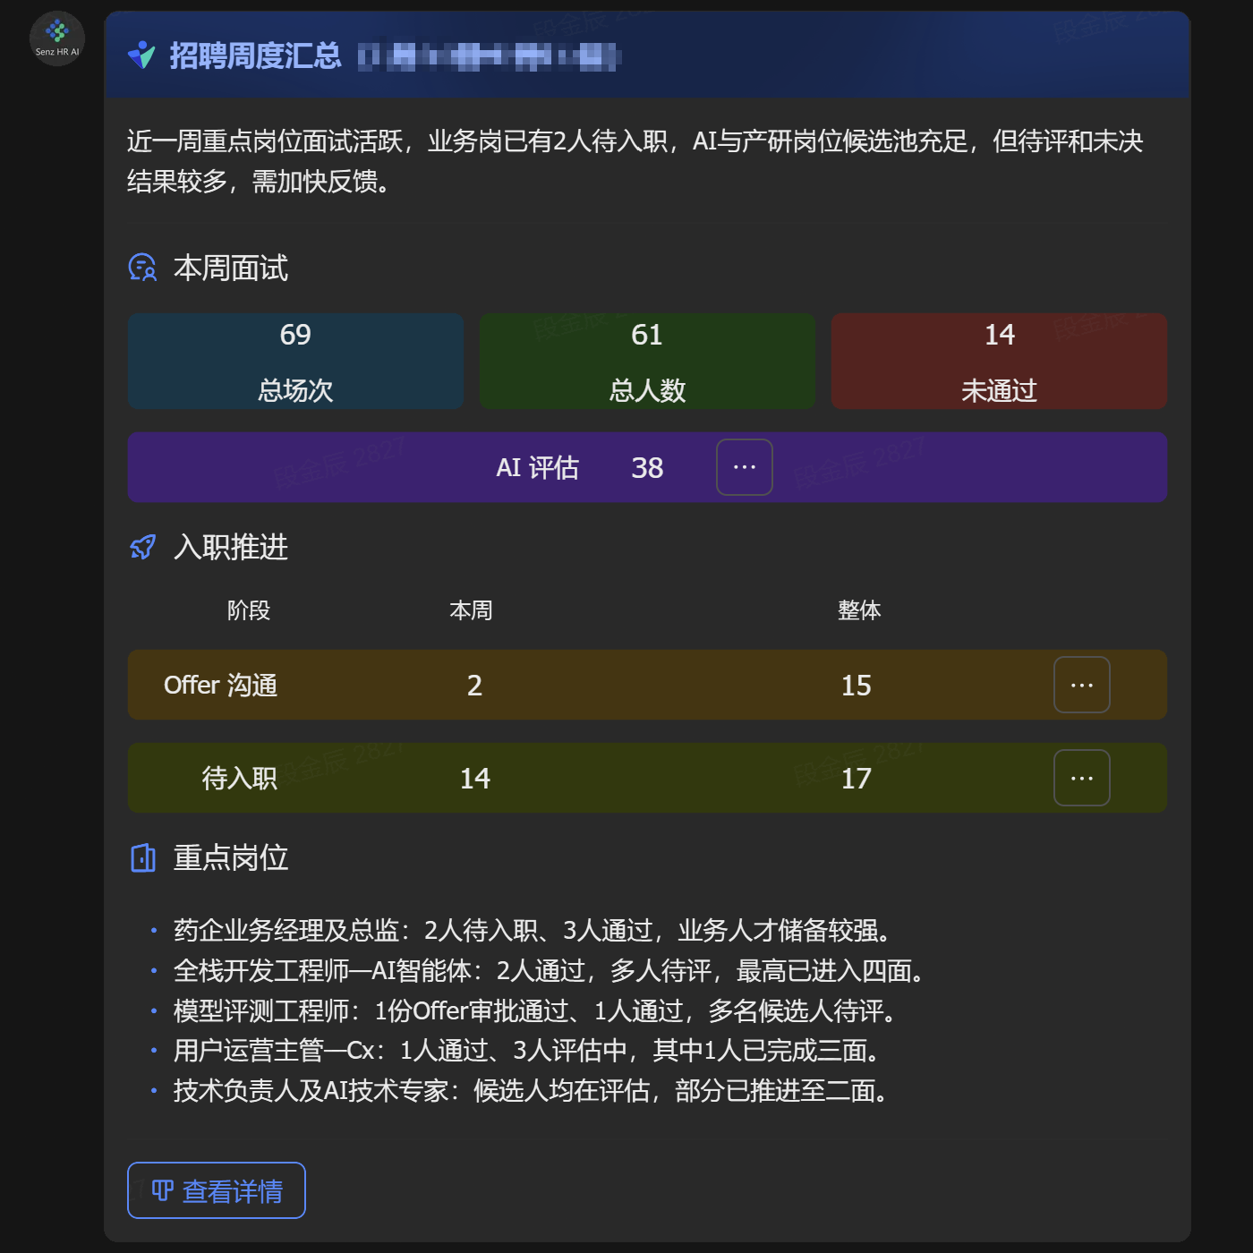
Example
Let’s start with a real-world example!
Recruitment Weekly
Data statistics
Status analysis
Notifications
Service integration
Notes:
To make the concepts easier to explain, we will use a real-world example throughout this article: a weekly recruitment data summary sent to the relevant stakeholders.
This weekly briefing is delivered through an enterprise messaging app. It contains a one-sentence overview, interview statistics for the past week, onboarding progress, an overview of key positions, and a link to the full report.
This service is itself only one component of a much larger intelligent recruitment system, which includes many other AI-powered capabilities.
Put simply, this example involves data aggregation, status analysis, notifications, and system integration.

Slide 14
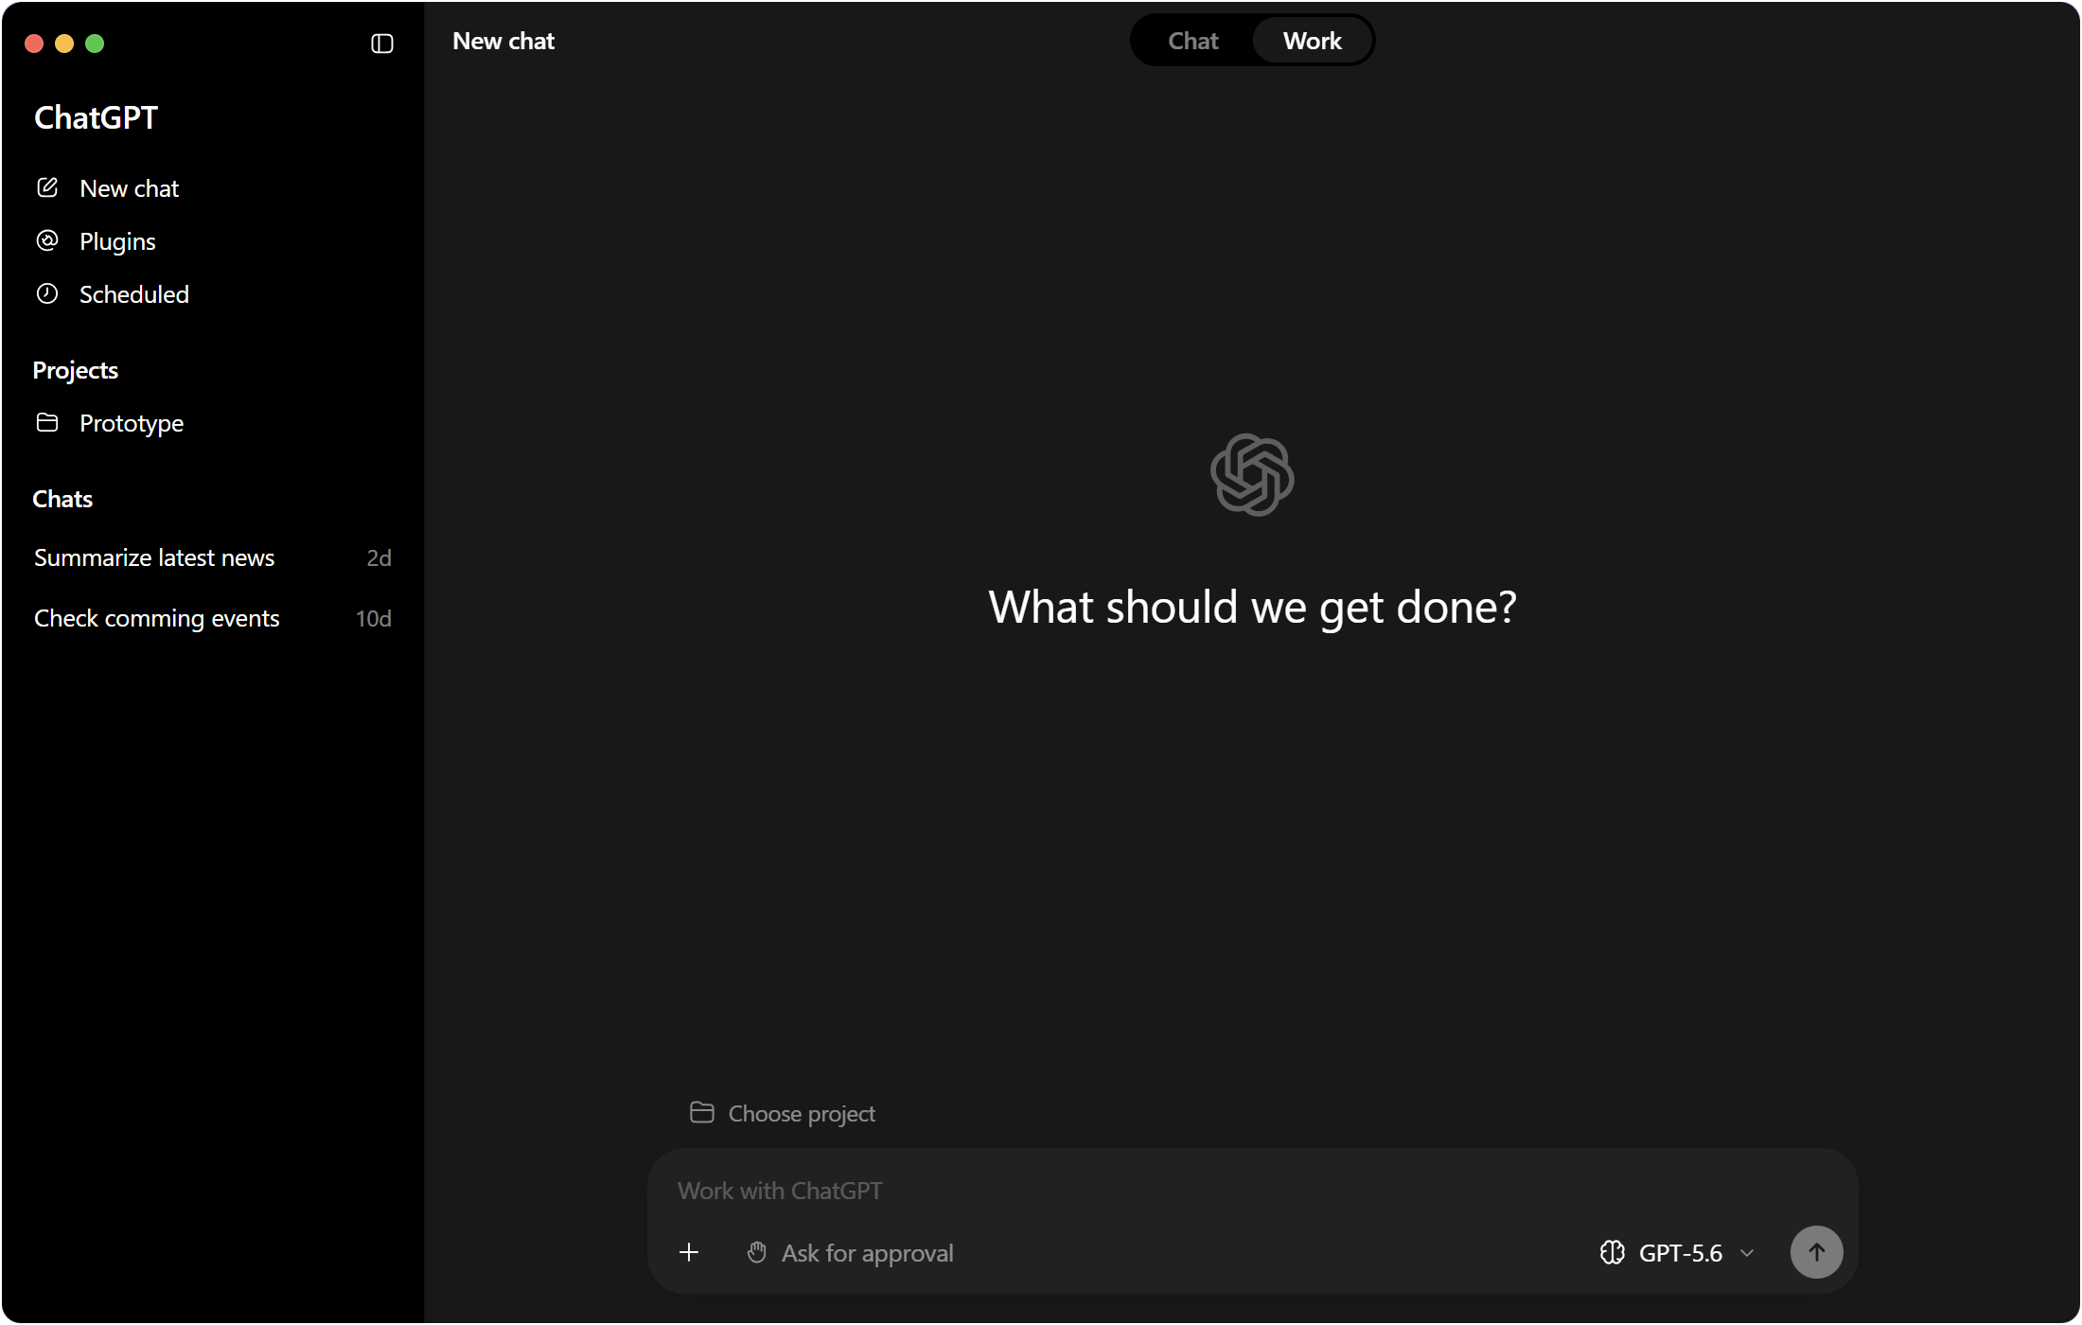
Chat to Implement
What do you think
about this kind of
conversation?
Generate a Lark/Teams interactive card notification to me, that summarizes
interview, offer, and onboarding data
from the past week,
along with an overview of key roles.
Notes:
To create such a service, we could open Codex and enter the prompt. The request appears clear enough. We can simply wait for it to run, review the result, and revise anything that does not work well.
This approach is simple, but it is not optimal. As mentioned earlier, although we can enjoy the benefits delivered by AI, the AI era is not merely a favorable trend we can passively follow. It is also a new challenge that requires us to rethink and adapt. We must continue to be courageous, keep learning, and find ways to make fuller use of AI.

Slide 15
Prompt Engineering
Solid Soft Skill
Solid Soft Skill
1
Engineering
Use a more rigorous and comprehensive prompt to ensure that the output meets expectations
Notes:
First, let us introduce the first Soft Skill considered to be Solid: Prompt Engineering.
“Solid” and “Soft” may appear to be opposites on some level, but everyone should understand the importance of Prompt Engineering, so this Soft Skill is indeed quite Solid.
AI Prompt Engineering involves targeted optimization of prompts for AI, and its effects can be significant. It received particular attention during the early stages of LLM development. As LLMs became more intelligent, it gradually faded from view. Yet the more demanding and exacting a project is—the more it qualifies as a high-leverage AI scenario—the more deeply and effectively we need to explore this field.

Slide 16
Descriptive Guidelines
Clear Objective and Output Specification
Context and Background
Data and Input Specification
Task Instructions and Edge Cases
Notes:
We can find a wealth of Prompt Engineering knowledge online, including many points worthy of attention. Several are listed below and explained in greater detail afterward:
Clearly define objectives and output specifications.
Provide appropriate context and background information.
Prepare data and specify input requirements.
Give clear task instructions and define how edge cases should be handled.

Slide 17
Clear Objective and Output Specification
State exactly what the AI task is expected to accomplish.
Define the expected output structure, tone, length, format, and level of detail.
For example,
Gen a Lark/Teams interactive card notification to me to summarize following.
Start with a one-sentence overview.
Week’s Interview Activity
Summarize using blocks with number figures and titles of interview sessions, candidates, rejections, and interviews with AI evaluations.
Onboarding Progress
Present in a table including weekly and historical cumulative headcounts, with separate rows for the 3 stages: Offer Communication, Pending Onboarding, and New Hires.
Key Roles
List 3-5 lines to provide updates on interview or onboarding progress.
Goal
Structure
Length
Format
Notes:
We need to state clearly the specific objective that the AI task must accomplish and define the expected output’s structure, tone, length, format, and level of detail. Only then can we reliably obtain the result we want.
For example, in the weekly recruitment briefing described earlier, we could clearly define the objective and output.
Here, the objective, structure—including subheadings and descriptions—content length, and format are all clearly defined. When the AI produces output according to these specifications, the result is much more likely to meet our expectations.

Slide 18
Context and Background
Provide the necessary information
Business
Context
User
Scenario
Relevant
Background
Notes:
We need to provide the necessary business background, user scenario, and other relevant information so that the AI can understand the objective and desired outcome of the current task more quickly and accurately.
For example, in the preceding scenario, I would also explain the exact definitions of the various onboarding statuses and what period “this week” refers to. This ensures that everyone uses the same interpretation for key metrics that might otherwise be ambiguous, reducing the likelihood of discovering inconsistent definitions during later validation and minimizing rework.

Slide 19
Data and Input Specification
Clearly describe the expected inputs
Specify the external data when and how they should be used
Job Application
Employee
Job
Candidate
Interview
Notes:
We can improve the accuracy and reliability of the AI’s data usage by describing the required input information precisely. This includes specifying what data is needed, where it should ideally be obtained, how different data sets are related, and what implicit information is hidden within their structures.
AI can often make its own judgments, locate information, and integrate it automatically. However, if you understand the upstream systems involved in the scenario, providing a clear description of the data sources can be extremely helpful. It is like being assigned a task together with an accurate and useful checklist: you would probably complete it much more efficiently.
In the recruitment example, the required information is not particularly easy to find. Within the system, data is scattered across multiple locations by hierarchy and type, with several levels and parallel relationships. As a result, retrieving what appears to be a simple piece of information may require calls to multiple APIs.
For instance, to find a candidate’s interview time and position, the system must first search the talent pool and identify the candidate. It must then use that person’s ID to find the corresponding application. The application contains a reference to the position, but only as an ID, with no other details. That ID must therefore be used to retrieve the position name from the job data. Meanwhile, the recruitment ID must be used to filter the interview records, identify which interview arrangements belong to that candidate, and retrieve the interview time for each one.
That entire chain of queries produces just one record. If information such as the data structure, relationships among data sets, and intended uses of the data is clearly explained to the AI, it can complete the task quickly, accurately, and consistently. The precise query sequence can then safely be left to the AI to orchestrate.

Slide 20
Task Instructions and Edge Cases
Break down the task into explicit, actionable steps and clarify how different situations should be handled.
Explain how the AI should respond when information is missing, contradictory, invalid, or outside the supported scope.
List applications and interviews firstly to group the counts by status.
For example,
Leave the total number of new hires blank, as this concept does not apply.
If the weekly count is zero, remove the entire row.
A
Key roles are defined as: ① roles with a high volume of recent interviews, ② senior-level roles, or ③ roles with significant business impact.
Consolidate roles within the same functional area and job category.
Notes:
The tasks we define are often complex. A high-level decomposition is therefore important to ensure that every step is executable. We should explain possible branches and situations, as well as how to handle edge cases such as missing, conflicting, invalid, or unsupported information. This helps ensure high-quality results under all circumstances.
The following examples from the recruitment scenario illustrate this:
Step decomposition
Replace the vague instruction “provide statistics” with “first list the application and interview records, and then calculate statistics by status.” This ensures that the calculations follow the approach we expect.
Edge-case handling
Leave the overall count for new hires blank because that figure is not meaningful. If there were no new hires during the week, remove the entire row. This clearly tells the AI how to handle this special case instead of leaving it to improvise.
Clear definitions
Define a key position as one that satisfies at least one of the following criteria: it has had a relatively high volume of interviews recently, it is a senior-level position, or it is highly relevant to the core business. Positions with identical responsibilities should also be consolidated for statistical purposes. This clarifies the meaning of the highly subjective term “key position” and helps ensure that subsequent judgments match expectations as closely as possible.

Slide 21
Additional Info
For more complex situations, additional information can also be provided.
Special Notes
Examples
Verification Checklist
Notes:
Of course, you can also add supplementary explanations, examples, result-validation criteria, and so on.

Slide 22
Advance Data Preparation
Premium Soft Skill
Solid Soft Skill
2
Engineering
Improve overall efficiency
by preparing the data in advance
Notes:
In addition to optimizing prompts, we can organize in advance the data that our AI service needs to read. Many of the AI’s deep-reasoning steps are related to data retrieval. If we have a way to obtain that data beforehand, efficiency will obviously improve.
The next Premium Soft Skill I would like to introduce is Advance Data Preparation.

Slide 23
Data Access
External Data
Multiple
APIs
Cascading Relationships
Dependencies
Source Identification
Considerations
Notes:
External data can take many forms and is often complex. It commonly involves multiple APIs or other types of data sources, with relationships and nested structures among them, as illustrated earlier in the recruitment example.
Sometimes, however, we can take an alternative route and obtain this data in advance through simpler methods. For example, we could create a report, establish all necessary mappings, download the resulting data directly, and then provide it to the AI.
This can save a great deal of LLM runtime. It eliminates the need to infer relationships among data sets during deep reasoning and avoids repeatedly interrupting and resuming the data-retrieval chain as information is fetched in batches.
Every time an LLM invokes a tool, its internal session is paused. Once the tool finishes, the result is returned and the session resumes. In effect, this is an internal sequence of conversations—quiet exchanges between the LLM and numerous tools.
Token consumption is also reduced substantially because many of these intermediate steps and back-and-forth interactions are eliminated.

Slide 24
Key Data Preparation
Clarify the key data and data flows
to streamline the data collection and dependency analysis phases
Job Application
Interview
Candidate
Job
Employee
Notes:
Creating a report is only one straightforward approach. Many other methods are available, and reports are not appropriate for every scenario.
Returning to the recruitment example, I created a foundational recruitment-and-interview data set. With each application at its center, it consolidates relevant information about the candidate, position, and employee—if the candidate has already joined—into one table in a multidimensional database. Interview records are then consolidated into another table.
The AI only needs to read these tables instead of repeatedly querying numerous irrelevant APIs. The data has also been streamlined and further processed: a considerable amount of unnecessary information has been removed, while a small amount of derived or mapped data has been added. As a result, the total data volume is actually smaller than before.

Slide 25
Reusable intermediate data
Prebuilding shared data as a cache or common pool
Enables faster access during AI execution
Scheduled
Precomputation
Updated on a fixed cycle
or triggered by events
Generated in advance when dependencies become available
Notes:
In fact, for large services and shared data platforms, there are many scenarios in which preprocessed data can be put to effective use. We can store this data online so that multiple AI services can access it, further increasing its utilization. Greater utilization means that the cost allocated to each individual use becomes lower.
Frequently accessed data can be maintained through scheduled updates or policy-based update mechanisms. Less frequently accessed data can be updated through event triggers after all its dependencies are ready, reducing the additional network overhead required for preparing the data.
The recruitment data described above uses scheduled updates. Although the weekly briefing itself is triggered infrequently, the intermediate data supports numerous modules in the HR AI system, as well as several higher-level reports and dashboards. Many of these services have strict freshness requirements, so the data is updated several times a day.
These updates are incremental rather than global, so network usage remains very low.

Slide 26
Data Flow
Traditional Data Sources
Simplified Data Sources
vs
Heavy flow
Lite flow
LLM
Source 1
Source 2
LLM
Intermediate
Notes:
Once the data has been streamlined, internal data exchange during AI execution becomes much simpler. There is no longer any need to call different APIs one round after another, and the number of internal Agent conversation turns is reduced dramatically.

Slide 27
Heavy Industry Tools
Superior Soft Skill
Solid Soft Skill
3
Engineering
Build tools that build tools
to make AI more AI-native
Notes:
Heavy industry refers to industries that provide the major means of production forming the material and technological foundation for all sectors of the national economy. Its products are primarily used in production, construction, and infrastructure rather than directly in consumers’ daily lives. Machines that produce other machines and tools that make other tools are also commonly considered part of heavy industry.
The next Superior Soft Skill I would like to introduce is Tools That Build Tools. It allows AI to return to its true nature and releases its fundamental productive power.
Mr. Trump recently suggested renaming AI “Superior Intelligence”—hence the word “Superior.”

Slide 28
Skill Story
Remember
that skill only provides
a more detailed description of what needs to be done.
LLM
Skill B
Skill D
Skill A
Tool 1
Skill E
Tool 2
Skill C
Tool 3
Tool 4
Tool 5
Notes:
Before introducing it, let us take another look at how the Skill model operates under the hood. It is quite fascinating.
As mentioned earlier, a Skill itself merely describes the execution path and strategy that a task or subtask should follow, the underlying tools it should invoke, its output constraints, and related information. These are all descriptions. Yet the execution of the specific steps described by a Skill actually points to other, lower-level tools.
Some of these tools may themselves be Skills. A Skill that combines multiple Skills is generally called a composite Skill. Others point directly to tools and are generally called atomic Skills. The tool itself does not necessarily reside inside the Skill. It may already exist or may have been installed separately through another Skill; the Skill simply explains how to use it.
A tool is usually a network request, a command-line program, or an MCP tool, although it may also be another built-in capability. Most tools are triggered through standardized formats. A Skill that describes how to call a tool therefore needs only to specify the tool’s type and name, together with the parameters to pass. The LLM will understand how to invoke it.
Ultimately, by combining these nested Skills, an LLM turns a natural-language statement into something that is actually executed.

Slide 29
Post Comments
(Lark for example)
When you just ask to post a comment in the specific online doc…
Host
Lark Wiki
LLM
curl
exec
Doc
https://open.feishu.cn/.well-known/skills
lark-drive
lark-doc
lark-cli
lark-drive-comment-location
lark-shared
lark-doc-fetch
lark-drive-add-comment
lark-shared-output-contract
lark-drive-list-comments
lark-shared-identity-and-permissions
Notes:
But just how deep does this nesting of Skills go? Let us examine an example: posting an inline comment on a Lark knowledge-base document.
Suppose the entire environment and configuration are ready: the Lark CLI has been installed and configured, and the document to be commented on is also available. Even under these well-prepared conditions, which Skills would an AI Agent invoke to post the comment?
First, based on the Skill information obtained when the Lark CLI was installed, the Agent knows that reading a document—which is necessary because it must understand the document’s content and internal structure, including the IDs of its components before it can comment—requires a Skill named `lark-doc`.
This Skill introduces basic information about Lark documents. It also states that the `lark-shared` Skill must be read first, so the LLM immediately reads that Skill in full. It then discovers in `lark-doc` that the specific procedure for reading a document is described by another Skill called `lark-doc-fetch`, which it also reads in full.
Next, the LLM needs to understand how to post a comment. That capability is described by the `lark-drive` Skill. Its prerequisites again point to `lark-shared`. It also references three more Skills that the LLM must study: `lark-drive-comment-location` for locating a comment position, `lark-drive-list-comments` for listing comments, and `lark-drive-add-comment` for adding a comment.
The sea of learning has no shore, and diligence is the vessel. Armed with its newly acquired knowledge and ideas, the LLM finally follows these Skills and uses its built-in command-execution tool to call the Lark CLI correctly, completing the simple task of posting a comment. It is quite an inspiring story.

Slide 30
Codify Workflow
Simplify by making them in a programming pipeline
LLM
Your Codify Tool
Ask for Data
via CLI / Open API
Access
Intermediate data
Doc on Lark Wiki / Loop
Then the world has gone quiet now
Notes:
Posting a comment is a small task. Yet many of the high-leverage scenarios mentioned earlier—including the recruitment example—have complex internal processes. Each small component can also be as complicated as posting a comment. The real complexity can therefore feel like the square of what we originally expected.
However, if a workflow is used frequently, we can codify it.
Returning to the weekly recruitment briefing, we created two data tables to store intermediate information. It would be perfectly valid to build them using the built-in reporting capabilities of a multidimensional database. But if a report or an off-the-shelf automation tool cannot meet the requirements, we may turn to AI to create the solution.
Even when AI is used, however, initializing and maintaining the table contents remains just as resource-intensive as before—apart from the efficiency gains of reuse. We still need to access multiple data sources, retrieve the information, integrate it, and finally store it in a new multidimensional database.
In reality, these processes do not need to involve an LLM at all. Data retrieval, integration, and online storage can all be implemented as conventional software, consuming no tokens—or very few tokens—while delivering significantly better performance and stability. In fact, the intermediate recruitment data store described above was implemented in code.

Slide 31
AI Coding
Need to code? Don’t worry, ask your AI Env to develop.
Your Wonderful Tools
Notes:
But does this not substantially raise the barrier to entry? Why do we suddenly need to write code?
Do not worry. Open Codex, GitHub Copilot, or another AI tool and let it handle the work.
You can first organize the data using the earlier approach, then ask the AI to turn the data-integration method into a program or Python script. Afterward, verify that the generated program or script runs correctly. Once it works, create a Skill that runs the script and let the AI trigger that Skill at the appropriate time.
Yes, it is exactly what you think: use AI to develop a tool that serves AI; have AI execute that tool according to the intended workflow; have AI read the information generated by the AI-built tool for AI consumption; and finally have AI produce the end result.
Everything comes together perfectly.

Slide 32
Dev Cost
This applies only to complex AI scenarios that can be reused
Notes:
This approach simply adds a tool that prepares data for AI in advance, but it can have a significant impact on all subsequent operations.
As noted in the discussion of applicable scenarios, this model is suitable only for complex, reusable workflows. Simpler scenarios do not need to include this “tool that builds tools” step.

Slide 33
Your Mind
Mind Soft Skill
Solid Soft Skill
4
Engineering
To truly embrace AI in the AI era
Think from AI’s perspective
Notes:
Even so, the ideas remain valuable for other scenarios. The purpose of this discussion is to help everyone realize that, to unlock AI’s full potential, we must both enjoy the convenience it brings and learn to use it from the perspective of how AI actually works today. Only then can we achieve substantial benefits and obtain the expected results.
At this point, you may be wondering: Where is the promised Skill that can dramatically boost AI efficiency?
Here comes the ultimate secret weapon: the Mind Soft Skill called Your Mind. And it belongs to you.

Slide 34
All Yours
In fact, the ultimate skill is not for AI, but for you!
Prompt Engineering
1
Solid Soft Skill
Advance Data Preparation
2
Premium Soft Skill
Heavy Industry Tools
3
Superior Soft Skill
Your Mind
4
Mind Soft Skill
√
Notes:
We began with the Solid Soft Skill—Prompt Engineering. We then progressed to the Premium Soft Skill—Advance Data Preparation—and moved on to the Superior Soft Skill—Tools That Build Tools. Finally, we arrive at the Mind Soft Skill—Your Mind.
That is right: this Skill is not for AI. It is for you. It is a Skill that helps you understand AI and use it in depth.
In English, “soft skills” generally refer to capabilities associated with emotional intelligence, while emotional intelligence usually concerns relationships between people. Here, however, I use the term to describe the fundamental relationship between humans and AI.
By using this series of Soft Skills as a starting point, you can gain a deeper understanding of how to control and work with AI effectively. It is both a methodology and a way of thinking—your Mind Soft Skill.

Slide 35
Evolution and Considering
The key is to identify the most suitable one
Different
Different
Approaches
Scenarios
Optimization strategies
Notes:
Different scenarios may require different approaches to implementation and optimization. The most important thing is to identify the approach best suited to each situation.
By introducing a methodology for improving the efficiency of complex, reusable AI scenarios, I hope this article provides useful ideas for how you work with AI in the future.

Slide 36
What’s Next
Reconsider what you truly want to achieve with AI.
Identify the prerequisites, processing rules, and output format required to achieve the goal.
Prepare everything that can be handled in advance—and, where possible, turn it into a tool.
Notes:
To summarize, when communicating with AI, make sure that you clearly define the task’s objective, inputs, outputs, constraints, boundaries, and other relevant requirements.
Whenever possible, prepare the necessary data in advance. You can even use AI to implement fixed tools and Skill-based agents for essential workflow steps that are not inherently related to the LLM itself.
In this way, you can ultimately build AI services that are efficient, stable, controllable, and capable of consistently delivering high-quality results.

Slide 37

The End
Thanks
(cc) Kingcean Tuan, 2026
Notes:
Hope it is helpful.

