Slide 1
Foundry Local
Intro | Kingcean Tuan | Oct, 2025

Slide 2

Intro
Currently, AI and its capabilities driven by large language models as the core interaction paradigm are shining brightly in the world. However, it must be acknowledged that due to limitations such as computational resources, model scale, and business integration, all of this is still in its early stages. Yet, people continue to explore in various directions, occasionally achieving breakthroughs.
Among these explorations, the application of smaller local models and their hybrid forms is one of the paths forward, aiming to address issues such as latency, server and bandwidth costs, and privacy concerns. Foundry Local is one such standardized framework designed to provide a simpler and more unified access method.
Foundry Local is currently in
PREVIEW
So, the features, approaches, and processes can change or have limited capabilities, before General Availability.
Installation
Foundry Local may ship by Windows or distribute by other apps. But it also can install manually in terminal.
Windows
macOS
> winget install Microsoft.FoundryLocal
> brew tap microsoft/foundrylocal
> brew install foundrylocal

Slide 3
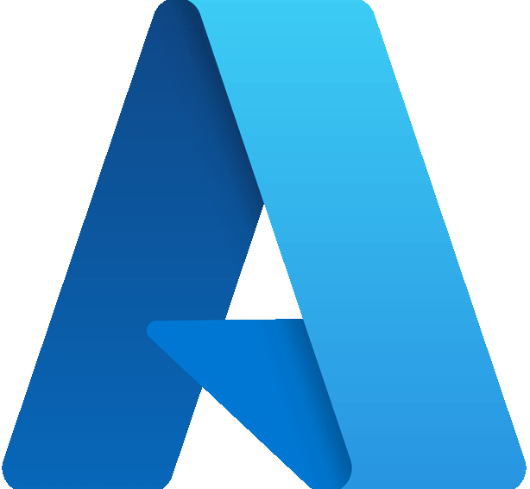

Relationship
App
Business Layer
Windows AI Foundry
Azure AI
Windows AI APIs
Foundry Local
Azure AI Foundry
Azure OpenAI
…
Base Layer
Windows ML
ONNX Runtime
EPs (CPU / CUDA / WebGPU / QNN / OpenVINO / NvTensorRTRTX / VitisAI)
Native ML Layer
Cloud
DirectML
Intel® OpenVINO™
QNN
…

Slide 4
Architecture
App
Foundry CLI
Foundry Local Manager (SDK)
by Windows App SDK
HTTP localhost
Cloud
Azure AI Foundry Catalog
Inference Service Agent
Foundry Local
Model Management
ONNX Runtime
Model Cache
EPs (CPU / CUDA / WebGPU / QNN / OpenVINO / NvTensorRTRTX / VitisAI)
Native ML API
NPU
WebGPU
CUDA
CPU

Slide 5
Model Lifecycle
Models in the cloud
Azure AI Foundry Catalog
Download
Storage (Local)
Local model
Delete
RAM
Load
Execute inference
Execute inference
Manual
Time-to-Live (10min by default)
Unload
Auto (after TTL)
Interact
Interact
App

Slide 6

Download & Run
App
Foundry Local Inference Service Agent
Azure AI Foundry Catalog
Local
Cloud
Download
Model info (manifest)
Get model info
Download model
CDN
Model
Model Cache
Save
Chat
Send message
Load model
ONNX Runtime
Execute inference
Get response

Slide 7

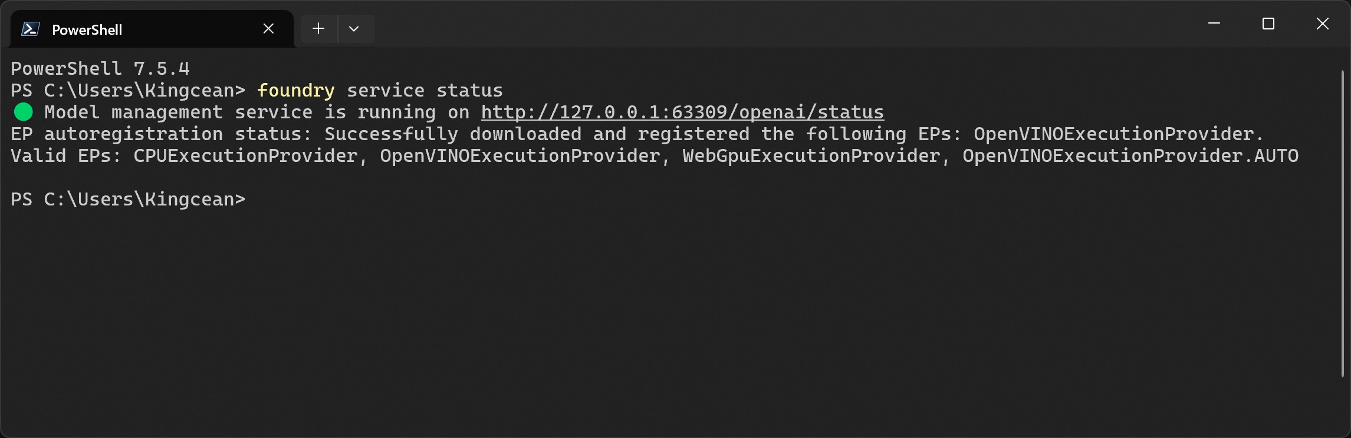
API
CLI
HTTP localhost
foundry.exe
Endpoint
Functions
Get service status | foundry service status | GET /openai/status
Local models | foundry cache list | GET /openai/models
Available models in cloud | foundry model list | GET /foundry/list
Download model | foundry model download <model> | POST /openai/download
Chat | foundry model use <model> | POST /openai/download
……

Slide 8
Thanks

