Slide 1
Raft the distributed consensus algorithm, and its TLA+ specifications
By Diego Onrago
Shujun Liu
04/23/2019

Slide 2
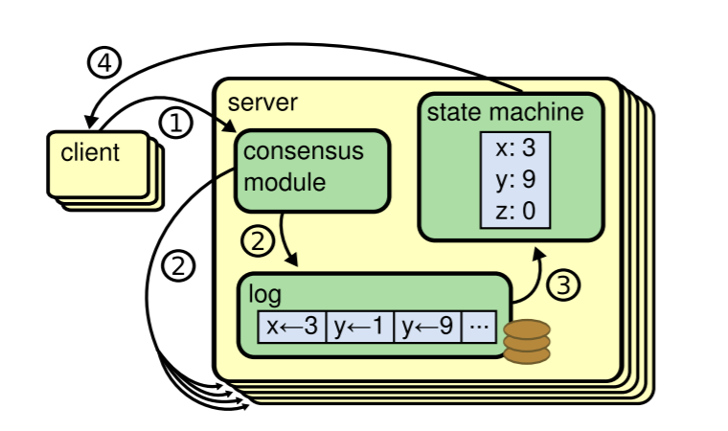
Raft
Diego Ongaro, 2014
REPLICATED state machines
Guarantees distributed consensus by replicating logs

Slide 3
Leader
States: Leader, Follower, Candidate
Only the leader can:
Process requests
Modify log

Slide 4
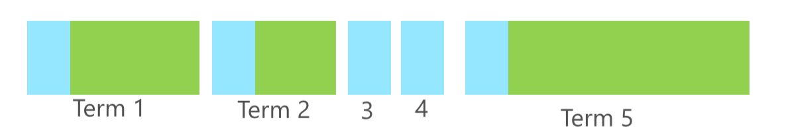
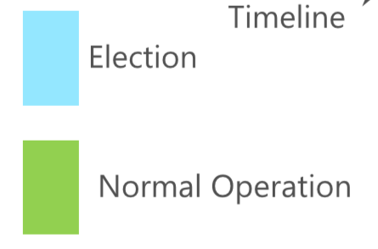
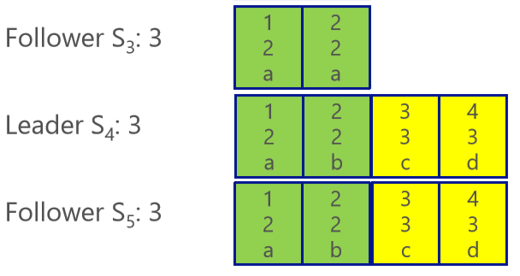
Term
Time of arbitrary length
Sign of time
Only machines in the same term can coordinate!

Slide 5
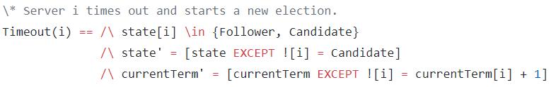
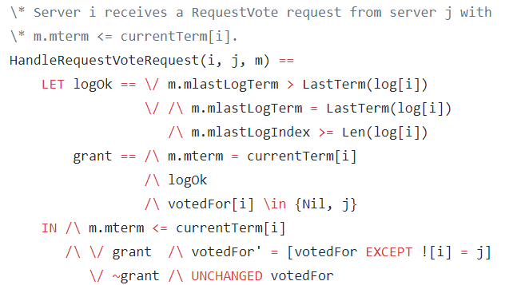
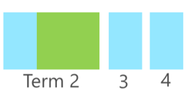
Leader Election
Started by timeout of a follower (randomized)
Term++ → Request vote →
Others check if log is better → Vote
Receive votes from *majority*
→ Become leader(3/5,5/8…)
Majority of all servers

Slide 6
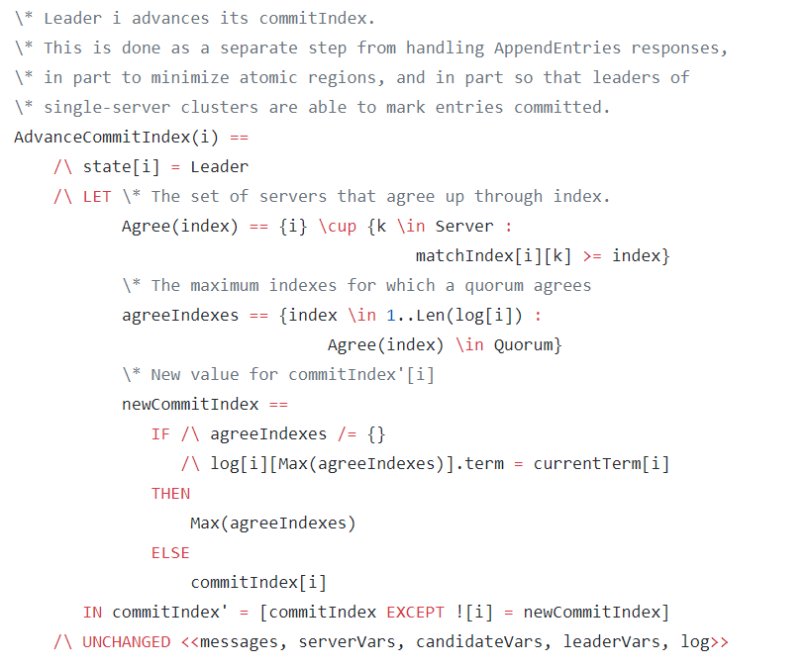
Log Replication
Committed: highest index that agreed upon, and logs before that

Slide 7
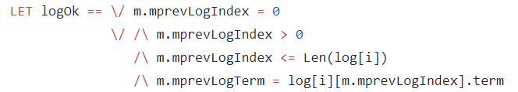
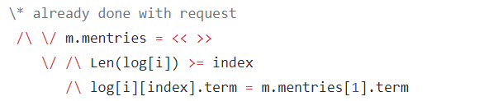
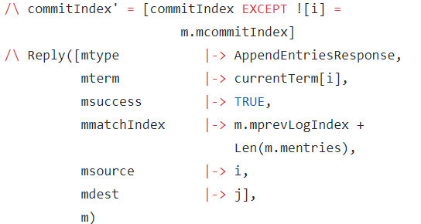
Log Replication
AppendEntriesRequest
Contains index and term of the last log entry before new ones
Force overwrite after last agreed entry
Reply when already done

Slide 8
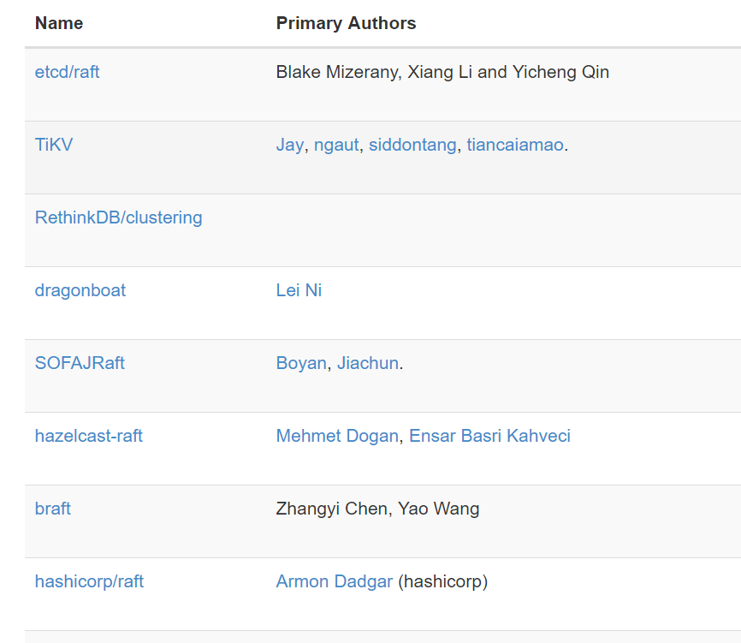
Applications
Fault tolerance
Configure sharing
Blockchain
……

Slide 9
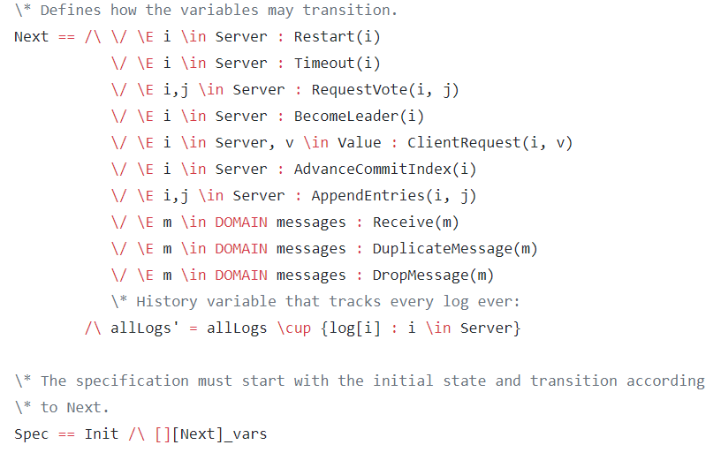
TLA+ for debugging

Slide 10
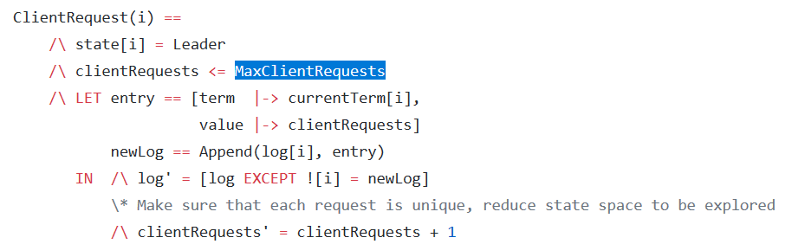
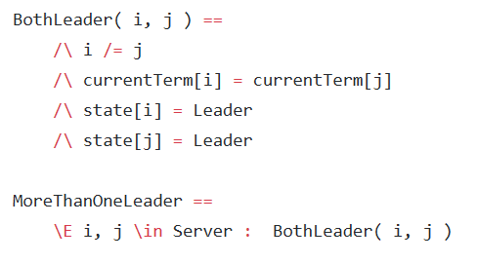

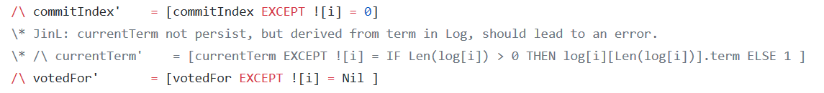
TLA+ for debugging
State Explosion?
Limit requests
Random search
……

Slide 11
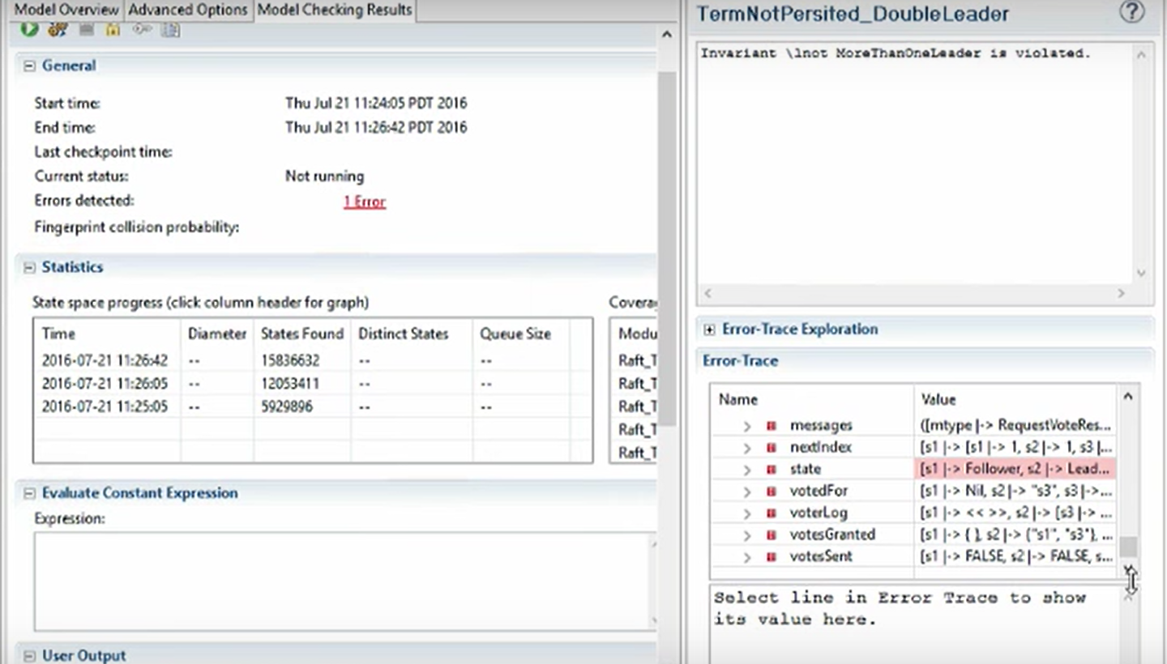

Slide 12
