Slide 1
Raft the distributed consensus algorithm, and its TLA+ specifications
By Diego Onrago
Shujun Liu
04/23/2019

Slide 2
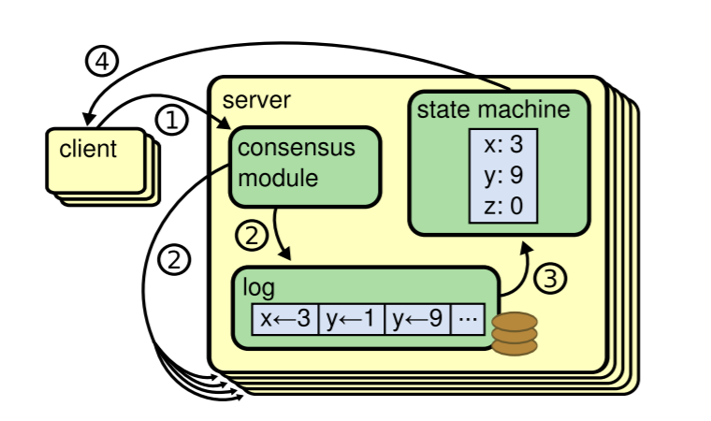
Raft
Diego Ongaro, 2014
REPLICATED state machines
Guarantees distributed consensus by replicating logs
Notes:
Raft is a distributed consensus algorithm, invented by Dr. Diego Ongaro in 2014. Just like its name, it’s designed for a group of distributed machines to reach some consensus. Note that the algorithm assumes that the machines do not know each other, so it also specifies the contents that the machines communicate. To say it more formally in the context of Raft, its goal is to form a group of Replicated State Machines. By replicated state machines, it is saying a group of state machines that are exactly the same and act exactly the same. When one state machine receives some requests and change some state, all the other machines should do the same transition; when one machine produces some output, all the other machines produce the same output. Raft achieves the consensus of the group of state machines by persisting some log in the group; Log here means a sequence of operations of a state machine. The mechanism of Raft tries to ensure that the logs, containing every action of the group of machine, is replicated to every machine in the group. Each log contains the same commands in the same order, so each state machine processes the same sequence of commands. Since the state machines are deterministic, each computes the same state and the same sequence of outputs.

Slide 3
Leader
States: Leader, Follower, Candidate
Only the leader can:
Process requests
Modify log
Notes:
The way that Raft ensure logs are replicated correctly is by choosing one server in the group to be a powerful leader. Machines other than the leader are called followers. The leader is powerful in ways that only the leader is able to accept requests from outside (and requests sent to any other server will be forwarded directly to the server); only the leader is able to replicate the log to the other servers after it processes the request; and the leader can decide what the log will be like but the other servers can only accept its modifications to the log. Because of this, the leader must be chosen carefully.

Slide 4
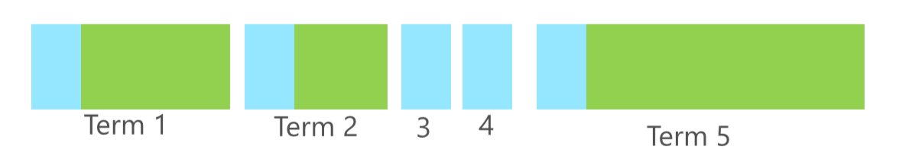
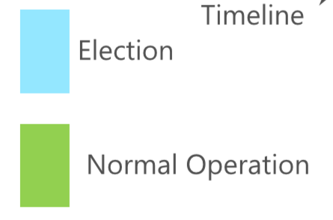
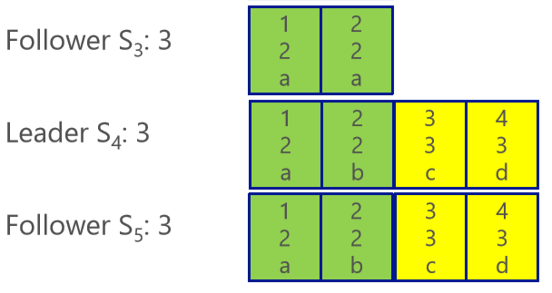
Term
Time of arbitrary length
Sign of time
Only machines in the same term can coordinate!
Notes:
Before going into the process of leader election, let’s first introduce an important concept in Raft, which is “term”. Rafts split time into terms of arbitrary length; for each term, at the start of the term the group of machines will try to elect a leader; once a leader is elected, it will have the responsibility for managing the logs until it fails. And when the leader fails, a new term starts and a new leader will be elected. Term can acts as a sign of time for the whole group, for every machine in the group, and for every entry in the log; which means every machine persists a current term number, and in every log entry the term when that action is taken is recorded. And only machines in the same term can coordinate. If one machine’s term is older than other machines, the others will not process its request and will send to it their own term which is newer, and this machine will correct its term and become a follower no matter what state it is in.

Slide 5
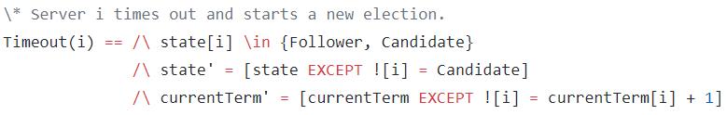
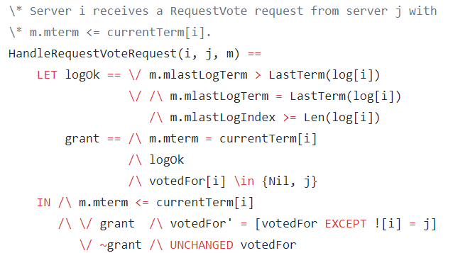
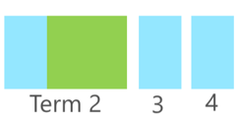
Leader Election
Started by timeout of a follower (randomized)
Term++ → Request vote →
Others check if log is better → Vote
Receive votes from *majority*
→ Become leader(3/5,5/8…)
Majority of all servers
Notes:
Let’s begin to introduce the election process. A followers know that the leader fails by not receiving a periodically heartbeat from the server for a period of time. When this happens, the follower advances its term, a new term begins, and it starts an election by sending all other servers a RequestVoteRequest; then the other servers receiving the request, if hasn’t voted for anyone in this term, will check—let’s assume they are in the same term—if the log stored in the server requesting vote is more up-to-date than the log of itself. If the log looks better, it will vote for the sender of the request. This is checked by looking at the index and term of the last log entry of the sender and see if it is newer than these of itself. Once the candidate receives votes from the majority of all servers – not just living server but all servers, it will become the leader. The timeout of heartbeat is randomly chosen to reduce the probability of two followers start voting at the same time; but when this happens or for some other reason no server received vote from the majority, there will be another timeout and the term will end with no leader.

Slide 6
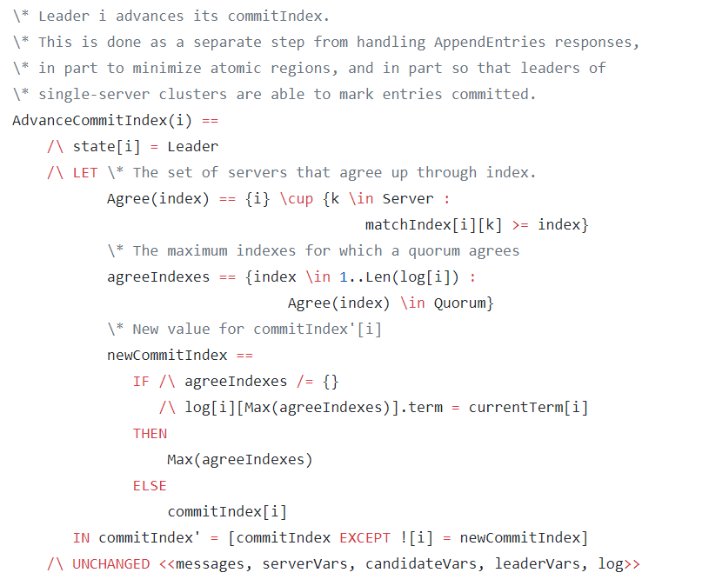
Log Replication
Committed: highest index that agreed upon, and logs before that
Notes:
After election, the leader begins to manage log. When the leader receives a request, it will process the request, do some action, add a new entry in the log, then try to replicate the log to the other machines,
and after the log is successfully replicated to a majority of machines, the leader will mark the new entry as “committed”. To say it more precisely, the log entry with highest index that the majority of machines agree upon, and the logs before that, is considered committed. This ensures that every committed entry will be in the log of every leader.

Slide 7
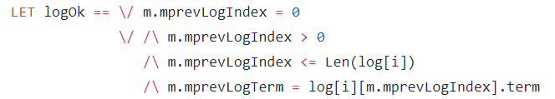
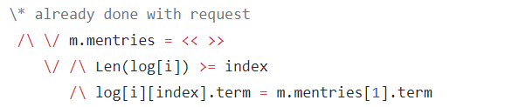
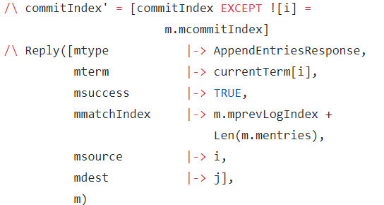
Log Replication
AppendEntriesRequest
Contains index and term of the last log entry before new ones
Force overwrite after last agreed entry
Reply when already done
Notes:
The leader updates other machines’ log by sending AppendEntriesRequest to them. The index and term of the last log entry before the new entries is contained in the request. When a follower receives such a request, it first checks this index and term of the last log entry; if it is newer than that of itself, it means that its log has more entries to repair so it will reject the request, and then the leader will send to it more log entries, and this follower’s all log entries after the last index they agree will be forced to be overwritten. But if everything is OK, the follower will add the entry to the log. We can see from the specifications that, if after this the follower receives another AppendEntriesRequest with the same index which is already agreed, it will advance its commit index and send a reply to the leader. With this information from the followers, the leader can know when to mark an entry as committed.

Slide 8
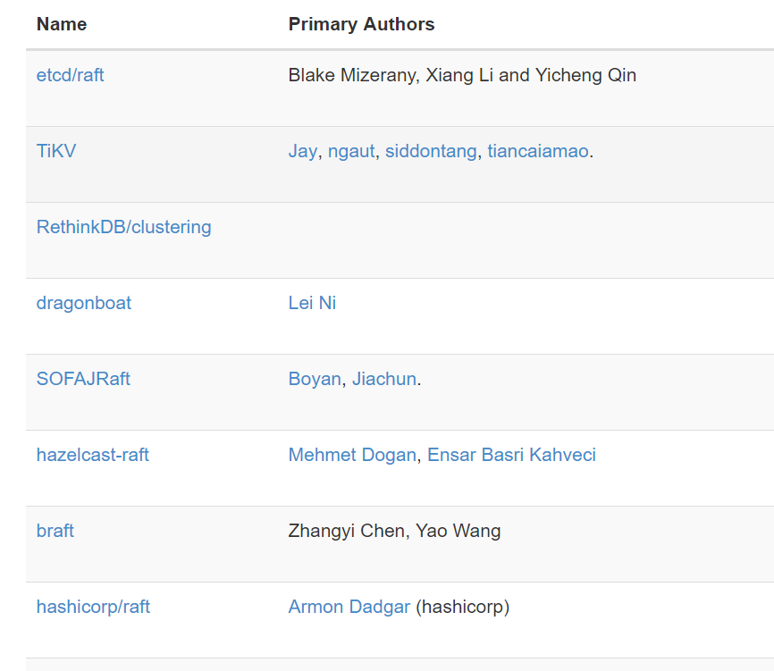
Applications
Fault tolerance
Configure sharing
Blockchain
……
Notes:
Although there could be many extensions, the contents above is the basic of Raft algorithm. It can be applicated to several distributed scenarios like fault tolerance, configuration sharing and blockchain.

Slide 9
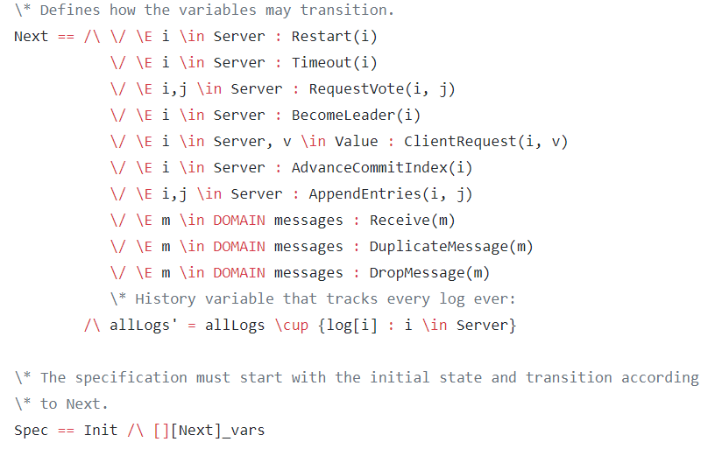
TLA+ for debugging
Notes:
It’s worth noting that the author said they used the TLA+ specifications to check it and successfully found some bugs.

Slide 10
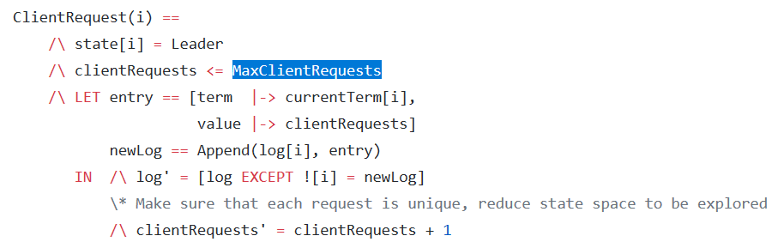
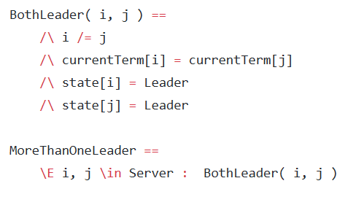

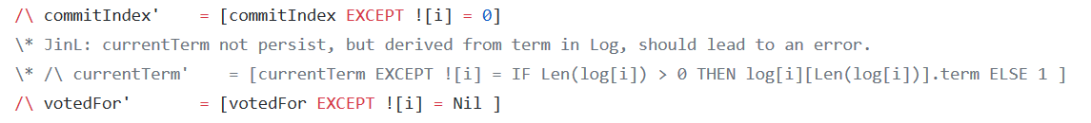
TLA+ for debugging
State Explosion?
Limit requests
Random search
……
Notes:
But a problem with this specification is that the state space could explode. In fact, when I run the model checker for the specification on my own machine, the state space increased to over 10 million within several minutes and still keeps growing. To tackle this problem, some modifications could be done to the original specifications, such as limiting the state space by limiting the max number of client requests. This modified code is from Github. After this we can check some properties of the algorithm in an acceptable time. For example, we can see here, if currentTerm of a server is not persist after a server restarts, it will lead to an error that there will be more than one leaders in the group.

Slide 11
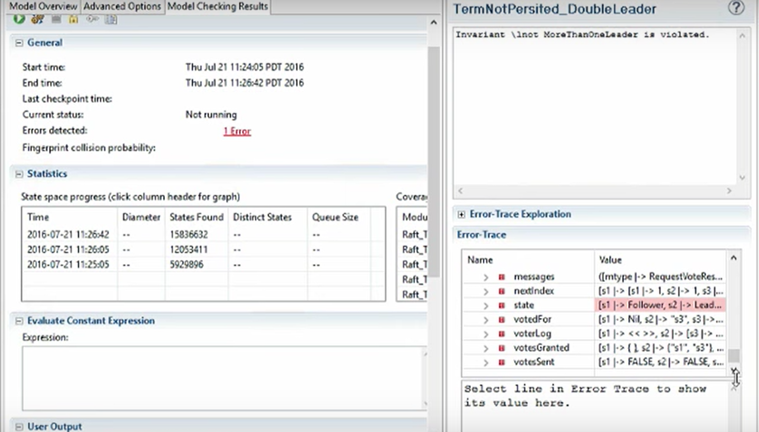
Notes:
After the modification it still needs several minutes to run, but we can see just a picture of the running result.

Slide 12
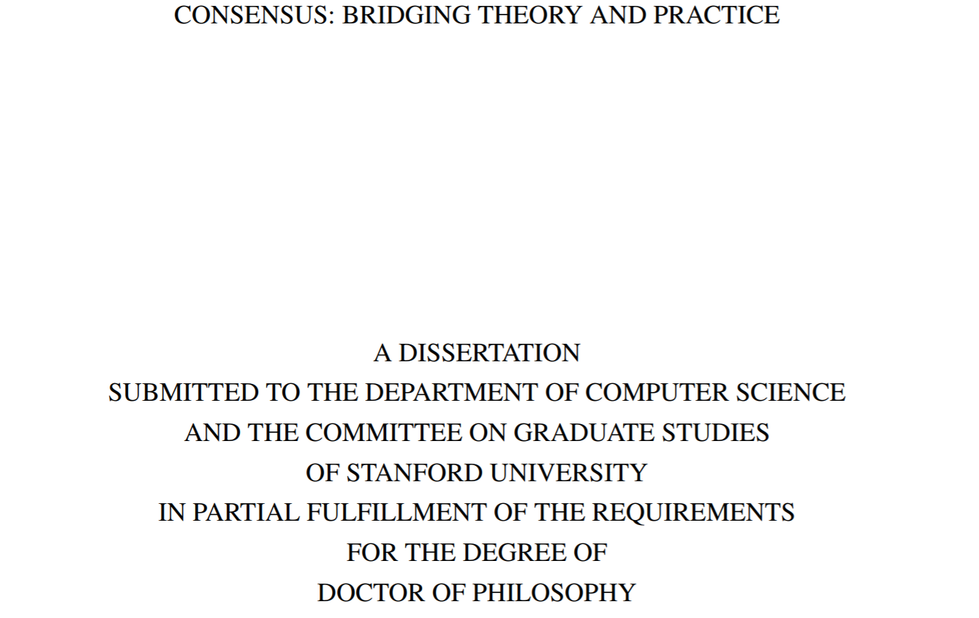
Notes:
As we see the explosion of state sometimes can limit the functionality of TLA+ to find errors. Lamport’s advice is to only use the most simplified core part of the algorithm, just like the consensus algorithm he himself invented earlier, called Paxos; but engineers find it difficult to implement Paxos because of lacking of details and after adding details, the algorithm become unproved again. So it may be a complicated tradeoff; and in fact we can see the title of the original paper of Raft, which is called “CONSENSUS: BRIDGING THEORY AND PRACTICE”.

