Slide 1
VALUE OF lOCAL sHOWROOMS TO ONLINE COMPETITORS
Paper Replication with R
Author: Jayarajan Samuel, Zhiqiang (Eric) Zheng, Ying Xie
Group Members: Luoying Chen, Beyza Celik, Duc Vu, Yihong Liu
Advanced Method: Generic Synthetic Control (GSC)

Slide 2
Why GSC?
Relax the assumption of pre-treatment parallel trends
Incorporate treatment heterogeneity across units
Account for potential unobserved factors that are time-variant at the unit level
In our data, DID may perform better then GSC because:
The treatment is randomly assigned, of which the parallel trend is one necessary condition
No treatment heterogeneity exists
Insufficient data
JUST GIVE A TRY!

Slide 3
What is GSC?
Interactive Fixed Effects (IFE)
accounts for latent factors whose effects may vary across time and units
but imposes constant treatment effect to all units
Synthetic Control (SC)
constructs synthetic control units to serve as counterfactuals for the treated units
but works for only one treated units

Slide 4

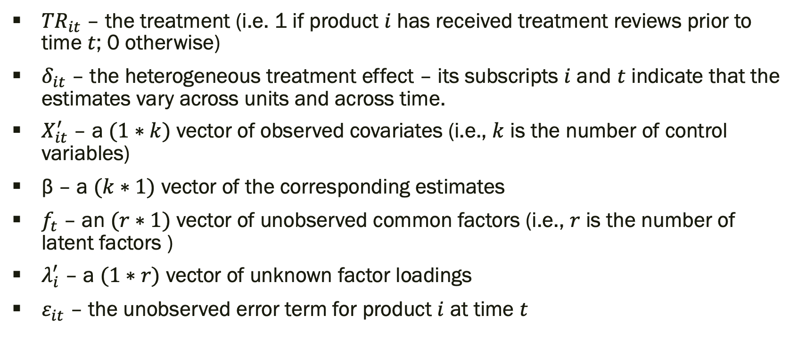
What is GSC? (cont.)
(Framework from IFE)
${TR}_{it}$ – the treatment (i.e. 1 if product $i$ has received treatment reviews prior to time $t$; 0 otherwise)
${\text{δ}}_{it}$ – the heterogeneous treatment effect – its subscripts $i$ and $t$ indicate that the estimates vary across units and across time.
$X_{it}^{′}$ – a $(1∗k)$ vector of observed covariates (i.e., $k$ is the number of control variables)
β – a $(k∗1)$ vector of the corresponding estimates
$f_{t}$ – an $(r∗1)$ vector of unobserved common factors (i.e., $r$ is the number of latent factors )
${\text{λ}}_{i}^{′}$ – a $(1∗r)$ vector of unknown factor loadings
${\text{ε}}_{it}$ – the unobserved error term for product $i$ at time $t$

Slide 5


What is GSC? (cont.)
Control units across all pre- and post- treatment time periods
${\text{δ}}_{it}{TR}_{it}$ is dropped from the previous equation since ${TR}_{it}=0$here
For each given value of $r$(the number of latent factors) the algorithm runs this equation and obtains the estimates $\hat{β}$ and $\hat{f_{t}}$

Slide 6

What is GSC? (cont.)
Treatment groups with each of the pre-treatment periods
Beginning with 𝑠 = 1, for all the products in the treatment group by taking one period out and using the remaining periods to estimate the factor loadings
$s$– the index of a pre-treatment period, ranging from 1 (the first pre-treatment period) to $t^{0}$ (the last pre-treatment period)
superscript $0$– the periods prior to the introduction of the treatment
subscript $−s$ – all periods except for $s$

Slide 7
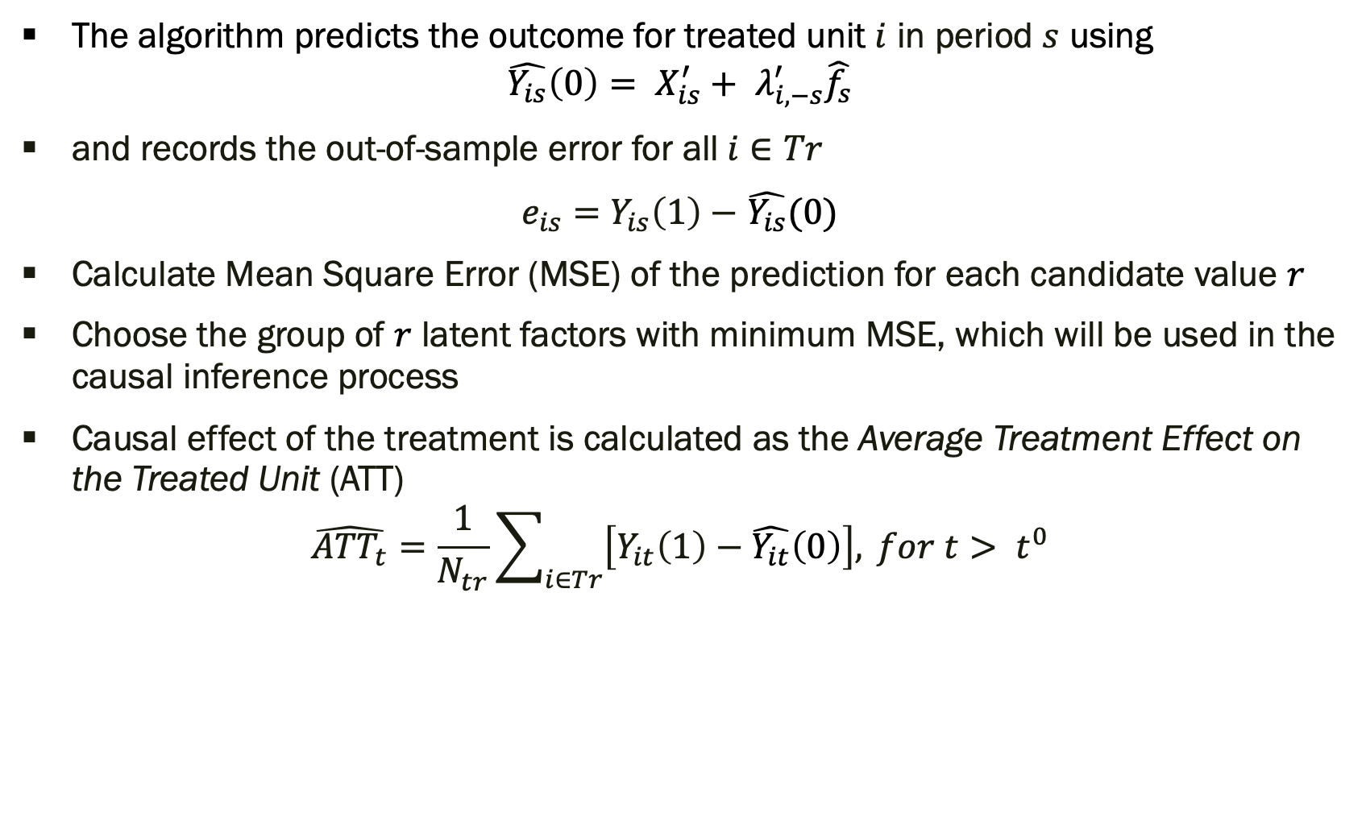
What is GSC? (cont.)
The algorithm predicts the outcome for treated unit $i$ in period $s$ using
$$\hat{Y_{is}}\left(0\right)= X_{is}^{′}+ λ_{i,−s}^{′}\hat{f_{s}}$$
and records the out-of-sample error for all $i∈Tr$
$e_{is}=$ $Y_{is}\left(1\right)−$ $\hat{Y_{is}}(0)$
Calculate Mean Square Error (MSE) of the prediction for each candidate value $r$
Choose the group of $r$ latent factors with minimum MSE, which will be used in the causal inference process
Causal effect of the treatment is calculated as the Average Treatment Effect on the Treated Unit (ATT)
$$\hat{{ATT}_{t}}=\frac{1}{N_{tr}}\sum_{i∈Tr}{\left[Y_{it}\left(1\right)−\hat{Y_{it}}\left(0\right)\right],} for t> t^{0}$$

Slide 8
Application
Package: gsynth in R
result <- gsynth(Y ~ TR + X, data = data, index = c(“unit”, “time”), r = c(0, #latentVariable), CV = TRUE, nboots = #bootstrapRun, min.T0 = #minPre-treatmentToBeUsed)
Drop the rows that have too few pre-treatment records
result:
MSE of each r and the best r
the Average Treatment Effect on the Treated Unit (ATT)
Coefficients for each control variable

Slide 9
Data
Xu (2017) suggests we should have at least 10 pre-treatment periods and 40 control units in the data
#pre-treatment:
10 (treatment started from Nov-2018)
#control units after aggregation:
2796 units in Amazon 0-mile data
2855 units in Amazon 5-mile data
conditions are satisfied

Slide 10
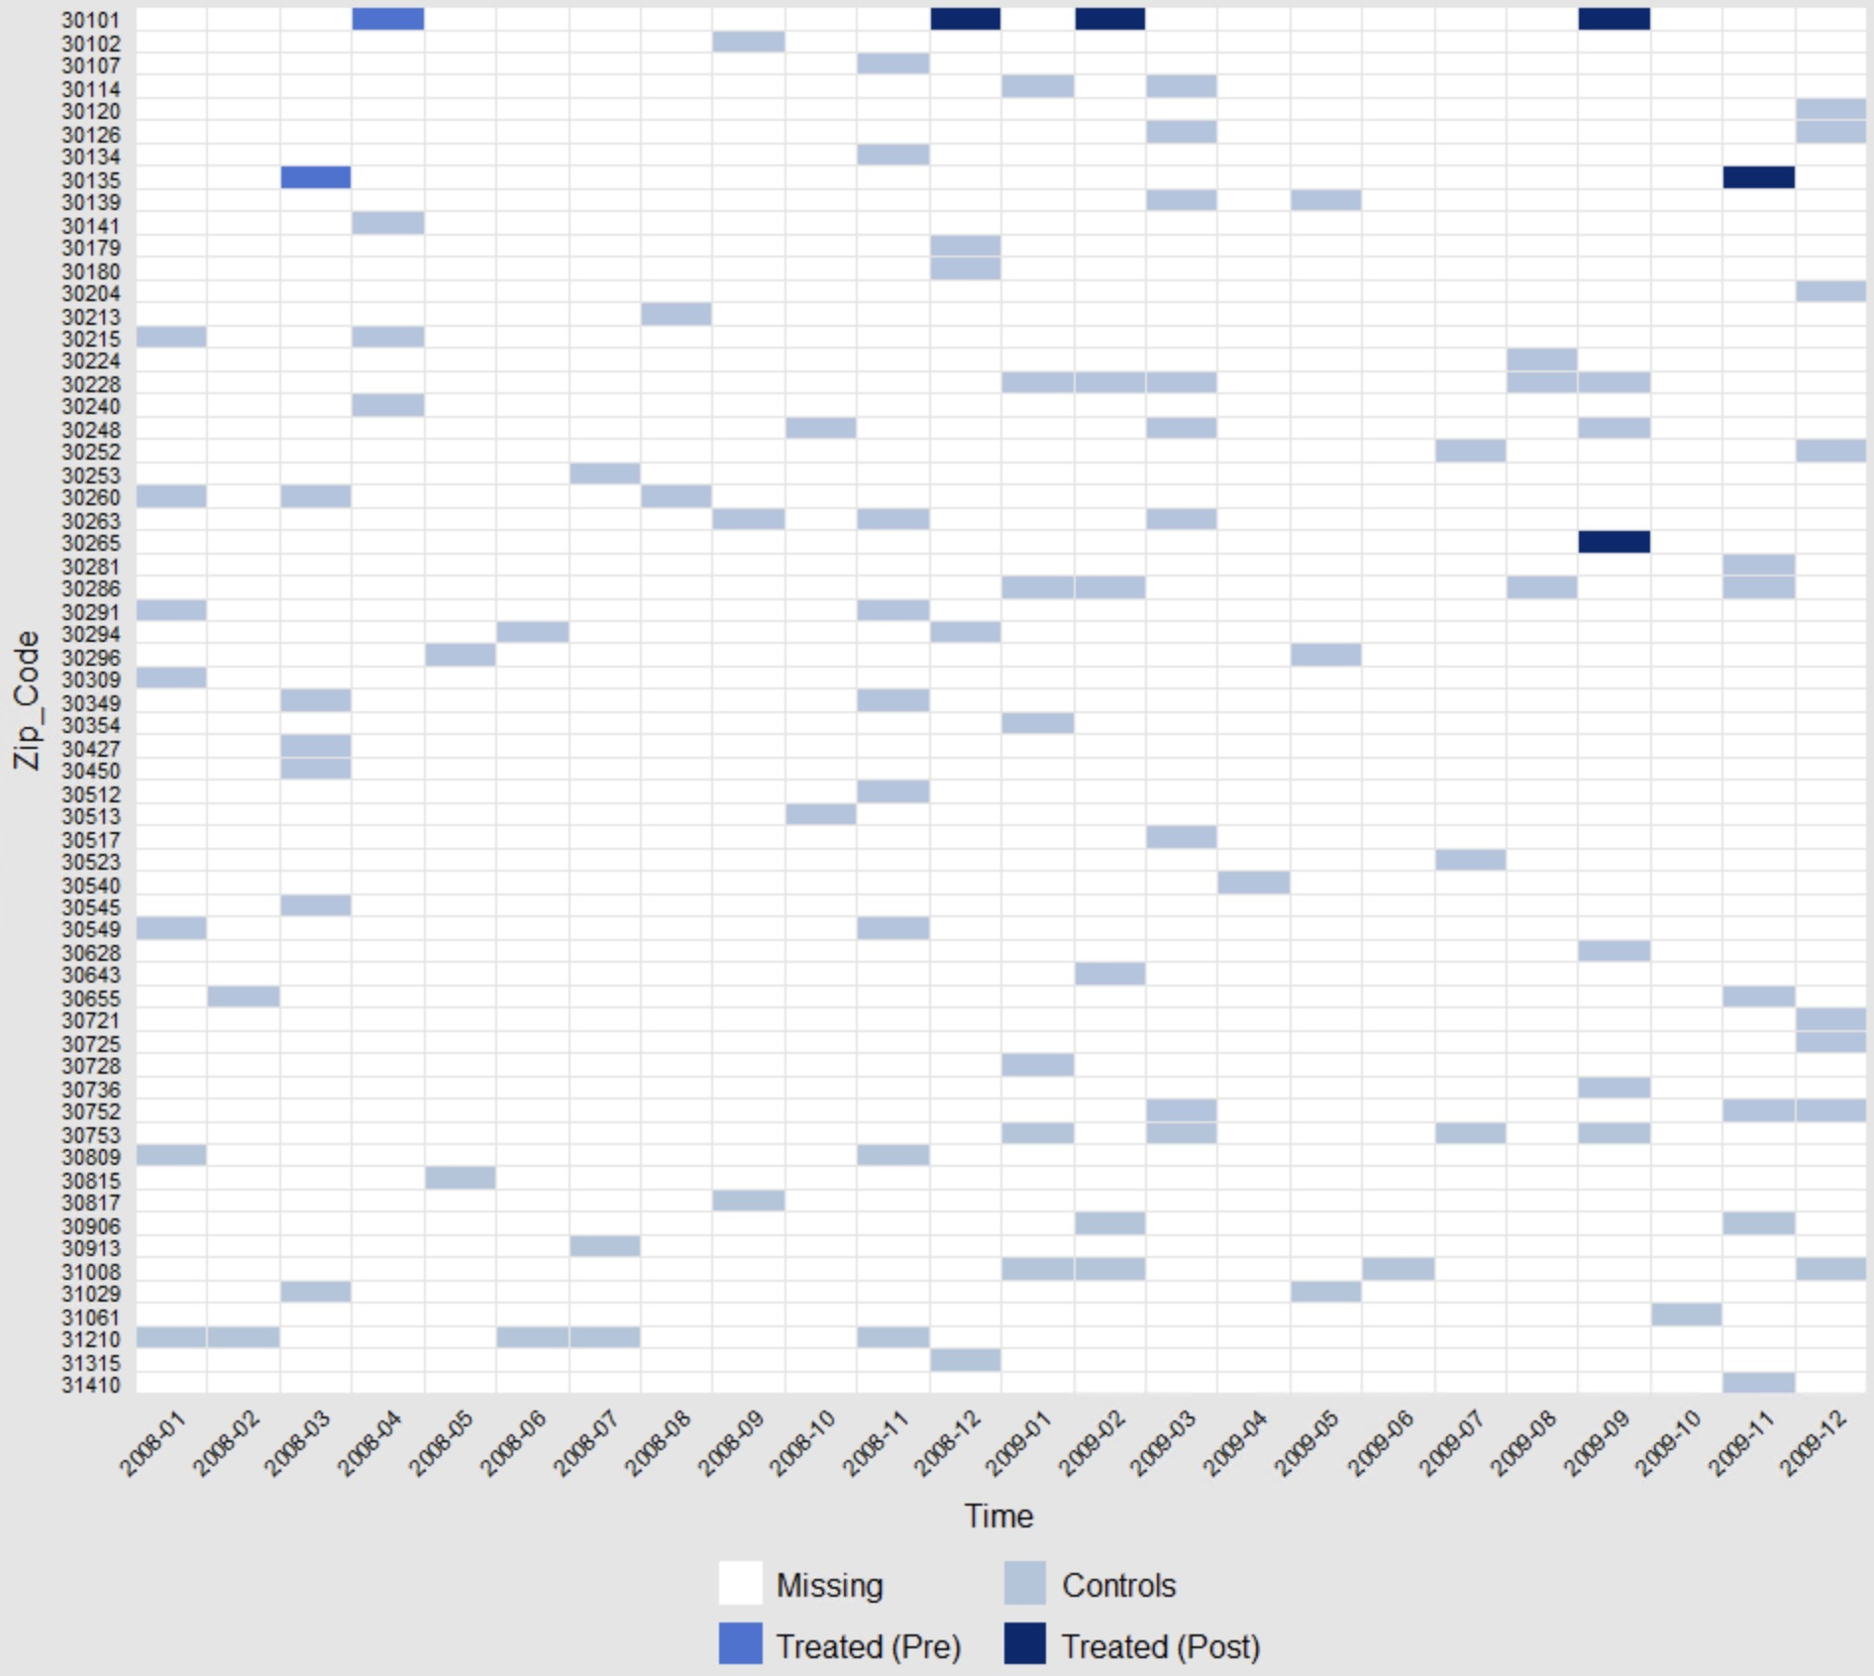
Data (cont.)
e.g. Amazon sales data after grouping
number of records available in months for all units
min: 1
mean: 1.789
median: 1
max: 20
Panel View of a Subset of Amazon Data after Grouping

Slide 11
Results
result <- gsynth(Y ~ TR + X, data = data, index = c(“unit”, “time”), r = c(0, #latentVariable), nboots = #bootstrapRun, min.T0 = #minPre-treatmentToBeUsed)
Y – AmazonTotalMonthlySales, AmazonPagesPerDollar, AmazonMinsPerDollar (all in log term; 0-mile & 5-mile)
TR – CCStorePresent × AfterStoreClosing
X – HouseHoldSize, Children, etc. (the ordinal observable factors that can be grouped by average)
r – {0, 1}
min.T0 = 3

Slide 12
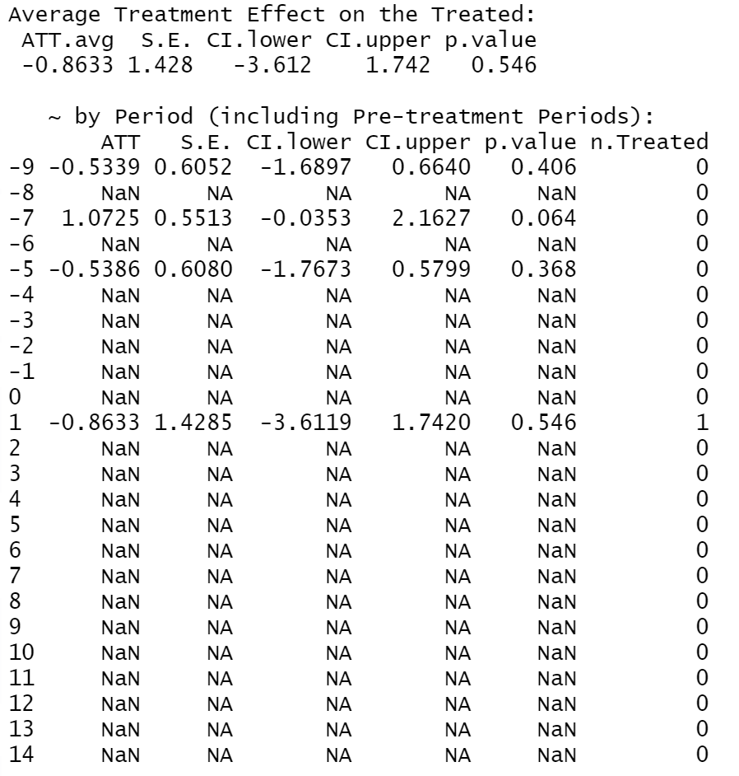
Results (cont.)
ATT by period for Amazon Sales Data – 0 mile

Slide 13
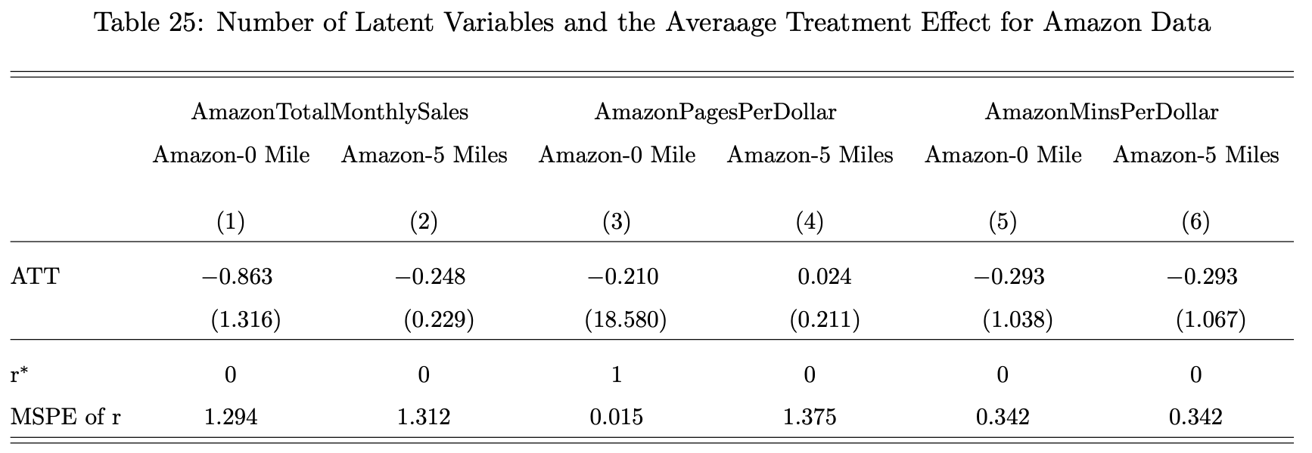
Results (cont.)

