Slide 2
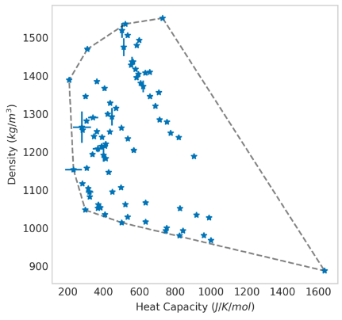
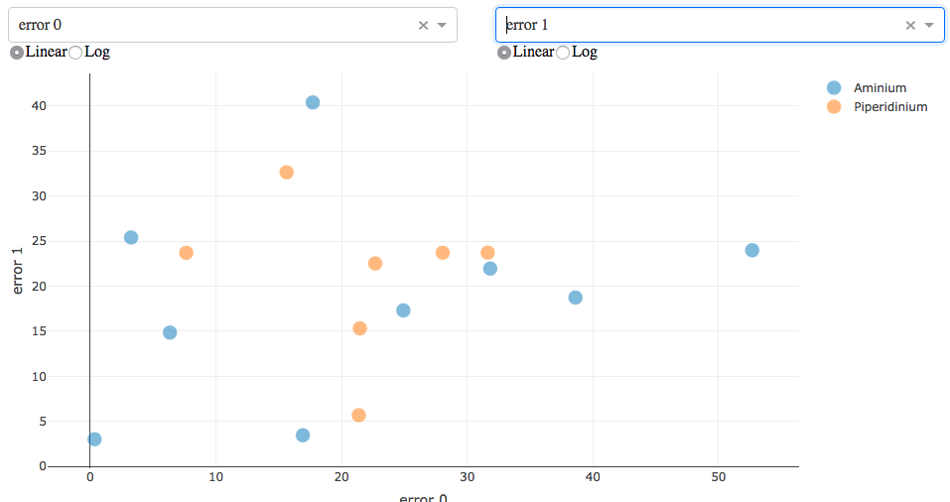
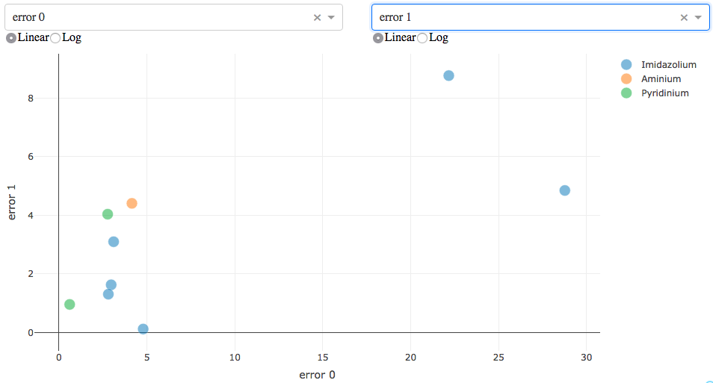
Results in very high error rates (~10-40%)
Target outside convex hull
Results in low error rates (~5%)
Target inside convex hull

Slide 3
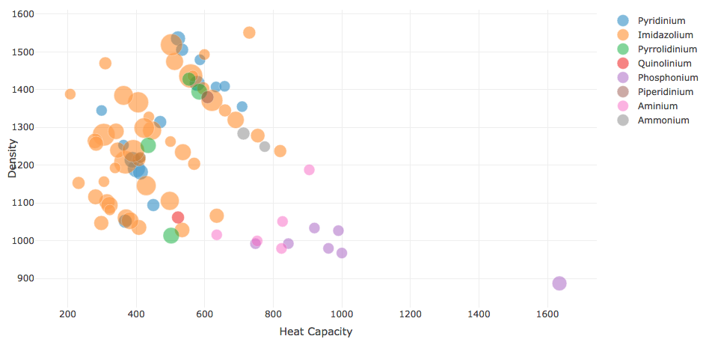
Primarily Imidazolium
Primarily Aminium/Ammonium

Slide 4
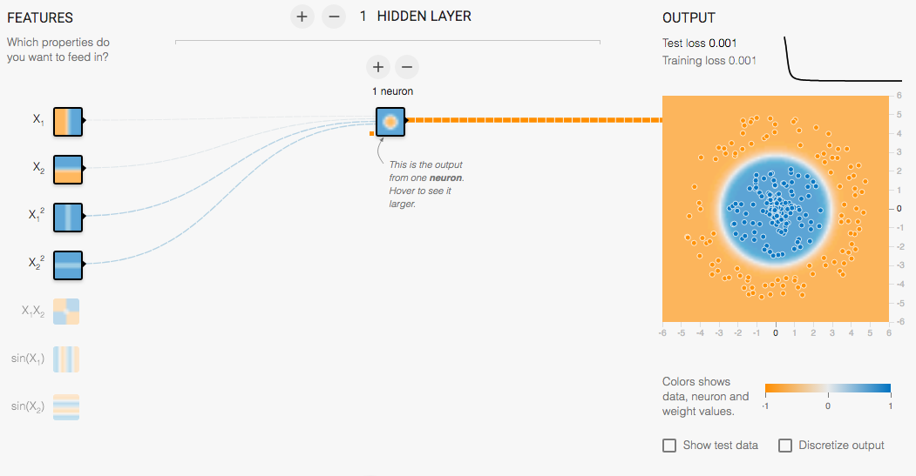
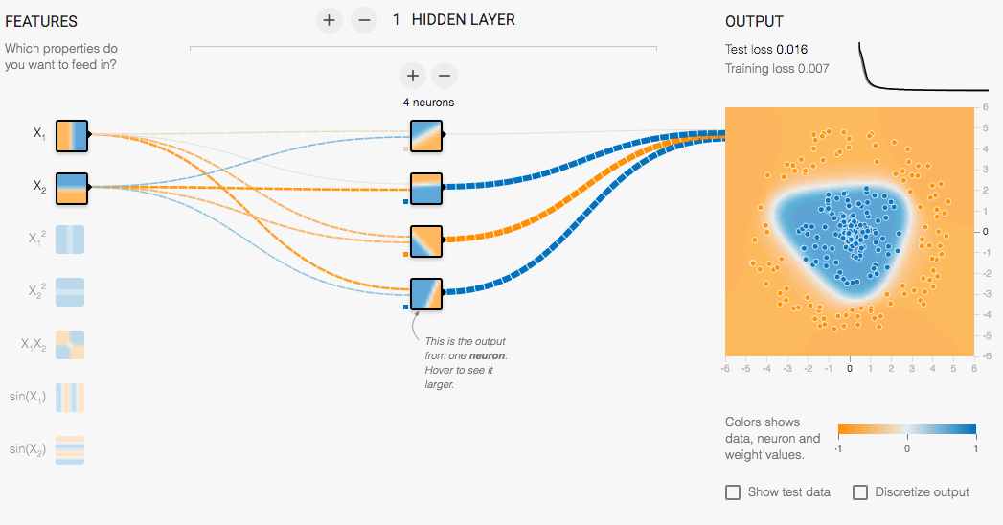
Feature
Engineering
Network
Architecture
vs

