Slide 1
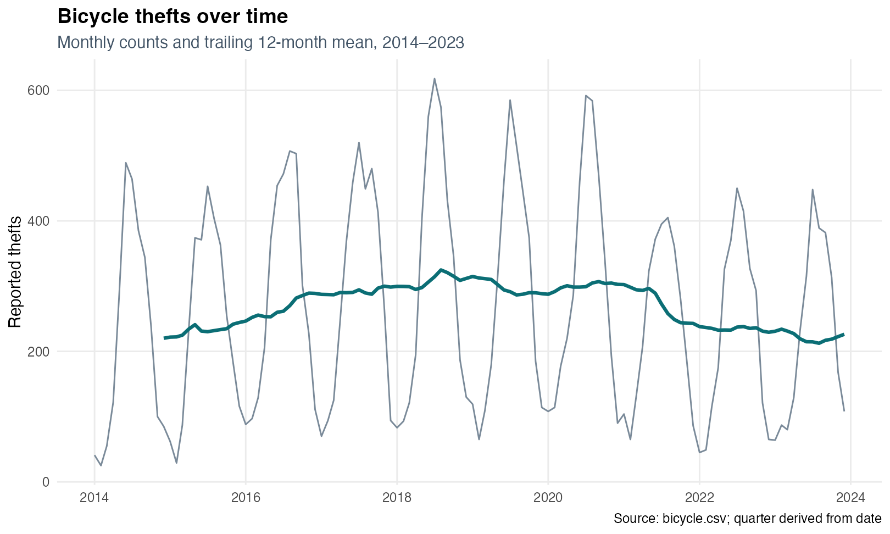
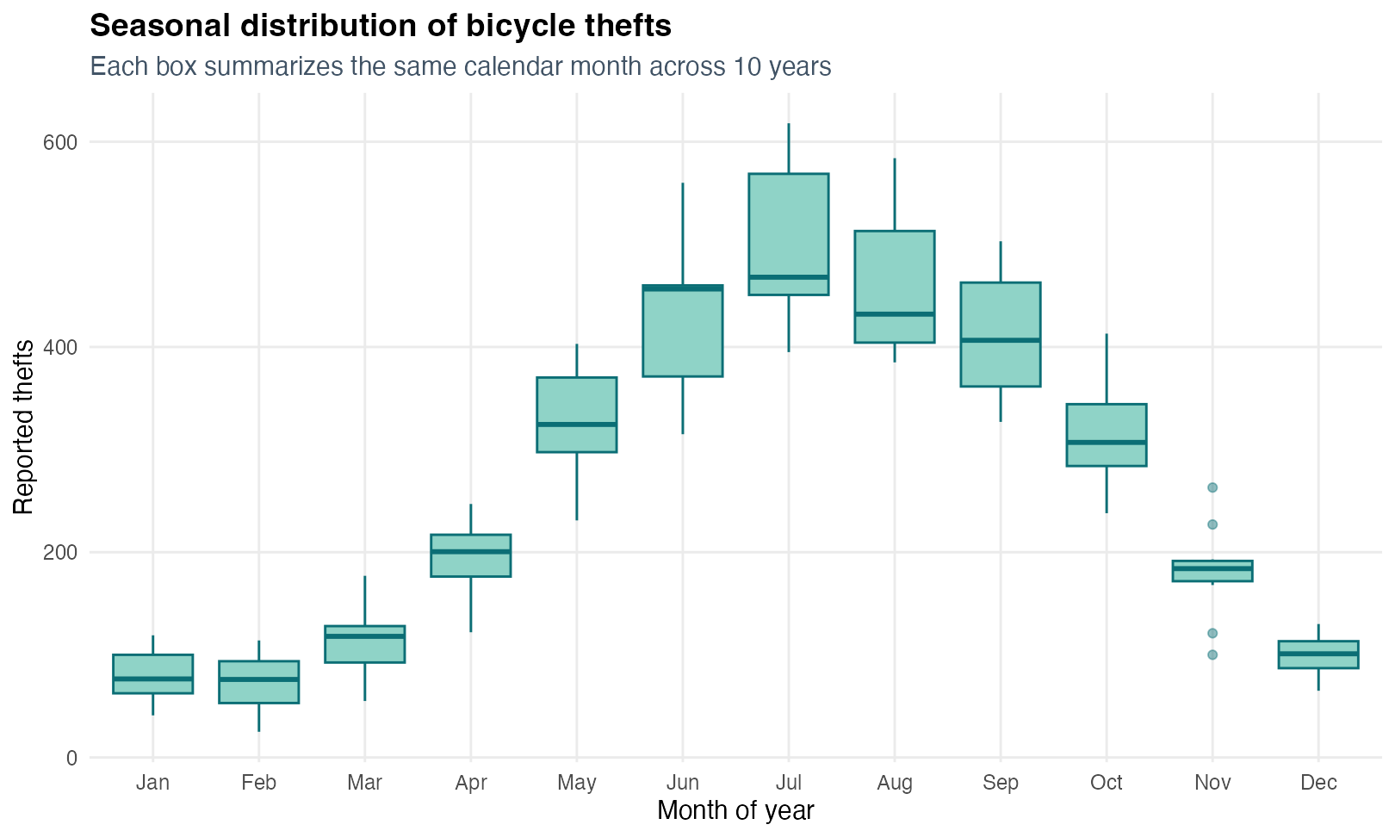
Toronto thefts peak in summer and downtown
Name: ____________________ Student ID: ____________________
31,833 incidents · 140 areas · 2014–2023
TEMPORAL SIGNAL
Reported bicycle thefts show strong seasonality: July has the highest average count, while winter months remain below 100 incidents.
1
Notes:
This project asks when and where reported bicycle thefts concentrate in Toronto. The dataset contains 31,833 incidents across 140 neighbourhoods from January 2014 to December 2023. The monthly series shows a repeating annual pulse, and the boxplots confirm that this is not a single-year anomaly. July is the highest month on average at about 500 reports, whereas January and February average fewer than 80. This strong seasonality motivates a model that represents both smooth long-run change and recurring annual cycles.
[Sources]
Course-provided dataset: bicycle.csv
Project audit: data_audit.csv
Project figures: 01_monthly_trend.png; 02_seasonality.png
[/Sources]

Slide 2
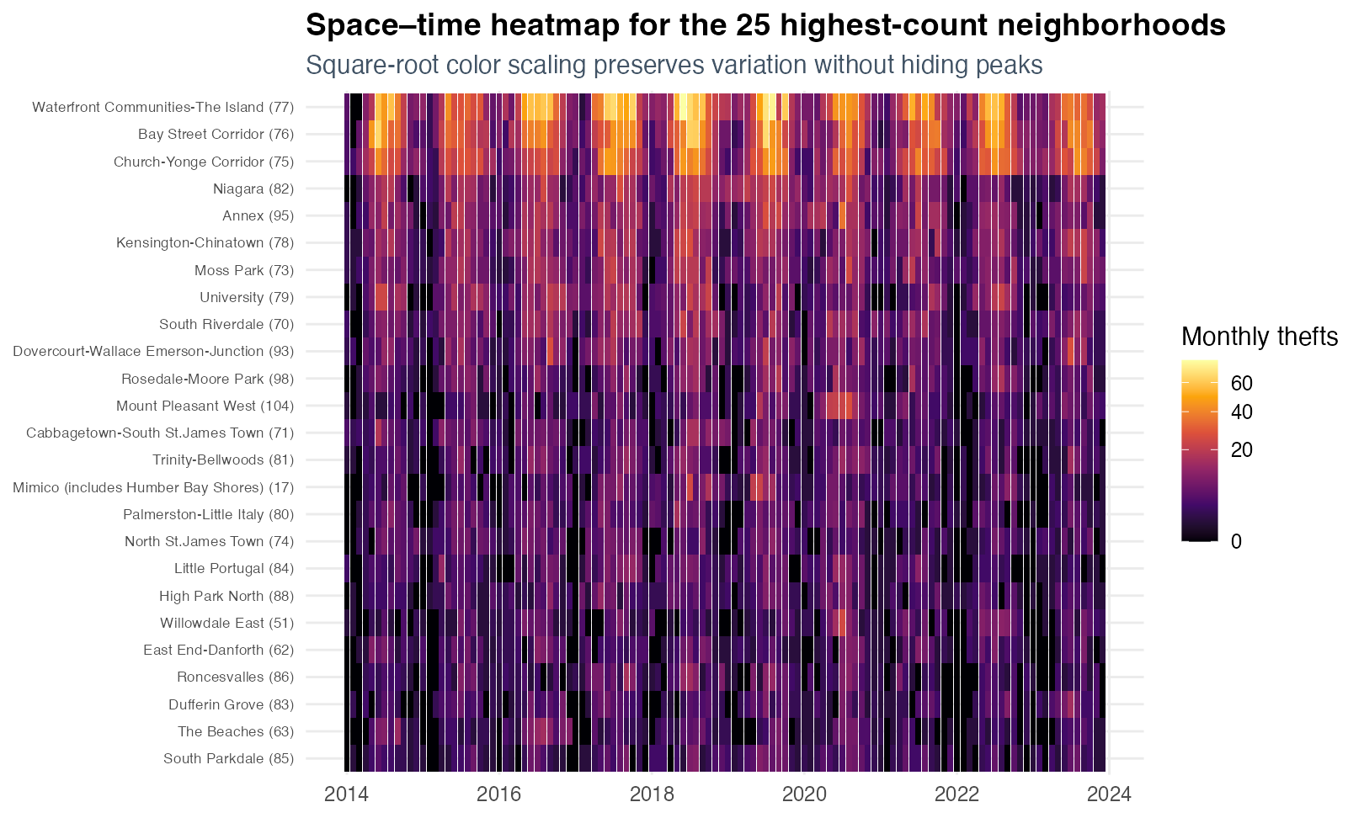
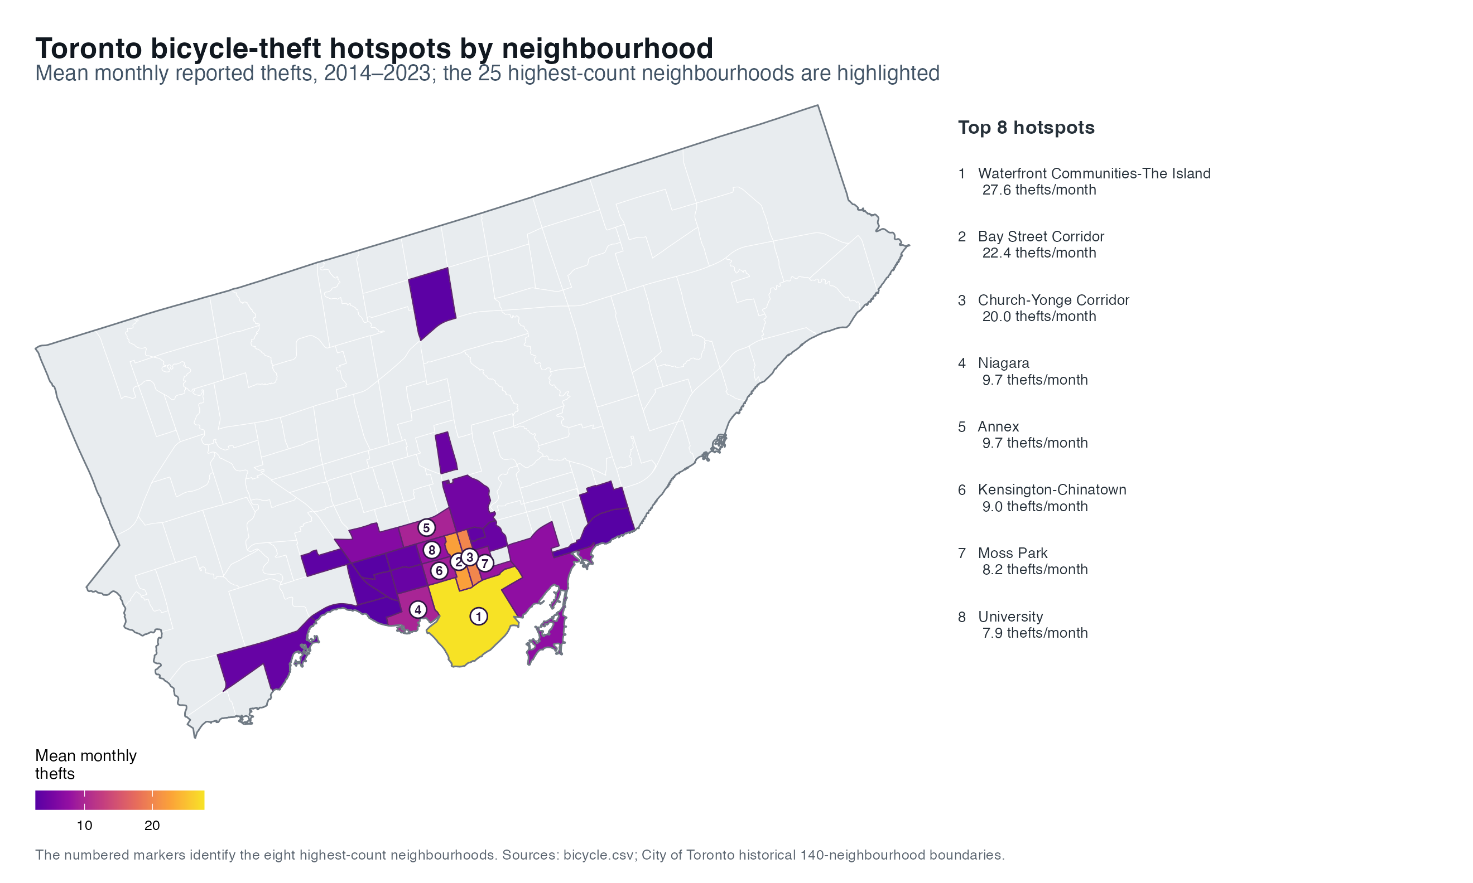
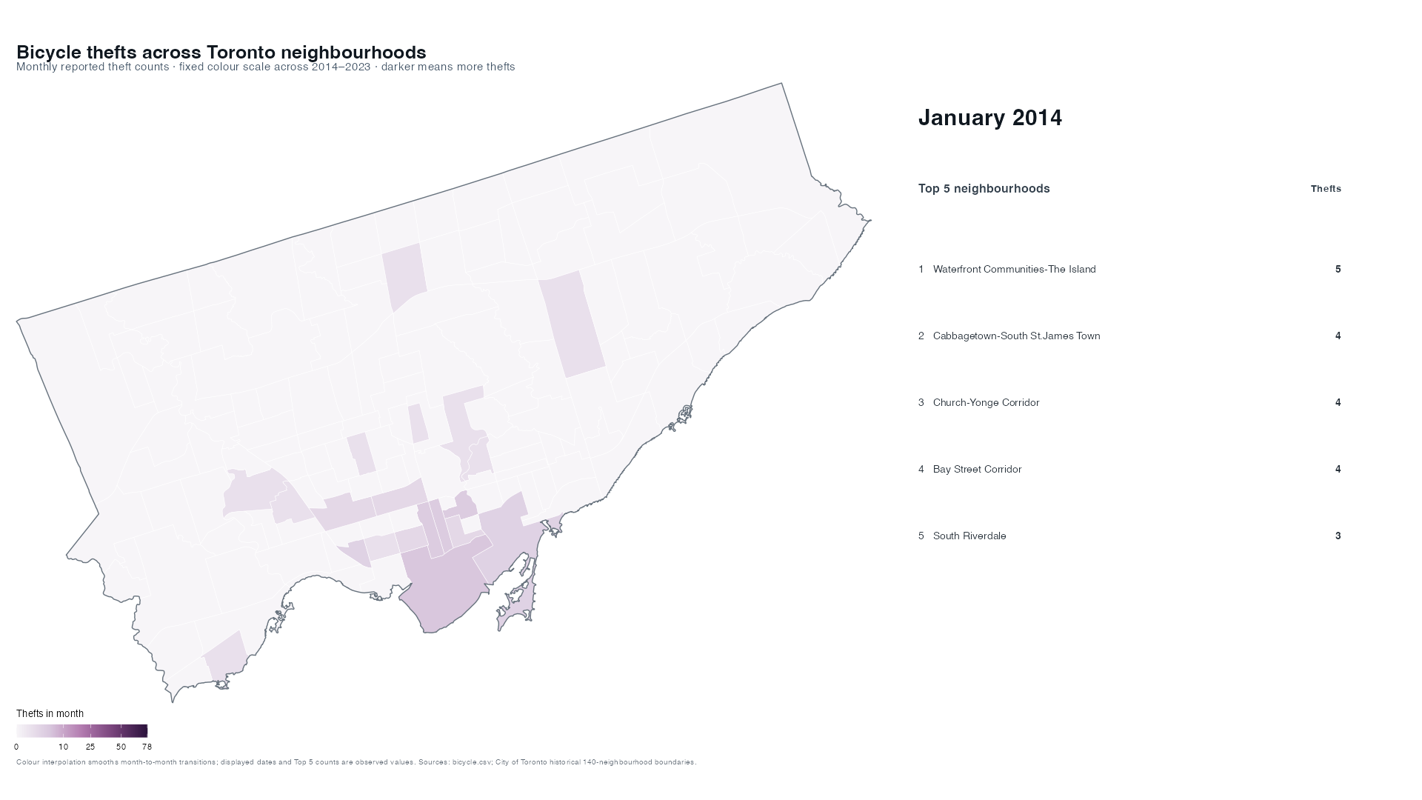

Downtown Toronto remains the theft hotspot
Waterfront 27.6/month · Bay Street 22.4 · Church–Yonge 20.0 · Top three = 26.4% of all incidents
▶ Companion 30-second animation included
SPATIAL SIGNAL
SPATIAL- TEMPORAL SIGNAL
Reported incidents remain persistently concentrated downtown.
Reported thefts rose to a 2018 peak, declined after 2020, repeatedly peaked in summer, and remained concentrated in downtown neighbourhoods.
2
Notes:
The heatmap adds the space-time dimension: the highest-count neighbourhoods brighten during the same warm-season peaks, but the ordering is persistent. Waterfront Communities–The Island averages 27.6 thefts per month, followed by Bay Street Corridor at 22.4 and Church–Yonge Corridor at 20.0. Together, these three neighbourhoods account for 26.4 percent of all incidents. The high-contrast map shows the concentration of long-run hotspots, and the companion animation shows month-to-month evolution.
[Sources]
Project analysis: top_25_neighbourhood_hotspots.csv
Project figures: 03b_neighbourhood_hotspot_map.png; 04_spacetime_heatmap.png
Companion media: toronto_bicycle_theft_animation_2014_2023.mp4
City of Toronto historical 140-neighbourhood boundaries: https://ckan0.cf.opendata.inter.prod-toronto.ca/dataset/fc443770-ef0a-4025-9c2c-2cb558bfab00/resource/9994da8e-5d35-438b-bfc4-eef14d09e035/download/neighbourhoods-historical-140-4326.geojson
[/Sources]

Slide 3
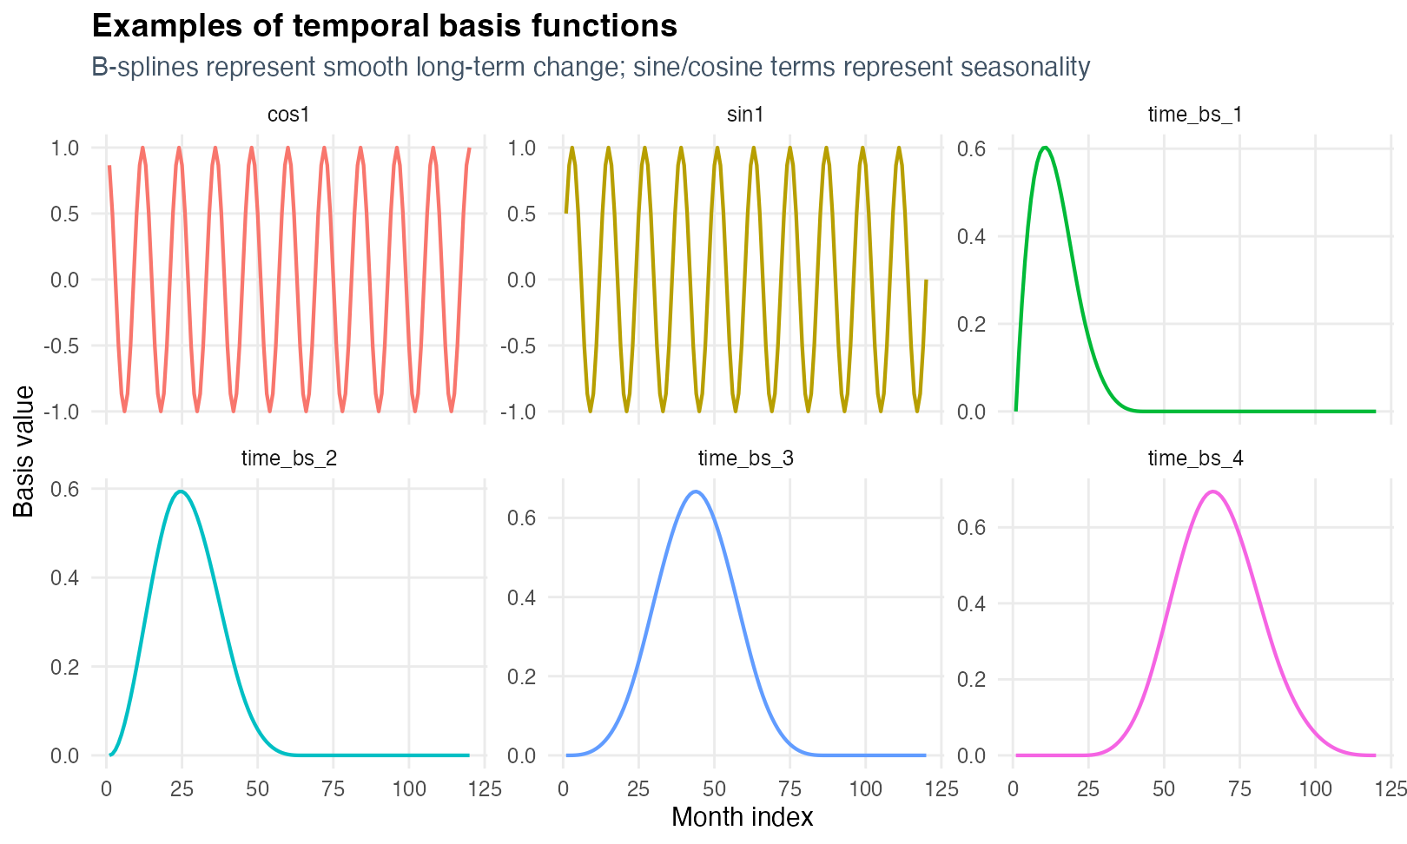
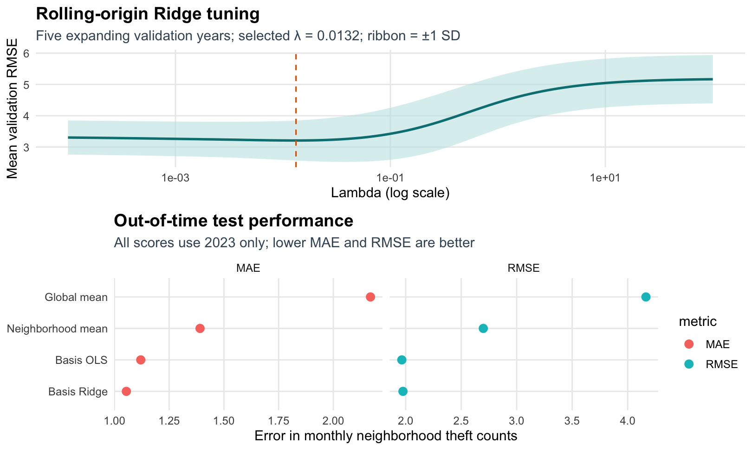
Basis functions encode time and space
Count → log1p → temporal + seasonal + spatial bases → OLS / Ridge
Rolling validation 2018–2022 → Final test 2023
B-splines + sine/cosine + 16 spatial RBFs + neighbourhood indicators
Ridge λ selected by lowest mean RMSE across five rolling folds
Basis Ridge
RMSE 1.98 · R² 0.774
3
Notes:
The model remains linear after transforming predictors into basis functions. Cubic B-splines describe smooth long-term change, sine and cosine terms describe annual seasonality, sixteen radial basis functions describe spatial proximity, and neighbourhood indicators absorb persistent local differences. Ridge is tuned by rolling-origin cross-validation using five expanding-window folds: each fold trains only on earlier years and validates on the next year from 2018 through 2022. Every fold rebuilds its basis recipe from training data only. The lambda with the lowest mean validation RMSE is 0.0132. The final Ridge model is fitted on 2014 to 2022, while 2023 remains an untouched out-of-time test. Basis OLS remains the unpenalised Task 4 benchmark.
[Sources]
Project model script: R/03_model.R
Project analysis: basis_metadata.csv; cross_validation_folds.csv; cross_validation_results.csv; model_metrics.csv
Project figures: 05_basis_functions.png; 06_model_comparison.png; 09_rolling_cross_validation.png
[/Sources]

Slide 4
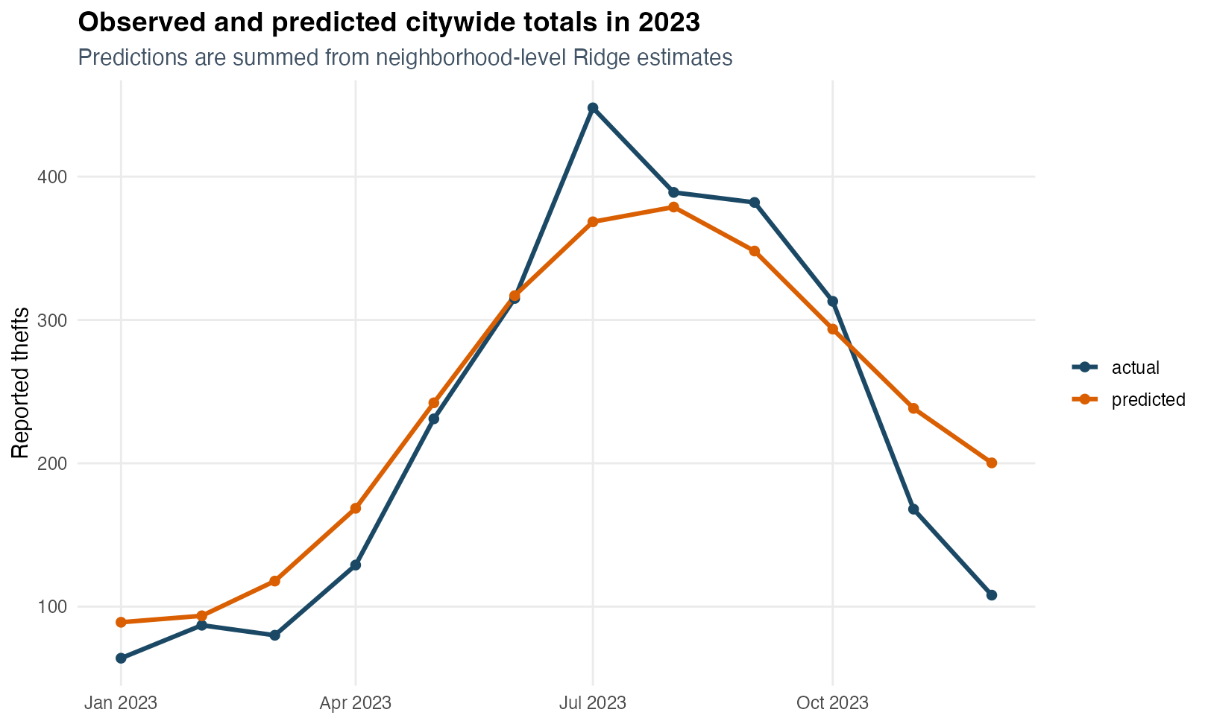
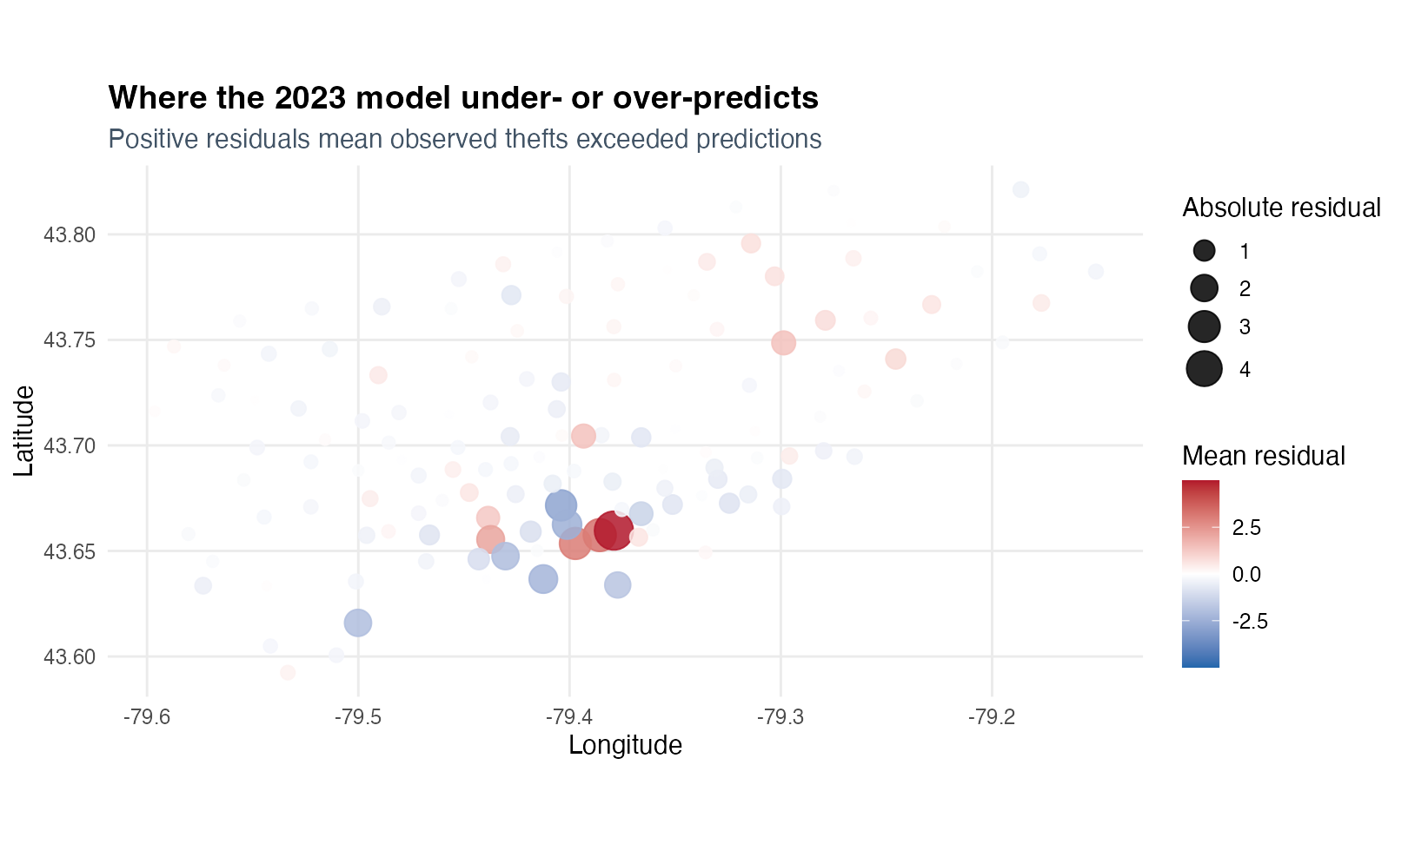
Seasonality is captured, but peaks are missed
WHAT THE MODEL GETS RIGHT
LIMITS ON INTERPRETATION
Basis Ridge: 26.8% lower RMSE vs neighbourhood-mean baseline
Seasonal rise and fall are reproduced
Largest positive errors remain near downtown hotspots
Reported incidents only; monthly neighbourhood aggregation
No weather, cycling exposure, land use or policing covariates
Association and prediction—not causality
4
Notes:
On the untouched 2023 test set, the cross-validated Basis Ridge model achieves MAE 1.05, RMSE 1.98, and R-squared 0.774. Its RMSE is approximately 26.8 percent lower than the neighbourhood-mean baseline. The prediction line reproduces the seasonal rise and decline, but smooths the largest July-to-October peaks. The largest positive mean residuals remain in Church-Yonge Corridor, Bay Street Corridor, and Kensington-Chinatown, so local shocks are not fully explained by the basis representation. These results are predictive associations, not causal effects. The data contain reported incidents only and omit weather, cycling exposure, land use, and policing.
[Sources]
Project analysis: model_metrics.csv; test_predictions.csv
Project figures: 07_observed_vs_predicted.png; 08_residual_map.png
[/Sources]

