Slide 1
CompE—Senior Design—Week 3
Teamwork (rev)
Team Effectiveness Survey
DHF
Gantt Chart
Preliminary Proposal
Elevator Pitch
D

Slide 2
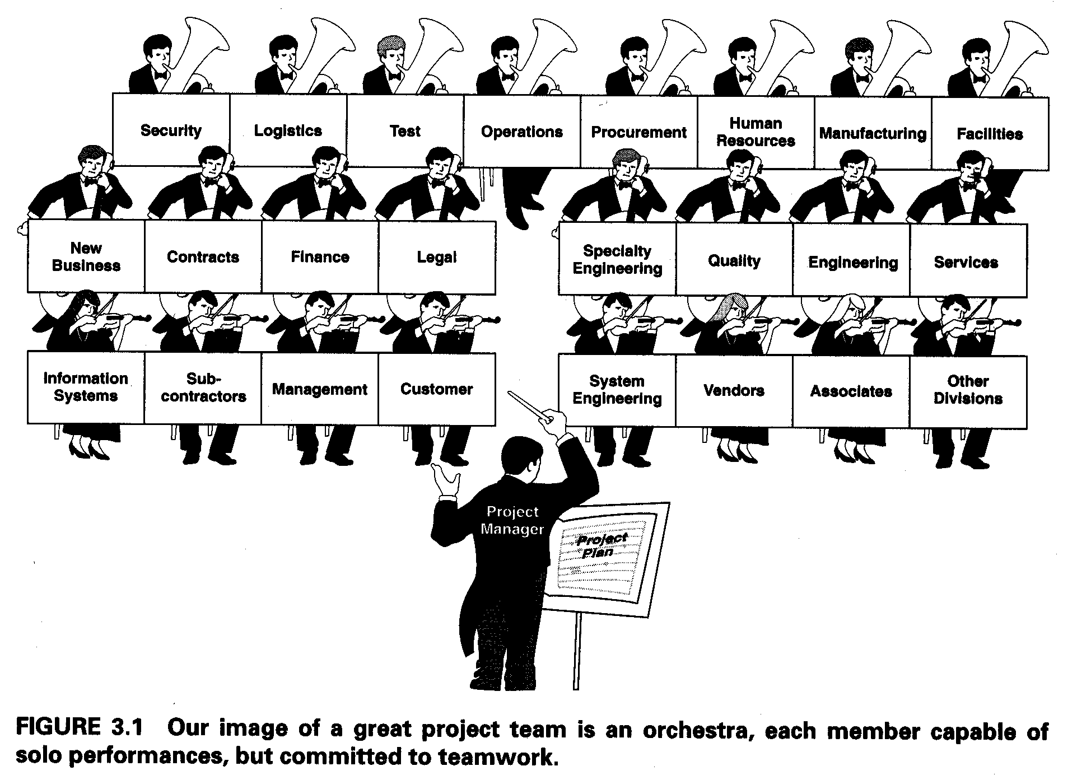
Teamwork (rev)
Team Effectiveness Survey I—due Sept 13
D

Slide 3
Stages of Team Development
(adapted from Forsyth, 1990)
Theory on team development predicts that teams, like individuals, pass through predictable, sequential stages over time. The most well known of these models is that of Tuckman (1965), who labeled the stages of team development as forming, storming, norming, performing, and adjourning.
Forming Storming Norming Performing
Adjourning
Notes:
(http://lowery.tamu.edu/teaming/morgan1/index.htm)

Slide 4
Teamwork (rev)
Team Effectiveness Survey I—due Sept 13
Article on Teamwork:
  Hitchhikers
  Couch Potatoes
D

Slide 5
CompE—Senior Design—Week 3
DHF
Where can I find it?
(Team sends me email with its location)
By Sunday Sept 13: 4a, 4b
D

Slide 6
CompE—Senior Design—Week 3
Gantt Chart
D
Plan out your project: Sept.—April
Make weekly entries
Rework schedule if necessary
This will be checked, along with your DHF

Slide 7
CompE—Senior Design—Week 3
Preliminary Proposal
What is your (preliminary) project name?
Who are the team members (and roles)?
Who is your advisor?
BRIEF overview of project & why it is needed
Example
D

Slide 8
CompE—Senior Design—Week 3
Elevator Pitch
Explain your project “in 1 elevator ride”
Audience is NOT made up of technical people
  Could be someone who would use your project
  Could be someone who would fund your project
  (different audiences—what aspects of your project will be important to them?)
D

