Slide 1
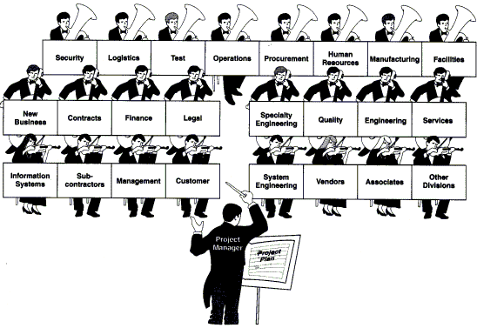
Management of Engineering Projects
Senior Design
Teamwork
Prepared by: Eng. Ahmed El Hadidi Edited by: Dr. L. K. Gaafar
Based on material from: http://lowery.tamu.edu/teaming/morgan1/index.htm
Additional mages from https://www.dreamstime.com/photos-images/diversity-work-board.html and from
https://www.google.com/search?sa=X&rlz=1C1GGRV_enUS751US751&q=conductor+gif&tbm=isch&source=univ&ved=2ahUKEwifxrzXyZ7kAhXkguAKHU-UCaIQ7Al6BAgEEBs&biw=1381&bih=885
Slides from:http://www1.aucegypt.edu/faculty/gaafar/Senior%20Project/Teamwork.ppt, 08/25/19

Slide 2
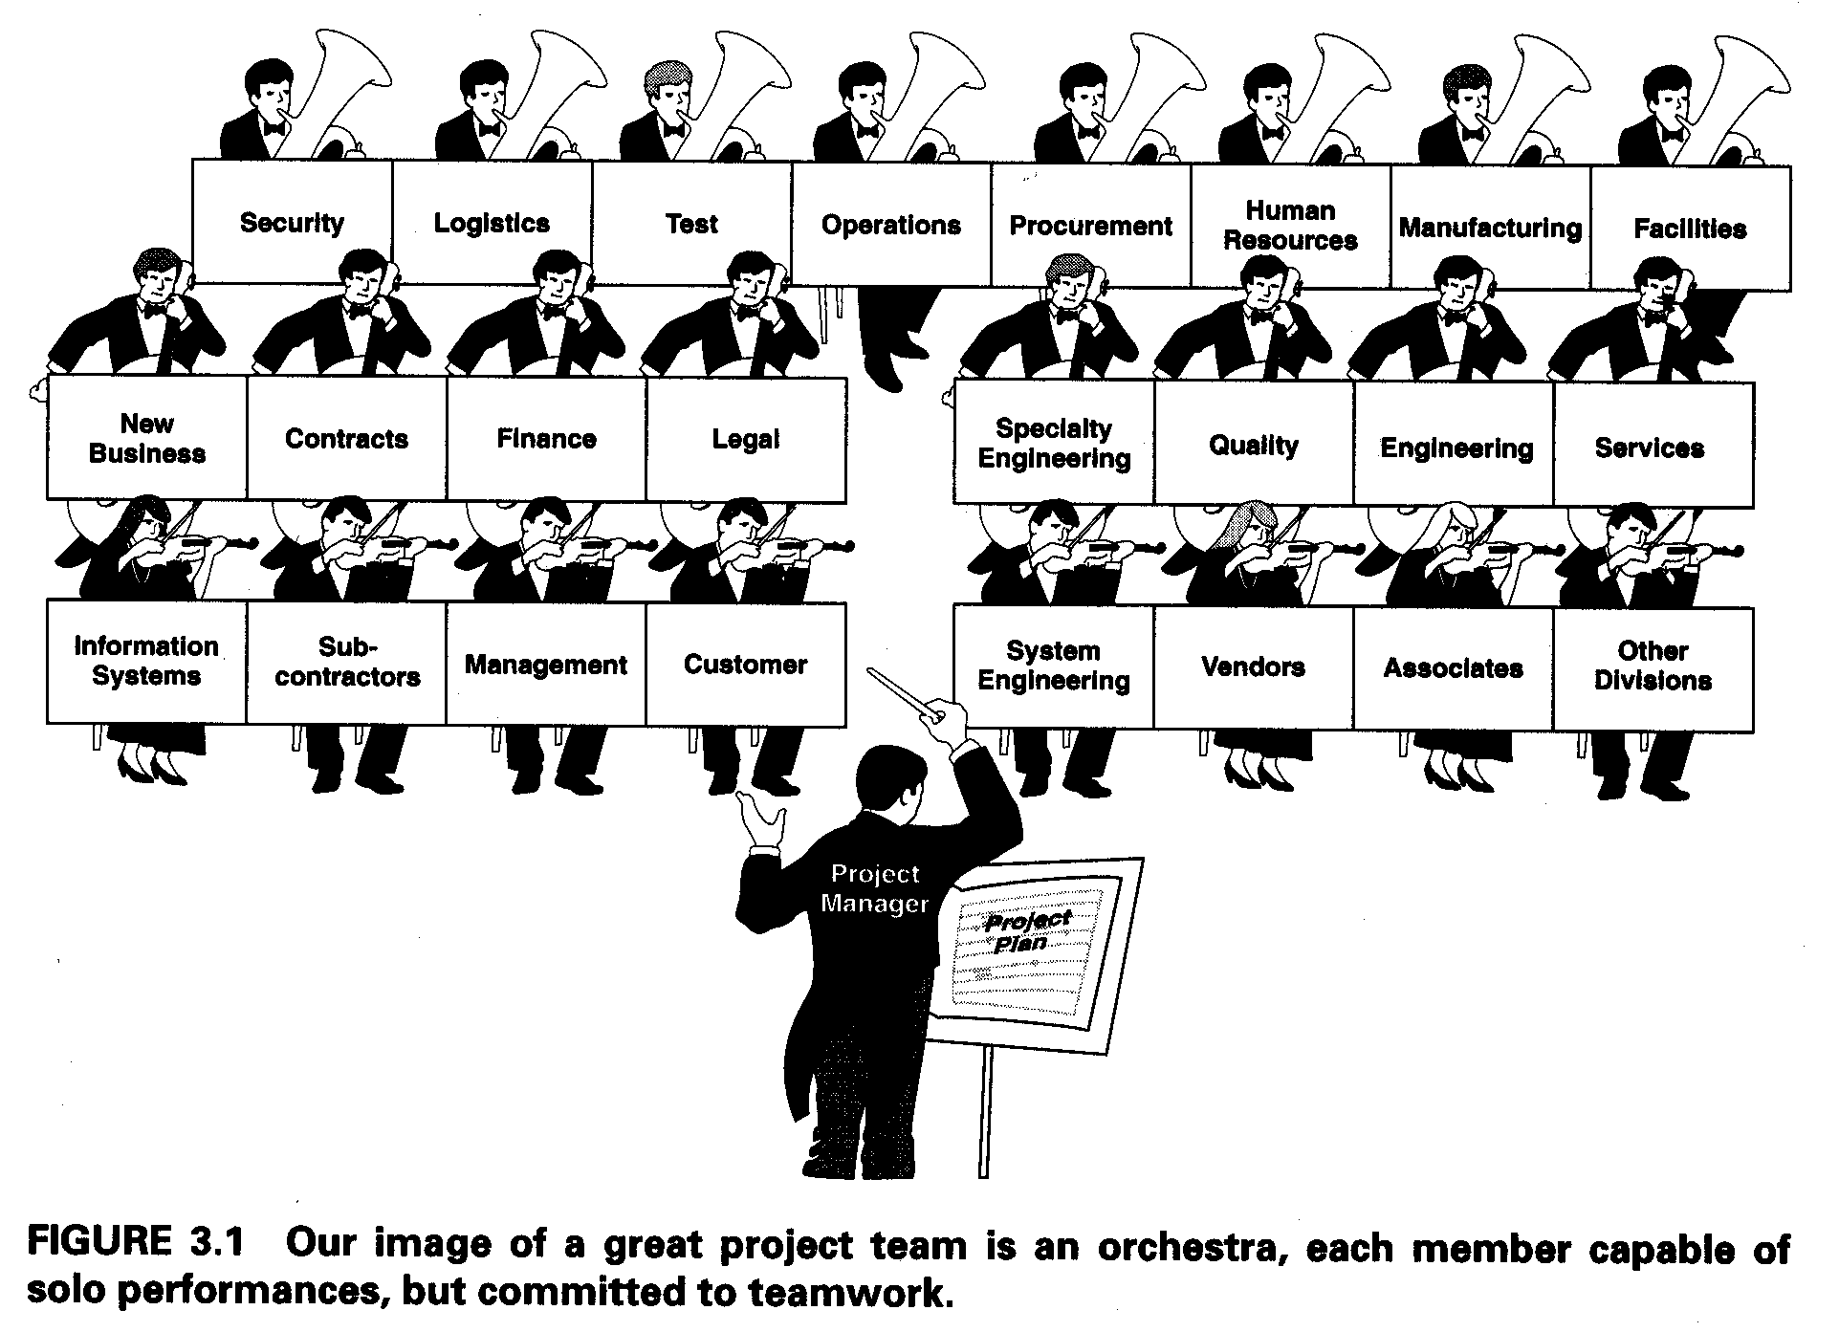
From the book Visualizing Project Management, 2000. By: Forsberg et al.

Slide 3

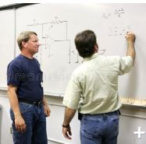
What is a team?
A team is a small number of people with complementary skills who are committed to a common purpose, performance goals, and approach for which they hold themselves mutually accountable
Small Number
Complementary Skills
Common Purpose & Performance Goals
Common Approach
Mutual Accountability
Notes:
(http://lowery.tamu.edu/teaming/morgan1/index.htm)

Slide 4
Learning Pyramid
Average Retention Rate
National Training Laboratories
Bethel, Maine 1-800-777-5227
Lecture
5%
Dale, Edgar, Audio-Visual Methods in Teaching, third edition, Holt Rinehart, Winston, 1969.
Reading
10%
Traditional
Audio-Visual
20%
Demonstration
30%
Discussion Group
50%
Teaming
Practice by Doing
75%
Teach Others / Immediate Use
90%
Notes:
(http://lowery.tamu.edu/teaming/morgan1/index.htm)

Slide 5
Team Composition and Roles
Right people should be assigned to the team.
Each person should be selected based on his or her knowledge and expertise.
In addition to selecting the appropriate people, there are also key roles that are essential to the overall team's success:
- Meeting leader
- Facilitator
- Team member
- Recorder
- Timekeeper
- Encourager/gatekeeper
- Devil’s advocate.
Notes:
(http://lowery.tamu.edu/teaming/morgan1/index.htm)

Slide 6
Five Issues to be Considered in Team Building
Interdependence
2. Goal Specification
3. Cohesiveness
4. Roles and Norms
5. Communication
Notes:
(http://lowery.tamu.edu/teaming/morgan1/index.htm)

Slide 7
Stages of Team Development
(adapted from Forsyth, 1990)
Theory on team development predicts that teams, like individuals, pass through predictable, sequential stages over time. The most well known of these models is that of Tuckman (1965), who labeled the stages of team development as forming, storming, norming, performing, and adjourning.
Forming Storming Norming Performing
Adjourning
Most of this academic year should be spent in “PERFORMING”
Notes:
(http://lowery.tamu.edu/teaming/morgan1/index.htm)

Slide 8
Stages of Team Development
(continued)
Stage
Major Processes
Characteristics
1. Forming
(orientation)
2. Storming (conflict)
3. Norming (cohesion)
Exchange of information; increased interdependency;
task exploration; identification of commonalties
Disagreement over procedures; expression of dissatisfaction; emotional responses; resistance
Growth of cohesiveness and unity; establishment of roles, standards, and relationships
Tentative interactions; polite discourse; concern over ambiguity;self-discourse
Criticism of ideas; poor attendance; hostility; polarization and
coalition forming
Agreement on procedures; reduction in role ambiguity; increased "we-feeling"
Notes:
(http://lowery.tamu.edu/teaming/morgan1/index.htm)

Slide 9
Stages of Team Development
(continued)
Stage
Major Processes
Characteristics
4. Performing
(performance)
5. Adjourning (dissolution)
Goal achievement;
high task orientation; emphasis on performance and production
Termination of roles; completion of tasks; reduction of
dependency
Decision making; problem solving; mutual cooperation
Disintegration and withdrawal; increased independence and
emotionality; regret
Notes:
(http://lowery.tamu.edu/teaming/morgan1/index.htm)

Slide 10
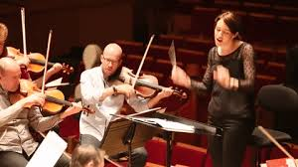
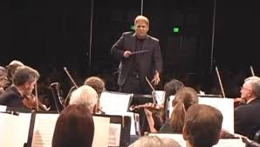
Team Leader
The team leader is the person who manages the team: calling and, if necessary, facilitating meetings, handling or assigning administrative details, orchestrating all team activities, and overseeing preparations for reports and presentations.
NOTE: a small team may decide to function more democratically but then each tem member is responsible for completing their work on time and the team needs a procedure to ensure that overall project remains on schedule
Notes:
(http://lowery.tamu.edu/teaming/morgan1/index.htm)

Slide 11

Team Members
Team members--typically three to four per team--are the rest of the people involved in the project. Team members are appointed by the Team leader or the Stakeholders. The nature of the project dictates who they are.
Notes:
(http://lowery.tamu.edu/teaming/morgan1/index.htm)

Slide 12
Other Important Roles
Recorder
The recorder is the team member who is responsible for making sure that the process(es) being used by the group is documented. This includes writing down all the important points of a discussion and preparing the minutes of a meeting.
Time Keeper
The time keeper has the responsibility of keeping the team moving so that they finish the task at hand.
Notes:
(http://lowery.tamu.edu/teaming/morgan1/index.htm)

Slide 13
Other Important Roles Continued
Encourager/ Gatekeeper
1- The task of giving encouragement to all the other team members.
2- The responsibility of maintaining a balanced level of participation for all the members.
3- Ensures all members ideas and thoughts are heard
Devil’s Advocate
The devil’s advocate takes a position opposite to that held by the team to ensure that all sides of an issue are considered.

Slide 14
Characteristics of a Good Team Leader
Works for consensus on decisions
Shares openly and authentically with others regarding personal feelings, opinions, thoughts, and perceptions about problems and conditions
Involves others in the decision-making process
Trusts, supports, and has genuine concern for other team members.
"Owns" problems rather than blaming them on others
When listening, attempts to hear and interpret communication from other's points of view
Influences others by involving them in the issue(s)
Notes:
(http://lowery.tamu.edu/teaming/morgan1/index.htm)

Slide 15
Characteristics of a Good Team Member
Encourages the development of other team members
Respects and is tolerant of individual differences
Acknowledges and works through conflict openly
Considers and uses new ideas and suggestions from others
Encourages feedback on own behavior
Understands and is committed to team objectives.
Does not engage in win/lose activities with other team members
Has skills in understanding what's going on in the group
Notes:
(http://lowery.tamu.edu/teaming/morgan1/index.htm)

Slide 16
Code of Cooperation
Should be developed, adopted, improved or modified by all team members.
Should always be visible to team members.
Sets a norm for behavior (Code of Ethics for your team)
Notes:
(http://lowery.tamu.edu/teaming/morgan1/index.htm)

Slide 17
Code of Cooperation
1. EVERY member is responsible for the team's progress and success.
2. Attend all team meetings and be on time.
3. Come prepared.
4. Carry out assignments on schedule.
5. Listen to and show respect for the contributions of other members; be an active listener.
6. CONSTRUCTIVELY criticize ideas , not persons.
7. Resolve conflicts constructively.
8. Pay attention, avoid disruptive behavior.
9. Avoid disruptive side conversations.
10. Only one person speaks at a time.
11. Everyone participates , no one dominates.
12. Avoid long anecdotes and examples.
13. No rank in the room.
14. Respect those not present.
15. Ask questions when you do not understand.
16. Attend to your personal comfort needs at any time but minimize team disruption.
Adapted from the Boeing Airplane Group team Member Training Manual
Notes:
(http://lowery.tamu.edu/teaming/morgan1/index.htm)

Slide 18
An Effective Code of Cooperation
1. Help each other be right, not wrong.
2. Look for ways to make new ideas work,not for reasons they won’t.
3. If in doubt, check it out! Don’t make negative assumptions
about each other.
4. Help each other win, and take pride in each other’s victories.
5. Speak positively about each other and about your organization at every opportunity.
6. Maintain a positive mental attitude no matter what the circumstances
7. Act with initiative and courage, as if it all depends on you.
8. Do everything with enthusiasm; it’s contagious.
9. Whatever you want; give it away.
10. Don’t lose faith.
11. Have fun!
Ford Motor Company
Notes:
(http://lowery.tamu.edu/teaming/morgan1/index.htm)

Slide 19
Problems Teams Face
Participation
Organization
Communication
Group Thinking

Slide 20
Common Teaming Problems
Lack of commitment
Dominating participants
Reluctant participants
Unquestioned acceptance of opinions as facts
Rush to accomplishment
Attribution
Wanderlust: (departure from the subject)
Feuding members
From Scholtes, Peter R., The Team Handbook, Joiner Associates (1988)
Notes:
(http://lowery.tamu.edu/teaming/morgan1/index.htm)

Slide 21

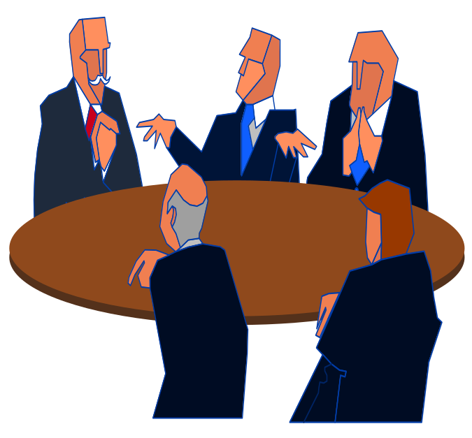
COMMUNICATION ROADBLOCKS
Demoralizing
Persuading
Ridiculing
Warning
Directing
Interrupting
Judging
Name Calling
Notes:
(http://lowery.tamu.edu/teaming/morgan1/index.htm)

Slide 22
Face-To-Face Communication
100 %
55%
37%
8%
0 %
Non-Verbals
Tone of Voice
Words (Verbal)
Notes:
(http://lowery.tamu.edu/teaming/morgan1/index.htm)

Slide 23

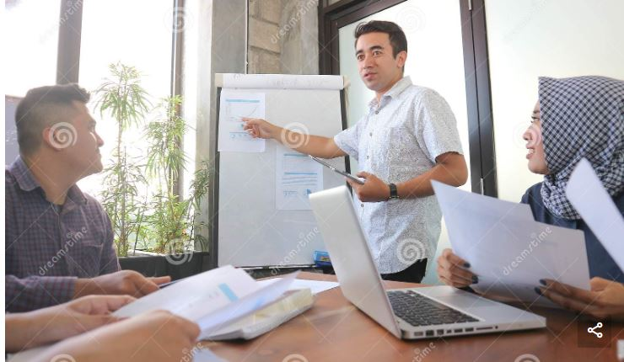
Listening Skills
Stop talking.
Engage in one conversation at a time.
Empathize with the person speaking.
Ask questions.
Don't interrupt.
Show interest.
Concentrate on what is being said.
Don't jump to conclusions.
Control your anger.
React to ideas, not to the speaker.
Listen for what is not said. Ask questions.
Share the responsibility for communication.
Stop talking.
Notes:
(http://lowery.tamu.edu/teaming/morgan1/index.htm)

Slide 24

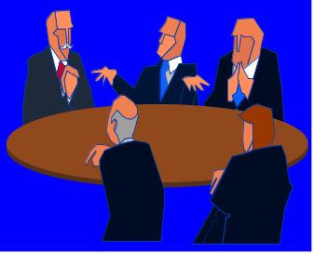
Listening Techniques
Critical Listening
  Separate fact from opinion.
Sympathetic Listening
  Don't talk - listen.
  Don't give advice - listen.
  Don't judge - listen.
Creative Listening
  Exercise an open mind.
  Supplement your ideas with another person's
  ideas and vice versa.
Notes:
(http://lowery.tamu.edu/teaming/morgan1/index.htm)

Slide 25
FIRST Seek the ‘Intersection’
Their
‘Position’
Your
‘Position’
Intersection
First, see the problem from the other point of view ; really seek FIRST to understand!
Second, identify the ‘Intersection’ ( i.e., where the ‘positions’ clearly overlap ).
Finally, select ONE issue at a time from outside the ‘Intersection’ to discuss and resolve.
Notes:
(http://lowery.tamu.edu/teaming/morgan1/index.htm)

Slide 26
Paraphrase for Understanding
Seek First to Understand, Then to be Understood *
Often we are either speaking or preparing to speak with the clear intent to reply, no?
Try listening with the intent to paraphrase what is being said by the other person.
To improve your understanding and to promote true consensus, paraphrase what was said by the speaker
  until the speaker agrees with your paraphrase !
Then, thoughtfully prepare and deliver your response.
This is often referred to as ‘empathic or reflective listening’.
* Covey, Stephen R., The 7 Habits of Highly Effective People, (1989), Simon & Schuster, Habits 4 and 5.
Notes:
(http://lowery.tamu.edu/teaming/morgan1/index.htm)

Slide 27

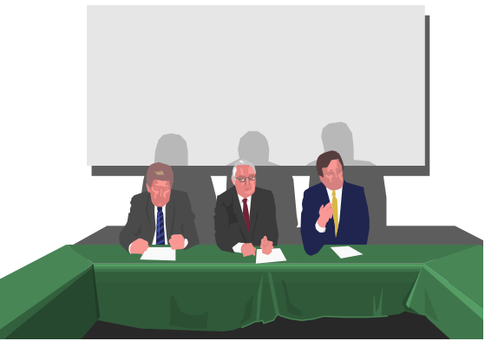
Constructive Feedback
is . . .
Communication to a person (or group) regarding the effect that a person's behavior has on another person or on the group
Perceptions, feelings, and reactions to the message
Notes:
(http://lowery.tamu.edu/teaming/morgan1/index.htm)

Slide 28
Constructive Feedback
Starting with the team leader and moving counter clockwise around the table, each team member should:
  consider the activities and tasks that the team has been involved in so far this semester
  then give POSITIVE constructive feedback to another team member using the constructive feedback structure of
  When You : I feel : Because
  each team member, as they receive the feedback, should listen reflectively and acknowledge that they have received the feedback (e.g., say ‘Thank You.’)
Repeat the previous process but this time move clockwise and give constructive feedback
Discuss the feedback and determine what team norms might be appropriate (i.e., useful or needed)
Notes:
(http://lowery.tamu.edu/teaming/morgan1/index.htm)

Slide 29
Constructive Feedback
You ARE expert on
  other people’s behavior
  your feelings
You are NOT an expert on
  your behavior
  other people’s feelings
Notes:
(http://lowery.tamu.edu/teaming/morgan1/index.htm)

Slide 30
How to Give Constructive Feedback
1. “When you . . .”
2. “I feel . . .”
3. “Because I . . .”
Start with a “When you . . .” statement that describes the behavior without judgment, exaggeration, labeling, attribution, or motives. Just state the facts as specifically as possible.
Tell how their behavior affects you. If you need more than a word or two to describe the feeling, it’s probably just some variation of joy, sorrow, anger, or fear.
Now say why you are affected that way. Describe the connection between the facts you observed and the feelings they provoke in you.
From Scholtes, Peter R., The Team Handbook, Joiner Associates (1988)
Notes:
(http://lowery.tamu.edu/teaming/morgan1/index.htm)

Slide 31
How to Give Constructive Feedback (cont.)
4. (Pause for Discussion)
5. “I would like . . .”
6. “Because . . .”
7. “What do you think . . .”
Let the other person respond.
Describe the change you want the other person to consider ...
... and why you think the change will alleviate the problem.
Listen to the other person’s response. Be prepared to discuss options and reach consensus on a solution.
Notes:
(http://lowery.tamu.edu/teaming/morgan1/index.htm)

Slide 32
How to Give Constructive Feedback (Example)
1. “When you . . .”
2. “I feel . . .”
“Because I . . .”
4. (Pause for Discussion)
5. “I would like . . .”
6. “Because . . .”
“When you are late for team meetings,
I get angry ...
... because I think it is wasting the time of all the other team members and we are never able to get through all of the agenda items.”
.......
“I would like you to consider finding some way of planning your schedule that lets you get to these team meetings on time. “
“Because that way we can be more productive at the team meetings and we can all keep to our tight schedules.”
Notes:
(http://lowery.tamu.edu/teaming/morgan1/index.htm)

Slide 33
Real-life Example: the Boeing 737 MAX Problems
Seattle Times:
Boeing & Aerospace
Business
Boeing’s 737 MAX ‘design failures’ and FAA’s ‘grossly insufficient’ review slammed
March 6, 2020 at 9:11 am Updated March 6, 2020 at 6:46 pm

