Slide 1


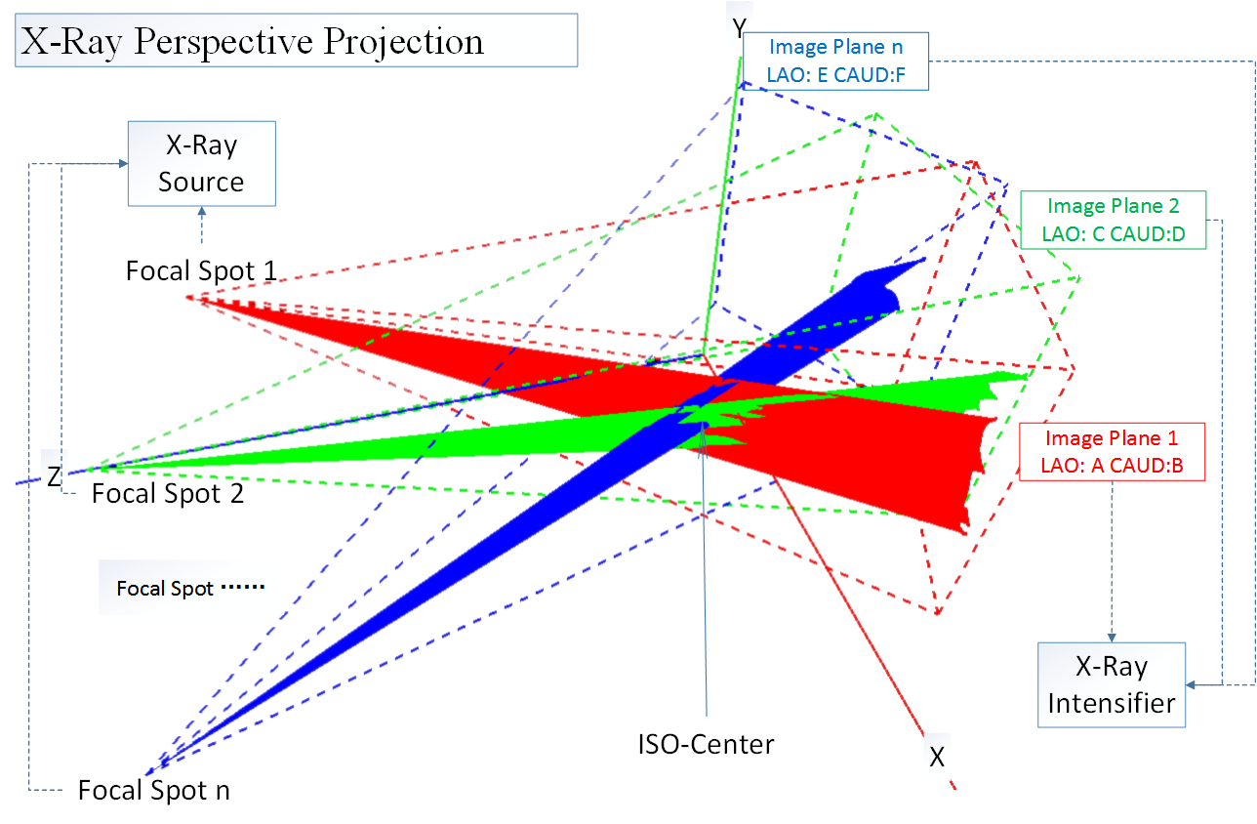
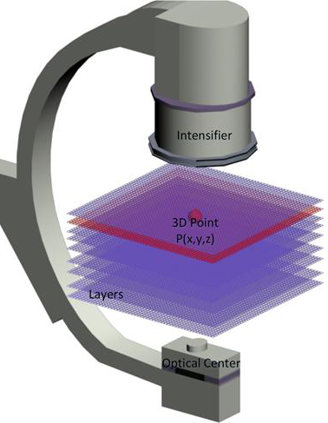

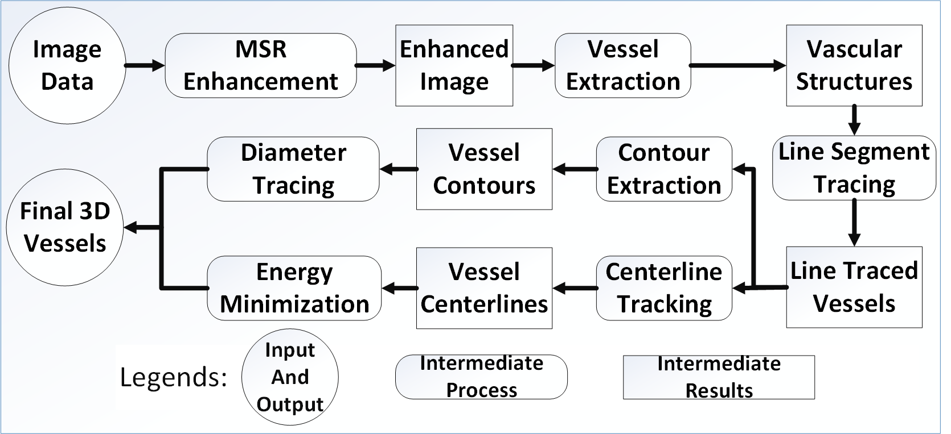
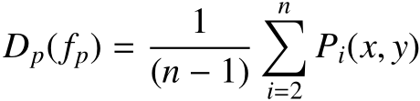
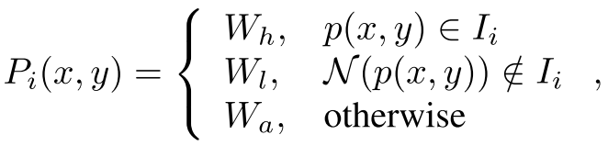
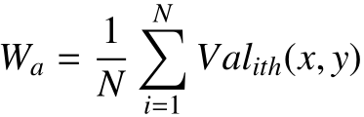
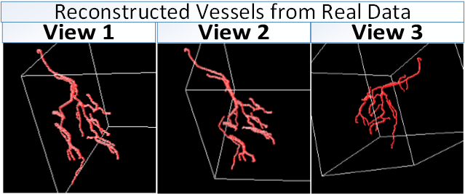
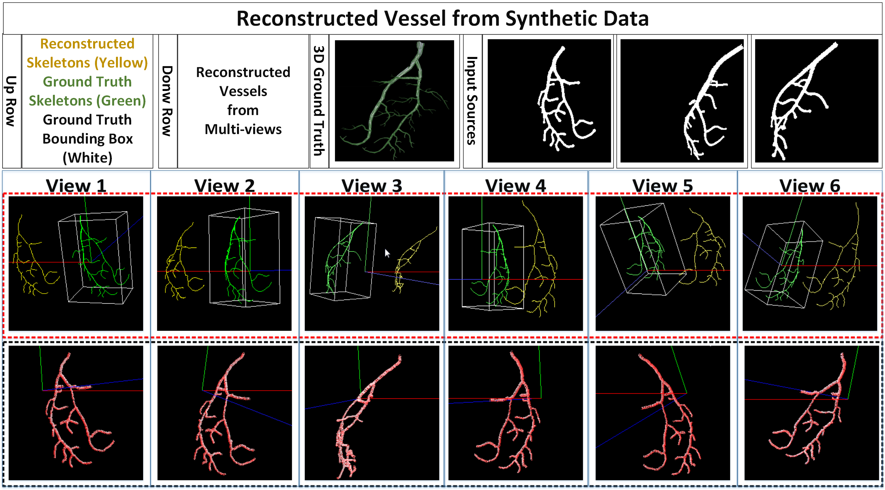

Efﬁcient 3D Reconstruction of Vessels from Multi-views of X-Ray Angiography
Xinglong Liu¹, Fei Hou¹, Aimin Hao¹, Hong Qin²
¹State Key Laboratory of Virtual Reality Technology and Systems, Beihang University, China
²Stony Brook University, Stony Brook, USA
1. Motivation and Challenges
7. 3D Reconstruction of Coronary Arteries
Intra-operative X-Ray is essential during some surgeries, such as percutaneous coronary intervention. The 2D X-Ray images have many shortcomings such as viewing angle dependence, magniﬁcation factor, overlapping, and the blurring between vessels, background, and other tissues/organs. Great efforts have been carried out on 3D reconstruction of coronary arteries to overcome the shortcomings of 2D images. Current 3D reconstruction methods mostly rely on the registration between image pairs, which are generally hard to enforce constraints such as consistency and continuity.
After $k+1$ iterations, the approximate subband
corresponding to a certain scale can be obtained, and $k$ detail
subbands are respectively the difference between the neighboring
approximate subband. It is exactly an anisotropic approximation to the Laplacian. Thus, multi-scale point features can be
obtained by extracting local minima/maxima from the detail subbands
across scales.
The imaging modality of the X-Ray is different from the ways other devices such as cameras or vidicons work in. The light source is the X-Ray source and the imaging plane is the intensifier. The imaging procedure is mostly like perspective projection under 3D space. We simulated this procedure using OpenGL.
2. Contributions
We use at least three views of angiograms at the same cardiac cycle and choose the projection view $I_{1}$ as a reference view which includes the least foreshortening and overlap among all the views. The 3D space is divided into 3D slices.
Therefore, for a given pixel $p$ on $I_{1}$ , the pair $(p, I_{i})$ uniquely identifies a point in 3D space. So, the goal of the 3D reconstruction is to optimally assign an label $I_{i}$ to each $p$ on the centerline of the reference view $I_{1}$ .This problem can be formulated as an energy minimization problem considering connectivity and topological structures.
We combine the MSR enhanced images which are mostly over extracted with line segments tracking methods to obtain more detailed vessels from blurry angiograms.
We divide the spaces between the X-Ray iso-center and the detector into slices in which we sample the 3D space points and project them to the image space considering consistency and continuity with their neighbors, overcoming the lack of constraints for typical registrations.
We formulate the 3D reconstruction as a global energy optimization problem and solve it by using belief propagation.
We implement a CUDA edition of Hessian-based vessel filter and centerline tracking method and gain great time efficiency.
3. Pipeline
The energy equation could be defined as
We define the $V_{p,q}(f_{p},f_{q})$ as the Euclidean distance between point $p,q$. And we define the $D_{p}(f_{p})$ as the color consistency.
$$V_{p}= V_{p−1}+ α minD_{p,q}\left(f_{p},f_{q}\right)+\left(1−α\right)V(p_{min})$$
Finally, we compute the minimum sum of all the grouped vessel skeletons’ cost, and obtain the optimal solution for the entire vessel skeleton tree.
8. Experimental Results
We test our reconstruction method on synthetic data and real clinical data, respectively. Compared with real data, the reconstruction of synthetic data is easy to assess because of the vessel ground truth.
4. Data acquisition and Preprocessing
For all procedures, we use two types of data. One is the synthetic data from our simulation system. Another one is the real data from clinical angiogram. We select one image from each view within mostly the same cardiac cycle and use them to reconstruct the vessels. To overcome the short comings such as the low image contrast, the low lumen with the wide dynamic range of original angiograms, we apply multi-scale retinex enhancement.
5. Vessel Extraction
After obtaining the high-contrast images pre-processed by MSR, we use the approach which relies on a multi-scale Hessian matrix that enhances the vascular structure. After processing the image, we compute the connectivity of the entire image using across template so that line segments whose length are smaller than a typical value are regarded as noise.
6. Centerline Tracking
After getting the binary images of vascular structure, we apply the centerline extraction method using multi-stencils fast marching (MSFM). Our method is done by solving the Eikonal equation at each point under several stencils which cover eight neighbors in 2D space and selecting the one which satisﬁes the upwind condition the most, this way we can achieve better accuracy.
9. Acknowledgment
This work is supported by National Natural Science Foundation of China (No. 61190120, 61190121, 61190125, 61300067, and 61300068) and National Science Foundation of USA (No. IIS-0949467, IIS-1047715, and IIS-1049448).

