Slide 1


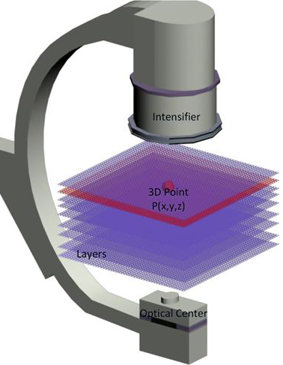
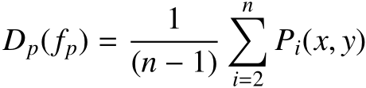
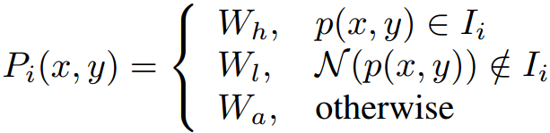
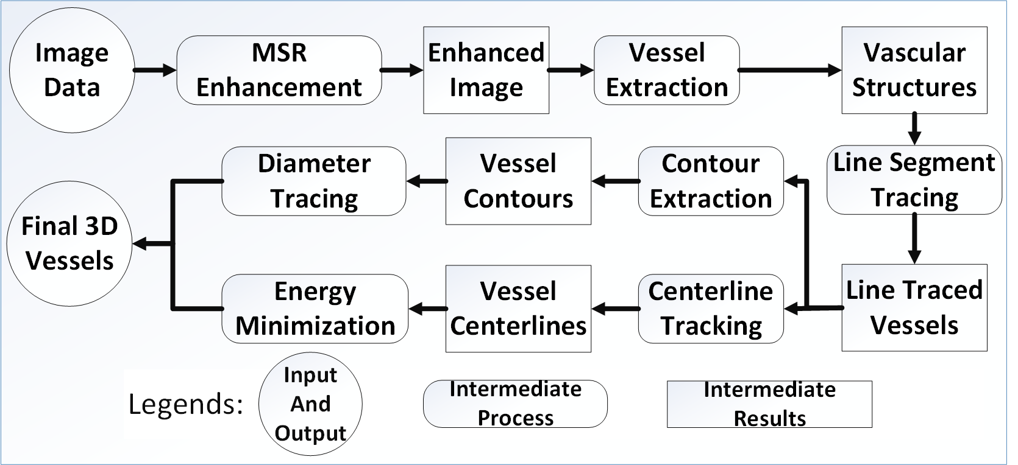

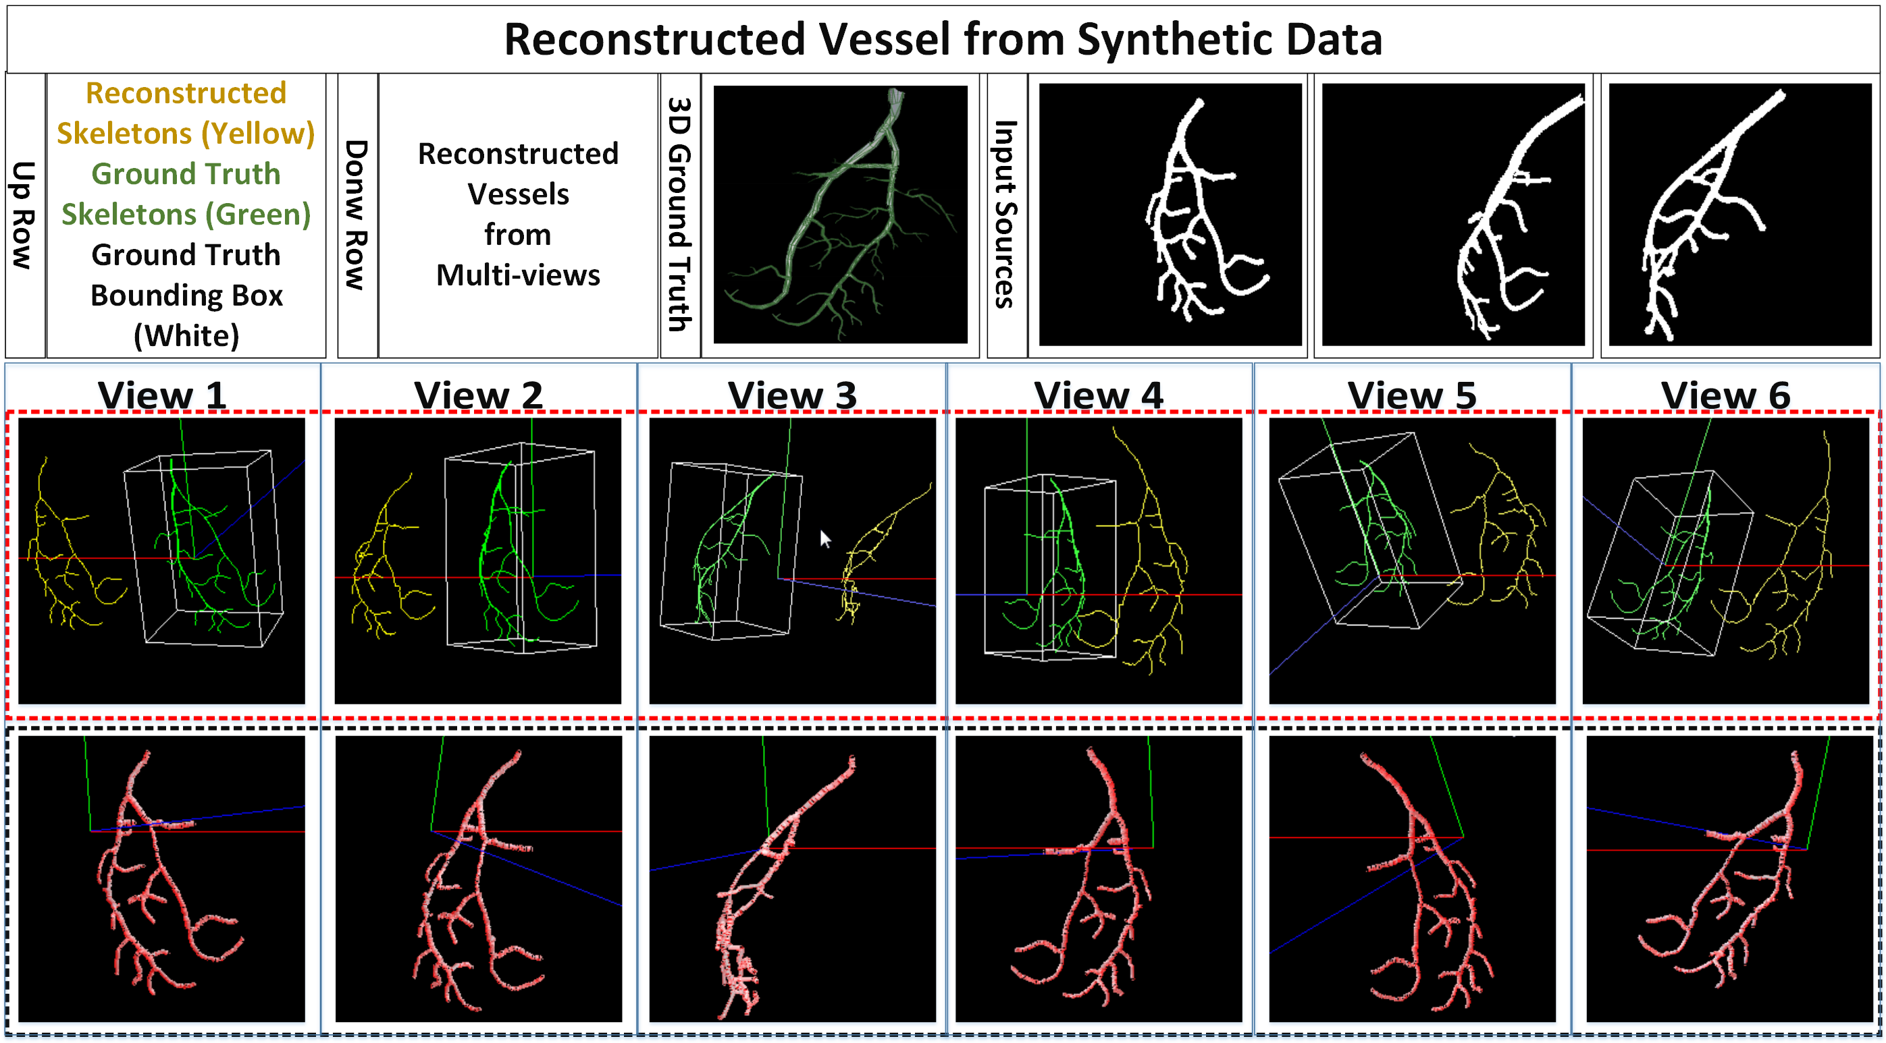
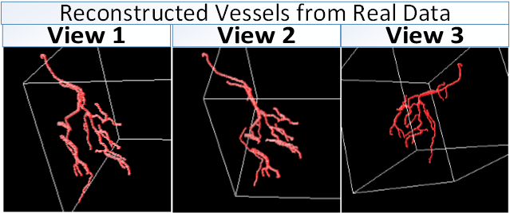
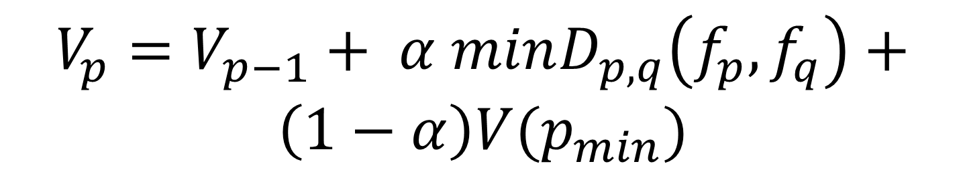

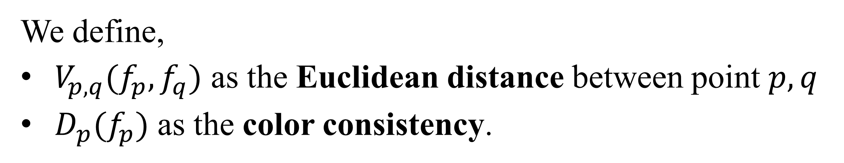
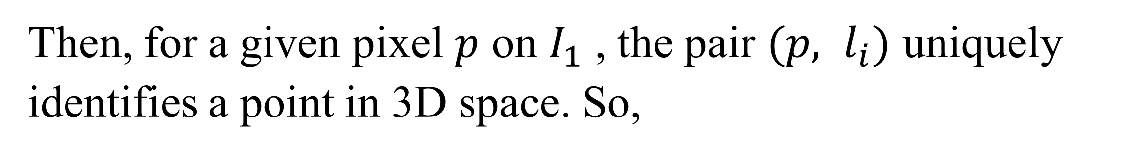
Efﬁcient 3D Reconstruction of Vessels from Multi-views of X-Ray Angiography
Xinglong Liu¹, Fei Hou¹, Shuai Li¹, Aimin Hao¹, Hong Qin²
¹State Key Laboratory of Virtual Reality Technology and Systems, Beihang University, China
²Stony Brook University, Stony Brook, USA
1. Motivation and Challenges
7. 3D Reconstruction of Coronary Arteries
The foundation of our method is,
We use three views’ images
Images at the same cardiac cycle
One image with least foreshortening and overlap as reference image $I_{1}$
The 3D space between optical-center and intensifier is divided into 3D slices $l=(l_{1},l_{2},…l_{k})$
Intra-operative X-Ray is essential during some surgeries. The 2D X-Ray images have many shortcomings such as viewing angle dependence, etc. Current 3D reconstruction methods are mostly relying on the registration between image pairs and hard to enforce constraints. We wanna develop an efficient vessel reconstruction system based on multiple X-Ray views considering consistency and continuity and help doctors understand the spatial configuration of coronary arteries of specific patients during operation.
specific patient during operation..
After $k+1$ iterations, the corresponding to a certain scale can be obtained, and $k$ difference between the neighboring
an anisotropic approximation to the Laplacian. Thus, multi-scale point features can be
obtained by extracting local minima/maxima from the detail
Then, for a given pixel $p$ on $I_{1}$ , the pair $(p, l_{i})$ uniquely identifies a point in 3D space. So,
2. Contributions
We divide the spaces between the X-Ray iso-center and the detector into slices. And we sample 3D space points and project them to the image space considering consistency and continuity with their neighbors.
We formulate the 3D reconstruction as a global energy optimization problem and solve it by using belief propagation.
We implement a CUDA edition of Hessian-based vessel filter and centerline tracking method and gain great time efficiency.
$$3D reconstruction≡assign l_{i} to each p on I_{1}$$
This is an energy minimization problem considering connectivity and topological structures. We use Belief Propagation(BP) to solve this problem.
Energy Equation, $E\left(f\right)=\sum_{p∈P}{D_{p}\left(f_{p}\right)+λ\sum_{p,q∈N}{V_{p,q}(f_{p},f_{q})}}$
We define,
$V_{p,q}(f_{p},f_{q})$ as the Euclidean distance between point $p,q$
$D_{p}(f_{p})$ as the color consistency.
3. Pipeline
$$V_{p}=V_{p−1}+ α minD_{p,q}\left(f_{p},f_{q}\right)+$$
$$\left(1−α\right)V(p_{min})$$
8. Experimental Results
4. Data acquisition and Preprocessing
We use two types of data,
Synthetic data from our simulation system.
Real data from clinical angiogram.
We select one image from each view within mostly the same cardiac cycle and use them to reconstruct the vessels. To enhance the images, we apply multi-scale retinex method.
The yellow lines indicate the reconstructed skeleton .The green lines are the ground truth got in our platform.
5. Vessel Extraction
For results from clinical data, the views and results can be found on the right.
This step is done by two procedures,
We firstly use the approach relying on a multi-scale Hessian matrix to extract the vascular structures.
Then, we compute the connectivity of the entire image using a cross template to filter tiny line segments.
6. Centerline Tracking
9. Acknowledgment
Using the binary images of vascular structures, we apply the centerline extraction method using multi-stencils fast marching (MSFM). Also, we obtain the vessel contours to compute the diameters at each centerline point.
This work is supported by National Natural Science Foundation of China (No. 61190120, 61190121, 61190125, 61300067, and 61300068) and National Science Foundation of USA (No. IIS-0949467, IIS-1047715, and IIS-1049448).

