Slide 1


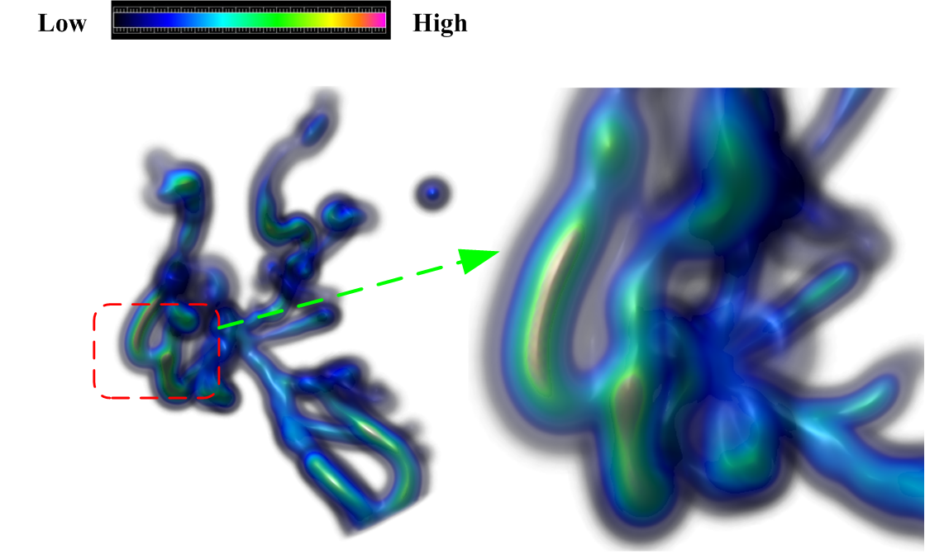
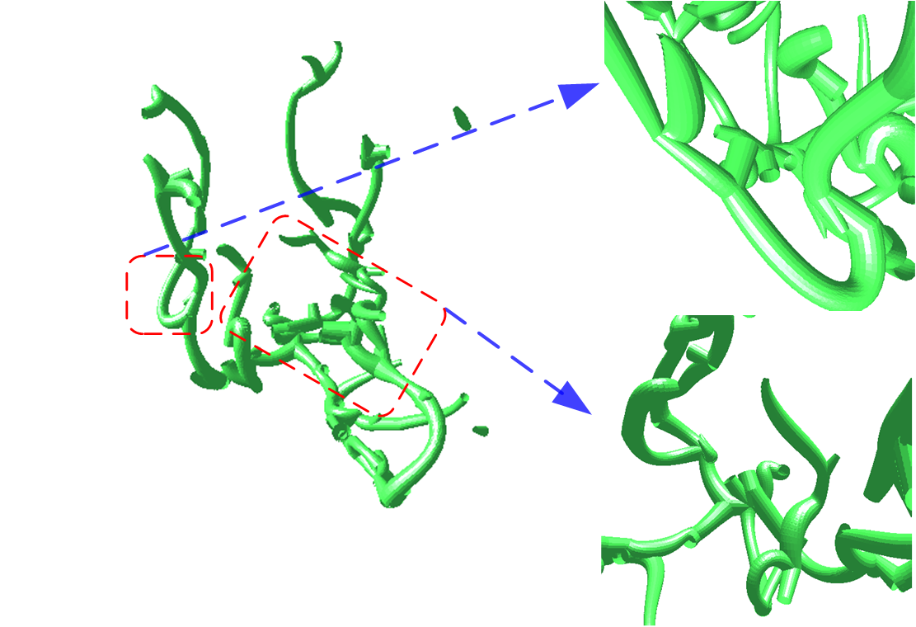
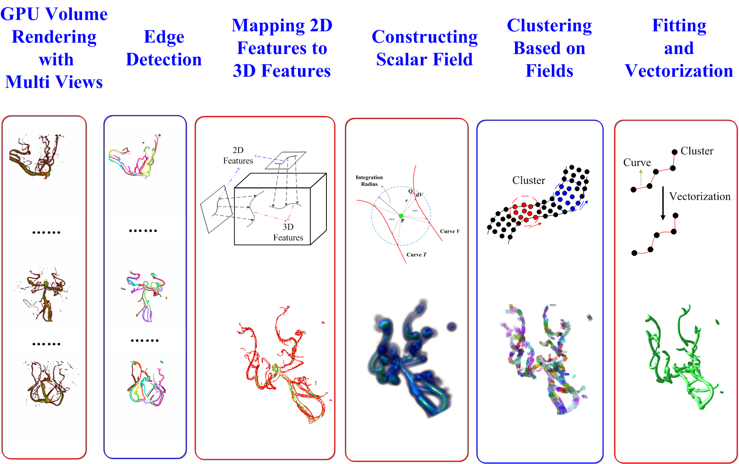
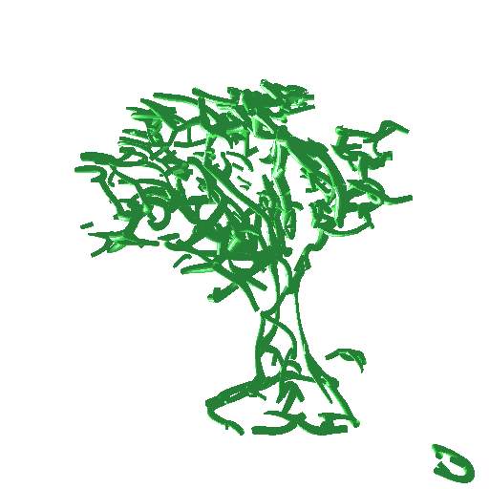
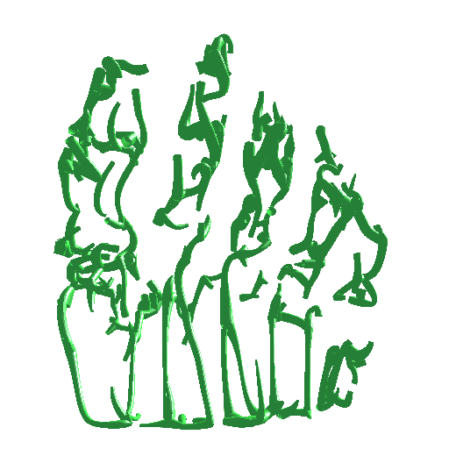
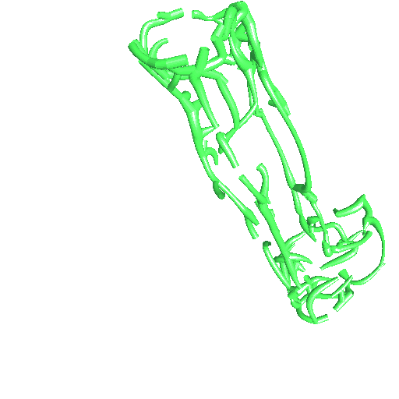
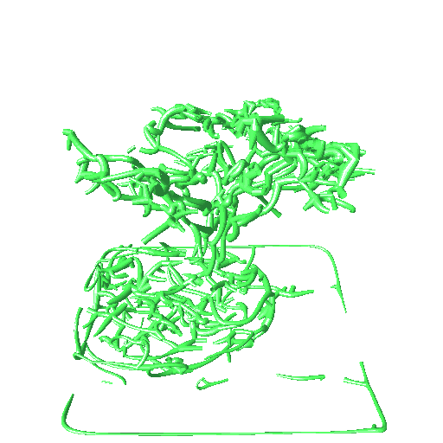
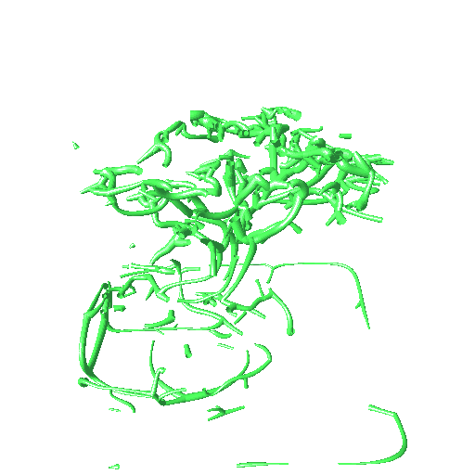
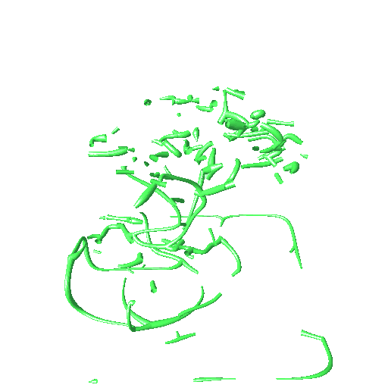
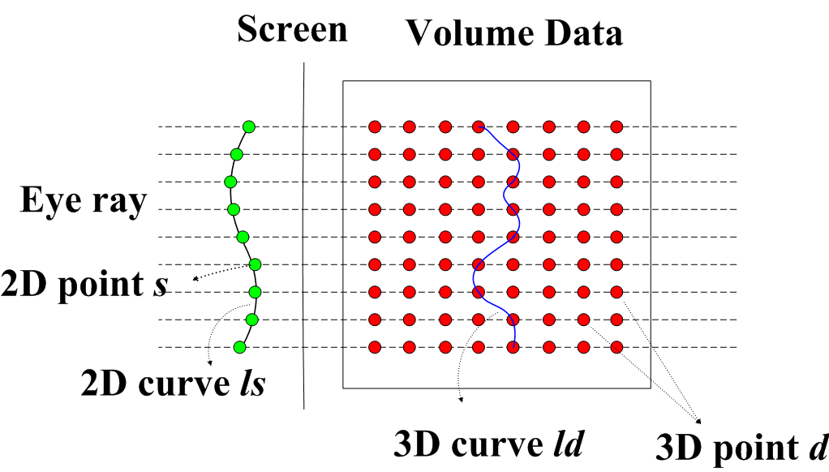
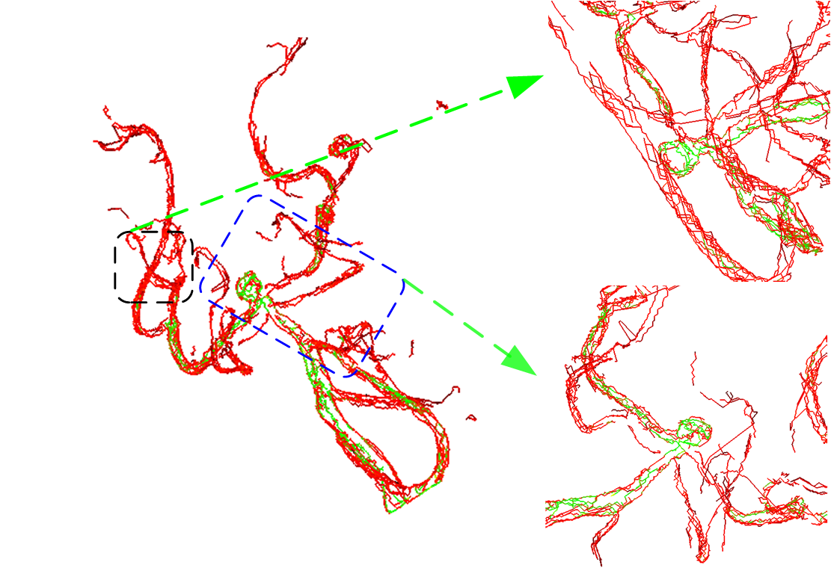
Direct Extraction of Feature Curves from Volume Image for Illustration and Vectorization
based on 2D/3D Curve Mapping
Liping Wang¹ Lili Wang¹ Fei Hou¹ Aimin Hao¹ Hong Qin²
¹State Key Laboratory of Virtual Reality Technology and Systems, Beihang University, China
²Stony Brook University, Stony Brook, USA
1. Introduction and Motivation
6. Clustering and Fitting Candidate Curves
After $k+1$ iterations, the approximate subband
corresponding to a certain scale can be obtained, and $k$ detail
subbands are respectively the difference between the neighboring
approximate subband. It is exactly an anisotropic approximation to the Laplacian. Thus, multi-scale point features can be
obtained by extracting local minima/maxima from the detail
Our approach is motivated by reconstructing 3D geometric information from multiple rendered images. The 2D rendered images are rich in the visual sense that convey the structure of volume data, so it is significant for the user to understand the structure of 3D volume data better if we can recover feature curves from those 2D images.
We construct a scalar field, which is implicitly defined by candidate curves, and a potential function representing the contribution of each 3D point to the scalar field.
2. Contributions
We directly extract candidate feature curves from volume data.
We back-project the 2D feature lines to 3D feature lines by formulating an energy optimization problem.
We cluster candidate features by constructing a scalar field and fit them to generate vectorized results in a piecewise fashion.
We implement most steps of our algorithm on GPU with CUDA acceleration.
We cluster the points into groups in least squares sense iteratively and link adjacent ones into curves. Finally, we use Bezier spline to fit them into vectorized curves.
3. Pipeline
7. Experimental Results
Some results are produced from several data sets, and the vectorized results with Bezier splines are scalable, smooth, and compact.
4. 2D Feature Curve Extraction
We apply GPU raycasting method to render volume data with six cameras, then we use Canny operator to obtain 2D feature curves.
5. Mapping to 3D Feature Curves
The user also can control different levels of details for volume illustration manually.
We map these 2D feature curves to 3D features via an energy minimization formulation and use dynamic programming to solve it on GPU.
8. Acknowledgments
This work is supported by National Natural Science Foundation of China (No. 61190120, 61190121, 61190125, 61300067, and 61300068) and National Science Foundation of USA (No. IIS-0949467, IIS-1047715, and IIS-1049448).

