Slide 1



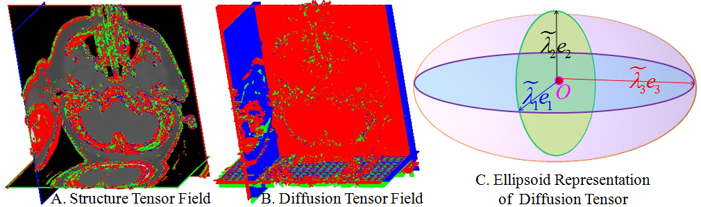
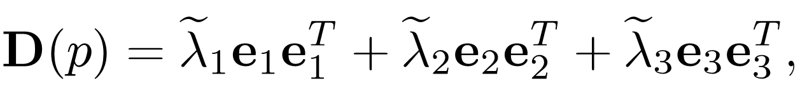
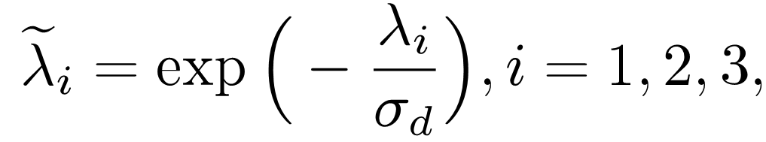
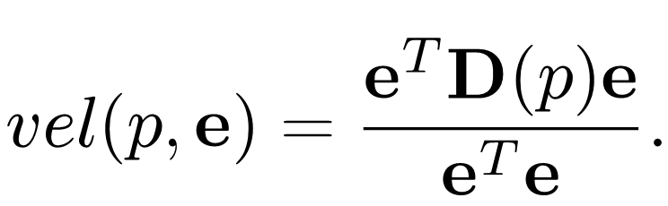


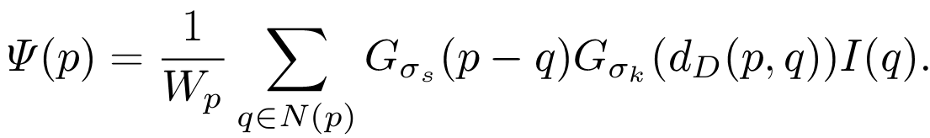
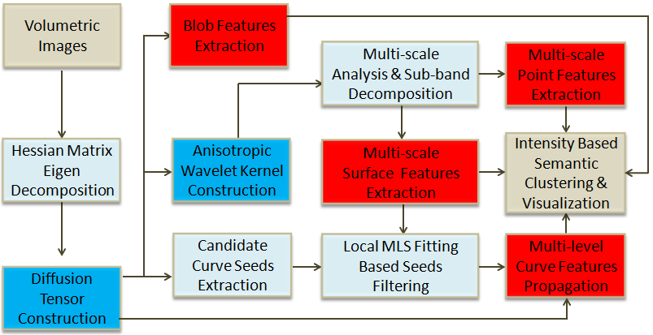
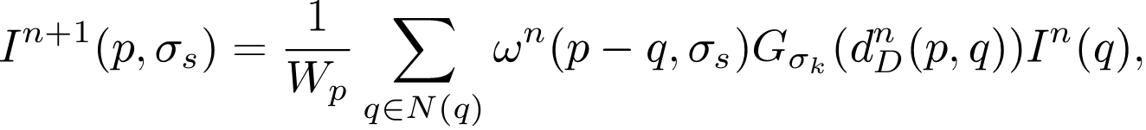
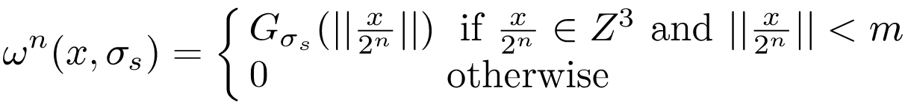

Multi-Scale, Multi-Level, Heterogeneous Features Extraction and Classification of Volumetric Medical Images
Shuai Li¹, Qinping Zhao¹, Shengfa Wang³, Aimin Hao¹, Hong Qin²
¹State Key Laboratory of Virtual Reality Technology and Systems, Beihang University, China
²Stony Brook University, Stony Brook, USA
³School of Mathematical Sciences, Dalian University of Technology, Dalian, China
1. Motivation and Challenges
After $k+1$ iterations, the approximate subband
corresponding to a certain scale can be obtained, and $k$ detail
subbands are respectively the difference between the neighboring
approximate subband. It is exactly an anisotropic approximation to the Laplacian. Thus, multi-scale point features can be
obtained by extracting local minima/maxima from the detail subbands
across scales.
Heterogeneous structural features can better transform the difficult problem of understanding a raw data set into a simpler problem of analyzing a collection of meaningful feature elements.
However, volumetric medical images typically have much more complex inner structure, the diverse features may scatter apart over non-manifold volumetric geometry, and the embedded structures usually have certain thickness. Meanwhile, simple feature extraction might obtain a large number of spurious small-scale structures, while user is generally only interested in a small fraction of some primary structure. Besides, the overall performance of feature extraction and classification largely depends on the quality of the feature measurements, noisy extent, and the original data size.
Thus, the definition of their heterogeneous structural feature tends to be highly subjective and very difficult to express. Quantitative refinement criteria with explicit physical meaning is urgently needed. And a unified and robust framework together with parallel computation is also non-trivial.
4. Hessian Eigen-system based Diffusion Tensor
To suppress the diffusion when cutting across sharp material boundaries, we formulate an anisotropic diffusion tensor by a spectral representation as
For a voxel on a boundary surface, all the directions aligning with its tangent plane are principal diffusion directions.
For a voxel on a sharp edge, the direction along the edge is principal diffusion direction.
5. DT Space based Anisotropic Convolution Kernel
DT-based anisotropic convolution kernel (DACK) is derived from the diffusion tensor and bilateral filter. Since the surfaces and boundaries in volumetric images still have various directions due to their intrinsic geometrical structure, we devise a directional anisotropic convolution kernel by introducing the distance metric in
diffusion tensor space. Given two neighboring voxels located at p and q , we define their distance in DT space as
is introduced to amend the gradient, which changes in response to the intensity change of the neighboring voxels.
describes the diffusivity and controls the diffusion directions and velocities. Then, we can define the DACK as
2. Contributions
(1) We devise a systematic and robust algorithm for semi-automatic heterogeneous structural feature extraction, classification, filtering and visualization, which requires no additional manual inputs except for a few threshold parameters.
(2) We define a diffusion tensor to facilitate the recognition of candidate curve seeds and blob features, guide CUDA-based global propagation of curve feature.
(3) We design a diffusion tensor based anisotropic convolution kernel to govern multi-scale point and surface feature extraction.
(4) We propose a projection distance based verification technique to exclude the false-alarm candidate curve seeds.
6. Multi-scale Point Features and Surface Features
3. Pipeline
We adopt dyadic wavelet transform to conduct DACK-based multi-scale analysis by
After k+1 iterations, the approximate subband corresponding to a certain scale can be obtained, and k detail subbands are respectively the difference between the neighboring approximate subband. It is exactly an anisotropic approximation to the Laplacian. Thus, multi-scale point features can be obtained by extracting local minima/maxima from the detail subbands across scales.
Page 1

Slide 2
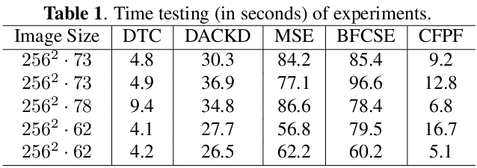
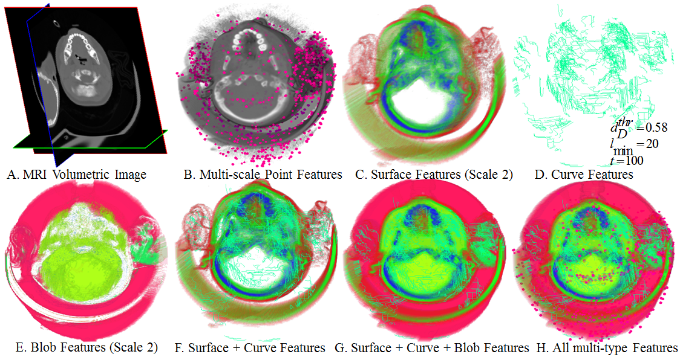
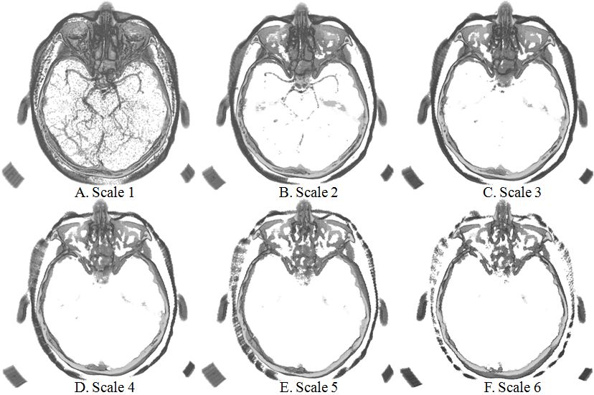
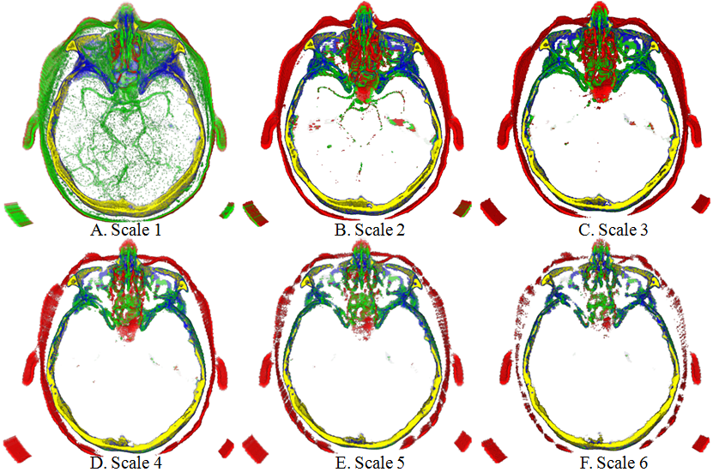
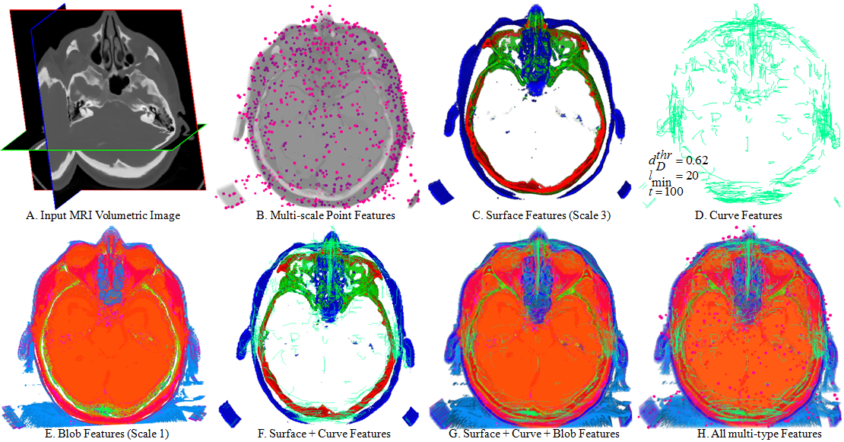







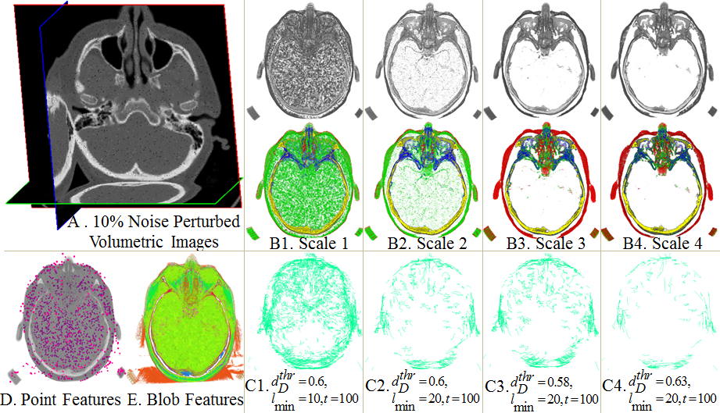
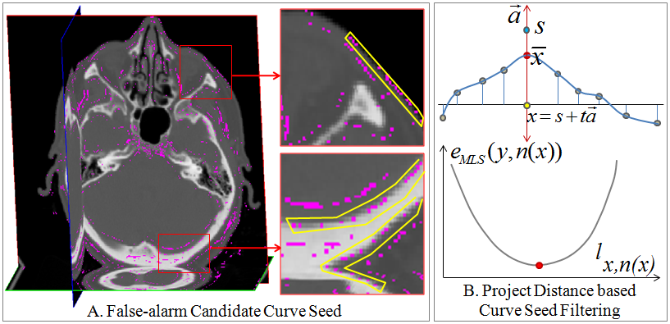

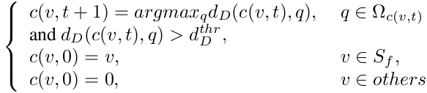

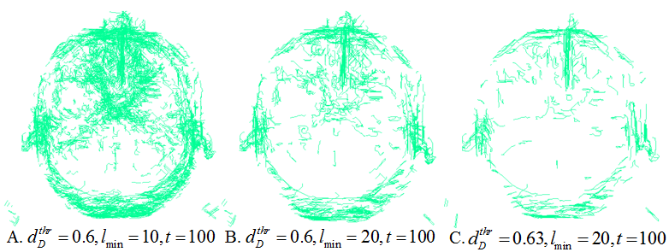
6. Multi-scale Point Features and Surface Features
8. Experimental Results
With no additional computation cost, we can obtain the multi-scale surface features directly from the decomposed detail subbands, since the highest frequency details usually correspond to finest scale features while lower frequency corresponds to coarser scale features. For a larger n each individual voxel will contribute less to the surface variation and high-frequency oscillations will be attenuated, which is analogous to a low-pass filter. Besides, the original intensity of volumetric images can provide enough information to discriminate different materials, thus we employ adaptive K-means algorithm to conduct further classification.
All the experiments is run on a commodity laptop with NVIDIA GeForce 330M GPU, Intel Core (TM) i7 CPU (1.6GHz, 2 cores) and 4G RAM.
Illustration of Multi-scale surface features
7. Blob Feature and Multi-level Curve Feature
We conduct DT eigen-values analysis to classify voxels into blobs, candidate curve seeds, and noise as
Blob: and are equally dominant ( );
Candidate curve seed: is dominant ( ), are close to 0;
Noise: are close to 0, and its principal diffusion
directions are different from its neighboring voxels.
However, some of the candidate curve seeds may be false-alarm due to the jagged boundary voxels, whose projection distance to the locally fitted surface will be relatively larger than the jagged voxels. Thus, we can filter out these false-alarm seeds according to the projection distance to by minimizing
Let be the line passing through x with direction
the surface is formed by points
Based on the filtered curve seed set, the curve features can be obtained through CUDA-based parallel propagation governed by diffusion tensor, which is defined as
9. Acknowledgement
is a threshold that controls the significant level of the curve feature, while the spurious small curves can be filtered out by using another threshold parameter to limit the arc-length of extracted curves.
This research is supported by National Natural Science Foundation of China (No.61190120, No.61190121 and No.61190125) and NSF grants IIS-1047715, and IIS-1049448.
We appreciate the people/organizations that provide the volumetric medical datasets on the website (http://www.volvis.org/) and (http://www9.informatik.uni-erlangen.de/External/vollib/).
And we also want to thank the anonymous reviewers for their valuable comments.
Page 2
[1] O. Monga and S. Benayoun, “Using partial derivatives of 3d images to extract typical surface features,” Computer Vision and Image Understanding, vol. 61, pp. 171–189, 1995.
[2] Y. Sato, C. F. Westin, A. Bhalerao, S. Nakajima, N. Shi-raga, S. Tamura, and R. Kikinis, “Tissue classification based on 3d local intensity structures for volume rendering,” IEEE Transactions on Visualization and Computer Graphics, vol. 6, pp. 160–180, 2000.
[3] C. Bajaj, Z.-Y. Yu, and M. Auer, “Volumetric feature extraction and visualization of tomographic molecular imaging,” Journal of Structural Biology, vol. 144, pp. 132–143, 2003.
[4] G. L. Kindlmann, X. Tricoche, and C.-F. Westin, “Delineating white matter structure in diffusion tensor mri with anisotropy creases,” Medical Image Analysis, vol. 11, no. 5, pp. 492–502, 2007.
[5] X. Tricoche, G. Kindlmann, and C.-F. Westin, “Invariant crease lines for topological and structural analysis of tensor fields,” IEEE Transactions on Visualization and Computer Graphics, vol. 14, no. 6, pp. 1627–1634, 2008.
[6] T. Schultz, H. Theisel, and H.-P. Seidel, “Crease surfaces: From theory to extraction and application to diffusion tensor mri,” IEEE Transactions on Visualization and Computer Graphics, vol. 16, pp. 109–119, 2010.
[7] V. Lempitsky, “Surface extraction from binary volumes with higher-order smoothness,” in Computer Vision and Pattern Recognition, 2010, pp. 1197 –1204.
[8] S.-d. Liu, W.-D. Cai, L.-F. Wen, S. Eberl, M.J. Fulham, and D.-G. Feng, “A robust volumetric feature extraction approach for 3d neuroimaging retrieval,” in Engineering in Medicine and Biology Society, 2010, pp. 5657 –5660.
[9] S. Barakat, N. Andrysco, and X. Tricoche, “Fast extraction of high-quality crease surfaces for visual analysis,” Computer Graphics Forum, vol. 30, no. 3, pp. 961–970, 2011.
[10] S.-F. Wang, T.-B. Hou, Z.-X. Su, and H. Qin, “Diffusion tensor weighted harmonic fields for feature classiication,” in Pacific Graphics, 2011, pp. 93–98.
[11] S.-F. Wang, T.-B. Hou, S. Li, Z.-X. Su, and H. Qin, “Anisotropic elliptic pdes for feature classification,” IEEE Transactions on Visualization and Computer Graphics, to appear, 2013.

