Slide 1
Alignment (I) Bioinformatics Applications (PLPTH813)
Sanzhen Liu
2/4/2025

Slide 2
Outline
Alignment overview
Dot plot
Dynamic alignment
(example: local alignment)
BLAST

Slide 3
Sequence alignment
Sequence alignment is the approach of comparing sequences of nucleotides or amino acids to identify regions of similarity.
Applications:
Measure relatedness between sequences
Identify homologous genes or duplication regions
Identify source of a sequence in a database
Locate the position of a sequence in the genome
etc.

Slide 4
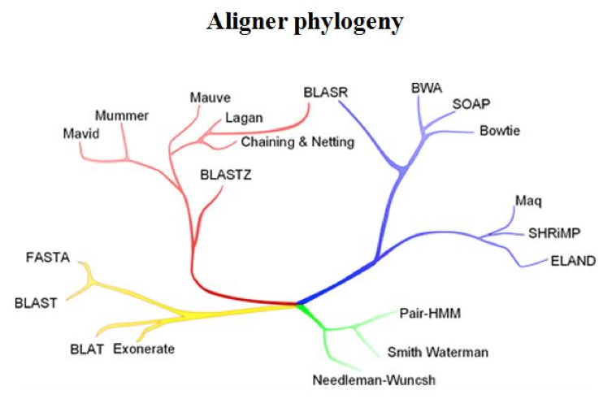
Alignment algorithms
long noisy reads or short reads
minimap2
Long sequences Short reads
Pairwise heuristic Sensitive aligners
http://evomicsorg.wpengine.netdna-cdn.com/wp-content/uploads/2014/01/alignCompare2.jpg

Slide 5
Dot matrices in a single-base resolution
a
c
g
c
g
a
Make dots for all nucleotide matches
Connect continuous matching dots
c
a
c
g

Slide 6
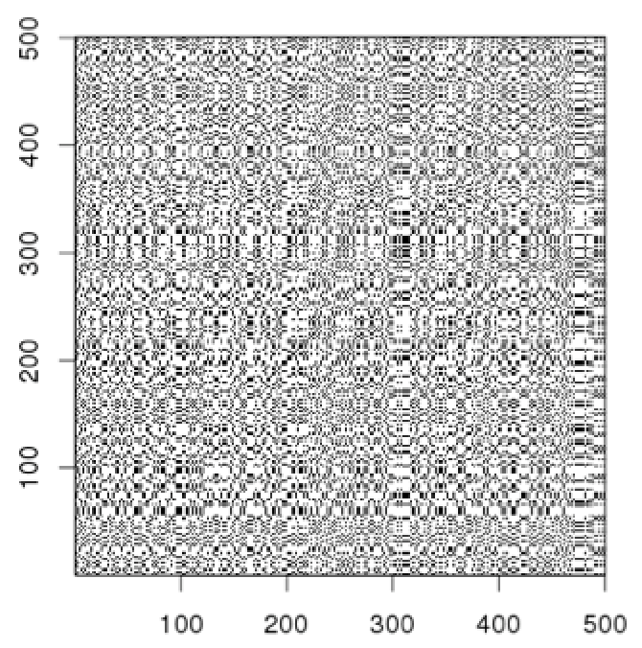
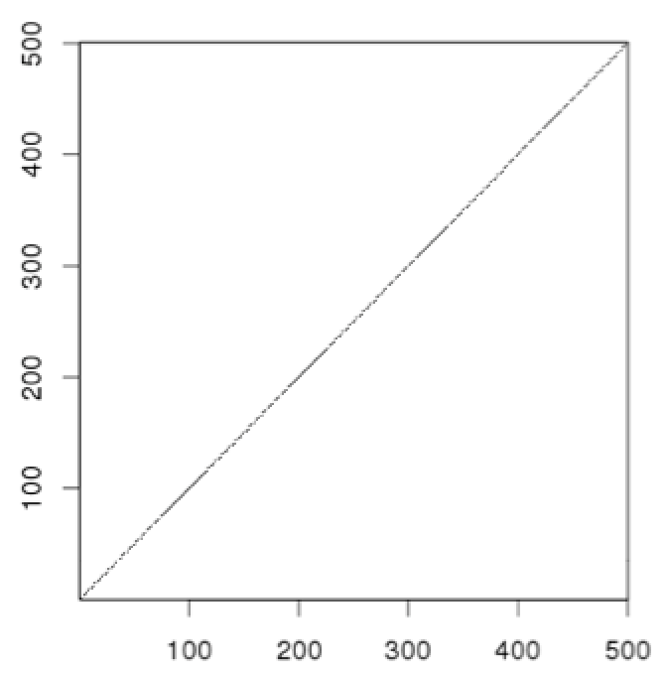
Dot plot comparison using windows
Dot matrices can be noisy due to insignificant matches
e.g., draw a dot/line only if at least 9 out of 10 nucleotides are identical.
window size = 10
minimum matches = 9
Solution: use a window and a threshold
compare sequences within a window (need choose window size)
require certain fraction of matches within window in order to display it with a dot

Slide 7
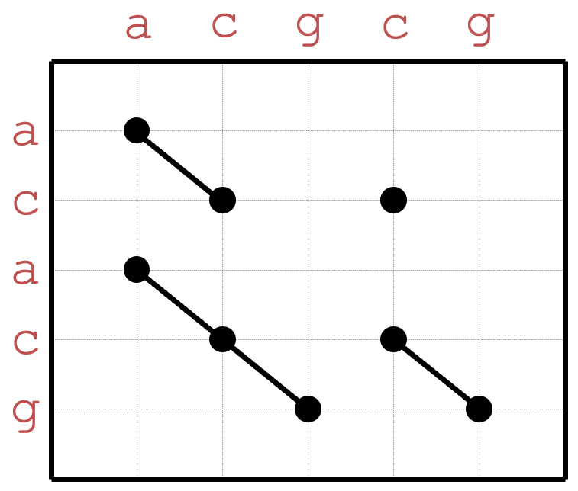
Dot plot with a window method
Window size = 4
Stringency = 3 (min matches)
a
c
g
c
g
a
c
a
c
g

Slide 8
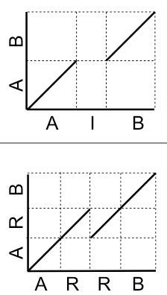
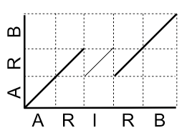
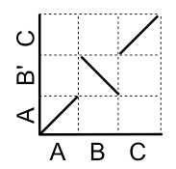
Dot-plots (examples)
query is identical to reference and contains no repeats
query
deletion of "I" in query
reference
query
deletion of a "R" in query
reference
deletion of "IR" in query
?
query
inversion
reference

Slide 9
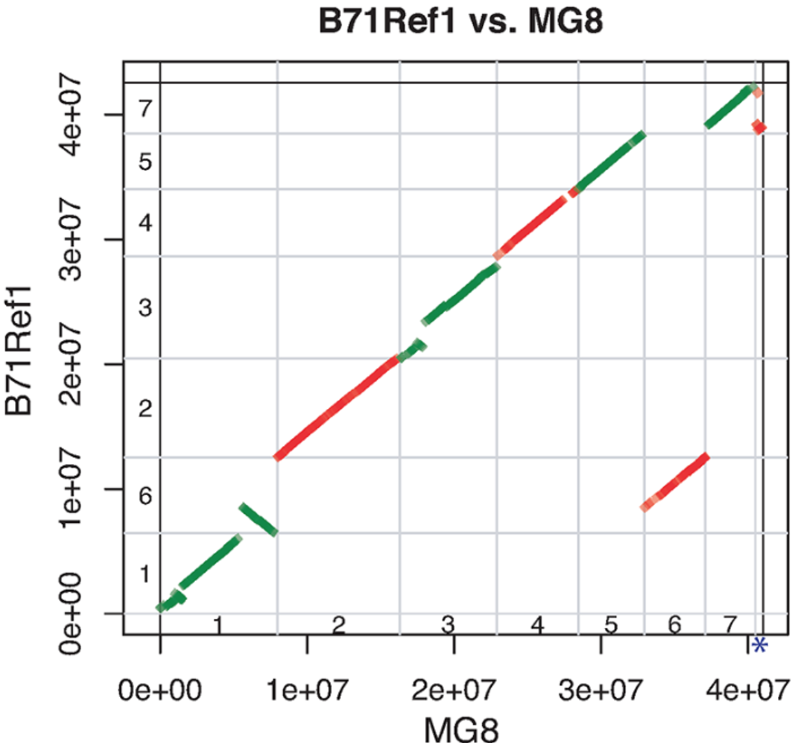
A dotplot from real genomic data
A dotplot to compare between the B71 assembly and the reference MG8
Alignments between the two assemblies were performed by using Nucmer. Only alignments with at least 10 kb match and at least 95% identity were shown.
Chromosomes numbers, 1–7, were indicated inside axes.

Slide 10
Outline
Alignment overview
Dot plot
Dynamic alignment
(example: local alignment)
BLAST

Slide 11
Local and global alignments
Local alignment: to find similar sequence regions between sequences
C T G T T G C T G C
T G C T G
Global alignment: to attempt to optimally align the entire length of two sequences.
C T G T T G C T G C
- T G - - - C T G -

Slide 12
Best (local) alignment
Question: How to determine which alignment is better?
Alignment 1: C T G T T G C T G C
T G C T G
Alignment 2: C T G T T G C T G C
T G - - - C T G
Need a scoring scheme:
e.g., match +1; mismatch -1; gap -2
then, a score can be assigned to each alignment

Slide 13
Best (local) alignment
match +1; mismatch -1; gap -2
Alignment 1: C T G T T G C T G C
T G C T G
1 2 1 2 3 score = 3
Alignment 2: C T G T T G C T G C
T G - - - C T G
1 2 0 -2 -4 -3 -2 -1 score = -1
match +1; mismatch -2; gap 0
Alignment 1: C T G T T G C T G C
T G C T G
1 2 0 1 2
Alignment 2: C T G T T G C T G C
T G - - - C T G
1 2 2 2 2 3 4 5
score = 2
score = 5

Slide 14
A classic algorithm for local alignment – Smith-Waterman
C T G T T G C T G C
T G C T G
Local alignment
List all possible alignments and to find the winner with the highest score?
Smith–Waterman (SW)
Using dynamic programming to find the best local alignment(s) between two sequences with respect to a scoring scheme
Notes:
• Dynamic programming is a method for solving optimization problems by breaking them down into smaller subproblems, solving each subproblem once, and storing the results to avoid redundant computations.
• It builds an optimal alignment score step by step by filling in a matrix (DP table).

Slide 15
Alignment with no gaps
C T G T T G C T G C
C T C T T G C T G C
Alignment with gaps – dynamic alignment
C T G T T G C T G C
C T C T - G C T G C

Slide 16
SW example
Question: to find the optimal local alignments between s and t.
s: CTGTTGCT t: ATGCTGCA
s
 | j | 1 | 2 | 3 | 4 | 5 | 6 | 7 | 8 | 9
i |  |  | C | T | G | T | T | G | C | T
1
2 | A
3 | T
4 | G
5 | C
6 | T
7 | G
8 | C
9 | A
Scoring rule:
match +1; mismatch -1; gap -2 (γ)
Initialize top row and leftmost column to zero.
t
http://rna.informatik.uni-freiburg.de/Teaching/index.jsp?toolName=Smith-Waterman

Slide 17
SW example
Question: to find the optimal local alignments between s and t.
s: CTGTTGCT t: ATGCTGCA
s
 | j | 1 | 2 | 3 | 4 | 5 | 6 | 7 | 8 | 9
i |  |  | C | T | G | T | T | G | C | T
1 |  | 0 | 0 | 0 | 0 | 0 | 0 | 0 | 0 | 0
2 | A | 0
3 | T | 0
4 | G | 0
5 | C | 0
6 | T | 0
7 | G | 0
8 | C | 0
9 | A | 0
Scoring rule:
match +1; mismatch -1; gap -2 (γ)
Initialize top row and leftmost column to zero.
Fill in the table using the following formula
C[i-1, j-1] | C[i-1, j]
C[i, j-1] | C[i, j]
t

Slide 18
SW example
Question: to find the optimal local alignments between s and t.
s: CTGTTGCT t: ATGCTGCA
s
 | j | 1 | 2 | 3 | 4 | 5 | 6 | 7 | 8 | 9
i |  |  | C | T | G | T | T | G | C | T
1 |  | 0 | 0 | 0 | 0 | 0 | 0 | 0 | 0 | 0
2 | A | 0
3 | T | 0
4 | G | 0
5 | C | 0
6 | T | 0
7 | G | 0
8 | C | 0
9 | A | 0
Scoring rule:
match +1; mismatch -1; gap -2 (γ)
Initialize top row and leftmost column to zero.
Fill in the table using the following formula
C[i-1, j-1] | C[i-1, j]
C[i, j-1] | C[i, j]
t

Slide 19
SW example
s
 | j | 1 | 2 | 3 | 4 | 5 | 6 | 7 | 8 | 9
i |  |  | C | T | G | T | T | G | C | T
1 |  | 0 | 0 | 0 | 0 | 0 | 0 | 0 | 0 | 0
2 | A | 0 | 0
3 | T | 0
4 | G | 0
5 | C | 0
6 | T | 0
7 | G | 0
8 | C | 0
9 | A | 0
Scoring rule:
match +1; mismatch -1; gap -2 (γ)
Initialize top row and leftmost column to zero.
Fill in the table using the following formula
C[i-1, j-1] | C[i-1, j]
C[i, j-1] | C[i, j]
t
0 - 1
0 - 2
0 - 2
0

Slide 20
SW example
s
Scoring rule:
match +1; mismatch -1; gap -2 (γ)
Initialize top row and leftmost column to zero.
Fill in the table using the following formula
 | j | 1 | 2 | 3 | 4 | 5 | 6 | 7 | 8 | 9
i |  |  | C | T | G | T | T | G | C | T
1 |  | 0 | 0 | 0 | 0 | 0 | 0 | 0 | 0 | 0
2 | A | 0 | 0 | 0
3 | T | 0 | 0 | 1
4 | G | 0
5 | C | 0
6 | T | 0
7 | G | 0
8 | C | 0
9 | A | 0
C[i-1, j-1] | C[i-1, j]
C[i, j-1] | C[i, j]
t
0 + 1
0 - 2
0 - 2
0

Slide 21
SW example (cont.)
Question: to find the optimal local alignments between s and t.
s: CTGTTGCT
t: ATGCTGCA
 | j | 1 | 2 | 3 | 4 | 5 | 6 | 7 | 8 | 9
i |  |  | C | T | G | T | T | G | C | T
1 |  | 0 | 0 | 0 | 0 | 0 | 0 | 0 | 0 | 0
2 | A | 0 | 0 | 0 | 0 | 0 | 0 | 0 | 0 | 0
3 | T | 0 | 0 | 1 | 0 | 1 | 1 | 0 | 0 | 1
4 | G | 0 | 0 | 0 | 2 | 0 | 0 | 2 | 0 | 0
5 | C | 0 | 1 | 0 | 0 | 1 | 0 | 0 | 3 | 1
6 | T | 0 | 0 | 2 | 0 | 1 | 2 | 0 | 1 | 4
7 | G | 0 | 0 | 0 | 3 | 1 | 0 | 3 | 1 | 2
8 | C | 0 | 1 | 0 | 1 | 2 | 0 | 1 | 4 | 2
9 | A | 0 | 0 | 0 | 0 | 0 | 1 | 0 | 2 | 3

Slide 22
SW example (cont.)
Question: to find the optimal local alignments between s and t.
s: CTGTTGCT t: ATGCTGCA
 | j | 1 | 2 | 3 | 4 | 5 | 6 | 7 | 8 | 9
i |  |  | C | T | G | T | T | G | C | T
1 |  | 0 | 0 | 0 | 0 | 0 | 0 | 0 | 0 | 0
2 | A | 0 | 0 | 0 | 0 | 0 | 0 | 0 | 0 | 0
3 | T | 0 | 0 | 1 | 0 | 1 | 1 | 0 | 0 | 1
4 | G | 0 | 0 | 0 | 2 | 0 | 0 | 2 | 0 | 0
5 | C | 0 | 1 | 0 | 0 | 1 | 0 | 0 | 3 | 1
6 | T | 0 | 0 | 2 | 0 | 1 | 2 | 0 | 1 | 4
7 | G | 0 | 0 | 0 | 3 | 1 | 0 | 3 | 1 | 2
8 | C | 0 | 1 | 0 | 1 | 2 | 0 | 1 | 4 | 2
9 | A | 0 | 0 | 0 | 0 | 0 | 1 | 0 | 2 | 3
To obtain the optimum local alignment,
Identify the highest scores in the matrix.
Then, go backwards to the cell with the highest score of the positions of (i − 1, j), (i, j − 1), and (i − 1, j − 1)
This procedure is repeated until a cell with zero value is reached.
s: CTGTTGCT
||||||
t: ATGCTGCA
s: CTGTTGCT
||||
t: ATGCTGCA

Slide 23
Global alignment – Needleman-Wunsch
Global alignments attempt to optimally align the entire length of two sequences.
s
+10 for match, -2 for mismatch, -5 for gap
 | j | 1 | 2 | 3 | 4 | 5 | 6 | 7 | 8 | 9
i |  |  | C | T | G | T | T | G | C | T
1 |  | 0 | -5 | -10 | -15 | -20 | -25 | -30 | -35 | -40
2 | A | -5 | -2 | -7 | -12 | -17 | -22 | -27 | -32 | -37
3 | T | -10 | -7 | 8 | 3 | -2 | -7 | -12 | -17 | -12
4 | G | -15 | -12 | 3 | 18 | 13 | 8 | 3 | -2 | -7
5 | C | -20 | -5 | -2 | 13 | 16 | 11 | 6 | 13 | 8
6 | T | -25 | -10 | 5 | 0 | 23 | 26 | 21 | 16 | 23
7 | G | -30 | -15 | 0 | 15 | 18 | 21 | 36 | 31 | 26
8 | C | -35 | -20 | -5 | 10 | 13 | 16 | 31 | 46 | 41
9 | A | -40 | -25 | -10 | 5 | 8 | 11 | 26 | 41 | 44
s: CTGTTGCT
t: ATGCTGCA
t
s: CTG-TTGCT
|| |||
t: ATGC-TGCA

Slide 24
BLAST (Basic Local Alignment Search Tool)
The classic algorithm, Smith–Waterman algorithm, optimizes the similar measure. It ensured the best performance on accuracy and the most precise results with respect to its scoring scheme.
However, Smith–Waterman algorithm is time-consuming and computational burdensome. It is not practical to apply it to align a query sequence to a large database.
BLAST emphasizes on speed to make the algorithm practical on huge genome databases.

Slide 25
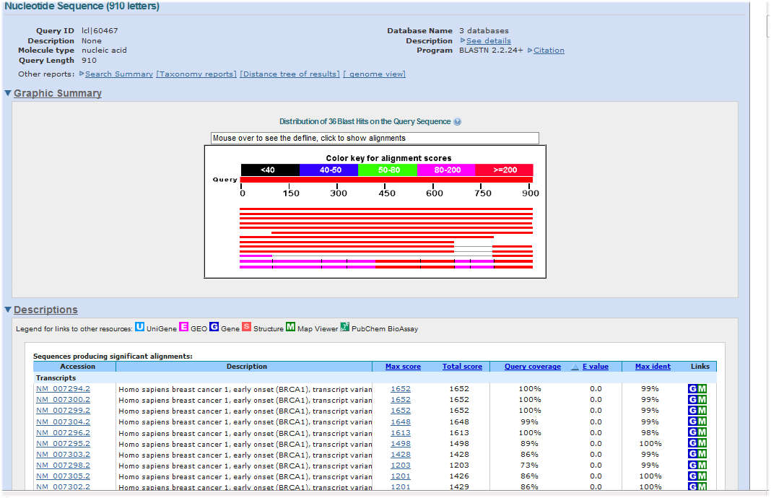
Question
Could you recall the procedure of a BLAST job to achieve the BLAST alignment results? And what does NCBI provide?
Notes:
Collect sequences to form a database
Provide a searching algorithm
Display the searching result

Slide 26
BLAST+
BLAST was first introduced by NCBI in 1989.
NCBI introduced BLAST+ in 2009, which is faster and allows more flexibility in output formats and in the search input.
It provides a variety of BLAST functions for both DNA and protein sequences.
For example:
blastp | Traditional BLASTP to compare a protein query to a protein database
blastn | Traditional BLASTN requiring an exact match of 11

Slide 27
BLAST algorithm
1. Make k-tuple words (seeds) of the query sequence.
CTGTTGCTCGTCTCGGGACTGT
CTG
TGT
GTT
…
2. List possible matching words for each k-tuple word & remove low-scoring words
k mismatch
CTG 0
ATG 1
TTG 1 high-scoring words
GTG 1
CAG 1
…
AAG 2
…

Slide 28
BLAST algorithm
3. Compare the high-scoring words to the database sequences to identify exact matches
k mismatch
CTG 0
ATG 1
TTG 1 high-scoring words
GTG 1
CAG 1
…
AAG 2
…
Database sequence
HSP
4. Extend the exact matches to both directions on the database sequences to obtain high-scoring segment pairs (HSPs)

Slide 29
Command line based BLAST
Step 1:
Computer/server
Install the “BLAST+” software package
Make databases of collected sequences
Step 2:
Run BLAST searching with your query sequences on the server

Slide 30
Step 1: Create a database
makeblastdb
A program to create a BLAST database
makeblastdb –in MG1655.fasta -out MG1655 -dbtype nucl
Database files were generated:
---output---
MG1655.nhr
MG1655.nin
MG1655.nsq
...

Slide 31
Step 2: BLAST a query to a DNA database
blastn
blastn -query MG1655dnaseq.fa –db MG1655
---output---
Query= MG1655_partial
Length=280
Score E
Sequences producing significant alignments: (Bits) Value
gi|556503834|ref|NC_000913.3| Escherichia coli str. K-12 substr... 518 1e-147
> gi|556503834|ref|NC_000913.3| Escherichia coli str. K-12 substr.
MG1655, complete genome
Length=4641652
Score = 518 bits (280), Expect = 1e-147
Identities = 280/280 (100%), Gaps = 0/280 (0%)
Strand=Plus/Plus
Query 1 TAGAAAATGCCCATGGCAAGAATAATACCGTCCAGAGCGAAATAACCCACGTTGTGCAGG 60
||||||||||||||||||||||||||||||||||||||||||||||||||||||||||||
Sbjct 10361 TAGAAAATGCCCATGGCAAGAATAATACCGTCCAGAGCGAAATAACCCACGTTGTGCAGG 10420
Query 61 TTAAGCAGAATGGTGGTCATGCCGAAGCCCATCAGGCCCAGCGGTGCCGGATTAGCCAAC 120
||||||||||||||||||||||||||||||||||||||||||||||||||||||||||||
Sbjct 10421 TTAAGCAGAATGGTGGTCATGCCGAAGCCCATCAGGCCCAGCGGTGCCGGATTAGCCAAC 10480
Query 121 TTAGTGTTGCCCATAATTCCTCAAAAATCATCATCGAATGAATGGTGAAATAATTTCCCT 180
||||||||||||||||||||||||||||||||||||||||||||||||||||||||||||
Sbjct 10481 TTAGTGTTGCCCATAATTCCTCAAAAATCATCATCGAATGAATGGTGAAATAATTTCCCT 10540
Query 181 GAATAACTGTAGTGTTTTCAGGGCGCGGCATAATAATCAGCCAGTGGGGCAGTGTCTACG 240
||||||||||||||||||||||||||||||||||||||||||||||||||||||||||||
Sbjct 10541 GAATAACTGTAGTGTTTTCAGGGCGCGGCATAATAATCAGCCAGTGGGGCAGTGTCTACG 10600
Query 241 ATCTTTTGAGGGGAAAATGAAAATTTTCCCCGGTTTCCGG 280
||||||||||||||||||||||||||||||||||||||||
Sbjct 10601 ATCTTTTGAGGGGAAAATGAAAATTTTCCCCGGTTTCCGG 10640

Slide 32
Select output format
blastn -query MG1655dnaseq.fa –db MG1655 –outfmt 6
query id | subject id | % identity | alignment length | mismatches | gap opens | q. start | q. end | s. start | s. end | evalue | bit score
MG1655_partial | gi|556503834|ref|NC_000913.3| | 100 | 280 | 0 | 0 | 1 | 280 | 10361 | 10640 | 1.00E-147 | 518

Slide 33
E-value
Score = 518 bits (280), Expect = 1e-147
Identities = 280/280 (100%), Gaps = 0/280 (0%)
Strand=Plus/Plus
Query 1 TAGAAAATGCCCATGGCAAGAATAATACCGTCCAGAGCGAAATAACCCACGTTGTGCAGG 60
||||||||||||||||||||||||||||||||||||||||||||||||||||||||||||
Sbjct 10361 TAGAAAATGCCCATGGCAAGAATAATACCGTCCAGAGCGAAATAACCCACGTTGTGCAGG 10420
…
Query 241 ATCTTTTGAGGGGAAAATGAAAATTTTCCCCGGTTTCCGG 280
||||||||||||||||||||||||||||||||||||||||
Sbjct 10601 ATCTTTTGAGGGGAAAATGAAAATTTTCCCCGGTTTCCGG 10640
E-value is a parameter that describes the number of hits that one can "expect" to see by chance when searching a database of a particular size. It is used to describe the significance (instead of a p-value) of each sequence alignment hit.
E-value = 1: One match with a similar score would be obtained simply by chance in the database.
The lower the E-value, the more "significant" the match is.

Slide 34
Score and Bit scores
Score = 518 bits (280), Expect = 1e-147
Identities = 280/280 (100%), Gaps = 0/280 (0%)
Strand=Plus/Plus
Query 1 TAGAAAATGCCCATGGCAAGAATAATACCGTCCAGAGCGAAATAACCCACGTTGTGCAGG 60
||||||||||||||||||||||||||||||||||||||||||||||||||||||||||||
Sbjct 10361 TAGAAAATGCCCATGGCAAGAATAATACCGTCCAGAGCGAAATAACCCACGTTGTGCAGG 10420
…
Query 241 ATCTTTTGAGGGGAAAATGAAAATTTTCCCCGGTTTCCGG 280
||||||||||||||||||||||||||||||||||||||||
Sbjct 10601 ATCTTTTGAGGGGAAAATGAAAATTTTCCCCGGTTTCCGG 10640
In the context of sequence alignments, a score is a numerical value that describes the overall quality of an alignment.
The bit-score is a rescaled alignment score to indicate the alignment quality, which is independent of the size of the database.
The higher the score/bit-score, the better the alignment.
Notes:
bit score lets you estimate the magnitude of the search space you would have to
look through before you would expect to find an score as good as or better than this one by
chance.
Ex: If the bit-score is 30, you would have to score, on average, about 2^30 = 1 billion independent segment
pairs to find a score this score by chance. Each additional bit doubles the size of the search space.

Slide 35
E-value: how likely
Bitscore: how well

Slide 36
Extract sequences or subsequences
blastdbcmd
Extract sequences from the database
# Use Gi ID to search*
blastdbcmd –db MG1655 -entry 556503834 -range 150-220
---output---
>gi|556503834|ref|NC_000913.3|:150-220 Escherichia coli str. K-12 substr. MG1655, complete genome
AGCGCACAGACAGATAAAAATTACAGAGTACACAACATCCATGAAACGCATTAGCACCACCATTACCACCA

Slide 37
BLAST tools
blastp: protein blast search - protein to protein
blastx: search protein databases using a translated nucleotide query - DNA (tr) to protein
tblastn: search translated nucleotide databases using a protein query - protein to DNA (tr)
tblastx: search translated nucleotide databases using a translated nucleotide query – DNA (tr) to DNA (tr)
* tr: translated

Slide 38
Summary
Dot plot: a usual tool to compare two sequences
Dynamic alignment: a basic alignment approach
Command line BLAST: a commonly used tool

