Slide 1
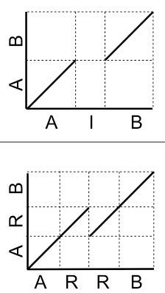
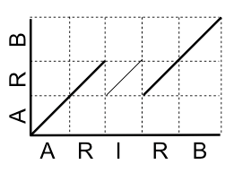
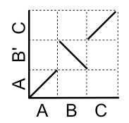
Dot-plots (examples)
Review
query is identical to reference and contains no repeats
query
deletion of "I" in query
reference
query
deletion of a "R" in query
reference
deletion of "IR" in query
Tandem repeats
query
inversion
reference

Slide 2
A classic algorithm – Smith-Waterman
Review
C T G T T G C T G C
T G C T G
Local alignment
List all possible alignments and to find the winner with the highest score?
Smith–Waterman (SW)
Using dynamic programming to find the best local alignment(s) between two sequences with respect to a scoring scheme
Notes:
• Dynamic programming is a method for solving optimization problems by breaking them down into smaller subproblems, solving each subproblem once, and storing the results to avoid redundant computations.
• It builds an optimal alignment score step by step by filling in a matrix (DP table).

Slide 3
Smith-Waterman
Review
 | j | 1 | 2 | 3 | 4 | 5 | 6 | 7 | 8 | 9
i |  |  | C | T | G | T | T | G | C | T
1 |  | 0 | 0 | 0 | 0 | 0 | 0 | 0 | 0 | 0
2 | A | 0 | 0 | 0 | 0 | 0 | 0 | 0 | 0 | 0
3 | T | 0 | 0 | 1 | 0 | 1 | 1 | 0 | 0 | 1
4 | G | 0 | 0 | 0 | 2 | 0 | 0 | 2 | 0 | 0
5 | C | 0 | 1 | 0 | 0 | 1 | 0 | 0 | 3 | 1
6 | T | 0 | 0 | 2 | 0 | 1 | 2 | 0 | 1 | 4
7 | G | 0 | 0 | 0 | 3 | 1 | 0 | 3 | 1 | 2
8 | C | 0 | 1 | 0 | 1 | 2 | 0 | 1 | 4 | 2
9 | A | 0 | 0 | 0 | 0 | 0 | 1 | 0 | 2 | 3
s: CTGTTGCT
||||
t: ATGCTGCA
s: CTGTTGCT
||||||
t: ATGCTGCA

Slide 4
BLAST+
Review
BLAST was first introduced by NCBI in 1989.
NCBI introduced BLAST+ in 2009, which is faster and allows more flexibility in output formats and in the search input.
It provides a variety of BLAST functions for both DNA and protein sequences.
For example:
blastp | Traditional BLASTP to compare a protein query to a protein database
blastn | Traditional BLASTN requiring an exact match of 11

Slide 5
E-value
Review
Score = 518 bits (280), Expect = 1e-147
Identities = 280/280 (100%), Gaps = 0/280 (0%)
Strand=Plus/Plus
Query 1 TAGAAAATGCCCATGGCAAGAATAATACCGTCCAGAGCGAAATAACCCACGTTGTGCAGG 60
||||||||||||||||||||||||||||||||||||||||||||||||||||||||||||
Sbjct 10361 TAGAAAATGCCCATGGCAAGAATAATACCGTCCAGAGCGAAATAACCCACGTTGTGCAGG 10420
…
Query 241 ATCTTTTGAGGGGAAAATGAAAATTTTCCCCGGTTTCCGG 280
||||||||||||||||||||||||||||||||||||||||
Sbjct 10601 ATCTTTTGAGGGGAAAATGAAAATTTTCCCCGGTTTCCGG 10640
E-value is a parameter that describes the number of hits that one can "expect" to see by chance when searching a database of a particular size.

Slide 6
Score and Bit scores
Review
Score = 518 bits (280), Expect = 1e-147
Identities = 280/280 (100%), Gaps = 0/280 (0%)
Strand=Plus/Plus
Query 1 TAGAAAATGCCCATGGCAAGAATAATACCGTCCAGAGCGAAATAACCCACGTTGTGCAGG 60
||||||||||||||||||||||||||||||||||||||||||||||||||||||||||||
Sbjct 10361 TAGAAAATGCCCATGGCAAGAATAATACCGTCCAGAGCGAAATAACCCACGTTGTGCAGG 10420
…
Query 241 ATCTTTTGAGGGGAAAATGAAAATTTTCCCCGGTTTCCGG 280
||||||||||||||||||||||||||||||||||||||||
Sbjct 10601 ATCTTTTGAGGGGAAAATGAAAATTTTCCCCGGTTTCCGG 10640
The bit-score is a rescaled alignment score to indicate the alignment quality, which is independent of the size of the database.
Notes:
bit score lets you estimate the magnitude of the search space you would have to
look through before you would expect to find an score as good as or better than this one by
chance.
Ex: If the bit-score is 30, you would have to score, on average, about 2^30 = 1 billion independent segment
pairs to find a score this score by chance. Each additional bit doubles the size of the search space.

Slide 7
Extract sequences or subsequences
blastdbcmd
Extract sequences from the database
# Use Gi ID to search*
blastdbcmd –db MG1655 -entry 556503834 -range 150-220
---output---
>gi|556503834|ref|NC_000913.3|:150-220 Escherichia coli str. K-12 substr. MG1655, complete genome
AGCGCACAGACAGATAAAAATTACAGAGTACACAACATCCATGAAACGCATTAGCACCACCATTACCACCA

Slide 8
BLAST tools
blastp: protein blast search - protein to protein
blastx: search protein databases using a translated nucleotide query - DNA (tr) to protein
tblastn: search translated nucleotide databases using a protein query - protein to DNA (tr)
tblastx: search translated nucleotide databases using a translated nucleotide query – DNA (tr) to DNA (tr)
* tr: translated

Slide 9
Quality check and trimming of NGS read data Bioinformatics Applications (PLPTH813)
Sanzhen Liu
2/6/2025

Slide 10
Outline
Sequence data format
Sequence quality
Quality checking (fastQC)
Sequence data processing (seqtk)
Sequence trimming (trimmomatic)

Slide 11
FASTA
Sequence FASTA file
>SEQ_ID
ATCAACTGATGCATC
Quality FASTA file
>SEQ_ID
28 30 33 34 33 35 38 37 36 35 38 35 36 36 30

Slide 12
Quality score
Sequence FASTA file
>SEQ_ID
ATCAACTGATGCATC
Quality FASTA file
>SEQ_ID
28 30 33 34 33 35 38 37 36 35 38 35 36 36 30
Phred quality score
Q = -10 x log₁₀(p) p = 10^{-Q/10}
where Q is the quality score and p is the probability of error
What does “Q = 30” indicate?
What is the quality score of a base with p = 0.01?
Notes:
quality_scores <- c(28, 30, 33, 34, 33, 35, 38, 37, 36, 35, 38, 35, 36, 36, 30)
sanger_format <- sprintf("%X", quality_scores + 33)
rawToChar(as.raw(as.hexmode(sanger_format)))

Slide 13
FASTQ
Sequence FASTA file
>SEQ_ID
ATCAACTGATGCATC
Quality FASTA file
>SEQ_ID
28 30 33 34 33 35 38 37 36 35 38 35 36 36 30
FASTQ
@SEQ_ID
ATCAACTGATGCATC
+SEQ_ID
=?BCBDGFEDGDEE?
@Sequence name
Sequence
+Sequence name or +
Quality
Notes:
quality_scores <- c(28, 30, 33, 34, 33, 35, 38, 37, 36, 35, 38, 35, 36, 36, 30)
sanger_format <- sprintf("%X", quality_scores + 33)
rawToChar(as.raw(as.hexmode(sanger_format)))

Slide 14
Convert quality score to characters (ASCII Table)
# | ASCII | # | ASCII | # | ASCII | # | ASCII | # | ASCII | # | ASCII | # | ASCII | # | ASCII
0 | null | 16 | data link escape | 32 | space | 48 | 0 | 64 | @ | 80 | P | 96 | ` | 112 | p
1 | start of header | 17 | device control 1/Xon | 33 | ! | 49 | 1 | 65 | A | 81 | Q | 97 | a | 113 | q
2 | start of text | 18 | device control 2 | 34 | " | 50 | 2 | 66 | B | 82 | R | 98 | b | 114 | r
3 | end of text | 19 | device control 3/Xoff | 35 | # | 51 | 3 | 67 | C | 83 | S | 99 | c | 115 | s
4 | end of transmission | 20 | device control 4 | 36 | $ | 52 | 4 | 68 | D | 84 | T | 100 | d | 116 | t
5 | enquire | 21 | negative acknowledge | 37 | % | 53 | 5 | 69 | E | 85 | U | 101 | e | 117 | u
6 | acknowledge | 22 | synchronous idle | 38 | & | 54 | 6 | 70 | F | 86 | V | 102 | f | 118 | v
7 | bell | 23 | end of transmission block | 39 | ' | 55 | 7 | 71 | G | 87 | W | 103 | g | 119 | w
8 | backspace | 24 | cancel | 40 | ( | 56 | 8 | 72 | H | 88 | X | 104 | h | 120 | x
9 | horizontal tab | 25 | end of medium | 41 | ) | 57 | 9 | 73 | I | 89 | Y | 105 | i | 121 | y
10 | linefeed | 26 | end of file/ substitute | 42 | * | 58 | : | 74 | J | 90 | Z | 106 | j | 122 | z
11 | vertical tab | 27 | escape | 43 | + | 59 | ; | 75 | K | 91 | [ | 107 | k | 123 | {
12 | form feed | 28 | file separator | 44 | , | 60 | < | 76 | L | 92 | \ | 108 | l | 124 | |
13 | carriage return | 29 | group separator | 45 | - | 61 | = | 77 | M | 93 | ] | 109 | m | 125 | }
14 | shift out | 30 | record separator | 46 | . | 62 | > | 78 | N | 94 | ^ | 110 | n | 126 | ~
15 | shift in | 31 | unit separator | 47 | / | 63 | ? | 79 | O | 95 | _ | 111 | o | 127 | DEL

Slide 15
Quality codes in FASTQ
!"#$%&'()*+,-./0123456789:;<=>?@ABCDEFGHIJKLMNOPQRSTUVWXYZ[\]^_`abcdefghijklmnopqrstuvwxyz{|}~
| | | | | |
33 59 64 73 104 126
0........................26...31.......40
Sanger Phred+33
raw reads typically (0, 40)
Source: en.wikipedia.org/wiki/FASTQ_format
# | ASCII | # | ASCII | # | ASCII | # | ASCII
33 | ! | 48 | 0 | 63 | ? | 78 | N
34 | " | 49 | 1 | 64 | @ | 79 | O
35 | # | 50 | 2 | 65 | A | 80 | P
36 | $ | 51 | 3 | 66 | B | 81 | Q
37 | % | 52 | 4 | 67 | C | 82 | R
38 | & | 53 | 5 | 68 | D | 83 | S
39 | ' | 54 | 6 | 69 | E | 84 | T
40 | ( | 55 | 7 | 70 | F | 85 | U
41 | ) | 56 | 8 | 71 | G | 86 | V
42 | * | 57 | 9 | 72 | H | 87 | W
43 | + | 58 | : | 73 | I | 88 | X
44 | , | 59 | ; | 74 | J | 89 | Y
45 | - | 60 | < | 75 | K | 90 | Z
46 | . | 61 | = | 76 | L | 91 | [
47 | / | 62 | > | 77 | M | 92 | \
= ? B
28 30 33

Slide 16
FASTQ quantity could have different codes
!"#$%&'()*+,-./0123456789:;<=>?@ABCDEFGHIJKLMNOPQRSTUVWXYZ[\]^_`abcdefghijklmnopqrstuvwxyz{|}~
| | | | | |
33 59 64 73 104 126
0........................26...31.......40
0........9.............................40
0.2......................26...31.........41
Sanger Phred+33, raw reads typically (0, 40)
Illumina 1.3+ Phred+64, raw reads typically (0, 40)
Illumina 1.8+ Phred+33, raw reads typically (0, 41)

Slide 17
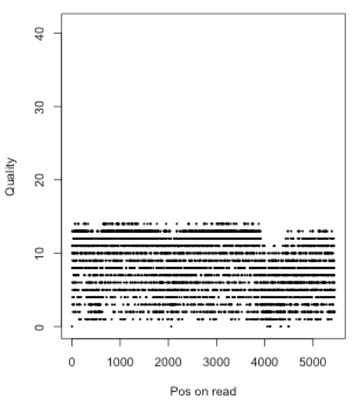
What platform was this read generated from?
Average quality?
Average probability of error rate?

Slide 18
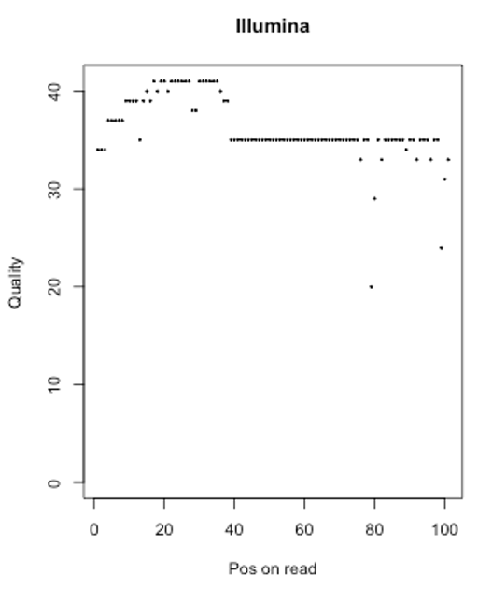
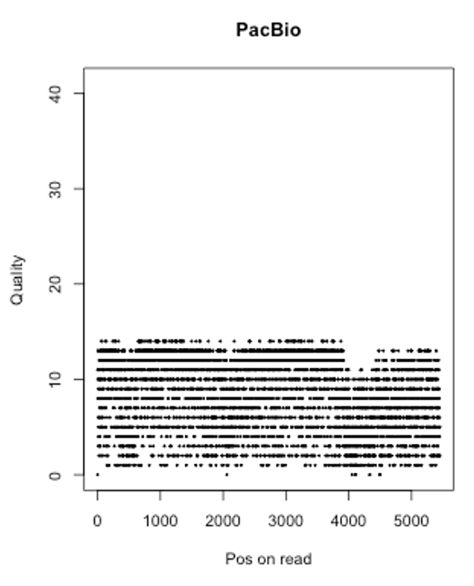
Typical reads in different platforms
Read length
Read quality

Slide 19
Illumina FASTQ
Single-end
Paired-end
@SEQ_ID
ATCAACTGATGCATC
+SEQ_ID
!''*((((***+))%
File1: forward seq
File2: reverse seq
@SEQ_ID/1
ATCAACTGATGCATC
+
!''*((((***+))%
@SEQ_ID/2
GATTTGGGGTTCCTG
+
)(%%%%).1***-+*

Slide 20
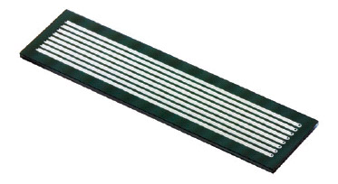
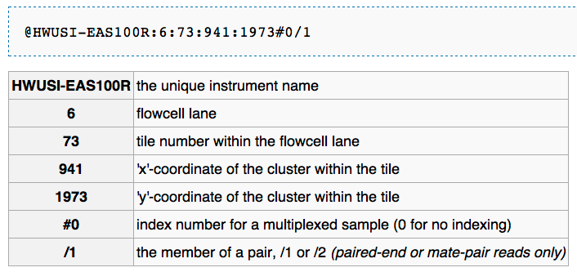

Illumina reads
Standard data format - FASTQ
@HWI-EAS100R:6:73:941:1973#0/1
GGGGGGAAGTCGGCAAAATAGATCCGTAACTTCGGG
+
a`abbbbabaabbababb^`[aaa`_N]b^ab^``a
Illumina Genome Analyzer

Slide 21
Overview sequencing data

Slide 22
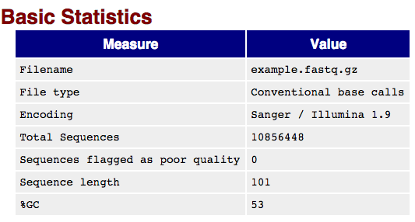
Data QC – FASTQC (I)
FASTQC is a tool to examine the quality of sequencing data
Easy to run: fastqc example.fastq
Rich output information
Output presented in the html format

Slide 23
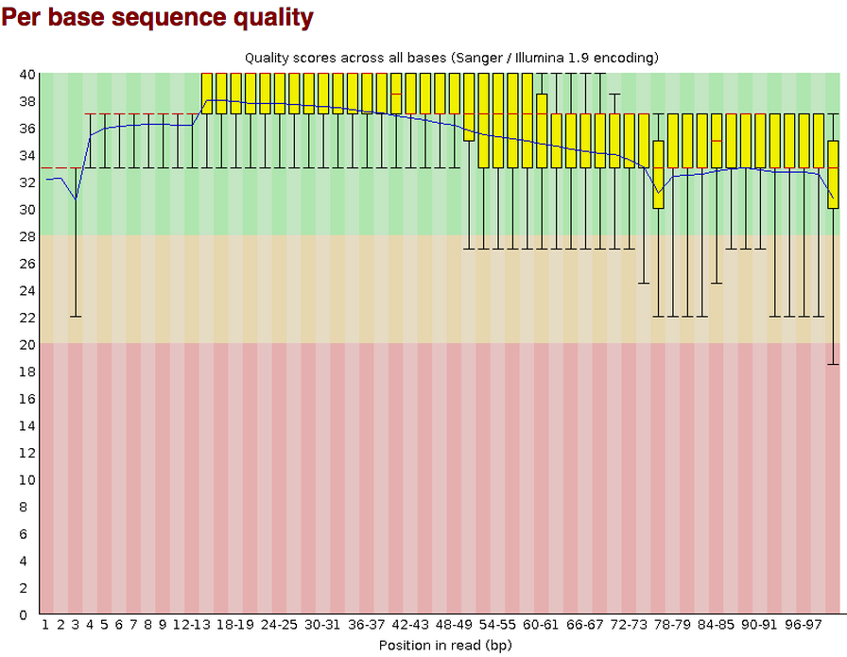
FASTQC (II)

Slide 24
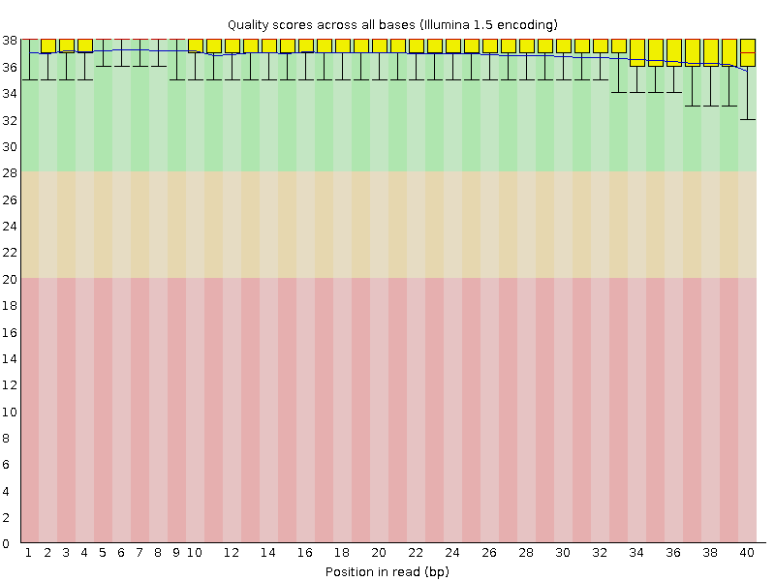
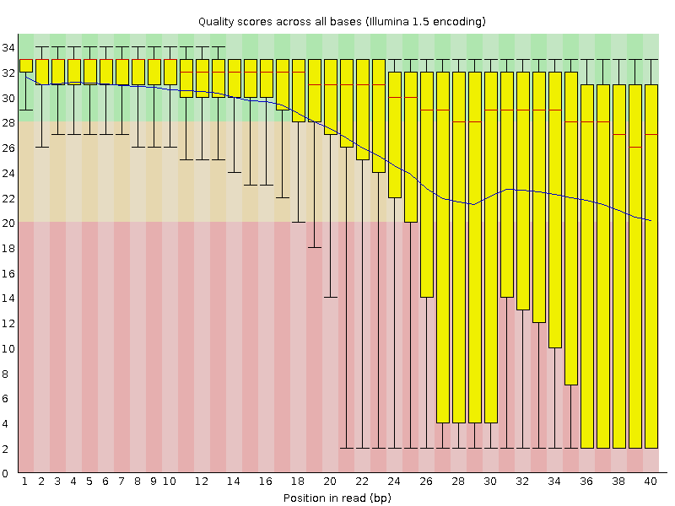
Good and Bad data
More information, please read:
http://www.bioinformatics.babraham.ac.uk/projects/fastqc/good_sequence_short_fastqc.html
http://www.bioinformatics.babraham.ac.uk/projects/fastqc/bad_sequence_fastqc.html

Slide 25
Tools for FAST[AQ] - seqtk
seqtk is a tool for processing sequences in the FASTA/Q format.
seq | common transformation of FASTA/Q
comp | get the nucleotide composition of FASTA/Q
sample | subsample sequences
subseq | extract subsequences from FASTA/Q
fqchk | fastq QC (base/quality summary)
mergepe | interleave two PE FASTA/Q files
trimfq | trim FASTQ using the Phred algorithm
hety | regional heterozygosity
gc | identify high- or low-GC regions
mutfa | point mutate FASTA at specified positions
mergefa | merge two FASTA/Q files
famask | apply a X-coded FASTA to a source FASTA
dropse | drop unpaired from interleaved PE FASTA/Q
rename | rename sequence names
…

Slide 26
seqtk examples (I)
Conversion of a FASTQ to a FASTA
seqtk seq -A in.fq > out.fa
seqtk seq -A in.fq.gz > out.fa
Reverse complement FASTA/Q:
seqtk seq -r in.fq > out.fq
Extract sequences with names in file name.lst, one sequence name per line:
seqtk subseq in.fq name.lst > out.fq
github.com/lh3/seqtk

Slide 27
seqtk examples (II)
Subsample 10,000 read pairs from two large paired FASTQ files
# remember to use the same random seed to keep pairing:
seqtk sample -s100 read1.fq 10000 > sub1.fq
seqtk sample -s100 read2.fq 10000 > sub2.fq
Trim 5bp from the left end of each read and 10bp from the right end:
seqtk trimfq -b 5 -e 10 in.fa > out.fa
Trim low-quality bases from both ends using the Phred algorithm:
seqtk trimfq in.fq > out.fq
Quality trimming
github.com/lh3/seqtk

Slide 28
Sequence trimming
Quality trimming: to remove low quality sequences
Adaptor trimming: to remove adaptor contamination

Slide 29
Quality trimming
Window scan method
the major steps in the quality trimming process involve calculating average quality within certain windows along the sequence
Sliding windows (window size and step size)
Maximum average errors (minimum average quality)
Average quality
Bioinformatics, 2001, 17:1093-1104

Slide 30
Quality trimming example
Window = 3 bp
Step = 1 bp
Minimum average quality score = 15
A | C | G | T | C | G | T | A | G
30 | 35 | 38 | 32 | 33 | 31 | 16 | 12 | 10
34
Clean read:
35
34
A | C | G | T | C | G
32
27
19
13

Slide 31
Adaptor contamination and trimming - SE
DNA fragment (or Insert)
Amplicon
Adaptor 1
Adaptor 2
SE read
Single-end (SE)
SE read

Slide 32
Adaptor contamination and trimming – PE
DNA fragment (or Insert)
Amplicon
Adaptor 1
Adaptor 2
Forward read
Reverse read
Paired-end (PE)
Forward read
Reverse read

Slide 33
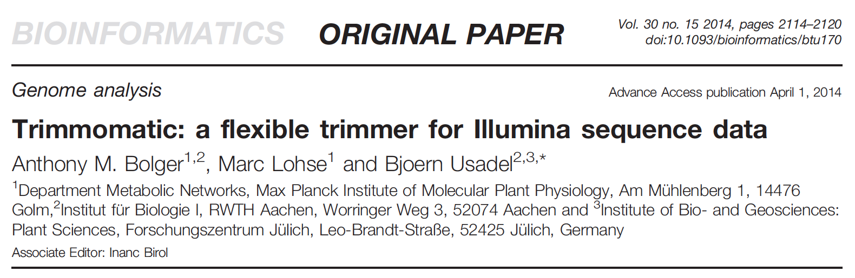
Trimmomatic – an innovative trimming tool

Slide 34
Trimmomatic – simple mode
Read 5’-3’
Read 5’-3’
If an alignment was identified, the alignment region plus the remainder after the alignment are removed.
Read 5’-3’
Read 5’-3’
Valid sequence
Trimmed sequence
Read 5’-3’
Notes:
In simple mode, each read is scanned from
the 5’ end to the 3’ end to determine if any of the user-provided
adapters are present. The standard ‘seed and extend’ approach
(Li and Homer, 2010) is used to find initial matches between the
technical sequences and the reads. The seed is not required to
match perfectly, and a user-defined number of mismatches are
tolerated. Based on this seed match, a local alignment is performed.
If the alignment score exceeds the user-defined threshold,
the aligned region plus the remainder after the alignment are
removed.

Slide 35
Simple mode: pro and cons
Simple mode has the advantage that it can detect any technical sequence at any location in the read, provided that the alignment is sufficiently long and the read is sufficiently accurate.
Issue: if the adaptor sequence on the read is too short to make the alignment, the adaptor sequence can not be trimmed.

Slide 36
Trimmomatic – panlindrome mode
the main algorithmic innovation is to identify adapter sequences through making use of paired information
Forward read
Reverse read
Forward read
Reverse read
Forward read
Reverse read
Notes:
Global alignment scoring is used to ensure an end-to-end match across the entire overlap

Slide 37
Trimmomatic – panlindrome mode
Forward read
Reverse read
A
B
C
D
Valid
Trimmed
Notes:
Global alignment scoring is used to ensure an end-to-end match across the entire overlap

Slide 38
Trimmomatic – panlindrome mode
Forward read
Reverse read
Three pre-required features:
1. both reads in a pair consist of an equal number of valid bases
2. the valid sequence of the two reads are reverse complements
3. the valid sequence of two read are followed by contaminating sequence from the “opposite” adapters
Forward read
Reverse read
Notes:
Global alignment scoring is used to ensure an end-to-end match across the entire overlap

Slide 39
Quality trimming in Trimmomatic
Sliding window quality trimming (SW)
Scan reads from the 5’ end of the read, and remove the 3’ end of the read when the average quality of a group of bases drops below a specified threshold.
Maximum Information (MI)
The trimming process becomes increasingly strict as it progresses through the read, rather than to apply a fixed quality threshold.

Slide 40
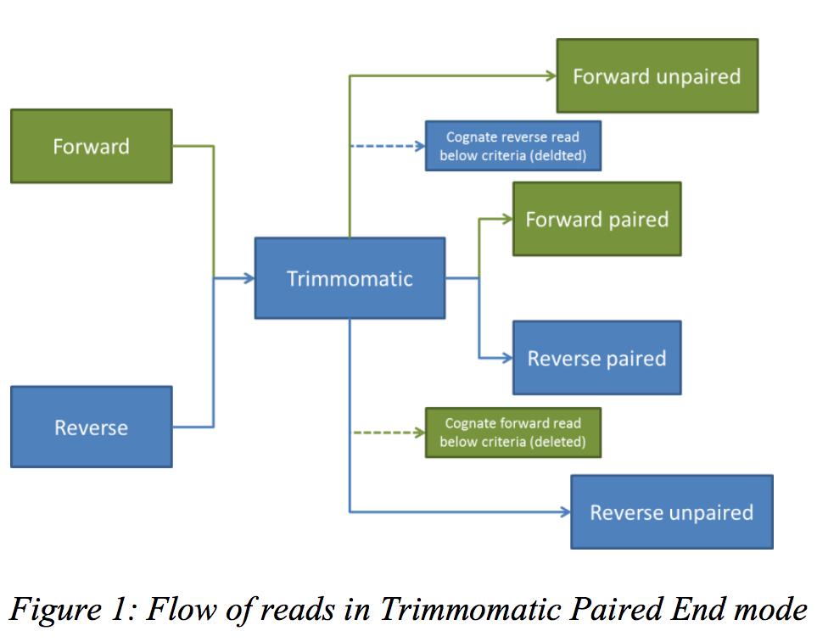
Output from Trimmomatic

Slide 41
Summary
FASTA and FASTQ
Sequence quality (Phred)
fastQC for quality checking
Trimmomatic for quality and adaptor trimming

Slide 42
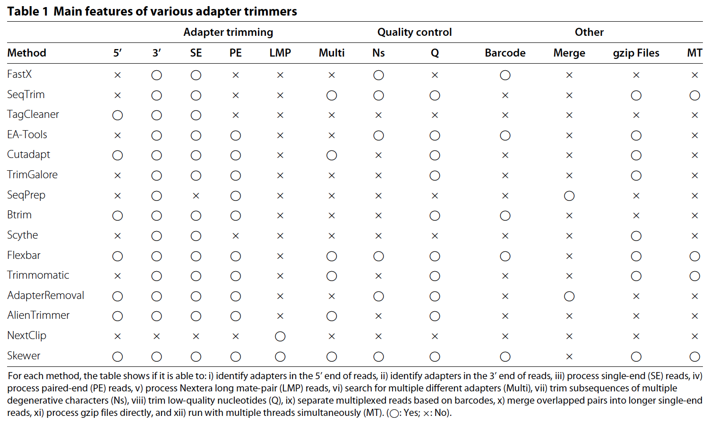
Comparison among trimming software packages

