Slide 1
QTL mapping and GWAS Bioinformatics Applications (PLPTH813)
Sanzhen Liu
4/17/2025

Slide 2
Goal of today’s lab
Perform QTL analysis with R/qtl
Perform GWAS analysis with GAPIT
Acknowledgements:
Some slides were prepared by Dr. Lei Li
QTL data from Dr. Karl W. Broman
GWAS data from Dr. Zhiwu Zhang

Slide 3
Working directories
In Beocat:
~/BA25/labs/lab10
~/BA25/labs/lab10/qtl
~/BA25/labs/lab10/gwas
~/BA25/labs/lab10/gwas/run1
~/BA25/labs/lab10/gwas/run2
~/BA25/labs/lab10/gwas/run3
mkdir ~/BA25/labs/lab10
cd ~/BA25/labs/lab10
mkdir qtl gwas
cd gwas
mkdir run1 run2 run3 run4

Slide 4
Install R/qtl
# install r/qtl package
install.packages("qtl")
library("qtl")
Note: If you have trouble to install the package in Rstudio, try installing it in the “terminal”.
module load R
R
install.packages("qtl")

Slide 5
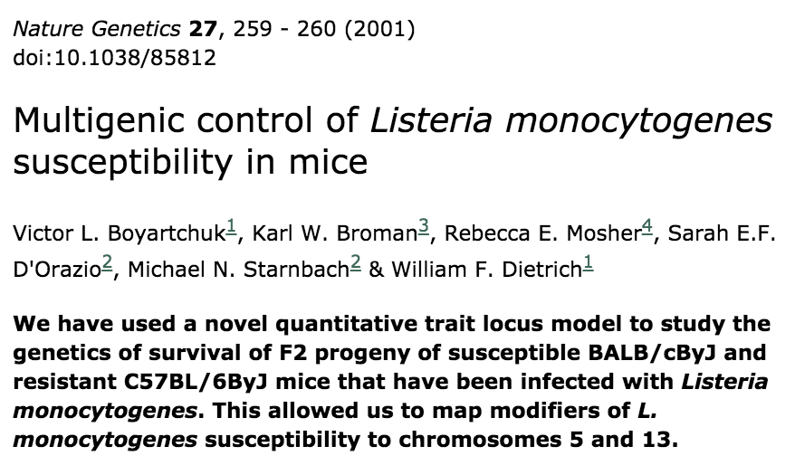
Data preparation

Slide 6
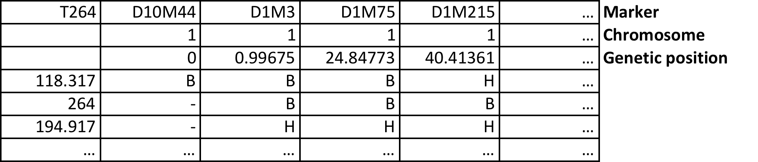
Data preparation
Phenotype

Slide 7
Read QTL data
# setup working directory
setwd("~/BA25/labs/lab10/qtl")
# read QTL data
qtl_data <- "http://www.rqtl.org/sampledata"
qtld <- read.cross(format = "csv",
dir = qtl_data,
file = "listeria.csv")

Slide 8
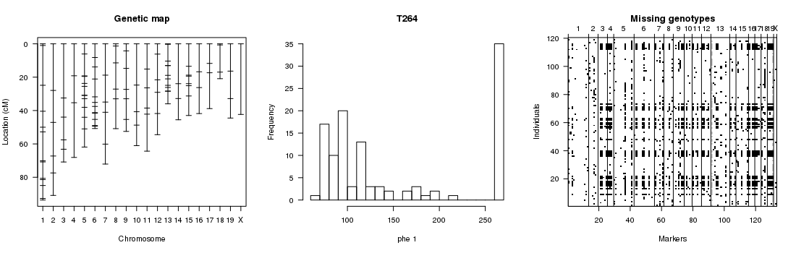
Check data
summary(qtld)
plotMap(qtld, show.marker.names = F)
plotPheno(qtld, pheno.col = 1)
plotMissing(qtld, reorder = TRUE)
# run the following scripts if "Shadow graphics device error" occurs:
options(bitmapType='cairo')
dev.off()

Slide 9
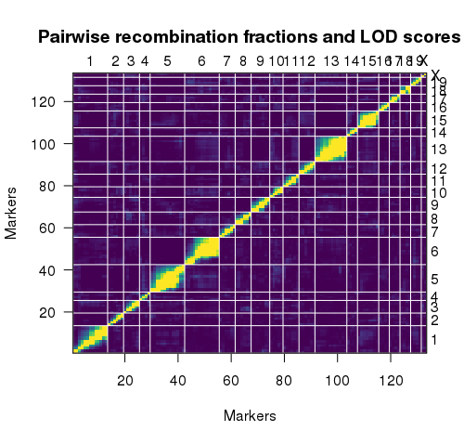
Recombination fractions
# estimate recombination fractions between all pairs of markers
qtld <- est.rf(qtld)
plotRF(qtld)
Upper left triangle:
recombination fractions (r)
Lower right triangle:
LOD scores for tests of r = 0.5

Slide 10
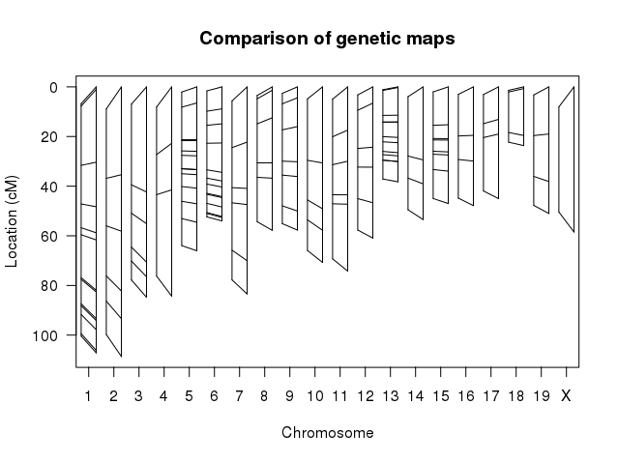
Construct a new genetic map
# Reconstruct a genetic map
newmap <- est.map(qtld, error.prob=0.01)
plotMap(qtld, newmap)
# Replace the genetic map with the new one
qtld <- replace.map(qtld, newmap)

Slide 11
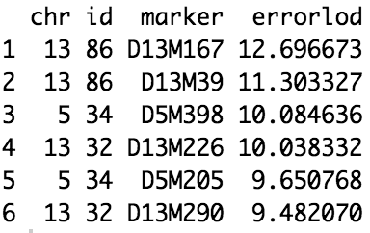
Identify genotypes that are likely wrong
# Calculate the error LOD score
qtld <- calc.errorlod(qtld, error.prob=0.01)
# List potential problematic markers
top.errorlod(qtld)

Slide 12
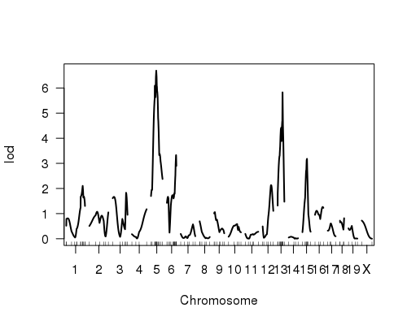
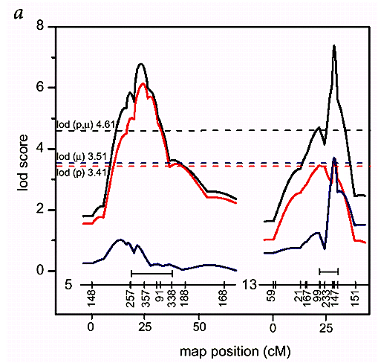
QTL mapping (interval mapping)
# determine probability of genotypes using multiple points data
qtld <- calc.genoprob(qtld, step=2, map.function="haldane")
# interval mapping
imqtl <- scanone(qtld, pheno.col=1, method="hk")
# plot
plot(imqtl)
Nature Genetics 27, 259 - 260 (2001)

Slide 13
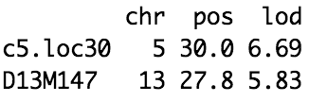
Permutation to determine a threshold
# QTL with permutation
imqtl.perm <- scanone(qtld, method="hk", n.perm=1000)
thresh1 <- summary(imqtl.perm , alpha=0.05)
# plot and highlight thresholds
plot(imqtl)
abline(h=thresh1, lty="dotted", col="red")
# summary
summary(imqtl, perm=imqtl.perm , alpha=0.05)

Slide 14
Problem 1
Change the Type I error threshold from 5% to 1% and draw the new threshold using the color of "orange"
# QTL with permutation
imqtl.perm <- scanone(qtld, method="hk", n.perm=1000)
thresh1 <- summary(imqtl.perm , alpha=0.05)
# plot and highlight thresholds
plot(imqtl)
abline(h=thresh1, lty="dotted", col="red")

Slide 15
Updated r/qrt
qtl2

Slide 16
Goal of today’s lab
Perform QTL analysis with R/qtl
Perform GWAS analysis with GAPIT

Slide 17
Installation of GAPIT3
install.packages("devtools")
devtools::install_github("jiabowang/GAPIT3",force=T)
library(GAPIT)
Note: If you have trouble for the installation, try this:
if (!require("BiocManager", quietly = TRUE))
install.packages("BiocManager")
BiocManager::install(c("snpStats", "rtracklayer", "GenomicRanges", "GenomInfoDb", "IRanges"))
devtools::install_github("SFUStatgen/LDheatmap")
devtools::install_github("jiabowang/GAPIT3",force=TRUE)
library(GAPIT)

Slide 18
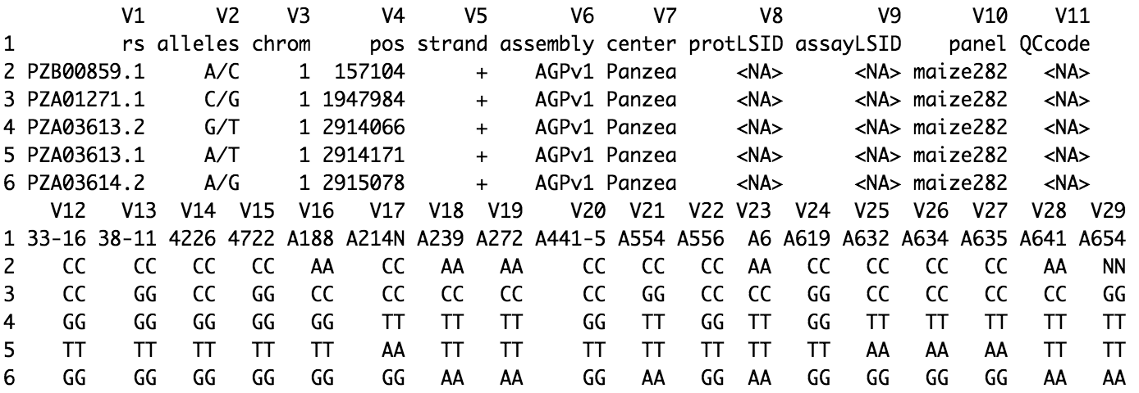
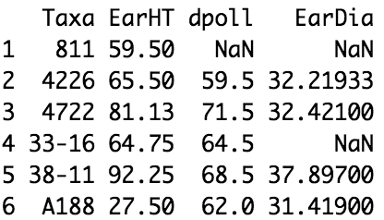
Prepare data for GAPIT
# setup working directory
setwd("~/BA25/labs/lab10/gwas/run1")
phenoFile <- system.file("extdata", "mdp_traits.txt.gz", package="GAPIT")
genoFile <- system.file("extdata", "mdp_genotype_test.hmp.txt.gz", package="GAPIT")
pheno <- read.table(phenoFile, header = TRUE)
geno <- read.table(genoFile, header = FALSE)

Slide 19
Q + K model using GAPIT
# step 2: Run GAPIT
library("GAPIT")
myGATIT <- GAPIT(Y=pheno[, 1:2],
G=geno,
PCA.total=3,
model="MLM")
Notes:
PCA.total refers to the number of principal components to include as covariates
MLM: Mixture Linear Model that include population structure and kinship

Slide 20
output result - I
# read an output file
out <- read.csv("GAPIT.Association.GWAS_Results.MLM.EarHT.csv")
out <- out[order(out$P.value), ]
head(out)
SNP | Chromosome | Position | P.value | maf | nobs | Rsquare.of.Model.without.SNP | Rsquare.of.Model.with.SNP | FDR_Adjusted_P.values | effect
PZA03188.4 | 1 | 280719882 | 0.000258998 | 0.28315412 | 279 | 0.2566854 | 0.2937205 | 0.5553945 | 1.88463
PZA03397.1 | 7 | 143547413 | 0.00035913 | 0.0125448 | 279 | 0.2566854 | 0.291982 | 0.5553945 | -1.176011
an1.5 | 1 | 175504926 | 0.001341724 | 0.38172043 | 279 | 0.2566854 | 0.2850641 | 1 | 2.589423
PZB01881.10 | 6 | 93263605 | 0.00212124 | 0.04301075 | 279 | 0.2566854 | 0.2826985 | 1 | NA
PZA03152.2 | 4 | 147044761 | 0.002350452 | 0.03584229 | 279 | 0.2566854 | 0.2821716 | 1 | 2.913919
PZA00277.9 | 2 | 141942814 | 0.002418229 | 0.19354839 | 279 | 0.2566854 | 0.2820258 | 1 | -1.284217

Slide 21
PCA - population structure
GAPIT.Genotype.PCA_2D.pdf

Slide 22
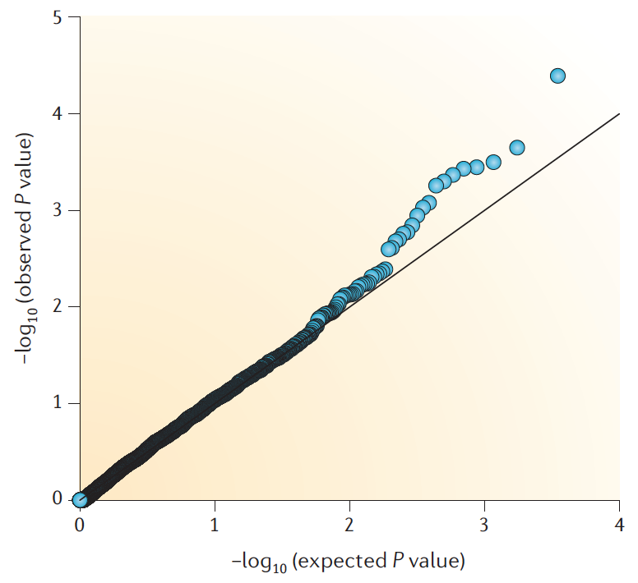
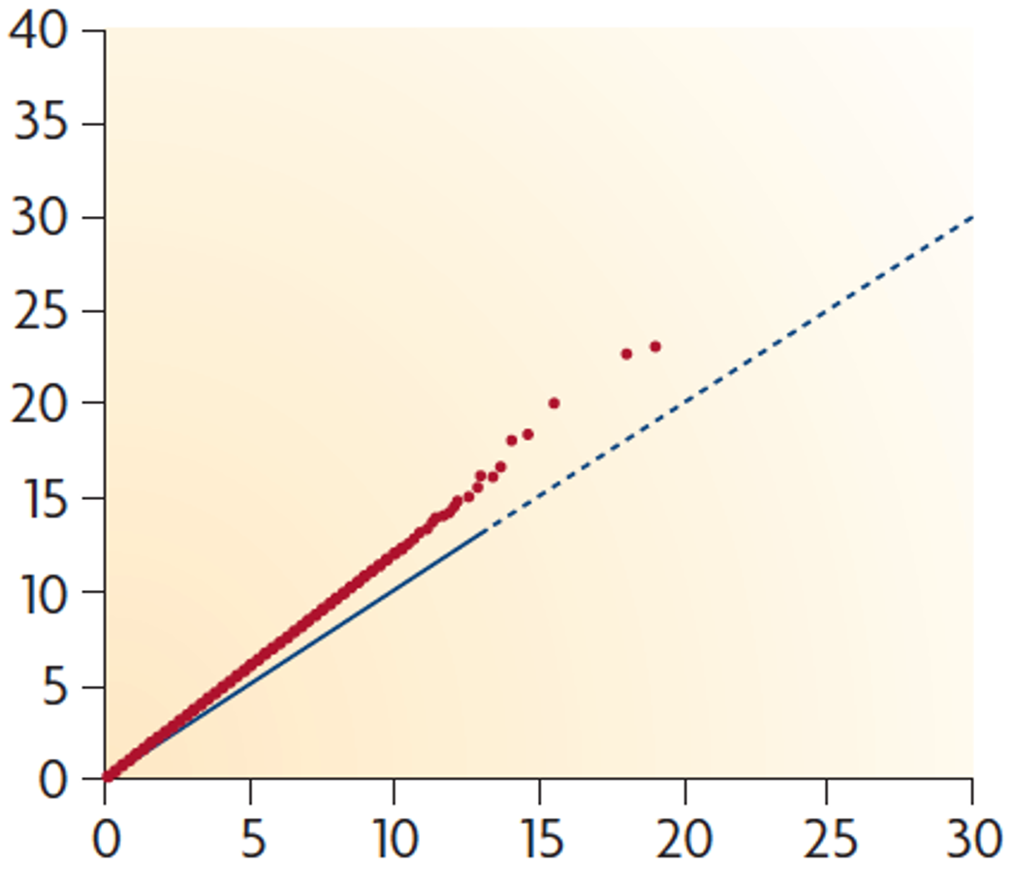
QQ plot
GAPIT.Association.QQ.MLM.EarHT.pdf

Slide 23
Manhattan plot
GAPIT.Association.Manhattan_Geno.MLM.EarHT.pdf

Slide 24
Problem 2 :Randomize the trait and run GAPIT
setwd("~/BA25/labs/lab10/gwas/run2")
# Randomize the trait and run GAPIT
random_pheno <- pheno[1]
random_pheno$RnEarHT <- sample(pheno[, 2])
…

Slide 25
Supply own data of population structure and kinship
# setup working directory
setwd("~/BA25/labs/lab10/gwas/run3")
# step 1: Set data directory and import files
dp <- "https://people.beocat.ksu.edu/~liu3zhen/PLPTH813/labs/QTLgwas"
myCV <- read.table(paste0(dp, "/Q_PCA3.txt"), header=T)
myKI <- read.table(paste0(dp, "/KSN.txt"), header=F)
# step 2: Run GAPIT
myGAPIT2 <- GAPIT(Y = pheno[, 1:2],
G = geno,
CV = myCV,
KI = myKI)

Slide 26
GAPIT with multiple models
# Run GAPIT with multiple models
setwd("~/BA25/labs/lab10/gwas/run4")
myGAPIT <- GAPIT(Y=pheno[, 1:3],
G=geno,
model=c("FarmCPU", "MLM"),
Multiple_analysis=TRUE)
the GAPIT guide

