Slide 1
Lab – DE Bioinformatics Applications (PLPTH813)
Sanzhen Liu
4/24/2025

Slide 2
Working directories
In Beocat:
~/BA25/labs/lab11
mkdir ~/BA25/labs/lab11

Slide 3
Install DESeq2
R code
if (!requireNamespace("BiocManager",quietly=T))
install.packages("BiocManager")
BiocManager::install("DESeq2")
Notes:
install.packages(“matrixStats”)
BiocManager::install("MatrixGenerics", "DelayedArray", "SummarizedExperiment")

Slide 4
Directories
Beocat terminal
mkdir ~/BA25/labs/lab11
cd ~/BA25/labs/lab11
mkdir 0_ref 1_raw 2_trim 3_aln 4_DE
0_ref
1_raw
2_trim
3_aln
4_DE

Slide 5
Codes for today’s lab
Beocat terminal
wget https://people.beocat.ksu.edu/~liu3zhen/PLPTH813/labs/DErun.tar.gz
tar -xf DErun.tar.gz

Slide 6
RNA-seq procedure
totalRNA
RNA to sequencing reads
1
sequencing
reads
reads to read counts per gene
QC, alignment
2
read counts
read counts to significant genes
statistical test
3
significance

Slide 7
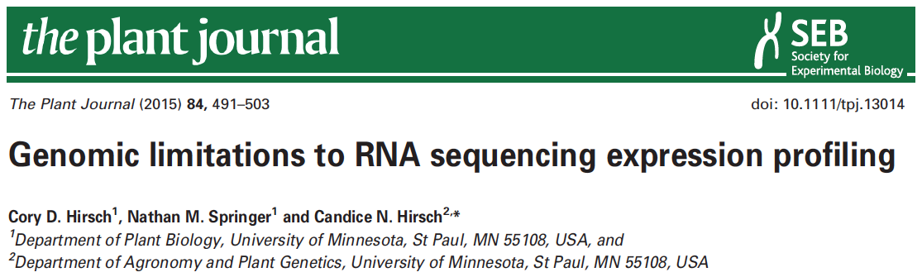

data information
SRR1238718
Makarevitch et al., 2015
Hirsch et al., 2016

Slide 8
Part I: Data downloading
Introduction of Sequence Read Archive (SRA) (2007)
Data download (SRA toolkit)
- fasterq-dump

Slide 9
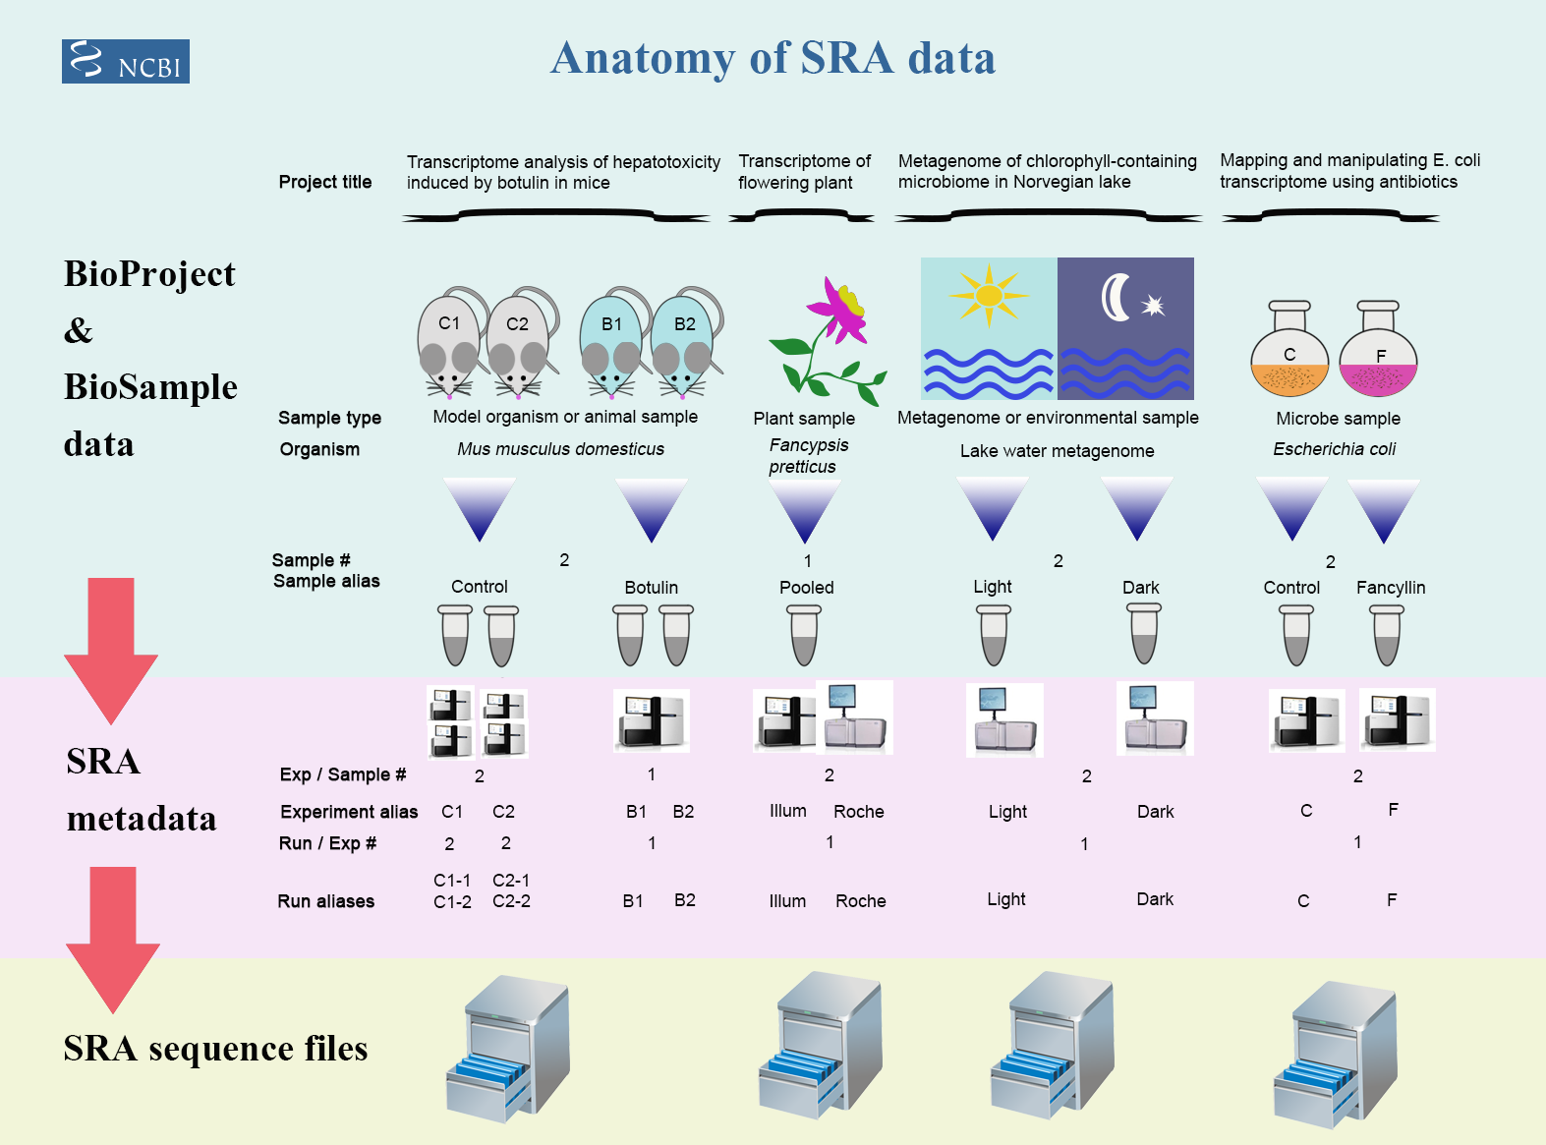
Framework of data submission

Slide 10
Metadata and sequence data
Study – a set of experiments with an overall goal
SRA Study accessions – SRP, DRP, or ERP
Experiment –laboratory operations on input material
SRA Experiment accessions – SRE, DRE, or ERE
Sample – An experiment targets one or more samples
SRA Sample accessions – SRS, DRS, or ERS
Run –the data gathered for a sample or sample bundle
SRA Run accessions – SRR, DRR, or ERR
Notes:
The SRA metadata describes the technical aspects of sequencing experiments: the sequencing libraries, preparation techniques and data files.

Slide 11
sra-toolkit
wget https://ftp-trace.ncbi.nlm.nih.gov/sra/sdk/3.2.1/sratoolkit.3.2.1-alma_linux64.tar.gz
tar -xf sratoolkit.3.2.1-alma_linux64.tar.gz
mv sratoolkit.3.2.1-alma_linux64 sratoolkit

Slide 12
format conversion - fastq-dump in Beocat
fasterq-dump [options] <accession>
#!/bin/bash -l
#SBATCH --mem-per-cpu=16G
#SBATCH --time=12:00:00
#SBATCH --nodes=1
#SBATCH –cpus-per-task=1
../utils/sratoolkit/bin/fasterq-dump
--split-files <accession>
../utils/sratoolkit/bin/fasterq-dump --split-files SRR1238718
SRR1238718_1.fastq
SRR1238718_2.fastq
No running
Notes:
# --split-files: write reads into different files

Slide 13
Beocat pipeline to download SRA in batch - I
# step 1: Prepare data: dataset.txt
Order | ID | Genotype | Sample | Treatment | Citation
1 | SRR1238718 | B73 | norm1 | norm | Hirsch2015TPJ
2 | SRR1819617 | B73 | norm2 | norm | Hirsch2015TPJ
3 | SRR1819621 | B73 | norm3 | norm | Hirsch2015TPJ
4 | SRR1238717 | B73 | cold1 | cold | Hirsch2015TPJ
5 | SRR1819204 | B73 | cold2 | cold | Hirsch2015TPJ
6 | SRR1819205 | B73 | cold3 | cold | Hirsch2015TPJ
Makarevitch et al., 2015
Hirsch et al., 2016

Slide 14
Beocat pipeline to download SRA in batch - II
# must check
meta_file=dataset.txt
srr_col=2
rename_col=4
# running
perl ../utils/scripts/fasterq_dump.sbatch.pl \
--in $meta_file \
--srrcol $srr_col
# create a script to rename downloaded files
cut $meta_file -f $srr_col,$rename_col | \
grep "^[EDS]RR" | \
sed 's/^/rename /g' | sed 's/\t/ /g' | \
sed 's/$/ *fastq/g’ > 2c_rename.sh
working directory: 1_raw
bash 1c_dn.sh

Slide 15
Beocat pipeline to download SRA in batch - III
# step 3: Check and run "rename.sh" to change names (optional)
After downloading is finished, …
bash 2c_rename.sh
# extract a subset for saving alignment time
bash 3c_subsample.sh
working directory: 1_raw

Slide 16
Part II. Trimming
perl ../utils/scripts/trimmomatic.sbatch.pl \
--mem 4G \
--time 1-00:00:00 \
--trim_shell "../utils/scripts/trimmomatic.pe.sh" \
--trimmomatic "../utils/Trimmomatic-0.38/trimmomatic-0.38.jar" \
--adaptor_file "../utils/Trimmomatic-0.38/adapters/TruSeq3-PE.fa" \
--indir "../1_raw" \
--outdir "." \
--fq1feature "_1.fastq" \
--fq2feature "_2.fastq" \
--threads 4 \
--min_len 40
working directory: 2_trim
bash 1c_trim.sh

Slide 17
Part II. Trimming: sbatch command
#!/bin/bash -l
#SBATCH --mem-per-cpu=4
#SBATCH --time=1-00:00:00
#SBATCH --cpus-per-task=4
module load Java
bash /homes/liu3zhen/local/slurm/trimmomatic/trimmomatic.pe.sh \
../utils/Trimmomatic-0.38/trimmomatic-0.38.jar \
../utils/Trimmomatic-0.38/adapters/TruSeq3-PE.fa \
../1_raw . _1.fastq _2.fastq 4 40 xxx.fastq
No running

Slide 18
RNA-Seq procedure
totalRNA
RNA to sequencing reads
1
sequencing
reads
reads to read counts per gene
QC, alignment
2
read counts
read counts to significant genes
statistical test
3
significance

Slide 19

STAR
as of 4/18/2021
High speed
Unbiased de novo detection of canonical junctions
discovery of non-canonical splices and chimeric transcripts
Capable of mapping full-length RNA sequences

Slide 20
STAR Reference genome indexing
sbatch 1c_star.index.sh
working directory: 0_ref
Index the reference genome with the annotation file
#!/bin/bash
#SBATCH --cpus-per-task=4
#SBATCH --mem-per-cpu=8g
#SBATCH --time=1-00:00:00
module load STAR
STAR --runThreadN 4 \
--runMode genomeGenerate \
--genomeDir "." \
--genomeFastaFiles B73v5.fasta \
--sjdbGTFfile B73v5.gtf \
--sjdbOverhang 100
Notes:
NOTE: In case of reads of varying length, the ideal value for --sjdbOverhang is max(ReadLength)-1. In most cases, the default value of 100 will work similarly to the ideal value.
9814814 1c_star.in wizard24 1 n 4 c 29.74gb/ 32gb 00:47:06 COMPLETED

Slide 21
Part III. STAR: sbatch script (one sample)
module load STAR
STAR --runThreadN 1 \
--genomeDir /homes/liu3zhen/teaching/datasets/DE/0-ref \
--readFilesIn ../2_trim/cold1.R1.pair.fq ../2_trim/cold1.R2.pair.fq \
--alignIntronMax 100000 \
--alignMatesGapMax 100000 \
--outFileNamePrefix cold1 \
--outSAMattrIHstart 0 \
--outSAMmultNmax 1 \
--outSAMstrandField intronMotif \
--outFilterIntronMotifs RemoveNoncanonicalUnannotated \
--outSAMtype BAM SortedByCoordinate \
--quantMode GeneCounts \
--outFilterMismatchNmax 1 \
--outFilterMismatchNoverLmax 0.02 \
--outFilterMatchNmin 40 \
--outSJfilterReads Unique \
--outFilterMultimapNmax 1 \
--outFilterMultimapScoreRange 2
No running

Slide 22
Part III. STAR: generate sbatch scripts and submit jobs
module load STAR
perl ../utils/scripts/STAR.module.sbatch.pl \
--mem 48 --threads 1 --time 12:00:00 \
--indir ../2_trim \
--dbdir ../0_ref \
--fq1feature .R1.pair.fq \
--fq2feature .R2.pair.fq \
--alignIntronMax 100000 \
--alignMatesGapMax 100000 \
--outSAMattrIHstart 0 \
--outSAMmultNmax 1 \
--outSAMstrandField intronMotif \
--outFilterIntronMotifs RemoveNoncanonicalUnannotated \
--outSAMtype "BAM SortedByCoordinate" \
--quantMode GeneCounts \
--outFilterMismatchNmax 1 \
--outFilterMismatchNoverLmax 0.05 \
--outFilterMatchNmin 40 \
--outSJfilterReads Unique \
--outFilterMultimapNmax 1 \
--outFilterMultimapScoreRange 2
working directory: 3_aln
No running

Slide 23
Part III. STAR: to generate sbatch scripts and submit jobs
module load STAR
perl ../utils/scripts/STAR.module.sbatch.pl \
--mem 48 --threads 1 --time 12:00:00 \
--indir ../../2_trim \
--dbdir ../../0_ref \
--fq1feature .R1.pair.fq \
--fq2feature .R2.pair.fq \
--alignIntronMax 100000 \
--alignMatesGapMax 100000 \
--outSAMattrIHstart 0 \
--outSAMmultNmax 1 \
--outSAMstrandField intronMotif \
--outFilterIntronMotifs RemoveNoncanonicalUnannotated \
--outSAMtype "BAM SortedByCoordinate" \
--quantMode GeneCounts \
--outFilterMismatchNmax 1 \
--outFilterMismatchNoverLmax 0.05 \
--outFilterMatchNmin 40 \
--outSJfilterReads Unique \
--outFilterMultimapNmax 1 \
--outFilterMultimapScoreRange 2
Working directory: 3_aln/testrun/
bash 1c_star.sh

Slide 24
STAR output – cold1 sample
cold1Aligned.sortedByCoord.out.bam
cold1Log.final.out
cold1Log.out
cold1Log.progress.out
cold1ReadsPerGene.out.tab
cold1SJ.out.tab

Slide 25
Install DESeq2
R code
if (!requireNamespace("BiocManager",quietly=T))
install.packages("BiocManager")
BiocManager::install("DESeq2")
Notes:
install.packages(“matrixStats”)
BiocManager::install("MatrixGenerics", "DelayedArray", "SummarizedExperiment")

Slide 26
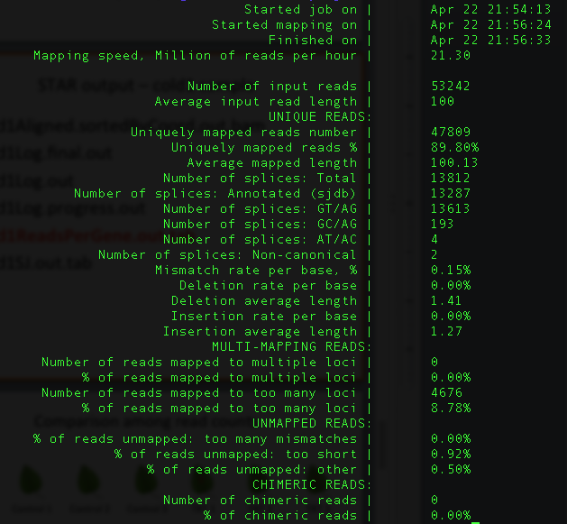
cold1Log.final.out

Slide 27
cold1ReadsPerGene.out.tab
column 1: gene ID
column 2: counts for unstranded RNA-seq
column 3: counts for the 1st read strand aligned with RNA (htseq-count option -s yes)
column 4: counts for the 2nd read strand aligned with RNA (htseq-count option -s reverse)
Notes:
https://github.com/alexdobin/STAR/issues/703
N_multimapping is the total number of multimapping reads, which are not counted at all, so the number is the same for each column. N_noFeature: if a read overlaps a gene on the opposite strand, it will be counted as noFeature for one of the stranded columns, but will be counted towards the gene (and not as noFeature) in the unstranded column. Hence N_noFeature(unstranded) can be < N_noFeature(+) + N_noFeature(-).
https://groups.google.com/g/rna-star/c/qFLxINhF7cI/m/D0v-BRtpDAAJ?pli=1
if exons of these two genes overlap completely on *opposite* strands, the unstranded counting will yield 0 - all the reads will be considered "ambiguous".
The stranded counts, however, will be done towards the correspodning gene.
The easiest way to check this is to view annotations on a genome browser.

Slide 28
RNA-Seq procedure
totalRNA
RNA to sequencing reads
1
sequencing
reads
reads to read counts per gene
QC, alignment
2
read counts
read counts to significant genes
statistical test
3
significance

Slide 29
R codes for differential expression analysis
4_DE/1c_de.R

Slide 30
Part IV. DE: merge counting data
R code
setwd("xxx/4_DE")
library("DESeq2")
### Parameters - Subject to change
datapath <- "../3_aln"
suffix <- "ReadsPerGene.out.tab"
count.files <- dir(path = datapath, pattern = suffix)

Slide 31
Part IV. DE: merge counting data
### merge all counts
allcounts <- NULL
for (cf in count.files) {
counts <- read.delim(paste0(datapath, "/", cf), header = F,
stringsAsFactors = F, skip = 4)
base <- gsub(suffix, "", cf)
counts <- counts[, 1:2]
colnames(counts) <- c("Gene", base)
### merge data
if (is.null(allcounts)) {
allcounts <- counts
} else {
allcounts <- merge(allcounts, counts, by = "Gene")
}
}
R code

Slide 32
data preparation for DESeq2 - I
R code
# count information
geneid <- allcounts$Gene
in.data <- allcounts[, 2:7]
in.data <- as.matrix(in.data)
rownames(in.data) <- geneid

Slide 33
data preparation for DESeq2 - II
R code
# sample names and grouping information (treatment)
sample.ids <- colnames(in.data)
treatment <- c("cold", "cold", "cold", "norm", "norm", "norm")
sample.info <- data.frame(row.names=sample.ids, trt=treatment)
dds <- DESeqDataSetFromMatrix(countData=in.data,
colData=sample.info, formula(~trt))
dds <- DESeq(dds, "Wald")

Slide 34
Wald test
Wald test is the default method in DESeq2 when comparing two groups.
DESeq2 implements the Wald test by:
Divide LFC (log2 fold change) by its standard error to obtain a z-statistic
The z-statistic is compared to a standard normal distribution, and a p-value is computed

Slide 35
Part V. DE using a developed function - I
R
### load modules
source("../utils/scripts/DESeq2.single.trt.R")
source("../utils/scripts/DE.summary.R")
### DE parameters
fdr.cutoff <- 0.05
# data reformat:
input <- allcounts[, 2:7]
rownames(input) <- allcounts[, 1]

Slide 36
Part V. DE using a developed function - II
R
# DE statistical analysis:
DE.out <- DESeq2.single.trt(input.matrix = input,
min.mean.reads = 5,
group1.col = 1:3,
group2.col = 4:6,
comparison = c("norm", "cold"),
geneID = rownames(input),
fdr = fdr.cutoff,
logpath = ".",
logfile = "cold-norm.log.md")

Slide 37
Part V. DE using a developed function - III
R
# merge DE with counts and output DE result:
DE.out <- data.frame(DE.out)
final.out <- merge(allcounts, DE.out,
by.x = "Gene",
by.y = "GeneID")
write.table(final.out, "cold-norm.DESeq2.txt",
sep="\t", quote=F, row.names=F)

Slide 38
DE output

Slide 39
Part VI. DE summary
R
de.summary <- DE.summary(DE.path=".",
DE.files="cold-norm.DESeq2.txt",
qval.feature=".qval",
log2FC.feature=".log2FC",
fdr=fdr.cutoff,
out.path=".",
out.file="cold-norm.DESeq2.summary.txt")

Slide 40
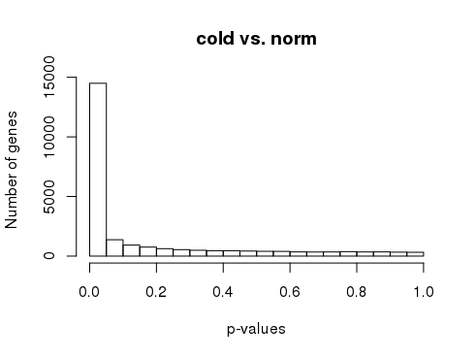
p-values
R
# p-value histogram
hist(DE.out$cold_norm.pval, xlab = "p-values",
ylab = "Number of genes", main = "cold vs. norm")

