Slide 1
Design of RNA-Seq and Result Interpretation (II)
Sanzhen Liu
Department of Plant Pathology
Kansas State University
@K-State IGF RNA-Seq Workshop (PLPTH885)
6/7/2018

Slide 2
Bioinformatics and Statistics (Illumina data)
reads (fastq read data)
alignment (GSNAP, STAR, or others)
Bioinformatics
read counts (HT-Seq, STAR)
statistical test (DESeq2, edgeR, or others)
q-values (FDR method)
Statistical analysis
significance

Slide 3
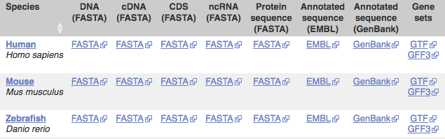
STAR pipeline – from reads to counts
Required files:
Reference genome (fasta file)
Gene information (gff or gtf gene annotation)
Reads (fastq files) – your own data
Many reference genomes and gff/gtf files are available at:
http://ensembl.org/info/data/ftp

Slide 4
Reads to counts - reference indexing
Reference genome sequences
“sorted or indexed” genome
one by one
one by one
reads
alignments
reads
alignments
STAR --runMode genomeGenerate \
--genomeDir . \
--genomeFastaFiles reference.fas \
--sjdbGTFfile genes.gtf \
--runThreadN 48

Slide 5
Reads to counts – alignment and read counting
STAR --genomeDir reference.fas \
--readFilesIn read1.fq read2.fq \
--alignIntronMax 100000 \
--alignMatesGapMax 100000 \
--outFileNamePrefix output \
--outSAMattrIHstart 0 \
--outSAMmultNmax 1 \
--outSAMstrandField intronMotif \
--outFilterIntronMotifs RemoveNoncanonicalUnannotated \
--outSAMtype BAM SortedByCoordinate \
--quantMode GeneCounts \
--outFilterMismatchNmax 5 \
--outFilterMismatchNoverLmax 0.05 \
--outFilterMatchNmin 50 \
--outSJfilterReads Unique \
--outFilterMultimapNmax 1 \
--outSAMmapqUnique 60 \
--outFilterMultimapScoreRange 2

Slide 6
Count matrix: Read counts (Raw) per gene
Gene | sample 1
gene 1 | 6,075
gene 2 | 295
... | ...
sample 2 | sample 3
5,934 | 3,370
377 | 169
... | ...

Slide 7
Overall difference of read counts among samples

Slide 8
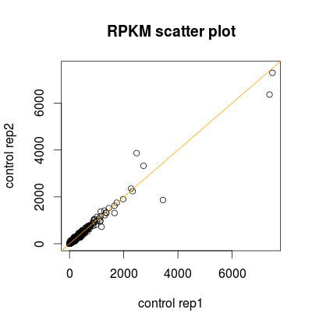
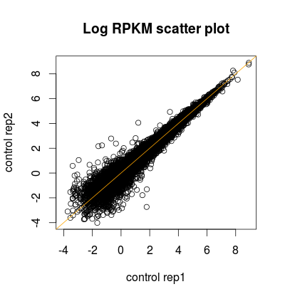
Scatter plot

Slide 9
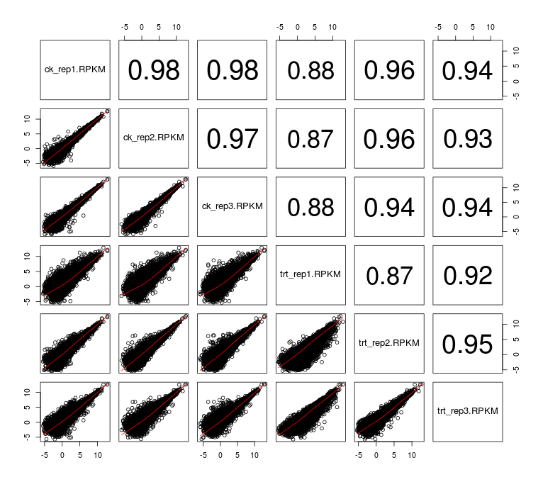
Pair-wise scatter plot

Slide 10
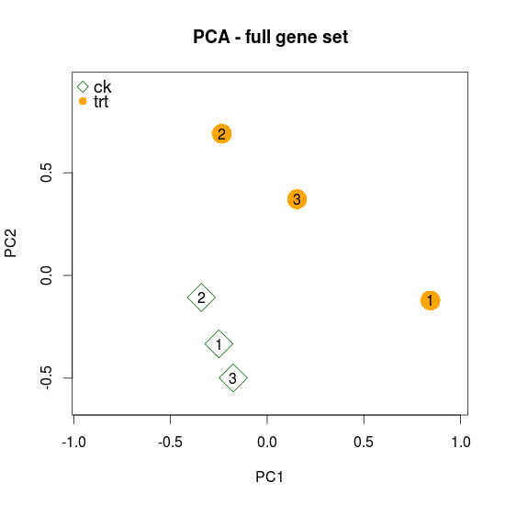
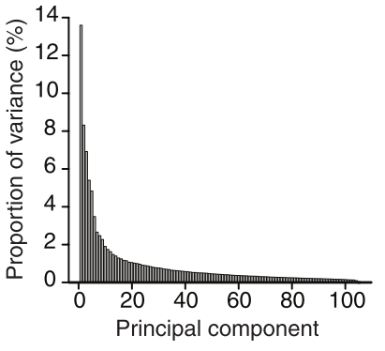
Principal Component Analysis (PCA)
PCA is a mathematical algorithm that reduces the dimensionality of the data while retaining most of the variation in the data set.
 | Control |  |  | Treatment
GeneID | Rep1 | Rep2 | Rep3 | Rep1 | Rep2 | Rep3
1 | 2679 | 2360 | 2573 | 2563 | 3398 | 3012
2 | 177 | 161 | 171 | 154 | 137 | 152
3 | 381 | 371 | 397 | 541 | 723 | 635
…
30000 | 990 | 1073 | 1236 | 850 | 672 | 859
Feature/variable | John | Mike | Jack | Justin
Weight (lb) | 150 | 243 | 186 | 128
Height (cm) | 171 | 190 | 178 | 175
…
Normalized and standardized data
PC2
PC1
Nature Biotech, 2008, 26:303-4

Slide 11
Statistical test for differential expression
Generalized Linear Model (GLM) to deal with count data
NB-GLM to incorporate dispersion into the model

Slide 12
Visualization of DE results

Slide 13

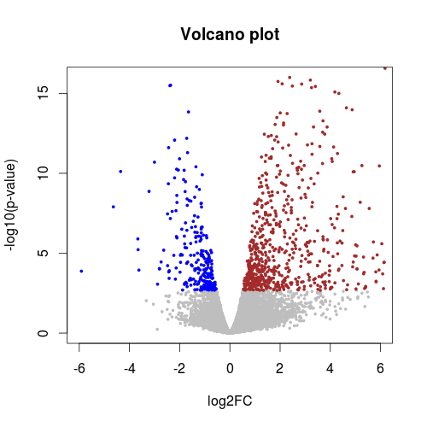
Volcano plot
 | DE Result
GeneID | Log2FC | p-value | -log10(pvalue)
1 | -0.40 | 0.037 | 1.43
2 | 0.03 | 0.916 | 0.04
3 | -0.89 | 2.42E-05 | 4.62
4 | 0.30 | 0.130 | 0.89
5 | -0.36 | 0.140 | 0.85
6 | -0.07 | 0.811 | 0.09
…

Slide 14
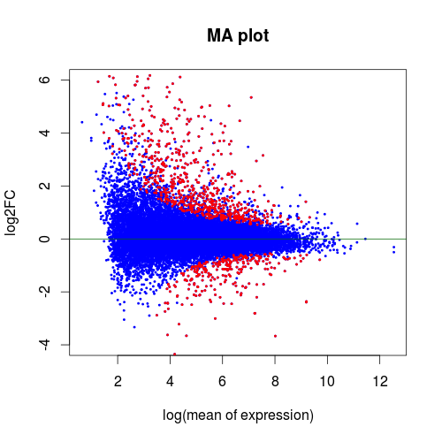
MA plot
M (log ratios) and A (mean average)
GeneID | Mean RPKM | log mean | log2FC
1 | 0.51 | -0.29 | -0.40
2 | 1.25 | 0.10 | 0.03
3 | 3.52 | 0.55 | -0.89
4 | 0.19 | -0.72 | 0.30
5 | 2.34 | 0.37 | -0.36
6 | 6.14 | 0.79 | -0.07
…
More at: en.wikipedia.org/wiki/MA_plot

Slide 15
Functional interpretation

Slide 16
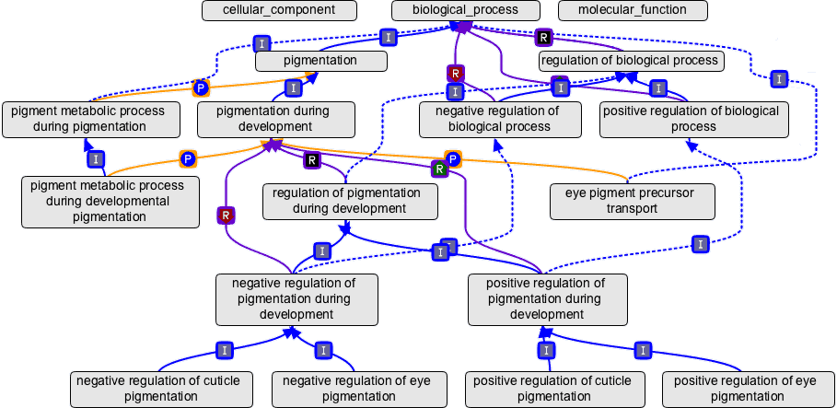
Gene ontology (GO)
An ontology is a representation of a body of knowledge, within a given domain. Ontologies usually consist of a set of classes or terms with relations that operate between them.
Source: geneontology.org
Three domains, three roots
Node: GO term (e.g., cell growth, GO:0016049, biological process)
Edge: term-term connection
Each GO term can be traced back to a root

Slide 17
Category enrichment
Green GO
significant
gene set
All genes
Is Green GO enriched in the significant gene set ?
Green GO is a GO ID (e.g., GO:0006519)

Slide 18
dance party
students who in a dance party
N=20
college students
N=100
Are the female / male students over-represented (enriched) in the party?

Slide 19
GO enrichment test – Fisher's Exact test
40 significant genes
GRMZM2G001475 | 1
GRMZM2G002652 | 2
GRMZM2G006480 | 3
… | …
GRMZM5G868038 | 40
Gene | GO accession
GRMZM2G001475 | GO:0006519
GRMZM2G001475 | GO:0016831
GRMZM2G001500 | GO:0005524
GRMZM2G001500 | GO:0006457
GRMZM2G001500 | GO:0051082
GRMZM2G001508 | GO:0003993
GRMZM2G001514 | GO:0003677
GRMZM2G001514 | GO:0004879
GRMZM2G001514 | GO:0005634
GRMZM2G001514 | GO:0006355
… | …
Gene | Significant?
GRMZM2G001475 | no
GRMZM2G002652 | no
GRMZM2G006480 | yes
… | …
GRMZM5G868038 | no
Question: Are the genes of this GO term enriched in the significant gene set?
Assumption: all genes are independent and equally likely to be selected as DEs.
2x2 Table for GO:0006519
 | GO:0006519 | Others
Significant | 5 | 210
Not significant | 35 | 39416
Fisher’s Exact Test:
p-value = 2.518e-06

Slide 20
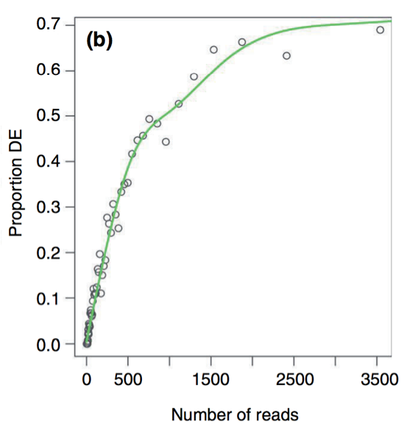
GOSeq
The likelihood of DE as a function of number of reads is quantified through fitting a monotonic function to “proportion of DE” versus “number of reads”.
The function is incorporated into the enrichment statistical test
Not all genes are equally likely to be selected as DEs.
Gene | Significant?
GRMZM2G001475 | no
GRMZM2G002652 | no
GRMZM2G006480 | yes
… | …
GRMZM5G868038 | no
Read counts
224
51
536
…
0
Proportion
0.16
0.05
0.38
…
0
3. Weighted sampling to perform enrichment test
GO:0006519 | # DE
Obs (from the DE analysis) | 5
1st weighted sampling | 1
2nd weighted sampling | 0
3rd weighted sampling | 2
… | …
p-value
Young MD, et al., (2010). Genome Biology, 11: R14.

Slide 21
Summary
R is an excellent tool for DE analysis and data visualization.
Many bioinformatics pipelines and statistical methods have been developed. Methods and parameters need to be carefully selected.
A proper GO enrichment test needs to be used.
Dobin A, Davis CA, Schlesinger F, Drenkow J, Zaleski C, Jha S, Batut P, Chaisson M, Gingeras TR. 2013. STAR: ultrafast universal RNA-seq aligner. Bioinformatics 29:15-21.
Love MI, Huber W, Anders S. 2014. Moderated estimation of fold change and dispersion for RNA-seq data with DESeq2. Genome Biol 15:550.
Young MD, Wakefield MJ, Smyth GK, Oshlack A. 2010. Gene ontology analysis for RNA-seq: accounting for selection bias. Genome Biol 11:R14.

