Slide 1
Differential Expression Bioinformatics Applications (PLPTH813)
Sanzhen Liu
4/15/2025

Slide 2
Outline
RNA-seq procedure
Statistical test of differential expression
Multiple testing correction
RNA-seq data processing
GO enrichment

Slide 3
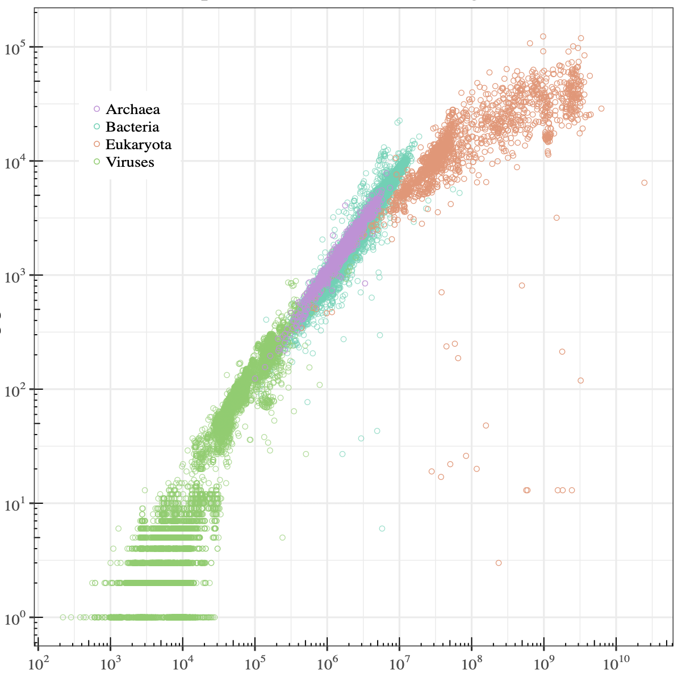
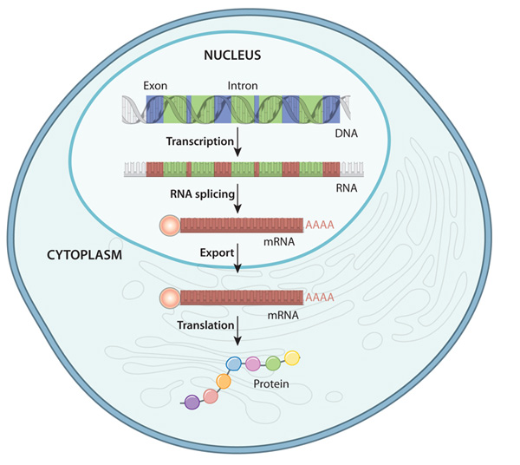
Transcriptome
A transcriptome is the full range of mRNA expressed by a cell, a tissue, or an organism.
10⁵
eukaryota
10⁴
bacteria
10³
archaea
Counts of protein genes
10²
10
viruses
wikipedia.org
DNA to protein in eukaryote
10³
10⁵
10⁷
10⁹
nature.com/scitable/topicpage/gene-expression-14121669
Genome size (bp)
Notes:
the set of mRNA transcripts produced in a particular cell or tissue type

Slide 4
Alternative splicing
Genome
transcription
exon
intron
Pre-mRNA
5'
AAAAA 3'
splicing
mRNA
transcript
5'
AAAAA 3'
alternative splicing
5'
AAAAA 3'
isoforms

Slide 5
levels of alternative splicing
In many eukaryotic organisms, the majority of genes are alternatively spliced to produce multiple transcript isoforms per gene.
In humans, for example, there is evidence for alternative splicing of more than 95% of genes, with an average of more than five isoforms per gene.
Tilgner et al. (2014) PNAS

Slide 6
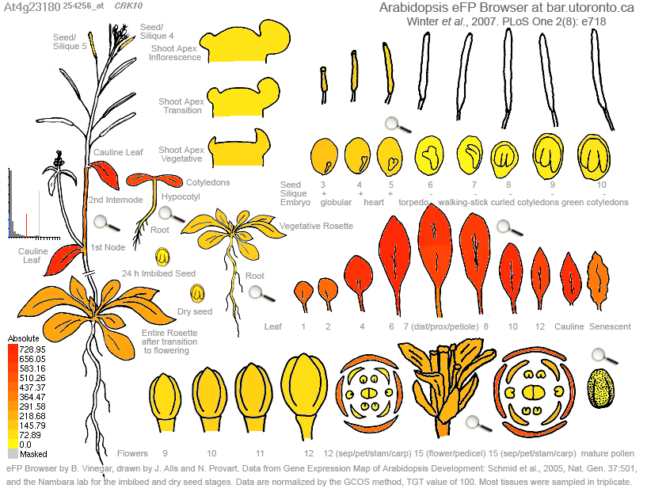

Transcriptome analysis (RNA-seq)
RNA-seq: which genes are expressed and the level of expression per gene
cragenomica.es
Expression profiles in different tissues
Response to biotic stress

Slide 7
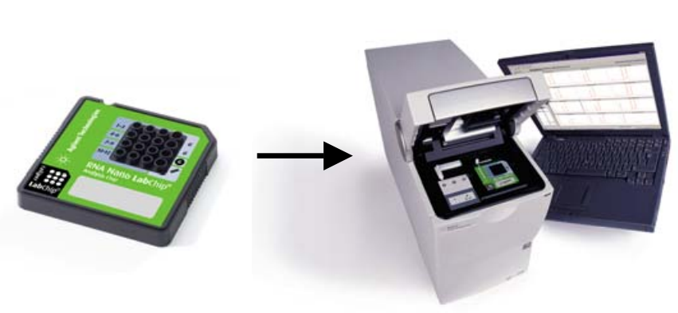
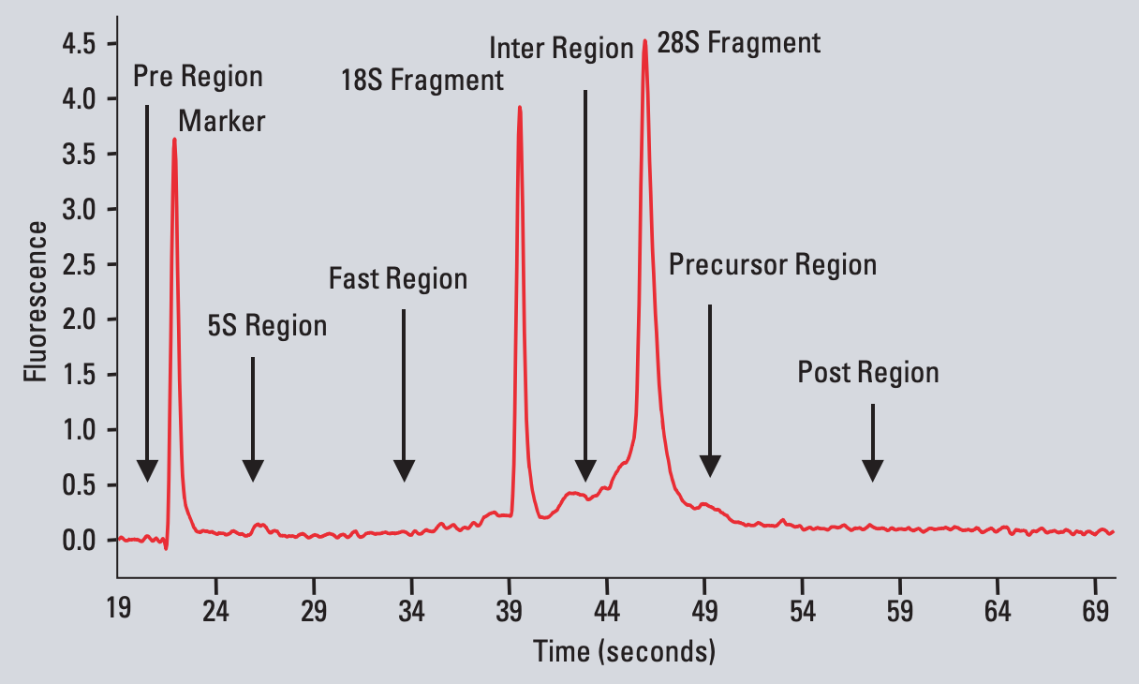
total RNA
Bioanalyzer
RNA-seq
total RNA
RIN: RNA Integrity Number
mRNA
a value from 1 to 10, with 10 being the least degraded.
DNA library
sequencing
reads
https://www.agilent.com/cs/library/applications/5989-1165EN.pdf

Slide 8
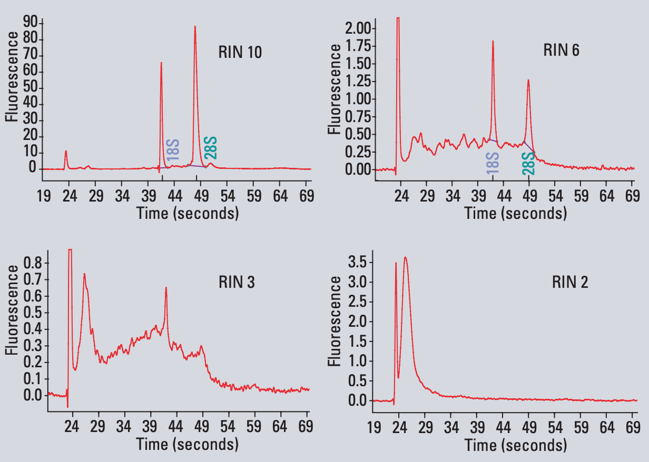
total RNA
RNA-Seq
total RNA
mRNA
DNA library
sequencing
reads
https://www.agilent.com/cs/library/applications/5989-1165EN.pdf

Slide 9
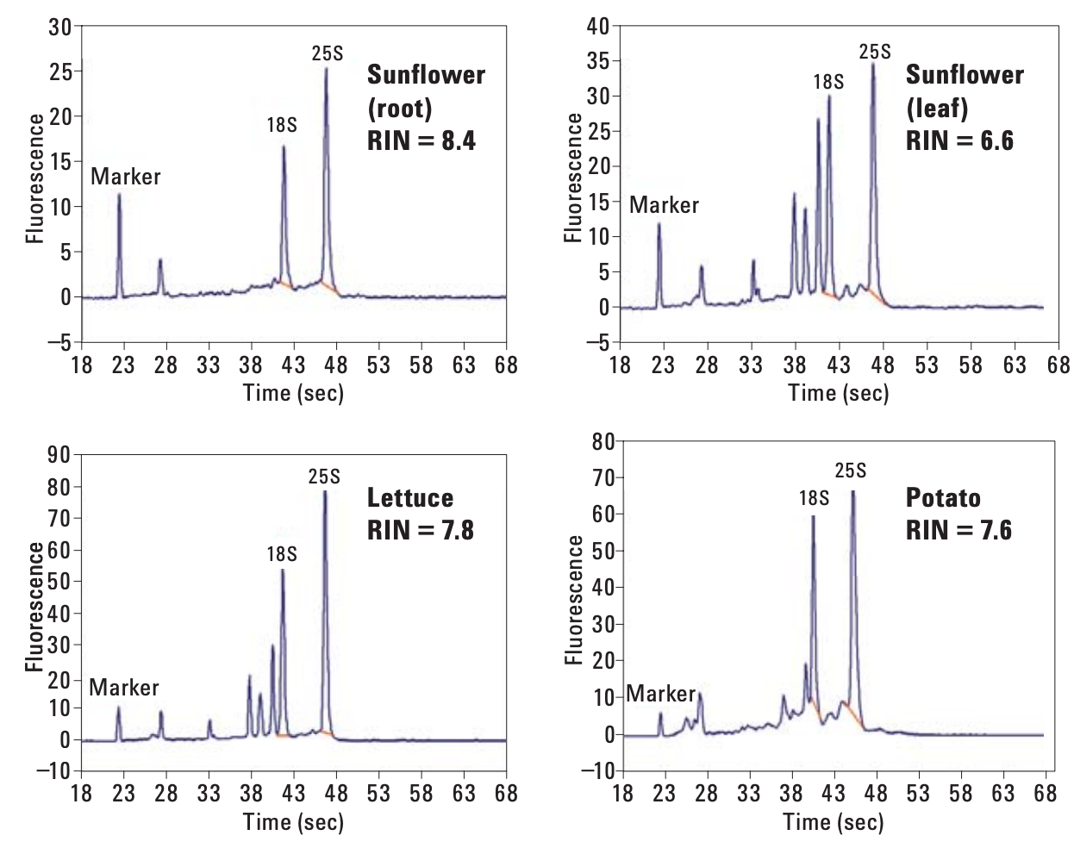
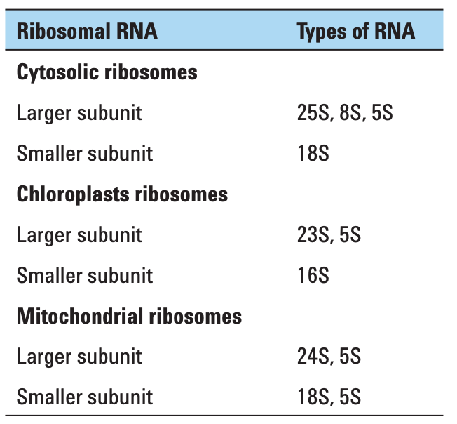
total RNA of plant tissues
Result of plant total RNA using the RNA 6000 Nano Kit
Table. Plant total RNA
https://www.agilent.com/cs/library/applications/5990-8850EN.pdf

Slide 10
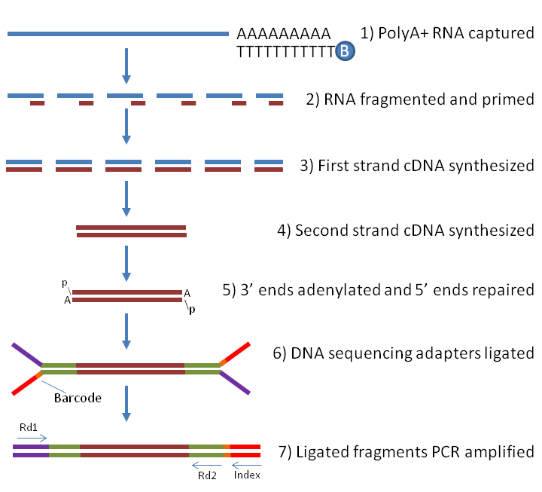
Illumina RNA-Seq library preparation
total RNA
mRNA
DNA library
sequencing
reads
PCR
labome.com/method/RNA-seq-Using-Next-Generation-Sequencing.html
review paper: doi.org/10.1093/nar/gky167

Slide 11
Illumina sequencing
total RNA
mRNA
Single-end
Paired-end
DNA library
sequencing
5'
AAAAA 3'
reads
reads

Slide 12
RNA-seq procedure for differential expression analysis
total RNA
RNA to sequencing reads
1
DNA library
reads
alignment
reads to read counts per gene
2
read counts
statistical test
read counts to significant genes
3
significance

Slide 13
Reads to read counts per gene
total RNA
exon
intron
DNA library
reads
1. reads
alignment
2. alignment to the reference genome (DNA sequence)
read counts
split read
read counts (N=19 if all aligned)
statistical test
An intron-aware aligner is important for RNA-seq reads alignment e.g., Tophat, GSNAP, STAR, HiSAT2
significance

Slide 14
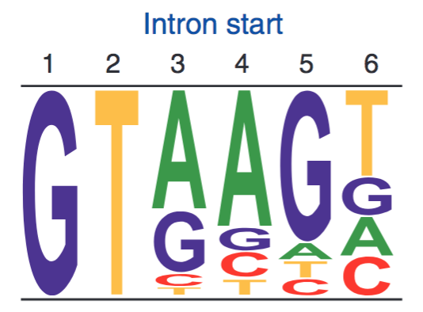
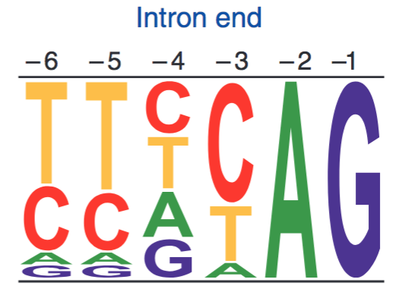
Exon-intron structure
Sequence logos representing weight matrices for the first six bases of an intron (left) and the last six bases of an intron (right). In plants and animals, ~99% of introns begin with GT.
exon
intron
exon
GT
AG

Slide 15
Alignment issues
Repeats
Sequencing errors
Polymorphisms (reference and sequenced individuals)
Quality of reference genomes (mis-assembly and incomplete genome)
reads
Ref
Notes:
reads are relatively short (30 to 150 bp), making it hard to unambiguously assign them to a specific location in the genome, especially in the presence of sequencing errors and repeat sequences.

Slide 16
Solutions to mitigate problems
Unique mapped reads
✗
✓
reads
Ref
Longer reads or Paired-end reads
reads
…
Ref
Tolerance of mismatches or gaps for each alignment
Better reference genome

Slide 17
Count matrix Read counts (Raw) per gene
total RNA
DNA library
reads
Gene | sample 1
gene 1 | 6,075
gene 2 | 295
... | ...
sample 2 | sample 3
5,934 | 3,370
377 | 169
... | ...
alignment
read counts
statistical test
significance

Slide 18

Read counts to significant genes
total RNA
T
 | Gene 1 | Others
Control 1 | C1 | N1 – C1
TRT 1 | T1 | N2 – T1
Control 1
TRT 1 (salt)
DNA library
RNA, Library
Sequencing
reads
Fisher’s Exact Test or χ² test on Gene 1
A p-value for Gene 1
Repeat on all the genes
p-values
Multiple testing correction
q-values
Declaration of significance
a significant gene set
alignment
N1 reads
N2 reads
Trimming, Alignment
Read counting per gene
read counts
statistical test
Gene | Control 1 | TRT 1
1 | C1 | T1
…
Sum | N1 | N2
significance

Slide 19
Read counts for differential expression analysis
 | Gene 1
Control 1 | C1
Control 2 | C2
Control 3 | C3
TRT 1 | T1
TRT 2 | T2
TRT 3 | T3
…

Slide 20
Statistical test for differential expression
Statistical test to discover differential expression (DE)
Count data: Generalized Linear Model (GLM) to deal with count data
e.g., Poisson GLM could handle count data but overdispersion exits
Dispersion issue: Using negative binomial GLM to incorporate dispersion into the model
edgeR (Robinson and Smyth, 2007), DESeq (Anders and Huber, 2010), NBPSeq (Di et al., 2011), and QuasiSeq (Lund 2012)

Slide 21
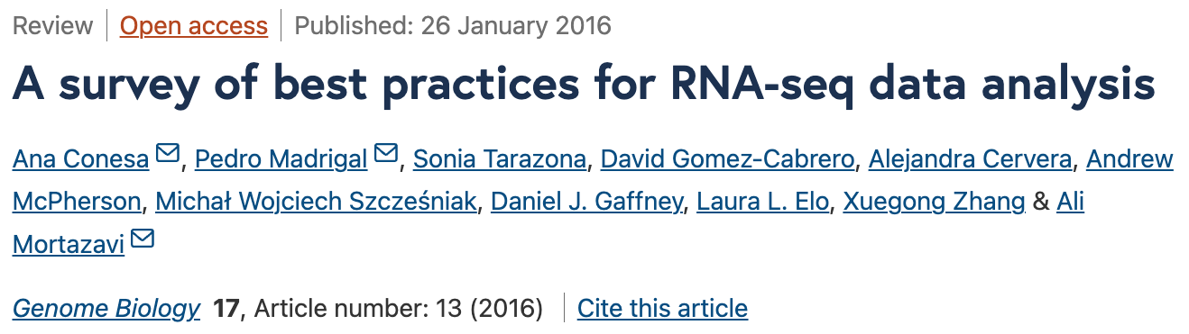

Slide 22
An RNA-seq experiment – source of variance
Question: what would cause the difference between two values, C1 and T1?
T
Control 1
TRT 1 (salt)
Treatment effect
Plant difference
RNA quality
Library preparation
Sequencing
Sampling
Sequencing depth
Gene 1 | C1 | T1
…
Sum | N1 | N2
Bio
TRT
Bio
other
Our interest:
the effect of the salt treatment on gene expression
Tech
Sample
Notes:
Index effect
Size selection
PCR Amplification

Slide 23
Source of variance in RNA-seq - sampling
Sampling variance derived from the inherent nature of counting experiments
Randomly sample 10⁷
First sampling | 6
Second sampling | 13
Third sampling | 8
total molecules: 10⁹
gene X: 1000 molecules
Randomly sample 10⁸
First sampling | 102
Second sampling | 93
Third sampling | 97
Sequence depth (sampling number) matters.

Slide 24

Technical replication
T
Control 1
Control 2
Control 3
TRT 1
TRT 2
TRT 3
within group
within group
between groups
Technical replication refers to the sequencing of multiple libraries derived from the same biological sample.
Technical
replicate
Bio
TRT
Compare to declare the significance
Bio
other
Extra power
Tech
Sample
Tech
Sample
within groups
between groups

Slide 25
Biological replication
T
T
T
Control 1
Control 2
Control 3
TRT 1
TRT 2
TRT 3
within group
within group
between groups
Biological replication refers to the sequencing of multiple libraries derived from different biological samples.
Biological
replicate
Bio
TRT
Compare to declare the significance
Technical
replicate
Bio
other
Bio
other
Tech
Tech
Tech
Sample
Sample
Sample
within groups
within groups
between groups

Slide 26
Biological replication
T
T
T
Control 1
Control 2
Control 3
TRT 1
TRT 2
TRT 3
within groups
within groups
between groups
Use biological replication instead of technical replication unless you have your own interest.
More replicates increase the power to detect small effect

Slide 27
Question I
Goal: to identify the DEs between two biological groups
Design: Each group has five biological replicates
To avoid messing up samples across groups. The experiment of each group was conducted separately.
Is this a sound experimental design? Why?
Bio
TRT
Bio
other
Bio
other
Tech
Tech
Sample
Sample
within groups
between groups

Slide 28
Comparison of read counts among different samples
T
T
T
Control 1
Control 2
Control 3
TRT 1
TRT 2
TRT 3
Gene 1 | C1 | C2 | C3 | T1 | T2 | T3
…
Sum | N1 | N2 | N3 | N4 | N5 | N6
Sequence depth (total read number) influences read counts. Therefore, raw read counts can not be compared directly.
Can we generate some comparable numbers among samples?

Slide 29
A normalization method: RPKM and FPKM
RPKM: Read number per kilobase of exons per million of total reads
Control 1
read count = 23
total reads: 15 millions of total reads
RPKM of X = 23 * 1000 / 500 / 15 = 3.1
?
exon 1 (220 bp)
exon 2 (280 bp)
Treatment 1
read count = 18
total reads: 10 millions of total reads
RPKM of X = 18 * 1000 / 500 / 10 = 3.6
?
exon 1 (220 bp)
exon 2 (280 bp)
FPKM: Fragment number per kilobase per million of total reads.
Fragment = one pair of paired-end reads or one single-end read

Slide 30
More about RPKM
RPKM = 5.1
RPKM = 1.5
gene A
gene B
Can we say that gene B has higher expression than gene A?
RPKM is not an ideal indicator to compare the expression/accumulation levels between two genes
amplification bias
alignment efficiency

Slide 31
Experimental Design
Sequencing depth
Increasing sequencing depth decreases sampling variance
Biological replication
Reasonable number of biological replication helps accurately estimate variances to achieve reliable statistical inference.
Randomization and unbiasedness
To avoid confounding effect

Slide 32


DE result
 | DE Result
GeneID | Log2FC* | p-value
1 | -0.40 | 0.037
2 | 0.03 | 0.916
3 | -0.89 | 2.42E-05
4 | 0.30 | 0.130
5 | -0.36 | 0.140
6 | -0.07 | 0.811
…
$$✓$$
$$✓$$
* Log2FC: log2 of fold change (TRT / control)

Slide 33
Single statistical test
H0: the null hypothesis
p = 0.05
not rejected
0
1

Slide 34
Single statistical test
H0: the null hypothesis
p = 0.05
rejected
0
1

Slide 35
Multiple testing correction
p = 0.05
0
1
p-value when a NULL hypothesis is true
"A p-value is ONLY statistically valid when a single score is computed."

Slide 36

DE result
 | DE Result
GeneID | Log2FC* | p-value
1 | -0.40 | 0.037
2 | 0.03 | 0.916
3 | -0.89 | 2.42E-05
4 | 0.30 | 0.130
5 | -0.36 | 0.140
6 | -0.07 | 0.811
…
$$☓$$
$$✓$$
* Log2FC: log2 of fold change (TRT / control)

Slide 37
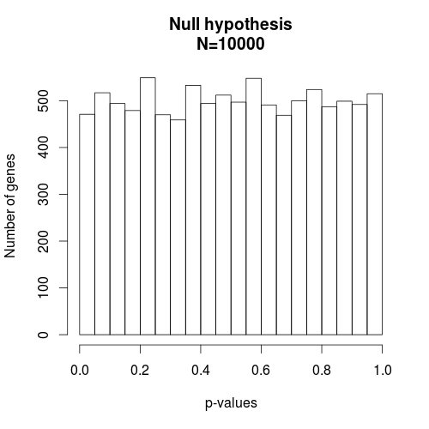
P-value distribution under the null hypothesis (e.g., no treatment effect)
No matter how stringent the criteria are, you’ll identify genes with very small p-values and the false discovery rate (FDR) is 100%.
When H0 is true, the p-value is distributed uniformly from 0 to 1.

Slide 38
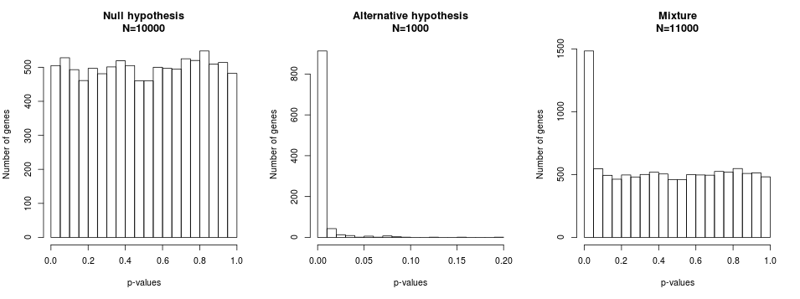
P-value distribution under both the null and non-null hypotheses
Cutoff: p=0.05
FDR=471/(471+989)=32%
Cutoff: p=0.01
FDR=102/(102+912)=10%
When the null hypothesis is true, the p-value is distributed uniformly.
When the null hypothesis is false, the p-value distribution is skewed toward 0.

Slide 39
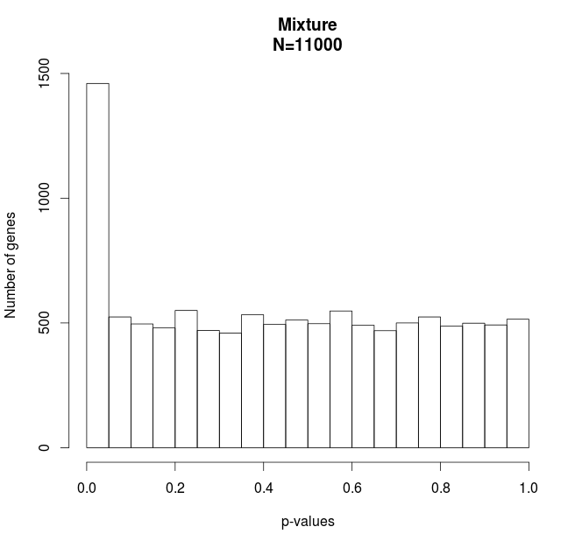
Multiple test correction – FDR method
True positive
P-values < 0.00009
DE=992
False DE=10
FDR 1%
False positive

Slide 40
q-values
The q-value is the smallest FDR for which we can reject the null hypothesis for that one test and all others with smaller p-values.
Total number of tests: m = 16
FDR (False Discovery Rate) methods (qvalue or BH) are methods to calculate q-values/adjusted p-values/corrected p-values based on p-values
Gene | p-values | q-values
1 | 0.000 | 0.006
2 | 0.002 | 0.015
3 | 0.009 | 0.059
4 | 0.013 | 0.063
5 | 0.035 | 0.139
6 | 0.051 | 0.171
7 | 0.155 | 0.442
8 | 0.197 | 0.492
9 | 0.247 | 0.539
10 | 0.358 | 0.651
11 | 0.426 | 0.656
12 | 0.526 | 0.702
13 | 0.622 | 0.777
14 | 0.782 | 0.920
15 | 0.925 | 0.974
16 | 0.992 | 0.992
5% FDR, q-values < 0.05
10% FDR, q-values < 0.1
20% FDR, q-values < 0.2

Slide 41
Question
If we identify 500 differential expression (DE) genes using the 5% FDR to account for multiple tests. Which one below is a better description?
1. I am 95% confident that 500 genes are DE.
2. The 5% genes (25 genes) in the set are expected to be false DE genes.

Slide 42
False discovery rate (concept)
For example, among 10,000 tests (10,000 genes), 100 significant genes are declared, in which 10 gene is falsely rejected. In this case, the false discovery rate is 10%.
 | True null hypothesis (H₀) | False null hypothesis (H₁) | Total
Rejected (Declared significance) | 10 | 90 | 100

Slide 43
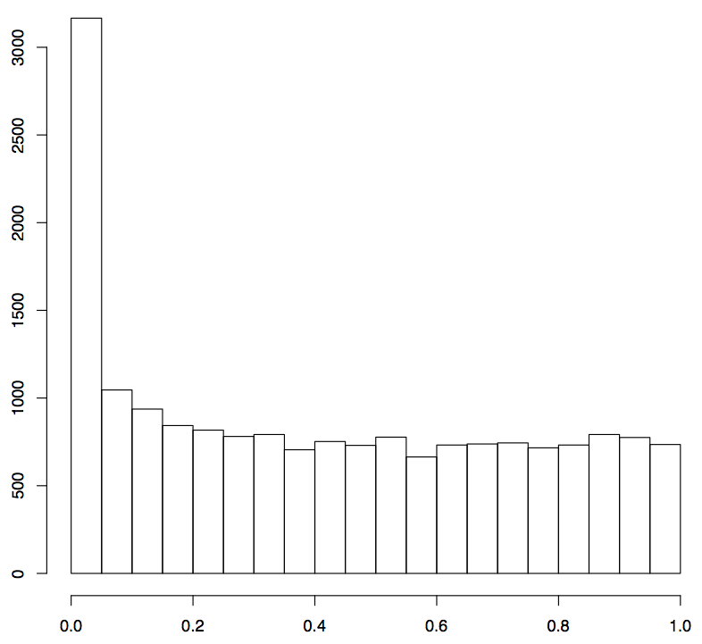
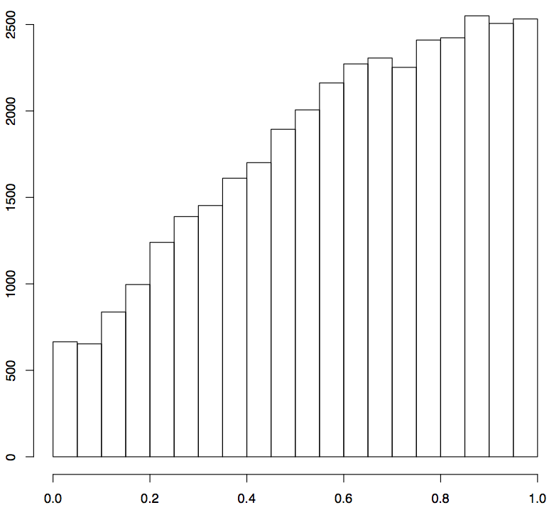
P-value histograms from real studies
1
2
Number of genes
p-values
p-values
If you perform an RNA-seq experiment, which one would you hope to obtain? Why?

Slide 44
P-value histograms from real studies
1
2
Number of genes
p-values
p-values
DE = 1,370, FDR=5%
DE = 0, FDR=20%

Slide 45
Outline
RNA-seq procedure
Statistical test of differential expression
Multiple testing correction
RNA-seq data processing
GO enrichment

Slide 46
RNA-seq procedure for differential expression analysis
total RNA
RNA to sequencing reads
1
DNA library
reads
alignment
reads to read counts per gene
2
read counts
statistical test
read counts to significant genes
3
significance

Slide 47
Keywords
total RNA
randomization, replication, RNA quality
DNA library
short or long reads
single- or paired-end reads, read length
sequencing depths
(e.g., >20 million short reads for most experiments)
reads
alignment
intron-spanning aligners
(e.g., STAR, HiSAT2)
read counts
statistical test
count data statistical analysis (DESeq2 & edgeR)
multiple test p-value adjustment (FDR method)
significance

Slide 48
Bioinformatics and Statistics (Illumina data)
reads (fastq read data)
alignment (STAR, or others)
Bioinformatics
read counts (HT-Seq, STAR)
statistical test (DESeq2, edgeR, or others)
q-values (FDR method)
Statistical analysis
significance

Slide 49
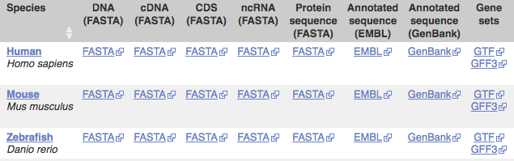
STAR pipeline – from reads to counts
Required files:
Reference genome (fasta file)
Gene information (gff or gtf gene annotation)
Reads (fastq files) – your own data
Many reference genomes and gff/gtf files are available at:
http://ensembl.org/info/data/ftp

Slide 50
Reads to counts - reference indexing
“sorted or indexed” genome
one by one
reads
alignments
STAR --runMode genomeGenerate \
--genomeDir . \
--genomeFastaFiles reference.fas \
--sjdbGTFfile genes.gtf \
--runThreadN 4

Slide 51
Reads to counts – alignment and read counting
STAR --genomeDir reference.fas \
--readFilesIn read1.fq read2.fq \
--alignIntronMax 100000 \
--alignMatesGapMax 100000 \
--outFileNamePrefix output \
--outSAMattrIHstart 0 \
--outSAMmultNmax 1 \
--outSAMstrandField intronMotif \
--outFilterIntronMotifs RemoveNoncanonicalUnannotated \
--outSAMtype BAM SortedByCoordinate \
--quantMode GeneCounts \
--outFilterMismatchNmax 5 \
--outFilterMismatchNoverLmax 0.05 \
--outFilterMatchNmin 50 \
--outSJfilterReads Unique \
--outFilterMultimapNmax 1 \
--outSAMmapqUnique 60 \
--outFilterMultimapScoreRange 2
Gene | sample 1
gene 1 | 6,075
gene 2 | 295
... | ...
sample 2 | sample 3
5,934 | 3,370
377 | 169
... | ...

Slide 52
Bioinformatics and Statistics (Illumina data)
reads (fastq read data)
alignment (STAR, or others)
Bioinformatics
read counts (HT-Seq, STAR)
statistical test (DESeq2, edgeR, or others)
q-values (FDR method)
Statistical analysis
significance

Slide 53
Outline
RNA-Seq procedure
Statistical test of differential expression
Multiple testing correction
RNA-seq data processing
GO enrichment

Slide 54
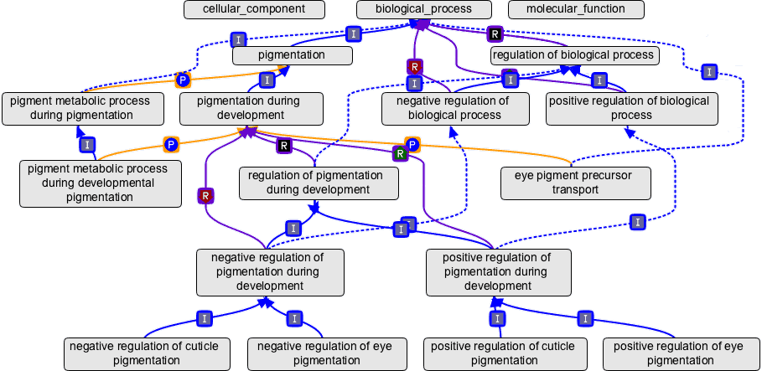
Gene ontology (GO)
An ontology is a representation of a body of knowledge, within a given domain. Ontologies usually consist of a set of terms with relations that operate between them.
Source: geneontology.org
Three domains, three roots
Node: GO term (e.g., cell growth, GO:0016049, biological process)
Edge: term-term connection, representing parent-child relationships
Each GO term can be traced back to a root

Slide 55
Gene ontology (GO)
GO classifies functions into three aspects:
MF: Molecular Function
molecular activities of gene products
CC: Cellular Component
where gene products are active
BP: Biological Process
pathways and larger processes made up of the activities of multiple gene products

Slide 56
GO enrichment
Green GO
significant
genes
All genes
Is Green GO enriched in the significant gene set ?

Slide 57
dance party
students who are in a dance party
N=200
college students
N=10,000
Are graduate students over-represented (enriched) in the party?

Slide 58
GO enrichment test – Fisher's Exact test
40 significant genes
GRMZM2G000012 | 1
GRMZM2G002342 | 2
GRMZM2G006480 | 3
… | …
GRMZM5G038156 | 40
Gene | GO accession
GRMZM2G001475 | GO:0006519
GRMZM2G001475 | GO:0016831
GRMZM2G001500 | GO:0005524
GRMZM2G001500 | GO:0006457
GRMZM2G001500 | GO:0051082
GRMZM2G001508 | GO:0003993
GRMZM2G001514 | GO:0003677
GRMZM2G001514 | GO:0004879
GRMZM2G001514 | GO:0005634
GRMZM2G001514 | GO:0006355
… | …
GO:0006519
Gene | Significant?
GRMZM2G001475 | no
GRMZM2G002652 | no
GRMZM2G006480 | yes
… | …
GRMZM5G868038 | no
Question: Are the significant genes enriched in this GO category?
Assumption: all genes are independent and equally likely to be selected as DEs.
2x2 Table for GO:0006519
 | GO:0006519 | Others
Significant | 5 | 35
Not significant | 210 | 39416
Fisher’s Exact Test:
p-value = 2.5e-06

Slide 59
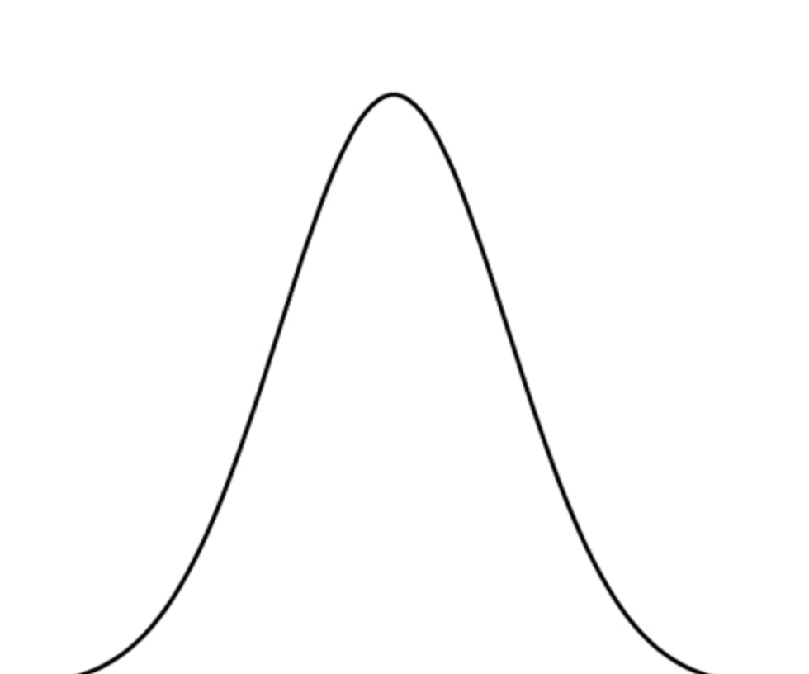
GO enrichment test – Random simulation
Gene | GO accession
GRMZM2G001475 | GO:0006519
GRMZM2G001475 | GO:0016831
GRMZM2G001500 | GO:0005524
GRMZM2G001500 | GO:0006457
GRMZM2G001500 | GO:0051082
GRMZM2G001508 | GO:0003993
GRMZM2G001514 | GO:0003677
GRMZM2G001514 | GO:0004879
GRMZM2G001514 | GO:0005634
GRMZM2G001514 | GO:0006355
… | …
40 DE genes
GRMZM2G000012 | 1
GRMZM2G002342 | 2
GRMZM2G006480 | 3
… | …
GRMZM5G038156 | 40
GO:0006519
Question: Are the significant genes enriched in this GO category?
Gene | Significant?
GRMZM2G001475 | no
GRMZM2G002652 | no
GRMZM2G006480 | yes
… | …
GRMZM5G868038 | no
5 DE and 210 non-DE
Randomly sample 40 DE
Randomly sample 40 DE
GRMZM2G001475 | no
GRMZM2G002652 | no
GRMZM2G006480 | no
… | …
GRMZM5G868038 | no
GRMZM2G001475 | no
GO:0006519 | # DE
1st sampling | 1
2nd sampling | 0
3rd sampling | 2
… | …
Gene | R
GRMZM2G001475 | no
GRMZM2G002652 | yes
GRMZM2G006480 | no
… | …
GRMZM5G868038 | no
…
1 DE and 214 non-DE
0 DE and 215 non-DE

Slide 60
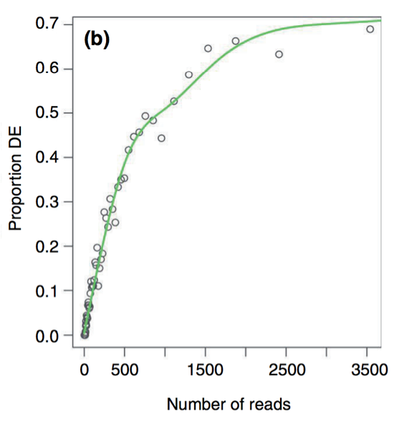
GOSeq: a package for GO enrichment analysis
Not all genes are equally likely to be selected as DEs.
Likelihood of DE as a function of number of reads is quantified via fitting a monotonic function to “proportion of DE” versus “number of reads”.
The function is incorporated into the enrichment statistical test
Gene
GRMZM2G001475
GRMZM2G002652
GRMZM2G006480
…
GRMZM5G868038
Read counts
224
51
536
…
0
Proportion
0.16
0.05
0.38
…
0
3. Weighted sampling to perform enrichment test
GO:0006519 | # DE
1st weighted sampling | 1
2nd weighted sampling | 0
3rd weighted sampling | 2
… | …
p-value
Young MD, et al., (2010). Genome Biology, 11: R14.

Slide 61
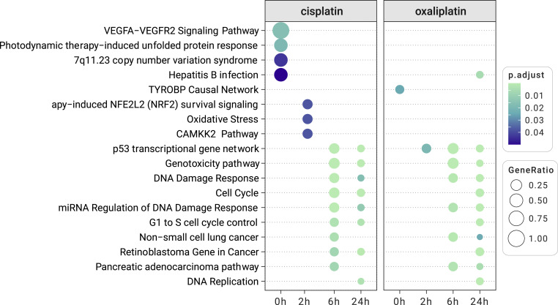
Clusterprofiler a POPULAR package for GO enrichment analysis
Wu et al, 2021, the Innovation https://doi.org/10.1016/j.xinn.2021.100141

Slide 62
Summary
Biological replication rather than technical replication are typically needed for an RNA-seq experiment.
Multiple test correction: P-values need to be corrected to account for multiple tests. The FDR method is a reliable approach for the correction.
Many bioinformatics pipelines and statistical methods have been developed. Identify good pipelines and pay attention to the parameters used in the pipeline.

Slide 63
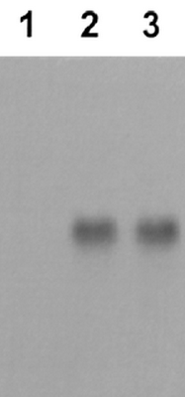
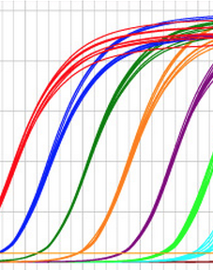
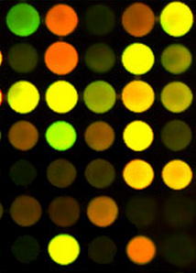
Approaches for quantification of gene expression
How can we measure the accumulative level of transcripts of a given gene in millions/billions of transcripts?
Northern blot
qRT-PCR
microarray
RNA-seq
biochemj.org
quantabio.com
csmbio.csm.jmu.edu

Slide 64
Rationale of RNA-seq (mRNA sequencing)
genomic DNA
10 millions of transcripts in each
exon
intron
gene of interest
100
5
sequence 1,000 transcripts
mRNA/transcript
0 0
Essentially, RNA-seq is designed to measure mRNA accumulation levels of genes by
1) recognizing transcripts based on sequences
2) and quantifying transcripts of each gene
sequence 1 million transcripts
10 1
Differential expression (DE)?

