Slide 1
Phylogenetic tree practice - from reads to trees
Sanzhen Liu
PLPTH813 Bioinformatics Applications
4/10/2025

Slide 2
Outline
Introduction about Covid-19
Built a tree through SNP discovery and iqtree

Slide 3
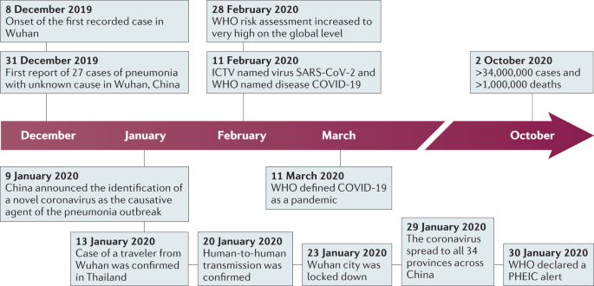
COVID-19
Area | Cases | Deaths
World | 123 M | 2.71 M
US | 29.8 M | 542 K
* as of 3/21/2021

Slide 4
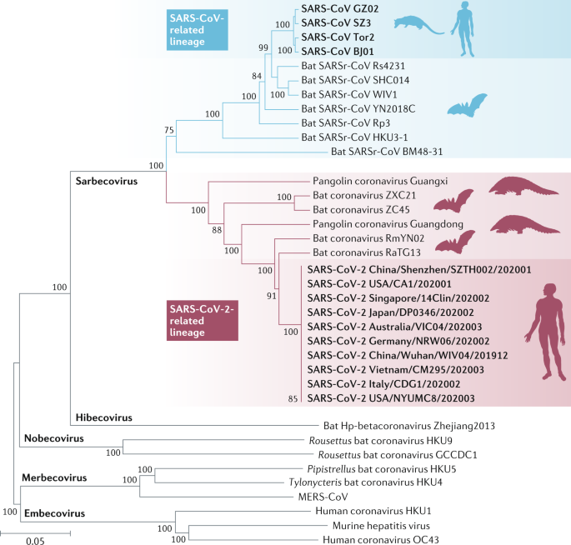
Genetic relationship with other virus
Genomic comparison
SARS-CoV-2 shares 79% with SARS-CoV
SARS-CoV-2 shares 50% with MERS-CoV

Slide 5
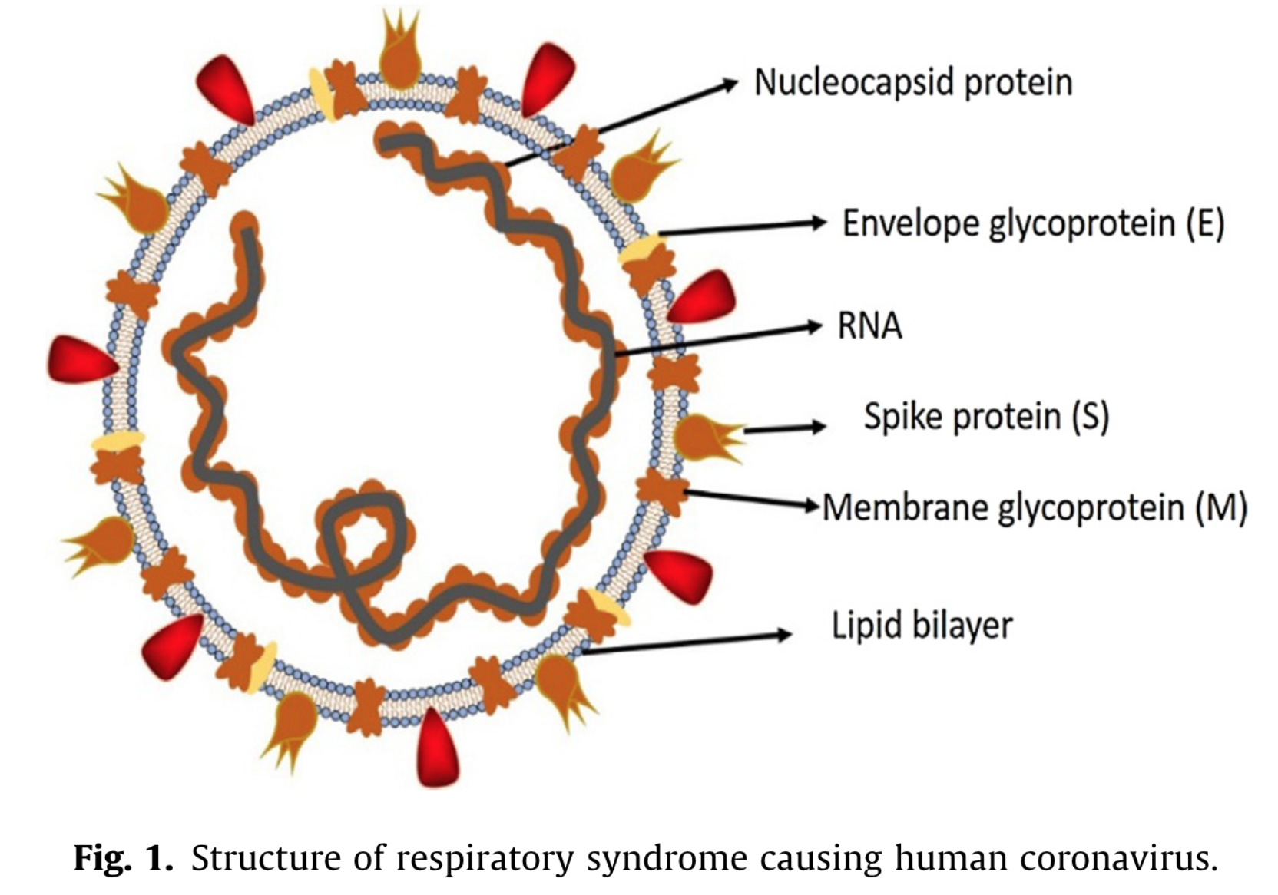
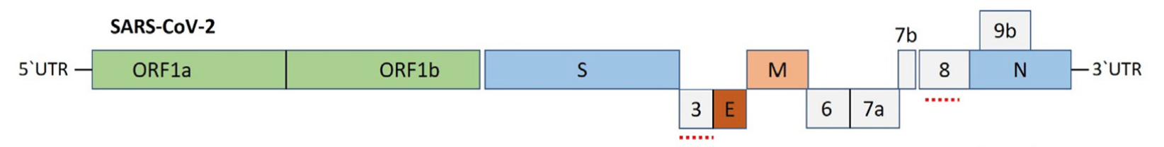
Severe acute respiratory syndrome coronavirus 2 (SARS-CoV2)
Notes:
Coronaviruses contain a positive-sense, single-stranded RNA genome.

Slide 6
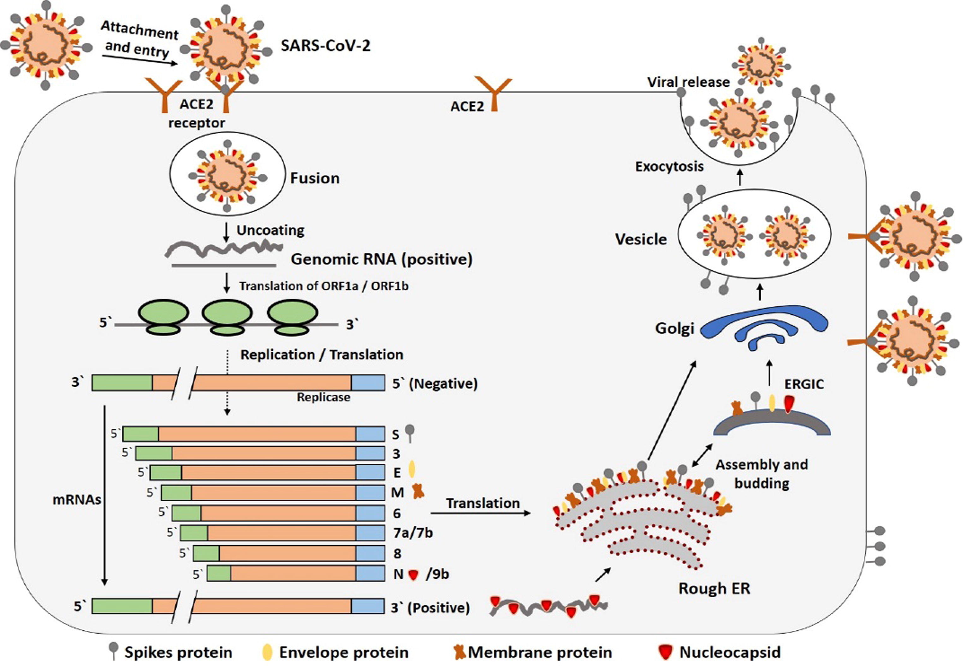
Infection and replication
Notes:
Fig. 3. The life cycle of SARS-CoV-2 in host cells; begins its life cycle when S protein binds to the cellular receptor ACE2. After receptor binding, the conformation change in the S protein facilitates viral envelope fusion with the cell membrane through the endosomal pathway. Then SARS-CoV-2 releases RNA into the host cell. Genome RNA is translated into viral replicase polyproteins pp1a and 1ab, which are then cleaved into small products by viral proteinases. The polymerase produces a series of subgenomic mRNAs by discontinuous transcription and finally translated into relevant viral proteins. Viral proteins and genome RNA are subsequently assembled into virions in the ER and Golgi and then transported via vesicles and released out of the cell. ACE2, angiotensin-converting enzyme 2; ER, endoplasmic reticulum; ERGIC, ER–Golgi intermediate compartment.

Slide 7
Reference genome
ASM985889v3
Organism name: Severe acute respiratory syndrome coronavirus
Date: 2020/01/13
Genbank assembly accession: GCA_009858895
Assembly method: Megahit v. V1.1.3
Sequencing technology: Illumina
~29.9 Kb
1 fragment
11 genes

Slide 8
Alignment to a reference, discovery of SNP, and tree construction with iqtree2
Each genome or sequence aligned to the reference genome
Alignments used for SNP discovery, or genotyping
Data conversion to compatible SNP data for iqtree2 analysis
Construction of a phylogenetic tree

Slide 9
Data and codes downloading
wget https://people.beocat.ksu.edu/~liu3zhen/PLPTH813/labs/tree_data_codes.tar.gz
tar -xf tree_data_codes.tar.gz

Slide 10
Data and codes
1_ref (reference genome)
2_reads (read data)
3_aln (BWA alignment)
4_snp (GATK SNPs)
5_tree (iqtree)
scripts (software packages)

Slide 11
Slurm command – sbatch (III)
hello.sh (or hello.sbatch)
#!/bin/bash
#SBATCH --time=1-00:00:00
#SBATCH --mem=1G
#SBATCH --cpus-per-task=1
echo "Hello World!"
sbatch hello.sh

Slide 12
1_ref: reference indexing bwa.index.sbatch gatk.index.sbatch
covid19ref.fasta
bwa index -p $prefix covid19ref.fasta
gatk CreateSequenceDictionary \
-R covid19ref.fasta -O covid19ref.dict
samtools faidx covid19ref.fasta

Slide 13
2_reads
s1_1.fq.gz
s1_2.fq.gz
s2_1.fq.gz
s2_2.fq.gz
s3_1.fq.gz
s3_2.fq.gz

Slide 14
3_aln (I) 1c_bwa.sh
perl ../scripts/bwa/bwa.sbatch.pl \
--mem 1G --time 1:00:00 \
--threads 1 \
--indir ../2_reads \
--outdir . \
--db ../1_ref/bwa/covid19ref \
--fq1feature _1.fq.gz \
--fq2feature _2.fq.gz

Slide 15
3_aln (II) 2c_sam2bam.sh
# SAM to sorted BAM
samtools view -@ $ncpu \
-bS $out.sam | \
samtools sort -@ $ncpu \
-o $out.bam -
# Index sorted BAM:
samtools index -@ $ncpu $out.bam

Slide 16
4_snp (I) – GATK 1c_gatk.sh
ref=../1_ref/gatk/covid19ref.fasta
bampath=../3_aln
outbase=covid
perl ../scripts/gatk/gatk.sbatch.pl \
--outbase $outbase \
--bampaths $bampath \
--ref $ref \
--otherpara "--sample-ploidy 1" \
--mem 4G

Slide 17
4_snp (II) – GATK filtering 2c_varselect.sh
# generate a bam list
vcf=xxx/covid.vcf
ref=../1_ref/gatk/covid19ref.fasta
out=covid
gatk SelectVariants \
-R $ref \
-V $vcf \
-select 'DP >= 20' \
-select 'DP <= 500' \
--restrict-alleles-to BIALLELIC \
-O ${out}.1.vcf &>${out}.1.log

Slide 18
4_snp (III) – formatting 3c_reformat.sh
in=covid.1.vcf
../scripts/gatk/vcf2phylip.py \
-i $in -f -m 3
The script converts SNPs in VCF format into a PHYLIP, FASTA, NEXUS, or binary NEXUS file for phylogenetic analysis.
-m: minimum of samples required to be present at a locus

Slide 19
5_tree (I) – model selection 1c_model.selection.sh
fasta=../4_snp/covid.1.min3.phy
in=covid.1
ln -s $fasta $in # softlink
# model test
../scripts/iqtree2/bin/iqtree2 -s $in -nt 1 -m MF
# -nt: number of threads
# -m MF: model selection
Best-fit model according to BIC: K2P

Slide 20
5_tree (II) – tree construction with a selected model 2c_iqtree.sh
fasta=../4_snp/covid.1.min3.phy
in=covid.2
ln -s $fasta $in
# model
model=K2P
../scripts/iqtree2/bin/iqtree2 -m $model -s $in -nt 1
maxium likelihood tree
covid.2.treefile

Slide 21
maxium likelihood tree covid.2.treefile
+-----------------------------------------------------------s1
|
+--s2
|
+--s3
Tree in newick format:
(s1:9.9999988658,s2:0.0702378591,s3:0.0647318661);

Slide 22
Interactive tree of life (iTOL)
https://itol.embl.de
Input data: Newick, Nexus, and phyloXML
Interactive editing
Output vector graphic images (editable)
https://itol.embl.de/help.cgi#popup
https://itol.embl.de/video_tutorial.cgi

Slide 23
References
Hu et al., Characteristics of SARS-CoV-2 and COVID-19, 2020, Nature Review Microbiology, 19: 1410154
Shereen et al., COVID-19 infection: Emergence, transmission, and characteristics of human coronaviruses, 2020, Journal of Advanced Research, 24:91-98

