Slide 1
QTL mapping and GWAS Bioinformatics Applications (PLPTH813)
Sanzhen Liu
3/30/2023

Slide 2
Goal of today’s lab
Perform QTL analysis with R/qtl
Perform GWAS analysis with GAPIT
Acknowledgements:
Some slides were prepared by Dr. Lei Li
QTL data from Dr. Karl W. Broman
GWAS data from Dr. Zhiwu Zhang

Slide 3
Install R/qtl
# install r/qtl package
install.packages("qtl")
library("qtl")
Note: If you have trouble to install the package in Rstudio, try installing it in the “terminal”.
module load R
R
Install.packages ("qtl")

Slide 4
Working directories
In Beocat Linux system:
Lab directory: lab07_QG
QTL directory: lab07_QG/qtl
GWAS directory: lab07_QG/gwas

Slide 5
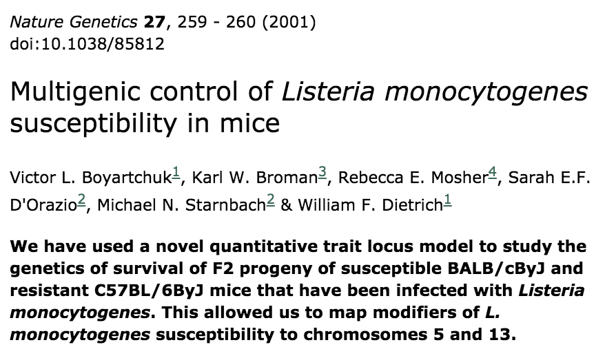
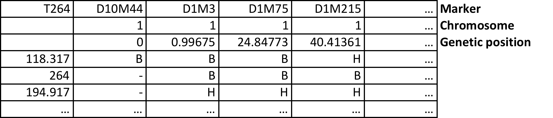
Data preparation
Phenotype

Slide 6
Read QTL data
# setup working directory
setwd(”xxx/lab07_QG/qtl")
# read QTL data
data_source <- "http://www.rqtl.org/sampledata"
qtld <- read.cross(format = "csv",
dir = data_source,
file = "listeria.csv")

Slide 7
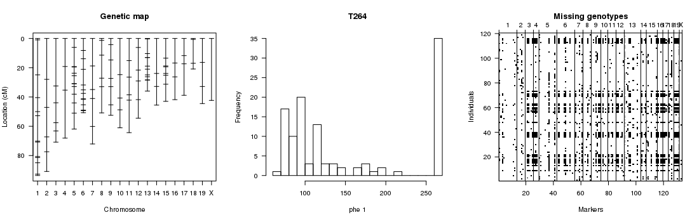
Check data
summary(qtld)
plotMap(qtld, show.marker.names = F)
plotPheno(qtld, pheno.col = 1)
plotMissing(qtld, reorder = TRUE)
# three in one
plot(qtld)

Slide 8
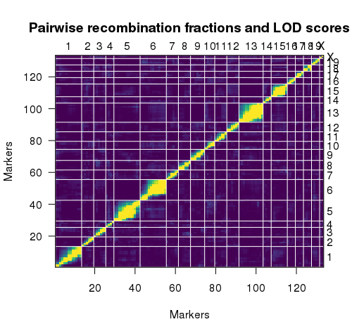
Recombination fractions
# estimate recombination fractions between all pairs of markers
qtld <- est.rf(qtld)
plotRF(qtld)
Upper left triangle:
recombination fractions (r)
Lower right triangle:
LOD scores for tests of r = 0.5

Slide 9
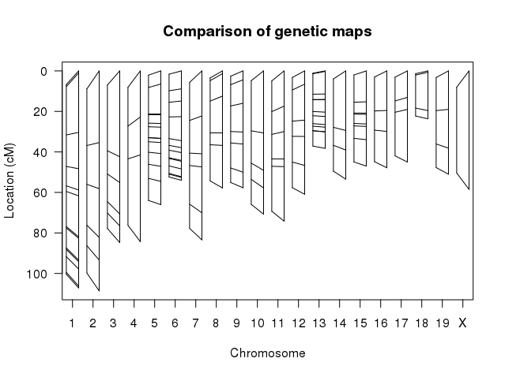
Construct a new genetic map
# Reconstruct a genetic map
newmap <- est.map(qtld, error.prob=0.01)
plotMap(qtld, newmap)
# Replace the genetic map with the new one
qtld <- replace.map(qtld, newmap)

Slide 10
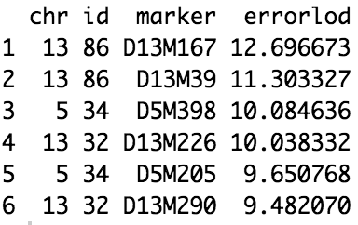
Identify genotypes that are likely wrong
# Calculate the error LOD score
qtld <- calc.errorlod(qtld, error.prob=0.01)
# List the genotypes that are likely error
top.errorlod(qtld)

Slide 11
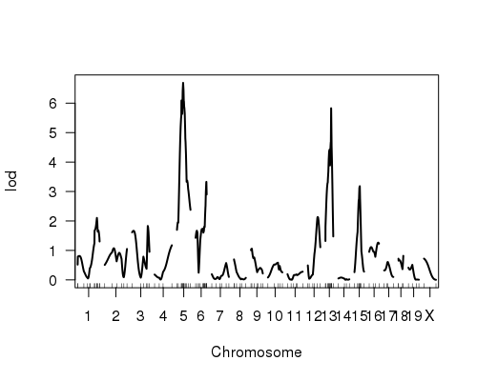
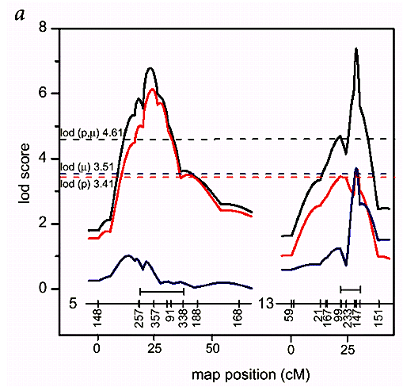
QTL mapping (interval mapping)
# determine probability of genotypes using multiple points data
qtld <- calc.genoprob(qtld, step=2, map.function="haldane")
# interval mapping
imqtl <- scanone(qtld, pheno.col=1, method="hk")
# plot
plot(imqtl)
Nature Genetics 27, 259 - 260 (2001)

Slide 12
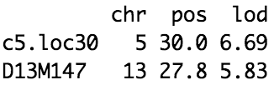
Permutation to determine a threshold
# QTL with permutation
imqtl.perm <- scanone(qtld, method = "hk", n.perm = 1000)
thresh1 <- summary(imqtl.perm , alpha = 0.05)
# plot and highlight thresholds
plot(imqtl)
abline(h = thresh1, lty = "dotted", col = "red")
# summary
summary(imqtl, perm = imqtl.perm , alpha = 0.05)

Slide 13
Updated r/qrt
qtl2

Slide 14
Goal of today’s lab
Perform QTL analysis with R/qtl
Perform GWAS analysis with GAPIT

Slide 15
Installation of GAPIT3
install.packages("devtools")
devtools::install_github("jiabowang/GAPIT3",force=TRUE)
library(GAPIT)
Note: If you have trouble for the installation, try this:
if (!require("BiocManager", quietly = TRUE))
install.packages("BiocManager")
BiocManager::install(c("snpStats", "rtracklayer", "GenomicRanges", "GenomInfoDb", "IRanges"))
devtools::install_github("SFUStatgen/LDheatmap")
devtools::install_github("jiabowang/GAPIT3",force=TRUE)
library(GAPIT)

Slide 16
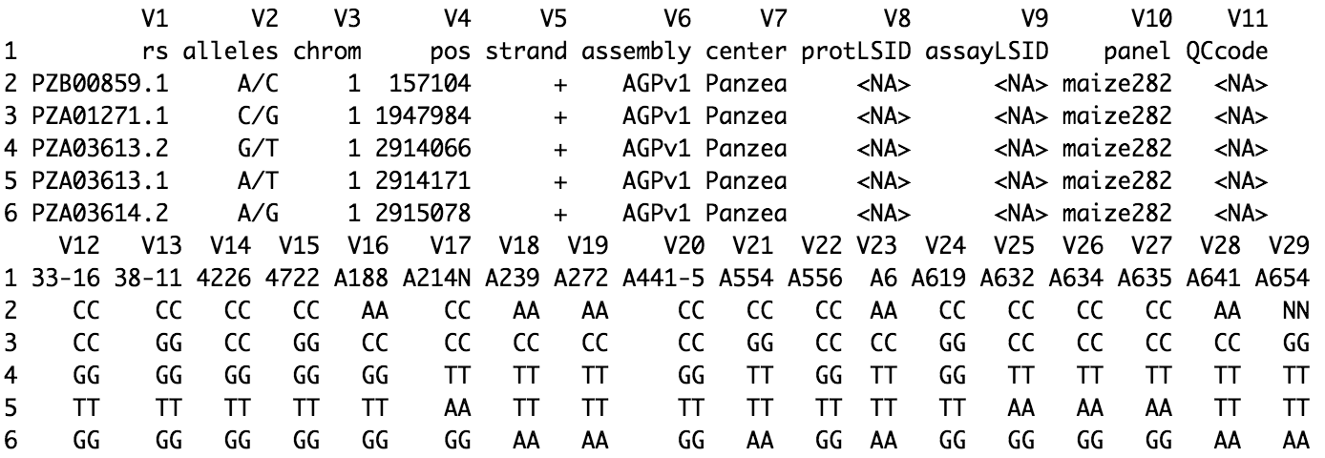
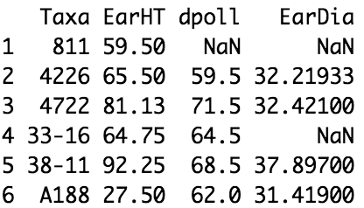
Prepare data for GAPIT
# setup working directory
setwd("xxx/lab07_QG/gwas/run1")
# data path
dp="https://people.beocat.ksu.edu/~liu3zhen/PLPTH813/labs/lab07_QTLgwas"
# step 1: Set data directory and import files
myY <- read.table(paste(dp, "/mdp_traits.txt", sep = ""), header = T)
myG <- read.delim(paste0(dp, "/mdp_genotype_test.hmp.txt"), header = F)

Slide 17
Q + K model using GAPIT
dp="https://people.beocat.ksu.edu/~liu3zhen/PLPTH813/labs/lab07_QTLgwas"
# step 1: Set data directory and import files
myY <- read.table(paste0(dp, "/mdp_traits.txt"), header=T)
myG <- read.delim(paste0(dp, "/mdp_genotype_test.hmp.txt"),
header=F)
# step 2: Run GAPIT
library("GAPIT")
myGAPIT <- GAPIT(Y=myY[, 1:2], G=myG, PCA.total=3)

Slide 18
output result - I
# output file GAPIT.MLM.EarHT.GWAS.Results.csv
out <- read.csv("GAPIT.Association.GWAS_Results.MLM.EarHT.csv")
out <- out[order(out$P.value), ]
head(out)
SNP | Chromosome | Position | P.value | maf | nobs | Rsquare.of.Model.without.SNP | Rsquare.of.Model.with.SNP | FDR_Adjusted_P.values | effect
PZA03188.4 | 1 | 280719882 | 0.000258998 | 0.28315412 | 279 | 0.2566854 | 0.2937205 | 0.5553945 | 1.88463
PZA03397.1 | 7 | 143547413 | 0.00035913 | 0.0125448 | 279 | 0.2566854 | 0.291982 | 0.5553945 | -1.176011
an1.5 | 1 | 175504926 | 0.001341724 | 0.38172043 | 279 | 0.2566854 | 0.2850641 | 1 | 2.589423
PZB01881.10 | 6 | 93263605 | 0.00212124 | 0.04301075 | 279 | 0.2566854 | 0.2826985 | 1 | NA
PZA03152.2 | 4 | 147044761 | 0.002350452 | 0.03584229 | 279 | 0.2566854 | 0.2821716 | 1 | 2.913919
PZA00277.9 | 2 | 141942814 | 0.002418229 | 0.19354839 | 279 | 0.2566854 | 0.2820258 | 1 | -1.284217

Slide 19
PCA - population structure

Slide 20
MAF and QQ plot

Slide 21
Manhattan plot
GAPIT.Association.Manhattan_Chro.MLM.EarHT.pdf

Slide 22
Supply own data of population structure and kinship
# setup working directory
setwd("xxx/lab07_QG/gwas/run2")
# step 1: Set data directory and import files
myCV <- read.table(paste(dp, "/Q_PCA3.txt", sep = ""), header = T)
myKI <- read.table(paste(dp, "/KSN.txt", sep = ""), header = F)
# step 2: Run GAPIT
myGAPIT2 <- GAPIT(Y = myY[, 1:2], G = myG,
CV = myCV, KI = myKI)

Slide 23
GAPIT with multiple models
# Run GAPIT with multiple models
myGAPIT <- GAPIT(Y=myY[, 1:2], G=myG, PCA.total=3,
model=c("FarmCPU", "Blink"),
Multiple_analysis=TRUE)
the GAPIT guide

