Slide 1
Quality check and trimming of sequencing reads Bioinformatics Applications (PLPTH813)
Sanzhen Liu
2/7/2023

Slide 2
Outline
Sequence data format
Sequence quality
Quality checking (fastQC)
Sequence data processing (seqtk)
Sequence trimming (trimmomatic)

Slide 3
FASTA
Sequence FASTA file
>SEQ_ID
ATCAACTGATGCATC
Quality FASTA file
>SEQ_ID
28 30 33 34 33 35 38 37 36 35 38 35 36 36 30

Slide 4
Quality score
Sequence FASTA file
>SEQ_ID
ATCAACTGATGCATC
Quality FASTA file
>SEQ_ID
28 30 33 34 33 35 38 37 36 35 38 35 36 36 30
Phred quality score
Q = -10 x log₁₀(p)
p = 10^{-Q/10}
where Q is the quality score and p is the probability of error
What does “Q = 30” indicate?
What is the quality score of a base with p = 0.01?
Notes:
quality_scores <- c(28, 30, 33, 34, 33, 35, 38, 37, 36, 35, 38, 35, 36, 36, 30)
sanger_format <- sprintf("%X", quality_scores + 33)
rawToChar(as.raw(as.hexmode(sanger_format)))

Slide 5
FASTQ
Sequence FASTA file
>SEQ_ID
ATCAACTGATGCATC
Quality FASTA file
>SEQ_ID
28 30 33 34 33 35 38 37 36 35 38 35 36 36 30
@Sequence name
FASTQ
@SEQ_ID
ATCAACTGATGCATC
+SEQ_ID
=?BCBDGFEDGDEE?
Sequence
+Sequence name
or
+
Quality
Notes:
quality_scores <- c(28, 30, 33, 34, 33, 35, 38, 37, 36, 35, 38, 35, 36, 36, 30)
sanger_format <- sprintf("%X", quality_scores + 33)
rawToChar(as.raw(as.hexmode(sanger_format)))

Slide 6
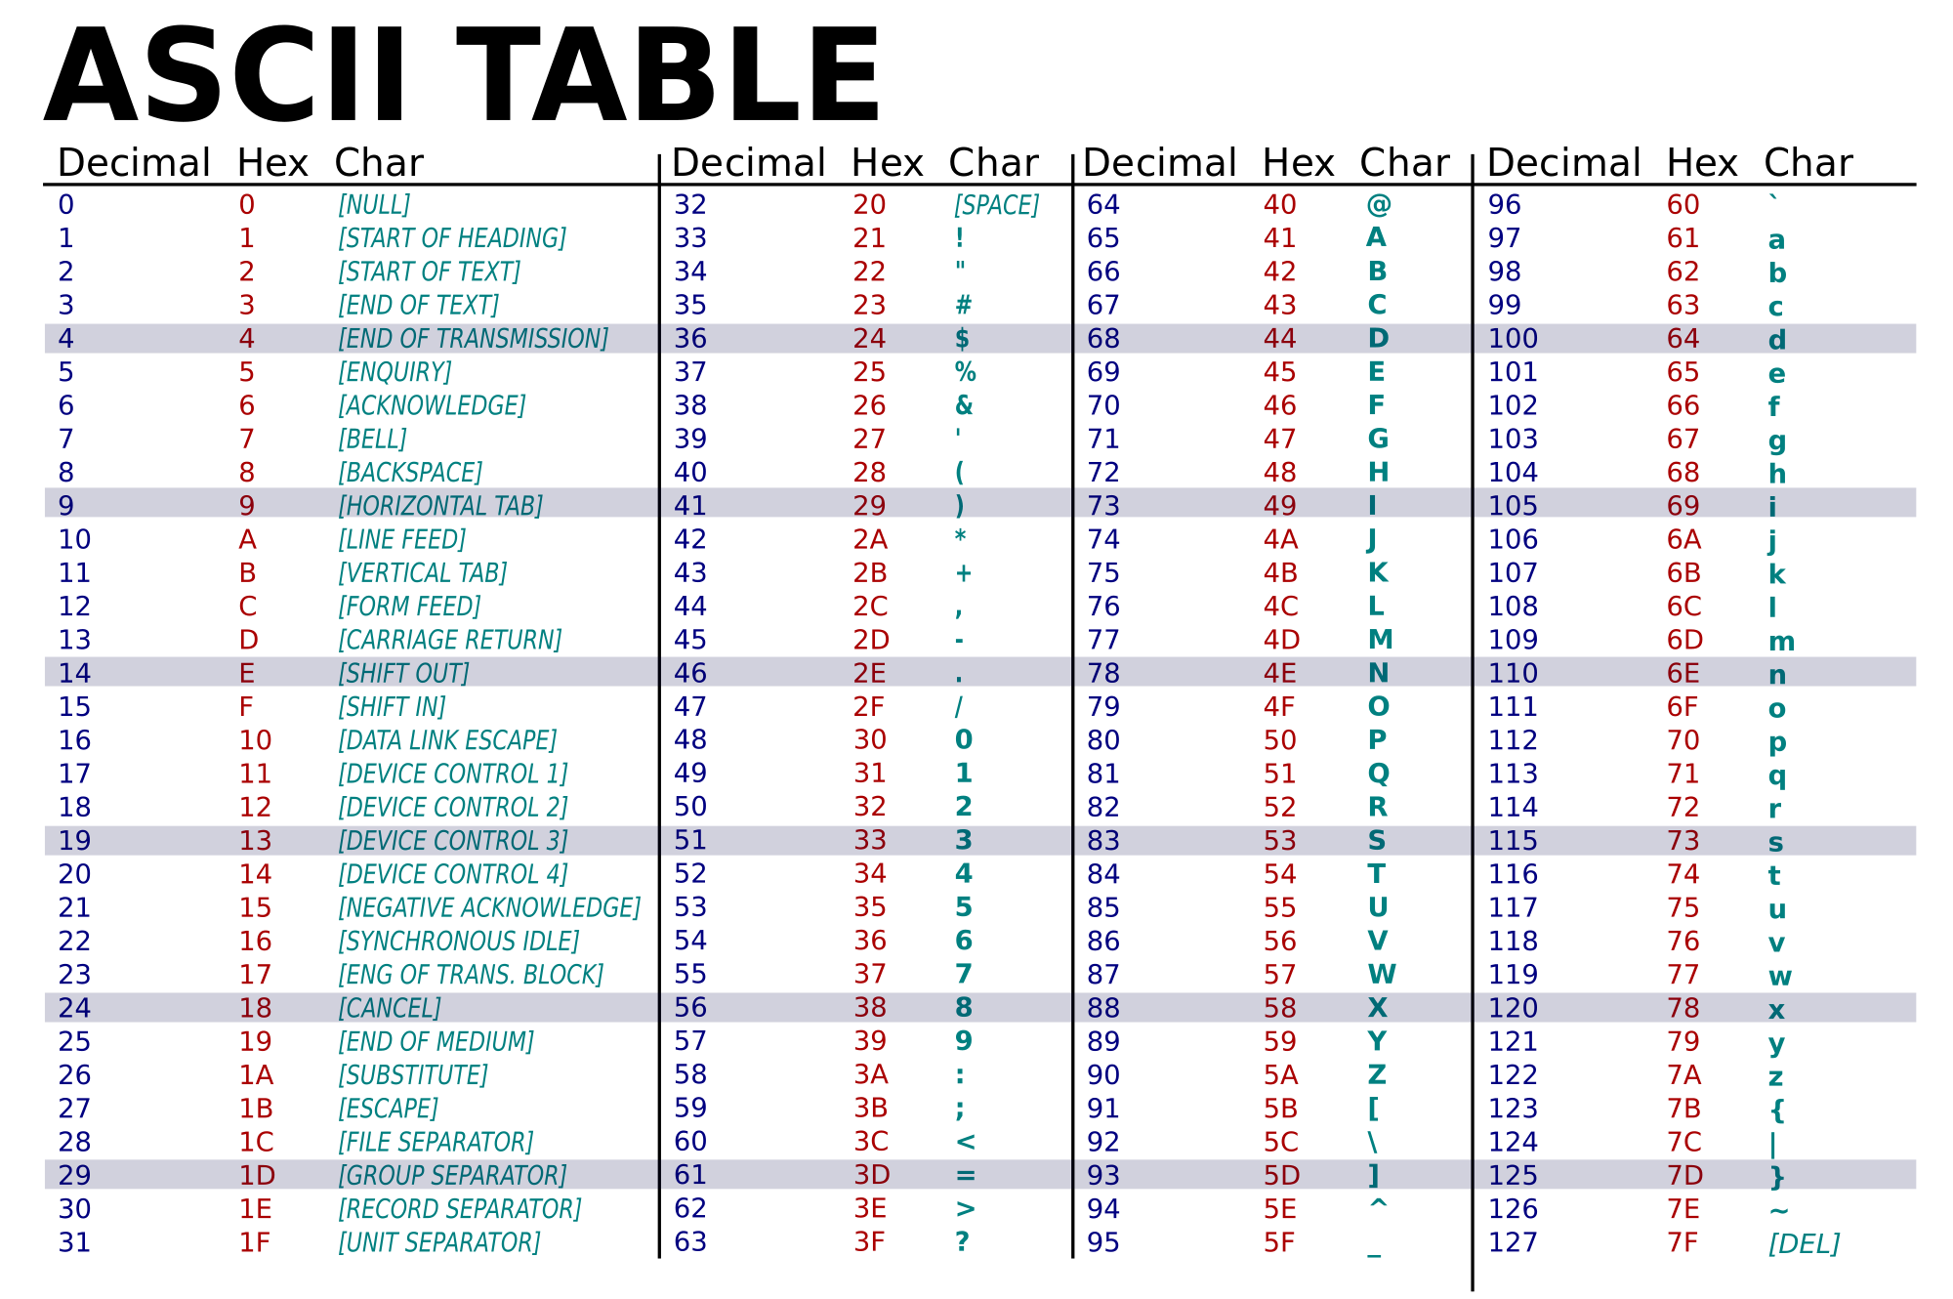
Convert quality score to characters

Slide 7
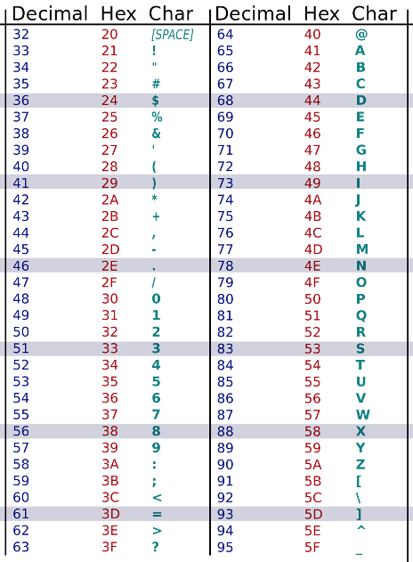
Quality codes in FASTQ
SSSSSSSSSSSSSSSSSSSSSSSSSSSSSSSSSSSSSSSSS.....................................................
..........................XXXXXXXXXXXXXXXXXXXXXXXXXXXXXXXXXXXXXXXXXXXXXX......................
...............................IIIIIIIIIIIIIIIIIIIIIIIIIIIIIIIIIIIIIIIII......................
.................................JJJJJJJJJJJJJJJJJJJJJJJJJJJJJJJJJJJJJJJ......................
LLLLLLLLLLLLLLLLLLLLLLLLLLLLLLLLLLLLLLLLLL....................................................
!"#$%&'()*+,-./0123456789:;<=>?@ABCDEFGHIJKLMNOPQRSTUVWXYZ[\]^_`abcdefghijklmnopqrstuvwxyz{|}~
| | | | | |
33 59 64 73 104 126
0........................26...31.......40
Sanger Phred+33
raw reads typically (0, 40)
Source: en.wikipedia.org/wiki/FASTQ_format
= ? B
28 30 33

Slide 8
FASTQ quantity could have different codes
SSSSSSSSSSSSSSSSSSSSSSSSSSSSSSSSSSSSSSSSS.....................................................
..........................XXXXXXXXXXXXXXXXXXXXXXXXXXXXXXXXXXXXXXXXXXXXXX......................
...............................IIIIIIIIIIIIIIIIIIIIIIIIIIIIIIIIIIIIIIIII......................
.................................JJJJJJJJJJJJJJJJJJJJJJJJJJJJJJJJJJJJJJJ......................
LLLLLLLLLLLLLLLLLLLLLLLLLLLLLLLLLLLLLLLLLL....................................................
!"#$%&'()*+,-./0123456789:;<=>?@ABCDEFGHIJKLMNOPQRSTUVWXYZ[\]^_`abcdefghijklmnopqrstuvwxyz{|}~
| | | | | |
33 59 64 73 104 126
0........................26...31.......40
0........9.............................40
0.2......................26...31.........41
Sanger Phred+33, raw reads typically (0, 40)
Illumina 1.3+ Phred+64, raw reads typically (0, 40)
Illumina 1.8+ Phred+33, raw reads typically (0, 41)
Source: en.wikipedia.org/wiki/FASTQ_format

Slide 9
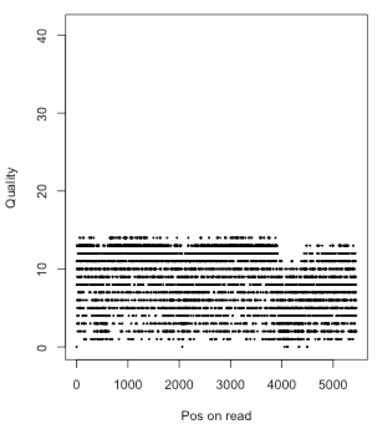
What platform was this read generated from?
Average quality?
Average probability of error rate?

Slide 10
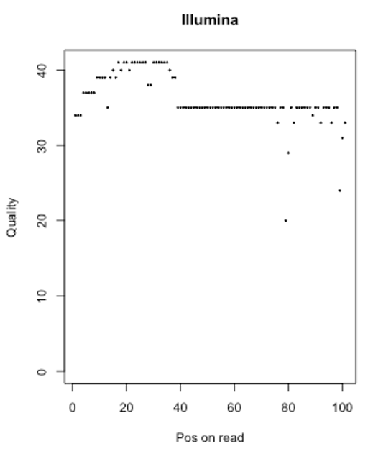
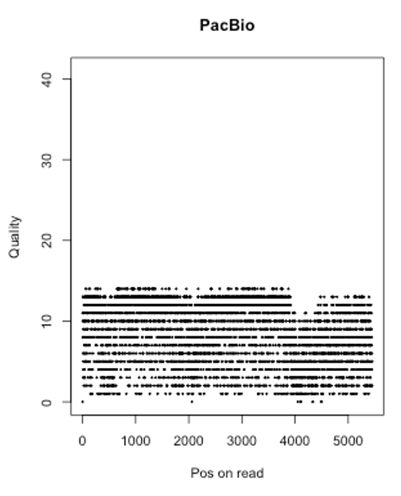
Typical reads in different platforms
Read length
Read quality

Slide 11

Illumina FASTQ
Single-end FASTQ file
@SEQ_ID
ATCAACTGATGCATC
+SEQ_ID
!''*((((***+))%
Paired-end FASTQ files
File1: forward seq
File2: reverse seq
@SEQ_ID/1
ATCAACTGATGCATC
+
!''*((((***+))%
@SEQ_ID/2
GATTTGGGGTTCCTG
+
)(%%%%).1***-+*

Slide 12
Overview sequencing data

Slide 13
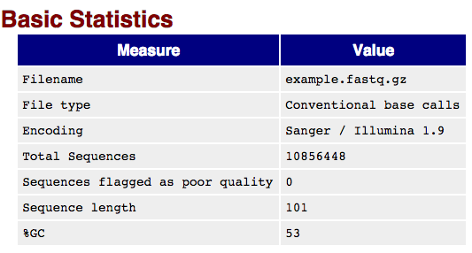
Data QC – FASTQC (I)
FASTQC is a tool to examine the quality of sequencing data
Easy to run: fastqc example.fastq
Rich output information
Output presented in the html format

Slide 14
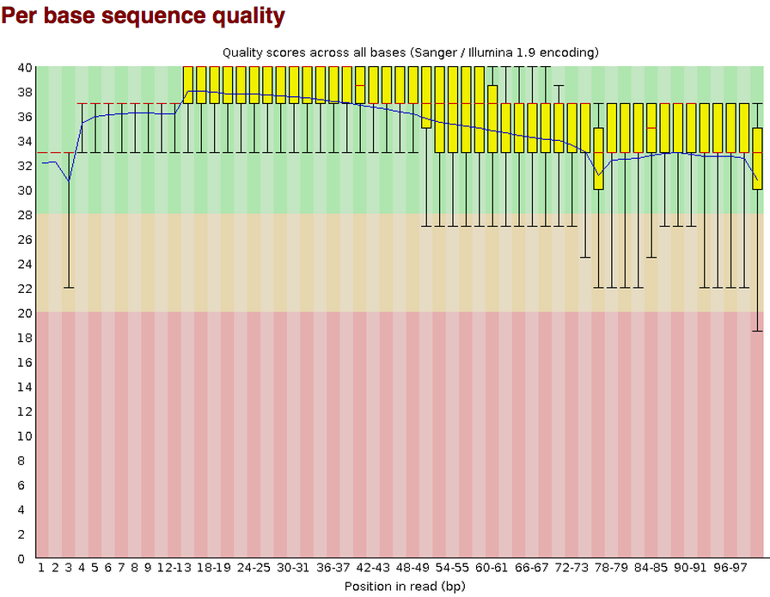
FASTQC (II)

Slide 15
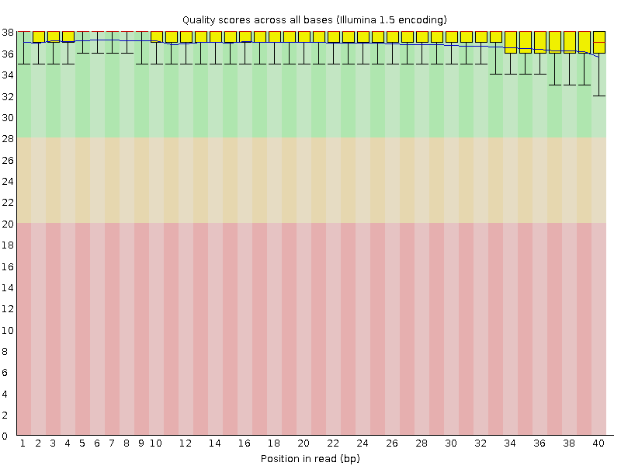
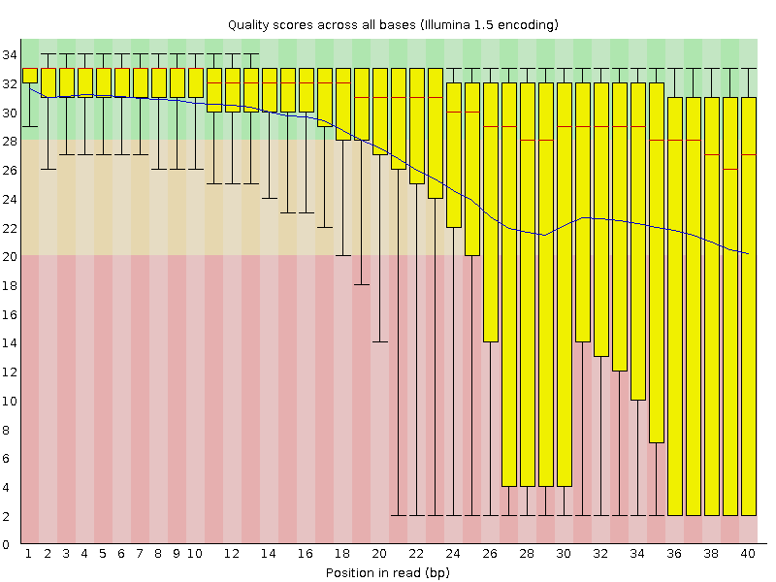
Good and Bad data
More information, please read:
http://www.bioinformatics.babraham.ac.uk/projects/fastqc/good_sequence_short_fastqc.html
http://www.bioinformatics.babraham.ac.uk/projects/fastqc/bad_sequence_fastqc.html

Slide 16
Tools for FAST[AQ] - seqtk
seqtk is a tool for processing sequences in the FASTA/Q format.
seq | common transformation of FASTA/Q
comp | get the nucleotide composition of FASTA/Q
sample | subsample sequences
subseq | extract subsequences from FASTA/Q
fqchk | fastq QC (base/quality summary)
mergepe | interleave two PE FASTA/Q files
trimfq | trim FASTQ using the Phred algorithm
hety | regional heterozygosity
gc | identify high- or low-GC regions
mutfa | point mutate FASTA at specified positions
mergefa | merge two FASTA/Q files
famask | apply a X-coded FASTA to a source FASTA
dropse | drop unpaired from interleaved PE FASTA/Q
rename | rename sequence names
randbase | choose a random base from hets
cutN | cut sequence at long N
listhet | extract the position of each het

Slide 17
seqtk examples (I)
Conversion of a FASTQ to a FASTA
seqtk seq -A in.fq > out.fa
seqtk seq -A in.fq.gz > out.fa
Reverse complement FASTA/Q:
seqtk seq -r in.fq > out.fq
Extract sequences with names in file name.lst, one sequence name per line:
seqtk subseq in.fq name.lst > out.fq
github.com/lh3/seqtk

Slide 18
seqtk examples (II)
Subsample 10,000 read pairs from two large paired FASTQ files
#(remember to use the same random seed to keep pairing):
seqtk sample -s100 read1.fq 10000 > sub1.fq
seqtk sample -s100 read2.fq 10000 > sub2.fq
Trim 5bp from the left end of each read and 10bp from the right end:
seqtk trimfq -b 5 -e 10 in.fa > out.fa
Trim low-quality bases from both ends using the Phred algorithm:
seqtk trimfq in.fq > out.fq
Quality trimming
github.com/lh3/seqtk

Slide 19
Sequence trimming
Quality trimming: to remove low quality sequences
Adaptor trimming: to remove adaptor contamination

Slide 20
Quality trimming
Window scan method
the major steps in the quality trimming process involve calculating average quality within certain windows along the sequence
Sliding windows (window size and step size)
Maximum average errors (minimum average quality)
Average quality
Bioinformatics, 2001, 17:1093-1104

Slide 21
Quality trimming example
Window = 3 bp
Step = 1 bp
Minimum average quality score = 15
Raw read:
A | C | G | T | C | G | T | A | G
30 | 35 | 38 | 32 | 33 | 31 | 16 | 12 | 10
34
35
34
32
27
19
13
Clean read:
A | C | G | T | C | G

Slide 22
Adaptor contamination and trimming
DNA fragment (or Insert)
Amplicon
Adaptor 1
Adaptor 2
SE read
Single-end (SE)
SE read
Forward read
Reverse read
Paired-end (PE)
Forward read
Reverse read

Slide 23
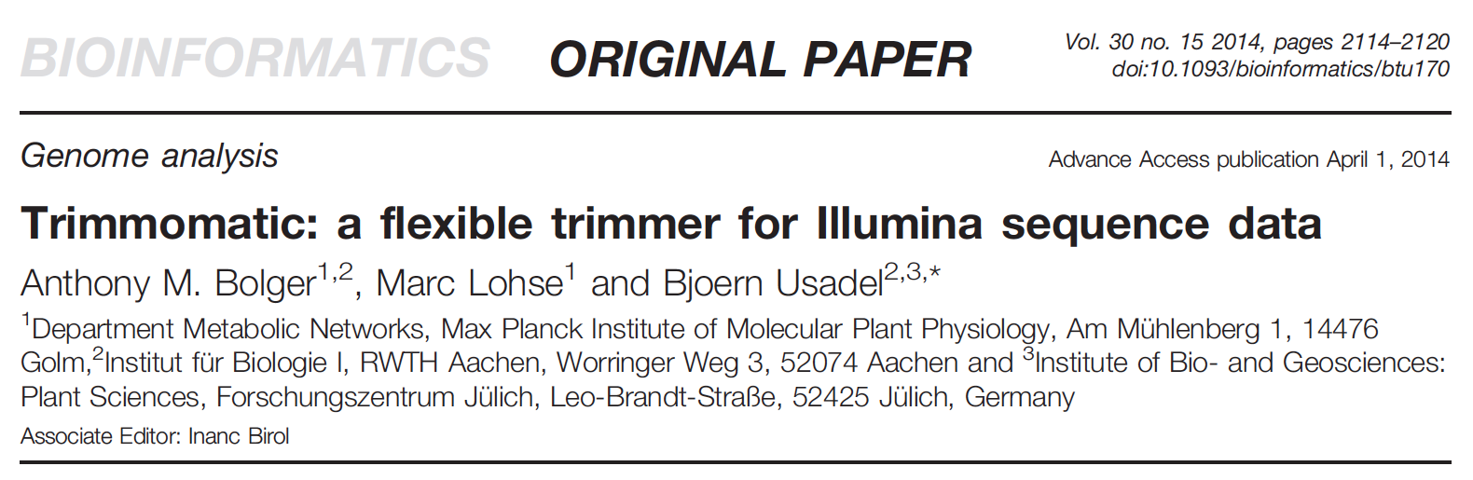
Trimmomatic – an innovative trimming tool

Slide 24
Trimmomatic – simple mode
Read 5’-3’
If an alignment was identified, the alignment region plus the remainder after the alignment are removed.
Read 5’-3’
Read 5’-3’
Read 5’-3’
Valid sequence
Trimmed sequence
Read 5’-3’
Notes:
In simple mode, each read is scanned from
the 5’ end to the 3’ end to determine if any of the user-provided
adapters are present. The standard ‘seed and extend’ approach
(Li and Homer, 2010) is used to find initial matches between the
technical sequences and the reads. The seed is not required to
match perfectly, and a user-defined number of mismatches are
tolerated. Based on this seed match, a local alignment is performed.
If the alignment score exceeds the user-defined threshold,
the aligned region plus the remainder after the alignment are
removed.

Slide 25
Simple mode: pro and cons
Simple mode has the advantage that it can detect any technical sequence at any location in the read, provided that the alignment is sufficiently long and the read is sufficiently accurate.
Issue: if the adaptor sequence on the read is too short to make the alignment, the adaptor sequence can not be trimmed.

Slide 26
Trimmomatic – panlindrome mode
the main algorithmic innovation is to identify adapter sequences through making use of paired information
Forward read
Reverse read
Forward read
Reverse read
Forward read
Reverse read
Notes:
Global alignment scoring is used to ensure an end-to-end match across the entire overlap

Slide 27
Trimmomatic – panlindrome mode
Forward read
Reverse read
A
B
C
D
Valid sequence
Trimmed sequence
Notes:
Global alignment scoring is used to ensure an end-to-end match across the entire overlap

Slide 28
Trimmomatic – panlindrome mode
Forward read
Reverse read
Three pre-required features:
1. both reads in a pair consist of an equal number of valid bases
2. the valid sequence of the two reads are reverse complements
3. the valid sequence of two read are followed by contaminating sequence from the “opposite” adapters
Forward read
Reverse read
Notes:
Global alignment scoring is used to ensure an end-to-end match across the entire overlap

Slide 29
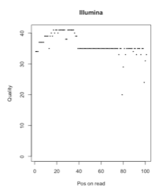
Quality trimming in Trimmomatic
Sliding window quality trimming (SW)
Scan reads from the 5’ end of the read, and remove the 3’ end of the read when the average quality of a group of bases drops below a specified threshold.
Maximum Information (MI)
The trimming process becomes increasingly strict as it progresses through the read, rather than to apply a fixed quality threshold.

Slide 30
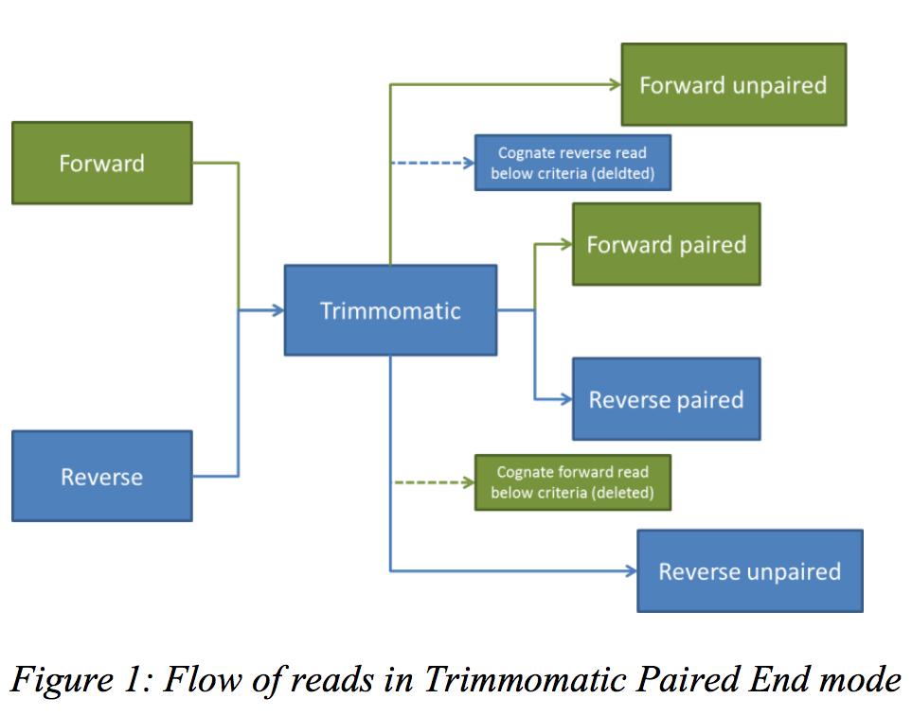
Output from Trimmomatic

Slide 31
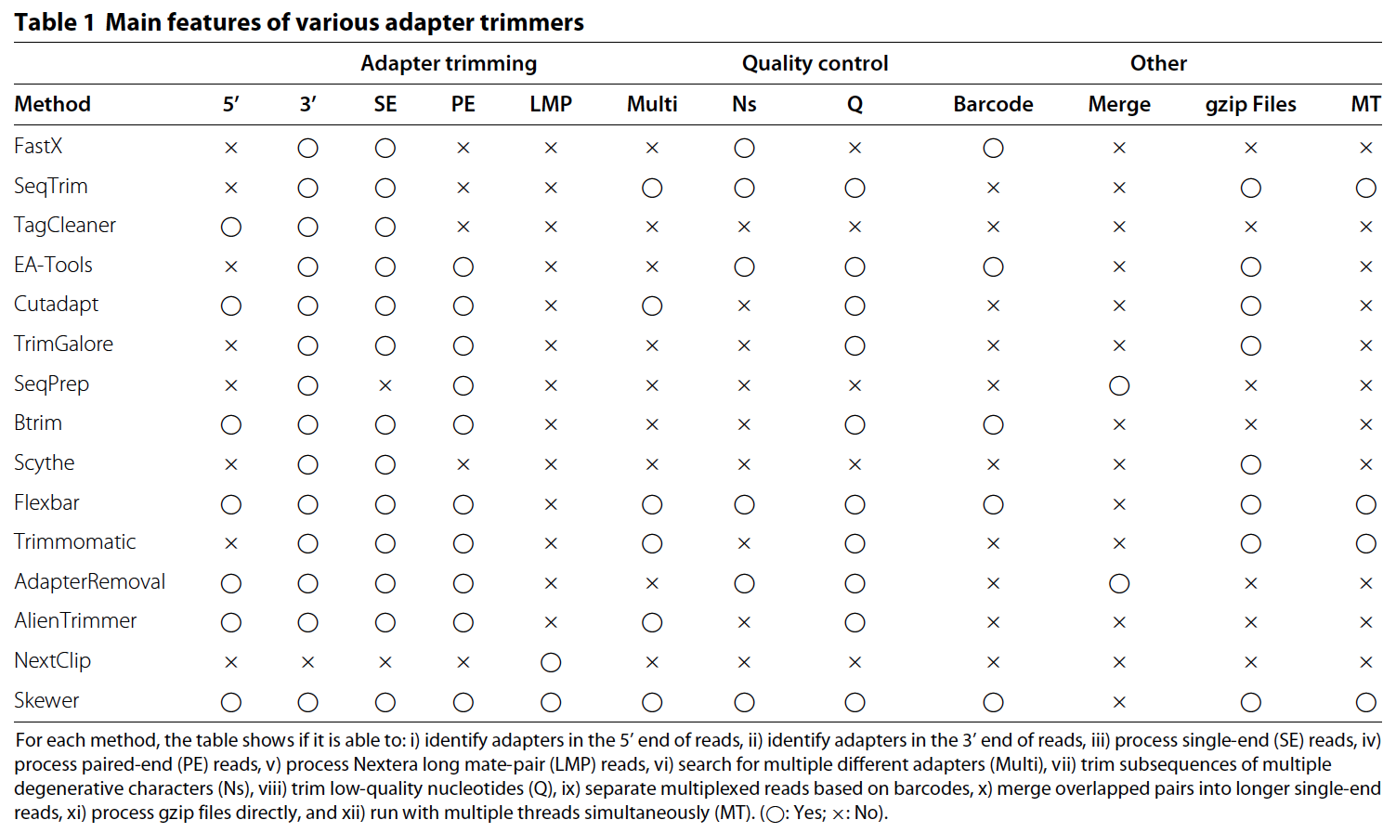
Comparison among trimming software packages

Slide 32
Summary
FASTA and FASTQ
Sequence quality (Phred)
fastQC for quality checking
Trimmomatic for quality and adaptor trimming

Slide 33
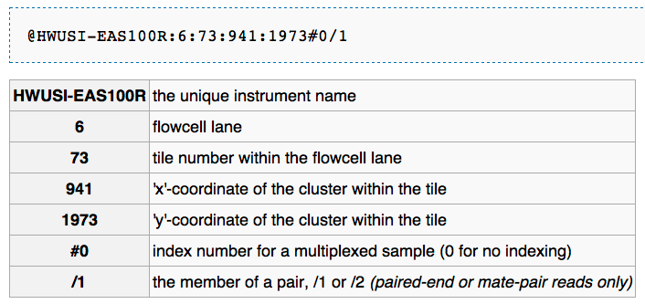
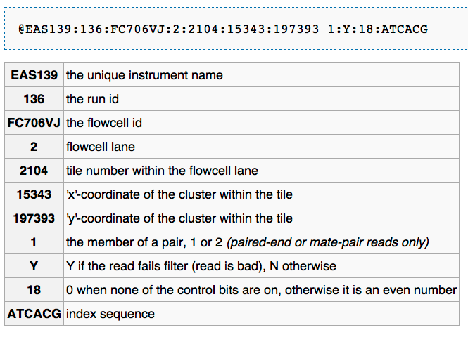

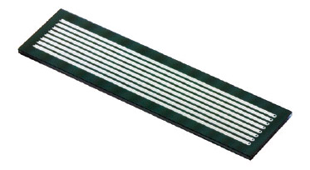
Illumina reads
Standard data format - FASTQ
@HWI-EAS225:3:1:2:854#0/1
GGGGGGAAGTCGGCAAAATAGATCCGTAACTTCGGG
+
a`abbbbabaabbababb^`[aaa`_N]b^ab^``a
http://en.wikipedia.org/wiki/FASTQ_format

