Slide 1
Lab – DE Bioinformatics Applications (PLPTH813)
Sanzhen Liu
4/24/2025

Slide 2
Install DESeq2
R code
if (!requireNamespace("BiocManager",quietly=T))
install.packages("BiocManager")
BiocManager::install("DESeq2")
Notes:
install.packages(“matrixStats”)
BiocManager::install("MatrixGenerics", "DelayedArray", "SummarizedExperiment")

Slide 3
RNA-seq procedure
totalRNA
RNA to sequencing reads
1
sequencing
reads
reads to read counts per gene
trim,alignment
2
read counts
read counts to significant genes
statistical test
3
significance

Slide 4
Directories
Beocat terminal
mkdir ~/BA25/labs/lab11
cd ~/BA25/labs/lab11

Slide 5
Codes for today’s lab
Beocat terminal
wget https://people.beocat.ksu.edu/~liu3zhen/PLPTH813/labs/DErun.tar.gz
tar -xf DErun.tar.gz

Slide 6
RNA-seq procedure
totalRNA
RNA to sequencing reads
1
sequencing
reads
reads to read counts per gene
trim,alignment
2
read counts
read counts to significant genes
statistical test
3
significance

Slide 7
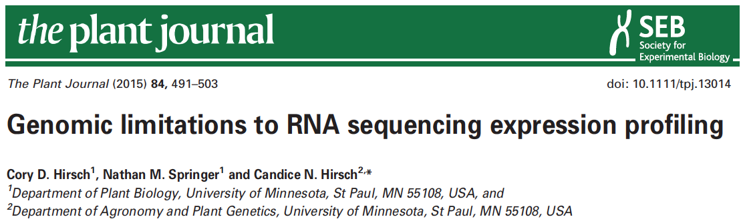

data information
SRR1238718
Makarevitch et al., 2015
Hirsch et al., 2016

Slide 8
Part I: Data downloading
Introduction of Sequence Read Archive (SRA) (2007)
Data download (SRA toolkit)
- fasterq-dump

Slide 9
sra-toolkit
wget https://ftp-trace.ncbi.nlm.nih.gov/sra/sdk/3.2.1/sratoolkit.3.2.1-alma_linux64.tar.gz
tar -xf sratoolkit.3.2.1-alma_linux64.tar.gz
mv sratoolkit.3.2.1-alma_linux64 sratoolkit

Slide 10
format conversion - fastq-dump in Beocat
fasterq-dump [options] <accession>
#!/bin/bash -l
#SBATCH --mem-per-cpu=16G
#SBATCH --time=12:00:00
#SBATCH --nodes=1
#SBATCH –cpus-per-task=1
../utils/sratoolkit/bin/fasterq-dump
--split-files <accession>
../utils/sratoolkit/bin/fasterq-dump --split-files SRR1238718
SRR1238718_1.fastq
SRR1238718_2.fastq
No running
Notes:
# --split-files: write reads into different files

Slide 11
Beocat pipeline to download SRA in batch - I
# step 1: Prepare data: dataset.txt
Order | ID | Genotype | Sample | Treatment | Citation
1 | SRR1238718 | B73 | norm1 | norm | Hirsch2015TPJ
2 | SRR1819617 | B73 | norm2 | norm | Hirsch2015TPJ
3 | SRR1819621 | B73 | norm3 | norm | Hirsch2015TPJ
4 | SRR1238717 | B73 | cold1 | cold | Hirsch2015TPJ
5 | SRR1819204 | B73 | cold2 | cold | Hirsch2015TPJ
6 | SRR1819205 | B73 | cold3 | cold | Hirsch2015TPJ
Makarevitch et al., 2015
Hirsch et al., 2016

Slide 12
Beocat pipeline to download SRA in batch - II
# must check
meta_file=dataset.txt
srr_col=2
rename_col=4
# running
perl ../utils/scripts/fasterq_dump.sbatch.pl \
--in $meta_file \
--srrcol $srr_col
# create a script to rename downloaded files
cut $meta_file -f $srr_col,$rename_col | \
grep "^[EDS]RR" | \
sed 's/^/rename /g' | sed 's/\t/ /g' | \
sed 's/$/ *fastq/g’ > 2c_rename.sh
working directory: 1_raw
bash 1c_dn.sh

Slide 13
Beocat pipeline to download SRA in batch - III
# step 3: Check and run "rename.sh" to change names (optional)
After downloading is finished, …
bash 2c_rename.sh
# extract a subset for saving alignment time
bash 3c_subsample.sh
working directory: 1_raw

Slide 14
Part II. Trimming
perl ../utils/scripts/trimmomatic.sbatch.pl \
--mem 4G \
--time 1-00:00:00 \
--trim_shell "../utils/scripts/trimmomatic.pe.sh" \
--trimmomatic "../utils/Trimmomatic-0.38/trimmomatic-0.38.jar" \
--adaptor_file "../utils/Trimmomatic-0.38/adapters/TruSeq3-PE.fa" \
--indir "../1_raw" \
--outdir "." \
--fq1feature "_1.fastq" \
--fq2feature "_2.fastq" \
--threads 4 \
--min_len 40
working directory: 2_trim
bash 1c_trim.sh

Slide 15
Part II. Trimming: sbatch command
#!/bin/bash -l
#SBATCH --mem-per-cpu=4
#SBATCH --time=1-00:00:00
#SBATCH --cpus-per-task=4
module load Java
bash /homes/liu3zhen/local/slurm/trimmomatic/trimmomatic.pe.sh \
../utils/Trimmomatic-0.38/trimmomatic-0.38.jar \
../utils/Trimmomatic-0.38/adapters/TruSeq3-PE.fa \
../1_raw . _1.fastq _2.fastq 4 40 xxx.fastq
No running

Slide 16
RNA-Seq procedure
totalRNA
RNA to sequencing reads
1
sequencing
reads
reads to read counts per gene
trim,alignment
2
read counts
read counts to significant genes
statistical test
3
significance

Slide 17

STAR
as of 4/18/2021
High speed
Unbiased de novo detection of canonical junctions
discovery of non-canonical splices and chimeric transcripts
Capable of mapping full-length RNA sequences

Slide 18
STAR Reference genome indexing
sbatch 1c_star.index.sh
working directory: 0_ref
Index the reference genome with the annotation file
#!/bin/bash
#SBATCH --cpus-per-task=4
#SBATCH --mem-per-cpu=8g
#SBATCH --time=1-00:00:00
module load STAR
STAR --runThreadN 4 \
--runMode genomeGenerate \
--genomeDir "." \
--genomeFastaFiles B73v5.fasta \
--sjdbGTFfile B73v5.gtf \
--sjdbOverhang 100
Notes:
NOTE: In case of reads of varying length, the ideal value for --sjdbOverhang is max(ReadLength)-1. In most cases, the default value of 100 will work similarly to the ideal value.
9814814 1c_star.in wizard24 1 n 4 c 29.74gb/ 32gb 00:47:06 COMPLETED

Slide 19
Part III. STAR: sbatch script (one sample)
module load STAR
STAR --runThreadN 1 \
--genomeDir /homes/liu3zhen/teaching/datasets/DE/0-ref \
--readFilesIn ../2_trim/cold1.R1.pair.fq ../2_trim/cold1.R2.pair.fq \
--alignIntronMax 100000 \
--alignMatesGapMax 100000 \
--outFileNamePrefix cold1 \
--outSAMattrIHstart 0 \
--outSAMmultNmax 1 \
--outSAMstrandField intronMotif \
--outFilterIntronMotifs RemoveNoncanonicalUnannotated \
--outSAMtype BAM SortedByCoordinate \
--quantMode GeneCounts \
--outFilterMismatchNmax 1 \
--outFilterMismatchNoverLmax 0.02 \
--outFilterMatchNmin 40 \
--outSJfilterReads Unique \
--outFilterMultimapNmax 1 \
--outFilterMultimapScoreRange 2
No running

Slide 20
Part III. STAR: generate sbatch scripts and submit jobs
module load STAR
perl ../utils/scripts/STAR.module.sbatch.pl \
--mem 48 --threads 1 --time 12:00:00 \
--indir ../2_trim \
--dbdir ../0_ref \
--fq1feature .R1.pair.fq \
--fq2feature .R2.pair.fq \
--alignIntronMax 100000 \
--alignMatesGapMax 100000 \
--outSAMattrIHstart 0 \
--outSAMmultNmax 1 \
--outSAMstrandField intronMotif \
--outFilterIntronMotifs RemoveNoncanonicalUnannotated \
--outSAMtype "BAM SortedByCoordinate" \
--quantMode GeneCounts \
--outFilterMismatchNmax 1 \
--outFilterMismatchNoverLmax 0.05 \
--outFilterMatchNmin 40 \
--outSJfilterReads Unique \
--outFilterMultimapNmax 1 \
--outFilterMultimapScoreRange 2
working directory: 3_aln
No running

Slide 21
Part III. STAR: to generate sbatch scripts and submit jobs
module load STAR
perl ../utils/scripts/STAR.module.sbatch.pl \
--mem 48 --threads 1 --time 12:00:00 \
--indir ../../2_trim \
--dbdir ../../0_ref \
--fq1feature .R1.pair.fq \
--fq2feature .R2.pair.fq \
--alignIntronMax 100000 \
--alignMatesGapMax 100000 \
--outSAMattrIHstart 0 \
--outSAMmultNmax 1 \
--outSAMstrandField intronMotif \
--outFilterIntronMotifs RemoveNoncanonicalUnannotated \
--outSAMtype "BAM SortedByCoordinate" \
--quantMode GeneCounts \
--outFilterMismatchNmax 1 \
--outFilterMismatchNoverLmax 0.05 \
--outFilterMatchNmin 40 \
--outSJfilterReads Unique \
--outFilterMultimapNmax 1 \
--outFilterMultimapScoreRange 2
Working directory: 3_aln/testrun/
bash 1c_star.sh

Slide 22
STAR output – cold1 sample
cold1Aligned.sortedByCoord.out.bam
cold1Log.final.out
cold1Log.out
cold1Log.progress.out
cold1ReadsPerGene.out.tab
cold1SJ.out.tab

Slide 23
Install DESeq2
R code
if (!requireNamespace("BiocManager",quietly=T))
install.packages("BiocManager")
BiocManager::install("DESeq2")
Notes:
install.packages(“matrixStats”)
BiocManager::install("MatrixGenerics", "DelayedArray", "SummarizedExperiment")

Slide 24
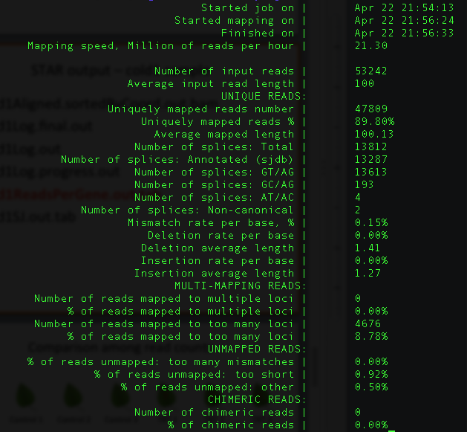
cold1Log.final.out

Slide 25
cold1ReadsPerGene.out.tab
column 1: gene ID
column 2: counts for unstranded RNA-seq
column 3: counts for the 1st read strand aligned with RNA (htseq-count option -s yes)
column 4: counts for the 2nd read strand aligned with RNA (htseq-count option -s reverse)
Notes:
https://github.com/alexdobin/STAR/issues/703
N_multimapping is the total number of multimapping reads, which are not counted at all, so the number is the same for each column. N_noFeature: if a read overlaps a gene on the opposite strand, it will be counted as noFeature for one of the stranded columns, but will be counted towards the gene (and not as noFeature) in the unstranded column. Hence N_noFeature(unstranded) can be < N_noFeature(+) + N_noFeature(-).
https://groups.google.com/g/rna-star/c/qFLxINhF7cI/m/D0v-BRtpDAAJ?pli=1
if exons of these two genes overlap completely on *opposite* strands, the unstranded counting will yield 0 - all the reads will be considered "ambiguous".
The stranded counts, however, will be done towards the correspodning gene.
The easiest way to check this is to view annotations on a genome browser.

Slide 26
RNA-Seq procedure
totalRNA
RNA to sequencing reads
1
sequencing
reads
reads to read counts per gene
trim,alignment
2
read counts
read counts to significant genes
statistical test
3
significance

Slide 27
R codes for differential expression analysis
4_DE/1c_de.R

Slide 28
Part IV. DE: merge counting data
R code
setwd("~/BA25/labs/lab11/DErun/4_DE")
library("DESeq2")
### Parameters - Subject to change
datapath <- "../3_aln"
suffix <- "ReadsPerGene.out.tab"
count.files <- dir(path = datapath, pattern = suffix)

Slide 29
Part IV. DE: merge counting data
### merge all counts
allcounts <- NULL
for (cf in count.files) {
counts <- read.delim(paste0(datapath, "/", cf), header = F,
stringsAsFactors = F, skip = 4)
base <- gsub(suffix, "", cf)
counts <- counts[, 1:2]
colnames(counts) <- c("Gene", base)
### merge data
if (is.null(allcounts)) {
allcounts <- counts
} else {
allcounts <- merge(allcounts, counts, by = "Gene")
}
}
R code

Slide 30
data preparation for DESeq2 - I
R code
# count information
geneid <- allcounts$Gene
in.data <- allcounts[, 2:7]
in.data <- as.matrix(in.data)
rownames(in.data) <- geneid

Slide 31
data preparation for DESeq2 - II
R code
# sample names and grouping information (treatment)
sample.ids <- colnames(in.data)
treatment <- c("cold", "cold", "cold", "norm", "norm", "norm")
sample.info <- data.frame(row.names=sample.ids, trt=treatment)
dds <- DESeqDataSetFromMatrix(countData=in.data,
colData=sample.info, formula(~trt))
dds <- DESeq(dds, "Wald")

Slide 32
Wald test
Wald test is the default method in DESeq2 when comparing two groups.
DESeq2 implements the Wald test by:
Divide LFC (log2 fold change) by its standard error to obtain a z-statistic
The z-statistic is compared to a standard normal distribution, and a p-value is computed

Slide 33
Part V. DE using a developed function - I
R
### load modules
source("../utils/scripts/DESeq2.single.trt.R")
source("../utils/scripts/DE.summary.R")
### setup FDR
fdr.cutoff <- 0.05
# data reformat
input <- allcounts[, 2:7]
rownames(input) <- allcounts[, 1]

Slide 34
Part V. DE using a developed function - II
R
# DE statistical analysis:
DE.out <- DESeq2.single.trt(input.matrix = input,
min.mean.reads = 5,
group1.col = 1:3,
group2.col = 4:6,
comparison = c("norm", "cold"),
geneID = rownames(input),
fdr = fdr.cutoff,
logpath = ".",
logfile = "cold-norm.log.md")

Slide 35
Part V. DE using a developed function - III
R
# merge DE with counts and output DE result:
DE.out <- data.frame(DE.out)
final.out <- merge(allcounts, DE.out,
by.x = "Gene",
by.y = "GeneID")
write.table(final.out, "cold-norm.DESeq2.txt",
sep="\t", quote=F, row.names=F)

Slide 36
DE output

Slide 37
Part VI. DE summary
R
de.summary <- DE.summary(DE.path=".",
DE.files="cold-norm.DESeq2.txt",
qval.feature=".qval",
log2FC.feature=".log2FC",
fdr=fdr.cutoff,
out.path=".",
out.file="cold-norm.DESeq2.summary.txt")

Slide 38
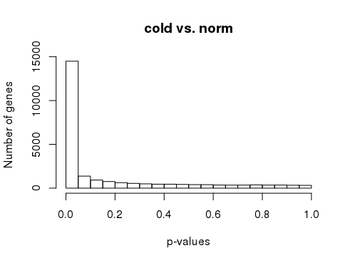
p-values
R
# p-value histogram
hist(DE.out$cold_norm.pval, xlab = "p-values",
ylab = "Number of genes", main = "cold vs. norm")

Slide 39
GO enrichment (I)
R
# install and load "clusterprofiler"
if (!require("BiocManager", quietly=T)) install.packages("BiocManager")
if (!require("clusterProfiler")) BiocManager::install("clusterProfiler")
library("clusterProfiler")
library(GO.db)

Slide 40
GO enrichment – (II)
R
# maize GO (2 columns)
setwd("~/BA25/labs/lab11/DErun/5_GO")
go <- read.delim("../data/B73_GO.maizeGDB.table.txt", header=F)
colnames(go) <- c("Gene", "GO")
go <- go[, c("GO", "Gene")] # switch gene and GO
# remove invalid GO
is_go_valid <- go$GO %in% keys(GOTERM)
go <- go[is_go_valid, ]

Slide 41
GO enrichment – (III)
R
# DEG
de <- read.delim("../4_DE/cold-norm.DESeq2.txt", stringsAsFactors=F)
deg <- de$Gene[de$cold_norm.qval<0.05 & abs(de$cold_norm.log2FC)>1]
# GO enrichment
de_go <- go[go$Gene %in% de$Gene, ]
goenrich <- enricher(deg, TERM2GENE=de_go)
go_ids <- goenrich@result$ID
go_terms <- Term(GOTERM[go_ids]) # convert ID to Term
goenrich@result$Description <- go_terms

Slide 42
GO enrichment – (IV: plotting)
R
# plotting
dotplot(goenrich, showCategory=10, title="GO Enrichment Barplot")
barplot(goenrich, showCategory=10, title="GO Enrichment Barplot")

