Slide 1
R Bioinformatics Applications (PLPTH813)
Sanzhen Liu
2/11/2021

Slide 2
Outline
How to access to R and Rstudio?
Data types
Data input and output
Package installation
Plotting

Slide 3
Rstudio
Rstudio is an open source integrated development environment (IDE) for R
On your own machine (Rstudio Desktop)
Download and install R
Download and install Rstudio
Use Rstudio at Beocat (Rstudio server)
https://rstudio.beocat.cis.ksu.edu/
Your KSU ID and password to login

Slide 4
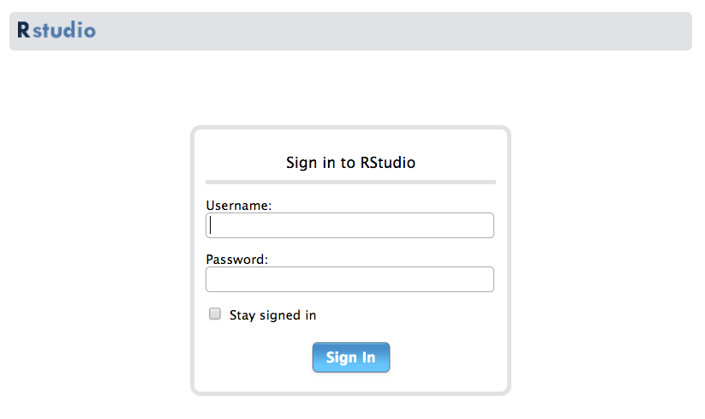
Rstudio at Beocat
rstudio.beocat.cis.ksu.edu

Slide 5
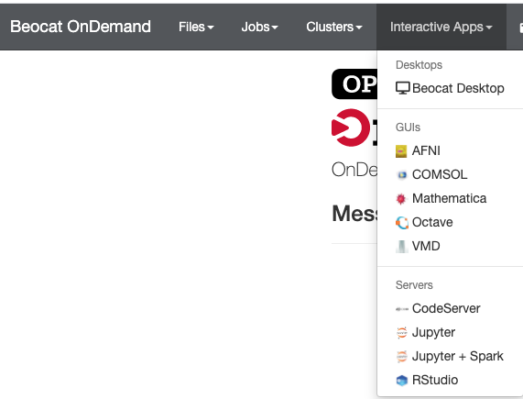
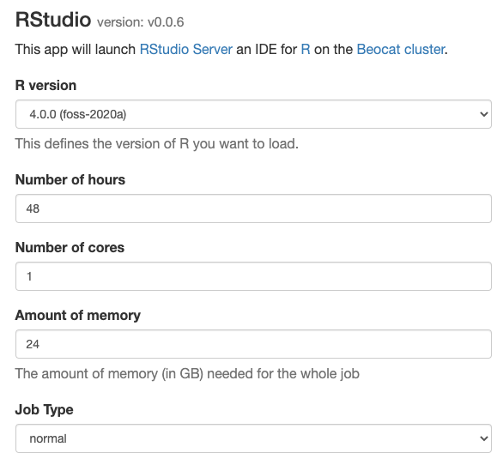
OpenDemand on Beocat
https://ondemand.beocat.ksu.edu

Slide 6
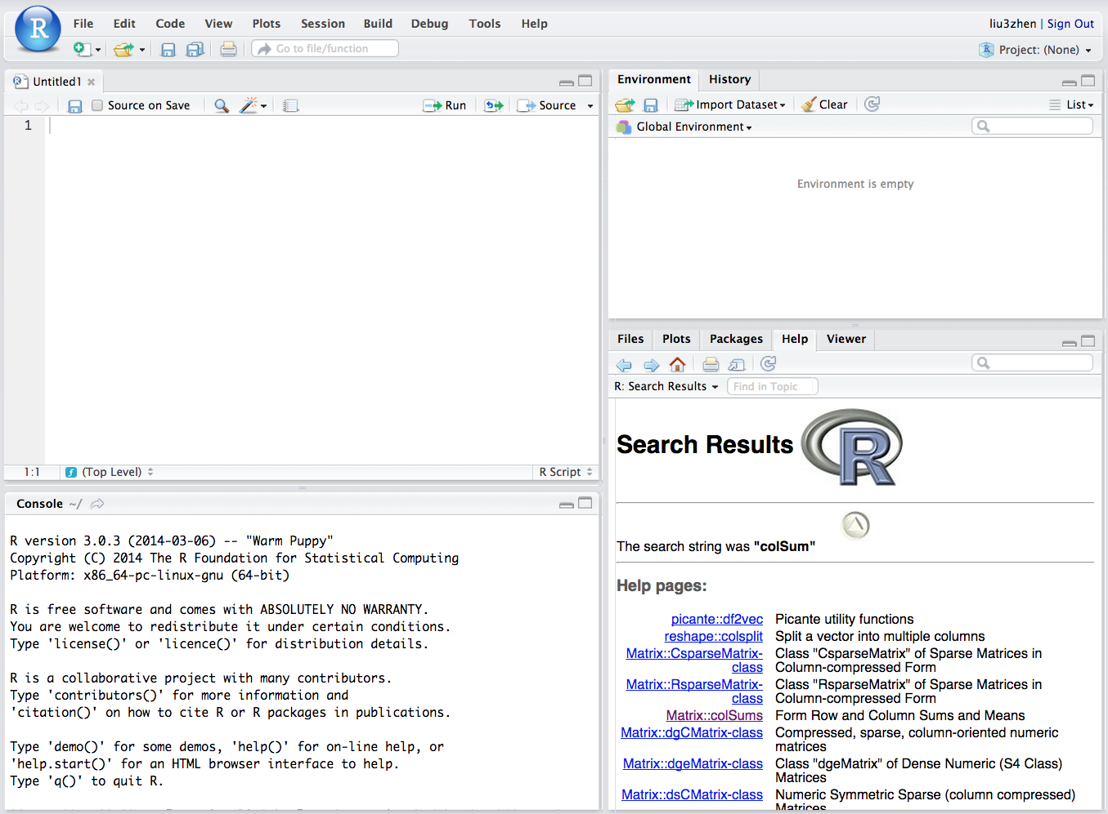
Rstudio

Slide 7
Create a folder in the Beocat server
Login Beocat server
Create a “lab03R” folder
mkdir ~/BA21/labs/lab03R

Slide 8
Simple examples
2 + 4
y <- 2 + 4
y
Y <- 2 + 4 # an example of the assignment
y == Y
# comments (#)
# Notes/explanation to the scripts, starting with a hashmark (‘#’), everything to the end of the line is a comment.
print(“hello world”)

Slide 9
Start to write R scripts
#####################################################
### PLPTH813 - Bioinformatics Application
### lab03 - R
### xxxxx
### 2/11/2021
#####################################################
### setup working directory
setwd("~/BA21/labs/lab03R")

Slide 10
vector - I
# Numeric vector
x <- c(10.4, 5.6, 3.1, 6.4, 21.7)
sum(x)
mean(x)
y <- 2
2*x + y
# Logical vector
lv <- c(TRUE, FALSE, TRUE, TRUE)
sum(lv) # count the number of TRUE
x <- c(10.4, 5.6, 3.1, 6.4, 21.7)
lv2 <- x > 10

Slide 11
vector - II
# Character vectors
cv <- c("a", "b", "c")
cv2 <- paste(cv, 1:3, sep="")
# Missing values: NA, not available
mvv <- c("a", "b", "c", NA)
is.na(mvv)

Slide 12
Select a subset and modify a vector
# Select a subset of a vector
x <- c(10.4, 5.6, 3.1, 6.4, 21.7)
x[c(2, 3)]
x[x>10]
x[-c(1,5)]
# Modify a vector
x[3] <- 23.1
x <- c(x, 10.9)
names(x) <- c("a", "b", "c", "d", "e", "f")

Slide 13
mode and length of a vector
# Mode
# numeric, character, logical
z <- 0:9
digits <- as.character(z) # convert to character
d <- as.integer(digits) # convert to integer
mode(digits)
# Length
length(z)
length(z) <- 5 # retain just the first 5 values

Slide 14
Can a vector contain different types of elements?
try:
c(1, "a")
c(1, TRUE)
c(TRUE, "a")
c(1, "a", TRUE)

Slide 15
factor
# factor = regular vector + Levels
state <- c("tas", "sa", "qld", "nsw")
statef <- factor(state)
statef
levels(statef)
state2 <- as.character(statef)
state2

Slide 16
matrix
# matrix: a special array with two dimensions
# cbind() by binding together matrices horizontally, or column-wise
# rbind() vertically, or row-wise.
num <- 1:25
numm <- matrix(num, nrow=5, byrow=T)
matrix(num, nrow=5, byrow=F)
nrow(numm)
dim(numm)
cbind(numm, numm[,1:2])
rbind(numm, numm[1:2, ])

Slide 17
list
# Objects can be any types or modes
lst <- list(name="Fred", wife="Mary", nkids=3, kid.ages=c(4,7,9))
lst[1] # sublist
lst[[1]] # first element in the list
lst$name # the element named “name”

Slide 18
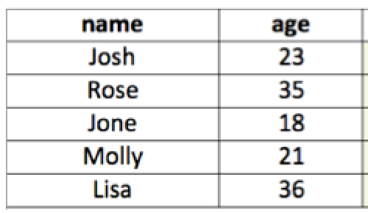
data.frame
Making a data frame: df
df <- data.frame(name=c("Josh", "rose"), age=c(23, 35))
Working with data frames
df$name
df[, 1]
df[[1]]
df[1]
head(df)
tail(df)
summary(df)
str(df)

Slide 19
Data import
# scan(): to read data from a file to a vector or list
cat("lisa Jone", "28 21", file = "hrdb.txt", sep = "\n")
hr <- scan("hrdb.txt", what=character())
hr
# read.table(): to read a data frame (table) directly
# read.delim, read.csv
d <- read.delim("hrdb.txt", sep = " ", header = F)
colnames(d) <- c("P1", "P2")

Slide 20
Data export
# write.table() or write.csv()
## To write a tab-delimited file:
x <- data.frame(a = "pi", b = pi)
write.table(x, file="foo.txt", sep="\t", row.names=FALSE)
## and to read this file back into R one needs
read.table("foo.txt")
## Alternatively
write.csv(x, file = "foo.csv", row.names=FALSE)
read.csv("foo.csv")

Slide 21
Problem
Create a data frame
three columns: 1. Name 2. Major 3. Gender
three rows (entries): members in the breakout room and you
write an output file
and then read the file to R and add one more column
(e.g., favorite color)

Slide 22
Package installation
install.packages('ggplot2')
or
install.packages('ggplot2', repos='http://cran.rstudio.com/')
### before using it, run:
library('ggplot2')

Slide 23
Scatter plot
# data
area <- state.x77[, "Area"]
pop <- state.x77[, "Population"]
# scatter plot
plot(area, pop, main="US States 1977")
# label points
state.max.area <- which.max(area)
points(area[state.max.area],
pop[state.max.area],
col="red", lwd=2)
points(area["Kansas"], pop["Kansas"],
col="purple", lwd=2)

Slide 24
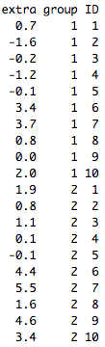
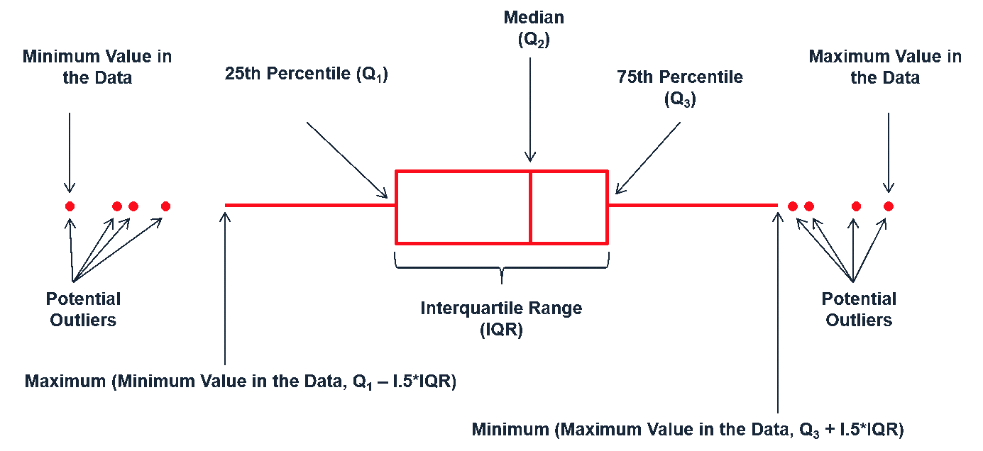
Boxplot
data: sleep
plot(extra ~ group, data = sleep)
boxplot(extra ~ group, data = sleep)

Slide 25
Histogram
hist(pop, main="US States 1977 Population")
hist(pop, ylab="Number of states", main="US States 1977 Population")

Slide 26
ggplot2 - I
library("ggplot2")
dsmall <- diamonds[sample(nrow(diamonds), 100), ]
qplot(carat, price, data = dsmall)
qplot(carat, price, data = dsmall, colour = color)
qplot(carat, price, data = dsmall, shape = cut)

Slide 27
ggplot2 - geom to control plot type
qplot is not limited to scatterplots, but can produce almost any kind of plot by varying the geom.
geom has many options:
"point" draws a scatterplot. This is the default.
"smooth" fits a smoother to the data
"boxplot" produces a box-and-whisker plot
"line" draw lines between the data points.
"histogram" draws a histogram
"bar" makes a bar chart
# Adding a smooth line or a fitted line
qplot(carat, price, data = dsmall, geom = c("point", "smooth"))

Slide 28
The function ggplot
ggplot(data = dsmall, mapping=aes(x=carat, y=price)) +
geom_point()
ggplot(data = dsmall) +
geom_point(mapping=aes(x=carat, y=price))
ggplot(data = dsmall) +
geom_point(aes(x=carat, y=price,
colour=carat, shape="square")) +
theme_bw()
# histogram
ggplot(dsmall) + geom_histogram(aes(price))
# 2D density plot
ggplot(dsmall) + geom_density_2d_filled(aes(x=carat, y=price))

Slide 29
The function ggplot (cont.)
ggplot(data = dsmall, mapping=aes(x=carat, y=price)) +
geom_point() +
facet_wrap(~cut)
ggplot(data = dsmall, mapping=aes(x=carat, y=price)) +
geom_point() +
facet_grid(clarity~cut)
Notes:
theme( plot.title = element_text(color="red", size=14, face="bold.italic"), axis.title.x = element_text(color="blue", size=14, face="bold"), axis.title.y = element_text(color="#993333", size=14, face="bold") )
ggtitle("Plot of length \n by dose") + xlab("Dose (mg)") + ylab("Teeth length")
labs(title="Plot of length \n by dose", x ="Dose (mg)", y = "Teeth length")
theme(axis.text.x = element_text(face="bold", color="#993333", size=14, angle=45), axis.text.y = element_text(face="bold", color="#993333", size=14, angle=45))
theme( axis.text.x = element_blank(), axis.text.y = element_blank(), axis.ticks = element_blank()) # no axes
theme(axis.line = element_line(colour, size, linetype, lineend, color))
scale_x_discrete(breaks=c("0.5","1","2"), labels=c("Dose 0.5", "Dose 1", "Dose 2"))
scale_x_continuous(name, breaks, labels, limits, trans)
scale_y_continuous(labels = scientific)

Slide 30
String operations
# data of “cvec”
# "google" "hello" "the" "world"
cvec <- c("google", "hello", "the", "world")
# nchar()
nchar(cvec)
# grep()
grep("o", cvec)
# sub()
sub("o", "O", cvec)
# gsub()
gsub("o", "O", cvec)

Slide 31
table
# table(): determining counts for each category
table(diamonds$cut)
table(diamonds$cut, diamonds$color)

Slide 32
Write your own function
Define a function
name <- function(arg_1, arg_2, ...) expression
# example 1
threetimes <- function(x) {
y <- 3*x
y
}
# example 2
threetimes <- function(x) {
3*x
}
threetimes(6)
threetimes(29)

Slide 33
Problem
Write a function to randomly select a gift for yourself from a gift store on the valentine's day and output the result as:
"Here is my Valentine's surprise: xxx"
# example store gifts
store <- c("chocolate", "rose", "diamond", "iphone", "nanopore flowcells")
# randomly select
sample
# print
cat or print

Slide 34
Data
Sequence quality scores from three platforms
Illumina
Ion Torrent (Proton)
PacBio
Data file: quality.txt

Slide 35
Data importing
data.url <- "https://raw.githubusercontent.com/liu3zhenlab/teaching/master/PLPTH813Bioinformatis/2021/data/quality.txt"
qual0 <- read.delim(data.url)
qual <- read.delim(dataurl, sep="\t", as.is=T, stringsAsFactors=F,
quote="{|}~")

Slide 36
Data checking
qual[, 2]
nrow(qual)
dim(qual)
colnames(qual)
nchar(qual$Quality)

Slide 37
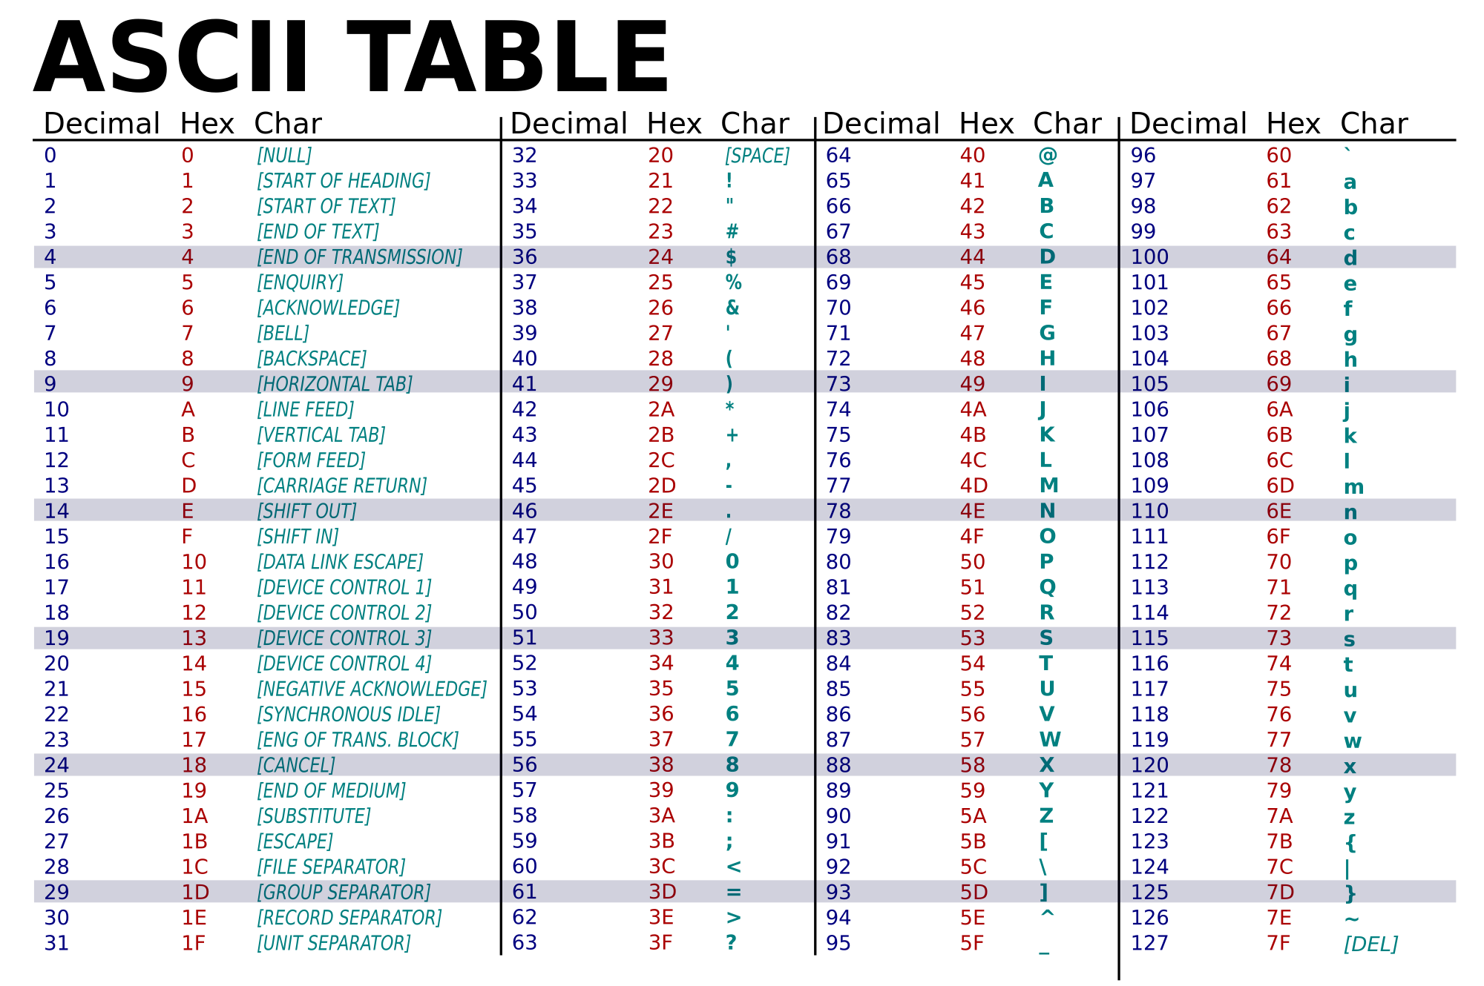
Convert quality score to numbers
charToRaw("[")
as.numeric(charToRaw("["))
charToRaw(as.character(qual[1, 2]))

Slide 38
Convert quality codes to quality scores
illumina <- as.numeric(charToRaw(as.character(qual[1, 2]))) - 33
proton <- as.numeric(charToRaw(as.character(qual[2, 2]))) - 33
pacbio <- as.numeric(charToRaw(as.character(qual[3, 2]))) - 33

Slide 39
Plotting
### Illumina quality
plot(1:nchar(qual[1, 2]), illumina, pch=19, cex=0.2, main="Illumina", xlab="Pos on read", ylab="Quality", ylim=c(0, 41))
### Proton quality
plot(1:nchar(qual[2, 2]), proton, pch=19, cex=0.2, main="Proton", xlab="Pos on read", ylab="Quality", ylim=c(0, 41))
### PacBio quality
plot(1:nchar(qual[3, 2]), pacbio, pch=19, cex=0.2, main="PacBio", xlab="Pos on read", ylab="Quality", ylim=c(0, 41))

Slide 40
Plotting three in one plot
par(mfrow=c(1, 3))
### Illumina quality
plot(1:nchar(qual[1, 2]), illumina, pch=19, cex=0.2, main="Illumina", xlab="Pos on read", ylab="Quality", ylim=c(0, 41))
### Proton quality
plot(1:nchar(qual[2, 2]), proton, pch=19, cex=0.2, main="Proton", xlab="Pos on read", ylab="Quality", ylim=c(0, 41))
### PacBio quality
plot(1:nchar(qual[3, 2]), pacbio, pch=19, cex=0.2, main="PacBio", xlab="Pos on read", ylab="Quality", ylim=c(0, 41))

Slide 41
Write a plotting function
qual.plot <- function(qual.data, encode=33, label="", ymax=41) {
### plot quality scores against base positions
qual.vals <- as.numeric(charToRaw(as.character(qual.data))) - encode
plot(1:length(qual.vals), qual.vals, pch=19, cex=0.4, main=label,
xlab="Position on read (bp)", ylab="Phred quality", ylim=c(0, ymax))
}

Slide 42
Plot three sets of quality scores using a newly written function
### plotting
par(mfrow=c(1, 3))
qual.plot(qual.data = qual[1, 2], label = "Illumina")
qual.plot(qual.data = qual[2, 2], label = "Proton")
qual.plot(qual.data = qual[3, 2], label = "PacBio")

Slide 43
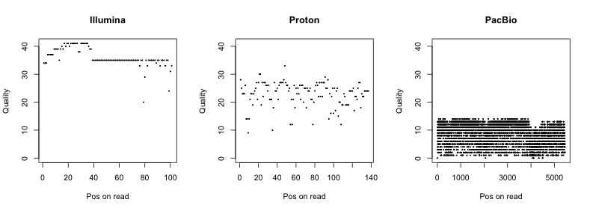
RESULT

Slide 44
Help information
help(nchar)
?nchar
??colsum
R reference card

