Slide 1
R Bioinformatics Applications (PLPTH813)
Sanzhen Liu
1/31/2023

Slide 2
Outline
R introduction
Data structure
Data input and output
Basic graphics
String operations
Functions
Simple statistical test

Slide 3
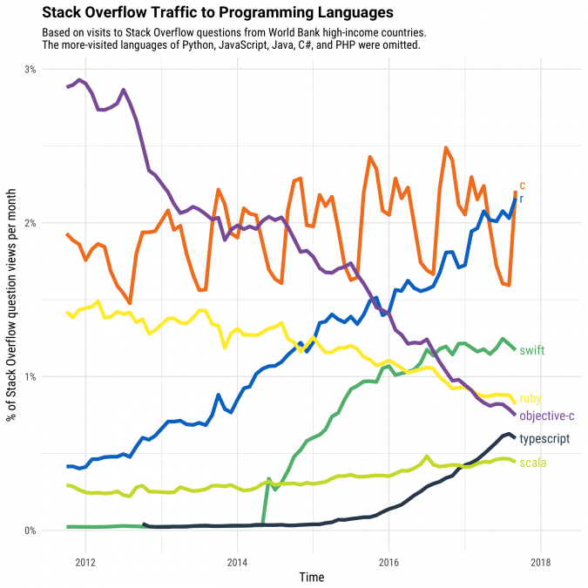
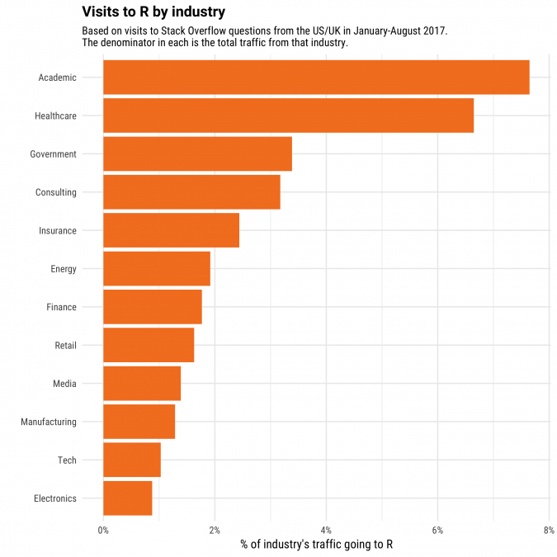
R
R is a programming language and a cutting-edge tool for data analysis, especially for statistical computing and graphics.
R is powerful. Applications are easily created by writing new functions. Functions are usually distributed through packages.
It has great community supports.
R is free
R has an excellent Integrated Development Environment (IDE) - Rstudio
R
Academic
www.r-project.org
https://stackoverflow.blog/2017/10/10/impressive-growth-r/
Notes:
data manipulation, calculation, graphical display

Slide 4
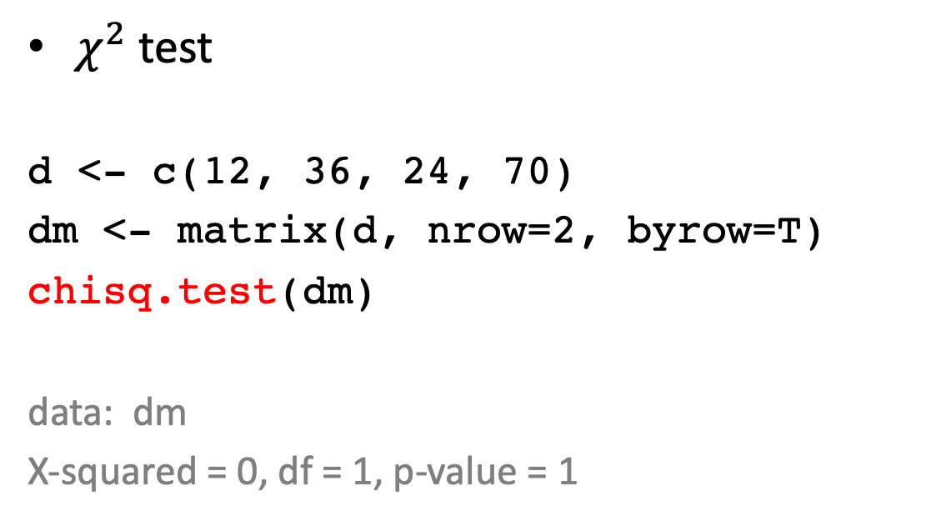
Example – statistical test
B
12 | 36
24 | 70
$χ^{2}$ test
d <- c(12, 36, 24, 70)
dm <- matrix(d, nrow=2, byrow=T)
chisq.test(dm)
data: dm
X-squared = 0, df = 1, p-value = 1
A

Slide 5
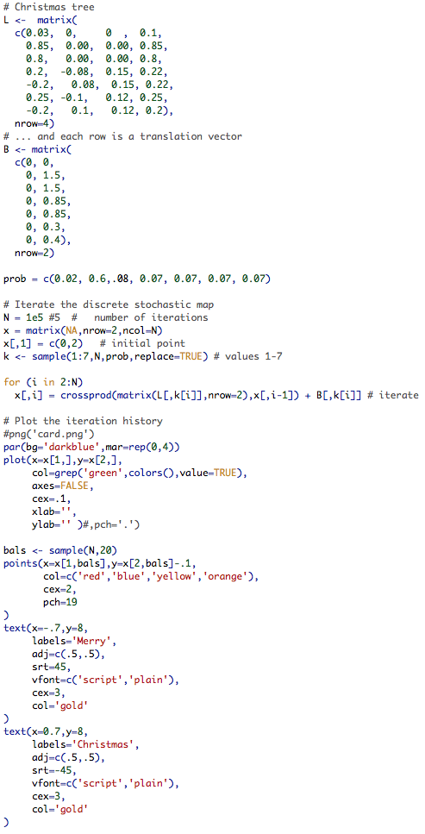
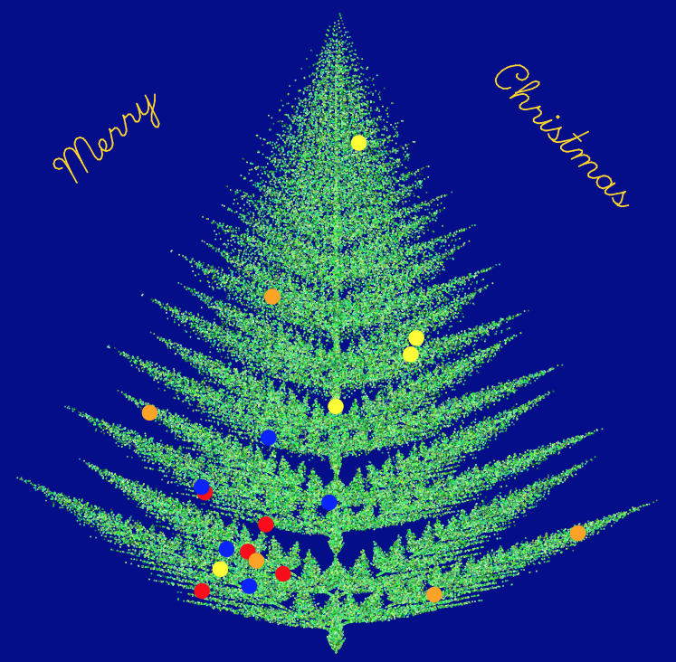
Example – Christmas tree

Slide 6
R commands, case sensitivity
Expression: Print the value and not save the value in the environment
2 + 4
68 * 0.15
Assignment: Assign values to a variable
y <- 2
y = 2
assign("y", 2)
Y <- 2 + 4
Comments (#)
Notes/explanation to the scripts, starting with a hashtag (‘#’), everything to the end of the line is a comment.
y <- 2 + 4 # an example of the assignment
y <- 2 + 4
Notes:
Elementary commands consist of either expressions or assignments. If an expression is given as a command, it is evaluated, printed (unless specifically made invisible), and the value is lost. An assignment also evaluates an expression and passes the value to a variable but the result is not automatically printed.

Slide 7
Data structure – vector (I)
A vector is a single entity consisting of an ordered collection of numbers, characters, logical quantities, etc.
Numeric vector
x <- c(10.4, 5.6, 3.1, 6.4, 21.7)
sum(x)
y <- 2
2*x + y
Logical vector
lv <- c(TRUE, FALSE, TRUE, TRUE)
lv == FALSE
sum(lv)
# The logical operators are <, <=, >, >=, ==, and !=.
# == for exact equality and != for inequality.
x <- c(10.4, 5.6, 3.1, 6.4, 21.7)
lv2 <- x > 10
c(10.4, 5.6, 3.1, 6.4, 21.7)
1st
2nd ...
x[2]

Slide 8
Data structure – vector (II)
Character vectors
cv <- c("a", "b", "c")
cv2 <- paste(cv, 1:3, sep="")
Missing values: NA, not available
mvv <- c("a", "b", "c", NA)
is.na(mvv)

Slide 9
Select a subset and modify a vector
Select a subset of a vector
x <- c(4, 5, 7, 3, 9)
x[c(2, 3)]
x[x>10]
x[-c(1,5)]
Modify a vector
x[3] <- 23.1
x <- c(x, 10.9)
names(x) <- c("a", "b", "c", "d", "e", "f")

Slide 10
mode and length of a vector
Mode
Vectors must have their values with the same mode, either numeric, character, logical, or other types.
z <- 0:9
is.numeric(z)
digits <- as.character(z) # convert to character
d <- as.integer(digits) # convert to integer
Length
length(z)
length(z) <- 5 # retain just the first 5 values

Slide 11
factor
Definition: A factor is a vector object used to specify a discrete classification (grouping) of the components of other vectors with the same length.
factor = regular vector + Levels
state <- c("tas", "sa", "qld", "nsw",
"nsw", "nt", "wa", "wa",
"qld", "vic", "nsw", "vic")
statef <- factor(state)
> statef
[1] tas sa qld nsw nsw nt wa wa qld vic nsw vic
Levels: nsw nt qld sa tas vic wa
> levels(statef)
[1] "nsw" "nt" "qld" "sa" "tas" "vic" "wa"
state2 <- as.character(statef)

Slide 12
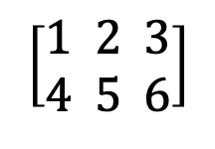
matrix
matrix: a collection of data elements arranged in a two-dimensional rectangular layout
$$\left[\begin{aligned}1 2 3 \\ 4 5 6\end{aligned}\right]$$
2 rows and 3 columns
num <- 1:6
numm <- matrix(num, nrow=2, byrow=T)
matrices can be built up by using the functions cbind() and rbind():
cbind(): binding together horizontally, or column-wise
rbind(): binding together vertically, or row-wise.

Slide 13
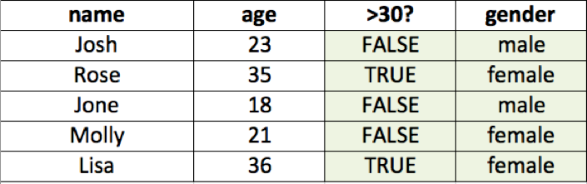
data.frame
Data frame
A data frame may be regarded as a matrix with columns possibly of differing modes and attributes. The data of a matrix are of the same type or mode.
Making data frames
df <- data.frame(name=c("Josh", "rose"), age=c(23, 35))
Working with data frames
> df$name
[1] Josh rose
Levels: Josh rose
> df[, 1]
[1] Josh rose
Levels: Josh rose
> df[[1]]
[1] Josh rose
Levels: Josh rose
> df[1]
name
1 Josh
2 rose
head(df); tail(df); summary(df); str(df)
Notes:
stop here

Slide 14
list
A list is a general form of vector in which the various elements need not be of the same type.
Objects can be any types or modes
lst <- list(name="Fred", wife="Mary", nkids=3, kid.ages=c(4,7,9))
> lst[1] # sublist
$name
[1] "Fred"
> lst[[1]] # first element in the list
[1] "Fred"
> lst$name # the element named “name”
[1] "Fred”
Notes:
lists are a general form of vector in which the various elements need not be of the same type, and are often themselves vectors or lists. Lists provide a convenient way to return the results of a statistical computation.

Slide 15
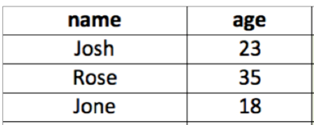
Problem
df <- data.frame(name=c("Josh","rose","John"),
age=c(23, 35, 18))
What are the values of
df[2, 1]
df[3, 2]
df[2]
df[, 2]
What is the difference between the last two?

Slide 16
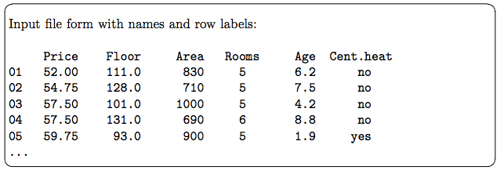
Data import
lisa Jone
28 21
scan(): to read data from a file to a vector or list
cat("lisa Jone", "28 21", file = "hrdb.txt", sep = "\n")
hr <- scan("hrdb.txt", what=character())
hr
"lisa" "Jone" "28" "21”
read.table(): to read a data frame (table) directly
read.delim, read.csv
d <- read.table(data)

Slide 17
Data export
write.table() or write.csv()
## To write a tab-delimited file:
x <- data.frame(a = "pi", b = pi)
write.table(x, file="foo.txt", sep="\t", row.names=FALSE)
## and to read this file back into R one needs
read.table("foo.txt")
## Alternatively
write.csv(x, file = "foo.csv”, row.names=FALSE)
read.csv("foo.csv")

Slide 18
Outline
R introduction
Data structure
Data input and output
Basic graphics
String operations

Slide 19
Basic graphics
plot(); points(); lines(); abline(); text(); legend()
High-level plot: create a new plot
plot(x, y, xlab, ylab, main, …)
Low-level plot: add to an existing plot
# add points
points(x, y)
# add lines
lines(x, y)
# add horizontal or vertical lines
abline(h, v)
# add text or legend
text()
legend()
main
ylab
xlab

Slide 20
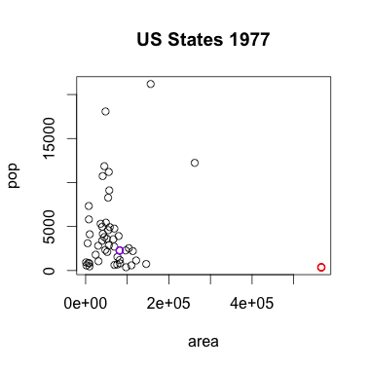
Scatter plot
# data
area <- state.x77[, "Area"]
pop <- state.x77[, "Population"]
# scatter plot
plot(area, pop, main="US States 1977")
# label points
state.max.area <- which.max(area)
points(area[state.max.area],
pop[state.max.area],
col="red", lwd=2)
points(area["Kansas"], pop["Kansas"],
col="purple", lwd=2)

Slide 21
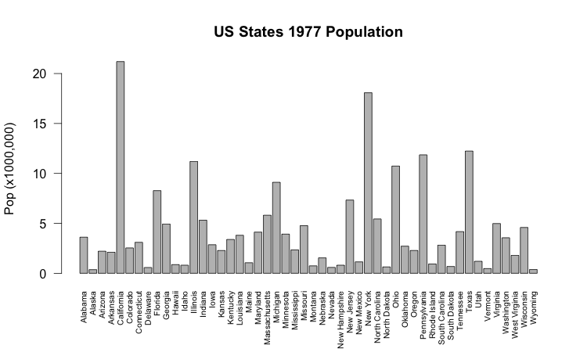
Barplot
barplot(pop/1000, las=2, cex.names=0.65, ylab="Pop (x1000,000)",
main="US States 1977 Population")

Slide 22
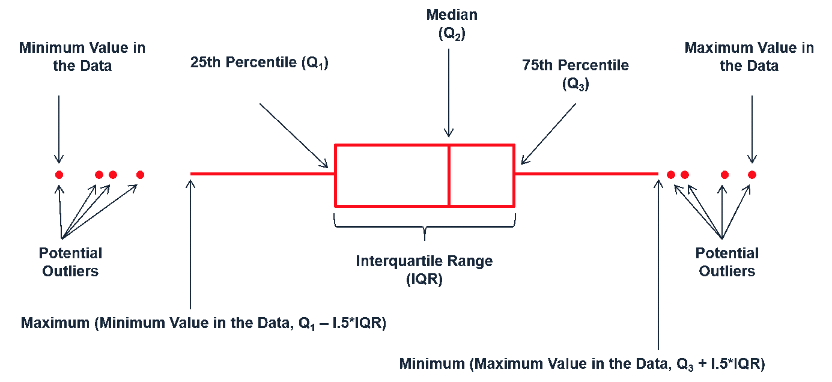
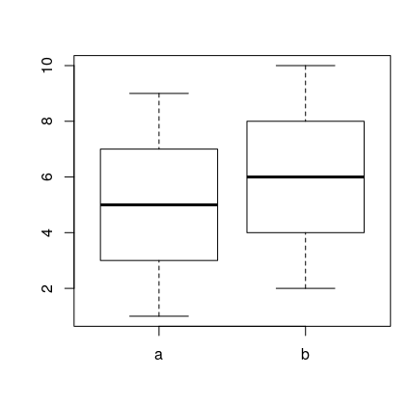
Boxplot
www.leansigmacorporation.com
y <- 1:10
x <- rep(c("a", "b"), 5)
boxplot(y ~ x)

Slide 23
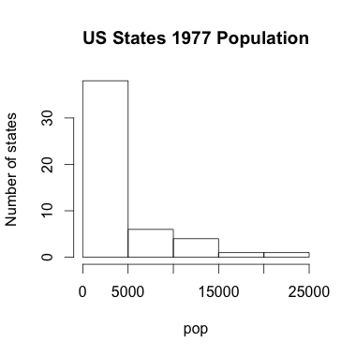
Histogram
hist(pop, ylab="Number of states", main="US States 1977 Population")

Slide 24
The function ggplot
ggplot(data = dsmall, mapping=aes(x=carat, y=price)) +
geom_point()
ggplot(data = dsmall) +
geom_point(mapping=aes(x=carat, y=price))
ggplot(data = dsmall) +
geom_point(aes(x=carat, y=price,
colour=carat, shape="square")) +
theme_bw()
# histogram
ggplot(dsmall) + geom_histogram(aes(price))
# 2D density plot
ggplot(dsmall) + geom_density_2d_filled(aes(x=carat, y=price))

Slide 25
The function ggplot (cont.)
ggplot(data = dsmall, mapping=aes(x=carat, y=price)) +
geom_point() +
facet_wrap(~cut)
ggplot(data = dsmall, mapping=aes(x=carat, y=price)) +
geom_point() +
facet_grid(clarity~cut)
Notes:
theme( plot.title = element_text(color="red", size=14, face="bold.italic"), axis.title.x = element_text(color="blue", size=14, face="bold"), axis.title.y = element_text(color="#993333", size=14, face="bold") )
ggtitle("Plot of length \n by dose") + xlab("Dose (mg)") + ylab("Teeth length")
labs(title="Plot of length \n by dose", x ="Dose (mg)", y = "Teeth length")
theme(axis.text.x = element_text(face="bold", color="#993333", size=14, angle=45), axis.text.y = element_text(face="bold", color="#993333", size=14, angle=45))
theme( axis.text.x = element_blank(), axis.text.y = element_blank(), axis.ticks = element_blank()) # no axes
theme(axis.line = element_line(colour, size, linetype, lineend, color))
scale_x_discrete(breaks=c("0.5","1","2"), labels=c("Dose 0.5", "Dose 1", "Dose 2"))
scale_x_continuous(name, breaks, labels, limits, trans)
scale_y_continuous(labels = scientific)

Slide 26
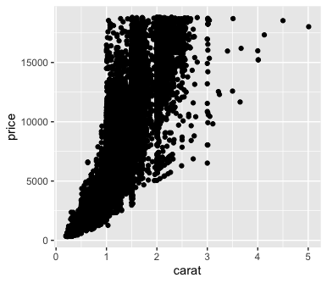
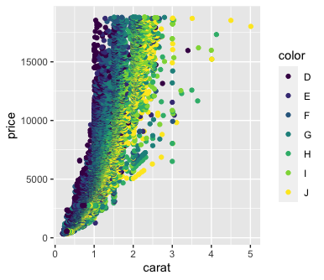
ggplot2 - an easy plotting package
diamonds
carat | cut | color | clarity | depth | table | price
0.23 | Ideal | E | SI2 | 61.5 | 55 | 326
0.21 | Premium | E | SI1 | 59.8 | 61 | 326
scatterplots showing the relationship between the price and carats (weight) of a diamond*.
ggplot(data=diamonds)+
geom_point(mapping=aes(x=carat, y=price))
ggplot(data=diamonds)+
geom_point(mapping=aes(x=carat, y=price, colour=color))
Template:
ggplot(data = <DATA>) + <GEOM_FUNCTION>(mapping = aes(<MAPPINGS>))
* https://r4ds.had.co.nz/data-visualisation.html

Slide 27
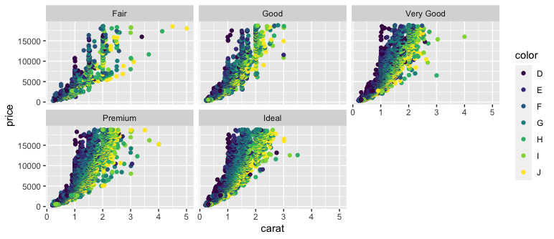
facets
For categorical variables, a plot can be split into facets, subplots that each display a subset of the data.
ggplot(data = mpg) +
geom_point(mapping = aes(x = displ, y = hwy)) +
facet_wrap(~ class, nrow = 2)

Slide 28
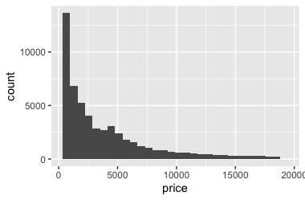
ggplot2 - geom to control plot type
geom_point() produces a scatterplot
geom_bar() makes a bar chart
geom_line() makes a line plot
geom_histogram() produces a histogram
Geom_boxplot() plot a boxplot
geom_polygon() draws polygons, which are filled paths
ggplot(data=diamonds)+
geom_histogram(mapping=aes(x=price))

Slide 29
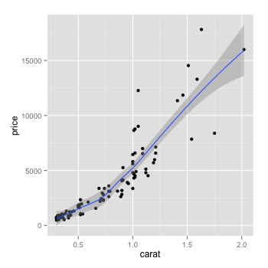
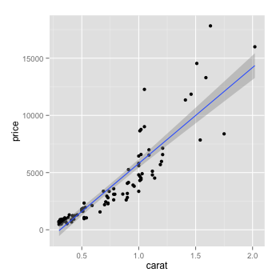
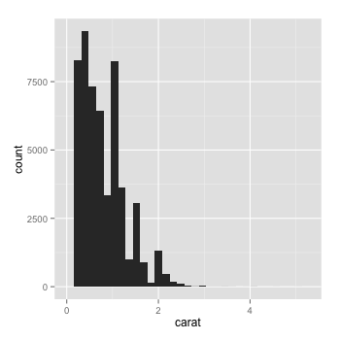
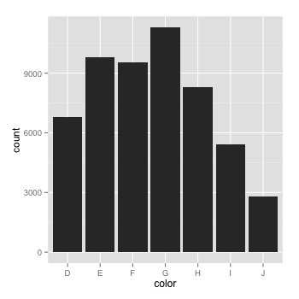
ggplot2 – a flexible tool to plot various plots
diamonds
carat | cut | color | clarity | depth | table | price
0.23 | Ideal | E | SI2 | 61.5 | 55 | 326
0.21 | Premium | E | SI1 | 59.8 | 61 | 326
Adding a smooth line or a fitted line
qplot(carat, price, data = diamonds, geom = c("point", "smooth"))
qplot(carat, price, data = diamonds, geom = c("point", "smooth"),
method = "lm")
Histogram and barplot
ggplot(data = diamonds) + geom_histogram(mapping=aes(carat))
qplot(color, data = diamonds, geom = "bar")

Slide 30
Outline
R introduction
Data structure
Data input and output
Basic graphics
String operations
Functions
Simple statistical test

Slide 31
String operations - nchar
nchar()
nchar the sizes of the corresponding elements of a vector.
nchar(cvec)
> cvec
[1] "google" "hello" "the" "world"
> nchar(cvec)
[1] 6 5 3 5

Slide 32
String operations - grep
grep()
grep searches for matches to argument pattern within each element of a character vector
grep("o", cvec)
> cvec
[1] "google" "hello" "the" "world"
> grep("o", cvec)
[1] 1 2 4

Slide 33
String operations – sub and gsub
sub() and gsub()
sub and gsub perform replacement of the first and all matches respectively.
sub("o", "O", cvec)
gsub("o", "O", cvec)
> cvec
[1] "google" "hello" "the" "world"
> sub("o", "O", cvec)
[1] "gOogle" "hellO" "the" "wOrld"
> gsub("o", "O", cvec)
[1] "gOOgle" "hellO" "the" "wOrld"

Slide 34
Outline
R introduction
Data structure
Data input and output
Basic graphics
String operations
Functions
Simple statistical test

Slide 35
function/module in R
If a procedure is repeated multiple times, it would be valuable to convert the procedure to a function/module.
Define a function
fun_name <- function(arg_1, arg_2, ...) expression
or
fun_name <- function(arg_1, arg_2, ...) {
expressions
}
Use a function
fun_name(arg_1, arg2, ...)

Slide 36
Function example 2
Define a function
name <- function(arg_1, arg_2, ...) expression
# example 1
threetimes <- function(x) {
y <- 3*x
y
}
> threetimes(6)
[1] 18
> val <- threetimes(29)
> val
[1] 87

Slide 37
Function example 2
# return the value of the nth element of the input vector
what_at_n <- function(in_vector, n) {
# initiate the output value
nth_val <- NA
if (n <= length(in_vector)) {
nth_val <- in_vector[n]
}
print_info <- paste("The value of element", n, "is", nth_val, sep=" ")
print(print_info)
nth_val
}
> what_at_n(c(36, 19, 13), 2)
[1] "The value of element 2 is 19"
[1] 19
> val2 <- what_at_n(c(36, 19, 13), 2)
[1] "The value of element 2 is 19"
> val2
[1] 19

Slide 38
base (build-in) functions in R
R has many build-in functions
If you have choices to use a build-in function, do not use your own function (efficiency and code sharing)

Slide 39
"apply" functions
apply
lapply
sapply
mapply
tapply
vapply
rapply
...
goal: to simplify coding and improve computation efficiency

Slide 40
apply()
apply(X, MARGIN, FUN, ...)
apply a function to margins of an array or matrix.
apply(d, 1, sum)
d
3.95 | 3.98 | 2.43
3.89 | 3.84 | 2.31
4.05 | 4.07 | 2.31
4.2 | 4.23 | 2.63
4.34 | 4.35 | 2.75
3.94 | 3.96 | 2.48
10.36
10.04
10.43
11.06
11.44
10.38
apply(d, 2, sum)
24.37 | 24.43 | 14.91
rowSums
colSums

Slide 41
apply - example
> head(diamonds)
carat cut color clarity depth table price x y z
1 0.23 Ideal E SI2 61.5 55 326 3.95 3.98 2.43
2 0.21 Premium E SI1 59.8 61 326 3.89 3.84 2.31
3 0.23 Good E VS1 56.9 65 327 4.05 4.07 2.31
4 0.29 Premium I VS2 62.4 58 334 4.20 4.23 2.63
5 0.31 Good J SI2 63.3 58 335 4.34 4.35 2.75
6 0.24 Very Good J VVS2 62.8 57 336 3.94 3.96 2.48
> apply(diamonds[, c("carat", "price")], 2, mean)
carat price
0.7979397 3932.7997219

Slide 42
combine your own function with apply
sumsqrt <- function(x) {
sum(sqrt(x))
}
apply(d, 1, sumsqrt)
or
apply(d, 1, function(x) sum(sqrt(x)))
3.95 | 3.98 | 2.43
3.89 | 3.84 | 2.31
4.05 | 4.07 | 2.31
4.2 | 4.23 | 2.63
4.34 | 4.35 | 2.75
3.94 | 3.96 | 2.48
5.54
5.45
5.55
5.73
5.83
5.55

Slide 43
tapply
tapply()
Applying a function to each element of a vector given by the category of each element, provided by the other vector.
> head(diamonds)
carat cut color clarity depth table price x y z
1 0.23 Ideal E SI2 61.5 55 326 3.95 3.98 2.43
2 0.21 Premium E SI1 59.8 61 326 3.89 3.84 2.31
3 0.23 Good E VS1 56.9 65 327 4.05 4.07 2.31
4 0.29 Premium I VS2 62.4 58 334 4.20 4.23 2.63
5 0.31 Good J SI2 63.3 58 335 4.34 4.35 2.75
6 0.24 Very Good J VVS2 62.8 57 336 3.94 3.96 2.48
> tapply(diamonds$price, diamonds$cut, mean)
Fair Good Very Good Premium Ideal
4358.758 3928.864 3981.760 4584.258 3457.542

Slide 44
table
table()
Determining counts for each category
> head(diamonds)
carat cut color clarity depth table price x y z
1 0.23 Ideal E SI2 61.5 55 326 3.95 3.98 2.43
2 0.21 Premium E SI1 59.8 61 326 3.89 3.84 2.31
3 0.23 Good E VS1 56.9 65 327 4.05 4.07 2.31
4 0.29 Premium I VS2 62.4 58 334 4.20 4.23 2.63
5 0.31 Good J SI2 63.3 58 335 4.34 4.35 2.75
6 0.24 Very Good J VVS2 62.8 57 336 3.94 3.96 2.48
> table(diamonds$cut)
Fair Good Very Good Premium Ideal
1610 4906 12082 13791 21551

Slide 45
Outline
R introduction
Data structure
Data input and output
Basic graphics
String operations
Functions
Simple statistical test

Slide 46
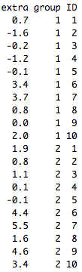
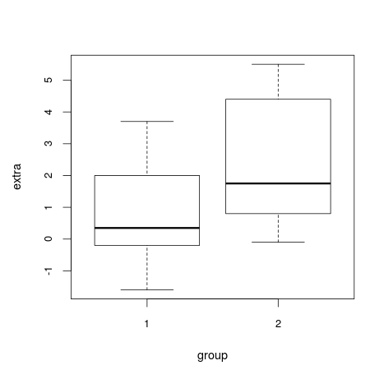
t-test
data: sleep
t.test
Performs one and two sample t-tests on vectors of data.
# Student's sleep data
plot(extra ~ group, data = sleep)
# t-test
with(sleep, t.test(extra[group == 1], extra[group == 2]))
# Formula
t.test(extra ~ group, data = sleep)

Slide 47
Linear models (I)
Fitting a linear model
lm(formula, data = data.frame)
pc <- lm(price ~ carat, data=diamonds)
summary(pc)
Residuals:
Min 1Q Median 3Q Max
-18585.3 -804.8 -18.9 537.4 12731.7
Coefficients:
Estimate Std. Error t value Pr(>|t|)
(Intercept) -2256.36 13.06 -172.8 <2e-16 ***
carat 7756.43 14.07 551.4 <2e-16 ***
---
Signif. codes: 0 ‘***’ 0.001 ‘**’ 0.01 ‘*’ 0.05 ‘.’ 0.1 ‘ ’ 1
Residual standard error: 1549 on 53938 degrees of freedom
Multiple R-squared: 0.8493, Adjusted R-squared: 0.8493
F-statistic: 3.041e+05 on 1 and 53938 DF, p-value: < 2.2e-16

Slide 48
ANOVA (I)
ANOVA
anova(model)
pcc <- lm(price ~ carat + cut, data=diamonds)
anova(pcc)
Analysis of Variance Table
Response: price
Df Sum Sq Mean Sq F value Pr(>F)
carat 1 7.2913e+11 7.2913e+11 319162.11 < 2.2e-16 ***
cut 4 6.1332e+09 1.5333e+09 671.17 < 2.2e-16 ***
Residuals 53934 1.2321e+11 2.2845e+06
---
Signif. codes: 0 ‘***’ 0.001 ‘**’ 0.01 ‘*’ 0.05 ‘.’ 0.1 ‘ ’ 1

Slide 49
ANOVA (II)
Comparing two models
anova(model1, model2)
pc <- lm(price ~ carat, data=diamonds)
pcc <- lm(price ~ carat + cut, data=diamonds)
anova(pc, pcc)
Analysis of Variance Table
Model 1: price ~ carat
Model 2: price ~ carat + cut
Res.Df RSS Df Sum of Sq F Pr(>F)
1 53938 1.2935e+11
2 53934 1.2321e+11 4 6133201436 671.17 < 2.2e-16 ***
---
Signif. codes: 0 ‘***’ 0.001 ‘**’ 0.01 ‘*’ 0.05 ‘.’ 0.1 ‘ ’ 1

Slide 50
chi-square test
B
chisq.test
d <- c(12, 36, 24, 70)
dm <- matrix(d, nrow=2, byrow=T)
chisq.test(dm)
data: dm
X-squared = 0, df = 1, p-value = 1
12 | 36
24 | 70
A

Slide 51
Online resources
"apply" function family
https://www.datacamp.com/community/tutorials/r-tutorial-apply-family#gs.YUI=Luc
Statistical modeling with R
https://www.datacamp.com/courses/statistical-modeling-in-r-part-1
http://www.analyticsforfun.com/2014/06/performing-anova-test-in-r-results-and.html

Slide 52
Get help
help(ls)
?ls
??colsum: ambiguous search
R reference card
stackoverflow
Google is the best helper!
R learning: http://swirlstats.com/

Slide 53
Rstudio
Rstudio is an open source integrated development environment (IDE) for R
On your own machine (Rstudio Desktop)
Download and install R
Download and install Rstudio
Use Rstudio at Beocat (Rstudio server)
rstudio.beocat.cis.ksu.edu
https://ondemand.beocat.ksu.edu
Your KSU ID and password to login

Slide 54

Adventures with R
http://www.nature.com/news/programming-tools-adventures-with-r-1.16609

Slide 55
sapply and lapply
sapply() and lapply()
work in a similar way, calling the specified function for each item of a list or vector.
> sapply(1:3, function(x) x^2)
[1] 1 4 9
lapply returns a list rather than a vector:
> lapply(1:3, function(x) x^2)
[[1]]
[1] 1
[[2]]
[1] 4
[[3]]
[1] 9

Slide 56
mapply
mapply()
vectorize arguments to a function that is not usually accepting vectors as arguments.
> rep(1:3, 3)
[1] 1 2 3 1 2 3 1 2 3
> mapply(rep, 1:3, 3)
[,1] [,2] [,3]
[1,] 1 2 3
[2,] 1 2 3
[3,] 1 2 3
> mapply(rep, 1:3, 3:1)
[[1]]
[1] 1 1 1
[[2]]
[1] 2 2
[[3]]
[1] 3
apply each element from the 3rd argument to each element in the 2nd argument using the function specified in the 1st argument
combine them by column or organize them in a data frame or list format

Slide 57
aggregate
aggregate(X, by, FUN, ...)
Splits the data into subsets, computes summary statistics for each, and returns the result in a convenient form.
carat cut color clarity depth table price x y z
1 0.23 Ideal E SI2 61.5 55 326 3.95 3.98 2.43
2 0.21 Premium E SI1 59.8 61 326 3.89 3.84 2.31
3 0.23 Good E VS1 56.9 65 327 4.05 4.07 2.31
4 0.29 Premium I VS2 62.4 58 334 4.20 4.23 2.63
5 0.31 Good J SI2 63.3 58 335 4.34 4.35 2.75
6 0.24 Very Good J VVS2 62.8 57 336 3.94 3.96 2.48
> aggregate(diamonds$price, by=list(diamonds$cut), FUN=mean)
Group.1 x
1 Fair 4358.758
2 Good 3928.864
3 Very Good 3981.760
4 Premium 4584.258
5 Ideal 3457.542
> tapply(diamonds$price, diamonds$cut, FUN=mean)
Fair Good Very Good Premium Ideal
4358.758 3928.864 3981.760 4584.258 3457.542

