Slide 1
Lab – DE Bioinformatics Applications (PLPTH813)
Sanzhen Liu
4/20/2023

Slide 2
Install DESeq2
R code
if (!requireNamespace("BiocManager",quietly=T))
install.packages("BiocManager")
BiocManager::install("DESeq2")
Notes:
install.packages(“matrixStats”)
BiocManager::install("MatrixGenerics", "DelayedArray", "SummarizedExperiment")

Slide 3
Codes for today’s lab
wget https://people.beocat.ksu.edu/~liu3zhen/PLPTH813/labs/lab10_DErun.tar.gz
tar -xf lab10_DErun.tar.gz

Slide 4
RNA-Seq procedure
total RNA
mRNA
RNA to sequencing reads
1
DNA library
sequencing
reads
reads to read counts per gene
c
2
QC, alignment
read counts
read counts to significant genes
statistical test
3
q-values/FDR
significance

Slide 5
Directories
mkdir 0_ref 1_raw 2_trim 3_aln 4_DE
0_ref
1_raw
2_trim
3_aln
4_DE

Slide 6
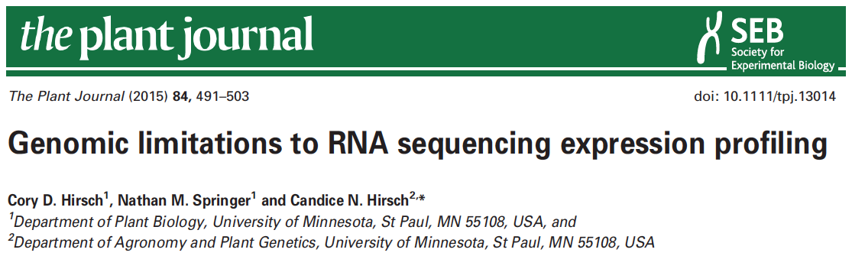

data information
SRR1238718
Makarevitch et al., 2015
Hirsch et al., 2016

Slide 7
Part I: Data downloading
Introduction of Sequence Read Archive (SRA) (2007)
Data download (SRA toolkit)
- fasterq-dump

Slide 8
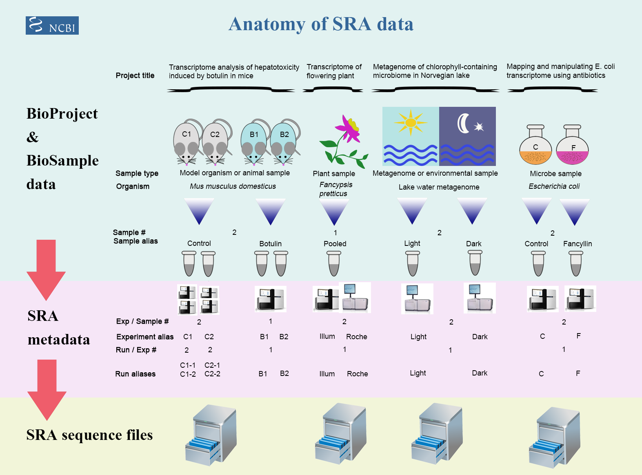
Framework of data submission

Slide 9
Metadata and sequence data
Study – a set of experiments with an overall goal
SRA Study accessions – SRP, DRP, or ERP
Experiment –laboratory operations on input material
SRA Experiment accessions – SRE, DRE, or ERE
Sample – An experiment targets one or more samples
SRA Sample accessions – SRS, DRS, or ERS
Run –the data gathered for a sample or sample bundle
SRA Run accessions – SRR, DRR, or ERR
Notes:
The SRA metadata describes the technical aspects of sequencing experiments: the sequencing libraries, preparation techniques and data files.

Slide 10
sra-toolkit
wget https://ftp-trace.ncbi.nlm.nih.gov/sra/sdk/3.0.2/sratoolkit.3.0.2-centos_linux64.tar.gz
tar -xf sratoolkit.3.0.2-centos_linux64.tar.gz
mv sratoolkit.3.0.2-centos_linux64 sratoolkit

Slide 11
format conversion - fastq-dump in Beocat
fasterq-dump [options] <accession>
#!/bin/bash -l
#SBATCH --mem-per-cpu=16G
#SBATCH --time=12:00:00
#SBATCH --nodes=1
#SBATCH –cpus-per-task=1
../utils/sratoolkit/bin/fasterq-dump
--split-files <accession>
../utils/sratoolkit/bin/fasterq-dump --split-files SRR1238718
SRR1238718_1.fastq
SRR1238718_2.fastq
No running
Notes:
# --split-files: write reads into different files

Slide 12
Beocat pipeline to download SRA in batch - I
# step 1: Prepare data: dataset.txt
Order | ID | Genotype | Sample | Treatment | Citation
1 | SRR1238718 | B73 | norm1 | norm | Hirsch2015TPJ
2 | SRR1819617 | B73 | norm2 | norm | Hirsch2015TPJ
3 | SRR1819621 | B73 | norm3 | norm | Hirsch2015TPJ
4 | SRR1238717 | B73 | cold1 | cold | Hirsch2015TPJ
5 | SRR1819204 | B73 | cold2 | cold | Hirsch2015TPJ
6 | SRR1819205 | B73 | cold3 | cold | Hirsch2015TPJ
Makarevitch et al., 2015
Hirsch et al., 2016

Slide 13
Beocat pipeline to download SRA in batch - II
working directory: 1_raw
# must check
meta_file=dataset.txt
srr_col=2
rename_col=4
# running
perl ../utils/scripts/fasterq_dump.sbatch.pl \
--in $meta_file \
--srrcol 2
# create a script to rename downloaded files
cut $meta_file -f $srr_col,$rename_col | \
grep "^[EDS]RR" | \
sed 's/^/rename /g' | sed 's/\t/ /g' | \
sed 's/$/ *fastq/g’ > 2c_rename.sh
bash 1c_dn.sh

Slide 14
Beocat pipeline to download SRA in batch - III
# step 3: Check and run "rename.sh" to change names (optional)
After downloading is finished, …
bash 2c_rename.sh
# extract a subset
# to save time for alignment
bash 3c_subsample.sh
working directory: 1_raw

Slide 15
Part II. Trimming
working directory: 2_trim
perl /homes/liu3zhen/local/slurm/trimmomatic/trimmomatic.sbatch.pl \
--mem 4G \
--time 1-00:00:00 \
--trim_shell "../utils/scripts/trimmomatic.pe.sh" \
--trimmomatic "../utils/Trimmomatic-0.38/trimmomatic-0.38.jar" \
--adaptor_file "../utils/Trimmomatic-0.38/adapters/TruSeq3-PE.fa" \
--indir "../1_raw" \
--outdir "." \
--fq1feature "_1.fastq" \
--fq2feature "_2.fastq" \
--threads 4 \
--min_len 40
bash 1c_trim.sh

Slide 16
Part II. Trimming: sbatch command
#!/bin/bash -l
#SBATCH --mem-per-cpu=4
#SBATCH --time=1-00:00:00
#SBATCH --cpus-per-task=4
module load Java
bash /homes/liu3zhen/local/slurm/trimmomatic/trimmomatic.pe.sh \
../utils/Trimmomatic-0.38/trimmomatic-0.38.jar \
../utils/Trimmomatic-0.38/adapters/TruSeq3-PE.fa \
../1_raw . _1.fastq _2.fastq 4 40 xxx.fastq
No running

Slide 17
RNA-Seq procedure
total RNA
mRNA
RNA to sequencing reads
1
DNA library
sequencing
reads
reads to read counts per gene
c
2
alignment
read counts
read counts to significant genes
statistical test
3
q-values/FDR
significance

Slide 18

STAR
as of 4/18/2021
High speed
Unbiased de novo detection of canonical junctions
discovery of non-canonical splices and chimeric transcripts
Capable of mapping full-length RNA sequences

Slide 19
STAR Reference genome indexing
sbatch 1c_star.index.sh
working directory: 0_ref
Index the reference genome with the annotation file
#!/bin/bash
#SBATCH --cpus-per-task=4
#SBATCH --mem-per-cpu=8g
#SBATCH --time=1-00:00:00
module load STAR
STAR --runThreadN 4 \
--runMode genomeGenerate \
--genomeDir "." \
--genomeFastaFiles B73v5.fasta \
--sjdbGTFfile B73v5.gtf \
--sjdbOverhang 100
Notes:
NOTE: In case of reads of varying length, the ideal value for --sjdbOverhang is max(ReadLength)-1. In most cases, the default value of 100 will work similarly to the ideal value.
9814814 1c_star.in wizard24 1 n 4 c 29.74gb/ 32gb 00:47:06 COMPLETED

Slide 20
Part III. STAR: sbatch script (one sample)
module load STAR
STAR --runThreadN 1 \
--genomeDir /homes/liu3zhen/teaching/datasets/DE/0-ref \
--readFilesIn ../2_trim/cold1.R1.pair.fq ../2_trim/cold1.R2.pair.fq \
--alignIntronMax 100000 \
--alignMatesGapMax 100000 \
--outFileNamePrefix cold1 \
--outSAMattrIHstart 0 \
--outSAMmultNmax 1 \
--outSAMstrandField intronMotif \
--outFilterIntronMotifs RemoveNoncanonicalUnannotated \
--outSAMtype BAM SortedByCoordinate \
--quantMode GeneCounts \
--outFilterMismatchNmax 1 \
--outFilterMismatchNoverLmax 0.02 \
--outFilterMatchNmin 40 \
--outSJfilterReads Unique \
--outFilterMultimapNmax 1 \
--outFilterMultimapScoreRange 2
No running

Slide 21
Part III. STAR: generate sbatch scripts and submit jobs
working directory: 3_aln
module load STAR
perl ../utils/scripts/STAR.module.sbatch.pl \
--mem 48 --threads 1 --time 12:00:00 \
--indir ../2_trim \
--dbdir ../0_ref \
--fq1feature .R1.pair.fq \
--fq2feature .R2.pair.fq \
--alignIntronMax 100000 \
--alignMatesGapMax 100000 \
--outSAMattrIHstart 0 \
--outSAMmultNmax 1 \
--outSAMstrandField intronMotif \
--outFilterIntronMotifs RemoveNoncanonicalUnannotated \
--outSAMtype "BAM SortedByCoordinate" \
--quantMode GeneCounts \
--outFilterMismatchNmax 1 \
--outFilterMismatchNoverLmax 0.05 \
--outFilterMatchNmin 40 \
--outSJfilterReads Unique \
--outFilterMultimapNmax 1 \
--outFilterMultimapScoreRange 2
No running

Slide 22
Part III. STAR: generate sbatch script and submit jobs
bash 1c_star.sh
Working directory: 3_aln/testrun/
module load STAR
perl ../utils/scripts/STAR.module.sbatch.pl \
--mem 48 --threads 1 --time 12:00:00 \
--indir ../../2_trim \
--dbdir ../../0_ref \
--fq1feature .R1.pair.fq \
--fq2feature .R2.pair.fq \
--alignIntronMax 100000 \
--alignMatesGapMax 100000 \
--outSAMattrIHstart 0 \
--outSAMmultNmax 1 \
--outSAMstrandField intronMotif \
--outFilterIntronMotifs RemoveNoncanonicalUnannotated \
--outSAMtype "BAM SortedByCoordinate" \
--quantMode GeneCounts \
--outFilterMismatchNmax 1 \
--outFilterMismatchNoverLmax 0.05 \
--outFilterMatchNmin 40 \
--outSJfilterReads Unique \
--outFilterMultimapNmax 1 \
--outFilterMultimapScoreRange 2

Slide 23
STAR output – cold1 sample
cold1Aligned.sortedByCoord.out.bam
cold1Log.final.out
cold1Log.out
cold1Log.progress.out
cold1ReadsPerGene.out.tab
cold1SJ.out.tab

Slide 24
Install DESeq2
R code
if (!requireNamespace("BiocManager",quietly=T))
install.packages("BiocManager")
BiocManager::install("DESeq2")
Notes:
install.packages(“matrixStats”)
BiocManager::install("MatrixGenerics", "DelayedArray", "SummarizedExperiment")

Slide 25
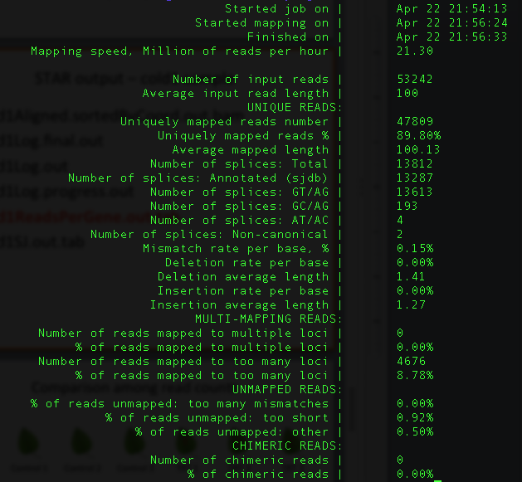
cold1Log.final.out

Slide 26
cold1ReadsPerGene.out.tab
column 1: gene ID
column 2: counts for unstranded RNA-seq
column 3: counts for the 1st read strand aligned with RNA (htseq-count option -s yes)
column 4: counts for the 2nd read strand aligned with RNA (htseq-count option -s reverse)
Notes:
https://github.com/alexdobin/STAR/issues/703
N_multimapping is the total number of multimapping reads, which are not counted at all, so the number is the same for each column. N_noFeature: if a read overlaps a gene on the opposite strand, it will be counted as noFeature for one of the stranded columns, but will be counted towards the gene (and not as noFeature) in the unstranded column. Hence N_noFeature(unstranded) can be < N_noFeature(+) + N_noFeature(-).
https://groups.google.com/g/rna-star/c/qFLxINhF7cI/m/D0v-BRtpDAAJ?pli=1
if exons of these two genes overlap completely on *opposite* strands, the unstranded counting will yield 0 - all the reads will be considered "ambiguous".
The stranded counts, however, will be done towards the correspodning gene.
The easiest way to check this is to view annotations on a genome browser.

Slide 27
RNA-Seq procedure
total RNA
mRNA
RNA to sequencing reads
1
DNA library
sequencing
reads
reads to read counts per gene
c
2
alignment
read counts
read counts to significant genes
statistical test
3
q-values/FDR
significance

Slide 28
R codes for differential expression analysis
4_DE/1c_de.R

Slide 29
Part IV. DE: merge counting data
R code
setwd("xxx/4_DE")
library("DESeq2")
### Parameters - Subject to change
datapath <- "../3_aln"
suffix <- "ReadsPerGene.out.tab"
count.files <- dir(path = datapath, pattern = suffix)
### merge all counts
allcounts <- NULL
for (cf in count.files) {
counts <- read.delim(paste0(datapath, "/", cf), header = F, stringsAsFactors = F, skip = 4)
base <- gsub(suffix, "", cf)
counts <- counts[, 1:2]
colnames(counts) <- c("Gene", base)
### merge data
if (is.null(allcounts)) {
allcounts <- counts
} else {
allcounts <- merge(allcounts, counts, by = "Gene")
}
}

Slide 30
data preparation for DESeq2
R code
# count information
geneid <- allcounts$Gene
in.data <- allcounts[, 2:7]
in.data <- as.matrix(in.data)
rownames(in.data) <- geneid
# sample names and grouping information (treatment)
sample.ids <- colnames(in.data)
treatment <- c("cold", "cold", "cold", "norm", "norm", "norm")
sample.info <- data.frame(row.names=sample.ids, trt=treatment)
dds <- DESeqDataSetFromMatrix(countData=in.data,
colData=sample.info, formula(~trt))
dds <- DESeq(dds, "Wald")

Slide 31
Wald test
Wald test is the default method in DESeq2 when comparing two groups.
DESeq2 implements the Wald test by:
Divide LFC (log2 fold change) by its standard error to obtain a z-statistic
The z-statistic is compared to a standard normal distribution, and a p-value is computed

Slide 32
DE output

Slide 33
Part VI. DE summary
R
de.summary <- DE.summary(DE.path=".",
DE.files="cold-norm.DESeq2.txt",
qval.feature=".qval",
log2FC.feature=".log2FC",
fdr=fdr.cutoff,
out.path=".",
out.file="cold-norm.DESeq2.summary.txt")

Slide 34
Part V. DE
R
### load modules
source("../utils/scripts/DESeq2.single.trt.R")
source("../utils/scripts/DE.summary.R")
### DE parameters
fdr.cutoff <- 0.05
# data reformat:
input <- allcounts[, 2:7]
rownames(input) <- allcounts[, 1]
# DE statistical analysis:
DE.out <- DESeq2.single.trt(input.matrix = input,
min.mean.reads = 5,
group1.col = 1:3,
group2.col = 4:6,
comparison = c("norm", "cold"),
geneID = rownames(input),
fdr = fdr.cutoff,
logpath = ".",
logfile = "cold-norm.log.md")
# merge DE with counts and output DE result:
DE.out <- data.frame(DE.out)
final.out <- merge(allcounts, DE.out, by.x = "Gene", by.y = "GeneID")
write.table(final.out, "cold-norm.DESeq2.txt", sep="\t", quote=F, row.names=F)

Slide 35
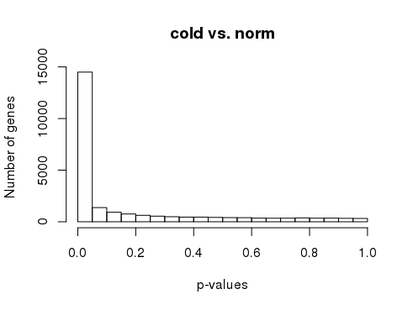
p-values
R
# p-value histogram
hist(DE.out$cold_norm.pval, xlab = "p-values",
ylab = "Number of genes", main = "cold vs. norm")

