Slide 1
Lab05 Command-line NCBI tools
Sanzhen Liu
PLPTH813
Feb 20, 2025

Slide 2
MUMmer installation
# install mummer
git clone https://github.com/mummer4/mummer.git
cd mummer
mkdir ~/local
autoreconf –fi
./configure --prefix ~/local
make
make install

Slide 3
conda installation
# download conda software
wget https://repo.anaconda.com/archive/Anaconda3-2024.10-1-Linux-x86_64.sh
# installation
sh Anaconda3-2024.10-1-Linux-x86_64.sh
# with -u if a previous installation exists
# sh Anaconda3-2024.10-1-Linux-x86_64.sh -u
Notes:
https://www.anaconda.com/products/distribution

Slide 4
Install Mummer via Conda
source ~/anaconda3/bin/activate
# Create a Conda environment (ba)
conda create -n ba
conda activate ba
# install mummer4
conda install -c bioconda mummer4
# install R
conda install conda-forge::r-base

Slide 5
ndotplot
# download ndotplot
git clone https://github.com/liu3zhenlab/ndotplot.git
cd ndotplot
perl ndotplot
# run
module load MUMmer
module load R
conda activate ba
perl ndotplot --query data/qry.fas \
--ref data/ref.fas \
--minaln 1000 \
--prefix out

Slide 6
ndotplot output

Slide 7
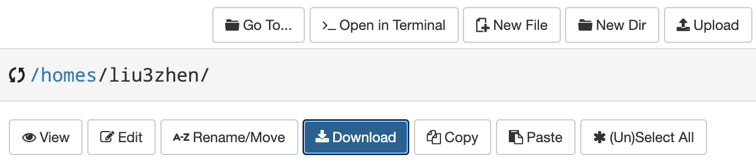
ondemand.beocat.ksu.edu

Slide 8
Problem 1
Two sequences:
ZmA
https://github.com/liu3zhenlab/teaching/raw/refs/heads/master/PLPTH813Bioinformatis/2025/3_data/lab03/ZmA.fasta
ZmB
https://github.com/liu3zhenlab/teaching/raw/refs/heads/master/PLPTH813Bioinformatis/2025/3_data/lab03/ZmB.fasta
Please download the data and plot a dotplot between the two sequences.
Possible parameter: --minaln 100

Slide 9
Outline
ndotplot
E-Utilities to retrieve Genbank data
Datasets to download genomic/genic sequences
SRA-toolkit to download sequencing reads

Slide 10
Edirect - intallation
Installation
sh -c "$(wget -q https://ftp.ncbi.nlm.nih.gov/entrez/entrezdirect/install-edirect.sh -O -)"
echo "export PATH=\$HOME/edirect:\$PATH" >> $HOME/.bashrc
Running:
module load Perl
source $HOME/.bashrc
esearch
# cpanm to install modules if needed

Slide 11
esearch - to search Entrez keywords in a certain NCBI database
esearch -db protein -query "lycopene cyclase"
esearch -db protein \
-query "lycopene cyclase [PROT] AND Streptomyces [ORGN]"
Notes:
The esearch command uses the ESearch utility to search an NCBI database for a query and finds the unique identifiers (UIDs; in the case of a PubMed search, PMIDs) for all records that match the search query.
Input
A search string, such as you would put into the web version of PubMed.
Output
A snippet of XML that includes a count of the number of records that match the search query, e.g.:
<ENTREZ_DIRECT> <Db>pubmed</Db> <WebEnv>NCID_1_1079563_130.14.18.34_9001_1472819698_1672866789_0MetA0_S_MegaStore_F_1</WebEnv> <QueryKey>1</QueryKey> <Count>1273159</Count> <Step>1</Step> </ENTREZ_DIRECT> In addition, esearch outputs the UIDs for the records that match the search query, and stores them on the History server, using the WebEnv and Query Key specified in the XML snippet.
Arguments
The esearch command allows the following arguments:
-db: The database you wish to search.
Example: -db pubmed
-query: Your search string, enclosed in double quotes. Note: if your search string includes quotation marks, you will need to “escape” these quotes by prefacing them with a backslash (“\”) character. This tells EDirect to interpret the quotation marks as just another character, and not a special character that marks the end of the -query argument. Otherwise, EDirect would interpret the first set of double quotation marks in your search string as marking the end of the query, and the rest of the string would not be searched.
Example: -query "breast cancer AND 2016[pdat]"
Example: -query "smith bh[author] AND \"science\"[journal]" (demonstrates “escaping” quotes with “\”)
-sort: Specifies the order in which your results will be sorted. The name of the sort order should be enclosed in double quotes (see examples below). Each database has different available sort orders.
For PubMed, the valid sort orders are:
First Author
Journal
Last Author
Pub Date
Recently Added
Relevance
Title
Example: -sort "First Author"
Example: -sort "Relevance"
-datetype: When limiting results by date, this specifies which of the several date fields on a record is used to limit. This argument should be used with the -days argument, or with -mindate and -maxdate. Available date types vary by database.
For PubMed, valid datetype values include:
CRDT: Create Date (For records added after December 18, 2008, this is the date the citation was first added to PubMed. For more details, see the entry for “Create Date” in MEDLINE/PubMed Data Element (Field) Descriptions.)
EDAT: Entrez Date (For records added after October 9, 2008, this is the date the citation was added to PubMed, except for records added more than twelve months after the date of publication. For more details, see the entry for “Entrez Date” in MEDLINE/PubMed Data Element (Field) Descriptions.)
PDAT: Publication Date (The article’s publication date.)
MHDA: MeSH Date (The date the citation was indexed with MeSH. If the citation has not yet been indexed, this will be the same as the Entrez Date.)
Example: -datetype PDAT
Note: You can also impose a date restriction on your search within your -query, just as you would when searching the web version of PubMed. For more information on searching PubMed by date, see PubMed Help: Searching by date.
-days: Limits results to records with dates no more than the specified number of days in the past, based on the date field specified in the -datetype argument.
Example: -datetype EDAT -days 5 (limits results to records added to the database in the last 5 days)
-mindate/-maxdate: Limits results to records with dates in a certain range, based on the date field specified in the -datetype argument. To specify a date range, you must provide both a -mindate and a -maxdate argument, as well as a -datetype argument.
Example: -datetype PDAT -mindate 1990 -maxdate 2000 (limits results to articles published between 1990 and 2000, inclusive)
-spell: Corrects misspellings in your search query.
Example: -query "neploasms" -spell (corrects the spelling of “neploasms” to “neoplasms”)
-log: In addition to the default XML snippet output, also shows the full E-utilities URL and the full query translation (like you would find in the “Search details” box on the web version of PubMed).
Example: esearch -db pubmed -query "heart attack" -log

Slide 12
esearch + efetch
efetch: formatted data records (e.g. abstracts, FASTA)
esearch -db protein -query "lycopene cyclase" | \
efetch –format fasta | \
> out.fasta

Slide 13
Download records from NCBI databases via efetch
# download GenBank FASTA sequences
efetch -db nuccore -id J01749,U54469 -format fasta
# extract abstracts
efetch -db pubmed -id 24102982,21171099 -format abstract
Notes:
Input
One or more unique identifiers (UIDs; when fetching from PubMed, PMIDs). These UIDs can be specified in the -id argument (see below), or can be retrieved from the History server.
Output
One or more records displayed in a chosen format:
A list of UIDs (i.e. PMIDs).
Abstract view, formatted in plain text.
MEDLINE view, including the field indicators.
The full XML of the record.
Arguments
The efetch command allows the following arguments:
-db: The database from which you wish to retrieve records.
Example: -db pubmed
-id: One or more UIDs (PMIDs, if your -db argument is pubmed), separated by commas.
Example: -id 24102982,21171099,17150207
Example: -id 26287646
-format: Specifies the format in which you wish to display the records.
For PubMed, the valid formats include:
uid: displays a list of UIDs (i.e. PMIDs).
abstract: displays the Abstract view, formatted in plain text.
medline: displays the MEDLINE view, including the field indicators.
xml: displays the full PubMed XML.
Example: -format uid
Example: -format xml
Examples:
Retrieve the record for PMID 25359968 in MEDLINE format:
efetch -db pubmed -id 25359968 -format medline Retrieve the record for PMID 26287646 in XML format:
efetch -db pubmed -id 26287646 -format xml Retrieve the records for PMIDs 24102982, 21171099, and 17150207 in abstract view:
efetch -db pubmed -id 24102982,21171099,17150207 -format abstract

Slide 14
Check publication records in PubMed for an author
# fun to try
esearch -db pubmed \
-query "xxx xxx[AUTH]" | \
efetch -format docsum | \
xtract -pattern DocumentSummary \
-sep "|" -element PubDate Title | \
sort
Notes:
xtract: Extract specific information
Input
One or more unique identifiers (UIDs; when fetching from PubMed, PMIDs). These UIDs can be specified in the -id argument (see below), or can be retrieved from the History server.
Output
One or more records displayed in a chosen format:
A list of UIDs (i.e. PMIDs).
Abstract view, formatted in plain text.
MEDLINE view, including the field indicators.
The full XML of the record.
Arguments
The efetch command allows the following arguments:
-db: The database from which you wish to retrieve records.
Example: -db pubmed
-id: One or more UIDs (PMIDs, if your -db argument is pubmed), separated by commas.
Example: -id 24102982,21171099,17150207
Example: -id 26287646
-format: Specifies the format in which you wish to display the records.
For PubMed, the valid formats include:
uid: displays a list of UIDs (i.e. PMIDs).
abstract: displays the Abstract view, formatted in plain text.
medline: displays the MEDLINE view, including the field indicators.
xml: displays the full PubMed XML.
Example: -format uid
Example: -format xml
Examples:
Retrieve the record for PMID 25359968 in MEDLINE format:
efetch -db pubmed -id 25359968 -format medline Retrieve the record for PMID 26287646 in XML format:
efetch -db pubmed -id 26287646 -format xml Retrieve the records for PMIDs 24102982, 21171099, and 17150207 in abstract view:
efetch -db pubmed -id 24102982,21171099,17150207 -format abstract

Slide 15
Outline
E-Utilities to retrieve Genbank data
Datasets to download genomic/genic sequences
SRA-toolkit to download sequencing reads

Slide 16

Explore NCBI Genome Data View (GDV)
https://www.ncbi.nlm.nih.gov/gdv

Slide 17
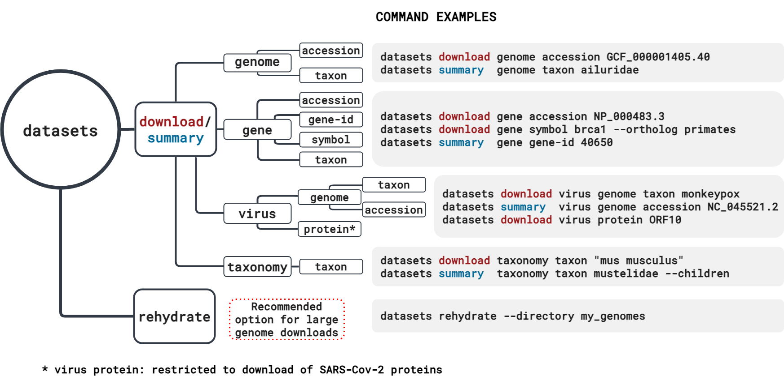
Datasets - to download sequence data from NCBI
datasets version: 16.39.0
Notes:
Input
One or more unique identifiers (UIDs; when fetching from PubMed, PMIDs). These UIDs can be specified in the -id argument (see below), or can be retrieved from the History server.
Output
One or more records displayed in a chosen format:
A list of UIDs (i.e. PMIDs).
Abstract view, formatted in plain text.
MEDLINE view, including the field indicators.
The full XML of the record.
Arguments
The efetch command allows the following arguments:
-db: The database from which you wish to retrieve records.
Example: -db pubmed
-id: One or more UIDs (PMIDs, if your -db argument is pubmed), separated by commas.
Example: -id 24102982,21171099,17150207
Example: -id 26287646
-format: Specifies the format in which you wish to display the records.
For PubMed, the valid formats include:
uid: displays a list of UIDs (i.e. PMIDs).
abstract: displays the Abstract view, formatted in plain text.
medline: displays the MEDLINE view, including the field indicators.
xml: displays the full PubMed XML.
Example: -format uid
Example: -format xml
Examples:
Retrieve the record for PMID 25359968 in MEDLINE format:
efetch -db pubmed -id 25359968 -format medline Retrieve the record for PMID 26287646 in XML format:
efetch -db pubmed -id 26287646 -format xml Retrieve the records for PMIDs 24102982, 21171099, and 17150207 in abstract view:
efetch -db pubmed -id 24102982,21171099,17150207 -format abstract

Slide 18
Installation of datasets
Go to the directory of “software” and create a new directory of “datasets”
Download datasets
wget https://ftp.ncbi.nlm.nih.gov/pub/datasets/command-line/v2/linux-amd64/datasets
chmod a+rx datasets
./datasets
wget https://ftp.ncbi.nlm.nih.gov/pub/datasets/command-line/v2/linux-amd64/dataformat
chmod a+rx dataformat
./dataformat

Slide 19
datasets for genomic data
# check the information of a reference genome for sorghum
./datasets summary genome taxon "Sorghum Bicolor" --reference
# download sequence data for a particular genome
./datasets download genome taxon "Sorghum bicolor" \
--reference --include genome,rna,cds,protein \
--filename BTx623.zip
cds_from_genomic.fna
GCF_000003195.3_Sorghum_bicolor_NCBIv3_genomic.fna
protein.faa
rna.fna
Notes:
Input
One or more unique identifiers (UIDs; when fetching from PubMed, PMIDs). These UIDs can be specified in the -id argument (see below), or can be retrieved from the History server.
Output
One or more records displayed in a chosen format:
A list of UIDs (i.e. PMIDs).
Abstract view, formatted in plain text.
MEDLINE view, including the field indicators.
The full XML of the record.
Arguments
The efetch command allows the following arguments:
-db: The database from which you wish to retrieve records.
Example: -db pubmed
-id: One or more UIDs (PMIDs, if your -db argument is pubmed), separated by commas.
Example: -id 24102982,21171099,17150207
Example: -id 26287646
-format: Specifies the format in which you wish to display the records.
For PubMed, the valid formats include:
uid: displays a list of UIDs (i.e. PMIDs).
abstract: displays the Abstract view, formatted in plain text.
medline: displays the MEDLINE view, including the field indicators.
xml: displays the full PubMed XML.
Example: -format uid
Example: -format xml
Examples:
Retrieve the record for PMID 25359968 in MEDLINE format:
efetch -db pubmed -id 25359968 -format medline Retrieve the record for PMID 26287646 in XML format:
efetch -db pubmed -id 26287646 -format xml Retrieve the records for PMIDs 24102982, 21171099, and 17150207 in abstract view:
efetch -db pubmed -id 24102982,21171099,17150207 -format abstract

Slide 20
datasets for gene data
# download gene data by RefSeq nucleotide or protein accessions
./datasets download gene accession NM_020107.5 NP_001334352.2
# download sequence data for all human genes.
./datasets download gene taxon human
# download gene data using Gene IDs, symbols, or accession numbers
./datasets download gene gene-id 59272 --ortholog mammals
./datasets download gene symbol cftr --ortholog all
./datasets download gene accession NM_000492.4 --ortholog primates
Notes:
Input
One or more unique identifiers (UIDs; when fetching from PubMed, PMIDs). These UIDs can be specified in the -id argument (see below), or can be retrieved from the History server.
Output
One or more records displayed in a chosen format:
A list of UIDs (i.e. PMIDs).
Abstract view, formatted in plain text.
MEDLINE view, including the field indicators.
The full XML of the record.
Arguments
The efetch command allows the following arguments:
-db: The database from which you wish to retrieve records.
Example: -db pubmed
-id: One or more UIDs (PMIDs, if your -db argument is pubmed), separated by commas.
Example: -id 24102982,21171099,17150207
Example: -id 26287646
-format: Specifies the format in which you wish to display the records.
For PubMed, the valid formats include:
uid: displays a list of UIDs (i.e. PMIDs).
abstract: displays the Abstract view, formatted in plain text.
medline: displays the MEDLINE view, including the field indicators.
xml: displays the full PubMed XML.
Example: -format uid
Example: -format xml
Examples:
Retrieve the record for PMID 25359968 in MEDLINE format:
efetch -db pubmed -id 25359968 -format medline Retrieve the record for PMID 26287646 in XML format:
efetch -db pubmed -id 26287646 -format xml Retrieve the records for PMIDs 24102982, 21171099, and 17150207 in abstract view:
efetch -db pubmed -id 24102982,21171099,17150207 -format abstract

Slide 21
Problems
Problem 1:
Identify and download the reference genome for the species of interest on using datasets
Problem 2:
Identify and download orthologs in mammals or plants of a gene of interest using datasets

