Slide 1
Deep learning Bioinformatics Applications (PLPTH813)
Sanzhen Liu
4/29/2021

Slide 2
conda installation
# download conda software
wget https://repo.anaconda.com/archive/Anaconda3-2020.11-Linux-x86_64.sh
# installation
sh Anaconda3-2020.11-Linux-x86_64.sh
# with -u if a previous installation exists
# sh Anaconda3-2020.11-Linux-x86_64.sh -u

Slide 3
Software installation
### install tensorflow in R
install.packages("tensorflow")
library("tensorflow")
install_tensorflow(
method = "conda",
conda_python_version = "3.6",
)
### confirm that the installation succeeded with:
library("tensorflow")
tf$constant("Hello Tensorflow")
### install keras
install.packages("keras")

Slide 4
Online tutorial
Basic Image Classification
https://tensorflow.rstudio.com/tutorials/beginners/basic-ml/tutorial_basic_classification/

Slide 5
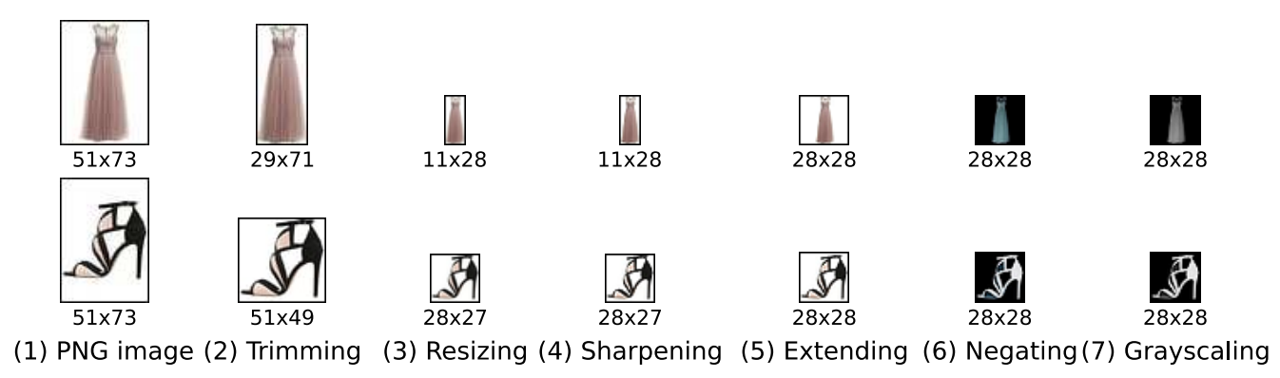
Data
https://arxiv.org/pdf/1708.07747.pdf
Fashion-MNIST: a Novel Image Dataset for Benchmarking Machine Learning Algorithms

Slide 6
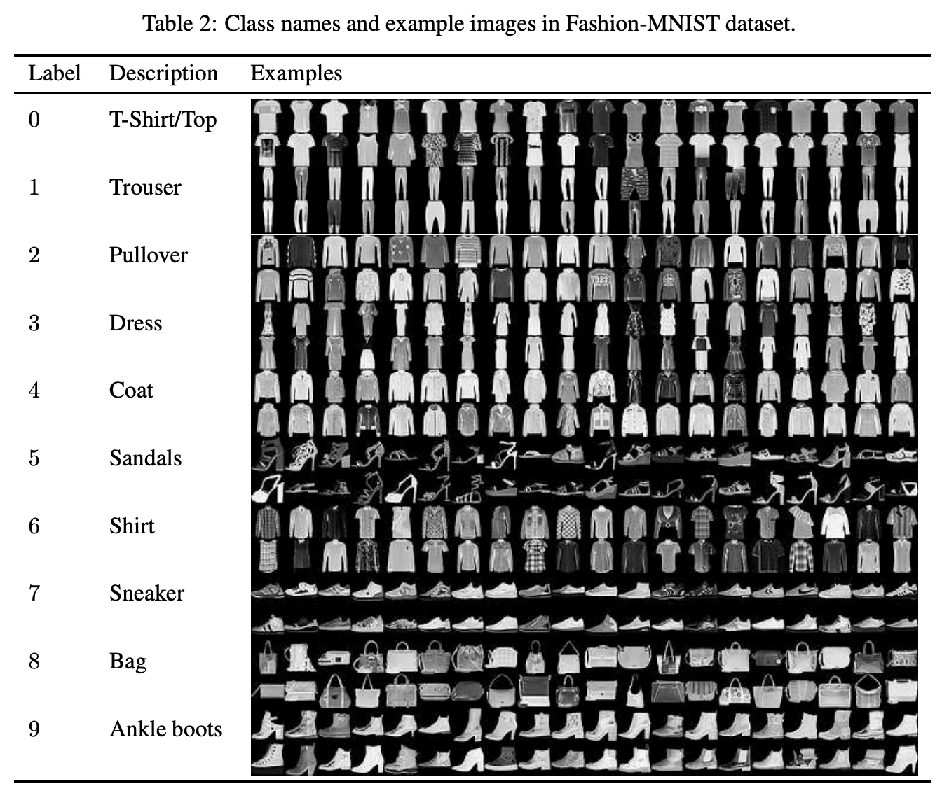
Example images from Fashion-MNIST

Slide 7
Data of image 1
[,1] [,2] [,3] [,4] [,5] [,6] [,7] [,8] [,9] [,10] [,11] [,12] [,13] [,14] …
[1,] 0 0 0 0 0 0 0 0 0 0 0 0 0 0
[2,] 0 0 0 0 0 0 0 0 0 0 0 0 0 0
[3,] 0 0 0 0 0 0 0 0 0 0 0 0 0 0
[4,] 0 0 0 0 0 0 0 0 0 0 0 0 1 0
[5,] 0 0 0 0 0 0 0 0 0 0 0 0 3 0
[6,] 0 0 0 0 0 0 0 0 0 0 0 0 6 0
[7,] 0 0 0 0 0 0 0 0 0 0 0 0 0 0
[8,] 0 0 0 0 0 0 0 0 0 0 0 1 0 69
[9,] 0 0 0 0 0 0 0 0 0 1 1 1 0 200
[10,] 0 0 0 0 0 0 0 0 0 0 0 0 0 183
[11,] 0 0 0 0 0 0 0 0 0 0 0 0 0 193
[12,] 0 0 0 0 0 0 0 0 0 1 3 0 12 219
[13,] 0 0 0 0 0 0 0 0 0 0 6 0 99 244
[14,] 0 0 0 0 0 0 0 0 0 4 0 0 55 236
[15,] 0 0 1 4 6 7 2 0 0 0 0 0 237 226
[16,] 0 3 0 0 0 0 0 0 0 62 145 204 228 207
[17,] 0 0 0 0 18 44 82 107 189 228 220 222 217 226
[18,] 0 57 187 208 224 221 224 208 204 214 208 209 200 159
[19,] 3 202 228 224 221 211 211 214 205 205 205 220 240 80
[20,] 98 233 198 210 222 229 229 234 249 220 194 215 217 241
[21,] 75 204 212 204 193 205 211 225 216 185 197 206 198 213
[22,] 48 203 183 194 213 197 185 190 194 192 202 214 219 221
[23,] 0 122 219 193 179 171 183 196 204 210 213 207 211 210
[24,] 0 0 74 189 212 191 175 172 175 181 185 188 189 188
[25,] 2 0 0 0 66 200 222 237 239 242 246 243 244 221
[26,] 0 0 0 0 0 0 0 40 61 44 72 41 35 0
[27,] 0 0 0 0 0 0 0 0 0 0 0 0 0 0
[28,] 0 0 0 0 0 0 0 0 0 0 0 0 0 0
28 × 28 grayscale

Slide 8
Libraries loading
library(keras)
#install.packages("tidyr")
#install.packages("ggplot2")
library(tidyr)
library(ggplot2)

Slide 9
Data loading
fashion_mnist <- dataset_fashion_mnist()
summary(fashion_mnist$train)
c(train_images, train_labels) %<-% fashion_mnist$train
c(test_images, test_labels) %<-% fashion_mnist$test
dim(train_images)
dim(train_labels)

Slide 10
Ten classes
class_names=c('T-shirt/top',
'Trouser',
'Pullover',
'Dress',
'Coat',
'Sandal',
'Shirt',
'Sneaker',
'Bag',
'Ankle boot')

Slide 11
Display image 1
image_1 <- as.data.frame(train_images[1, , ])
colnames(image_1) <- seq_len(ncol(image_1))
image_1$y <- seq_len(nrow(image_1))
image_1 <- gather(image_1, "x", "value", -y)
image_1$x <- as.integer(image_1$x)
# plot the first image
ggplot(image_1, aes(x = x, y = y, fill = value)) +
geom_tile() +
scale_fill_gradient(low="white", high="black", na.value=NA) +
scale_y_reverse() +
theme_minimal() +
theme(panel.grid = element_blank()) +
theme(aspect.ratio = 1) +
xlab("") +
ylab("")

Slide 12
Scale image data
# scale these values to a range of 0 to 1 before feeding to the neural network model.
train_images <- train_images / 255
test_images <- test_images / 255

Slide 13
Set and compile the model
### set the layer
model <- keras_model_sequential() %>%
layer_flatten(input_shape = c(28, 28)) %>%
layer_dense(units = 128, activation = 'relu') %>%
layer_dense(units = 10, activation = 'softmax')
### compile
model %>% compile(
optimizer = 'adam',
loss = 'sparse_categorical_crossentropy',
metrics = c('accuracy')
)
# Adam optimization is a stochastic gradient descent method.
# categorical_crossentropy produces a one-hot array containing the probable match for each category; sparse_categorical_crossentropy produces a category index of the most likely matching category.

Slide 14
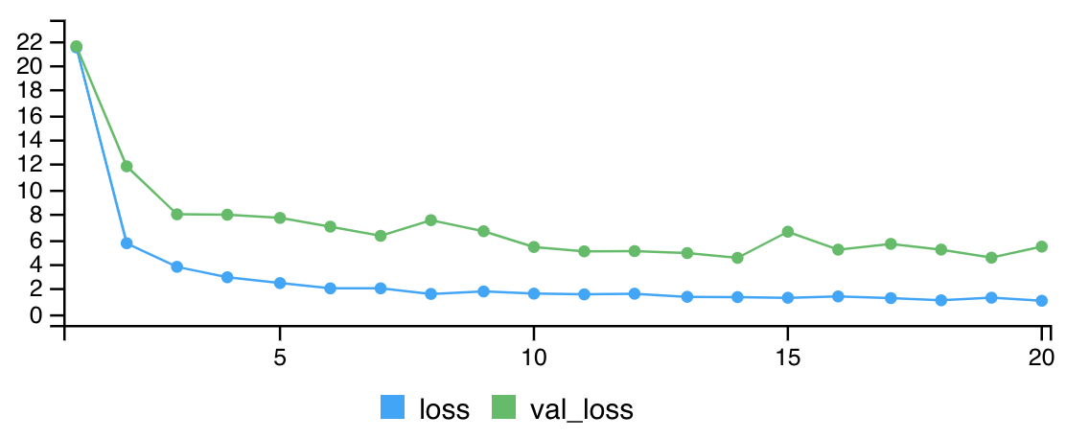
training
### training
model %>% fit(train_images, train_labels,epochs=30,
validation_split=0.3, verbose=2)
### select epoch=5
model %>% fit(train_images, train_labels,
epochs=5, verbose=2)
Notes:
One epoch consists of one full training cycle on the training set. Once every sample in the set is seen, you start again - marking the beginning of the 2nd epoch.

Slide 15
prediction
### prediction
predictions <- model %>% predict(test_images)
predictions[1, ]
which.max(predictions[1, ])
class_names[which.max(predictions[1, ])]
class_pred <- model %>% predict_classes(test_images)
class_pred[1:20]

Slide 16
Manually check some prediction results
par(mfcol=c(4,4))
par(mar=c(0, 0, 1.5, 0), xaxs='i', yaxs='i')
for (i in 1:16) {
img <- test_images[i, , ]
img <- t(apply(img, 2, rev))
# subtract 1 as labels go from 0 to 9
predicted_label <- which.max(predictions[i, ]) - 1
true_label <- test_labels[i]
if (predicted_label == true_label) {
color <- '#008800'
} else {
color <- '#bb0000'
}
image(1:28, 1:28, img, col=gray((0:255)/255),
xaxt='n', yaxt='n',
main = paste0(class_names[predicted_label + 1], " (",
class_names[true_label + 1], ")"),
col.main = color)
}

Slide 17
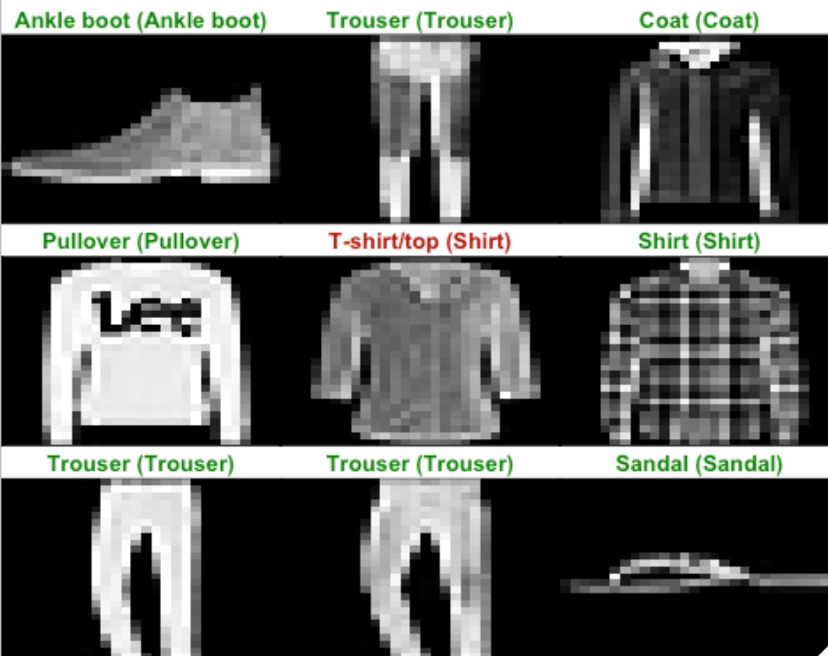
Manual checking

Slide 18
Prediction image 1
### predict image 1
img <- test_images[1, , , drop = FALSE]
prediction1 <- model %>% predict(img)
prediction1
class_names[which.max(prediction1)]
[1] "Ankle boot"

