Slide 1
Beocat job submission
Sanzhen Liu
PLPTH813 Bioinformatics Applications
3/11/2025

Slide 2
Outline
Slurm job submission and scheduling
easysbatch
Project discussion

Slide 3
Beocat: a High-Performance Computing (HPC) cluster
headnodes
compute
nodes
>10,000 cores
storage
>3 PB
1 PB = ~1,000 TB
Running jobs on the Beocat cluster involves submitting a job script to the scheduler which will allocate the resources and run codes.
https://support.beocat.ksu.edu/Docs/ProposalDescription

Slide 4

SLURM: a job submission and scheduling system
Slurm
headnodes
storage
job scheduling
resource allocation
compute
nodes
users
queued jobs
https://slurm.schedmd.com/quickstart.html

Slide 5
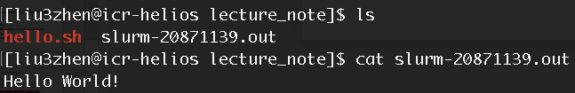
Slurm command – sbatch (I)
hello.sh
#!/bin/bash
echo "Hello World!"
sh hello.sh
sbatch: submit a job to the cluster
sbatch hello.sh

Slide 6
Slurm command – sbatch (II)
sbatch \
--cpus-per-task=1 \
--mem=1G \
--time=1-00:00:00 \
hello.sh
request resources
# 1-00:00:00: 1 day, 0 hour, 0 minute, and 0 second
# By default, time is 1 hour.

Slide 7
Slurm command – sbatch (III)
hello.sh
#!/bin/bash
#SBATCH --time=1-00:00:00
#SBATCH --mem=1G
#SBATCH --cpus-per-task=1
echo "Hello World!"
sbatch hello.sh

Slide 8
Slurm command - scancel
scancel: cancel jobs
scancel 1187082
scancel –u <user_name>

Slide 9
Slurm commands - squeue
squeue: check job status
squeue
squeue | grep <user_name>
$ squeue | grep liu3zhen
20874984 ksu-biol- hello.sh liu3zhen R 0:11 1 wizard24
20874986 ksu-biol- hello2.sh liu3zhen PD 0:00 1 (Resources)

Slide 10
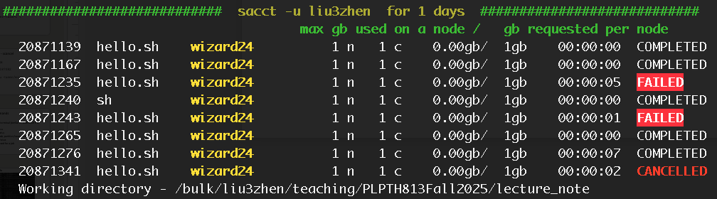
"Beocat" script – kstat
kstat –d 1 # status of jobs within 1 day

Slide 11
More Slurm commands
srun: run a job from a terminal (similar to sbatch but it is interactive running) sinfo: check system status sview: check system, job, partition/reservation status sacct: list of jobs and status sstat: show resource used for a job

Slide 12
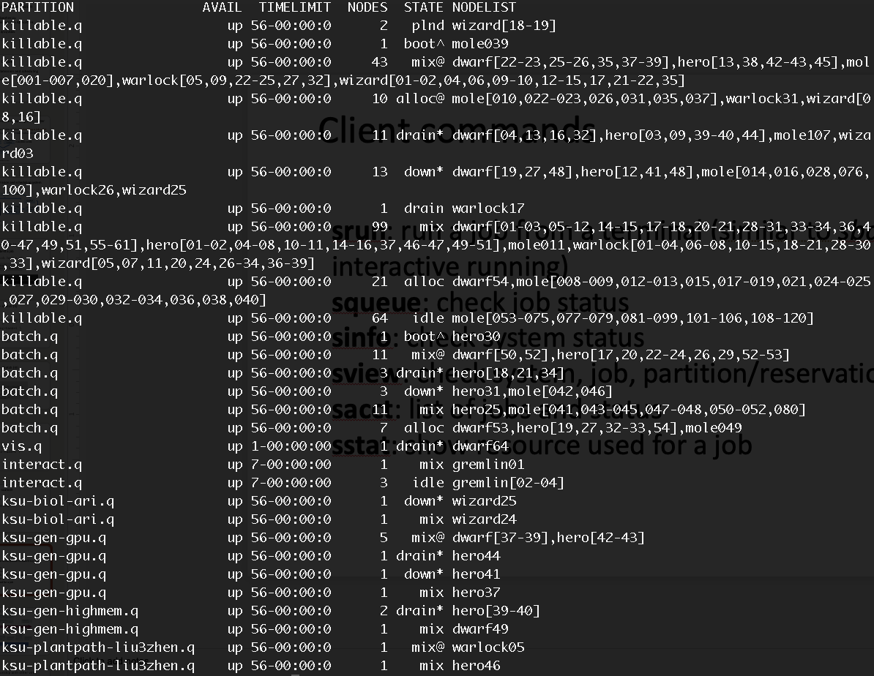
Slurm commands – sinfo

Slide 13
Example: SAM conversion to BAM sam2bam.sh
#!/bin/bash
#SBATCH --cpus-per-task=4
#SBATCH --mem-per-cpu=1G
#SBATCH --time=1-00:00:00
module load SAMtools
ncpu=4
for sam in *.sam
do
echo $sam
out=$(echo $sam | sed 's/.sam//g');
echo $out
# convert SAM to BAM:
samtools view -@ $ncpu -bS $out.sam \
| samtools sort -@ $ncpu -o $out.bam -
# Index sorted BAM:
samtools index -@ $ncpu $out.bam
done

Slide 14
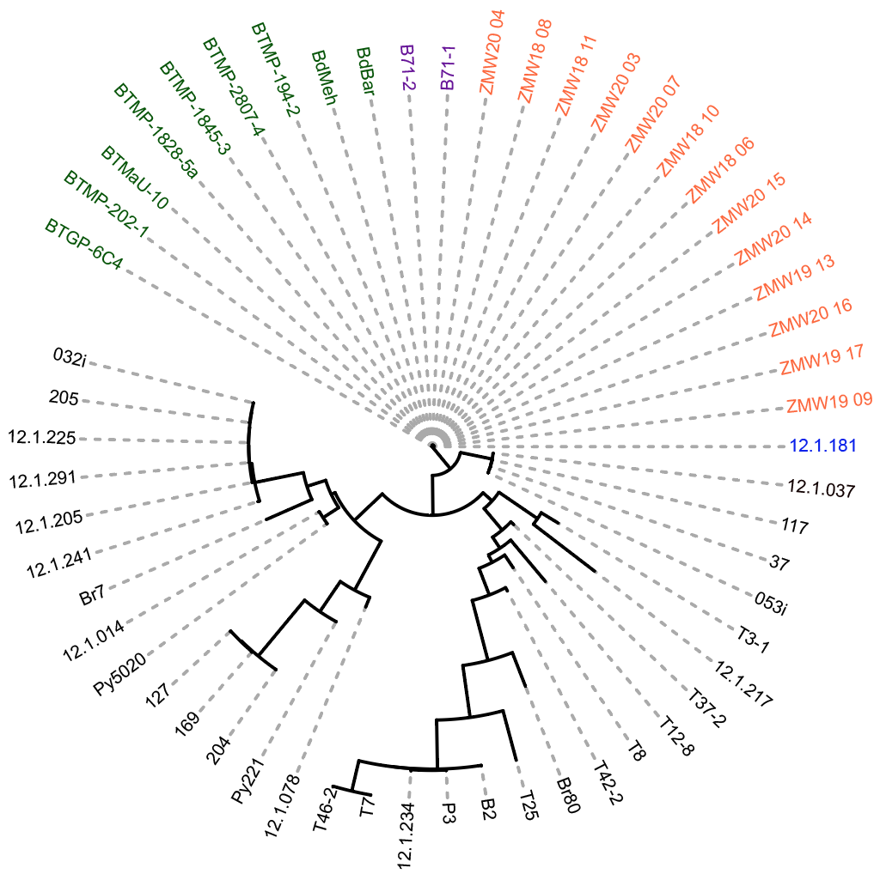
Array jobs
Job arrays offer a mechanism for submitting and managing collections of similar jobs
sbatch --array 1-5
# cancel jobs (assuming job ID is 12345) scancel 12345_1 # cancel array job 1 scancel 12345_[1-3] # cancel array jobs 1-3

Slide 15
Outline
Slurm job submission and scheduling
easysbatch
Project discussion

Slide 16
Motivation
To submit jobs in an array manner is a good way to manage jobs on the Slurm system. However, to submit array jobs takes time to organize codes and input files.
In addition, it is necessary to document parameters for regular analyses so those parameters can be repeatedly and consistently used. Therefore, easysbatch was developed.

Slide 17
easysbatch
Usage: perl esbatch --inlist <filelist> --cmd [options]
[Selected options]
--indir <str> path to input data(.)
--inpattern <str> regular expression pattern to filter files
--cmd* <str> command (e.g., gzip); required
--preset <file> preset .json file to store parameters
--submit submit the slurm job if specified
perl esbatch --inpattern "fq$" --cmd "gzip" --submit

Slide 18
case 1: gzip a set of files
task: is to gzip *fastq files in the directory of data
- One way is to generate a list of input files and then run esbatch
ls -1 data/*fastq > fqlist
esbatch --inlist fqlist --cmd gzip --submit
- The other way is to input the file pattern and automatically identify files to gzip esbatch --indir data --inpattern fastq$ --cmd gzip --submit

Slide 19
Outline
Slurm job submission and scheduling
easysbatch
Project discussion

Slide 20
Projects
You are expected to design projects after the spring break.
The project can be related to your own research projects or the utilization of public data for meaningful analysis.
This can be a group project but at most 3 persons per group.

Slide 21
Project examples
Comparison of algorithms for genome assemblies
GWAS of a trait and post-GWAS analysis
Differential expression (RNA-seq analysis and visualization)
Reproduce a computational work from a paper
Learn to use a bioinformatics software package; the package should be relatively new and useful

Slide 22
More about the project
April 1st: title, team members, and project abstract (no more than 200 words – brief background, questions/objective, brief plan and expected outcomes)
May 1st , 3rd , 8th : Presentation
15 min for each project with 1-2 team members
20 min for each project with 3 team members
Project submission
Presentation slides and codes, which will be shared among us.

