Slide 1
Design of RNA-seq Experiments and Differential Expression Analysis Genomic Technologies Workshop (PLPTH885)
Sanzhen Liu
6/8/2022

Slide 2
Schedule
9:30 am Lecture 6 - Sanzhen Liu
Design of RNA-Seq Experiments and Differential Expression Analysis
10:50 am Break
11:00 am Computer Lab 2 - Guifang Lin, Sanzhen Liu
Introduction to R programming language
12:30 pm Lunch on your own
1:30 - 3pm Computer Lab 3 - Sanzhen Liu, Guifang Lin
RNA-Seq data analysis using R

Slide 3
Outline
RNA-seq procedure
Statistical test of differential expression (DE)
Multiple testing correction
Data virualization
Gene ontology (GO) enrichment

Slide 4
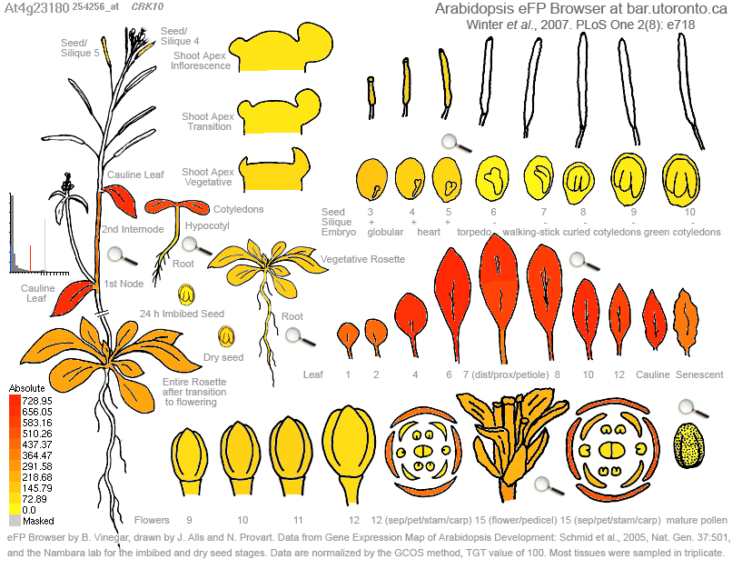
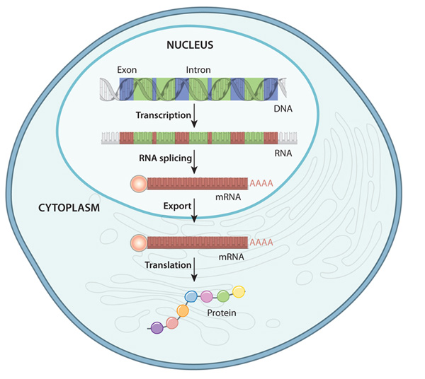
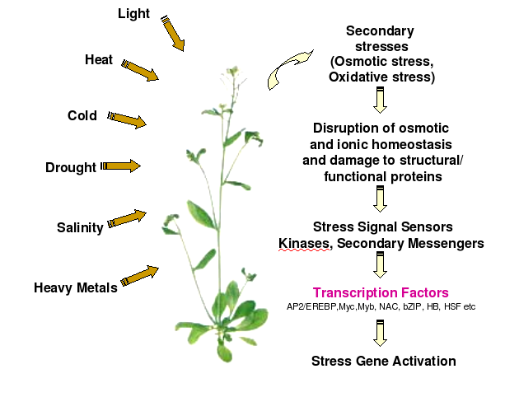

Gene expression
Expression profiles in different tissues
DNA to protein in eukaryote
caps.ncbs.res.in
Adaptation to environmental change
nature.com/scitable/topicpage/gene-expression-14121669
What are expression levels of transcripts?
cragenomica.es
Response to biotic stress

Slide 5
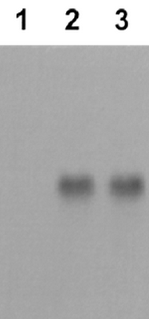
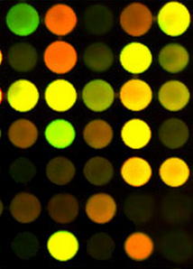
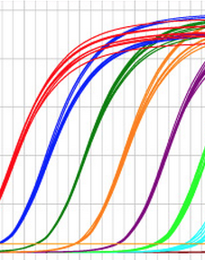
Approaches for quantification of gene expression
How can we measure the accumulative level of transcripts of a given gene in millions/billions of transcripts?
Northern
blot
qRT-PCR
microarray
RNA-seq
biochemj.org
quantabio.com
csmbio.csm.jmu.edu

Slide 6
Rationale of RNA-seq (mRNA sequencing)
genomic DNA
10 millions of transcripts in each cell
Including a gene of interest
exon
intron
100
5
mRNA/transcript
sequence 1,000 transcripts
0 0
Essentially, RNA-seq is designed to measure mRNA accumulation levels of genes by
1) recognizing transcripts based on sequences
2) and quantifying transcripts of each gene
sequence 1 million transcripts
10 1
Differential expression (DE)?

Slide 7
RNA-Seq procedure
total RNA
mRNA
RNA to sequencing reads
1
DNA library
sequencing
reads
reads to read counts per gene
2
alignment
read counts
read counts to significant genes
statistical test
3
q-values/FDR
significance

Slide 8
Reads to read counts per gene
total RNA
exon
intron
mRNA
DNA library
sequencing
1. reads
reads
2. alignment to the reference genome (DNA sequence)
split read
alignment
read counts
An intron-aware aligner is important for RNA-seq reads alignment e.g., STAR, HiSAT2
statistical test
3. read counts
q-values
N = 19 if all reads can be confidently mapped to the reference genome
significance

Slide 9
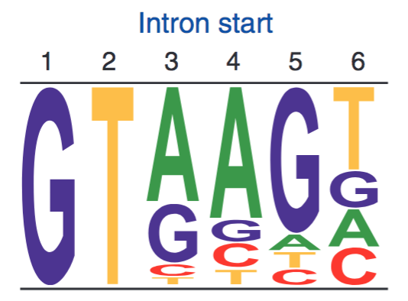
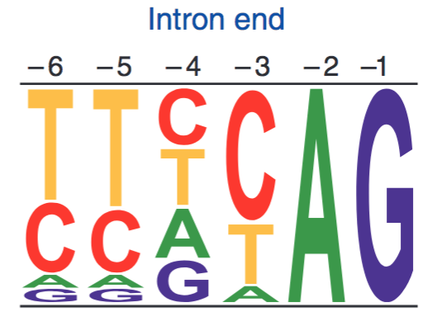
Exon-intron structure
Sequence logos representing weight matrices for the first six bases of an intron (left) and the last six bases of an intron (right). In plants and animals, ~99% of introns begin with GT.
exon
intron
exon
GT
AG

Slide 10
Alignment issues
Repeats
Sequencing errors
Polymorphisms (reference and sequenced individuals)
Quality of reference genomes (mis-assembly and incomplete genome)
reads
Ref
Notes:
reads are relatively short (30 to 150 bp), making it hard to unambiguously assign them to a specific location in the genome, especially in the presence of sequencing errors and repeat sequences.

Slide 11
Solutions to mitigate problems
Unique mapped reads
reads
✗
✓
Ref
Longer reads or Paired-end reads
reads
…
Ref
Tolerance of mismatches or gaps for each alignment
Better reference genome

Slide 12
Count matrix Read counts (Raw) per gene
total RNA
mRNA
DNA library
sequencing
Gene | sample 1
gene 1 | 6,075
gene 2 | 295
... | ...
sample 2 | sample 3
5,934 | 3,370
377 | 169
... | ...
reads
alignment
read counts
statistical test
q-values
significance

Slide 13

Read counts to significant genes
total RNA
mRNA
2x2 Table for Gene 1
T
 | Gene 1 | Others
Control 1 | C1 | N1 – C1
TRT 1 | T1 | N2 – T1
DNA library
Control 1
TRT 1 (salt)
sequencing
RNA
Library
Sequencing
Fisher’s Exact Test or χ² test on Gene 1
A p-value for Gene 1
Repeat on all the genes
p-values
Multiple testing correction
q-values
Declaration of significance
a significant gene set
reads
alignment
N1 reads
N2 reads
Trimming
Alignment
Read counting per gene
read counts
statistical test
Gene | Control 1 | TRT 1
1 | C1 | T1
2 | C2 | T2
…
Sum | N1 | N2
q-values
significance

Slide 14
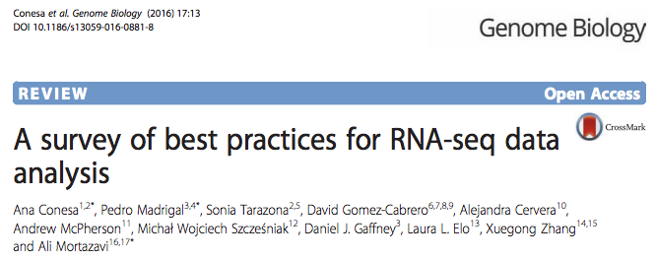
Statistical test for differential expression
Statistical test to discover differential expression (DE)
Count data: Generalized Linear Model (GLM) to deal with count data
e.g., Poisson GLM could handle count data but overdispersion exits
Dispersion issue: Using negative binomial GLM to incorporate a dispersion parameter into the model
edgeR (Robinson and Smyth, 2007), DESeq (Anders and Huber, 2010), NBPSeq (Di et al., 2011), and QuasiSeq (Lund 2012)

Slide 15
An RNA-Seq experiment – source of variance
Question: what could cause the difference between two values, C1 and T1?
T
Control 1
TRT 1 (salt)
Gene 1 | C1 | T1
…
Sum | N1 | N2
Treatment effect
Plant difference
RNA quality
Library preparation
Sequencing
Sampling
Sequencing depth
Bio
TRT
Bio
other
Our interest:
the effect of the salt treatment on gene expression
Tech
Sample
Notes:
Index effect
Size selection
PCR Amplification

Slide 16
Source of variance in RNA-Seq - sampling
Sampling variance derived from the inherent nature of counting experiments
Randomly sample 10⁷
First sampling | 6
Second sampling | 13
Third sampling | 8
total molecules: 10⁹
gene X: 1000 molecules
Randomly sample 10⁸
First sampling | 102
Second sampling | 93
Third sampling | 97
Sequence depth (sampling number) matters.

Slide 17

Technical replication
T
Control 1
Control 2
Control 3
TRT 1
TRT 2
TRT 3
within groups
within groups
between groups
Bio
TRT
Compare to declare the significance
Technical
replicate
Technical replication refers to the sequencing of multiple libraries derived from the same biological sample.
Bio
other
Tech
Tech
Sample
Sample
within groups
between groups
Spurious power

Slide 18
Biological replication
T
T
T
Control 1
Control 2
Control 3
TRT 1
TRT 2
TRT 3
within groups
within groups
between groups
Biological replication refers to the sequencing of multiple libraries derived from different biological samples.
Biological
replicate
Bio
TRT
Compare to declare the significance
Technical
replicate
Bio
other
Bio
other
Tech
Tech
Tech
Sample
Sample
Sample
within groups
within groups
between groups
Use biological replication instead of technical replication unless you have your own interest.
More replicates increase the power to detect small effect

Slide 19
Question
Goal: to identify the DEs between two biological groups
Design: Each group has five biological replicates
To avoid messing up samples across groups. The experiment of each group was conducted separately.
Is this a sound experimental design? Why?
Bio
TRT
Bio
other
Bio
other
Tech
Tech
Sample
Sample
within groups
between groups

Slide 20
Comparison of read counts among different samples
T
T
T
Control 1
Control 2
Control 3
TRT 1
TRT 2
TRT 3
Gene 1 | C1 | C2 | C3 | T1 | T2 | T3
…
Sum | N1 | N2 | N3 | N4 | N5 | N6
Sequence depth (total read number) influences read counts. Therefore, raw read counts can not be compared directly.
Can we generate some comparable numbers among samples?

Slide 21
A normalization method: RPKM and FPKM
RPKM: Read number per kilobase of exons per million of total reads
Control 1
read count = 23
total reads: 15 millions of total reads
RPKM of X = 23 * 1000 / 500 / 15 = 3.1
?
exon 1 (220 bp)
exon 2 (280 bp)
Treatment 1
read count = 18
total reads: 10 millions of total reads
RPKM of X = 18 * 1000 / 500 / 10 = 3.6
?
exon 1 (220 bp)
exon 2 (280 bp)
gene X
FPKM: Fragment number per kilobase per million of total reads.
Fragment = one pair of paired-end reads or one single-end read

Slide 22
More about RPKM
RPKM = 5.1
RPKM = 1.5
gene A
gene B
Can we say that the gene B has higher expression than the gene A?
RPKM is not an ideal indicator to compare the expression/accumulation levels between two genes
amplification bias
alignment efficiency

Slide 23
Experimental Design
Sequencing depth
Increasing sequencing depth decreases sampling variance
Biological replication
Reasonable number of biological replication helps accurately estimate variances to achieve reliable statistical inference.
Randomization and unbiasedness
To avoid confounding effect

Slide 24
DE result
 | DE Result
GeneID | Log2FC* | p-value
1 | -0.40 | 0.037
2 | 0.03 | 0.916
3 | -0.89 | 2.42E-05
4 | 0.30 | 0.130
5 | -0.36 | 0.140
6 | -0.07 | 0.811
…
* Log2FC: log2 of fold change (trt / control)

Slide 25
Single statistical test
H0: the null hypothesis
p = 0.05
not rejected
0
1

Slide 26
Single statistical test
H0: the null hypothesis
p = 0.05
rejected
0
1

Slide 27
Multiple testing correction
p = 0.05
0
1
p-value when a NULL hypothesis is true
"A p-value is only statistically valid when a single score is computed."

Slide 28
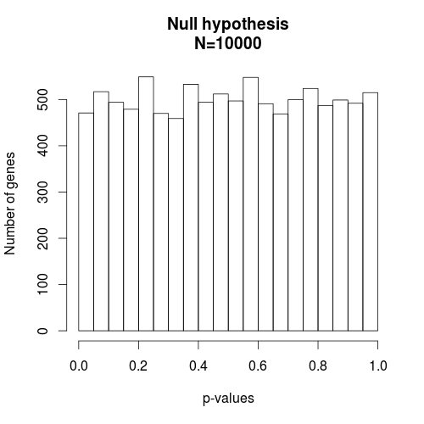
P-value distribution under the null hypothesis (e.g., no treatment effect)
No matter how stringent the criteria are, you’ll identify genes with very small p-values and the false discovery rate (FDR) is 100%.
When the null hypothesis is true, the p-value is distributed uniformly from 0 to 1.

Slide 29
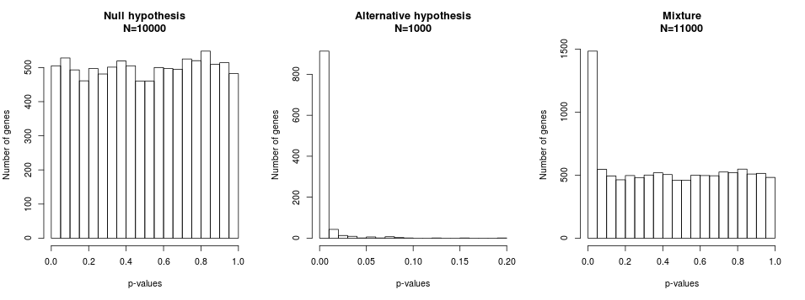
P-value distribution under both the null and non-null hypotheses
When the null hypothesis is true, the p-value is distributed uniformly.
When the null hypothesis is false, the p-value distribution is skewed toward 0.
Cutoff: p=0.05
FDR=471/(471+989)=32%
Cutoff: p=0.01
FDR=102/(102+912)=10%

Slide 30
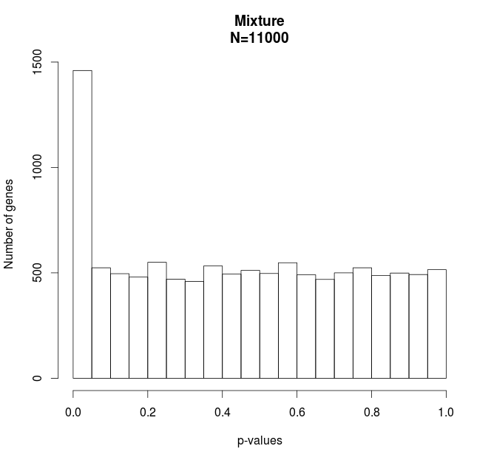
Multiple test correction – FDR method
True positive
P-values < 0.00009
DE=992
False DE=99
FDR 10%
False positive

Slide 31
q-values
The q-value is the smallest FDR for which we can reject the null hypothesis for that one test and all others with smaller p-values.
Gene | p-values | q-values
1 | 0.000 | 0.006
2 | 0.002 | 0.015
3 | 0.009 | 0.059
4 | 0.013 | 0.063
5 | 0.035 | 0.139
6 | 0.051 | 0.171
7 | 0.155 | 0.442
8 | 0.197 | 0.492
9 | 0.247 | 0.539
10 | 0.269 | 0.539
11 | 0.358 | 0.651
12 | 0.396 | 0.656
13 | 0.426 | 0.656
14 | 0.493 | 0.702
15 | 0.526 | 0.702
16 | 0.622 | 0.777
17 | 0.782 | 0.920
18 | 0.862 | 0.958
19 | 0.925 | 0.974
20 | 0.992 | 0.992
FDR (False Discovery Rate) method (BH) is a method to calculate q-values/adjusted p-values/corrected p-values based on p-values
5% FDR, q-values < 0.05
10% FDR, q-values < 0.1
20% FDR, q-values < 0.2
Total number of tests: m = 20

Slide 32
Question
If we identify 500 differential expression (DE) genes using the 5% FDR to account for multiple tests. Which one below is a better description?
1. I am 95% confident that 500 genes are DE.
2. The 5% genes (25 genes) in the set are expected to be false DE genes.

Slide 33
False discovery rate (concept)
For example, among 10,000 tests (10,000 genes), 100 significant genes are declared, in which 10 gene is falsely rejected. In this case, the false discovery rate is 10%.
 | True null hypothesis (H₀) | False null hypothesis (H₁) | Total
Rejected (Declared significance) | 10 | 90 | 100

Slide 34
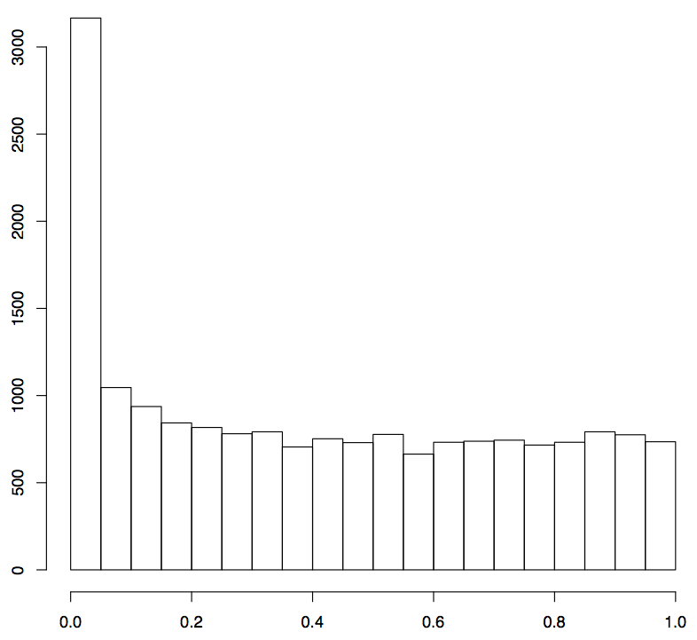
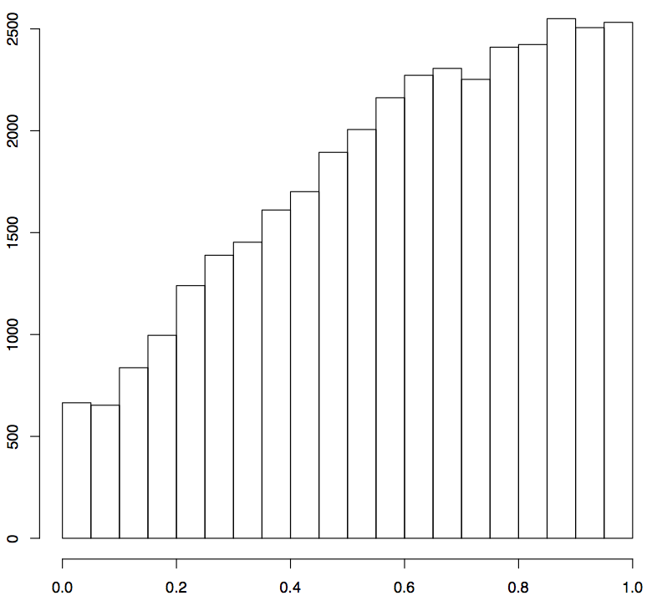
P-value histograms from real studies
1
2
Number of genes
p-values
p-values
If you perform an RNA-Seq experiment, which one would you hope to obtain? Why?

Slide 35
P-value histograms from real studies
1
2
Number of genes
p-values
p-values
DE = 1,370, FDR=5%
DE = 0, FDR=20%

Slide 36
RNA-Seq procedure
total RNA
mRNA
RNA to sequencing reads
1
DNA library
sequencing
reads
reads to read counts per gene
2
alignment
read counts
read counts to significant genes
statistical test
3
q-values/FDR
significance

Slide 37
Keywords
total RNA
mRNA
randomization, replication, RNA quality
DNA library
short or long reads
single- or paired-end reads, read length
sequencing depths
(e.g., >20 million short reads for most experiments)
sequencing
reads
alignment
intron-spanning aligners
(e.g., STAR, HiSAT2)
read counts
statistical test
count data statistical analysis (DESeq2 & edgeR)
multiple test p-value adjustment (FDR method)
q-values
significance

Slide 38
5-minute break

Slide 39
Bioinformatics and Statistics (Illumina data)
reads (fastq read data)
alignment (STAR, or others)
Bioinformatics
read counts (HT-Seq, STAR)
statistical test (DESeq2, edgeR, or others)
q-values (FDR method)
Statistical analysis
significance

Slide 40
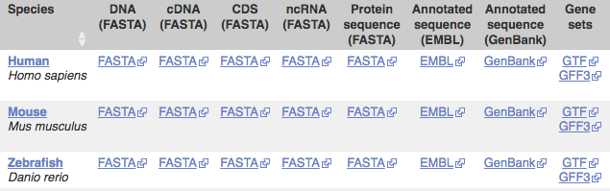
STAR pipeline – from reads to counts
Required files:
Reference genome (fasta file)
Gene information (gff or gtf gene annotation)
Reads (fastq files) – your own data
Many reference genomes and gff/gtf files are available at:
http://ensembl.org/info/data/ftp

Slide 41
Reads to counts - reference indexing
“sorted or indexed” genome
one by one
reads
alignments
STAR --runMode genomeGenerate \
--genomeDir . \
--genomeFastaFiles reference.fas \
--sjdbGTFfile genes.gtf \
--runThreadN 12

Slide 42
Reads to counts – alignment and read counting
STAR --genomeDir reference.fas \
--readFilesIn read1.fq read2.fq \
--alignIntronMax 100000 \
--alignMatesGapMax 100000 \
--outFileNamePrefix output \
--outSAMattrIHstart 0 \
--outSAMmultNmax 1 \
--outSAMstrandField intronMotif \
--outFilterIntronMotifs RemoveNoncanonicalUnannotated \
--outSAMtype BAM SortedByCoordinate \
--quantMode GeneCounts \
--outFilterMismatchNmax 5 \
--outFilterMismatchNoverLmax 0.05 \
--outFilterMatchNmin 50 \
--outSJfilterReads Unique \
--outFilterMultimapNmax 1 \
--outSAMmapqUnique 60 \
--outFilterMultimapScoreRange 2

Slide 43
Count matrix: Read counts (Raw) per gene
Gene | sample 1
gene 1 | 6,075
gene 2 | 295
... | ...
sample 2 | sample 3
5,934 | 3,370
377 | 169
... | ...

Slide 44
Overall comparisons of read counts among samples

Slide 45
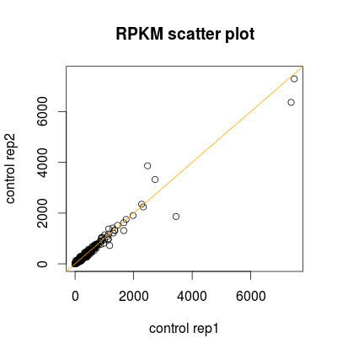
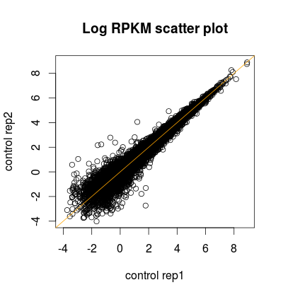
Scatter plot

Slide 46
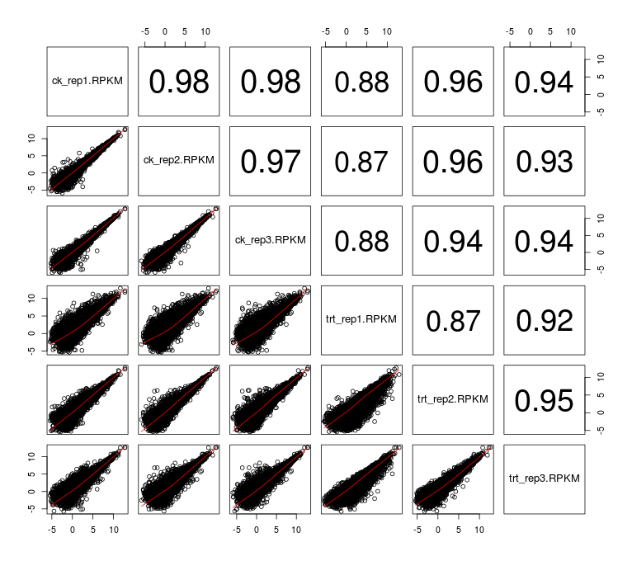
Pair-wise scatter plot

Slide 47
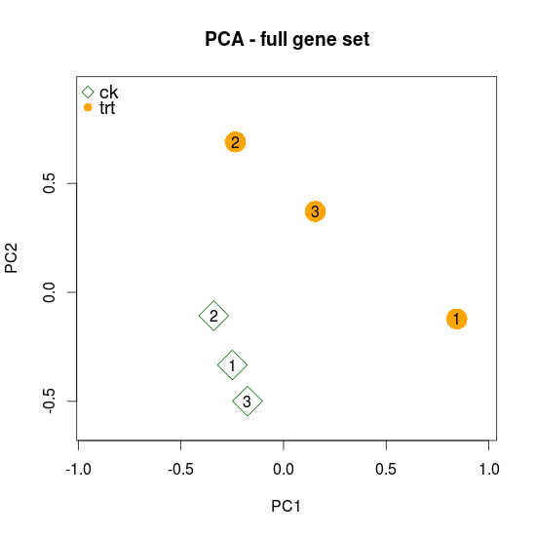
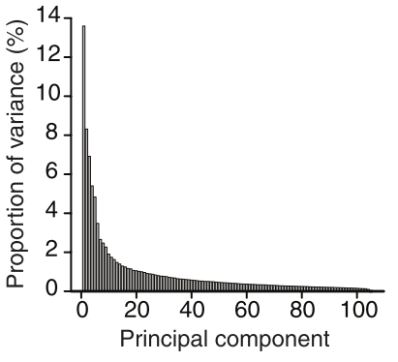
Principal Component Analysis (PCA)
PCA is a mathematical algorithm that reduces the dimensionality of the data while retaining most of the variation in the data set.
 | Control |  |  | Treatment
GeneID | Rep1 | Rep2 | Rep3 | Rep1 | Rep2 | Rep3
1 | 2679 | 2360 | 2573 | 2563 | 3398 | 3012
2 | 177 | 161 | 171 | 154 | 137 | 152
3 | 381 | 371 | 397 | 541 | 723 | 635
…
30000 | 990 | 1073 | 1236 | 850 | 672 | 859
Feature/variable | John | Mike | Jack | Justin
Weight (lb) | 150 | 243 | 186 | 128
Height (cm) | 171 | 190 | 178 | 175
…
Normalized and standardized data
PC2
PC1
Nature Biotech, 2008, 26:303-4

Slide 48
Overview of differential expression

Slide 49

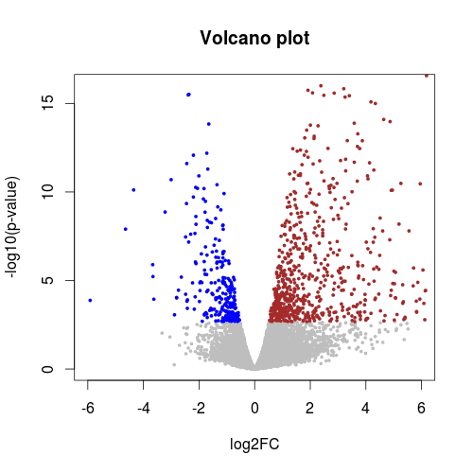
Volcano plot
 | DE Result
GeneID | Log2FC | p-value | -log10(pvalue)
1 | -0.40 | 0.037 | 1.43
2 | 0.03 | 0.916 | 0.04
3 | -0.89 | 2.42E-05 | 4.62
4 | 0.30 | 0.130 | 0.89
5 | -0.36 | 0.140 | 0.85
6 | -0.07 | 0.811 | 0.09
…

Slide 50
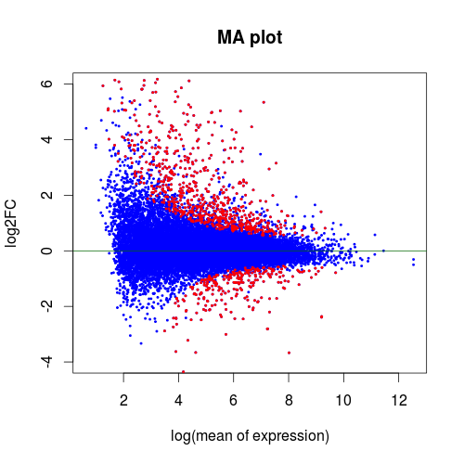
MA plot
M (log ratios) and A (mean average)
GeneID | Mean RPKM | log mean | log2FC
1 | 0.51 | -0.29 | -0.40
2 | 1.25 | 0.10 | 0.03
3 | 3.52 | 0.55 | -0.89
4 | 0.19 | -0.72 | 0.30
5 | 2.34 | 0.37 | -0.36
6 | 6.14 | 0.79 | -0.07
…
More at: en.wikipedia.org/wiki/MA_plot

Slide 51
Gene ontology enrichment analysis

Slide 52
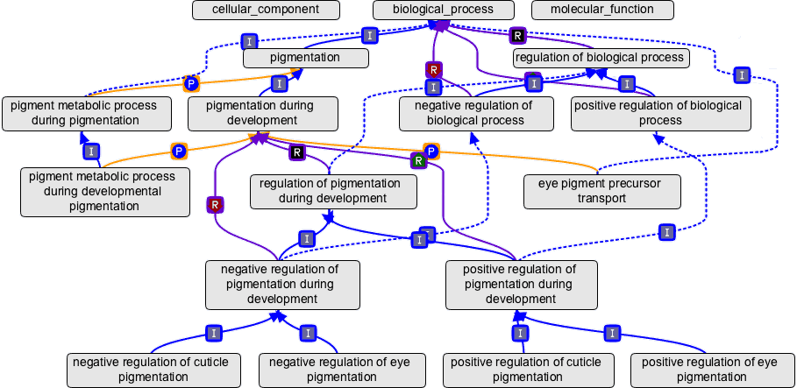
Gene ontology (GO)
An ontology is a representation of a body of knowledge, within a given domain. Ontologies usually consist of a set of classes or terms with relations that operate between them.
Source: geneontology.org
Three domains, three roots
Node: GO term (e.g., cell growth, GO:0016049, biological process)
Edge: term-term connection
Each GO term can be traced back to a root

Slide 53
Category enrichment
Green GO
significant
genes
All genes
Is Green GO enriched in the significant gene set ?
Green GO is a GO ID (e.g., GO:0006519)

Slide 54
dance party
students who are in a dance party
N=20
college students
N=100
Are graduate students over-represented (enriched) in the party?

Slide 55
GO enrichment test – Fisher's Exact test
40 significant genes
GRMZM2G000012 | 1
GRMZM2G002342 | 2
GRMZM2G006480 | 3
… | …
GRMZM5G038156 | 40
Gene | GO accession
GRMZM2G001475 | GO:0006519
GRMZM2G001475 | GO:0016831
GRMZM2G001500 | GO:0005524
GRMZM2G001500 | GO:0006457
GRMZM2G001500 | GO:0051082
GRMZM2G001508 | GO:0003993
GRMZM2G001514 | GO:0003677
GRMZM2G001514 | GO:0004879
GRMZM2G001514 | GO:0005634
GRMZM2G001514 | GO:0006355
… | …
GO:0006519
Question: Are the genes of this GO term enriched in the significant gene set?
Gene | Significant?
GRMZM2G001475 | no
GRMZM2G002652 | no
GRMZM2G006480 | yes
… | …
GRMZM5G868038 | no
Assumption: all genes are independent and equally likely to be selected as DEs.
2x2 Table for GO:0006519
Fisher’s Exact Test:
p-value = 2.5e-06
 | GO:0006519 | Others
Significant | 5 | 35
Not significant | 210 | 39416

Slide 56
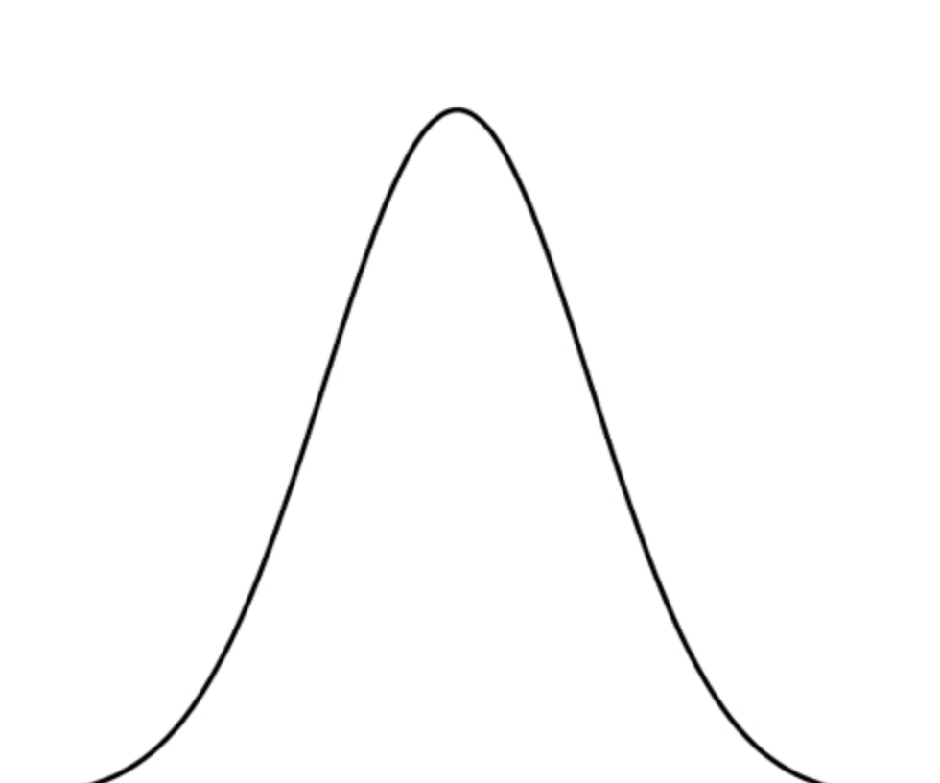
GO enrichment test – Fisher's Exact test
40 DE genes
GRMZM2G000012 | 1
GRMZM2G002342 | 2
GRMZM2G006480 | 3
… | …
GRMZM5G038156 | 40
Gene | GO accession
GRMZM2G001475 | GO:0006519
GRMZM2G001475 | GO:0016831
GRMZM2G001500 | GO:0005524
GRMZM2G001500 | GO:0006457
GRMZM2G001500 | GO:0051082
GRMZM2G001508 | GO:0003993
GRMZM2G001514 | GO:0003677
GRMZM2G001514 | GO:0004879
GRMZM2G001514 | GO:0005634
GRMZM2G001514 | GO:0006355
… | …
GO:0006519
Question: Are the genes of this GO term enriched in the significant gene set?
Gene | Significant?
GRMZM2G001475 | no
GRMZM2G002652 | no
GRMZM2G006480 | yes
… | …
GRMZM5G868038 | no
5 DE and 210 non-DE
Randomly sample 40 DE
Randomly sample 40 DE
GO:0006519 | # DE
1st sampling | 1
2nd sampling | 0
3rd sampling | 2
… | …
GO:0006519
GO:0006519
Gene | R
GRMZM2G001475 | no
GRMZM2G002652 | yes
GRMZM2G006480 | no
… | …
GRMZM5G868038 | no
GRMZM2G001475 | no
GRMZM2G002652 | no
GRMZM2G006480 | no
… | …
GRMZM5G868038 | no
GRMZM2G001475 | no
…
1 DE and 214 non-DE
0 DE and 215 non-DE

Slide 57
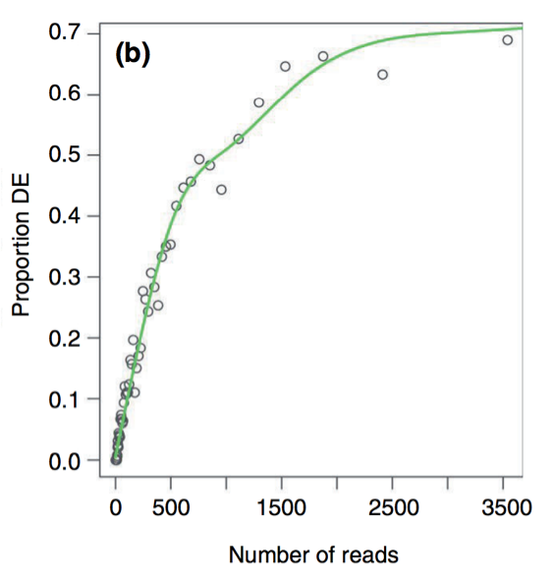
GOSeq
The likelihood of DE as a function of number of reads is quantified through fitting a monotonic function to “proportion of DE” versus “number of reads”.
The function is incorporated into the enrichment statistical test
Not all genes are equally likely to be selected as DEs.
Gene
GRMZM2G001475
GRMZM2G002652
GRMZM2G006480
…
GRMZM5G868038
Read counts
224
51
536
…
0
Proportion
0.16
0.05
0.38
…
0
3. Weighted sampling to perform enrichment test
GO:0006519 | # DE
1st weighted sampling | 1
2nd weighted sampling | 0
3rd weighted sampling | 2
… | …
p-value
Young MD, et al., (2010). Genome Biology, 11: R14.

Slide 58
Summary
Biological replication rather than technical replication are typically needed for an RNA-Seq experiment.
P-values need to be corrected to account for multiple tests. The FDR method is a reliable approach for the correction.
Many bioinformatics pipelines and statistical methods have been developed. Most methods work fine but parameters in each method need to be carefully selected.

Slide 59
REFERENCES
DESeq2 tutorial: http://bioconductor.org/packages/devel/bioc/vignettes/DESeq2/inst/doc/DESeq2.html
Benjamini Y, et al. 1995. Controlling the False Discovery Rate - a Practical and Powerful Approach to Multiple Testing. Journal of the Royal Statistical Society Series B-Methodological 57:289-300.
Conesa A, et al. 2016. A survey of best practices for RNA-seq data analysis. Genome Biol 17:13.
Love MI, et al. 2014. Moderated estimation of fold change and dispersion for RNA-seq data with DESeq2. Genome Biol 15:550.
Robinson MD, et al. 2010. edgeR: a Bioconductor package for differential expression analysis of digital gene expression data. Bioinformatics 26:139-140.

