Slide 1
Text editors Bioinformatics Applications (PLPTH813)
Sanzhen Liu
1/19/2023

Slide 2
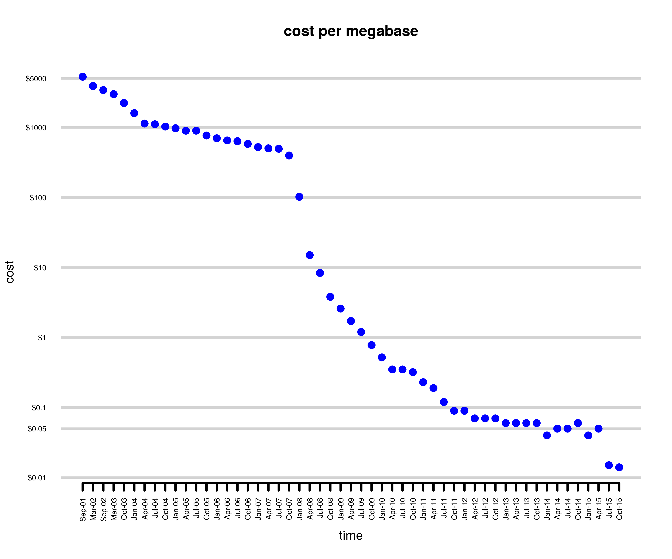
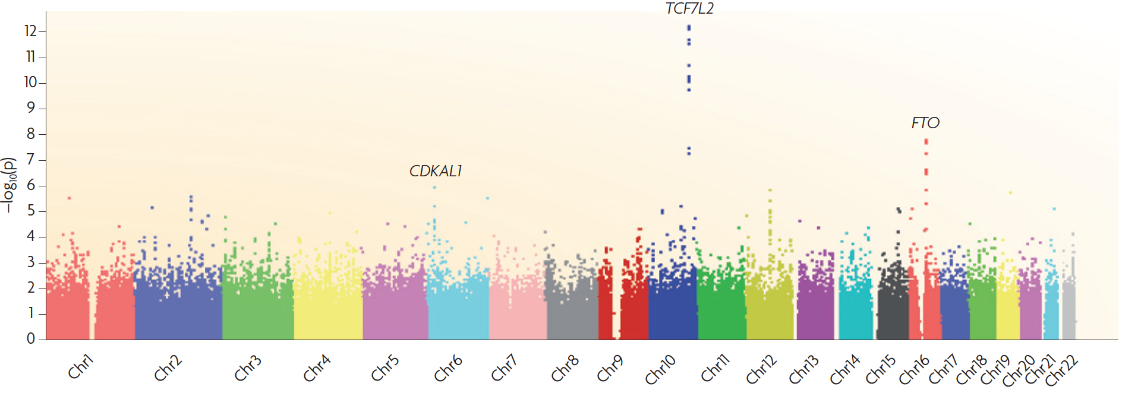
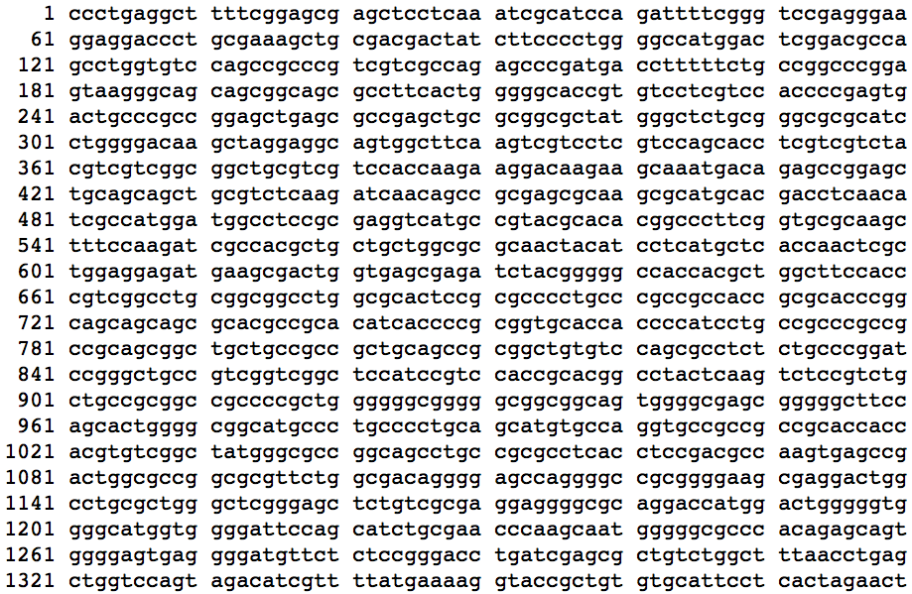
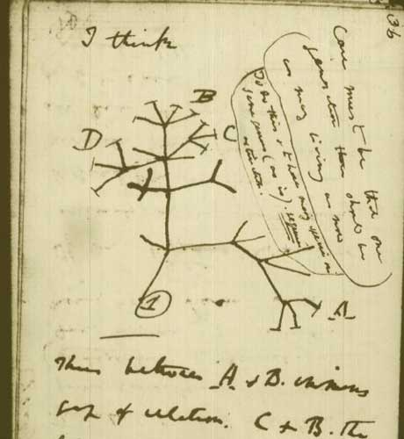

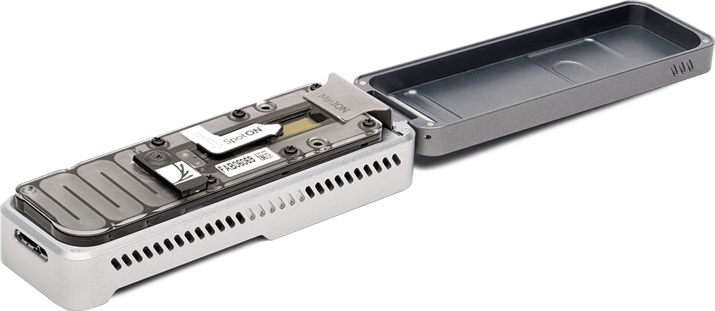

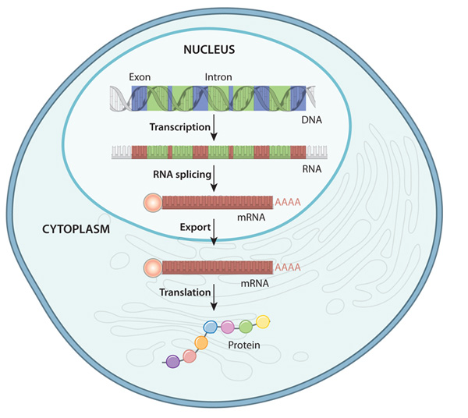
Review

Slide 3
Outline
Goal: to understand the tools used to edit text files
Formats of text data files
Excel to generate a text file and tips in Excel
BBEdit (Mac) Notepad++ (PC): text editor
Regular expression
vi: a powerful text editor

Slide 4


Software for text editing

Slide 5
flat file
Flat file
Simple format, consisting of readable characters
ASCII (American Standard Code for Information Interchange, 128 characters)
No rich format control (e.g. bold or Italics, etc)
Easy for sharing
The organization of data in a text file
Most popular formats for tabular data: space or tab separated data file (.txt) and comma-separated values (.csv)
Most popular format for DNA/protein sequences: FASTA format (.fa, .fas, .fasta)

Slide 6
File formats
Tab separated file (.txt)
name age >30? gender
Josh 23 FALSE male
Rose 35 TRUE female
Comma-separated file (.csv)
name,age,>30?,gender
Josh,23,FALSE,male
Rose,35,TRUE,female
FASTA (.fa, .fas, .fasta)
>Aa1
CCATCTCATCCCTGCGTGTCTCCGACTCAG
>Aa2
CTGAGTCGGAGACACGCAGGGATGAGATGGTT

Slide 7
Text editors
Notepad or Notepad++ (PC)
TextEdit (Mac)
BBEdit (Mac)
vi (Unix and Linux)
Emacs
Atom
Powershell???
Word (PC and Mac): save as …
Excel (PC and Mac): save as …
etc

Slide 8
Newline – end of line (EOL)
Two types of EOL: line feed (LF) and carriage return (CR):
LF: \n
CR: \r
• LF: Unix, Linux, OS X
• CR: Mac OS up to version 9 and OS-9
• CR+LF: Microsoft Windows
http://en.wikipedia.org/wiki/Newline

Slide 9
Outline
Formats of text data files
Excel to generate a text file and tips in Excel
BBEdit (Mac) Notepad++ (PC): text editor
Regular expression
vi: another text editor

Slide 10
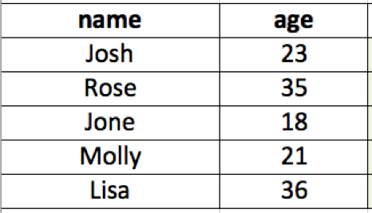
Excel to generate a text file
copy and paste to a text editor (e.g. vi)
save as …

Slide 11
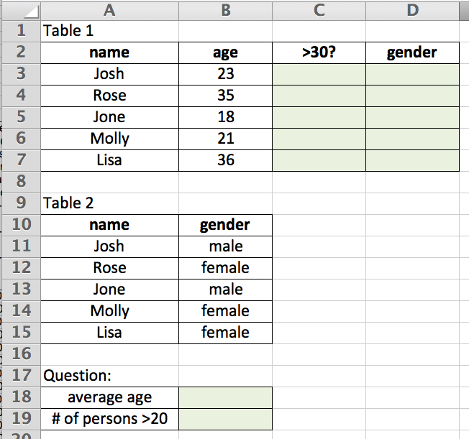
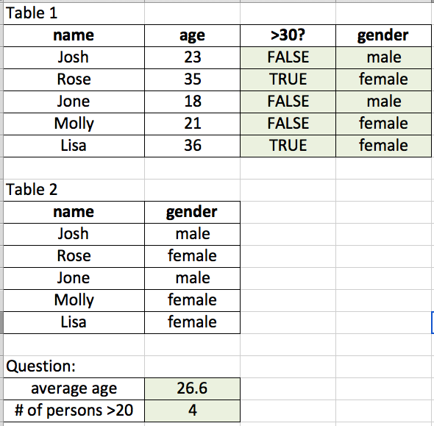
Excel function - examples
Q1: =AVERAGE(B3:B7)
Q2: =COUNTIF(B3:B7, ">20")
Q3: =B3>30
Q4: search information at Table 2
1. define the Table 2: gender (control + l)
2. =VLOOKUP(A3, gender, 2, FALSE)
Q3 Q4
Q1
Q2
VLOOKUP(What you want to look up, where you want to look for it, the column number in the range containing the value to return, Approximate or Exact match – indicated as 1/TRUE, or 0/FALSE).
XLOOKUP?

Slide 12

Useful functions in Excel
max/min/average/sum
len/left/right
if/countif
>, <, =
& (concatenate)
vlookup
Functions can be combined.

Slide 13
Problem 1
Replace the words containing “genome” with “XXX” regardless of letter case.
Genome old and new charted the emergence of agriculture. Contemporary Europeans carry DNA inherited from light-skinned, brown-eyed farmers who migrated from the Middle East beginning 7,000–8,000 years ago, in addition to more-ancient ancestry. The achievements of these early farmers — domestication of crops such as wheat and barley — are also being understood through genome sequencing.
Which software and what trick will you use?

Slide 14
Problem 2
Replace the words containing “genome” with “XXX” regardless of letter case (e.g., Genome = genome = genomes = Genomes).
Genomes old and new charted the emergence of agriculture. Contemporary Europeans carry DNA inherited from light-skinned, brown-eyed farmers who migrated from the Middle East beginning 7,000–8,000 years ago, in addition to more-ancient ancestry. The achievements of these early farmers — domestication of crops such as wheat and barley — are also being understood through genome sequencing. In July, a consortium reported a draft copy of the gargantuan wheat genome, which contains 124,000 genes and 17 billion nucleotides. Another group released the genomes of 3,000 rice varieties. - Science 2014
Which software and what trick will you use?

Slide 15
Outline
Formats of text data files
Excel to generate a text file and tips in Excel
BBEdit (Mac) Notepad++ (PC): text editor
Regular expression
vi: another text editor

Slide 16
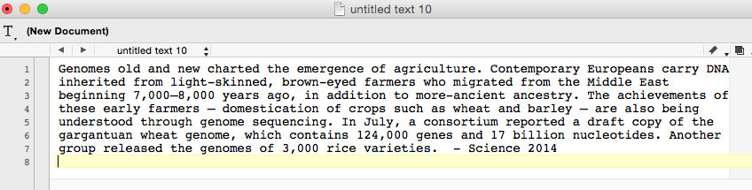
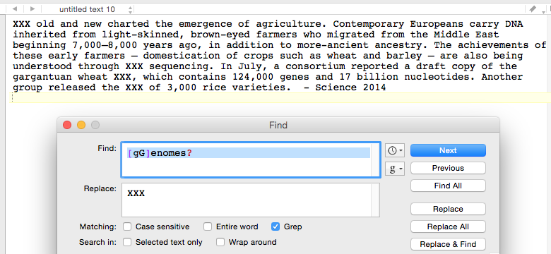
BBEdit
A flexible text editor with powerful functions of searching and editing.

Slide 17
Regular expression
Regular expression (regex or regexp) is a sequence of characters that forms a search pattern.
Search Genome or genomes:
[gG]enomes?
[] : a single character of a range indicated in the square brackets
?: no matches or just one match

Slide 18
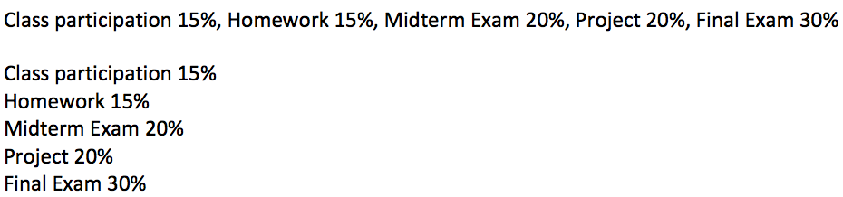
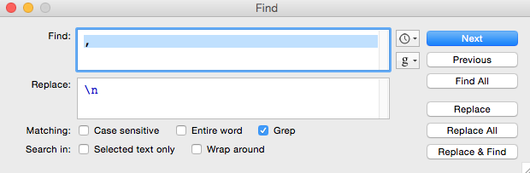
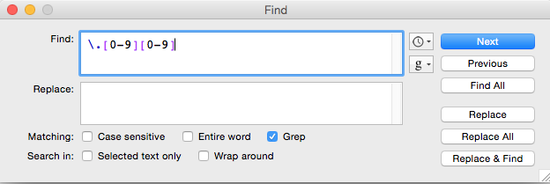
BBEdit – more examples
\n: end of line character (line separator)
Class participation 15.01%, Homework 15.03%, Midterm Exam 20.10%, Project 20.10%, Final Exam 30.01%
\.[0-9][0-9]
\.: the character of “.”
. : any character

Slide 19
More regex characters
Wildcard
\w : letters, numbers, and _
. : any character except \n \r
? : no matches or just one match
+ : one or more matches
* : any character
\d : numerical digits
\t : Tab
\r : return; also used as the generic end-of-line in BBEdit
\n : line-feed character; also used as the generic end-of-line in Notepad++
\s : space, tab, or end of line
[A-Z]: a single character of the ranges indicated in square brackets
[^A-Z]: a single character including all characters not in the brackets.
Note that this will include \n unless otherwise specified.
^ : match the start of the line, i.e., the position before the first character
$ : match the last position before the end-of-line character
Notes:
Caret

Slide 20
Regular expression (I)
\t : a tab character
\r (or \n): end-of-line
Potato,apple,orange
Regexp | Replace
, | \t
Potato apple orange
Regexp | Replace
\t | \n
Potato
apple
orange

Slide 21
Regular expression (II)
^ beginnings
$ endings
Potato
apple
orange
Potato
apple
orange
Regexp | Replace
^ | -
Regexp | Replace
$ | s
-Potato
-apple
-orange
Potatos
apples
oranges

Slide 22
Regular expression (III)
\w a word character, including letters, numbers and underscore
\d : numerical digits
I have 5 apples.
I have 5 apples.
Regexp | Replace
^\w | We
Regexp | Replace
\d | a lot of
We have 5 apples.
I have a lot of apples.

Slide 23
Regular expression (IV)
+ : 1 or more previous regular expression
? : 0 or 1 previous regular expression
. : any character except \n \r
potato,apple,orange
potato,apple,orange
potato,apple,orange
Regexp | Replace
p+ | -
Regexp | Replace
p? | -
Regexp | Replace
p. | -
-otato,a-le,orange
--o-t-a-t-o-,-a---l-e-,-o-r-a-n-g-e
-tato,a-le,orange

Slide 24

Regular expression (V)
[A-Z] : any single letter
NspI
[AG]CATG[CT]
select 2012, 2013, 2014
201[2-4]
{} : specify a range of numbers to repeat the match of the immediately preceding character.
Poly A (12 A in a row)
A{12}
Poly A (10-12 A in a row)
A{10,12}
Poly A (>=10 A in a row)
A{10,}
Notes:
POSIX: Portable Operating System Interface

Slide 25
Regular expression (VI)
|
|: or
hello|hi
Match either hello or hi in the text
Notes:
POSIX: Portable Operating System Interface

Slide 26
Questions
K-[Ss]tate|KSU
^[AGCT]+

Slide 27
Regular expression
Regular expression is for pattern searches
It is commonly employed in programming languages
The rules vary depending on the specific implementation (or programming languages or versions) in use.
Does Google provide search with regular expressions?
"genome * sequencing"

Slide 28
Outline
Formats of text data files
Excel to generate a text file and tips in Excel
BBEdit (Mac) Notepad++ (PC): text editor
Regular expression
vi: another text editor

Slide 29
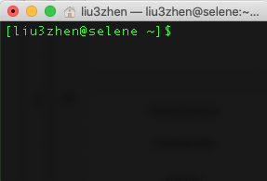
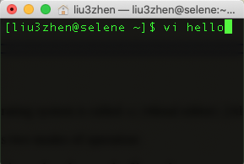
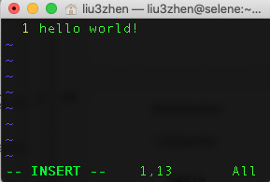
vi is a text editor created for the Unix operating system. - fast and powerful
In a Unix/Linux system, any “words” typed are commands
What can we do if we need to type data or codes?
vi is a command to execute a program

Slide 30
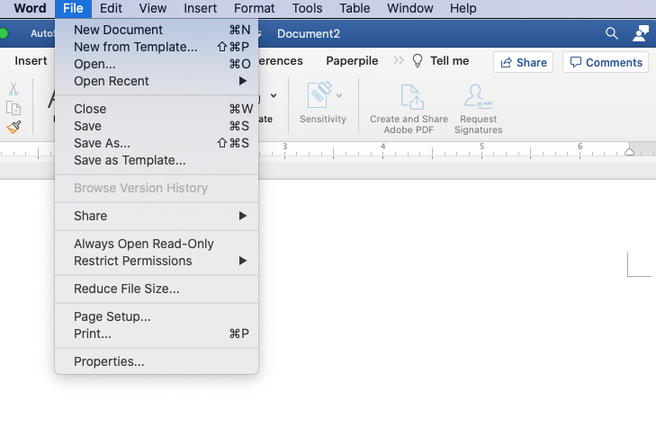
vi
vi has two modes:
insert mode (edit as other text editors)
command mode (commands that control the edit session).
switch modes by using “i” and “ESC” key
Your keyboard controls “everything”.

Slide 31
Actions in command mode
Search: to search content using “/”
/<text or regular expression>
Delete contents for example by lines
Copy and paste

Slide 32
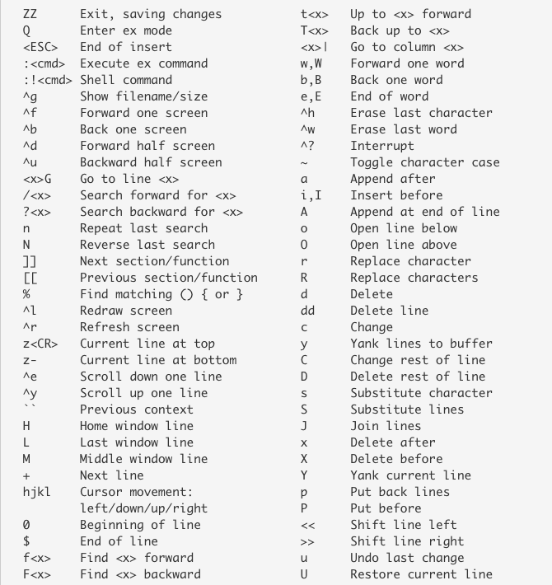
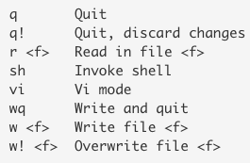
Command list
ex command
https://kb.iu.edu/d/afdc

Slide 33
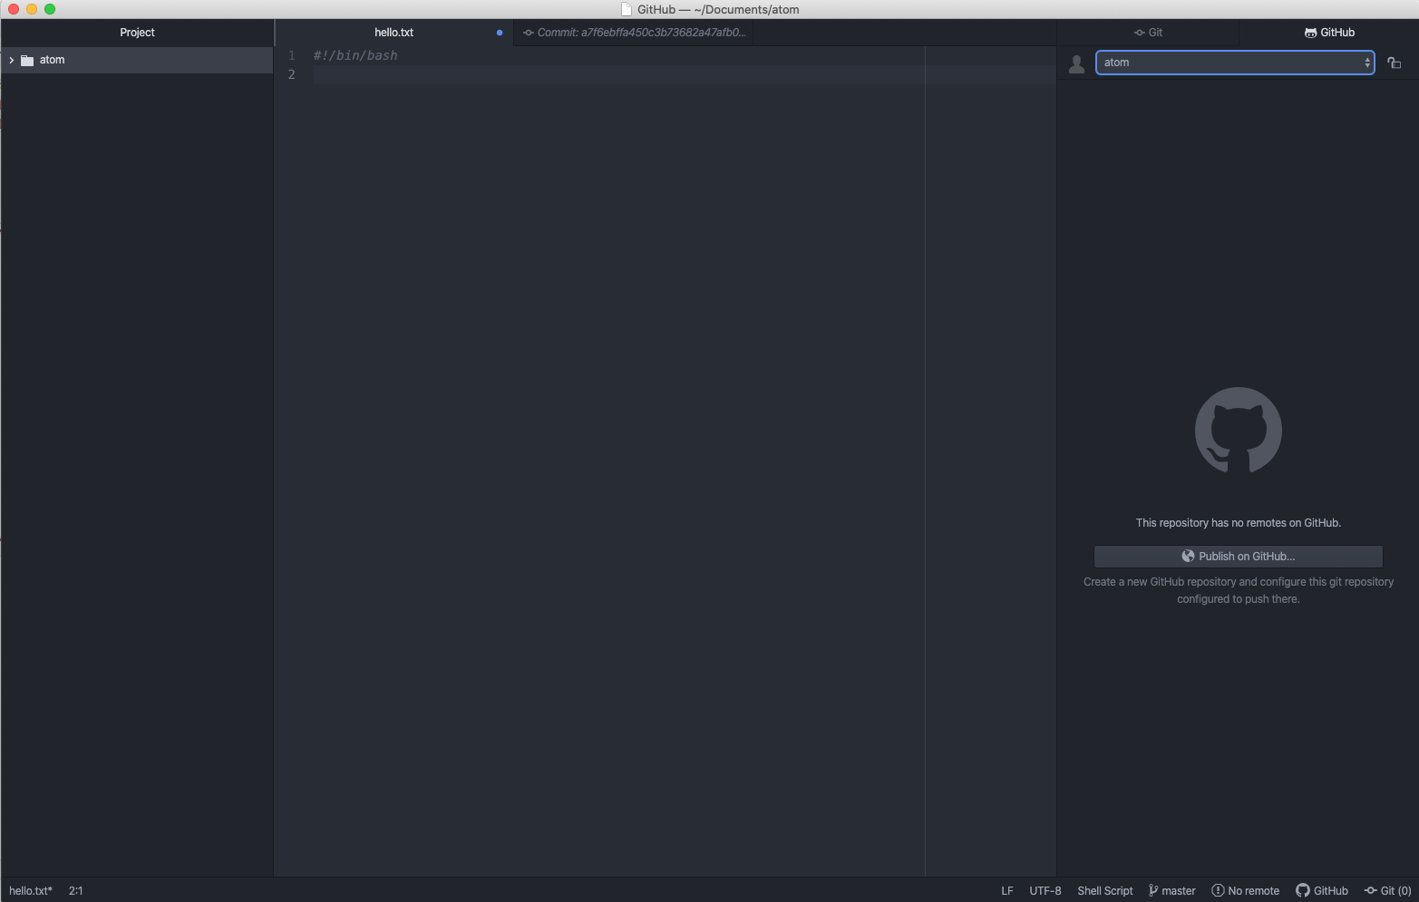
Atom (atom.io)
A modern desktop text editor
Version control through git and GitHub
…

Slide 34
Goal of today’s lab
Familiar to Excel functions
Practice using regular expression in BBEdit
Try vi at Beocat
for PC, download the software "putty" and "notepad++"
32 or 64 bits
for mac, download "BBEdit"

