Slide 1
Unix Bioinformatics Applications (PLPTH813)
Sanzhen Liu
1/24/2023

Slide 2
Review
Flat file
Two types of line feed (LF, \n) and carriage return (CR, \r)
Excel functions (average, vlookup, ...)
Regular expression
e.g., 1) T{10,12} 2) ^$
vi has two modes:
insert mode
command mode

Slide 3
Today
What is Unix?
Why do we need to learn Unix?
Useful commands

Slide 4

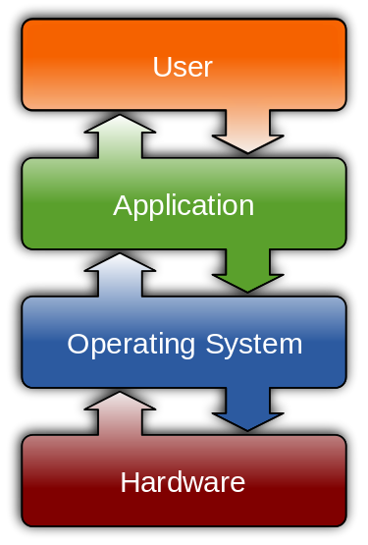
Unix is one of Operating Systems (OSs)
wikipedia.com
Control Hardware
Run Applications
Manage Data
www.cj-computers.com
OS, Linux, Window

Slide 5

Parts of Unix OS
kernel (k) - provides the basic software connection to the hardware, managing memory, schedules, and input/output.
shell - as an interpreter to translate commands and pass them to the kernel for execution.
build-in commands - are the built-in system utilities that provide users basic functions, such as content listing (ls), file copying (cp).
applications - are additional application programs.
applications
build-in
commands
shell
k

Slide 6
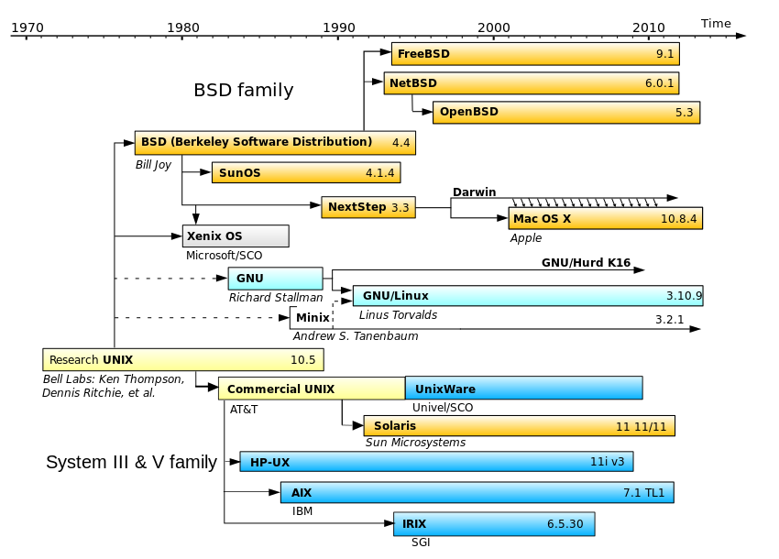
Evolution of UNIX-based Operating Systems
en.wikipedia.org/wiki/Unix-like

Slide 7

Linux Distributions
Liu lab
Ubuntu
VERSION=18.04.1 LTS
Beocat
CentOS
VERSION=7.0.2009
cpagnews.com/
Change the following three file names to file names ended up with .fasta
a.txt b.txt c.txt
Ubuntu:
rename 's/txt/fasta/' *txt
CentOS:
rename 'txt' 'fasta' *txt

Slide 8
Unix philosophy
the use of plain text for storing data
a hierarchical file system
treating devices and certain types of inter-process communication (IPC) as files
small programs that can be strung together through a command-line interpreter using pipes

Slide 9
Why do we need to learn Unix?
To access to powerful computer servers ( e.g., to enable to handle large data)
To use advanced tools in research projects (most genomic software packages are run in the Unix system)
To perform reproducible data analyses
... maybe, easier to find a job

Slide 10
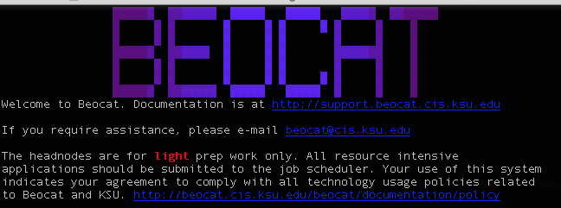
The terminal emulator
A terminal emulator allows users to access to a computer or server.
Mac OS X:
Terminal
iterm2
Linux:
Linux console
Microsoft Windows:
PuTTY
AbsoluteTelnet
Mintty
xterm

Slide 11
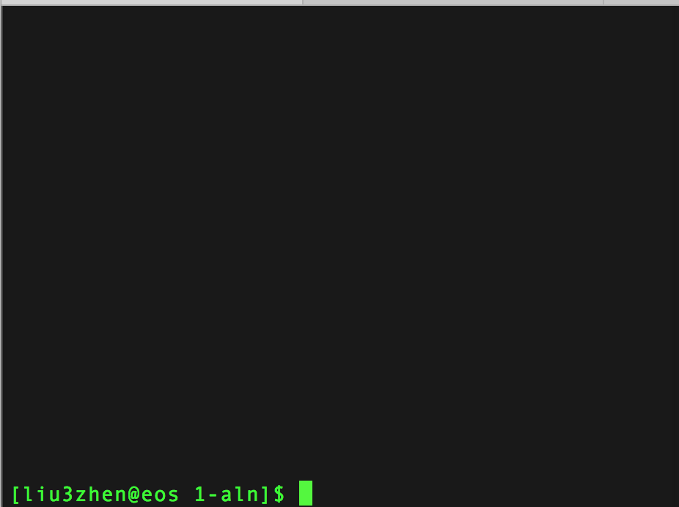
Imagining
If you are working on data using an OS platform, what basic operations are needed?
Notes:
directory / files

Slide 12
file systems

Slide 13
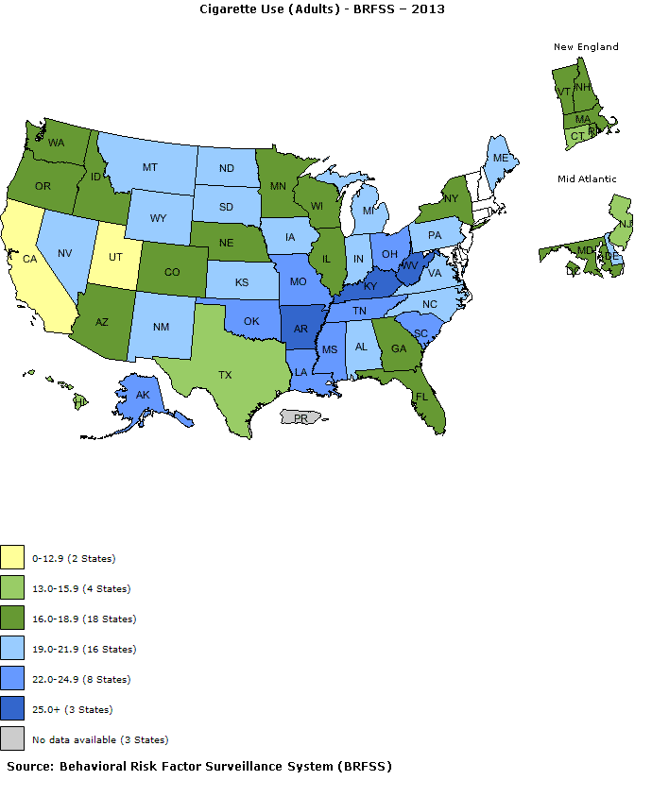
Example datasets
adult.txt
youth.txt

Slide 14

Directories and files
Under the directory:
/homes/liu3zhen/teaching/PLPTH83
Absolute path
/homes/liu3zhen/teaching/BA19
Relative path
. (current directory)
.. (parental directory)
~ (home directory, e.g., /homes/liu3zhen)

Slide 15
cd, mkdir, pwd
Directory: /homes/liu3zhen/teaching/datasets
cd - change the working directory
% cd /homes/liu3zhen/teaching/
% cd ..
% cd ~
% cd ~/teaching/datasets/
mkdir - make directories
% mkdir xxx
pwd - print name of current working directory
% pwd

Slide 16
ls
ls – list directory contents
% ls
adult.txt youth.txt
% ls -1
adult.txt
youth.txt
% ls -la
# -la = -l & -a, long format and list all files
Total 4
drwxr-xr-x 2 liu3zhen liulab 4096 Jan 1 15:44 .
drwxr-xr-x 3 liu3zhen liulab 4096 Jan 1 13:51 ..
-rw-r--r-- 1 liu3zhen liulab 887 Jan 1 14:03 adult.txt
-rw-r--r-- 1 liu3zhen liulab 869 Jan 1 14:03 youth.txt

Slide 17
File information
drwxr-xr-x 2 liu3zhen liulab 4096 Jan 1 15:44 .
drwxr-xr-x 3 liu3zhen liulab 4096 Jan 1 13:51 ..
-rw-r--r-- 1 liu3zhen liulab 887 Jan 1 14:03 adult.txt
-rw-r--r-- 1 liu3zhen liulab 869 Jan 1 14:03 youth.txt
# directories + files
group
size
date of last modification
user
Position | Meaning
1 | "d" if a directory, "-" if a normal file
2, 3, 4 | read, write, execute permission for user (owner) of file
5, 6, 7 | read, write, execute permission for group
8, 9, 10 | read, write, execute permission for other (world)
drwxr-xr-x
-r-xr-xrwx

Slide 18
chmod
chmod - change the access permissions to files and directories
-rw-r--r-- 1 liu3zhen liu3zhen_users 887 Jan 1 14:03 adult.txt
% chmod g+w adult.txt
-rw-rw-r-- 1 liu3zhen liu3zhen_users 887 Jan 1 14:03 adult.txt
% chmod ug-w adult.txt
-r--r--r-- 1 liu3zhen liu3zhen_users 887 Jan 1 14:03 adult.txt
% chmod u+w,go-r adult.txt
-r-------- 1 liu3zhen liu3zhen_users 887 Jan 1 14:03 adult.txt
u (user), g (group), o (other), a (all)
Operators: + (add), - (remove), = (specify the exact mode)

Slide 19
cp, mv, rm
cp - copy files and directories
cp <oldfile> <newfile>
% cp adult.txt adult.tmp.txt
mv - move (rename) files
mv <oldfile> <newfile>
% mv adult.tmp.txt adult.second.txt
rm - remove files or directories
rm <filename>
rm <directory> -r
% rm adult.second.txt

Slide 20
contents of files

Slide 21
head/tail
head - output the first part of files
% head adult.txt
# Cigarette Usage (Adult 2013)
# Source: Behavioral Risk Factor Surveillance System
# http://apps.nccd.cdc.gov/statesystem
State Adult Cigarette Use (%)
Alabama 21.5
Alaska 22.6
Arizona 16.3
Arkansas 25.9
California 12.5
Colorado 17.7
tail - output the last part of files
% tail adult.txt
South Dakota 19.6
Tennessee 24.3
Texas 15.9
Utah 10.3
Vermont 16.6
Virginia 19
Washingon 16.1
West Virginia 27.3
Wisconsin 18.7
Wyoming 20.6
-n <number of lines>

Slide 22
more/less
more and less display contents of large files page by page or scroll line by line up and down.
less ("less is more") is a bit smarter than more:
% less filename
To display line numbers:
% less -N filename
% more adult.txt
% less adult.txt

Slide 23
cat, paste
cat - concatenate files and print on the standard output
% cat adult.txt youth.txt > two.cat.txt
# “>” redirect the output
paste - merge lines of files
% paste adult.txt youth.txt > two.merge.txt
State | Adult Cigarette Use (%) | State | Youth Cigarette Use (%)
Alabama | 21.5 | Alabama | NA
Alaska | 22.6 | Alaska | 10.6
… | … | … | …

Slide 24
wc
wc - print line, word, and byte counts for each file
% wc adult.txt
55 133 887 adult.txt
% wc -l adult.txt
55 adult.txt
% wc -l two.cat.txt
110 two.cat.txt

Slide 25
grep
grep - print lines matching a pattern
grep <pattern> filename
% grep "Kansas" adult.txt
Kansas 20
% grep "#" adult.txt
# Cigarette Usage (Adult 2013)
# Source: Behavioral Risk Factor Surveillance System
# http://apps.nccd.cdc.gov/statesystem
Notes:
STOP HERE 1/24

Slide 26
grep examples using regular expression
% grep -e Kansas -e Alaska adult.txt
Alaska 22.6
Kansas 20
% grep -v -e Kansas -e Alaska adult.txt
% grep "^>" fasta.file
% grep "^>" fasta.file -c
% grep "^>" fasta.file -v
http://www.thegeekstuff.com/2009/03/15-practical-unix-grep-command-examples

Slide 27
grep examples using regular expression
% grep -e Kansas -e Alaska adult.txt
Alaska 22.6
Kansas 20
% grep -v -e Kansas -e Alaska adult.txt
% grep "^>" fasta.file # names of sequences
% grep "^>" fasta.file -c # number of sequences
% grep "^>" fasta.file -v # sequence lines
http://www.thegeekstuff.com/2009/03/15-practical-unix-grep-command-examples

Slide 28
cut
cut - select sections from each line of file
State | Adult Cigarette Use (%) | State | Youth Cigarette Use (%)
Alabama | 21.5 | Alabama | NA
Alaska | 22.6 | Alaska | 10.6
… | … | … | …
% cut two.merge.txt -f 2
Adult Cigarette Use (%)
21.5
22.6
…
% cut two.merge.txt -f 1,2,4
State | Adult Cigarette Use (%) | Youth Cigarette Use (%)
Alabama | 21.5 | NA
Alaska | 22.6 | 10.6
… | … | …

Slide 29
The concept of “pipe”
Pipe is a method of inter-process communication
Pipe collects the output of one program on the left side and inputs the collected data to the program on right side
| is the pipe symbol
Combining programs with different functions into one to tackle more complicated tasks
Pipe
program 1
program 2
…
head input -n 10 | tail -n 1
10th line of the input

Slide 30
Problem
Please apply grep, head, and tail to extract the 4th line that is not started with “#” from the file of “adult.txt”.
% head adult.txt
# Cigarette Usage (Adult 2013)
# Source: Behavioral Risk Factor Surveillance System
# http://apps.nccd.cdc.gov/statesystem
State Adult Cigarette Use (%)
Alabama 21.5
Alaska 22.6
Arizona 16.3
Arkansas 25.9
California 12.5
Colorado 17.7
Notes:
grep “^#” -v | head -n 3 | tail -n 1
hash sign

Slide 31
Pipe example
State | Adult Cigarette Use (%) | State | Youth Cigarette Use (%)
Alabama | 21.5 | Alabama | NA
Alaska | 22.6 | Alaska | 10.6
… | … | … | …
% paste adult.txt youth.txt | grep "#" -v | cut -f 1,2,4 | head
State | Adult Cigarette Use (%) | Youth Cigarette Use (%)
Alabama | 21.5 | NA
Alaska | 22.6 | 10.6
Arizona | 16.3 | 14.1
Arkansas | 25.9 | 19.1
California | 12.5 | NA
Colorado | 17.7 | NA
Connecticut | 15.5 | 13.5
Delaware | 19.6 | 14.2
District of Columbia | 18.8 | NA

Slide 32
sort - sort lines of text files
cat fruit.txt
orange 8
apple 6
peach 12
banana 5
sort fruit.txt
apple 6
banana 5
orange 8
peach 12
sort -k 2 fruit.txt
peach 12
banana 5
apple 6
orange 8
sort -k 2n fruit.txt
banana 5
apple 6
orange 8
peach 12
sort -k 2nr fruit.txt
peach 12
orange 8
apple 6
banana 5
sort -k 1,2 fruit.txt
apple 6
banana 5
orange 8
peach 12
http://www.theunixschool.com/2012/08/linux-sort-command-examples.html

Slide 33
find - search for files in a directory hierarchy
find [pathnames] [conditions]
# Finding files >10M
find . -size +10M
# Finding files <10M
find . -size -10M
# find a file
find -name "fruit.txt"
# find a file in the current directory
find -maxdepth 1 -name "fruit.txt"

Slide 34
find - II
# find files containing a specific word in its name
find -name "fruit*"
# find files whose name are not "fruit.txt"
find -not -name "fruit.txt"
# find files modified within 30 minutes
find . -mmin -30
# find files modified within 1 day
find . -mtime -1
# find files accessed within 1 hour.
find . -amin -60
http://www.folkstalk.com/2011/12/101-examples-of-using-find-command-in.html

Slide 35
sed - a stream editor used for modifying files in unix
fruit.txt
orange 8
apple 6
peach 12
banana 5
sed 's/apple/strawberry/' fruit.txt
orange 8
strawberry 6
peach 12
banana 5
sed 's/apple/strawberry/g' fruit.txt
orange 8
strawberry 6
peach 12
banana 5

Slide 36
sed - II
fruit.txt
orange 8
apple 6
peach 12
banana 5
sed 's/apple/{&}/' fruit.txt
orange 8
{apple} 6
peach 12
banana 5
sed '/12/ s/peach/kiwi/' fruit.txt
orange 8
apple 6
kiwi 12
banana 5

Slide 37

wget
wget <url link to a file>
wget <a ftp link>
example:
wget https://as2.ftcdn.net/v2/jpg/05/03/89/91/1000_F_503899118_vcDwyhOuGYA9Z1h0jiHlnjrXQK0Z1DYr.jpg

Slide 38
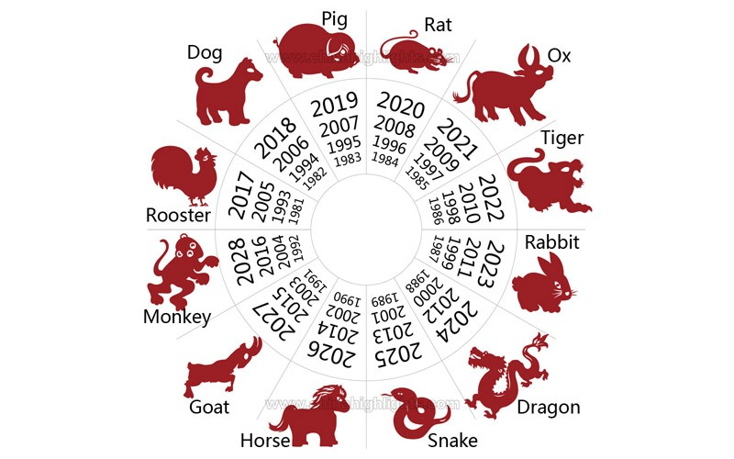
Chinese Zodiac

Slide 39

date, cal, sleep
date - print or set the system date and time
% date
cal - displays a calendar
% cal Feb 2014
sleep - delay for a specified amount of time
% sleep 2 #2 seconds pause
% sleep 1h

Slide 40
history, clear
history - document of command lines
% history
clear - clear the terminal screen
% clear

Slide 41
man
Manual Pages
% man grep
Detailed information about each command
Could be too detailed to find the answer
Sometimes it is more efficient to …
Google “how-to”
Ask questions

