Slide 1
BEDtools, software installation, Git Bioinformatics Applications (PLPTH813)
Sanzhen Liu
2/13/2025

Slide 2
Outline
BED format
BEDtools and examples
Software installation
GitHub

Slide 3
BEDtools (I)
intersect Find overlapping intervals in various ways.
window Find overlapping intervals within a window
closest Find the closest, potentially non-overlapping interval.
coverage Compute the coverage over defined intervals.
map Apply a function to a column
genomecov Compute the coverage over an entire genome.
merge Combine overlapping/nearby intervals
cluster Cluster (but don't merge) overlapping/nearby intervals.
complement Extract intervals _not_ represented by an interval file.
shift Adjust the position of intervals.
subtract Remove intervals based on overlaps b/w two files.
slop Adjust the size of intervals.
flank Create new intervals from flanks of existing intervals.
sort Order the intervals in a file.
random Generate random intervals in a genome.
shuffle Randomly redistribute intervals in a genome.
sample Sample random records from file using reservoir sampling.
spacing Report the gap lengths between intervals in a file.
annotate Annotate coverage of features from multiple files.

Slide 4
BEDtools (II) - Fasta manipulation
getfasta Use intervals to extract sequences from a FASTA file.
maskfasta Use intervals to mask sequences from a FASTA file.
nuc Profile the nucleotide content of intervals
Beocat: module load BEDTools

Slide 5
BED format (Tab-separated file) (I)
The first three required BED fields are:
1. chrom - the chromosome
2. chromStart - the starting position; 0-based
3. chromEnd - the ending position; 1-based
e.g., the first 100 bases of chromosome 1
chr1 0 100
0-based 0 1 2 3 4 5
1-based 1 2 3 4 5 6
A C C T G A

Slide 6
BED format (II)
The additional optional BED fields are:
4. name - Defines the name of the BED line.
5. score - A score between 0 and 1000
6. strand - Defines the strand - either '+' or '-’
…
e.g., the first 100 bases of chromosome 1
chr1 0 100 region1 . +
chr1 100 200 region2 . -
…

Slide 7
Extract promoter sequences of genes (I)
Required input information
a BED file of genes (.bed)
Genome sequences (.fasta)
Chromosome/contig lengths (.length)
length of promoters to be extracted
How To Use Bedtools To Extract Promoters?

Slide 8
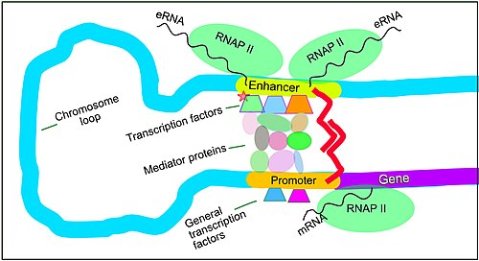
Promoters of genes
promoter
Gene (+)
Gene start
promoter
Gene (-)
wikipedia
Gene start

Slide 9
Extract promoter sequences of genes (I)
Required input information
a BED file of genes (.bed)
Genome sequences (.fasta)
Chromosome/contig lengths (.length)
length of promoters to be extracted

Slide 10
Extract promoter sequences of genes (II)
bed=genes.bed
ref=ref.fasta
clen=chrs.length
promoter_len=2000
out=genes.promoter
# generate a BED file
bedtools flank -i $bed -g $clen \
-l $promoter_len -r 0 -s > $out.bed
# extract sequence
bedtools getfasta -s -fi $ref \
-bed $out.bed -fo ${out}.fasta

Slide 11
BEDtools - flank
-b bp flanking in each direction.
-l bp flanking from start coordinate.
-r bp flanking from end coordinate
-s define “start” and “end” based on strand.
bedtools flank -i $bed -g $clen \
-l $promoter_len -r 0 -s
-i input bed
-g chromosome/contig size
-l
-r
-s
X
+/-
-l
-r
-s
+
-
-r
-l
1
10,000 bp

Slide 12
Promoter - example
1. ref.fas
>ref AAAAAAAAAAAAAAAAAAAACCCCCCCCCCCCCCCCCCCCAAGGGGGGGGGGGGGGGGGG
2. gene.bed
ref 20 40 a1 0.5 + ref 20 40 a2 0.5 -
3. ref.length
ref 60
bedtools flank -i gene.bed -g ref.length \
-l 20 -r 0 -s > gene.promoter.bed
Output:
ref 0 20 a1 0.5 +
ref 40 60 a2 0.5 -

Slide 13
BEDtools - getfasta
-fi Input FASTA file
-fo Output file
-bed BED/GFF/VCF file of ranges to extract from -fi
-s Force strandedness. If the strand is minus(-), the sequence will be reverse complemented.
1. ref.fas
>ref AAAAAAAAAAAAAAAAAAAACCCCCCCCCCCCCCCCCCCCAAGGGGGGGGGGGGGGGGGG
2. gene.promoter.bed
ref 0 20 a1 0.5 +
ref 40 60 a2 0.5 -
bedtools getfasta -s \
-fi ref.fas \
-bed gene.promoter.bed \
-fo gene.promoter.fas
Output:
>ref:0-20(+)
AAAAAAAAAAAAAAAAAAAA
>ref:40-60(-)
CCCCCCCCCCCCCCCCCCTT

Slide 14
intersect (I)
cat d1.bed
chr1 10 100 a1 . +
chr1 200 300 a2 . +
chr1 500 550 a3 . +
cat d2.bed
chr1 10 20 a1 . +
chr1 150 250 a2 . +
chr1 600 750 a3 . +

Slide 15
intersect (II)
cat d1.bed
chr1 10 100 a1 . +
chr1 200 300 a2 . +
chr1 500 550 a3 . +
cat d2.bed
chr1 10 20 a1 . +
chr1 150 250 a2 . +
chr1 600 750 a3 . +
bedtools intersect -a d1.bed -b d2.bed
chr1 10 20 a1 . +
chr1 200 250 a2 . +
Overlapping regions

Slide 16
intersect (III)
cat d1.bed
chr1 10 100 a1 . +
chr1 200 300 a2 . +
chr1 500 550 a3 . +
cat d2.bed
chr1 10 20 a1 . +
chr1 150 250 a2 . +
chr1 600 750 a3 . +
bedtools intersect -a d1.bed -b d2.bed -wo
chr1 10 100 a1 . + chr1 10 20 a1 . + 10
chr1 200 300 a2 . + chr1 150 250 a2 . + 50
-wo: write the original A and B entries plus the number of base pairs of overlap between the two features.

Slide 17
intersect (IV)
cat d1.bed
chr1 10 100 a1 . +
chr1 200 300 a2 . +
chr1 500 550 a3 . +
cat d2.bed
chr1 10 20 a1 . +
chr1 150 250 a2 . +
chr1 600 750 a3 . +
bedtools intersect -a d1.bed -b d2.bed -wao
chr1 10 100 a1 . + chr1 10 20 a1 . + 10
chr1 200 300 a2 . + chr1 150 250 a2 . + 50
chr1 500 550 a3 . + . -1 -1 . -1 . 0
-wao: write the original A and B entries plus the number of base pairs of overlap between the two features. A features w/o overlap are also reported.

Slide 18
coverage
bedtools coverage -abam $bam -b $bed
Bed input:
Interval_1 | 0 | 16451 | 10 | -3.84
…
Output:
1 2 3 4
Interval_1 0 16451 10 -3.84 5432 16302 16451 0.9909
1. Read number
2. Coverage (bp)
3. Original length
4. Coverage (%)

Slide 19
closest
# find the closest, non-overlapping gene for each peak interval
bedtools closest \
-a peak.bed -b genes.bed \
-io \
> peak.near.genes.bed
# -io Ignore features in B that overlap A. That is, we want close, yet not touching features only.

Slide 20
slop & complement
# Add 500 bp up and downstream of each probe
bedtools slop \
-i probes.bed \
-b 500 \
> p.500bp.bed
# Get a BED file of regions not covered by the input BED
bedtools complement \
-i p.500bp.bed \
-g hg18.genome \
> p.500bp.complement.bed

Slide 21
window
#Report genes within 10kb upstream or downstream of Copy number variants (CNVs)
bedtools window -a CNVs.bed -b genes.bed -w 10000
# Report genes within 10kb upstream or 5kb downstream of CNVs
bedtools window -a CNVs.bed -b genes.bed -l 10000 -r 5000
#Report SNPs within 5kb upstream or 1kb downstream of genes
# Define upstream and downstream based on strand
bedtools window -a genes.bed -b snps.bed -l 5000 -r 1000 –sw
# -sw: define -l and -r based on strand

Slide 22
merge
# Merge overlapping repetitive elements into a single entry
bedtools merge -i repeatMasker.bed
chr1 10 100 a1 . +
chr1 50 300 a2 . +
chr1 500 600 a3 . +
chr1 10 300
chr1 500 600
# Merge nearby (within 1kb) repetitive elements into a single entry
bedtools merge -i repeatMasker.bed -d 1000
chr1 10 100 a1 . +
chr1 50 300 a2 . +
chr1 500 600 a3 . +
chr1 10 600

Slide 23
Outline
BED format
BEDtools and examples
Software installation
GitHub

Slide 24
A general guide for C software packages
Compile source codes
- convert human readable codes to machine code
./configure
make
sudo make install
Requires administrative (root) privileges
./configure --prefix ~/local
make
make install

Slide 25
HiSat2 (example: compiled package)
wget https://cloud.biohpc.swmed.edu/index.php/s/hisat2-220-Linux_x86_64/download
mv download hisat2-220-Linux_x86_64.zip
unzip hisat2-220-Linux_x86_64.zip
cd hisat2-2.2.0/
# Edit ~/.bashrc
# PATH=$PATH:~/software/hisat2/hisat2-2.2.0
source ~/.bashrc
which hisat2
#~/software/hisat2/hisat2-2.2.0/hisat2

Slide 26
bwa (uncompiled package)
wget https://sourceforge.net/projects/bio-bwa/files/bwa-0.7.17.tar.bz2/download
mv download bwa-0.7.17.tar.bz2
tar -xf bwa-0.7.17.tar.bz2
cd bwa-0.7.17
# compile
make
# modify ~/.bashrc
PATH=$PATH:~/software/bwa/bwa-0.7.17:~/software/hisat2/hisat2-2.2.0:
source ~/.bashrc
bwa
Notes:
"make" is a command that is often used for compiling software from source code on Unix systems. The "make" command reads a Makefile, which is a file that describes how the software should be compiled and linked, and then invokes a set of build tools to compile the software. The Makefile typically specifies dependencies between different source files and libraries, and "make" uses this information to determine which files need to be recompiled when changes are made to the source code.

Slide 27
conda
Conda is an open-source package management system and environment management system.
Conda installs, runs and updates packages and their dependencies.
Overall, conda can be a powerful tool for scientific computing and data science, providing a convenient way to manage dependencies and environments and making it easy to install and use complex software packages.

Slide 28
conda installation
# download conda software
wget https://repo.anaconda.com/archive/Anaconda3-2024.10-1-Linux-x86_64.sh
# installation
sh Anaconda3-2024.10-1-Linux-x86_64.sh
# with -u if a previous installation exists
# sh Anaconda3-2024.10-1-Linux-x86_64.sh -u
Notes:
https://www.anaconda.com/products/distribution

Slide 29
Software installation via conda
conda create -n <env_name>
conda activate <env_name>
conda install xxx
# install package through bioconda channel
conda install -c bioconda xxx
conda-env list
conda activate <env_name>

Slide 30
Git and GitHub
Git was developed by Linux Torvalds in 2005
Git is command line tools for version control
Git can create branches and merge branches
GitHub is a web platform to use Git for version control, collaboration, and project management
Repository is for organizing codes and data
Collaboration: pull requests, code reviews, and issue tracking
Social features: followers, stars, Q&A, and forks.

Slide 31
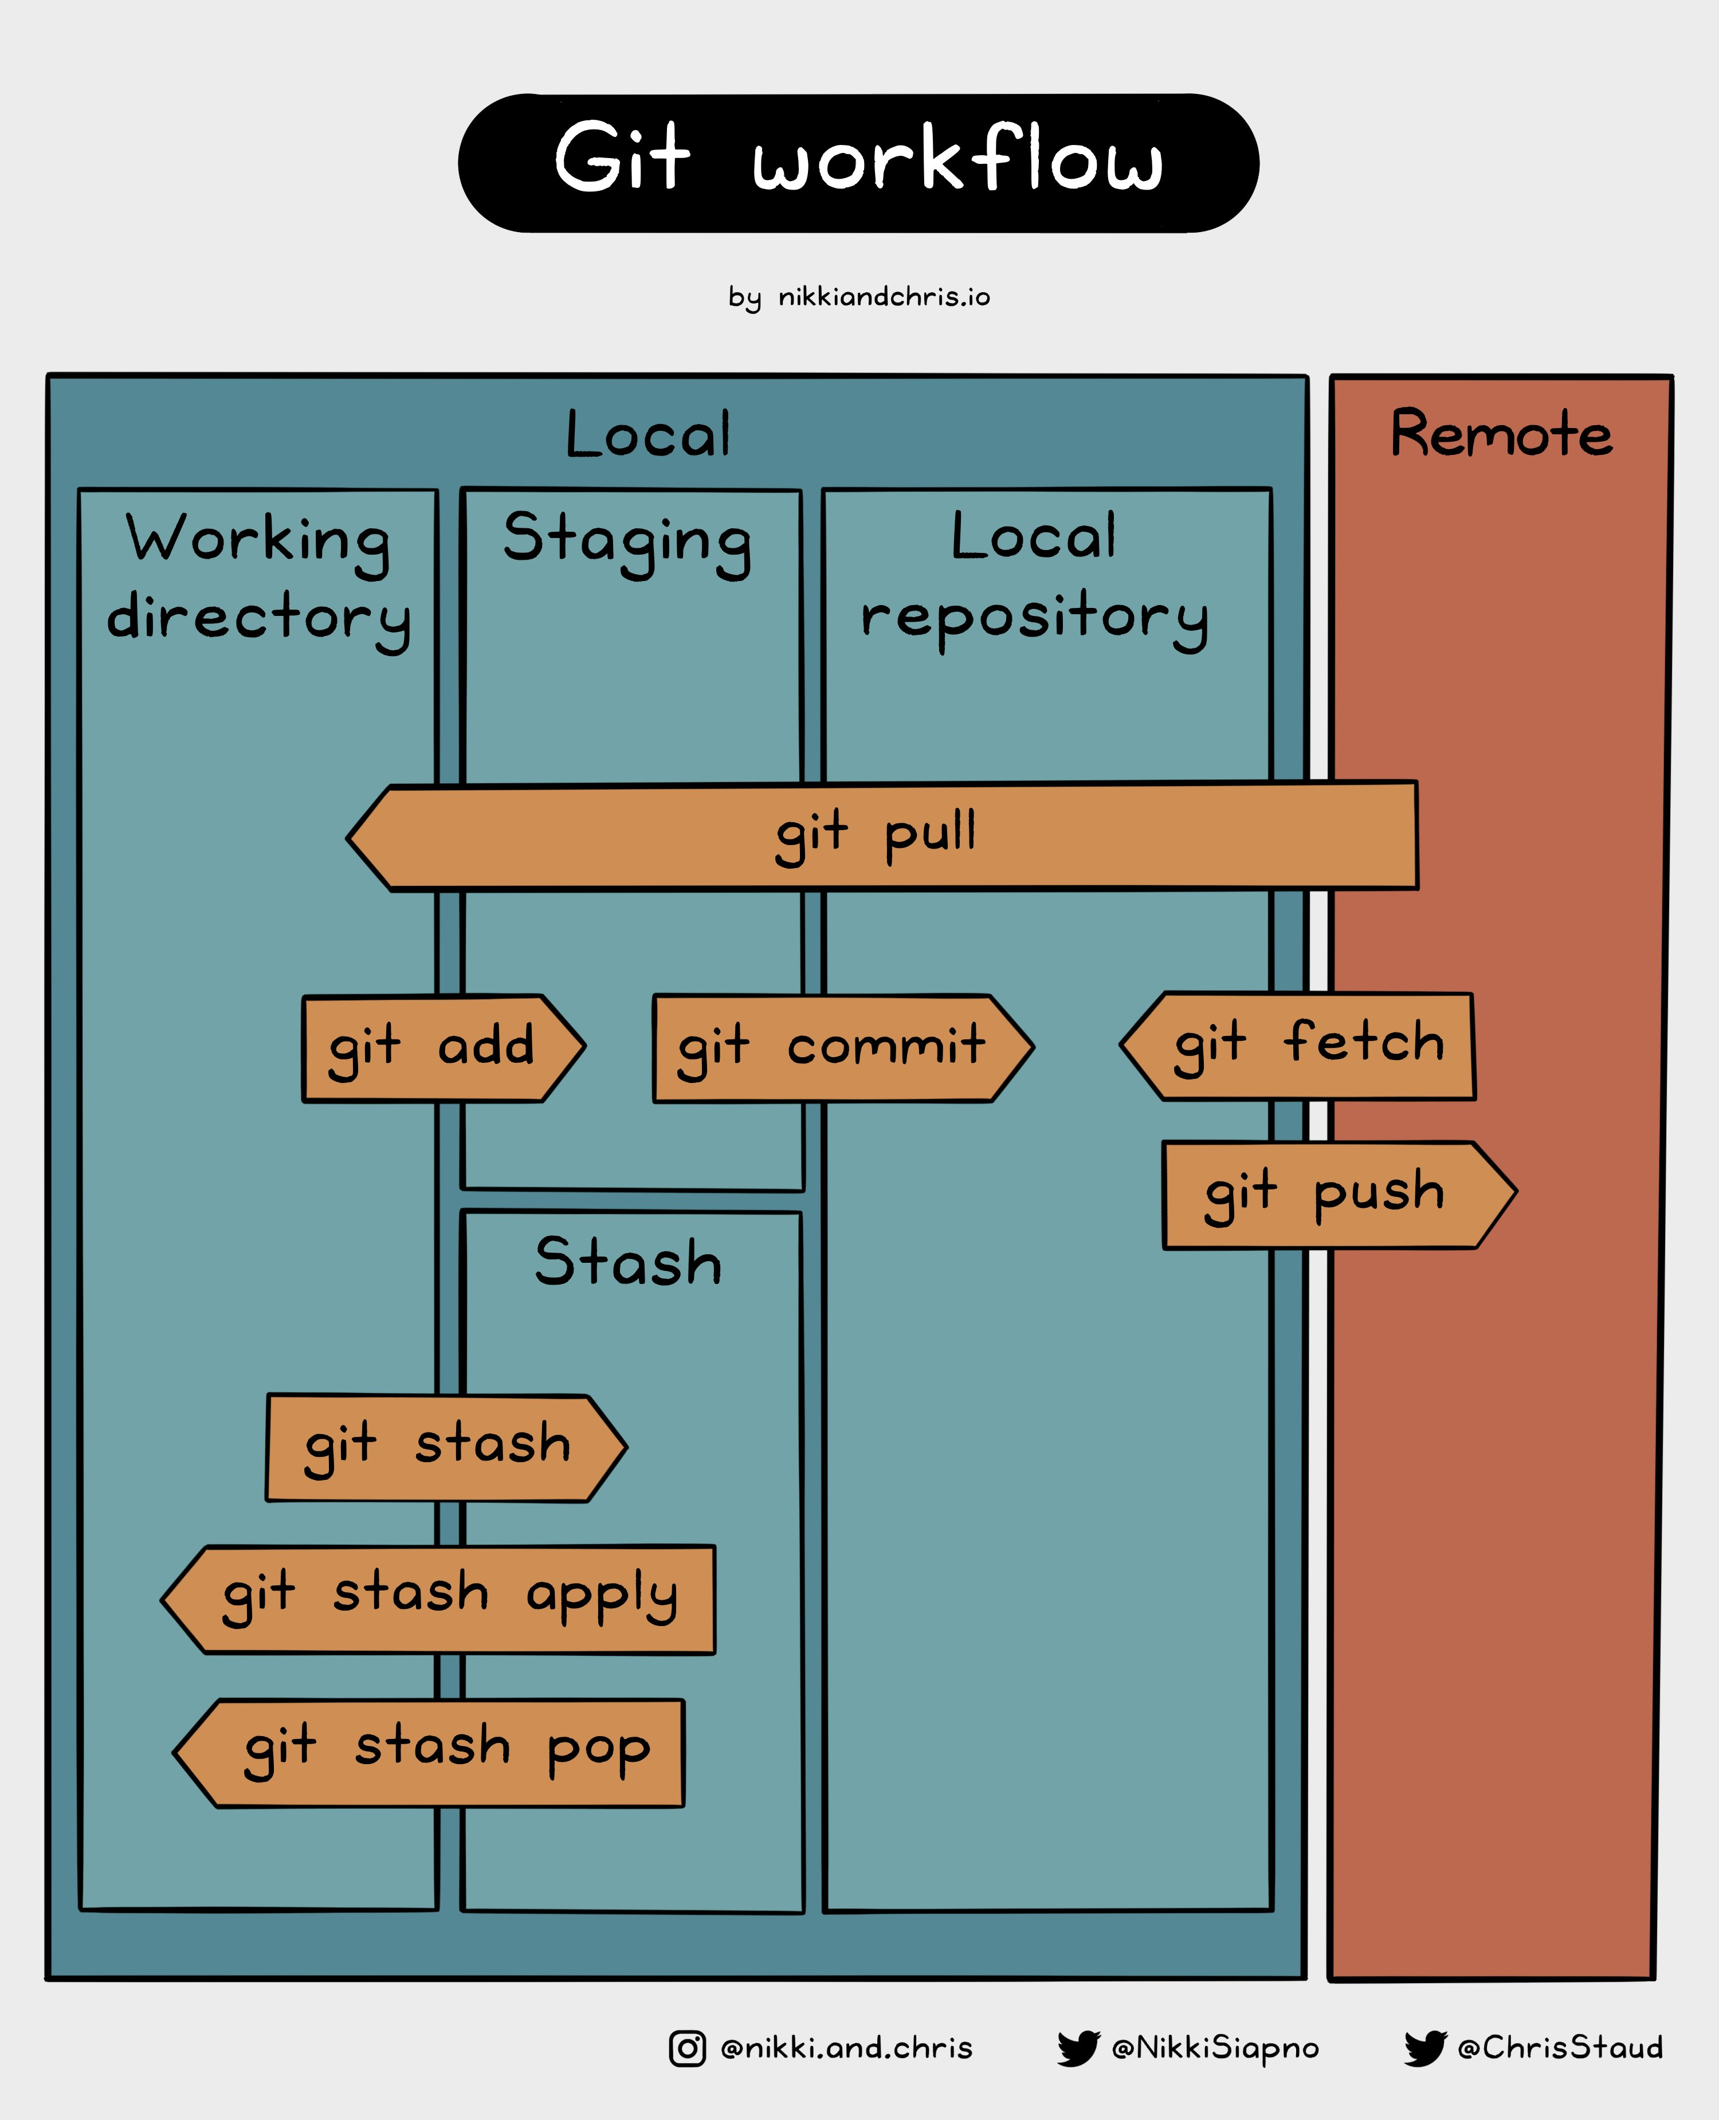
GitHub Cheat Sheet

Slide 32

Git commands
git add .
git commit -m "hello"
git push
Working directory
Staging
Local repository
Remote
GitHub
add
commit
push
git add .
GitHub Desktop
git commit -m ”xxx"
git push
Notes:
git stash command. To apply stashed changes, you can use the git stash apply command, and to discard stashed changes, you can use the git stash drop command.

Slide 33
BED format (III)
Other optional fields
(could be flexible and more fields)
thickStart - coordinate to start drawing a solid rectangle
thickEnd - coordinate to stop drawing a solid rectangle
itemRgb - an RGB colour value (e.g. 0,0,255).
e.g.,
chr1 0 100 region1 . + 0 100 255,0.0

