Slide 1
Command-line NCBI tools (E-Utilities, Dataset, faster-dump)
Sanzhen Liu
Feb 18, 2025

Slide 2
BED format
review
1. chrom - the chromosome
2. chromStart - the starting position; 0-based
3. chromEnd - the ending position; 1-based
4. name - Defines the name of the BED line.
5. score - A score between 0 and 1000
6. strand - Defines the strand - either '+' or '-’
…
e.g., the first 100 bases of chromosome 1
chr1 0 100 region1 . +
chr1 100 200 region2 . -
…

Slide 3
BEDtools
review
intersect Find overlapping intervals in various ways.
window Find overlapping intervals within a window
closest Find the closest, potentially non-overlapping interval.
coverage Compute the coverage over defined intervals.
map Apply a function to a column
genomecov Compute the coverage over an entire genome.
merge Combine overlapping/nearby intervals
cluster Cluster (but don't merge) overlapping/nearby intervals.
complement Extract intervals _not_ represented by an interval file.
shift Adjust the position of intervals.
subtract Remove intervals based on overlaps b/w two files.
slop Adjust the size of intervals.
flank Create new intervals from flanks of existing intervals.
sort Order the intervals in a file.
random Generate random intervals in a genome.
shuffle Randomly redistribute intervals in a genome.
sample Sample random records from file using reservoir sampling.
spacing Report the gap lengths between intervals in a file.
annotate Annotate coverage of features from multiple files.

Slide 4
A general guide for C software packages
review
Compile source codes
- convert human readable codes to machine code
./configure --prefix ~/local
make
make install

Slide 5
conda
review
Conda is an open-source package management system and environment management system.
Conda installs, runs and updates packages and their dependencies.
Overall, conda can be a powerful tool for scientific computing and data science, providing a convenient way to manage dependencies and environments and making it easy to install and use complex software packages.

Slide 6
Git commands
review
Working directory
Staging
Local repository
Remote
GitHub
add
commit
push
git add .
git commit -m ”xxx"
git push
Notes:
git stash command. To apply stashed changes, you can use the git stash apply command, and to discard stashed changes, you can use the git stash drop command.

Slide 7
Outline
E-Utilities to retrieve Genbank data
Datasets to download genomic/genic sequences
SRA-toolkit to download sequencing reads

Slide 8
NCBI (National Center for Biotechnology Information)
The NCBI is a branch of the National Institutes of Health (NIH). It was founded in 1988 and is funded by the government of the US.
The GenBank is an annotated collection of all publicly available nucleotide sequences and their protein translations. It is produced and maintained by the NCBI

Slide 9
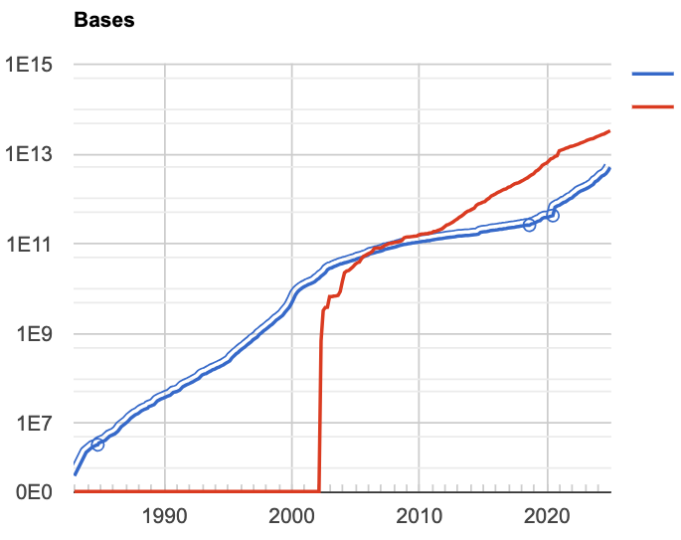
Genbank
The GenBank contains data for ~480,000 named organisms obtained through submissions from individual laboratories. Genbank exchanges data daily with the European Nucleotide Archive (ENA) and the DNA Data Bank of Japan (DDBJ).
traditional GenBank
Whole Genome Shotgun (WGS) assemblies
Double every 18 months

Slide 10
Access to GenBank
Search GenBank sequences with Entrez Nucleotide
Search and align GenBank sequences using BLAST
FTP server: ftp://ftp.ncbi.nlm.nih.gov/genbank
Search and download sequences using NCBI e-utilities

Slide 11
Edirect - E-utilities on the Unix Command Line
EDirect provides access to the NCBI's suite of databases (publication, sequence, structure, gene, variation, expression, etc.) from a Unix terminal.
Installation
sh -c "$(wget -q https://ftp.ncbi.nlm.nih.gov/entrez/entrezdirect/install-edirect.sh -O -)"
echo "export PATH=\$HOME/edirect:\$PATH" >> $HOME/.bashrc
Running:
module load Perl
# cpanm to install modules if needed

Slide 12
esearch - to search Entrez keywords in a certain NCBI database
esearch -db pubmed -query "diabetes AND pregnancy" -sort "Relevance"
<ENTREZ_DIRECT>
<Db>protein</Db>
<WebEnv>MCID_67707f33de35c4ab830ac868</WebEnv>
<QueryKey>1</QueryKey>
<Count>41373</Count>
<Step>1</Step>
<Elapsed>1</Elapsed>
</ENTREZ_DIRECT>
Output:
XML Document Summaries
Notes:
All EDirect programs are designed to work on large sets of data. They handle many technical details behind the scenes (avoiding the learning curve normally required for E-utilities programming). Intermediate results are either saved on the Entrez history server or instantiated in the hidden message. For best performance, obtain an API Key from NCBI, and place the following line in your .bash_profile and .zshrc configuration files:
export NCBI_API_KEY=unique_api_key

Slide 13
esearch - to search Entrez keywords in a certain NCBI database
esearch -db protein -query "lycopene cyclase"
<ENTREZ_DIRECT>
<Db>protein</Db>
<WebEnv>MCID_67707f33de35c4ab830ac868</WebEnv>
<QueryKey>1</QueryKey>
<Count>41373</Count>
<Step>1</Step>
<Elapsed>1</Elapsed>
</ENTREZ_DIRECT>
Notes:
The esearch command uses the ESearch utility to search an NCBI database for a query and finds the unique identifiers (UIDs; in the case of a PubMed search, PMIDs) for all records that match the search query.
Input
A search string, such as you would put into the web version of PubMed.
Output
A snippet of XML that includes a count of the number of records that match the search query, e.g.:
<ENTREZ_DIRECT> <Db>pubmed</Db> <WebEnv>NCID_1_1079563_130.14.18.34_9001_1472819698_1672866789_0MetA0_S_MegaStore_F_1</WebEnv> <QueryKey>1</QueryKey> <Count>1273159</Count> <Step>1</Step> </ENTREZ_DIRECT> In addition, esearch outputs the UIDs for the records that match the search query, and stores them on the History server, using the WebEnv and Query Key specified in the XML snippet.
Arguments
The esearch command allows the following arguments:
-db: The database you wish to search.
Example: -db pubmed
-query: Your search string, enclosed in double quotes. Note: if your search string includes quotation marks, you will need to “escape” these quotes by prefacing them with a backslash (“\”) character. This tells EDirect to interpret the quotation marks as just another character, and not a special character that marks the end of the -query argument. Otherwise, EDirect would interpret the first set of double quotation marks in your search string as marking the end of the query, and the rest of the string would not be searched.
Example: -query "breast cancer AND 2016[pdat]"
Example: -query "smith bh[author] AND \"science\"[journal]" (demonstrates “escaping” quotes with “\”)
-sort: Specifies the order in which your results will be sorted. The name of the sort order should be enclosed in double quotes (see examples below). Each database has different available sort orders.
For PubMed, the valid sort orders are:
First Author
Journal
Last Author
Pub Date
Recently Added
Relevance
Title
Example: -sort "First Author"
Example: -sort "Relevance"
-datetype: When limiting results by date, this specifies which of the several date fields on a record is used to limit. This argument should be used with the -days argument, or with -mindate and -maxdate. Available date types vary by database.
For PubMed, valid datetype values include:
CRDT: Create Date (For records added after December 18, 2008, this is the date the citation was first added to PubMed. For more details, see the entry for “Create Date” in MEDLINE/PubMed Data Element (Field) Descriptions.)
EDAT: Entrez Date (For records added after October 9, 2008, this is the date the citation was added to PubMed, except for records added more than twelve months after the date of publication. For more details, see the entry for “Entrez Date” in MEDLINE/PubMed Data Element (Field) Descriptions.)
PDAT: Publication Date (The article’s publication date.)
MHDA: MeSH Date (The date the citation was indexed with MeSH. If the citation has not yet been indexed, this will be the same as the Entrez Date.)
Example: -datetype PDAT
Note: You can also impose a date restriction on your search within your -query, just as you would when searching the web version of PubMed. For more information on searching PubMed by date, see PubMed Help: Searching by date.
-days: Limits results to records with dates no more than the specified number of days in the past, based on the date field specified in the -datetype argument.
Example: -datetype EDAT -days 5 (limits results to records added to the database in the last 5 days)
-mindate/-maxdate: Limits results to records with dates in a certain range, based on the date field specified in the -datetype argument. To specify a date range, you must provide both a -mindate and a -maxdate argument, as well as a -datetype argument.
Example: -datetype PDAT -mindate 1990 -maxdate 2000 (limits results to articles published between 1990 and 2000, inclusive)
-spell: Corrects misspellings in your search query.
Example: -query "neploasms" -spell (corrects the spelling of “neploasms” to “neoplasms”)
-log: In addition to the default XML snippet output, also shows the full E-utilities URL and the full query translation (like you would find in the “Search details” box on the web version of PubMed).
Example: esearch -db pubmed -query "heart attack" -log

Slide 14
esearch
esearch -db protein \
-query "lycopene cyclase [PROT] AND Streptomyces [ORGN]"
<ENTREZ_DIRECT>
<Db>protein</Db>
<WebEnv>MCID_67707e5d2a962480ee0ceb3c</WebEnv>
<QueryKey>1</QueryKey>
<Count>702</Count>
<Step>1</Step>
<Elapsed>1</Elapsed>
</ENTREZ_DIRECT>

Slide 15
esearch + efetch
efetch: formatted data records (e.g. abstracts, FASTA)
esearch -db protein -query "lycopene cyclase" | \
efetch –format fasta | \
> out.fasta

Slide 16
Download records from NCBI databases via efetch
# download GenBank FASTA sequences
efetch -db nuccore -id J01749,U54469 -format fasta
# extract abstracts
efetch -db pubmed -id 24102982,21171099 -format abstract
Notes:
Input
One or more unique identifiers (UIDs; when fetching from PubMed, PMIDs). These UIDs can be specified in the -id argument (see below), or can be retrieved from the History server.
Output
One or more records displayed in a chosen format:
A list of UIDs (i.e. PMIDs).
Abstract view, formatted in plain text.
MEDLINE view, including the field indicators.
The full XML of the record.
Arguments
The efetch command allows the following arguments:
-db: The database from which you wish to retrieve records.
Example: -db pubmed
-id: One or more UIDs (PMIDs, if your -db argument is pubmed), separated by commas.
Example: -id 24102982,21171099,17150207
Example: -id 26287646
-format: Specifies the format in which you wish to display the records.
For PubMed, the valid formats include:
uid: displays a list of UIDs (i.e. PMIDs).
abstract: displays the Abstract view, formatted in plain text.
medline: displays the MEDLINE view, including the field indicators.
xml: displays the full PubMed XML.
Example: -format uid
Example: -format xml
Examples:
Retrieve the record for PMID 25359968 in MEDLINE format:
efetch -db pubmed -id 25359968 -format medline Retrieve the record for PMID 26287646 in XML format:
efetch -db pubmed -id 26287646 -format xml Retrieve the records for PMIDs 24102982, 21171099, and 17150207 in abstract view:
efetch -db pubmed -id 24102982,21171099,17150207 -format abstract

Slide 17
Check publication records from PubMed
Activity
# fun to try
esearch -db pubmed \
-query "xxx xxx[AUTH]" | \
efetch -format docsum | \
xtract -pattern DocumentSummary \
-sep "|" -element PubDate Title | \
sort
Notes:
xtract: Extract specific information
Input
One or more unique identifiers (UIDs; when fetching from PubMed, PMIDs). These UIDs can be specified in the -id argument (see below), or can be retrieved from the History server.
Output
One or more records displayed in a chosen format:
A list of UIDs (i.e. PMIDs).
Abstract view, formatted in plain text.
MEDLINE view, including the field indicators.
The full XML of the record.
Arguments
The efetch command allows the following arguments:
-db: The database from which you wish to retrieve records.
Example: -db pubmed
-id: One or more UIDs (PMIDs, if your -db argument is pubmed), separated by commas.
Example: -id 24102982,21171099,17150207
Example: -id 26287646
-format: Specifies the format in which you wish to display the records.
For PubMed, the valid formats include:
uid: displays a list of UIDs (i.e. PMIDs).
abstract: displays the Abstract view, formatted in plain text.
medline: displays the MEDLINE view, including the field indicators.
xml: displays the full PubMed XML.
Example: -format uid
Example: -format xml
Examples:
Retrieve the record for PMID 25359968 in MEDLINE format:
efetch -db pubmed -id 25359968 -format medline Retrieve the record for PMID 26287646 in XML format:
efetch -db pubmed -id 26287646 -format xml Retrieve the records for PMIDs 24102982, 21171099, and 17150207 in abstract view:
efetch -db pubmed -id 24102982,21171099,17150207 -format abstract

Slide 18
Outline
E-Utilities to retrieve Genbank data
Datasets to download genomic/genic sequences
SRA-toolkit to download sequencing reads

Slide 19
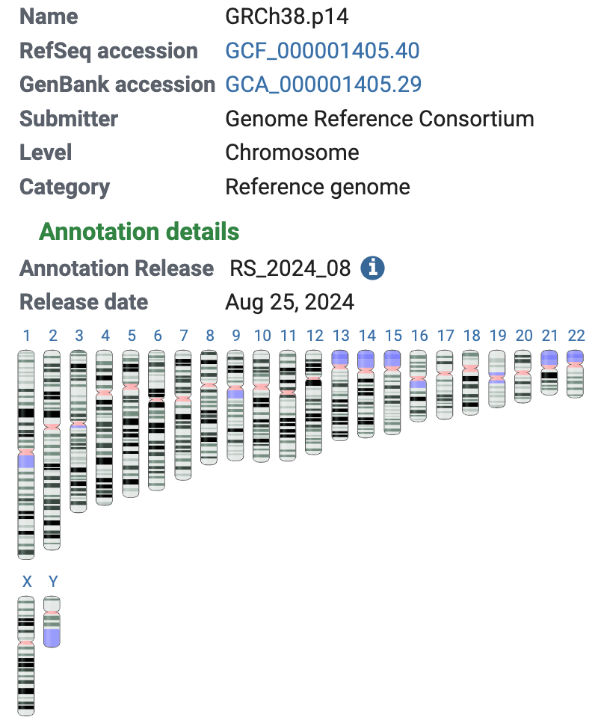
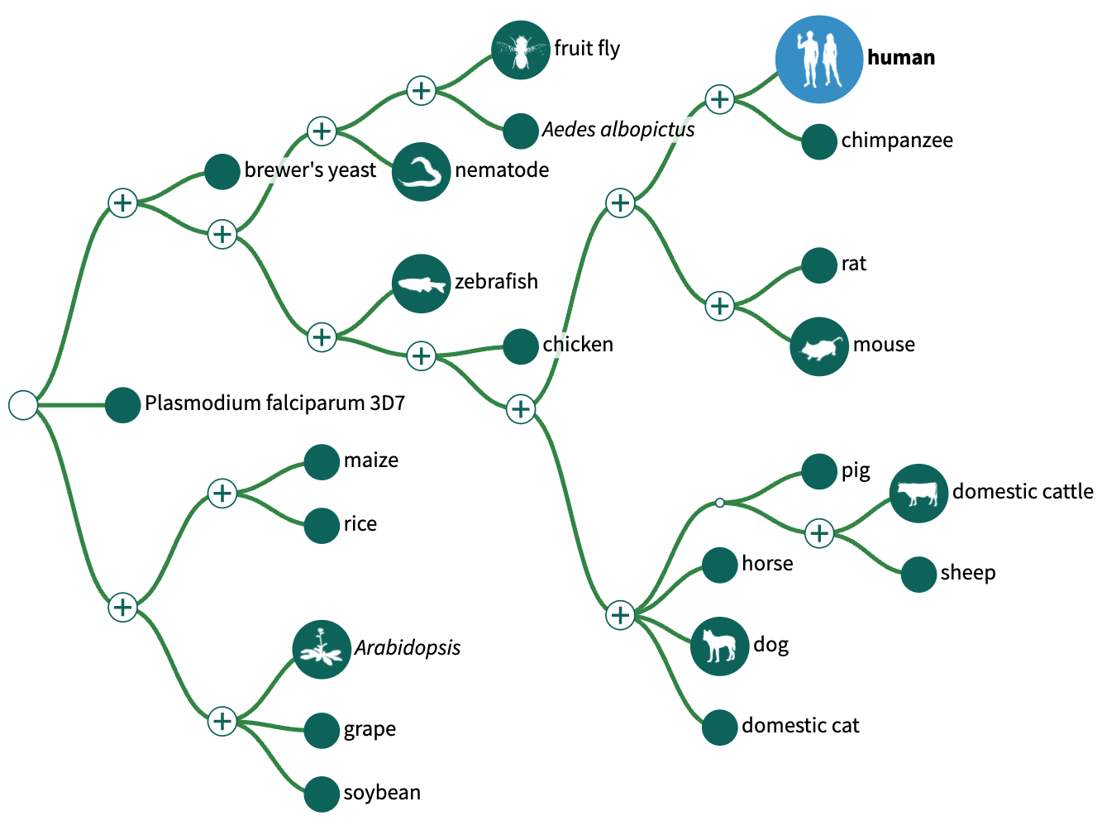
NCBI Genomes
NCBI Genome Data View (GDV) hosts genome assemblies of 3,490 organisms (as of 2/16/2025)
https://www.ncbi.nlm.nih.gov/gdv

Slide 20
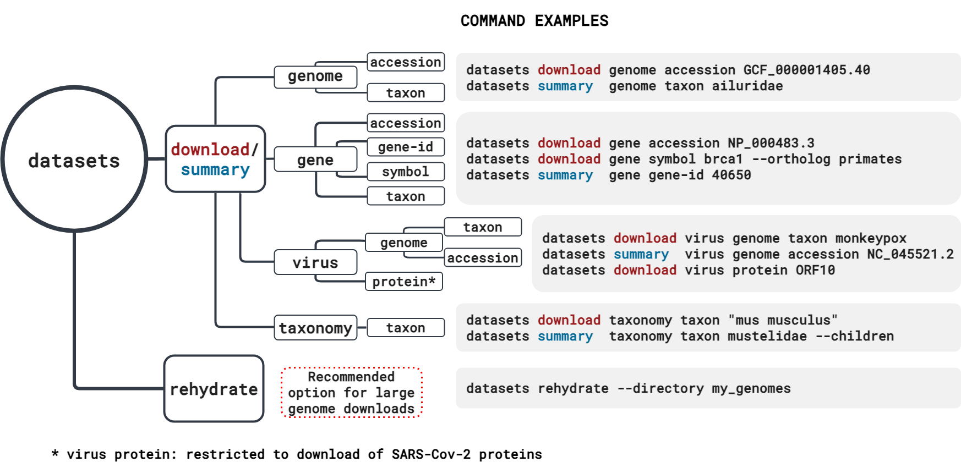
Datasets - to download sequence data from NCBI
datasets version: 16.39.0
Notes:
Input
One or more unique identifiers (UIDs; when fetching from PubMed, PMIDs). These UIDs can be specified in the -id argument (see below), or can be retrieved from the History server.
Output
One or more records displayed in a chosen format:
A list of UIDs (i.e. PMIDs).
Abstract view, formatted in plain text.
MEDLINE view, including the field indicators.
The full XML of the record.
Arguments
The efetch command allows the following arguments:
-db: The database from which you wish to retrieve records.
Example: -db pubmed
-id: One or more UIDs (PMIDs, if your -db argument is pubmed), separated by commas.
Example: -id 24102982,21171099,17150207
Example: -id 26287646
-format: Specifies the format in which you wish to display the records.
For PubMed, the valid formats include:
uid: displays a list of UIDs (i.e. PMIDs).
abstract: displays the Abstract view, formatted in plain text.
medline: displays the MEDLINE view, including the field indicators.
xml: displays the full PubMed XML.
Example: -format uid
Example: -format xml
Examples:
Retrieve the record for PMID 25359968 in MEDLINE format:
efetch -db pubmed -id 25359968 -format medline Retrieve the record for PMID 26287646 in XML format:
efetch -db pubmed -id 26287646 -format xml Retrieve the records for PMIDs 24102982, 21171099, and 17150207 in abstract view:
efetch -db pubmed -id 24102982,21171099,17150207 -format abstract

Slide 21
Installation of datasets
Download datasets
wget https://ftp.ncbi.nlm.nih.gov/pub/datasets/command-line/v2/linux-amd64/datasets
chmod a+rx datasets
./datasets
wget https://ftp.ncbi.nlm.nih.gov/pub/datasets/command-line/v2/linux-amd64/dataformat
chmod a+rx dataformat
./dataformat

Slide 22
Examples using datasets for genomic data (I)
# check the information of a reference genome for sorghum
datasets summary genome taxon "Sorghum Bicolor" --reference
# download sequence data for a particular genome
datasets download genome taxon "Sorghum bicolor" \
--reference --include genome,rna,cds,protein \
--filename BTx623.zip
cds_from_genomic.fna
GCF_000003195.3_Sorghum_bicolor_NCBIv3_genomic.fna
protein.faa
rna.fna
Notes:
Input
One or more unique identifiers (UIDs; when fetching from PubMed, PMIDs). These UIDs can be specified in the -id argument (see below), or can be retrieved from the History server.
Output
One or more records displayed in a chosen format:
A list of UIDs (i.e. PMIDs).
Abstract view, formatted in plain text.
MEDLINE view, including the field indicators.
The full XML of the record.
Arguments
The efetch command allows the following arguments:
-db: The database from which you wish to retrieve records.
Example: -db pubmed
-id: One or more UIDs (PMIDs, if your -db argument is pubmed), separated by commas.
Example: -id 24102982,21171099,17150207
Example: -id 26287646
-format: Specifies the format in which you wish to display the records.
For PubMed, the valid formats include:
uid: displays a list of UIDs (i.e. PMIDs).
abstract: displays the Abstract view, formatted in plain text.
medline: displays the MEDLINE view, including the field indicators.
xml: displays the full PubMed XML.
Example: -format uid
Example: -format xml
Examples:
Retrieve the record for PMID 25359968 in MEDLINE format:
efetch -db pubmed -id 25359968 -format medline Retrieve the record for PMID 26287646 in XML format:
efetch -db pubmed -id 26287646 -format xml Retrieve the records for PMIDs 24102982, 21171099, and 17150207 in abstract view:
efetch -db pubmed -id 24102982,21171099,17150207 -format abstract

Slide 23
Examples using datasets for genomic data (II)
# check genomes submitted from 1/1/2024 for Zea mays
datasets summary genome taxon "Zea mays" \
--released-after 01/01/2024 \
--as-json-lines | \
dataformat tsv genome \
--fields assminfo-assembly-method,assminfo-level,organism-infraspecific-cultivar

Slide 24
Examples using datasets for gene data (I)
# download gene data by RefSeq nucleotide or protein accessions
datasets download gene accession NM_020107.5 NP_001334352.2
# download sequence data for all human genes.
datasets download gene taxon human
# download gene data using Gene IDs, symbols, or accession numbers
datasets download gene gene-id 59272 --ortholog mammals
datasets download gene symbol cftr --ortholog all
datasets download gene accession NM_000492.4 --ortholog primates
Default output: ncbi_dataset.zip, including:
protein.faa,
rna.fna
other files
Notes:
Input
One or more unique identifiers (UIDs; when fetching from PubMed, PMIDs). These UIDs can be specified in the -id argument (see below), or can be retrieved from the History server.
Output
One or more records displayed in a chosen format:
A list of UIDs (i.e. PMIDs).
Abstract view, formatted in plain text.
MEDLINE view, including the field indicators.
The full XML of the record.
Arguments
The efetch command allows the following arguments:
-db: The database from which you wish to retrieve records.
Example: -db pubmed
-id: One or more UIDs (PMIDs, if your -db argument is pubmed), separated by commas.
Example: -id 24102982,21171099,17150207
Example: -id 26287646
-format: Specifies the format in which you wish to display the records.
For PubMed, the valid formats include:
uid: displays a list of UIDs (i.e. PMIDs).
abstract: displays the Abstract view, formatted in plain text.
medline: displays the MEDLINE view, including the field indicators.
xml: displays the full PubMed XML.
Example: -format uid
Example: -format xml
Examples:
Retrieve the record for PMID 25359968 in MEDLINE format:
efetch -db pubmed -id 25359968 -format medline Retrieve the record for PMID 26287646 in XML format:
efetch -db pubmed -id 26287646 -format xml Retrieve the records for PMIDs 24102982, 21171099, and 17150207 in abstract view:
efetch -db pubmed -id 24102982,21171099,17150207 -format abstract

Slide 25
Output example
# download gene data using Gene IDs, symbols, or accession numbers
datasets download gene gene-id 59272 --ortholog mammals
protein.faa: 419 protein sequences:
>XP_025842512.1 ACE2 [organism=Vulpes vulpes] [GeneID=112910549]
>XP_025842513.1 ACE2 [organism=Vulpes vulpes] [GeneID=112910549]
>XP_021788732.1 ACE2 [organism=Papio anubis] [GeneID=101008749]
>XP_021788733.1 ACE2 [organism=Papio anubis] [GeneID=101008749]
>NP_001277036.1 ACE2 [organism=Capra hircus] [GeneID=102184608]
>XP_005701129.2 ACE2 [organism=Capra hircus] [GeneID=102184608] [isoform=X1]
>XP_017899103.1 ACE2 [organism=Capra hircus] [GeneID=102184608] [isoform=X2]
…

Slide 26
Ensembl: an alternative source of genomic data
Ensembl genome database project is a project at the European Bioinformatics Institute.
Ensembl is a well-known genome browsers for the retrieval of genomic information.

Slide 27
Ensembl ftp
Human reference genome
https://www.ensembl.org/Homo_sapiens/Info/Index
ftp links for many other species:
https://ftp.ensemblgenomes.ebi.ac.uk/pub/
bacteria/
fungi/
metazoa/
plants/

Slide 28
An example using Ensembl data
plants/
current/
fasta/
gff3/ gtf/
zea_mays/
dna/
cdna/
cds/
pep/
: Genomic DNA
: cDNA – transcripts
: Coding sequences
: Protein sequences

Slide 29
Outline
E-Utilities to retrieve Genbank data
Datasets to download genomic/genic sequences
SRA-toolkit to download sequencing reads

Slide 30
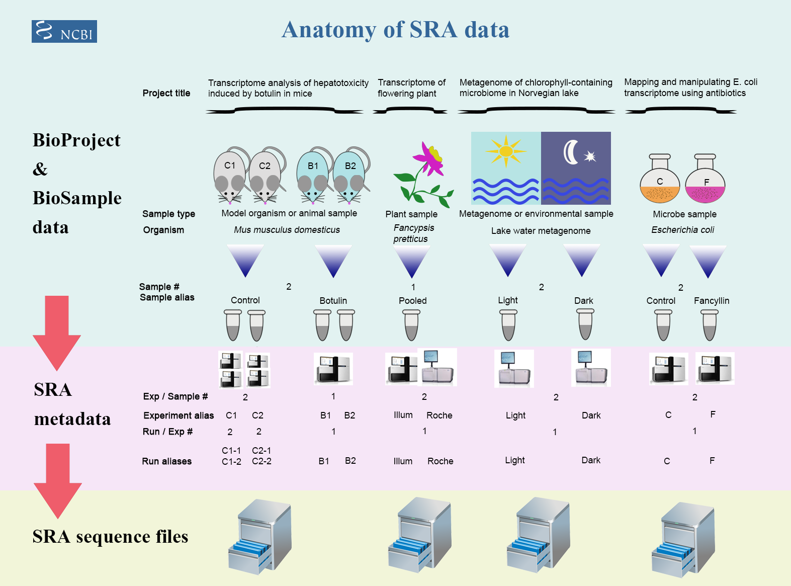
Sequence Read Archive
Sequence Read Archive (SRA) contains reads from NGS studies.

Slide 31
Accessions and sequence data
Study – a set of experiments with an overall goal
SRA Study accessions – SRP, DRP, or ERP
Sample – An experiment targets one or more samples
SRA Sample accessions – SRS, DRS, or ERS
Run –the data gathered for a sample or sample bundle
SRA Run accessions – SRR, DRR, or ERR
BioProject
BioSample
SRA data
SRR1238718
Notes:
The SRA metadata describes the technical aspects of sequencing experiments: the sequencing libraries, preparation techniques and data files.

Slide 32
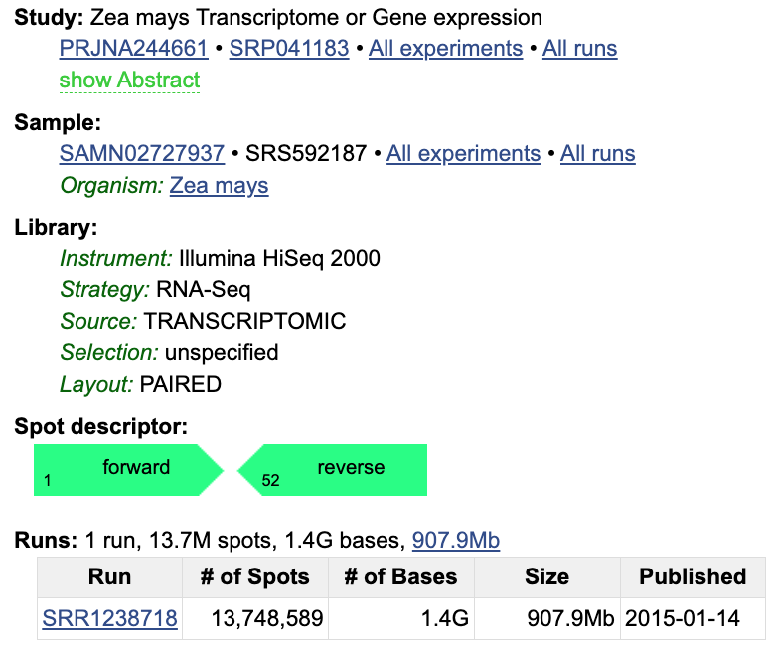
SRR1238718: B73_control_R1
Notes:
The SRA metadata describes the technical aspects of sequencing experiments: the sequencing libraries, preparation techniques and data files.

Slide 33
sra-toolkit
a collection of tools and libraries for using data in Sequence Read Archives.
Installation
wget https://ftp-trace.ncbi.nlm.nih.gov/sra/sdk/current/sratoolkit.current-centos_linux64.tar.gz
tar –xf sratoolkit.current-centos_linux64.tar.gz
mv sratoolkit.3.2.0-centos_linux64 sratoolkit

Slide 34
Download SRA reads using the SRA-toolkit command fasterq-dump
fasterq-dump [options] <accession>
fasterq-dump SRR1238718
spots read : 13,748,589
reads read : 27,497,178
reads written : 27,497,178
SRR1238718_1.fastq
SRR1238718_2.fastq
Notes:
# --split-files: write reads into different files

Slide 35
Summary
E-Utilities: to conveniently retrieve Genbank data
Dataset: to download sequences of genomes, proteins, and genes.
faster-dump: to download publicly available read data

