Slide 1
Phylogeny Bioinformatics Applications (PLPTH813)
Sanzhen Liu
3/21/2023

Slide 2
Outline
Background
Algorithms to build phylogeny
Interpretation of phylogenic trees

Slide 3
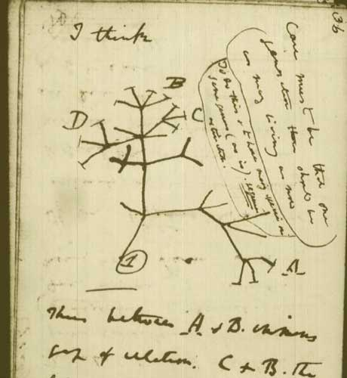
Tree of life
The tree of life is used to describe the relationships between organisms. Its use dates back to at least the early 1800s. It was employed by Charles Darwin to express the concept of the branching divergence of varieties and then species in a process of descent from common ancestors.
Ernst Haeckel coined the term phylogeny for the evolutionary relationships of species through time, and went further than Darwin in proposing phylogenic histories of life. The modern development of this idea is called the phylogenetic tree.
- wikipedia
A page from Darwin's Notebook B showing his sketch of the tree of life
theguardian.com

Slide 4
Evolution and Phylogeny
Evolution is a process of change. At the molecular level, evolution is a process of mutation with selection.
Phylogeny is the inference of evolutionary relationships, providing hypotheses of past biological events.

Slide 5
Applications of phylogenic trees (examples)
to represent the relationships among species/isolates/varieties/genotypes/lines
to describe relationships among homologs in a gene family
to infer the evolutionary and epidemiological dynamics of pathogens
to classify metagenomic sequences
Nowadays, every biologist needs to know something about phylogenetic inference!

Slide 6
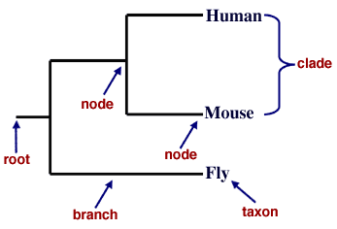
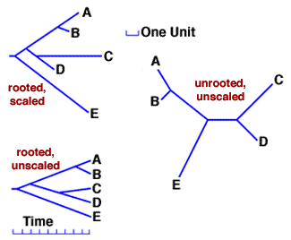
Tree components
A phylogeny is a tree containing nodes that are connected by braches (edges). The pattern of branching determines the tree's topology.
Root represents a common ancestor of all taxa shown in the tree.
Rooted trees are thus directional, since all taxa evolved from the root.
Unrooted trees illustrate relationships only.
www.talkorigins.org/faqs/comdesc/phylo.html

Slide 7
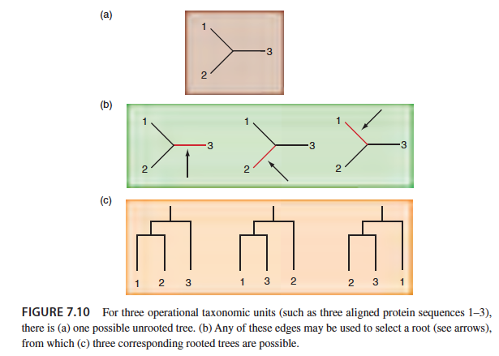
An unrooted tree

Slide 8
Approaches to construct phylogenic trees
Phylogenetic methods
Distance-based
Character-based
least square
minimum evolution
neighbor joining
maximum parsimony
maximum likelihood
Bayesian inference
UPGMA

Slide 9
Distance-based method
Distance calculation to build a distance matrix
A distance matrix is a table that indicates pairwise dissimilarity.
 | A | B | C | D
A | 0 | 3 | 4 | 6
B | 3 | 0 | 5 | 7
C | 4 | 5 | 0 | 6
D | 6 | 7 | 6 | 0
 | B | C | D
A | 3 | 4 | 6
B |  | 5 | 7
C |  |  | 6
example from Barbara Holland

Slide 10
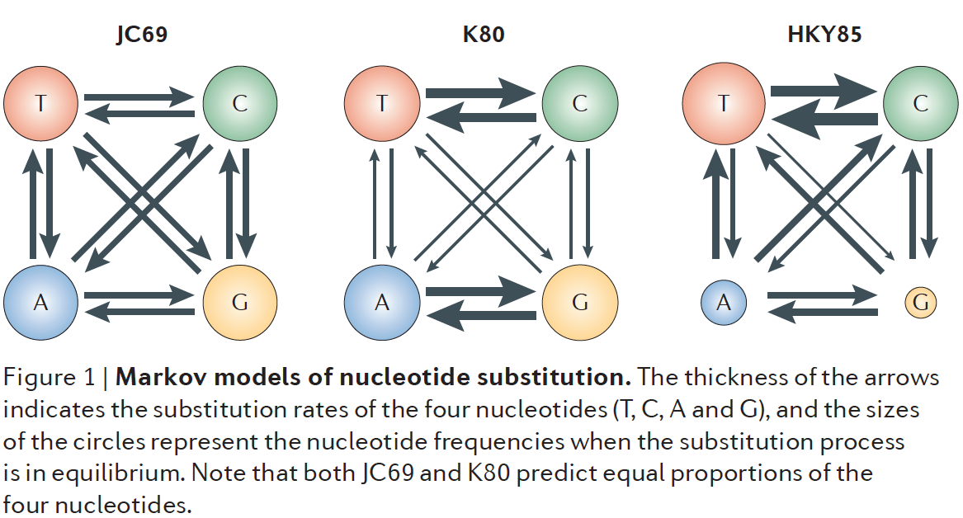
Distance between DNA sequences
Distance (e.g., percentage of difference) between DNA sequences
A | ATTTGCGGTA
B | ATCTGCGATA
C | ATTGCCGTTT
D | TTCGCTGTTT
e.g., DNA sequences
 | A | B | C | D
A | 0 | 0.2 | 0.4 | 0.7
B | 0.2 | 0 | 0.5 | 0.6
C | 0.4 | 0.5 | 0 | 0.3
D | 0.7 | 0.6 | 0.3 | 0
example from Barbara Holland
Notes:
Pairwise sequence distances are
calculated assuming a Markov chain model of nucleotide
substitution. Several commonly used models are illustrated
in FIG. 1. The JC69 model assumes an equal rate
of substitution between any two nucleotides, whereas
the K80 model assumes different rates for transitions
and transversions. Both models predict equal frequencies
of the four nucleotides. The assumption of equal
base frequencies is relaxed in the HKY85 model and
the general time reversible (GTR) model.

Slide 11
From distance matrix to a tree
 | B | C | D
A | 3 | 4 | 6
B |  | 5 | 7
C |  |  | 6
 | B | C | D
A | 3 | 4 | 7
B |  | 4 | 7
C |  |  | 6
?
C
C
Distance-based
A
2
A
2
1
1
1
1
2
4
2
4
least square
minimum evolution
neighbor joining
B
B
D
D
Perfect match
No perfect matches
example from Barbara Holland

Slide 12

Distance-based method – least squares
least squares
 | B | C | D
A | 3 | 4 | 7
B |  | 4 | 7
C |  |  | 6
1
C
A
B
D
 | B | C | D
A | d_{AB} | d_{AC} | d_{AD}
B |  | d_{BC} | d_{BD}
C |  |  | d_{CD}
Determine distance matrix for a given tree
For a given tree, determine Q values
Repeat 1 and 2 for all the possible trees
The tree with the smallest Q score is the least squares estimate of the true tree.
2
3
Q₁, Q₂, Q₃, …
4
The tree with the smallest Q

Slide 13
least squares example
1) A tree is proposed and a new distance matrix is determined based on the tree
2) Determine Q values for the new tree
C
d_{ij}(hat)
d_{ij}
A
1
2
 | B | C | D
A | 3 | 4 | 7
B |  | 4 | 7
C |  |  | 6
1
 | B | C | D
A | 3 | 4 | 5
B |  | 5 | 6
C |  |  | 5
2
3
B
D
(3-3)² + (4-4)² + (5-7)² +
(5-4)² + (6-7)² + (5-6)² = 7

Slide 14
least squares example (cont.)
3) Repeat 1 and 2 for all the proposed trees
4) The tree with the smallest Q score is the least squares estimate of the true tree.
C
least squares
A
2
C
A
B
1
d_{ij}
A
...
1
 | B | C | D
A | 3 | 4 | 7
B |  | 4 | 7
C |  |  | 6
B
2
4
D
C
D
tree 1
tree 2
B
 | B | C | D
A | 3 | 4 | 6
B |  | 5 | 7
C |  |  | 6
D
Q = 2

Slide 15
minimum evolution
minimum evolution
uses the tree length (which is the sum of branch lengths) instead of Q for tree selection. Under the minimum evolution criterion, shorter trees are more likely to be correct than longer trees are.
sum of d_{ij}(hat)
 | B | C | D
A | 3 | 4 | 6
B |  | 5 | 7
C |  |  | 6
 | B | C | D
A | 3 | 4 | 5
B |  | 5 | 6
C |  |  | 5
3 + 4 + 6 + 5 + 7 + 6 = 31
<
3 + 4 + 5 + 5 + 6 + 5 = 28

Slide 16
neighbor joining (overview)
neighbor joining (the most popular algorithm)
- Find a close pair of leaves that are far from other leaves
The algorithm operates by starting with a star tree and successively choosing a pair of taxa to join together (based on the taxon distances), until a fully resolved tree is obtained.

Slide 17
neighbor joining (NJ) procedure - I
Distance matrix (n=4)
 | A | B | C | D
A | 0 | 2 | 4 | 6
B |  | 0 | 3 | 7
C |  |  | 0 | 10
D |  |  |  | 0
D
a star tree
A
C
B

Slide 18
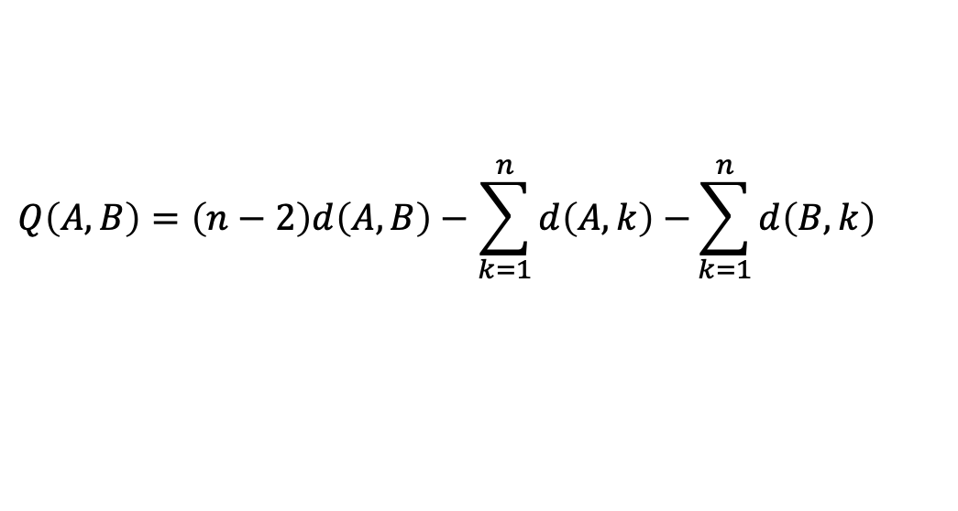
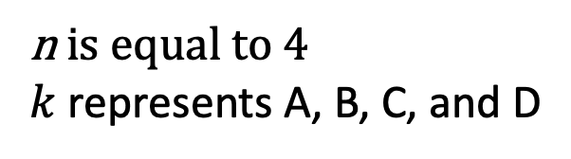
neighbor joining (NJ) procedure - II
calculate Q (Q matrix)
Distance matrix
(n=4)
 | A | B | C | D
A | 0 | 2 | 4 | 6
B |  | 0 | 3 | 7
C |  |  | 0 | 10
D |  |  |  | 0
$$Q\left(A,B\right)=\left(n−2\right)d\left(A,B\right)−\sum_{k=1}^{n}{d\left(A,k\right)−}\sum_{k=1}^{n}{d\left(B,k\right)}$$
Q_{AB} = (4-2)*2 - (2 + 4 + 6) - (2 + 3 + 7) = -20
Q matrix
 | A | B | C | D
A | 0 | -20
B |  | 0
C |  |  | 0
D |  |  |  | 0
n is equal to 4
$k$ represents A, B, C, and D

Slide 19
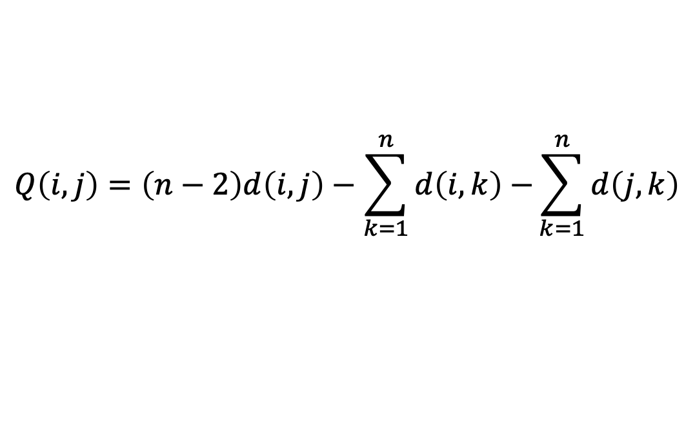
neighbor joining (NJ) procedure - III
Find the lowest Q_{i,j}
i and j are joined to a newly node (e.g., AD)
The new node is connected to the central node.
Distance matrix
(n=4)
 | A | B | C | D
A | 0 | 2 | 4 | 6
B |  | 0 | 3 | 7
C |  |  | 0 | 10
D |  |  |  | 0
$$Q\left(i,j\right)=\left(n−2\right)d\left(i,j\right)−\sum_{k=1}^{n}{d\left(i,k\right)−}\sum_{k=1}^{n}{d\left(j,k\right)}$$
Q_{AC} = (4-2)*4 - (2+ 4 + 6) - (4 + 3 + 9) = -20
Q_{AD} = (4-2)*6 - (2 + 4 + 6) - (6 + 7 + 9) = -22
Q_{BC} = (4-2)*3 - (2 + 3 + 7) - (4 + 3 + 9) = -20
Q_{BD} = (4-2)*7 - (2 + 3 + 7) - (6 + 7 + 9) = -20
Q_{CD} = (4-2)*9 - (4 + 3 + 6) - (6 + 7 + 6) = -14
Q matrix
 | A | B | C | D
A | 0 | -20 | -20 | -22
B |  | 0 | -20 | -20
C |  |  | 0 | -14
D |  |  |  | 0
D
A
C
E
A
C
D
B
B

Slide 20
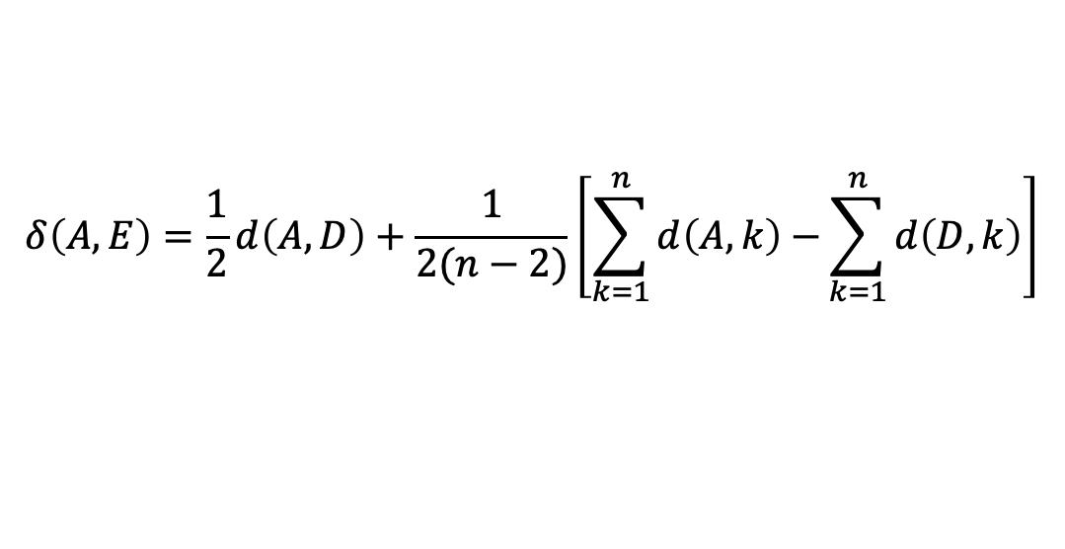
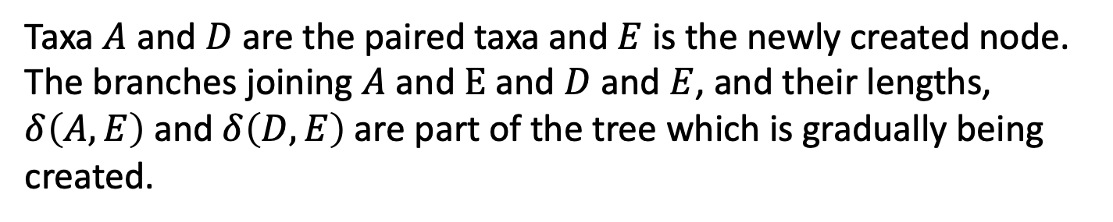
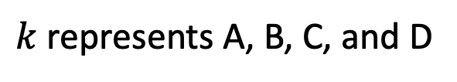
neighbor joining (NJ) procedure - IV
Calculate the distance from each of the taxa in the pair to this new node.
$$δ\left(A, E\right)=\frac{1}{2}d\left(A,D\right)+\frac{1}{2(n−2)}\left[\sum_{k=1}^{n}{d\left(A,k\right)−}\sum_{k=1}^{n}{d\left(D,k\right)}\right]$$
A
C
E
D
B
$$δ\left(D, E\right)=d\left(A,D\right)−δ\left(A, E\right)$$
$k$ represents A, B, C, and D
Taxa $A$ and $D$ are the paired taxa and $E$ is the newly created node. The branches joining $A$ and$E$ and $D$ and $E$, and their lengths, $δ\left(A,E\right)$and $δ\left(D,E\right)$are part of the tree which is gradually being created.

Slide 21
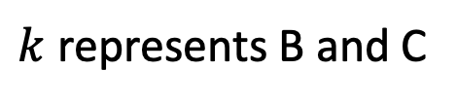
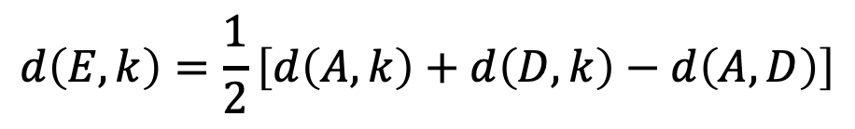
neighbor joining (NJ) procedure - V
Calculate the distance from each of the taxa outside of this pair to the new node.
Repeat 1-4 until resolving all
Updated distance matrix
 | E | B | C
E | 0
B |  | 0
C |  |  | 0
$$d\left(E,k\right)=\frac{1}{2}\left[d\left(A,k\right)+d\left(D,k\right)−d\left(A,D\right)\right]$$
$k$ represents B and C
A
C
A
B
E
E
F
D
B
D
C

Slide 22
neighbor joining (summary)
neighbor joining (the most popular algorithm)
- Find a close pair of leaves that are far from other leaves
The algorithm operates by starting with a star tree and successively choosing a pair of taxa to join together (based on the taxon distances), until a fully resolved tree is obtained.

Slide 23
UPGMA (unweighted pair group method with arithmetic mean)
UPGMA is a simple agglomerative (bottom-up) hierarchical clustering method, constructing a rooted tree.
Based on a (dis)similarity matrix, at each step, the nearest two clusters are combined into a higher-level cluster.
similarity matrix
two nearest clusters
Updated similarity matrix*
*recalculates the distance of the joint pair by taking the average
tree
UPGMA assumption: the distances from the root to every branch tip are equal.
Notes:
The main difference between UPGMA and neighbor joining tree is that UPGMA is an agglomerative hierarchical clustering method based on the average linkage method whereas neighbor-joining tree is an iterative clustering method based on the minimum-evolution criterion. Furthermore, UPGMA produces a rooted phylogenetic tree while neighbor-joining tree method produces an unrooted phylogenetic tree. Since UPGMA method assumes equal rates of evolution, branch tips come out equal while as neighbor-joining tree method allows unequal rates of evolution, the branch lengths are proportional to the amount of change.
UPGMA (unweighted pair group method with arithmetic mean) and neighbor-joining (NJ) tree are the two types of algorithms, which build phylogenetic trees from a distance matrix. Generally, UPGMA is a simple, fast but, unreliable method while neighbor-joining tree method is a comparatively rapid method, giving better results when compared to the UPGMA method.

Slide 24
Approaches to construct phylogenic trees
Phylogenetic methods
Distance-based
Character-based
least square
minimum evolution
neighbor joining
maximum parsimony
maximum likelihood
Bayesian inference

Slide 25
Character-based methods
Character-based
maximum parsimony
maximum likelihood
Bayesian inference

Slide 26
character-based method - maximum parsimony
(1) GGA ACA (3)
\1 1/ Tree score
\ 2 /
GGG --- ACG Tree I: 4
/ \
/0 0\
(2) GGG ACG (4)
The maximum parsimony method minimizes the number of changes on a phylogenetic tree.
The character length is the minimum number of changes required for that site, whereas the tree score is the sum of character lengths over all sites. The maximum parsimony tree is the tree that minimizes the tree score.
1 GGA
2 GGG
3 ACA
4 ACG
(1) GGA GGG (2)
\1 1/
\ 1 /
GCA --- GCG Tree II: 5
/ \
/1 1\
(3) ACA ACG (4)
(1) GGA GGG (2)
\2 1/
\ 0 /
GCG --- GCG Tree III: 6
/ \
/1 2\
(4) ACG ACA (3)
http://www.icp.ucl.ac.be/~opperd/private/parsimony.html

Slide 27
maximum likelihood
maximum likelihood
The tree is a model, whereas branch lengths on a given tree are parameters in the model.
P(Data|Model): the probability or likelihood of observing the data given the model
1. Optimization of branch lengths to calculate the tree likelihood, P(Data|Model), for each candidate tree
2. Determination of likelihoods of many trees and find the one with the maximum likelihood.

Slide 28
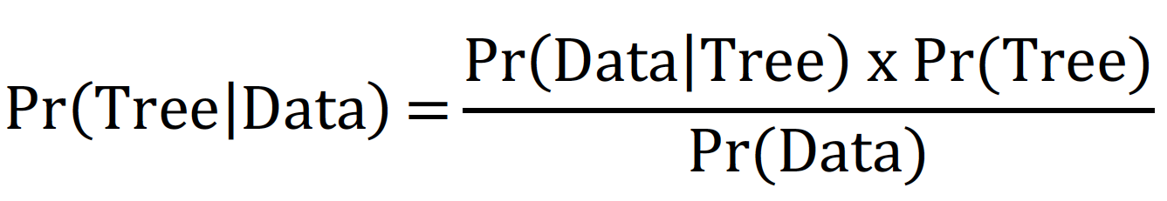
Bayesian inference methods
Bayesian inference methods
Pr(Tree) is the prior probability for a tree
Pr(Data|Tree) is the likelihood or probability of the data given the tree
P(Tree|Data) is the posterior probability.
the posterior probability of a tree is the probability that the tree is correct

Slide 29
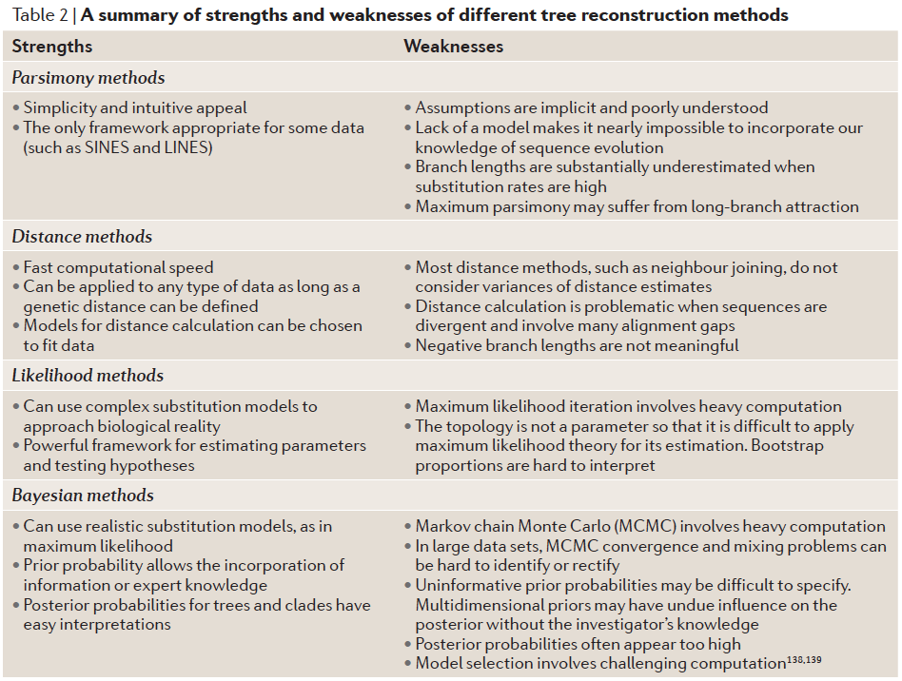
Strengths and weaknesses

Slide 30
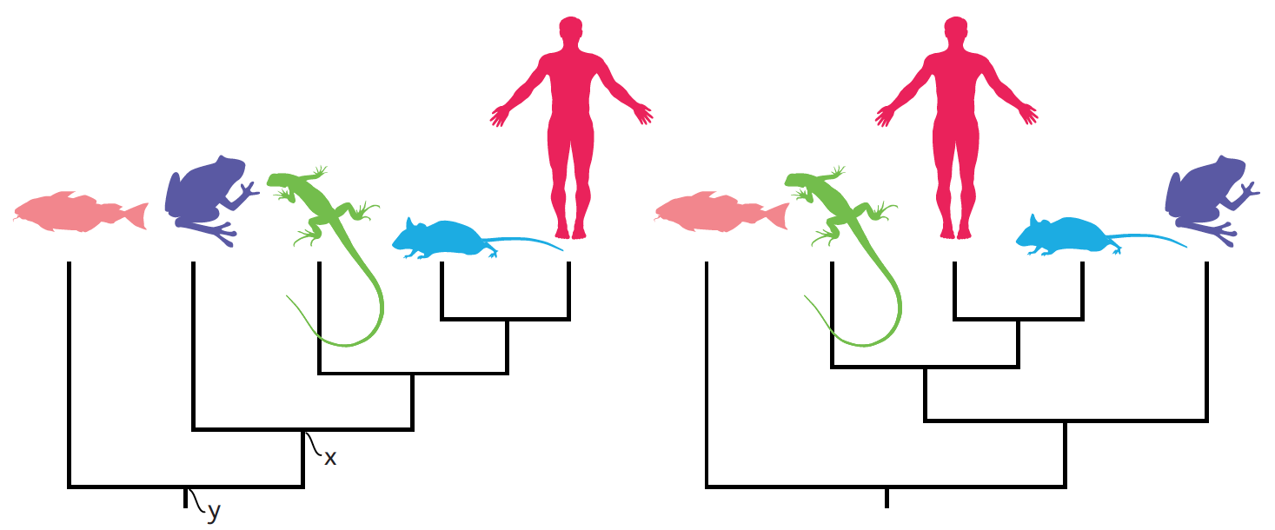
Which tree is correct?
“just as beginning students in geography need to be taught how to read maps, so beginning students in biology should be taught how to read trees and to understand what trees communicate.” - Robert O’Hara
The more recently species share a common ancestor, the more closely related they are.
Baum et al., 2005, Science. 310: 979-978

Slide 31
Interpretation of a tree
The correct way to read a tree is as a set of hierarchically nested groups, known as clades.

Slide 32
Flat file formats for phylogenetic trees
Newick: Newick files are simply text files that consist of one or more tree descriptions in the Newick notation.
Nexus: Nexus is widely used in phylogenetics and can contain trees in Newick notation and furthermore also information about taxa and phylogenetic data sets such as sequence alignments.
phyloXML: phyloXML is a XML format for the analysis, exchange, and storage of phylogenetic trees (or networks) and associated data. It allows to store much more information about the tree nodes.

Slide 33
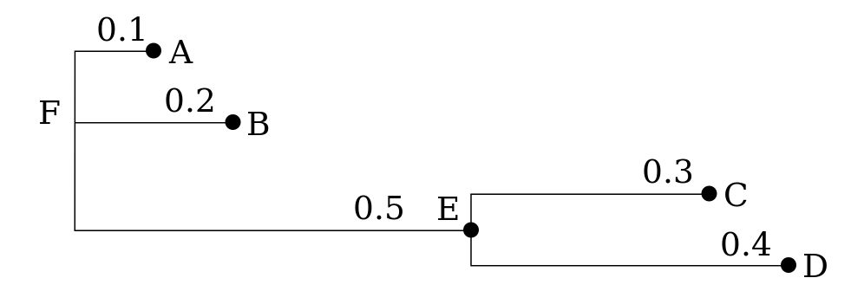
an example of the Newick format
Newick file:
Notes:
(,,(,))
(A,B,(C,D))
(A,B,(C,D)E)F
(:0.1,:0.2,(:0.3,:0.4):0.5)
(:0.1,:0.2,(:0.3,:0.4):0.5):0.0
(A:0.1,B:0.2,(C:0.3,D:0.4):0.5)
(A:0.1,B:0.2,(C:0.3,D:0.4)E:0.5)F
((B:0.2,(C:0.3,D:0.4)E:0.5)F:0.1)A
no nodes are named
leaf nodes are named
all nodes are named
all but root node have a distance to parent
all have a distance to parent
distances and leaf names (popular)
distances and all names
a tree rooted on a leaf node (rare)

Slide 34
Outgroup rooting
Many methods (e.g., NJ) construct unrooted trees. An outgroup can be introduced to identify the “root”. Although the inferred tree for all species is still unrooted, the root is believed to be located along the branch that leads to the outgroup so that the tree for the ingroup species is rooted. This strategy is called outgroup rooting.
A good outgroup needs to satisfy:
not a member of the ingroup
close related to the ingroup

Slide 35
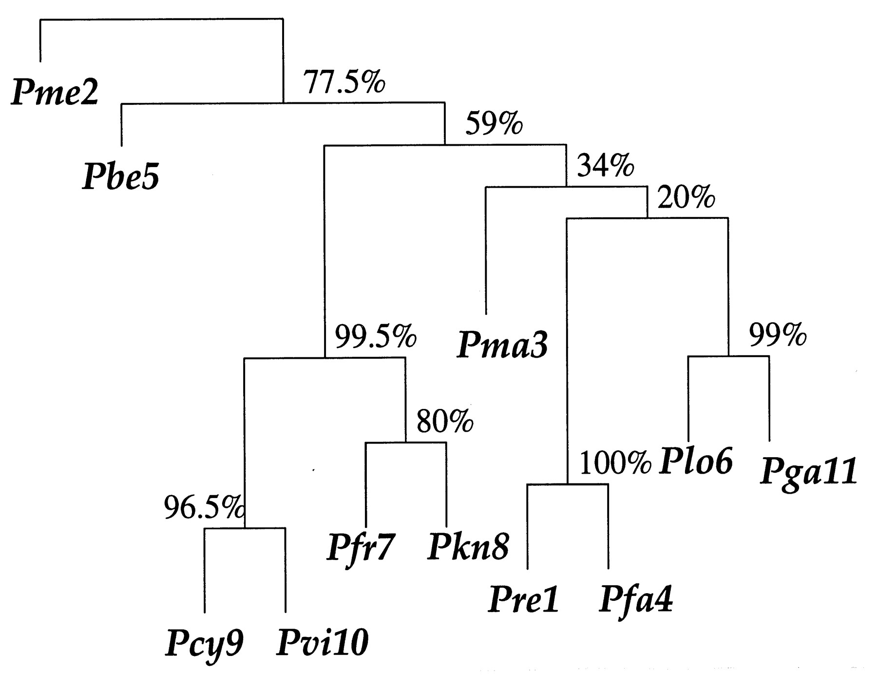
Tree evaluation: Bootstrap analysis
Bootrapping measures how consistently the data support given taxon bipartitions (Hedges, 1992).
Plo6 and Pga11 are grouped together in 99% bootstrap replicates.
* B = 200 bootstrap replications.
Bradley Efron et al. PNAS 1996;93:13429
Notes:
In phylogenetics, bootstrapping is conducted using the columns of the character matrix. Each pseudoreplicate contains the same number of species (rows) and characters (columns) randomly sampled from the original matrix, with replacement. A phylogeny is reconstructed from each pseudoreplicate, with the same methods used to reconstruct the phylogeny from the original data. For each node on the phylogeny, the nodal support is the percentage of pseudoreplicates containing that node.

Slide 36
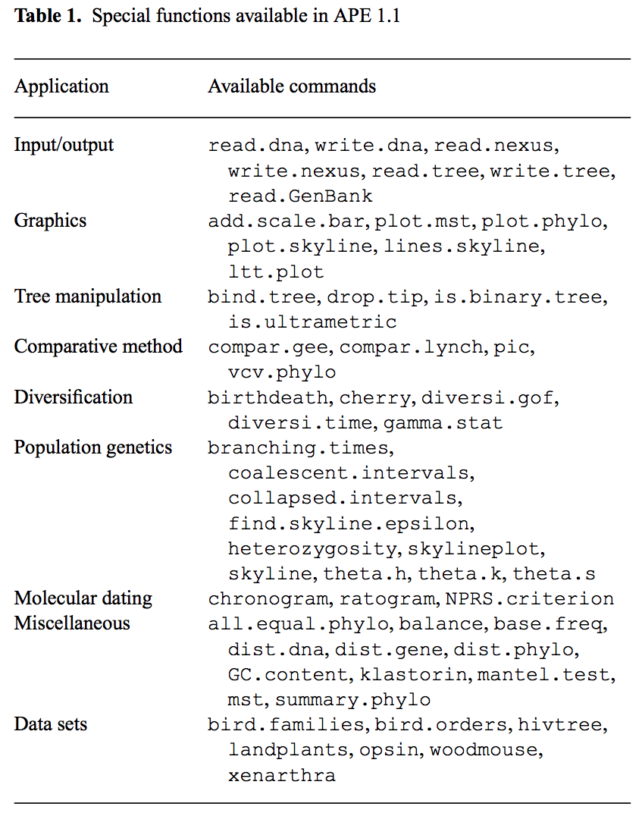
An R package - ape
Analysis of Phylogenetics and Evolution ("ape") is an R software package for use in molecular evolution and phylogenetics.

Slide 37
References
Yang et al., 2012, Molecular phylogenetics: principles and practice, Nature Reviews Genetics, 13: 303-314
Paradis et al., 2004, APE: Analyses of Phylogenetics and Evolution in R language, Bioinformatics, 20 (2): 289-290
Baum et al. The tree-thinking challenge, 2005, Science, 310:979-980

Slide 38
Other useful resources
Combine multiple R packages to build trees with different algorithm
https://www.molecularecologist.com/2016/02/26/quick-and-dirty-tree-building-in-r/
ape manual
https://cran.r-project.org/web/packages/ape/ape.pdf

