Slide 1
Genomic Assembly (lab) Bioinformatics Applications (PLPTH813)
Sanzhen Liu
5/1/2025

Slide 2
Today's Lab
Genome assemblies using SOAPdenovo2
Long-read genome assemblies with Canu
Polishing (error correction) with Illumina data

Slide 3
lab12

Slide 4
Data and software
# download data for today's practice
wget https://people.beocat.ksu.edu/~liu3zhen/PLPTH813/labs/assembly.tar.gz
tar -xf assembly.tar.gz
assembly/
├── data
├── soapdn01
├── canu
├── pilon
└── software

Slide 5
Illumina reads
MG1655_1.5M_R1.fastq.gz
MG1655_1.5M_R2.fastq.gz

Slide 6
SOAPdenovo2
De Bruijn graph assembler
SOAPdenovo is a novel short-read assembler that can build a de novo draft assembly for the human-sized genomes.
SOAPdenovo2 uses a new algorithm design that reduces memory consumption in graph construction, resolves more repeat regions in contig assembly, increases coverage and length in scaffold construction, improves gap closing, and optimizes for large genome.
Two modules in SOAPdenovo2: SOAPdenovo-63mer and SOAPdenovo-127mer

Slide 7
working directory - SOAPdenovo assembly
soapdn01

Slide 8
MG1655 assembly step1: SOAPdenovo2 configure file
configure.MG1655.txt
#maximal read length
max_rd_len=125
[LIB]
#average insert size
avg_ins=300
#if sequence needs to be reversed
reverse_seq=0
# assemble to contigs
asm_flags=3 ## both contig and scaffold assembly
#use all the bases of each read
rd_len_cutoff=125
#cutoff value of pair number for a reliable connection
pair_num_cutoff=3
#minimum aligned length to contigs for a reliable read location
map_len=50
#a pair of fastq file, read 1 file should be followed by read 2 file
q1=../data/MG1655/MG1655_1.5M_R1.fastq.gz
q2=../data/MG1655/MG1655_1.5M_R2.fastq.gz

Slide 9
MG1655 assembly Step 2: Run SOAPdenovo2
MG1655.soapdn.sbatch
#!/bin/bash
#SBATCH --cpus-per-task=1
#SBATCH --mem-per-cpu=8g
#SBATCH --time=1-00:00:00
../software/SOAPdenovo2/SOAPdenovo-63mer all \
-s configure.MG1655.txt \
-K 31 -d 2 -R -o MG1655kmer31 \
-p 1 -F -L 200 -b 800 -N 5000000 \
1>MG1655kmer31.log \
2>MG1655kmer31.err
sbatch MG1655.soapdn.sbatch
Notes:
9714251 MG1655.soa hero46 1 n 1 c 3.94gb/ 12gb 00:03:30 COMPLETED
-s <string> configFile: the config file of solexa reads
-o <string> outputGraph: prefix of output graph file name
-K <int> kmer(min 13, max 63/127): kmer size, [23]
-p <int> n_cpu: number of cpu for use, [8]
-a <int> initMemoryAssumption: memory assumption initialized to avoid further reallocation, unit G, [0]
-d <int> KmerFreqCutoff: kmers with frequency no larger than KmerFreqCutoff will be deleted, [0]
-R (optional) resolve repeats by reads, [NO]
-D <int> EdgeCovCutoff: edges with coverage no larger than EdgeCovCutoff will be deleted, [1]
-M <int> mergeLevel(min 0, max 3): the strength of merging similar sequences during contiging, [1]
-m <int> max k when using multi kmer
-e <int> weight to filter arc when linearize two edges(default 0)
-r (optional) keep available read(*.read)
-E (optional) merge clean bubble before iterate
-f (optional) output gap related reads in map step for using SRkgf to fill gap, [NO]
-k <int> kmer_R2C(min 13, max 63): kmer size used for mapping read to contig, [K]
-F (optional) fill gaps in scaffold, [NO]
-u (optional) un-mask contigs with high/low coverage before scaffolding, [mask]
-w (optional) keep contigs weakly connected to other contigs in scaffold, [NO]
-G <int> gapLenDiff: allowed length difference between estimated and filled gap, [50]
-L <int> minContigLen: shortest contig for scaffolding, [K+2]
-c <float> minContigCvg: minimum contig coverage (c*avgCvg), contigs shorter than 100bp with coverage smaller
than c*avgCvg will be masked before scaffolding unless -u is set, [0.1]
-C <float> maxContigCvg: maximum contig coverage (C*avgCvg), contigs with coverage larger than C*avgCvg or
contigs shorter than 100bp with coverage larger than 0.8*C*avgCvg will be masked before scaffolding unless -u is
set, [2]
-b <float> insertSizeUpperBound: (b*avg_ins) will be used as upper bound of insert size for large insert size
( > 1000) when handling pair-end connections between contigs if b is set to larger than 1, [1.5]
-B <float> bubbleCoverage: remove contig with lower cvoerage in bubble structure if both contigs' coverage are
smaller than bubbleCoverage*avgCvg, [0.6]
-N <int> genomeSize: genome size for statistics, [0]
-V (optional) output visualization information of assembly, [NO]

Slide 10
Slurm: job scheduler
sbatch xxx.sbatch # to submit jobs
kstat -d 1 # to monitor jobs

Slide 11
MG1655 k-mer31 assembled result
MG1655kmer31.contig
MG1655kmer31.scafSeq
MG1655kmer31.scafStatistics
more MG1655kmer31.scafStatistics

Slide 12
SOAPdenovo guide
-s <string> configFile: the config file of solexa reads
-o <string> outputGraph: prefix of output graph file name
-K <int> kmer(min 13, max 63/127): kmer size, [23]
-p <int> n_cpu: number of cpu for use, [8]
-a <int> initMemoryAssumption: memory assumption initialized to avoid further reallocation, unit G, [0]
-d <int> KmerFreqCutoff: kmers with frequency no larger than KmerFreqCutoff will be deleted, [0]
-R (optional) resolve repeats by reads, [NO]
-D <int> EdgeCovCutoff: edges with coverage no larger than EdgeCovCutoff will be deleted, [1]
-M <int> mergeLevel(min 0, max 3): the strength of merging similar sequences during contiging, [1]
-m <int> max k when using multi kmer
-e <int> weight to filter arc when linearize two edges(default 0)
-r (optional) keep available read(*.read)
-E (optional) merge clean bubble before iterate
-f (optional) output gap related reads in map step for using SRkgf to fill gap, [NO]
-k <int> kmer_R2C(min 13, max 63): kmer size used for mapping read to contig, [K]
-F (optional) fill gaps in scaffold, [NO]
-u (optional) un-mask contigs with high/low coverage before scaffolding, [mask]
-w (optional) keep contigs weakly connected to other contigs in scaffold, [NO]
-G <int> gapLenDiff: allowed length difference between estimated and filled gap, [50]
-L <int> minContigLen: shortest contig for scaffolding, [K+2]
-c <float> minContigCvg: minimum contig coverage (c*avgCvg), contigs shorter than 100bp with coverage smaller
than c*avgCvg will be masked before scaffolding unless -u is set, [0.1]
-C <float> maxContigCvg: maximum contig coverage (C*avgCvg), contigs with coverage larger than C*avgCvg or
contigs shorter than 100bp with coverage larger than 0.8*C*avgCvg will be masked before scaffolding unless -u is
set, [2]
-b <float> insertSizeUpperBound: (b*avg_ins) will be used as upper bound of insert size for large insert size
( > 1000) when handling pair-end connections between contigs if b is set to larger than 1, [1.5]
-B <float> bubbleCoverage: remove contig with lower cvoerage in bubble structure if both contigs' coverage are
smaller than bubbleCoverage*avgCvg, [0.6]
-N <int> genomeSize: genome size for statistics, [0]
-V (optional) output visualization information of assembly, [NO]
http://soap.genomics.org.cn/soapdenovo.html

Slide 13
Your turn
We used kmer=31 for the assemblies
Now please try using kmer=59 for the assemblies
soapdn02

Slide 14
Today's Lab
Genome assemblies using SOAPdenovo2
Long-read genome assemblies with Canu
Polishing with Illumina data

Slide 15
Data
PacBio data
pacbio_cmnHF4_1.fastq.gz
Illumina data
HF4.R1.pair.fq.gz
HF4.R2.pair.fq.gz

Slide 16
working directory - canu assembly
canu

Slide 17
Canu assembly
canu.01.sh
#!/bin/bash -l
indata=../data/HF4/pacbio/pacbio_cmnHF4_1.fastq.gz
out=cmnHF4
# load canu
module load canu
# run canu
canu -d $out -p $out \
genomeSize=3m \
-gridOptions="--time=1-00:00:00" \
-pacbio $indata
bash canu.01.sh

Slide 18
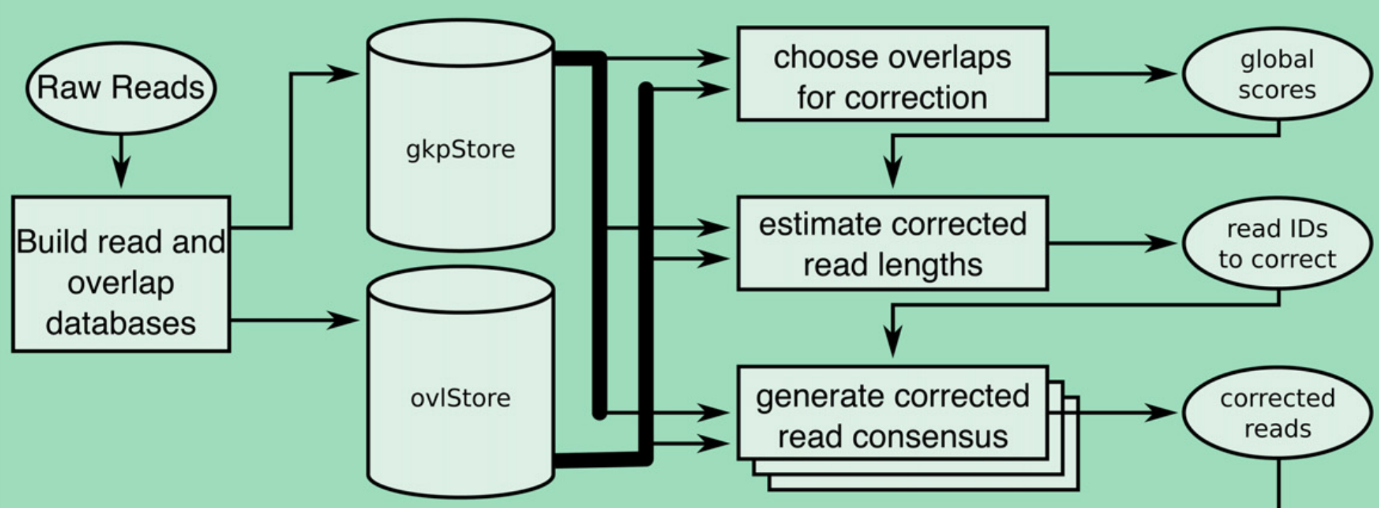
Canu - read correction
Koren et al., Genome Research, 27:722–736 (2017)

Slide 19
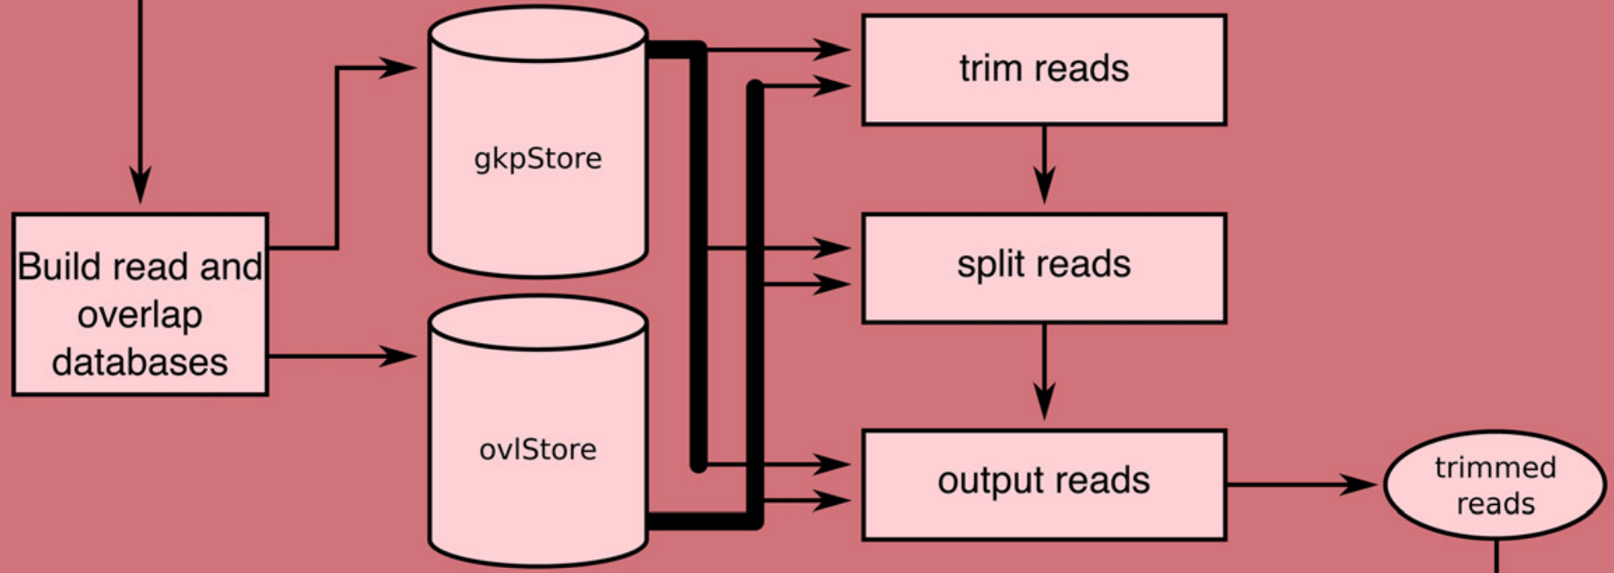
Canu - read trimming

Slide 20
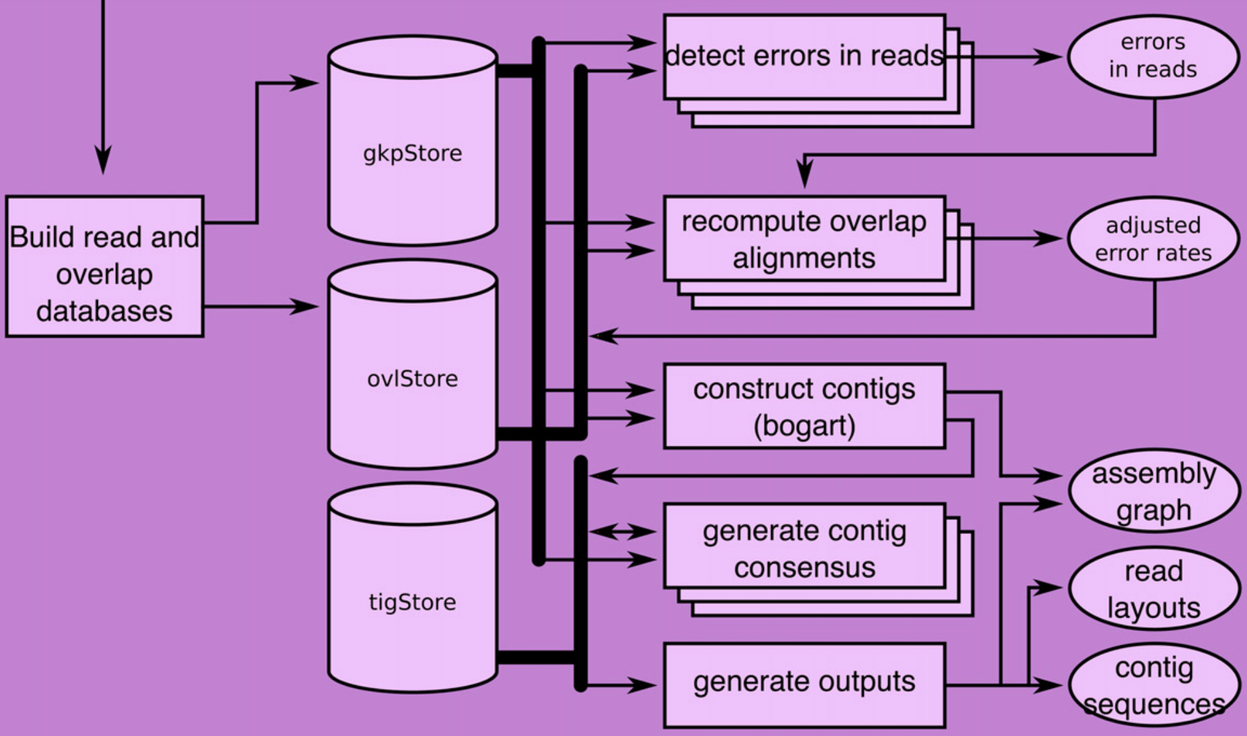
Canu - assembly (consensus and contigs)

Slide 21
canu output
cmnHF4.correctedReads.fasta.gz
cmnHF4.trimmedReads.fasta.gz
cmnHF4.contigs.fasta
cmnHF4.report
5 sequences in the final assembly
Assembly total length | 3,052,746
NG50 | 2,106,990

Slide 22
working directory - Pilon polishing
pilon

Slide 23
Polishing with Illumina data – BWA alignment (step 1)
#!/bin/bash –l
#SBATCH --cpus-per-task=1
#SBATCH --mem-per-cpu=4G
#SBATCH --time=1-00:00:00
asmpath=../canu/cmnHF4/
asm=cmnHF4.contigs.fasta
pe1=../data/HF4/illumina/HF4.R1.pair.fq.gz
pe2 =../data/HF4/illumina/HF4.R2.pair.fq.gz
out=HF4aln
# index
module load BWA
ln -s $asmpath/$asm .
bwa index $asm
# alignment
bwa mem $asm $pe1 $pe2 > $out.sam
# sam2bam
module load SAMtools
samtools view -b $out.sam -o $out.bam
samtools sort $out.bam -o $out.sort.bam
samtools index $out.sort.bam
# cleanup
rm *sam
rm cmnHF4.contigs.fasta.*
rm HF4aln.bam
sbatch 1c_aln.sh
Notes:
1c_aln.sh wizard24 1 n 1 c 0.51gb/ 4gb 00:02:44 COMPLETED

Slide 24
BWA alignment output
HF4aln.sort.bam
HF4aln.sort.bam.bai
Notes:
1c_aln.sh wizard24 1 n 1 c 0.51gb/ 4gb 00:02:44 COMPLETED

Slide 25
Polishing with Illumina data – Pilon polishing (step 2)
#!/bin/bash
#SBATCH --cpus-per-task=1
#SBATCH --mem-per-cpu=4G
#SBATCH --time=1-00:00:00
asm=cmnHF4.contigs.fasta
module load Java
java -jar ../software/pilon/pilon-1.24.jar --genome $asm \
--frags HF4aln.sort.bam \
--output HF4polished_1 \
--minmq 30 --minqual 15 \
--threads 1 --changes --outdir . >pilon.log
2c_pilon.sh
Notes:
2c_pilon.s warlock05 1 n 1 c 1.40gb/ 4gb 00:00:34 COMPLETED

Slide 26
changes
HF4polished.changes
tig00000001:27 | tig00000001_pilon:27 | . | G
tig00000001:147-148 | tig00000001_pilon:148 | GT | .
tig00000001:258 | tig00000001_pilon:257 | . | G
tig00000001:282 | tig00000001_pilon:282 | . | G
tig00000001:296 | tig00000001_pilon:297 | . | G
tig00000001:308 | tig00000001_pilon:310 | . | C
tig00000001:410 | tig00000001_pilon:413 | . | C
...

Slide 27
Pilon output
HF4polished.fasta
>tig00000001_pilon
>tig00000002_pilon
>tig00000003_pilon
>tig00000004_pilon
>tig00000005_pilon
# remove "_pilon"
sed -i 's/_pilon//' HF4polished.fasta

Slide 28
SOAPdenovo2 installation
# under assembly/software/
git clone https://github.com/aquaskyline/SOAPdenovo2.git
cd SOAPdenovo2
make

Slide 29
Download Pilon (binary version) to software directory
wget https://github.com/broadinstitute/pilon/releases/download/v1.24/pilon-1.24.jar

