Slide 1
BEDtools, software installation, Git Bioinformatics Applications (PLPTH813)
Sanzhen Liu
4/11/2023

Slide 2
Outline
BED format
BEDtools and examples
Software installation

Slide 3
BEDtools (I)
intersect Find overlapping intervals in various ways.
window Find overlapping intervals within a window
closest Find the closest, potentially non-overlapping interval.
coverage Compute the coverage over defined intervals.
map Apply a function to a column
genomecov Compute the coverage over an entire genome.
merge Combine overlapping/nearby intervals
cluster Cluster (but don't merge) overlapping/nearby intervals.
complement Extract intervals _not_ represented by an interval file.
shift Adjust the position of intervals.
subtract Remove intervals based on overlaps b/w two files.
slop Adjust the size of intervals.
flank Create new intervals from flanks of existing intervals.
sort Order the intervals in a file.
random Generate random intervals in a genome.
shuffle Randomly redistribute intervals in a genome.
sample Sample random records from file using reservoir sampling.
spacing Report the gap lengths between intervals in a file.
annotate Annotate coverage of features from multiple files.

Slide 4
BEDtools (II) - Fasta manipulation
getfasta Use intervals to extract sequences from a FASTA file.
maskfasta Use intervals to mask sequences from a FASTA file.
nuc Profile the nucleotide content of intervals
Beocat: module load BEDTools

Slide 5
BED format (Tab-separated file) (I)
The first three required BED fields are:
1. chrom - the chromosome
2. chromStart - the starting position; 0-based
3. chromEnd - the ending position; 1-based
e.g., the first 100 bases of chromosome 1
chr1 0 100

Slide 6
BED format (II)
The additional optional BED fields are:
4. name - Defines the name of the BED line.
5. score - A score between 0 and 1000
6. strand - Defines the strand - either '+' or '-’
…
e.g., the first 100 bases of chromosome 1
chr1 0 100 region1 . +
chr1 100 200 region2 . -
…

Slide 7
BED format (III)
Other optional fields
(could be flexible and more fields)
thickStart - coordinate to start drawing a solid rectangle
thickEnd - coordinate to stop drawing a solid rectangle
itemRgb - an RGB colour value (e.g. 0,0,255).
e.g.,
chr1 0 100 region1 . + 0 100 255,0.0

Slide 8
Extract promoter sequences of genes (I)
Required input information
a BED file of genes (.bed)
Genome sequences (.fasta)
Chromosome/contig lengths (.length)
length of promoters to be extracted
How To Use Bedtools To Extract Promoters?

Slide 9
Extract promoter sequences of genes (II)
bed=genes.bed
ref=ref.fasta
clen=chrs.length
promoter_len=2000
out=genes.promoter
# generate a BED file
bedtools flank -i $bed -g $clen \
-l $promoter_len -r 0 -s > $out.bed
# extract sequence
bedtools getfasta -s -fi $ref \
-bed $out.bed -fo ${out}.fasta

Slide 10
BEDtools - flank
-b bp flanking in each direction.
-l bp flanking from start coordinate.
-r bp flanking from end coordinate
-s define “start” and “end” based on strand.
-l
-r
+
1
10,000 bp
-l
-r
-s
X
-
1
10,000 bp
-r
-l
-s
-
1
10,000 bp

Slide 11
Promoter - example
1. ref.fas
>ref AAAAAAAAAAAAAAAAAAAACCCCCCCCCCCCCCCCCCCCAAGGGGGGGGGGGGGGGGGG
2. gene.bed
ref 20 40 a1 0.5 + ref 20 40 a2 0.5 -
3. ref.length
ref 60
bedtools flank -i gene.bed -g ref.length \
-l 20 -r 0 -s > gene.promoter.bed
Output:
ref 0 20 a1 0.5 +
ref 40 60 a2 0.5 -

Slide 12
BEDtools - getfasta
-fi Input FASTA file
-fo Output file
-bed BED/GFF/VCF file of ranges to extract from -fi
-s Force strandedness. If the strand is minus(-), the sequence will be reverse complemented.
bedtools getfasta -s -fi ref.fas \
-bed gene.promoter.bed \
-fo gene.promoter.fas
1. ref.fas
>ref AAAAAAAAAAAAAAAAAAAACCCCCCCCCCCCCCCCCCCCAAGGGGGGGGGGGGGGGGGG
2. gene.promoter.bed
ref 0 20 a1 0.5 +
ref 40 60 a2 0.5 -
>ref:0-20(+)
AAAAAAAAAAAAAAAAAAAA
>ref:40-60(-)
CCCCCCCCCCCCCCCCCCTT
Output:

Slide 13
intersect (I)
cat d1.bed
chr1 10 100 a1 . +
chr1 200 300 a2 . +
chr1 500 550 a3 . +
cat d2.bed
chr1 10 20 a1 . +
chr1 150 250 a2 . +
chr1 600 750 a3 . +

Slide 14
intersect (II)
cat d1.bed
chr1 10 100 a1 . +
chr1 200 300 a2 . +
chr1 500 550 a3 . +
cat d2.bed
chr1 10 20 a1 . +
chr1 150 250 a2 . +
chr1 600 750 a3 . +
bedtools intersect -a d1.bed -b d2.bed
chr1 10 20 a1 . +
chr1 200 250 a2 . +

Slide 15
intersect (III)
cat d1.bed
chr1 10 100 a1 . +
chr1 200 300 a2 . +
chr1 500 550 a3 . +
cat d2.bed
chr1 10 20 a1 . +
chr1 150 250 a2 . +
chr1 600 750 a3 . +
bedtools intersect -a d1.bed -b d2.bed -wo
chr1 10 100 a1 . + chr1 10 20 a1 . + 10
chr1 200 300 a2 . + chr1 150 250 a2 . + 50
-wo: write the original A and B entries plus the number of base pairs of overlap between the two features.

Slide 16
intersect (IV)
cat d1.bed
chr1 10 100 a1 . +
chr1 200 300 a2 . +
chr1 500 550 a3 . +
cat d2.bed
chr1 10 20 a1 . +
chr1 150 250 a2 . +
chr1 600 750 a3 . +
bedtools intersect -a d1.bed -b d2.bed -wao
chr1 10 100 a1 . + chr1 10 20 a1 . + 10
chr1 200 300 a2 . + chr1 150 250 a2 . + 50
chr1 500 550 a3 . + . -1 -1 . -1 . 0
-wao: write the original A and B entries plus the number of base pairs of overlap between the two features. A features w/o overlap are also reported.

Slide 17
coverage
bedtools coverage -abam $bam -b $bed
Bed input:
Interval_1 1 16452 10 -3.84
…
Output:
1 2 3 4
Interval_1 1 16452 10 -3.84 5432 16302 16451 0.9909
1. Read number
2. Coverage (bp)
3. Original length
5. Coverage (%)

Slide 18
closest
# find the closest, non-overlapping gene for each peak interval
bedtools closest -a peak.bed -b genes.bed -io > peak.near.genes.bed

Slide 19
slop & complement
# Add 500 bp up and downstream of each probe
bedtools slop -i probes.bed -b 500 > p.500bp.bed
# Get a BED file of all regions not covered by the probes (+500 bp up/down)
bedtools complement -i p.500bp.bed -g hg18.genome > p.500bp.complement.bed

Slide 20
window
#Report genes within 10kb upstream or downstream of CNVs.
bedtools window -a CNVs.bed -b genes.bed -w 10000
# Report genes within 10kb upstream or 5kb downstream of CNVs.
bedtools window -a CNVs.bed -b genes.bed -l 10000 -r 5000
#Report SNPs within 5kb upstream or 1kb downstream of genes. Define upstream and downstream based on strand.
bedtools window -a genes.bed -b snps.bed -l 5000 -r 1000 -sw

Slide 21
merge
# Merge overlapping repetitive elements into a single entry.
bedtools merge -i repeatMasker.bed
# Merge overlapping repetitive elements into a single entry, returning the number of entries merged.
bedtools merge -i repeatMasker.bed -n
# Merge nearby (within 1kb) repetitive elements into a single entry.
bedtools merge -i repeatMasker.bed -d 1000

Slide 22
Outline
BED format
BEDtools and examples
Software installation

Slide 23
HiSat2 (example: compiled package)
wget https://cloud.biohpc.swmed.edu/index.php/s/hisat2-220-Linux_x86_64/download
mv download hisat2-220-Linux_x86_64.zip
unzip hisat2-220-Linux_x86_4.zip
cd hisat2-2.2.0/
# Edit ~/.bashrc
# PATH=$PATH:~/software/hisat2/hisat2-2.2.0:…
source ~/.bashrc
which hisat2
#~/software/hisat2/hisat2-2.2.0/hisat2

Slide 24
bwa (uncompiled package)
wget https://sourceforge.net/projects/bio-bwa/files/bwa-0.7.17.tar.bz2/download
mv download bwa-0.7.17.tar.bz2
tar -xf bwa-0.7.17.tar.bz2
cd bwa-0.7.17
# compile
make
# change ~/.bashrc
PATH=$PATH:~/software/bwa/bwa-0.7.17:~/software/hisat2/hisat2-2.2.0:…
source ~/.bashrc
bwa

Slide 25
conda
Conda is an open-source package management system and environment management system.
Conda quickly installs, runs and updates packages and their dependencies.

Slide 26
conda installation
# download conda software
wget https://repo.anaconda.com/archive/Anaconda3-2020.11-Linux-x86_64.sh
# installation
sh Anaconda3-2020.11-Linux-x86_64.sh
# with -u if a previous installation exists
# sh Anaconda3-2020.11-Linux-x86_64.sh -u

Slide 27
Software installation via conda
conda create -n <env_name>
conda activate <env_name>
conda install xxx
# install package through bioconda channel
conda install -c bioconda xxx
conda-env list
conda activate <env_name>

Slide 28
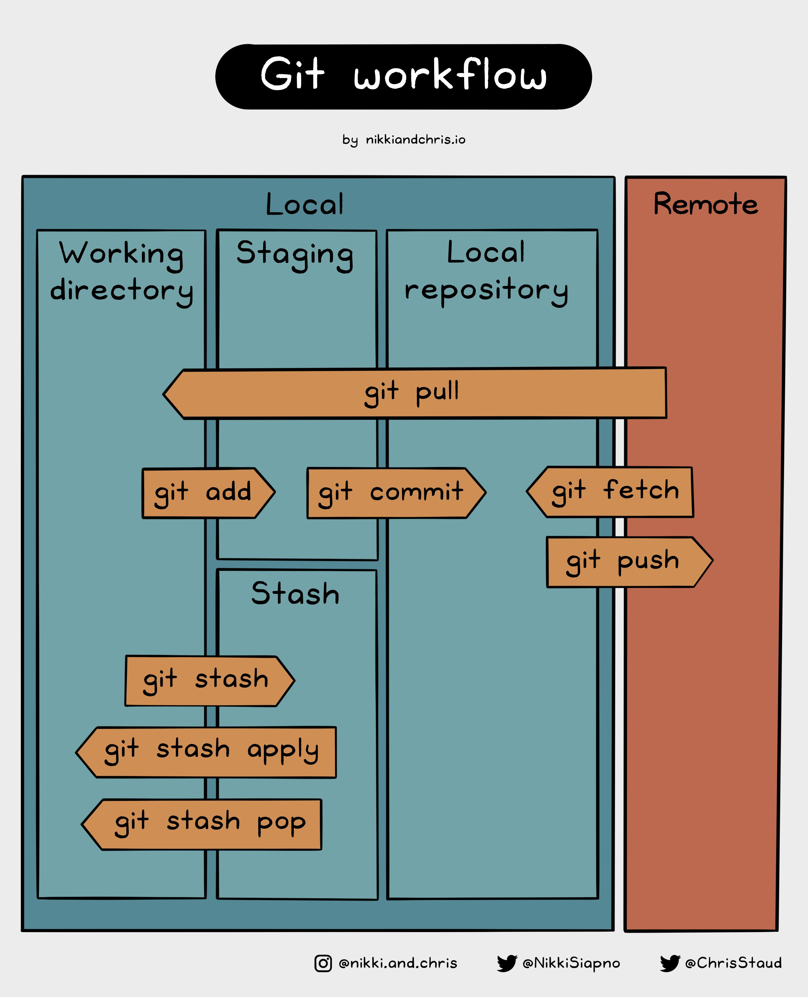
Git tools

