Slide 1
Overview & Topic 1: Basis for command lines Bioinformatics Applications (PLPTH813)
Welcome to Bioinformatics Applications Spring 2025
Sanzhen Liu
1/21/2025

Slide 2
Goals
The course will cover the basic computational skills, principles of regular bioinformatics applications and emphasize the practice of bioinformatics.
Computational skills
Computational algorithms
Biological applications

Slide 3
Course materials are online
Course site at GitHub
https://github.com/liu3zhenlab/teaching/tree/master/PLPTH813Bioinformatis/2025
Course information
Lecture slides
Labs files
K-State Canvas

Slide 4
Lecture topics
Basic Unix
Basic R, Python
Introduction of NGS and NGS bioinformatics tools
NCBI tools
DNA and protein sequence alignments
Genome variants
Phylogeny
QTL and GWAS, Genomic selection
Protein structure – Alphafold3
Genome assembly
Comparative genomics
RNA-seq, scRNA-seq
Applications of LLM

Slide 5
Grading
Grading
Participation 5%, Homework 30%, Midterm Exam 20%, Project 15%, final Exam 30%
Two exams
Midterm (March 13th, 10:30-12:20 Th4031)
Final exam (May 15th, 9:40-11:30am Th4031)
Notes:
5/15/2025, Thursday
9:40AM - 11:30AM
Throckmorton 4031

Slide 6
topic I – basis for command-line analysis
Formats of text data files
Excel to generate a text file and tips in Excel
BBEdit (Mac) / Notepad++ (PC): text editor
Regular expression
vi: another text editor

Slide 7
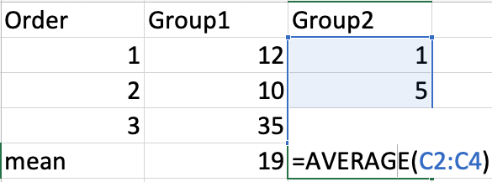
Reasons for command-line analyses
To perform efficient and reproducible data analyses
To use advanced tools in research projects (most genomic software packages are run in the Unix system)
To access to powerful computer servers (e.g., Beocat)
R program:
mean(group1)
mean(group2)

Slide 8
flat file (text file)
# | ASCII | # | ASCII | # | ASCII | # | ASCII
0 | null | 32 | space | 64 | @ | 96 | `
1 | start of header | 33 | ! | 65 | A | 97 | a
2 | start of text | 34 | " | 66 | B | 98 | b
3 | end of text | 35 | # | 67 | C | 99 | c
4 | end of transmission | 36 | $ | 68 | D | 100 | d
5 | enquire | 37 | % | 69 | E | 101 | e
6 | acknowledge | 38 | & | 70 | F | 102 | f
7 | bell | 39 | ' | 71 | G | 103 | g
8 | backspace | 40 | ( | 72 | H | 104 | h
9 | horizontal tab | 41 | ) | 73 | I | 105 | i
10 | linefeed | 42 | * | 74 | J | 106 | j
11 | vertical tab | 43 | + | 75 | K | 107 | k
12 | form feed | 44 | , | 76 | L | 108 | l
13 | carriage return | 45 | - | 77 | M | 109 | m
14 | shift out | 46 | . | 78 | N | 110 | n
15 | shift in | 47 | / | 79 | O | 111 | o
16 | data link escape | 48 | 0 | 80 | P | 112 | p
17 | device control 1/Xon | 49 | 1 | 81 | Q | 113 | q
18 | device control 2 | 50 | 2 | 82 | R | 114 | r
19 | device control 3/Xoff | 51 | 3 | 83 | S | 115 | s
20 | device control 4 | 52 | 4 | 84 | T | 116 | t
21 | negative acknowledge | 53 | 5 | 85 | U | 117 | u
22 | synchronous idle | 54 | 6 | 86 | V | 118 | v
23 | end of transmission block | 55 | 7 | 87 | W | 119 | w
24 | cancel | 56 | 8 | 88 | X | 120 | x
25 | end of medium | 57 | 9 | 89 | Y | 121 | y
26 | end of file/ substitute | 58 | : | 90 | Z | 122 | z
27 | escape | 59 | ; | 91 | [ | 123 | {
28 | file separator | 60 | < | 92 | \ | 124 | |
29 | group separator | 61 | = | 93 | ] | 125 | }
30 | record separator | 62 | > | 94 | ^ | 126 | ~
31 | unit separator | 63 | ? | 95 | _ | 127 | DEL
Simple format, consisting of readable characters
ASCII (American Standard Code for Information Interchange, 128 characters)
No rich format control (e.g. bold or Italics, etc)
Easy for sharing

Slide 9
File formats
tab
Tab separated file (.txt)
name age >30? gender
Josh 23 FALSE male
Rose 35 TRUE female
Comma-separated file (.csv)
name,age,>30?,gender
Josh,23,FALSE,male
Rose,35,TRUE,female
FASTA (.fa, .fas, .fasta)
>Aa1
CCATCTCATCCCTGCGTGTCTCCGAAG
>Aa2
CTGAGTCGGAGACACGCAGGGAT
End of line

Slide 10
Newline – end of line (EOL)
Two types of EOL: linefeed (LF) and carriage return (CR):
LF: \n
CR: \r
• LF: Unix, Linux, OS X
• CR: Mac OS up to version 9 and OS-9
• CR+LF: Microsoft Windows
http://en.wikipedia.org/wiki/Newline
# | ASCII
10 | linefeed
13 | carriage return

Slide 11


Software for text editing

Slide 12
Text editors
Notepad or Notepad++ (PC)
TextEdit (Mac)
BBEdit (Mac)
vi (Unix and Linux)
Emacs
Atom
Powershell
Word (PC and Mac): save as …
Excel (PC and Mac): save as …

Slide 13
Outline
Formats of text data files
Excel to generate a text file and tips in Excel
BBEdit (Mac) Notepad++ (PC): text editor
Regular expression
vi: another text editor

Slide 14
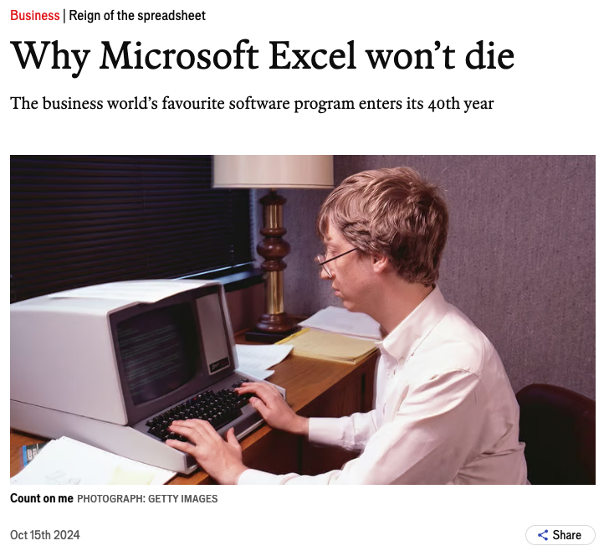
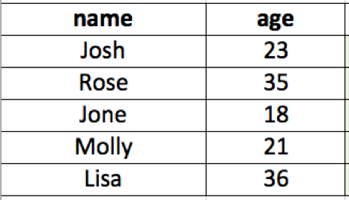
Excel to generate a text file
copy and paste to a text editor (e.g. vi)
save as …
40 years!
economics.com

Slide 15
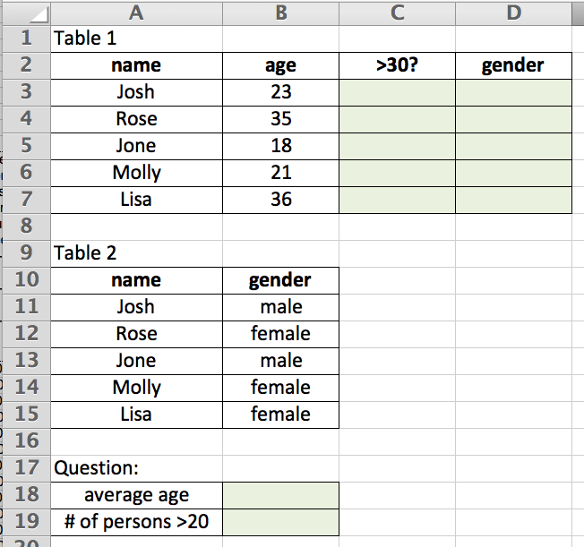
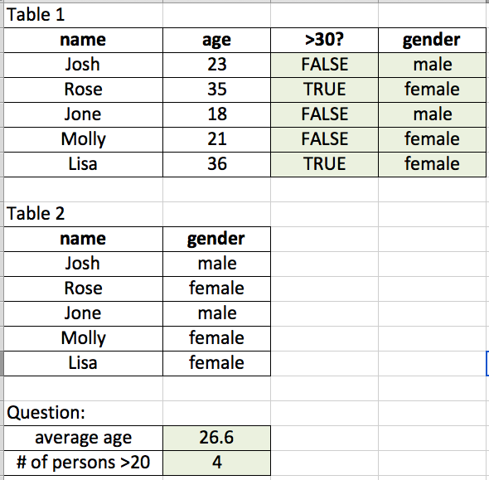
Excel function - examples
Q1: =AVERAGE(B3:B7)
Q2: =COUNTIF(B3:B7, ">20")
Q3: =B3>30
Q4: search information at Table 2
1. define the Table 2: gender (control + l)
2. =VLOOKUP(A3, gender, 2, FALSE)
Q3 Q4
Q1
Q2
VLOOKUP(What you want to look up, where you want to look for it, the column number in the range containing the value to return, Approximate or Exact match – indicated as 1/TRUE, or 0/FALSE).
XLOOKUP?

Slide 16

Useful functions in Excel
max/min/average/sum
len/left/right
if/countif
>, <, =
& (concatenate)
vlookup
Functions can be combined.

Slide 17
Problem 1
Replace the words containing “genome” with “XXX” regardless of cases.
Genome old and new charted the emergence of agriculture. Contemporary Europeans carry DNA inherited from light-skinned, brown-eyed farmers who migrated from the Middle East beginning 7,000–8,000 years ago, in addition to more-ancient ancestry. The achievements of these early farmers — domestication of crops such as wheat and barley — are also being understood through genome sequencing.
Which software and what trick will you use?

Slide 18
Problem 2
Replace the words containing “genome” with “XXX” regardless of letter case (e.g., Genome = genome = genomes = Genomes).
Genomes old and new charted the emergence of agriculture. Contemporary Europeans carry DNA inherited from light-skinned, brown-eyed farmers who migrated from the Middle East beginning 7,000–8,000 years ago, in addition to more-ancient ancestry. The achievements of these early farmers — domestication of crops such as wheat and barley — are also being understood through genome sequencing. In July, a consortium reported a draft copy of the gargantuan wheat genome, which contains 124,000 genes and 17 billion nucleotides. Another group released the genomes of 3,000 rice varieties. - Science 2014
Which software and what trick will you use?

Slide 19
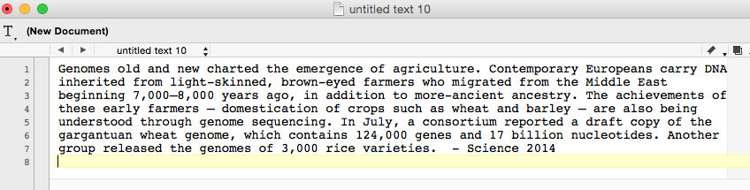
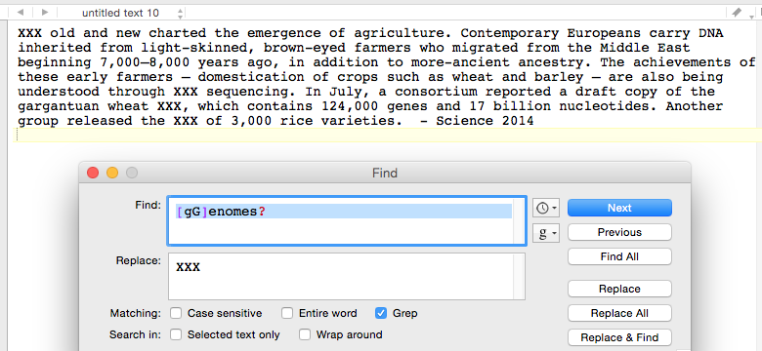
BBEdit
A flexible text editor with powerful functions of searching and editing.

Slide 20
Regular expression
Regular expression (regex or regexp) is a sequence of characters that forms a search pattern.
Search Genome or genomes:
[gG]enomes?
[] : a single character of a range indicated in the square brackets
?: no matches or just one match

Slide 21
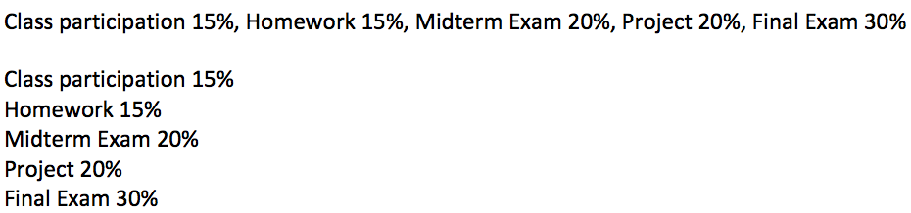
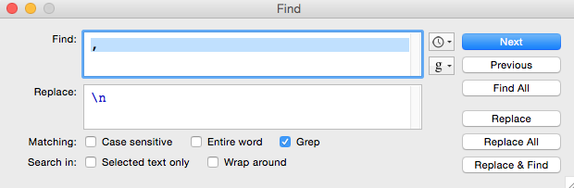
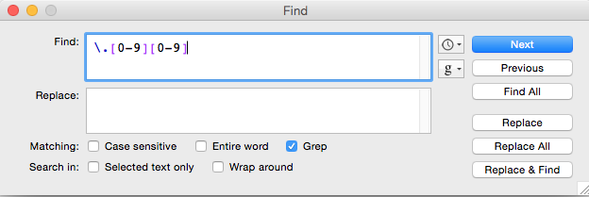
BBEdit – more examples
\n: end of line character (line separator)
Class participation 15.01%, Homework 15.03%, Midterm Exam 20.10%, Project 20.10%, Final Exam 30.01%
\.[0-9][0-9]
\.: the character of “.”
. : any character

Slide 22
More regex characters
Wildcard
\w : letters, numbers, and _
. : any character except \n \r
? : no matches or just one match
+ : one or more matches
* : any character
\d : numerical digits
\t : Tab
\r : return; also used as the generic end-of-line in BBEdit
\n : line-feed character; also used as the generic end-of-line in Notepad++
\s : space, tab, or end of line
[A-Z]: a single character of the ranges indicated in square brackets
[^A-Z]: a single character including all characters not in the brackets.
Note that this will include \n unless otherwise specified.
^ : match the start of the line, i.e., the position before the first character
$ : match the last position before the end-of-line character
Notes:
Caret

Slide 23
Regular expression (I)
\t : a tab character
\r (or \n): end-of-line
Potato apple orange
Regexp | Replace
\t | \n
Potato,apple,orange
Potato
apple
orange
Regexp | Replace
, | \t

Slide 24
Regular expression (II)
^ beginnings
$ endings
Potato
apple
orange
Potato
apple
orange
Regexp | Replace
^ | -
Regexp | Replace
$ | s
-Potato
-apple
-orange
Potatos
apples
oranges

Slide 25
Regular expression (III)
\w a word character, including letters, numbers and underscore
\d : numerical digits
I have 5 apples.
I have 5 apples.
Regexp | Replace
^\w | We
Regexp | Replace
\d | a lot of
We have 5 apples.
I have a lot of apples.

Slide 26
Regular expression (IV)
+ : 1 or more previous regular expression
? : 0 or 1 previous regular expression
. : any character except \n \r
potato,apple,orange
potato,apple,orange
potato,apple,orange
Regexp | Replace
p+ | -
Regexp | Replace
p? | -
Regexp | Replace
p. | -
-otato,a-le,orange
--o-t-a-t-o-,-a---l-e-,-o-r-a-n-g-e
-tato,a-le,orange

Slide 27

Regular expression
A Adenine A
C Cytosine C
G Guanine G
T Thymine T
W Weak A/T
S Strong C/G
M Amino A/C
K Keto G/T
R Purine A/G
Y Pyrimidine C/T
B Not A C/G/T
D Not C A/G/T
H Not G A/C/T
V Not T A/C/G
N Any A/C/G/T
[A-Z] : any single letter
[AG]CATG[CT]
NspI
Notes:
POSIX: Portable Operating System Interface

Slide 28
Regular expression (V)
{} : specify a range of numbers to repeat the match of the immediately preceding character.
Poly A (12 A in a row)
A{12}
Poly A (10-12 A in a row)
A{10,12}
Poly A (>=10 A in a row)
A{10,}
Notes:
POSIX: Portable Operating System Interface

Slide 29
Regular expression (VI)
|
|: or
hello|hi
Match either hello or hi in the text
Notes:
POSIX: Portable Operating System Interface

Slide 30
Questions
K-[Ss]tate|KSU
^[AGCT]+

Slide 31
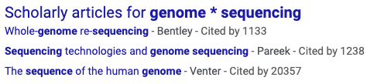
Regular expression
Regular expression is for pattern searches
It is commonly employed in programming languages
The rules vary depending on the specific implementation (or programming languages or versions) in use.
Does Google provide search with regular expressions?
"genome * sequencing"

Slide 32
Outline
Formats of text data files
Excel to generate a text file and tips in Excel
BBEdit (Mac) Notepad++ (PC): text editor
Regular expression
vi: another text editor

Slide 33
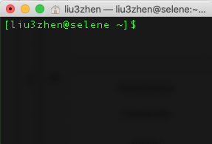
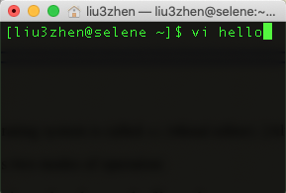
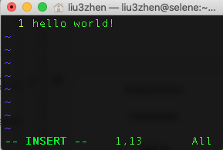
vi is a text editor created for the Unix operating system. - fast and powerful
In a Unix/Linux system, any “words” typed are commands
What can we do if we need to type data or codes?
vi is a command to execute a program

Slide 34
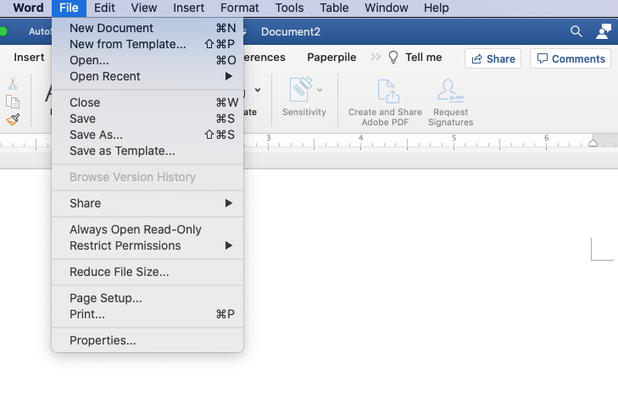
vi
vi has two modes:
insert mode (edit as other text editors)
command mode (commands that control the edit session).
switch modes by using “i” and “ESC” key
Your keyboard controls
“everything”.

Slide 35
Actions in command mode
Search: to search content using “/”
/<text or regular expression>
Delete contents for example by lines
Copy and paste

Slide 36
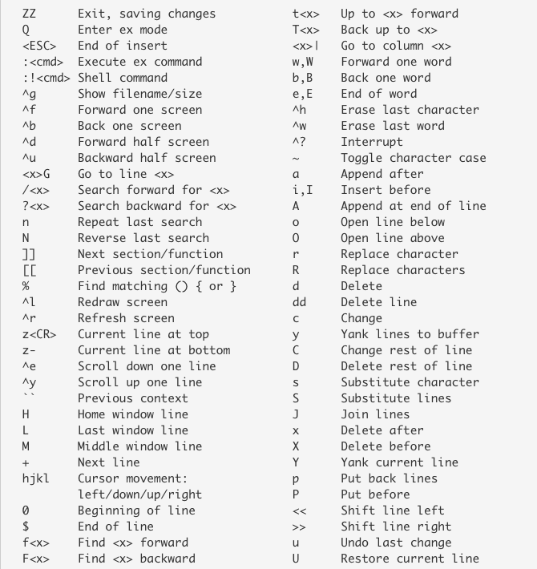
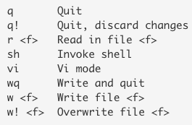
Command list
exit commands
https://kb.iu.edu/d/afdc

