Slide 1
Genomic variants Bioinformatics Applications (PLPTH813)
Sanzhen Liu
4/3/2025

Slide 2
To-do analysis
Discover variants of two E. coli strains DH10B and MG1655 relative to a reference genome
Reference genome: K-12 MG1655
Illumina data sets: DH10B and MG1655

Slide 3
GATK pipeline
Alignment of sequences to a reference genome
GATK variant calling

Slide 4
Data downloading
# go to your lab directory
cd xxx (e.g., labs)
# download today’s lab data
wget https://people.beocat.ksu.edu/~liu3zhen/PLPTH813/labs/variants.tar.gz
# a tar file will be downloaded
# unfold the file
tar -xf variants.tar.gz

Slide 5
Data
# E.coli K-12 MG1655 reference
./references
Ecoli_k12_MG1655.fasta
# example reads data:
./data
DH10B.10.pair1.fq
DH10B.10.pair2.fq
MG1655.10.pair1.fq
MG1655.10.pair2.fq
# Alignment data:
./data
DH10B.parse.bam
DH10B.parse.bam.bai
MG1655.parse.bam
MG1655.parse.bam.bai

Slide 6
Reference indexing
In directory "bwa"
### indexing the reference
module load BWA
bwa index Ecoli_k12_MG1655.fasta
Notes:
[bwa_index] Pack FASTA... 0.10 sec
[bwa_index] Construct BWT for the packed sequence...
[bwa_index] 1.86 seconds elapse.
[bwa_index] Update BWT... 0.03 sec
[bwa_index] Pack forward-only FASTA... 0.03 sec
[bwa_index] Construct SA from BWT and Occ... 0.64 sec
[main] Version: 0.7.17-r1188
[main] CMD: bwa index Ecoli_k12_MG1655.fasta
[main] Real time: 2.968 sec; CPU: 2.666 sec

Slide 7
BWA alignment – DH10B reads
In directory "bwa"
### alignment
ref=Ecoli_k12_MG1655.fasta
pe1=DH10B.10.pair1.fq
pe2=DH10B.10.pair2.fq
bwa mem -T 40 -R '@RG\tID:S1\tSM:DH10B' \
$ref $pe1 $pe2 \
1>DH10B.sam 2>DH10B.log

Slide 8
Problem: BWA alignment – MG1655 reads
In directory "bwa"
Please modify to code for alignments of MG1655 reads
### alignment
ref=Ecoli_k12_MG1655.fasta
pe1=DH10B.10.pair1.fq
pe2=DH10B.10.pair2.fq
bwa mem -T 40 -R '@RG\tID:S1\tSM:DH10B' \
$ref $pe1 $pe2 \
1>DH10B.sam 2>DH10B.log

Slide 9
SAM to BAM – DH10B
In directory "bwa"
module load SAMtools
# convert SAM to BAM:
samtools view -bS DH10B.sam > DH10B.tmp.bam
# convert SAM to BAM:
samtools sort -o DH10B.bam DH10B.tmp.bam
# Index sorted BAM:
samtools index DH10B.bam
# cleanup
rm DH10B.tmp.bam

Slide 10
SAM to BAM – MG1655
In directory "bwa"
module load SAMtools
# convert SAM to BAM:
samtools view -bS DH10B.sam > DH10B.tmp.bam
# convert SAM to BAM:
samtools sort -o DH10B.bam DH10B.tmp.bam
# Index sorted BAM:
samtools index DH10B.bam
# cleanup
rm DH10B.tmp.bam

Slide 11
Examine alignments
module load SAMtools
samtools flagstat ./data/DH10B.parse.bam
samtools flagstat ./data/MG1655.parse.bam
936747 + 0 in total (QC-passed reads + QC-failed reads)
0 + 0 secondary
2 + 0 supplementary
0 + 0 duplicates
936747 + 0 mapped (100.00%:-nan%)
936745 + 0 paired in sequencing
471775 + 0 read1
464970 + 0 read2
933933 + 0 properly paired (99.70%:-nan%)
934412 + 0 with itself and mate mapped
2333 + 0 singletons (0.25%:-nan%)
0 + 0 with mate mapped to a different chr
0 + 0 with mate mapped to a different chr (mapQ>=5)
In directory "variants"
tips: samtools flags 147
PAIRED,PROPER_PAIR,REVERSE,READ2

Slide 12
Prior to GATK, the reference genome needs to be indexed
# cd references
### indexing
module load SAMtools
samtools dict Ecoli_k12_MG1655.fasta > Ecoli_k12_MG1655.dict
samtools faidx Ecoli_k12_MG1655.fasta
In directory "references"
Check the output

Slide 13
HaplotypeCaller of GATK4
USAGE: HaplotypeCaller [arguments]
Call germline SNPs and indels via local re-assembly of haplotypes
Required Arguments:
-I:String BAM/SAM/CRAM file containing reads.
-O:String File to which variants should be written.
-R:String Reference sequence file.

Slide 14
GATK to SNP discovery
### using HaplotypeCaller from GATK
# cd GATK
module load GATK
gatk HaplotypeCaller \
--java-options '-Xmx8G' \
-R ../references/Ecoli_k12_MG1655.fasta \
-I ../data/DH10B.parse.bam \
-I ../data/MG1655.parse.bam \
-ploidy 1 \
-O variants.raw.vcf &>variants.log
In directory "GATK"
Notes:
4-5 min to finish

Slide 15
Variant filtering
In directory "GATK"
gatk SelectVariants \
-R ../references/Ecoli_k12_MG1655.fasta \
-V variants.raw.vcf \
-select 'QD >= 10.0' \
-select 'DP >= 10.0' \
--restrict-alleles-to BIALLELIC \
-select-type SNP \
-O selected.snp.vcf &>selected.log
INFO:AC=1;AF=0.500;AN=2;BaseQRankSum=1.125;DP=39;FS=16.048;MLEAC=1;MLEAF=0.500;MQ=60.00;MQRankSum=0.000;QD=29.53;ReadPosRankSum=-0.506;SOR=1.023
for example: QD: Variant Confidence/Quality by Depth
Notes:
-select-type:Type
Select only a certain type of variants from the input file This argument may be specified
0 or more times. Default value: null. Possible values: {NO_VARIATION, SNP, MNP, INDEL,
SYMBOLIC, MIXED}
10.0 worked but 10 did not work; strang
--restrict-alleles-to:NumberAlleleRestriction
Select only variants of a particular allelicity Default value: ALL. Possible values:
{ALL, BIALLELIC, MULTIALLELIC}

Slide 16
VCF to table
In directory "GATK"
gatk VariantsToTable \
-V selected.snp.vcf \
-R ../references/Ecoli_k12_MG1655.fasta \
-F CHROM -F POS -F REF -F ALT \
--genotype-fields "GT" \
-O selected.snp.txt &>var2table.log
# Input: VCF
# Output: a table format
# Fields: CHROM POS REF ALT DH10B.GT MG1655.GT

Slide 17
IGV installation
Download the software:
https://software.broadinstitute.org/software/igv/download
Ondemand for data transferring
- reference genome
- bam (bam.bai) files
- vcf files

Slide 18
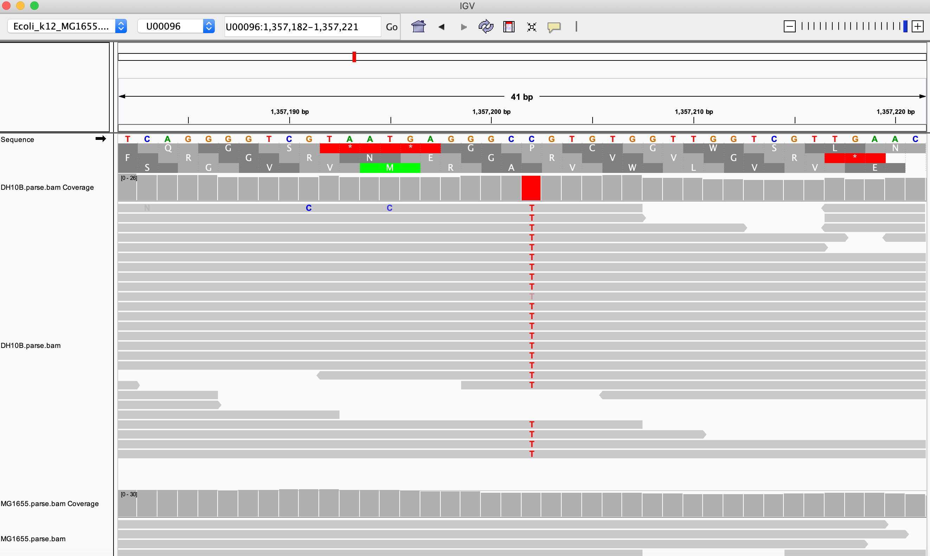
IGV to check a SNP site
U00096:1357202

Slide 19
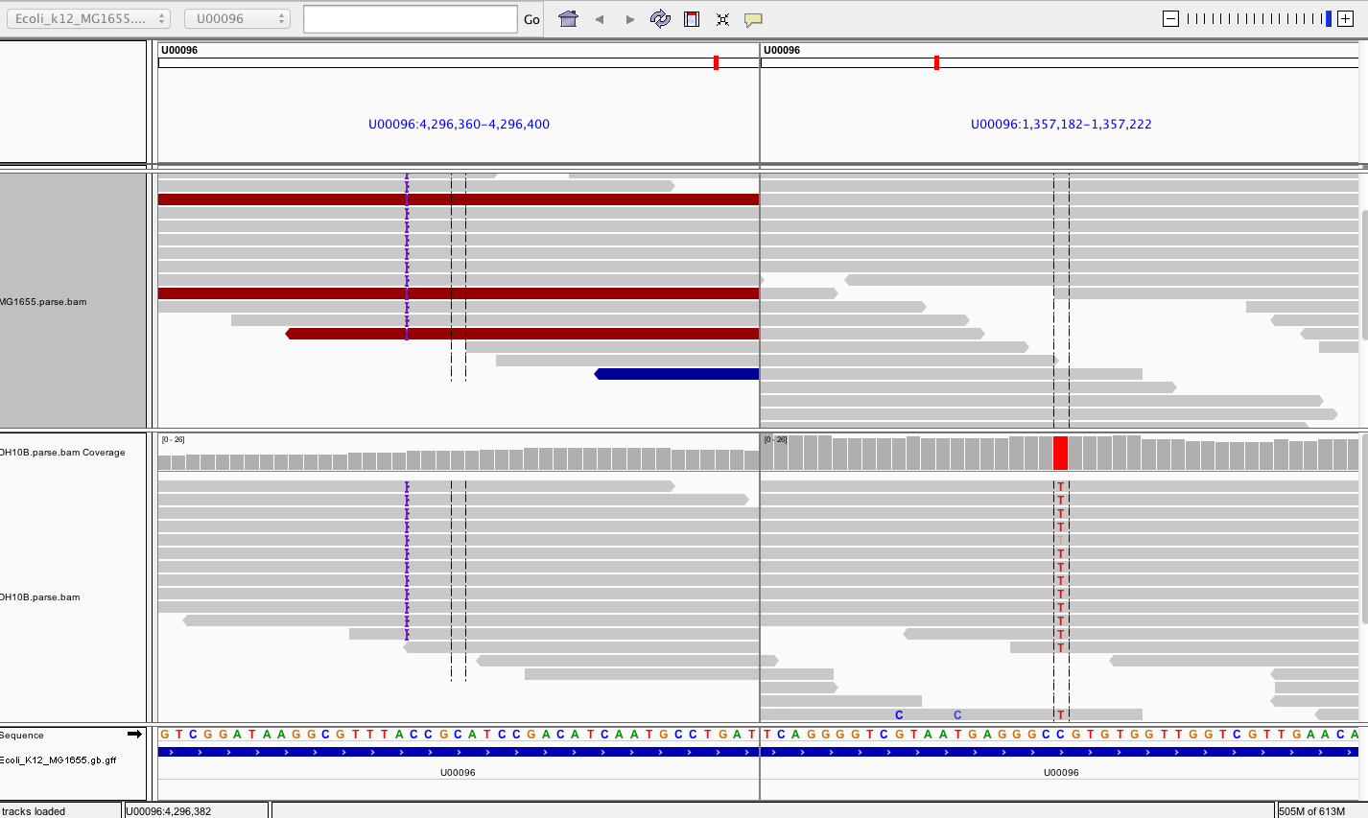
IGV to check alignment at two regions
U00096:xxxxxx U00096: xxxxxxx (separated by a blank space)

