Slide 1
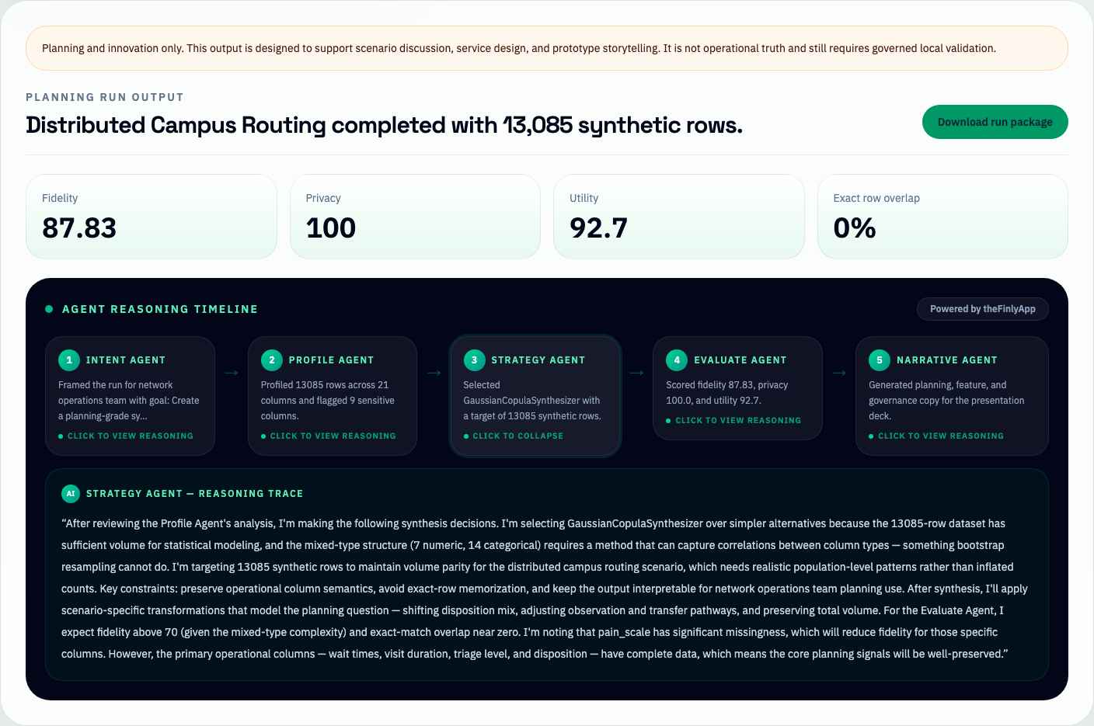
METHODOLOGY
1/3
From Public ED Data To Southlake Future-State Planning Scenarios
Core Message
We turn safe public ED data into synthetic planning artifacts for Southlake's distributed-health-network questions, then make the limitations visible. Reasoning supported by TheFinlyApp — an agentic intelligence platform adapted for healthcare planning.
Agentic synthetic data workflow for distributed-health-network planning questions.
Input
Curated public ED dataset used as a safe planning stand-in.
Agent Flow
Goal framing -> profile -> plan -> generate -> evaluate -> caution report.
Southlake Lens
Distributed campus routing, community diversion, growth, and surge scenarios.
Outputs
Synthetic dataset, metrics dashboard, caution summary, export ZIP, pitch artifacts.
Planning questions: campus routing | observation demand | transfer pathways | closer-to-home care
Message for judges: the product is not only about generating rows; it is about making synthetic planning data usable and governed.

Slide 2
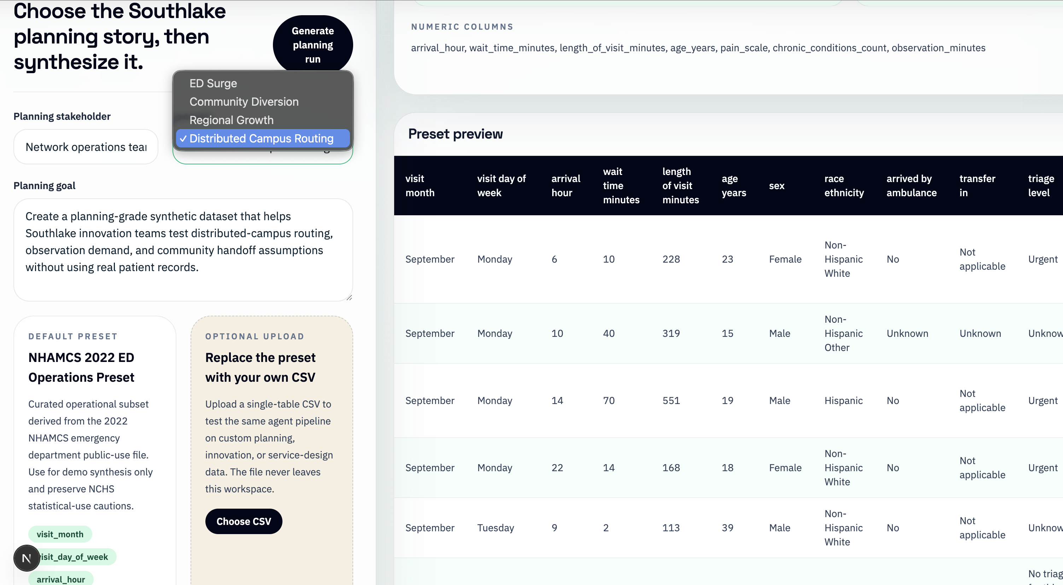
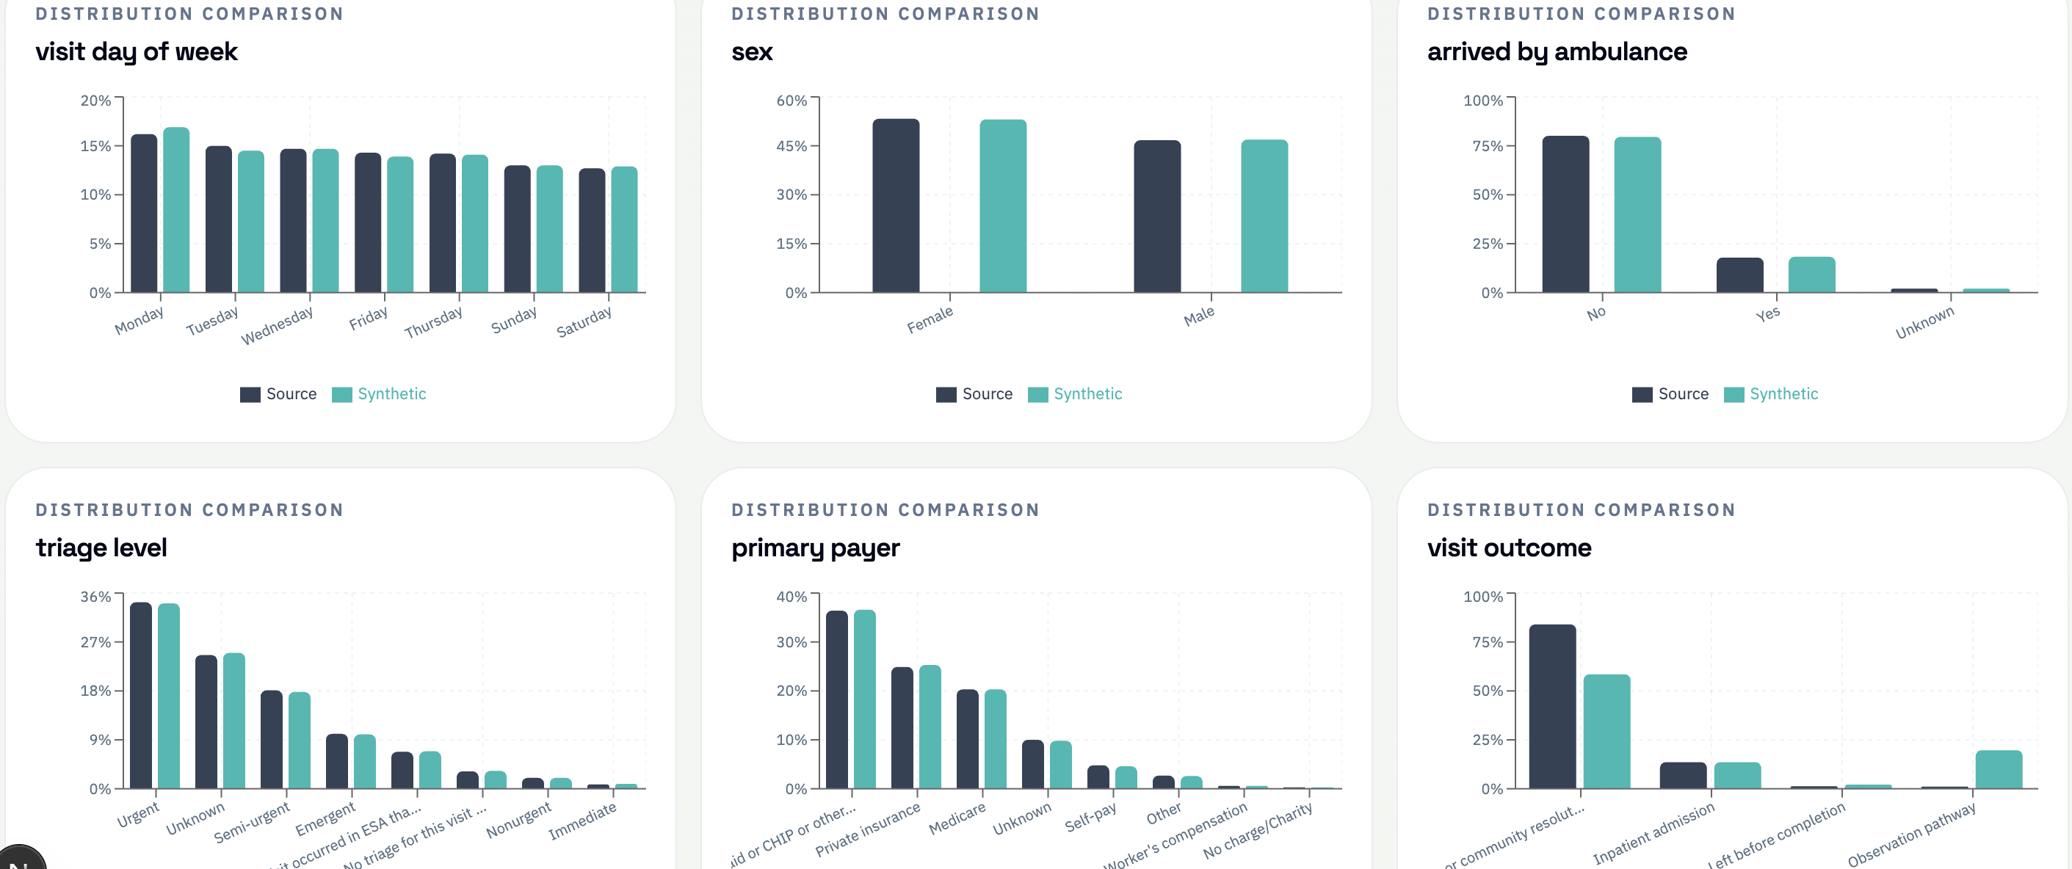
FEATURES
2/3
What The Studio Actually Does
Visible evaluation, synthetic data output, and exportable artifacts — the studio shows its work at every step.
Feature Highlights
Per-column fidelity scoring — numeric and categorical columns evaluated separately with clear visual breakdown
Source-vs-synthetic distribution charts show how well the generated data preserves real ED patterns
Side-by-side data preview lets planners compare source and synthetic rows directly
Exportable evaluation package — synthetic dataset, metrics, caution report, and pitch artifacts in one ZIP
Caption
Pitch note: judges can see both the data product and the explanation product, with a reliable saved-run path if live generation is slow.
Caption

Slide 3
CAUTIONS
3/3
What The Studio Is Safe For, And What It Is Not
Synthetic data is useful for planning and experimentation, but it is not local operational truth.
Good For
Planning, innovation, and prototyping conversations
Scenario workshops about distributed-campus routing and community diversion
Testing dashboards, workflows, and early-stage analytics without real patient records
Pitch-day storytelling backed by metrics, cautions, and exportable artifacts
Not Ready For
Clinical care, staffing commitments, reimbursement, or patient-level action
Claims about Southlake's real patient mix or operational truth from a U.S. public-use source
A full hospital digital twin or a validated multi-table operational model
Production use without governance, privacy review, and validation on governed local data
Best next step: validate the workflow with governed Southlake data, operational owners, and formal privacy review.
Credibility note: this caution slide is a strength. It shows the team understands healthcare risk and is not overselling the prototype.

