Slide 1

Network for Earthquake Engineering Simulation (NEES) Design Review
2/21/2012
ARMS 1098B
NEES Team

Slide 2
Agenda
Introduction
Overview of NEES
Clients needs and requirements
Project overview
Project 1: Interface
Project 2: Shake Table
Open Discussion
NEES Team

Slide 3
Team Overview: Organization
Team Leader
Amit Soni
Project 1:
Interface
Project 2:
Shake Table
Project Leader
Hamza Khan
Project Leader
Bilal Khan
Christopher Kidwell
Benjamin Eng
Steven Bogenschutz
Mohammed Faizan Azam
NEES Team

Slide 4

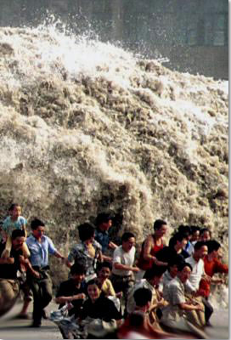
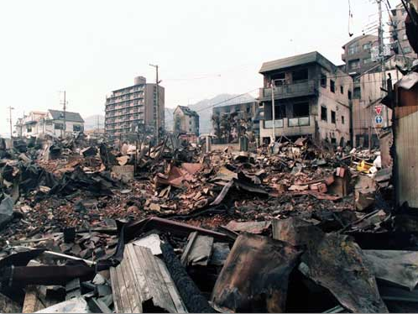

Project Partner
NEES
What is NEES?
What does NEES do?

Slide 5
NEES Network for Earthquake Engineering Simulation
Develop software tools and database for research purposes
Accelerate innovations in infrastructure design and construction practices
Promote communication among researchers around the world
Reduce cost and minimize damage during earthquakes and tsunamis

Slide 6
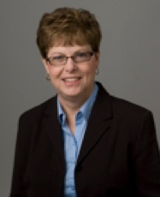
Our clients from NEES
Pamela McClure
NEEScomm Instructional Designer
Network for Earthquake Engineering
Simulations, NEES
207 S. Martin Jischke Dr, Suite 301
West Lafayette, In 47907
Phone: 765.496.3134
Email: pmcclure@purdue.edu

Slide 7
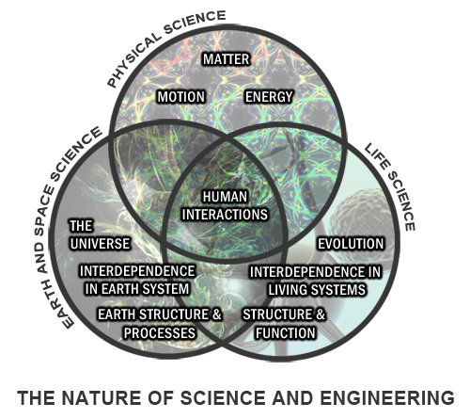

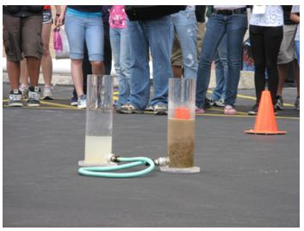
Curernt Client
NEES Education Outreach and Training (EOT)

Slide 8
EOT
Goals: - raise awareness of earthquake engineering
- Bring sciences and engineering to classroom - raise students interest in pursuing a career of earthquake engineering and science
8

Slide 9
EPICS Project Spring 2012
MYOE - make your own earthquake
Use QCN accelerometer and other available educational materials
Developed and tested by personnel at UCSB for use in classroom settings where children jump up and down to create vibrations that are captured and displayed on a computer screen and/or printer.
Notes:
Add pictures and video

Slide 10
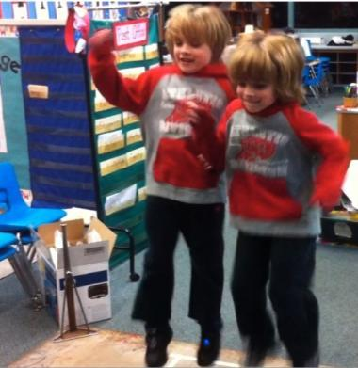
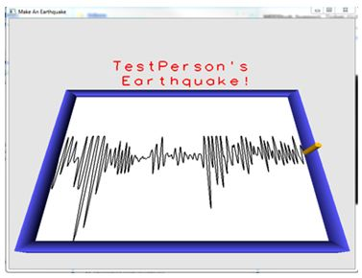
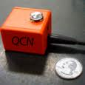
Current Make Your Own Earthquake System
PC Display
PC
Platform w/ accelerometer
NEES Team

Slide 11
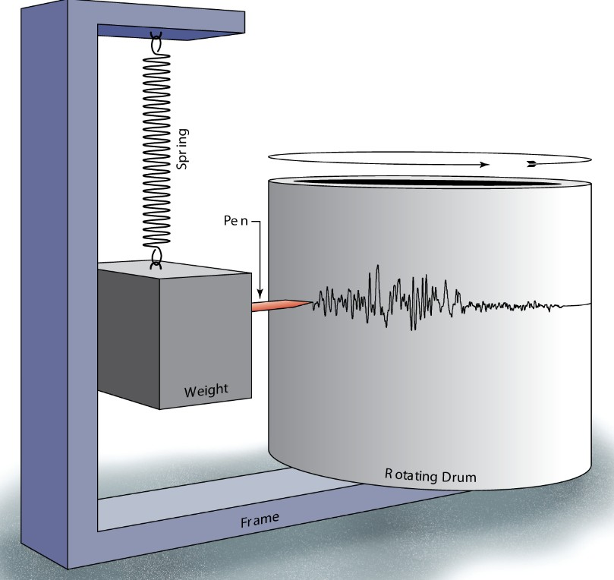
MYOE
Simple concept !
Record the viberation

Slide 12
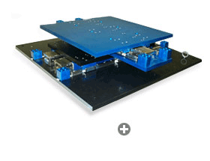
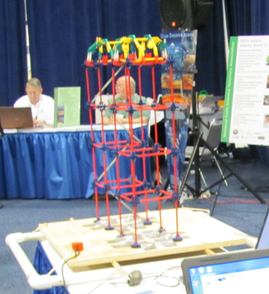
Shake Table
Current use of ST
-doing demo dynamics motion characteristic
-design compeition
Constraints –expensive, immobile,
Notes:
Shake table
video

Slide 13
EPICS-NEES-Spring 2012
Our Goal: Enhancing the Make-Your-Own-Earthquake (MYOE) exhibit
expand and enhancing the use of this module
find new ways to use these materials to teach more earthquake engineering concepts.
Make experience more interactive and memorable
Modular design for future enhancement and reusability
More FUN for kids!
NEES Team

Slide 14
Enhancement for the MYOE
Physical Models
Visual Display
Mounting Mechanism
User Interface
Controller
Shaking Platform
Jumping Platform
Sensor Input QNC?
Motion Mechanism

Slide 15
Enhancement for the MYOE
Physical Models
Visual Display
User Interface
Mounting Mechanism
Controller
Jumping Platform
Sensor Input QNC?
Shaking Platform
Motion Mechanism

Slide 16
Enhancement for the MYOE
Physical Models
Visual Display
Mounting Mechanism
User Interface
Controller
Interface
Shaking Platform
Jumping Platform
Sensor Input QNC?
Motion Mechanism

Slide 17
Enhancement for the MYOE
Wireless user Interface
Physical Models
Visual Display
Mounting Mechanism
User Interface
Shake Table
Controller
Shaking Platform
Jumping Platform
Sensor Input QNC?
Wireless Sensor Input
Motion Mechanism

Slide 18
Epics NEES Interface Team
Jingye Liu
Dongyang Fu
Zachary Golden
Andrew Grosinger
Nikhilgandhi Manojkumar

Slide 19
Introduction
Overview
Accelerometer
Microcontroller
Driver Circuit
User Interface

Slide 20
Overview
Visual Feedback
Mount/
house
Mount/
house
Mount/
Housing
Mounting
Input requests
Sensor
microC
Low current
signal
Motor driver
High current
Motor
Power
Power
Position Sensor
Power

Slide 21
function | Means 1 | Means 2 | Means 3 | Means
Sensor | QNC | Analog 1 | WII
microC | Arduino | PIC series | Hand built
Motor Driver | Purchase 1 | Purchase 2 | Hand built
Motor
Position sensor | Limit switch | Potentiometer on motor shaft
Input requests Frequency/Amplitude Mode Selection Run/Stop | Computer keyboard | Potentiometer | switches
Visual Feedback | Computer screen | LCD | LEDS | lights
DC Power supplies | Batteries | One for each device | Single - distributed
Interface housing
microC housing
Motor Drive housing
Power supply housing

Slide 22
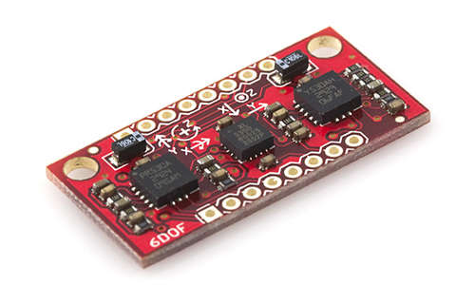
Accelerometer
QCN, Quake-Catcher Network
Measure acceleration from jump platform
Send signal to micro controller
Current
Alternative

Slide 23
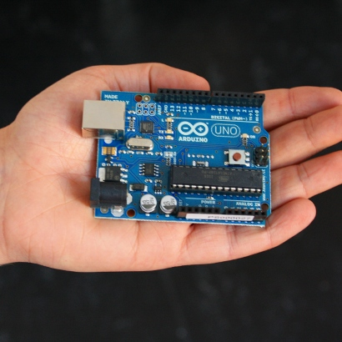
Microcontroller and Code
Receive Frequency from Accelerometer/Manual User Input
Convert Frequency to (PWM)
Send PWM to Driver Circuit
Control Direction of the Motor
Code in “Sketch”

Slide 24
Input request
Visual Feedback
Input requests
Mode
Run
Frequency
Amplitude
Earthquake type
Update Display
False
Run?
True
Calibrate start position
Mode Selection
(Mode)
Harmonic
Freq, Ampl
Historical
Earthquake type
Sensor Driven
Step request timing
Input request
False
Run?
True
Run=False
True
Limit hit?
False
Stepper motor drive logic

Slide 25
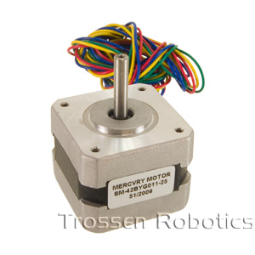
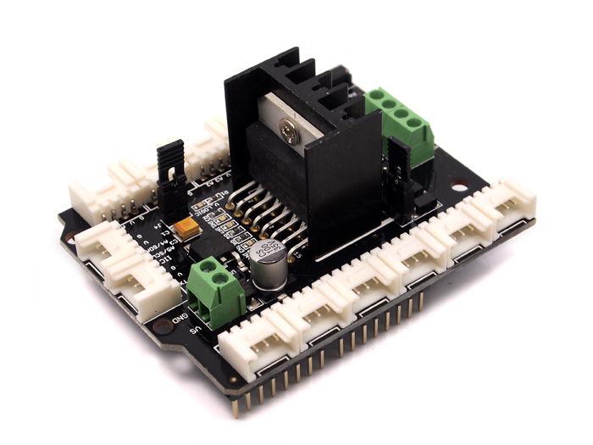
Driver Circuit
“Shake” the Table
Interface with Microcontroller
Stepper Motor

Slide 26

Motor Circuit Considerations
Needed Driver to Interface with Microcontroller
Needed 0.75W
Needed Small Size for Shake Table
Needed Stepper Motor
COST!!!!!!!!!!!!!!!!!!!!!! Am I right people?

Slide 27
Why We Chose This Motor
Ability to Interface With Microcontroller
Delivers Up to 4.3W
42.3 x 42.3 mm
Smooth Transitions
Very Inexpensive
Drivers and Motor: $45.00

Slide 28
Project Timeline – Interface Team
Tasks | Date | Duration (Days)
Research Stepper Motor and Driver System: | 1/9/2012 | 28
Review Program: | 1/31/2012 | 28
Test and Retest Stepper Motor Driver: | 1/31/2012 | 42
Test and Retest Program: | 2/14/2012 | 42
Test Entire System All Parts Put Together: | 3/20/2012 | 35

Slide 29
Timeline

Slide 30
Budget for Interface Team
Item | Description and Justification | Estimated Cost
Stepper Motor | This motor is required to move the table in a linear to an fro movement | $50
Driver | This is the driver system that controls the motor | $100

Slide 31
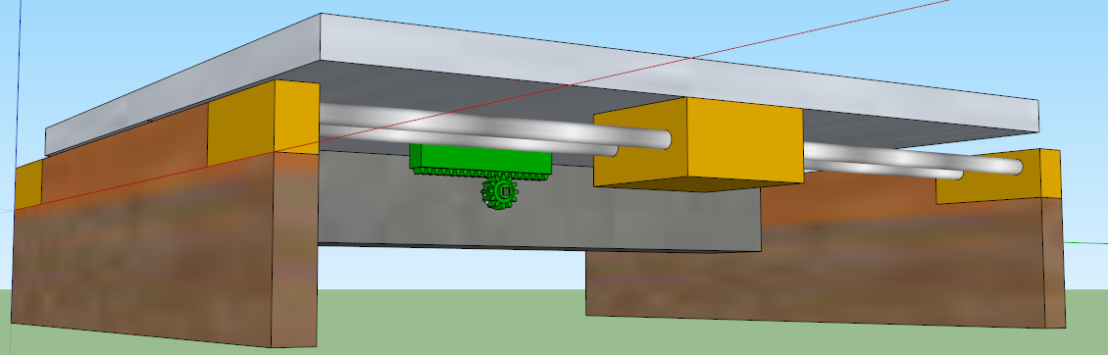
Shake Table
EPICS NEES
31

Slide 32

Introduction
Shake Table
Mohammed Faizan Azam
Amit Soni
Benjamin Eng
Bilal Khan
EPICS NEES
32

Slide 33
Project Background
Shake Table
Develop a simple shake table to simulate earthquake effects on structures for educational purposes.
Project began January 10, 2012
To develop an interactive and fun demonstration of earthquake effects.
Develop a shake table and an interface that works with the table
Stakeholder are NEES, School teachers and students that will use the table to learn.
EPICS NEES
33

Slide 34
Design Requirements
Shake Table
Shake table must be able to oscillate at different frequencies based on an input.
Come from basic requirements given and from implied requirements.
Will be met when final product performs as desired
Not yet complete
EPICS NEES
34

Slide 35
Engineering analysis and Changes
Performed engineering analysis to determine motor specifications
Decided to use two linear guides instead of one
Prevent uneven weight distribution
Prevent twisting
Moved position of the motor gear mounting.
Was connected to the guides
Moved to connect to the shake surface.
EPICS NEES

Slide 36
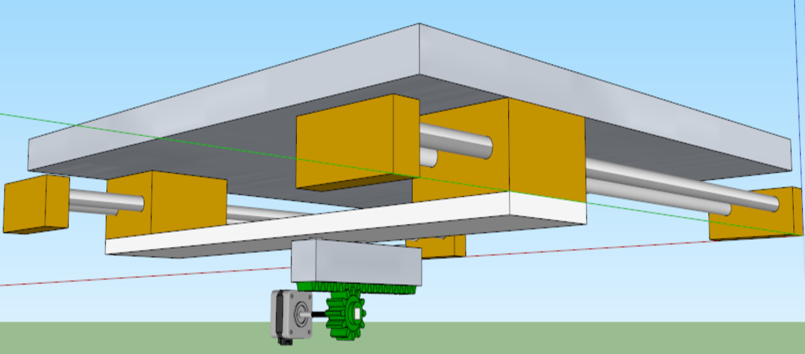

Slide 37
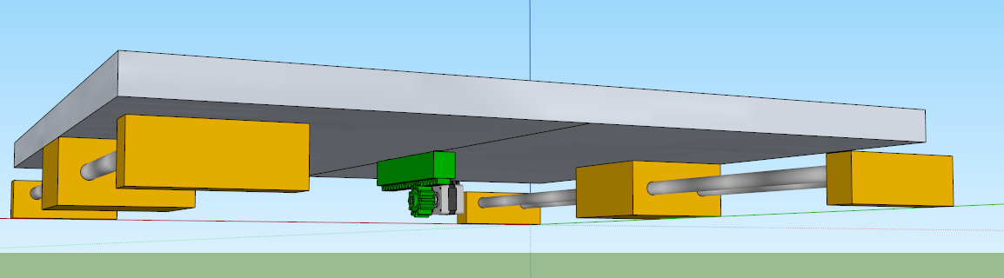

Slide 38
Safety
Concern of safety of moving parts
Designed box to prevent too much access.
Sliding surface will slide with little space for fingers.
Safety is constantly a factor.
EPICS NEES

Slide 40
Mounting the Motor
Connecting motor to slides.
With two slides:
How to connect the motor?
Used an aluminum L-bracket to mount motor
EPICS NEES

Slide 41
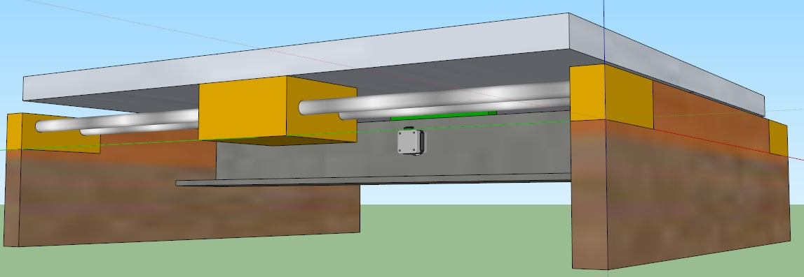

Slide 42
Next Phase
Decisions to move from one phase to the next
Final CAD approval and rendering
Parts ordered and received
Construction

Slide 43
Budget Information
Shake Table
Appendix C: Budget Report
Project : Shake Table
Item | Description and Justification | Estimated Cost
Stepper Motor | This motor is required to move the table in a linear to an fro movement | $50
Driver | This is the driver system that controls the motor | $100
Linear Guide System | Platform will be mounted on this guide and a motor will be attached | $100
Rack and Pinion | This gear will be attached to the motor and linear guide | $50
Total |  | $300
EPICS NEES
43

Slide 44
Discussion of future plans
Shake Table
Finishing final designs of the table.
Modfied gear mount.
Add the box that will surround equipment
Order parts
Construct prototype
Troubleshoot and refine
Test
Estimated delivery date.
April 30, 2012
EPICS NEES
44

Slide 45
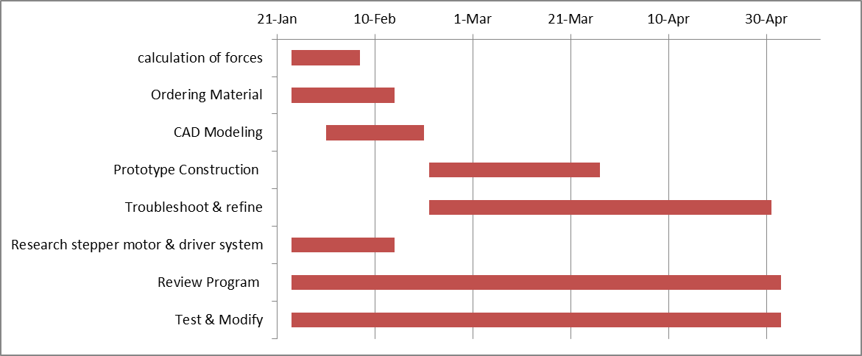
Discussion of future plans
EPICS NEES

Slide 46
Questions?
EPICS NEES

