Slide 1
COMP1110/6710
By 刘易
01/11/2020

Slide 2
形式语言理论Formal Grammars
形式语言理论是用数学方法研究自然语言和人工语言如程序设计语言的语法的理论。它只研究语言的组成规则(syntax)，不研究语言的含义(semantics)!
形式语言理论在自然语言的理解和翻译、计算机语言的描述和编译、社会和自然现象的模拟、语法制导的模式识别等方面有广泛的应用。

Slide 3
形式语言的形式文法
形式文法被严格地定义为四元组G=（N，T，P，S）
S：start 开始符号
P：productions 生成式集合
T：terminal 终结符集合
N：Nonterminal 非终结符集合
Very basic syntax of EBNF production rules:
• ‘=’ defines a production rule
• ‘|’ identifies alternates (e.g. ‘1’ | ‘2’ | ‘3’ )
• ‘{’, ‘}’ identify expressions that may occur zero or more times (e.g. ‘1’, { ‘0’ } )
• ‘[’, ‘]’ identify expressions that may occur zero or one time (e.g. ‘1’, [ ‘0’ ])
• ‘,’ identifies concatenation
• ‘-’ identifies exceptions
• ‘(’, ‘)’ identify groups
• ‘;’ terminates a production rule

Slide 4
形式语言例题1
Q4.4 [5 Marks] Grammars
Given the following EBNF expressions, identify the one that best defines a grammar for accepting four-digit binary numbers (e.g. 1010, 1111, 0001, 1000, etc.).
For reference, some symbols of EBNF are as follows:
= defines a production rule
, concatenation
| alternation / choice
[...] optional - zero or one
{...} optional - zero or more
(...) grouping
- exception
; terminates a production rule.
a)
binary = digit, digit, digit, digit
digit = [ '0' | '1’ ]
b)
binary = [ digit ]
digit = { '0' , '1’ }
c)
binary = digit, digit, digit, digit
digit = '0' | '1’
d)
binary = [ digit ]
digit = [ '0' | '1' ]

Slide 5
形式语言例题2
Given the following EBNF grammar:
game=(complete|partial),{' ',complete},[' ',partial];
partial=number,' ',move;
complete=partial,' ',move;
number=nzdigit,{digit},'.';
nzdigit='1'|'2'|'3'|'4'|'5'|'6'|'7'|'8'|'9';
digit=nzdigit|'0';
move=[piece],[rank],[file],['x'],rank,file;
piece='K'|'Q'|'R'|'B'|'N';
rank='a'|'b'|'c'|'d'|'e'|'f'|'g'|'h';
file='1'|'2'|'3'|'4'|'5'|'6'|'7'|'8';
Q6.4 [5 Marks] Grammars
This question relates to sentences in a language defined by a simple EBNF grammar. For reference, some symbols of EBNF are as follows:
= defines a production rule
, concatenation
| alternation / choice
[...] optional - zero or one
{...} optional - zero or more
(...) grouping
- exception
; terminates a production rule.
Identify which of the following strings cannot be produced by the grammar.
a)
1. e4 e5 2. Nf3 Nc6 3. Bb5
b)
2. e4 d5 1. Nf3 dxe4
c)
3. Bb5 a6 4. Bxc6 dxc6
d)
6. Nf6 d5xe 7. Nc3

Slide 6
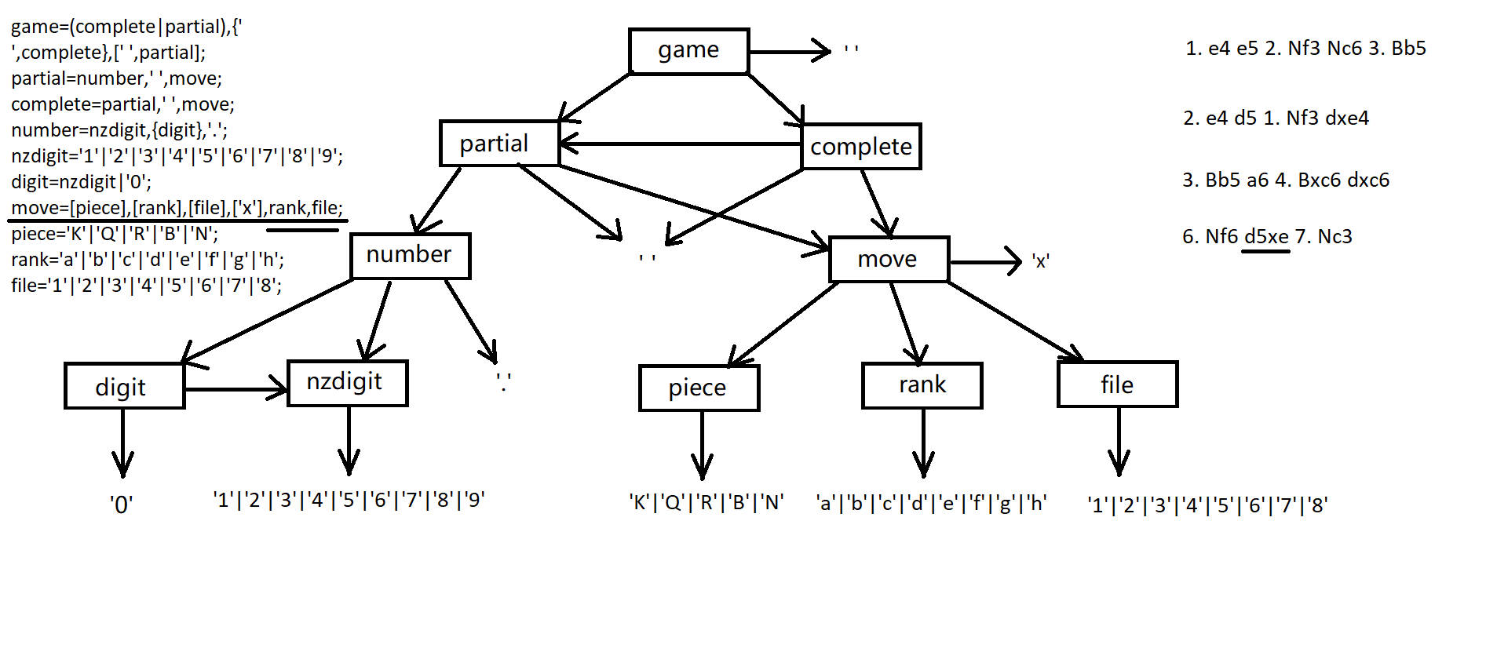
形式语言例题2

Slide 7
多线程
synchronized关键字
synchronized 是 Java 中的关键字，是利用锁的机制来实现同步的。锁机制有如下两种特性：
互斥性：即在同一时间只允许一个线程持有某个对象锁，通过这种特性来实现多线程中的协调机制，这样在同一时间只有一个线程对需同步的代码块(复合操作)进行访问。互斥性我们也往往称为操作的原子性。
可见性：必须确保在锁被释放之前，对共享变量所做的修改，对于随后获得该锁的另一个线程是可见的（即在获得锁时应获得最新共享变量的值），否则另一个线程可能是在本地缓存的某个副本上继续操作从而引起不一致。
考点看代码

Slide 8
多线程例题1
Given the following four Java code fragments, identify the one least likely to contain a race condition.
a)
private void work(int jobnum) {
try { Thread.sleep(1); }
catch (InterruptedException e) { e.printStackTrace(); }
}
private int incJobNum() { return jobnumber++; }
@Override public void run() {
int jobnum;
while ((jobnum = incJobNum()) < WORK_ITEMS) {
work(jobnum);
}
}
b)
private void work(int jobnum) {
try { Thread.sleep(1); }
catch (InterruptedException e) { e.printStackTrace(); }
}
synchronized private int incJobNum() { return jobnumber++; }
@Override public void run() {
int jobnum;
while ((jobnum = incJobNum()) < WORK_ITEMS) {
work(jobnum);
}
c)
synchronized private void work(int jobnum) {
try { Thread.sleep(1); }
catch (InterruptedException e) { e.printStackTrace(); }
}
private int incJobNum() { return jobnumber++; }
@Override public void run() {
int jobnum;
while ((jobnum = incJobNum()) < WORK_ITEMS) { work(jobnum); }
}
d)
private void work(int jobnum) { Thread.sleep(1); }
private int incJobNum() { return jobnumber++; }
@Override public void run() {
int jobnum;
while ((jobnum = incJobNum()) < WORK_ITEMS) { work(jobnum);
}
}

Slide 9
多线程例题2
Given the following four Java code fragments, identify the one least likely to contain a race condition.
a)
private void work(int jobnum) {
try {
Thread.sleep(1);
} catch (InterruptedException e) {
e.printStackTrace();
}
}
private int incJobNum() {
return jobnumber++;
}
@Override
public void run() {
int jobnum;
while ((jobnum = incJobNum()) < WORK_ITEMS) {
work(jobnum);
}
}
b)
private void work(int jobnum) {
try {
Thread.sleep(1);
} catch (InterruptedException e) {
e.printStackTrace();
}
}
synchronized
private int incJobNum() {
return jobnumber++;
}
@Override
public void run() {
int jobnum;
while ((jobnum = incJobNum()) < WORK_ITEMS) {
work(jobnum);
}
}
c)
synchronized
private void work(int jobnum) {
try {
Thread.sleep(1);
} catch (InterruptedException e) {
e.printStackTrace();
}
}
private int incJobNum() {
return jobnumber++;
}
@Override
public void run() {
int jobnum;
while ((jobnum = incJobNum()) < WORK_ITEMS) {
work(jobnum);
}
}
d)
private void work(int jobnum) {
Thread.sleep(1);
}
private int incJobNum() {
return jobnumber++;
}
@Override
public void run() {
int jobnum;
while ((jobnum = incJobNum()) < WORK_ITEMS) {
work(jobnum);
}
}

Slide 10
二叉查找树Binary Search Tree
二叉搜索树允许快速查找、添加或者删除某一个节点，并且它是动态的集合。
二叉搜索树按照关键字顺序地保存节点，因此查找和其他操作可以使用二叉搜索原理：当在树（或者寻找插入新节点的地方）中查找节点时，它从根节点遍历到叶节点，与每个节点的关键字进行比较，然后基于比较结果，决定继续在左子树或者右子树中进行搜索。平均而言，每次比较将跳过树的大约一半的元素，这使得每次查找，插入或删除一个节点所花费的时间与树的节点个数的对数成（树的高度）正比，比线性表的性能要好很多。
二叉搜索树具有以下性质：
如果节点的左子树不空，则左子树上所有结点的值均小于等于它的根结点的值；
如果节点的右子树不空，则右子树上所有结点的值均大于等于它的根结点的值；
任意节点的左、右子树也分别为二叉查找树；

Slide 11
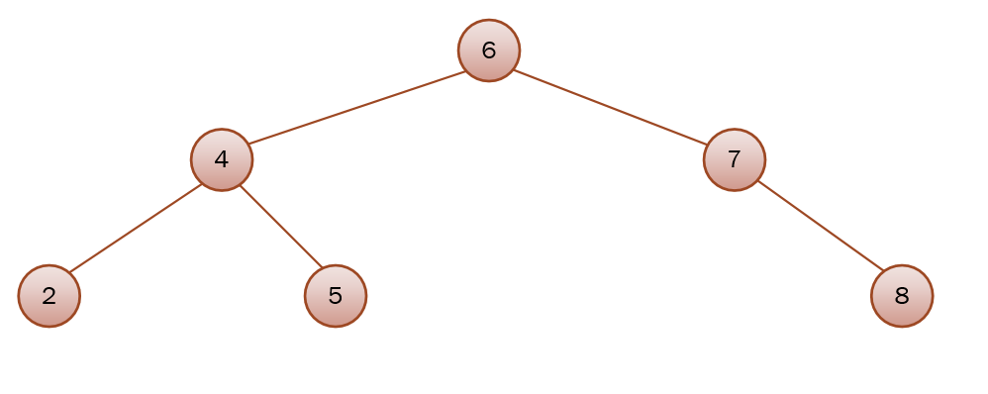
二叉查找树Binary Search Tree

Slide 12
二叉查找树搜索5

Slide 13
二叉查找树插入46

